Slide 1
PP Physics Goals for RUN 15 and 16

Slide 2
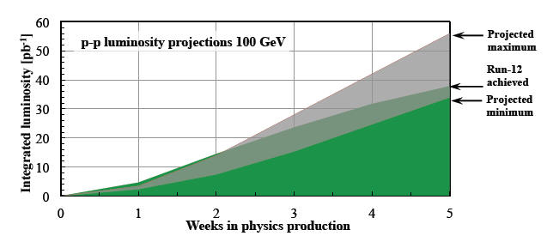
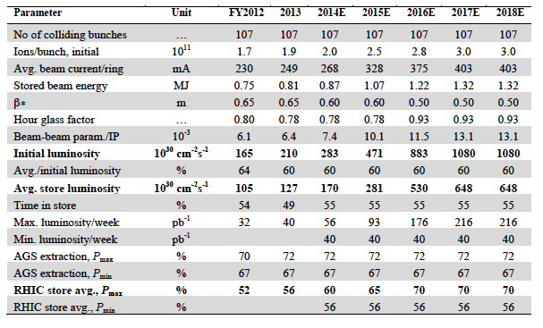
CAD Guidance
http://www.rhichome.bnl.gov/RHIC/Runs/RhicProjections.pdf
polarisation: 60%
250 GeV:
lets assume dynamic β*
works → can gain 2x
lumi per 2013 fill
impact of no 500 GeV running
between
2013 and 2016 unknown
Other Info:
Talk by Wolfram: http://www.star.bnl.gov/~eca/pp-pA-LoI/2014-0321%20p+p%20and%20p+Au%20in%202020+.pptx
Lumi-Document: http://www.star.bnl.gov/~eca/pp-pA-LoI/pp.pA.Lumi.2020+V2.docx

Slide 3
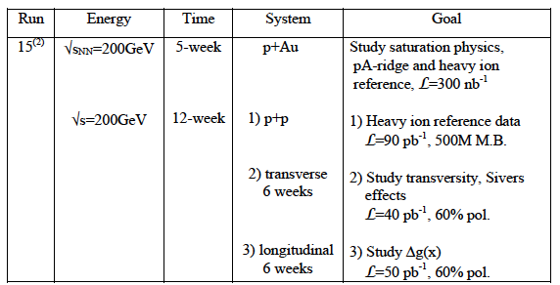
RHIC RUNNING AND PERFORMANCE MILESTONES
Run 9+11+12+13
Ws
Run 9+11+12+13+15
jets + di-jets
Run 15+16
and the nice results
from 11 & 12
Proposed
in 2014-2015
BUR

Slide 4
pp Run-15: GoAls
200 GeV longitudinal polarized pp
increase statistics on A_{LL} jets and di-jets at mid rapidity
explore A_{LL} in FMS
200 GeV transverse polarised pp
understand the underlying physics of forward A_{N}
direct γ A_{N}; A_{N} for diffractive and rapidity gap events
improve statistics on A_{N}(π⁰,η) → reach high p_{t} with good statistics
improve statistics on all mid-rapidity Sivers, IFF and Collins observables
central and forward diffractive production in p^{(↑)}p, p^{(↑)}A
elastic scattering in p^{(↑)}p^{(↑)}
200 GeV transverse polarised pA
study saturation effects
first measurement of g^{A}(x,Q²) and g^{A}(x,Q²,b) through direct photon and UPC J/Ψ
unravel the underlying subprocess by measuring A_{N}(π⁰,γ)
study GPDs trough exclusive J/Ψ
AND
much more

Slide 5
Important
Run-15 needs to provide comparison data for HFT program
MTD comparison data can also be collected at 500 GeV pp
Following Hardware needs to be in place
FMS → refurbishment is going well
Preshower → on track design finalized → presentations in pp-pA-LoI meetings
pp2pp → have problems with funding and schedule at the moment, pushing to sort it out

Slide 6
Run 16 possible Scenarios
22 weeks running
suggestion split between AuAu → HFT, MTD
transverse polarized pp running at 500 GeV
Goal
measure increase statistics for Sivers and Collins jet measurements in mid-rapidity
measure sea-quark sivers, pin down TMD-evolution and try to resolve NSAC HP13
HOW?
measure simultaneously A_{N} for γ, W^{+/-} Z⁰, DY
DY and W^{+/-} Z⁰ give Q² evolution
W^{+/-} give sea-quark sivers
All three A_{N} for γ, W^{+/-} Z⁰, DY give sign change

Slide 7
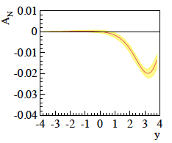
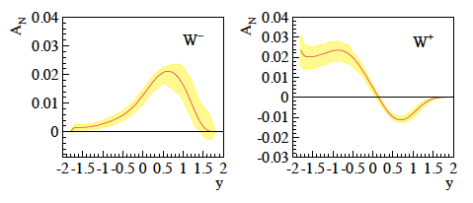
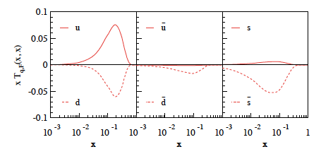
New Theory predictions
Z. Kang et al. arXiv:1401.5078v1
0 < p_{T} 3 GeV
4 < Q < 9 GeV
0 < p_{T} 1 GeV
Q² = 2.4 GeV²
sea quarks
completely
unconstrained
impacts A_{N}(DY,W±, Z⁰,γ)
new calculations for
A_{N}(Z⁰,γ) coming
and maximized sea-quarks

Slide 8
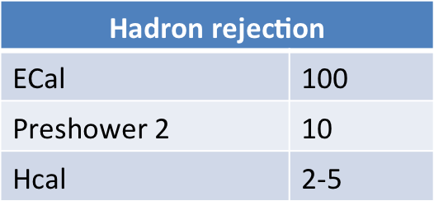
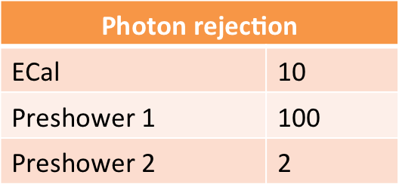
A_{n} DY
Details:
https://drupal.star.bnl.gov/STAR/system/files/2014-01-11_DrellYan.pptx
Requirements:
Drell-Yan needs ~10⁷-10⁶ suppression of hadron pairs
Forward rapidity naturally suppresses QCD background
Track multiplicities are small with reasonable hadron rejection
charge identification is mainly helping a small m_{inv}<2 GeV/c²
Transverse asymmetries need h>2
Background asymmetries a problem if S/B~1
Mapping out 4< m_{inv}<9 GeV/c² needs a recorded lumi of 1 fb⁻¹
scales with 1/polarization !!!
L_{int} = 1fb⁻¹
rejections per track:
→ FMS
→ just building one
can be replaced by
postshower
→ use FMSPS technology
possible till run 16
tracking: → charge separation: 2

Slide 9
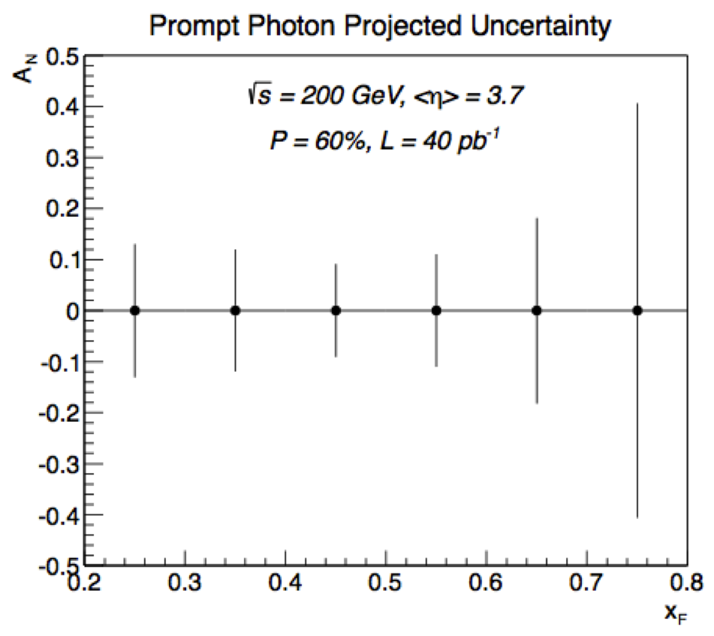
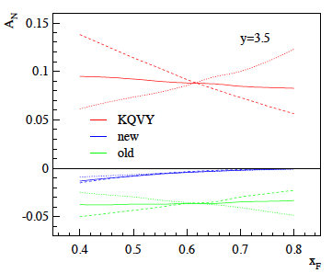
A_{n} direct Photon at 500 GeV
Proof of principle from Run-15 200 GeV data:
500 GeV need to reach same high x_{f} as at 200 GeV
bigger background from merged π⁰
FMS Preshower need to help to separate merged π⁰ from single γ
Can be done
check out: https://drupal.star.bnl.gov/STAR/system/files/2014-03_28_FMS.preshower.pdf
√s = 200 GeV
dashed curve is the direct asymmetry A_{N}^{dir},
dotted curve is the fragmentation asymmetry A_{N}^{frag},
solid curve is the overall spin asymmetry.
The different colors represent different assumptions
about the magnitude of the Sivers asymmetry
Old paper by Z. Kang no evolution

Slide 10
Summary
Run-15:
follow last years BUR
of course improve plots, arguments and so on with
what we have learned in the last year
Run-16:
transverse polarized pp at 500 GeV
need delivered Lumi: 600 – 800 pb⁻¹ but with cleaner TPC performance
→ less pile up
→ push CAD to make the dynamic β* squeeze working

Slide 11
BACKUP

Slide 12
The famous sign change of the Sivers fct.
critical test for our understanding of TMD’s and TMD factorization
Twist-3 formalism predicts the same
DIS:
γq-scattering
attractive FSI
pp:
qqbar-anhilation
repulsive ISI
QCD:
Sivers_{DIS} = - Sivers_{DY} or Sivers_{W} or Sivers_{Z0}
A_{N}(direct photon) measures the sign change through Twist-3
All can be measured in one 500 GeV Run

Slide 13
Collected Luminosity with longitudinal Polarization
Year | √s [GeV] | Recorded PHENIX | Recorded STAR | Pol [%]
2002 (Run 2) | 200 | / | 0.3 pb⁻¹ | 15
2003 (Run 3) | 200 | 0.35 pb⁻¹ | 0.3 pb⁻¹ | 27
2004 (Run 4) | 200 | 0.12 pb⁻¹ | 0.4 pb⁻¹ | 40
2005 (Run 5) | 200 | 3.4 pb⁻¹ | 3.1 pb⁻¹ | 49
2006 (Run 6) | 200 | 7.5 pb⁻¹ | 6.8 pb⁻¹ | 57
2006 (Run 6) | 62.4 | 0.08 pb⁻¹ |  | 48
2009 (Run9) | 500 | 10 pb⁻¹ | 10 pb⁻¹ | 39
2009 (Run9) | 200 | 14 pb⁻¹ | 25 pb⁻¹ | 55
2011 (Run11) | 500 | 27.5 / 9.5pb⁻¹ | 12 pb⁻¹ | 48
2012 (Run12) | 500 | 30 / 15 pb⁻¹ | 82 pb⁻¹ | 50/54

Slide 14
Collected Luminosity with transverse Polarization
Year | √s [GeV] | Recorded PHENIX | Recorded STAR | Pol [%]
2001 (Run 2) | 200 | 0.15 pb⁻¹ | 0.15 pb⁻¹ | 15
2003 (Run 3) | 200 | / | 0.25 pb⁻¹ | 30
2005 (Run 5) | 200 | 0.16 pb⁻¹ | 0.1 pb⁻¹ | 47
2006 (Run 6) | 200 | 2.7 pb⁻¹ | 8.5 pb⁻¹ | 57
2006 (Run 6) | 62.4 | 0.02 pb⁻¹ |  | 53
2008 (Run8) | 200 | 5.2 pb⁻¹ | 7.8 pb⁻¹ | 45
2011 (Run11) | 500 | / | 25 pb⁻¹ | 48
2012 (Run12) | 200 | 9.2/4.3 pb⁻¹ | 22 pb⁻¹ | 61/58

Slide 15
Key measurements for polarized pp scattering
deliverables | observables | what we learn | requirements | comments/competition
HP13 (2015) Test unique QCD predictions for relations between single-transverse spin phenomena in p-p scattering and those observed in deep-inelastic lepton scattering. | A_{N} for γ , W^{+/-},Z⁰, DY | Do TMD factorization proofs hold. Are the assumptions of ISI and FSI color interactions in pQCD are attractive and repulsive, respectively correct | high luminosity trans pol pp at √s=500 GeV DY: needs instrumentation to suppress QCD backgr. by 10⁶ at 3<y<4 | A_{N} DY: >=2020 might be to late in view of COMPASS A_{N}W,Z: can be done earlier, i.e. 2016
HP13 (2015) and flavor separation | A_{N} for γ , charged identified(?) hadrons, jets and diffractive events in pp and pHe-3 | underlying subprocess causing the big A_{N} at high x_{f} and y | high luminosity trans pol pp at √s=200 GeV, (500 GeV jets ?) He-3: 2 more snakes; He-3 polarimetry; full Phase-II RP | the origin of the big A_{N} at high x_{f} and y is a legacy of pp and can only be solved in pp what are the minimal observables needed to separate different underlying subprocesses
transversity and collins FF | IFF and A_{UT} for collins observables, i.e. hadron in jet modulations A_{TT} for DY | TMD evolution and transversity at high x cleanest probe, sea quarks | high luminosity trans pol pp at √s=200 GeV & 500 GeV | how does our kinematic reach at high x compare with Jlab12 A_{TT} unique to RHIC
flavour separated helicity PDFs polarization dependent FF | A_{LL} for jets, di-jets, h/γ-jets at rapidities > 1 D_{LL} for hyperons | Δg(x) at small x Δs(x) and does polarization effect fragmentation | high luminosity long. pol pp at √s=500 GeV Forward instrumentation which allows to measure jets and hyperons. Instrumentation to measure the relative luminosity to very high precision | eRHIC will do this cleaner and with a wider kinematic coverage
Searches for a gluonic bound state in central exclusive diffraction in pp | PWA of the invariant mass spectrum in pp→p’M_{X}p’ in central exclusive production | can exotics, i.e. glue balls, be seen in pp | high luminosity pp at √s=200 GeV & 500 GeV full Phase-II RP | how does this program compare to Belle-II & PANDA

Slide 16
Key measurements for p↑A scattering
deliverables | observables | what we learn | requirements | comments/competition
DM8 (2012) determine low-x gluon densities via p(d) A | direct photon potentially correlations, i.e. photon-jet | initial state g(x) for AA-collisions | A-scan | LHC and inclusive DIS in eA eA: clean parton kinematics LHC wider/different kinematic reach; NA61
impact parameter dependent g(x,b) | c.s. as fct. of t for VM production in UPC (pA or AA) | initial state g(x,b) for AA-collisions | high luminosity, clean UPC trigger | LHC and exclusive VM production in eA eA: clean parton kinematics LHC wider/different kinematic reach
“saturation physics” | di-hadron correlations, γ-jet, h-jet & NLO DY, diffraction pT broadening for J/Ψ & DY -> Q_{s} | is the initial state for AA collisions saturated measurement of the different gluon distributions CNM vs. WW | capability to measure many observables precisely large rapidity coverage to very forward rapidities polarized pA A scan | complementary to eA, tests universality between pA and eA
CNM effects | R_{pA} for many different final states K⁰, p, K, D⁰, J/Ψ, .. as fct of rapidity and collision geometry | is fragmentation modified in CNM heavy quarks vs. light quarks in CNM | A scan to tag charm in forward direction → μ-vertex | separation of initial and final state effects only possible in eA
long range rapidty correlations “ridge” | two-particle correlation at large pseudo-rapidity Δη | do these correlations also exist in pA as in AA | tracking and calorimetry to very high rapidities | interesting to see the √s dependence of this effect compared to LHC
is GPD E_{g} different from zero | A_{UT} for J/Ψ through UPC Ap↑ | GPD E_{g} is responsible for L_{g}→ first glimpse |  | unique to RHIC till EIC turns on
underlying subprocess for A_{N}(π⁰) | A_{N} for π⁰ and γ | underlying subprocess for A_{N}(π⁰) sensitivity to Q_{s} | good π⁰ and γ reconstruction at forward rapidities | resolving a legacy in transversely polarized pp collisions

