Slide 1
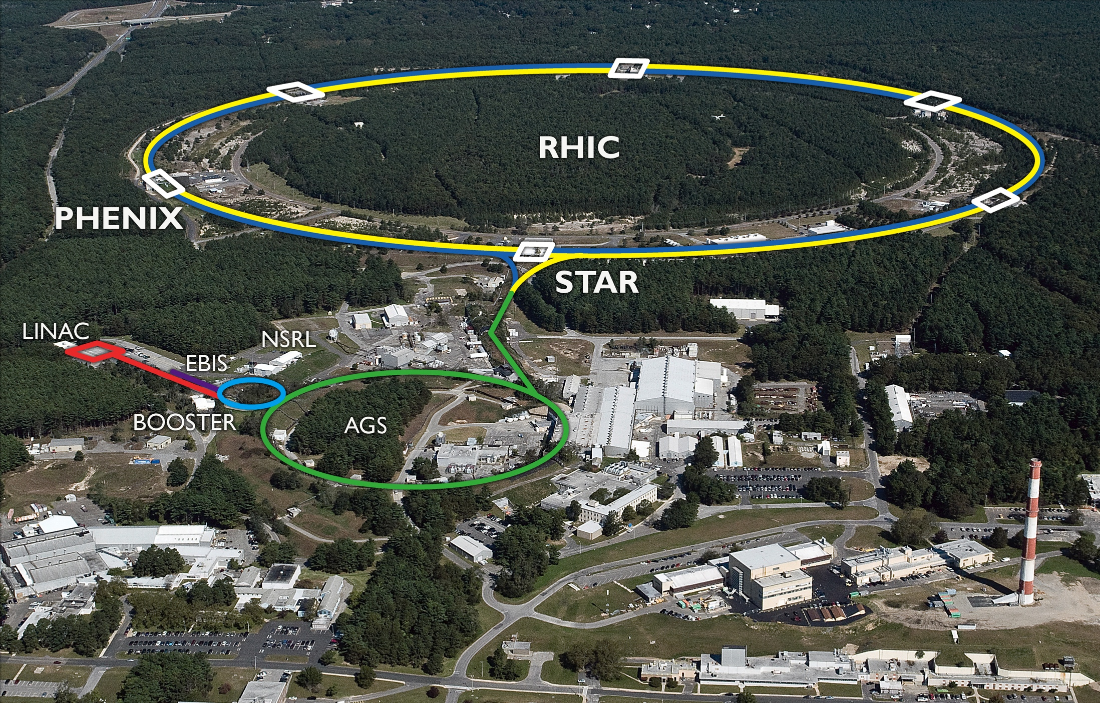
RHIC – p+p and p+Au projections for 2018+
21 March 2014
STAR meeting
Notes:
09:05, 20+5 min

Slide 2
p+p luminosity projections 2018+
Luminosity increase driven by bunch intensity and bunch length, based on
New polarized source (first operated in 2013)
Electron lenses (under commissioning)
Pile-up at peak luminosity going from 1.7 (2013) to 7.7 (2018)

Slide 3
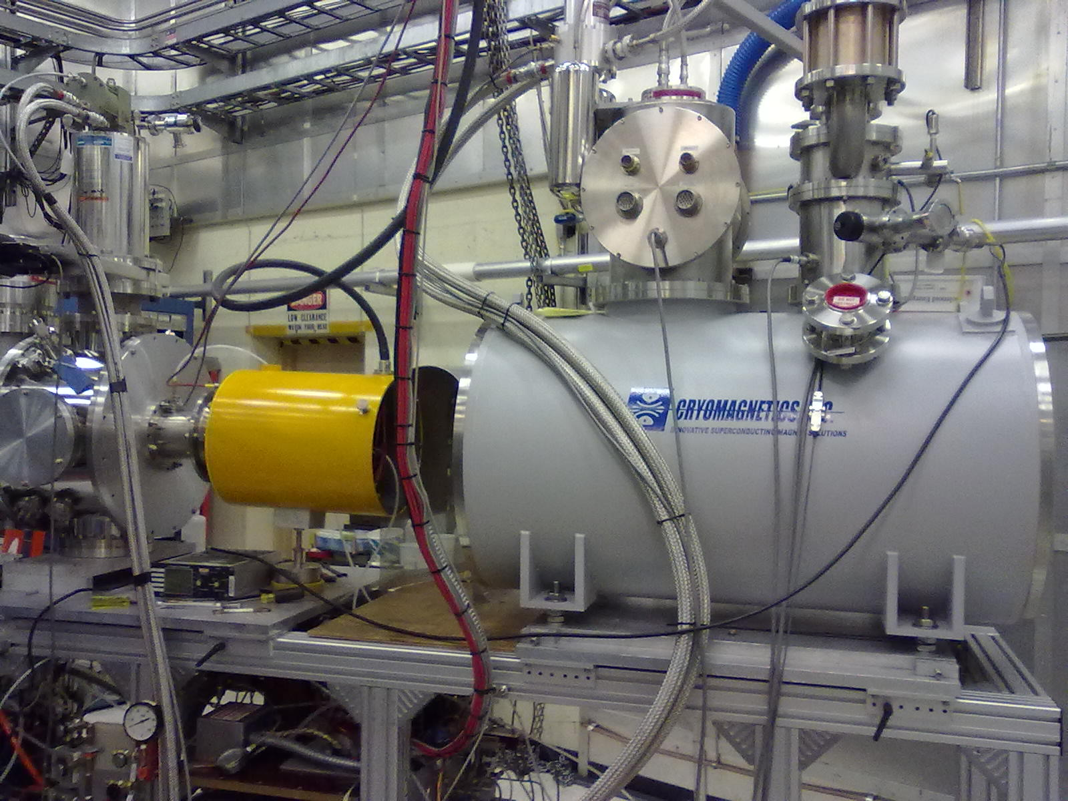
Optically Pumped Polarized H– source (OPPIS) – A. Zelenski
Capital project FY2009-11, $1.1M
Commissioned before and during Run-13
Reliable operation
Maintenance time significantly reduced
Performance increase to date
Maximum Booster intensity: 2x higher than Run-12
Polarization: 81%, 2% higher than Run-12 (at nominal intensity 5x10¹¹)
Expect further intensity and polarization increases
Will be primarily used to increase brightness
Polarization at store can be reduced by accelerating smaller beams
Setup on 10 May 2012
New Atomic Beam Source
(ABS)
New superconducting solenoid

Slide 4
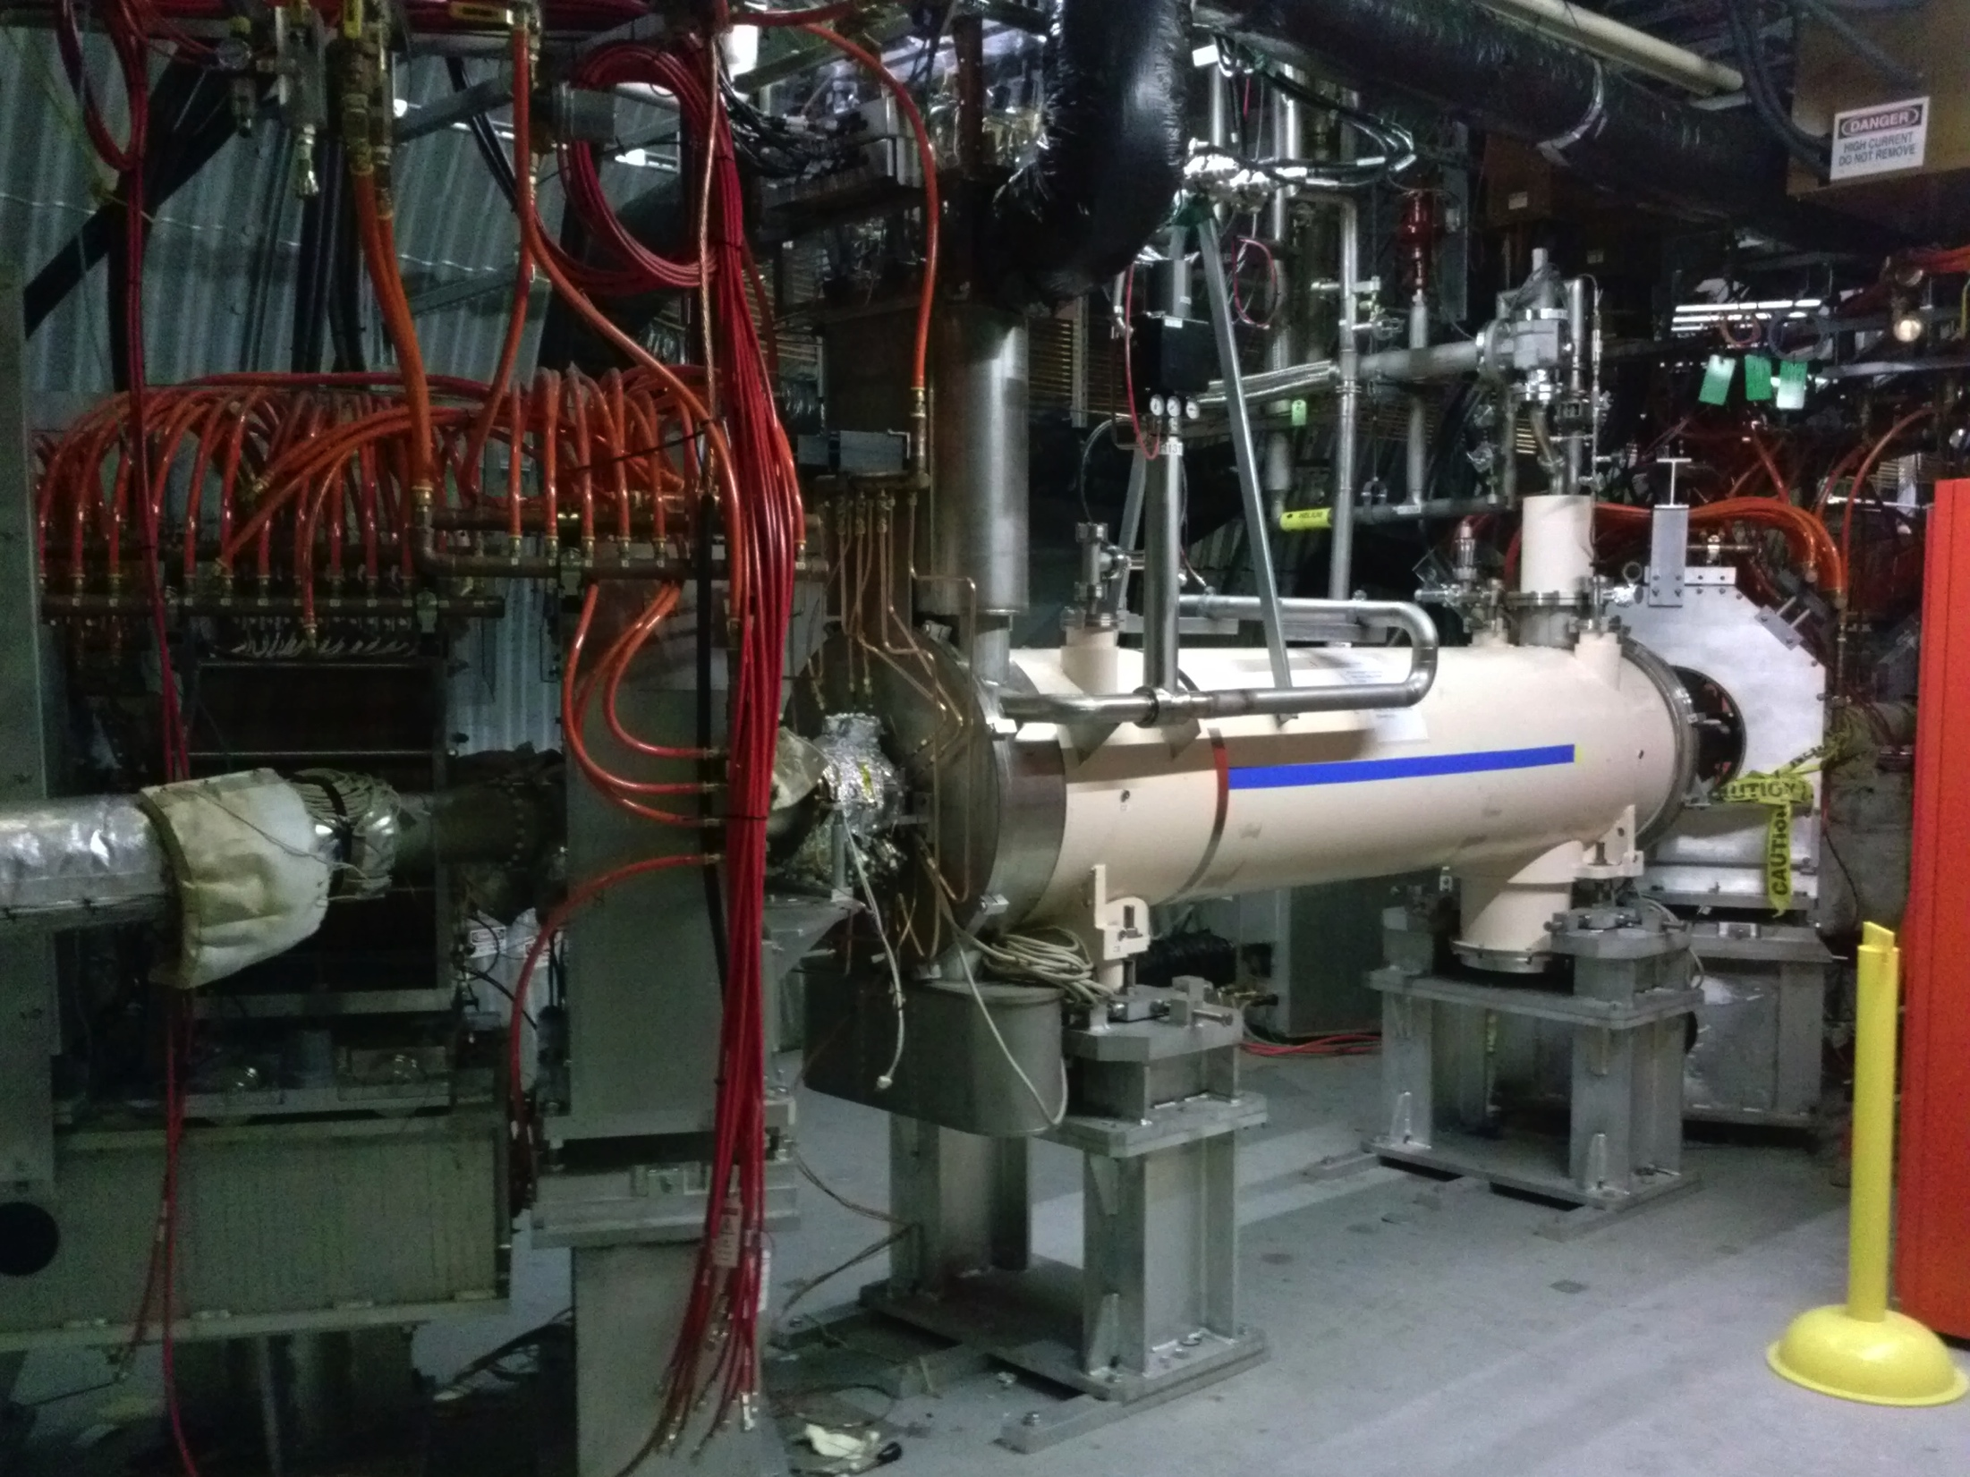
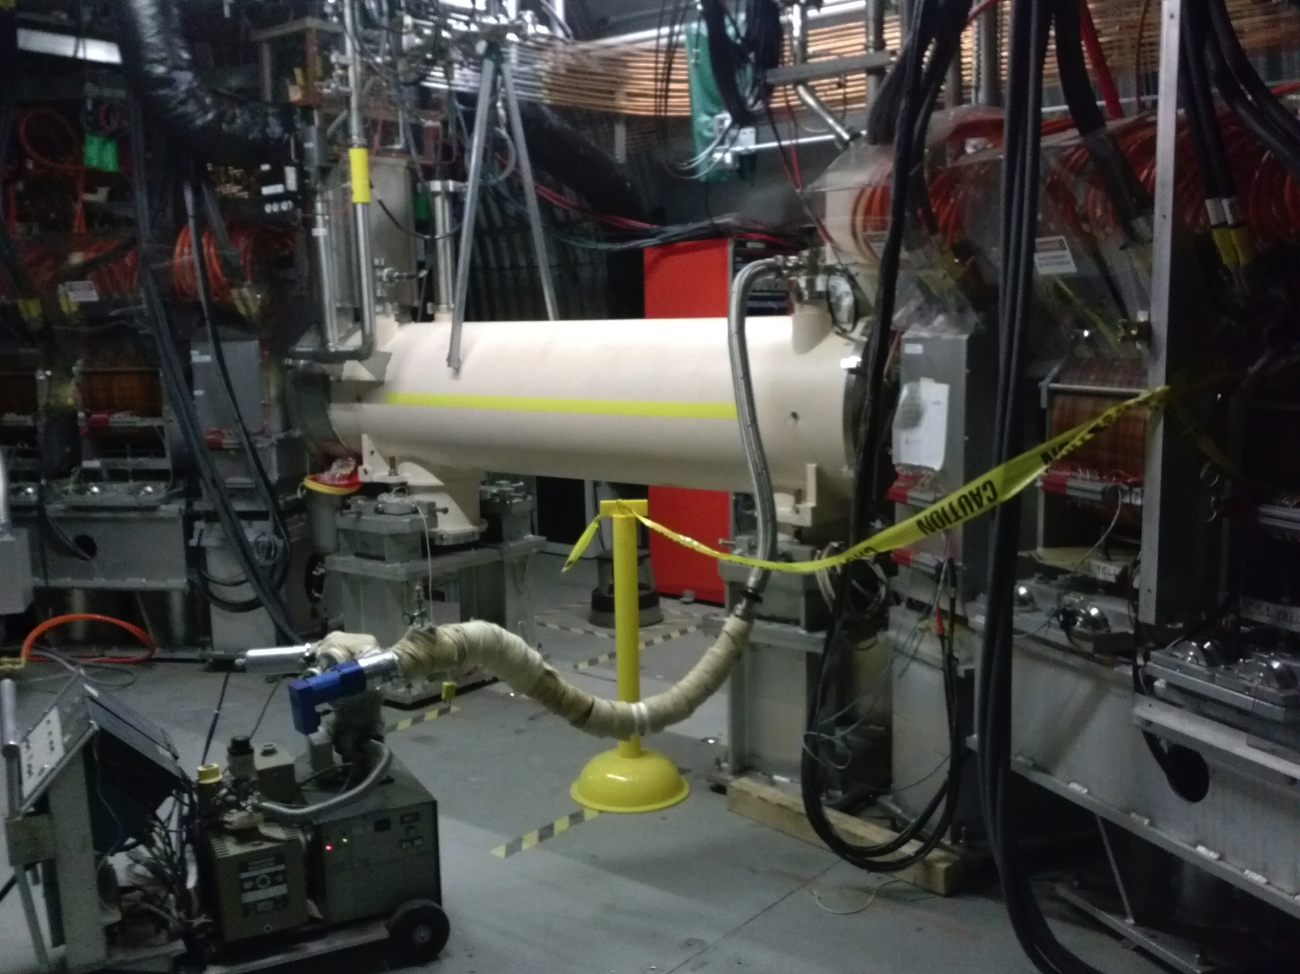
Electron lenses – under commissioning
Goal: ~2x increase in average polarized proton luminosity
Both lenses installed
Magnetic structure operational (3 T of 6 T for main field so far)
Demonstrated 1 A pulsed e-beam in Blue/Yellow, 1 A DC in Yellow
Running with pulsed e-beams parasitically to Au+Au stores
First beam-beam experiments expected on 3 April 2014
Working on transverse alignment of electron and proton beams
Expect to be operational for Run-15
installed Blue lens
installed Yellow lens

Slide 5
High-intensity operation
In addition to OPPIS and electron lenses a number of other systems need to be readied for high-intensity operation:
SAD/ASE – completed 2011
Evaluated Booster/AGS/RHIC effects (CAD MAC-08, 2012)
Evaluated: ramp efficiency, radiation safety, beam dump, collimation system, rf systems, resistive wall heating, instabilities, cryogenic BPM cables
Need:
Dump kicker upgrade (ferrite heating with beam current) – summer 2014
Orbit interlock to prevent BPM cable overheating – tested in Run-13

Slide 6
Possible pile-up mitigation
Pile-up of up 8 events per bunch-bunch crossing at peak luminosity
Could be reduces with lower initial β* and subsequent β*-squeeze during the store
Planning to test a similar scheme during Run-14 Au+Au
Still need full beam-beam compensation with electron lenses (beam-beam effect independent of β*)
Dynamic β* squeeze will reduce delivered luminosity (but may increase useful luminosity)

Slide 7
p+Au luminosity projections 2018+
Luminosity increase driven by bunch intensity, based on
New polarized source for protons (first operated in 2013)
Incremental increases for Au ions (EBIS/Booster/AGS/RHIC)
Electron lenses (under commissioning)

