Slide 1
Dileptons and photons from the Hadronization Process
Guangyao Chen
Rainer J. Fries
Department of Physics and Astronomy & Cyclotron Institute
Texas A&M University

Slide 2
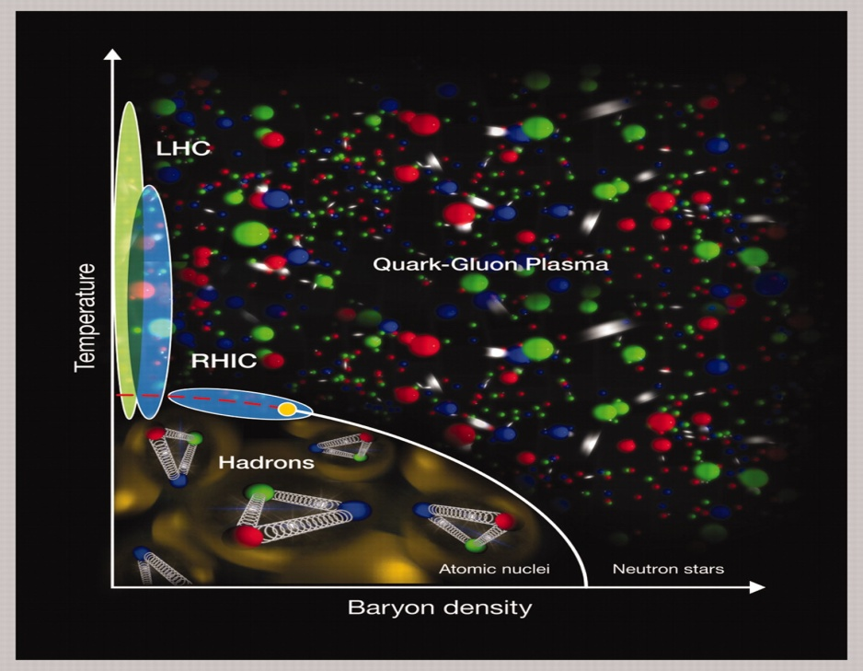
Sources of E&M Probes
Initial Hard Scattering and fragmentation of jets
Pre-equilibrium phase/Glasma?
QGP
Hadronic Gas
Jet-medium interaction ,VMD)
Phase transition?
Hadronization involves charged particles, should be a source of EM radiation!
Q: Is it large?

Slide 3
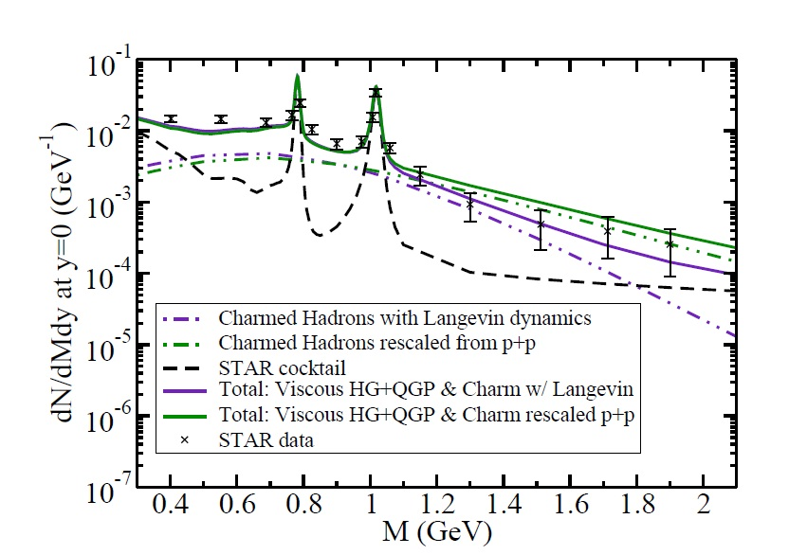
State of Art
Dilepton/Photon production: clear separation between QGP and Hadronic Phase
QGP ( , )
Hadronic Gas ( )
Vujanovic, G et al, QM 2012
Questions: Large photon v2, dilepton enhancement……

Slide 4
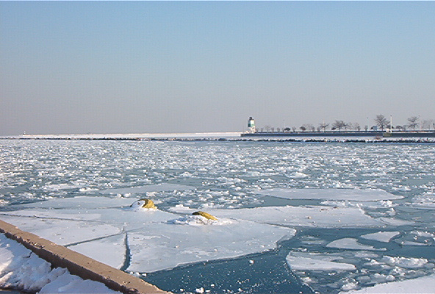
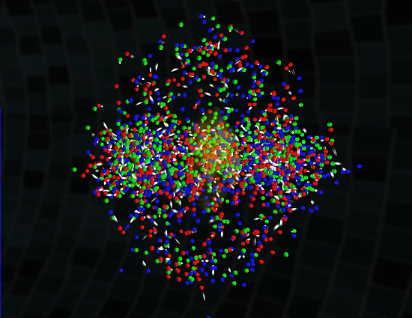
First Order v.s. Crossover Phase Transition
Typical 1st order phase transition.
Lattice: Hadron QGP is a crossover.
Ice and water are well separated during a 1st order phase transition.
Good for 1st order.
WB Collaboration & hotQCD Collaboration
Q: Can hadrons or resonance states coexist with partons in a finite temperature window around Tc?
A: Maybe.
Shuryak, E et al, 2003

Slide 5
Our Approach
Assume coexistence of q,g,π and rho;
or coexistence of q,g and HRG in a
temperature range around Tc.
Use vacuum quark meson coupling;
No strangeness yet;
No baryons yet.
Include photon/dilepton production channels through “quark recombination” like graphs.

Slide 6
Quark Pion Coupling
Pseudo scalar meson interaction Lagrangian
Quark recombination into pion with photon/dilepton.
Compton scattering of quark and pion.
Suzuki and R.~K.~Bhaduri, 1983

Slide 7
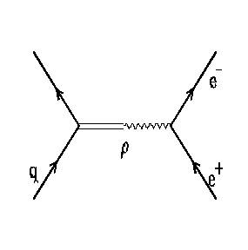
Quark Rho Coupling
Vector meson interaction Lagrangian
Quark recombination into rho with photon/dilepton.
Compton scattering of quark and rho.
Quark annihilation via intermediate rho.
Polleri et al, 1997
Thoma, M et al, 2001
Greiner, C et al, 2010

Slide 8
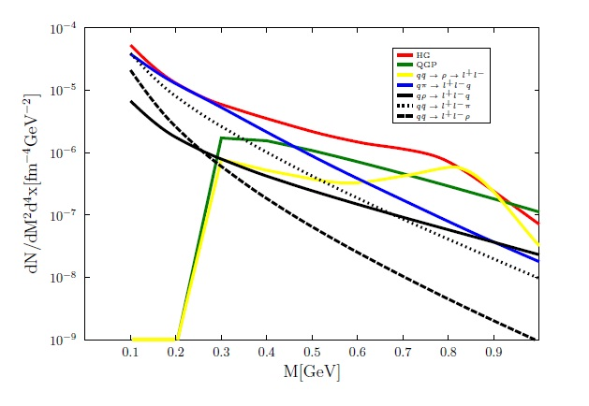
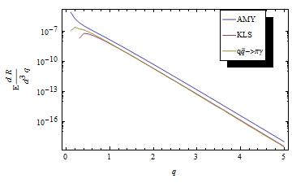
Dilepton/Photon Production Rate
Quark-meson interactions are significant for dilepton.
Photon production rates are at the order of 1st order QCD rate, less than AMY.
Dilepton rate at T=180 MeV
Photon rate at T=164 MeV
Rapp and Wambach, 1999
Arnold et al, 2001
Greiner, C et al, 2010
Kapusta et al, 1991

Slide 9
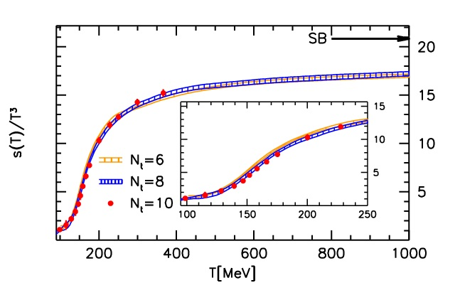
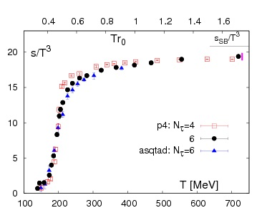
Counting Degrees of Freedom
Constraint from lQCD
Quasi Particle description of QGP
WB Collaboration, 2010
hotQCD Collaboration, 2008
Peshier et al, PLB,1994
Renk et al, PRC, (2002)
Rapp, PRC, (2002)

Slide 10
Counting Degrees of Freedom
Constraint from lQCD
Quasi Particle description of QGP
WB Collaboration, 2010
hotQCD Collaboration, 2008
Peshier et al, PLB,1994
Renk et al, PRC, (2002)
Rapp, PRC, (2002)

Slide 11
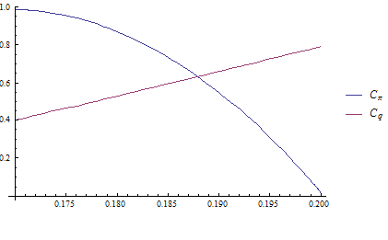
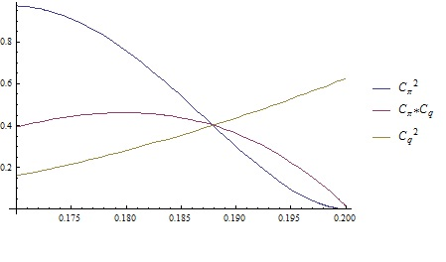
A Possible Scenario (I)
Temperature | Ingredients | Dilepton Source
T>200MeV | QGP with thermal mass
170MeV<T<200MeV | Pion,Rho,QGP. | quark meson interaction.
T<170 | HRG. | Hadronic rate from Rapp&Wambach.
Fraction of QGP and HG
Weight of interaction channels

Slide 12
Rates from Scenario I

Slide 13
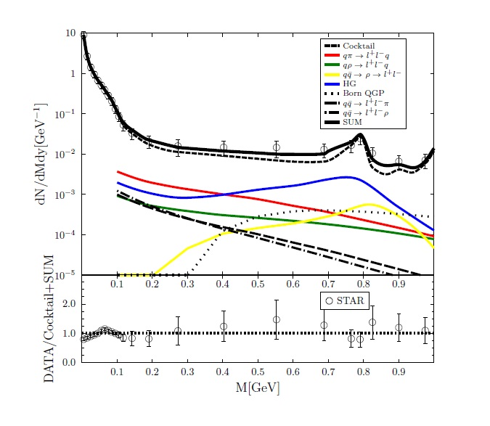
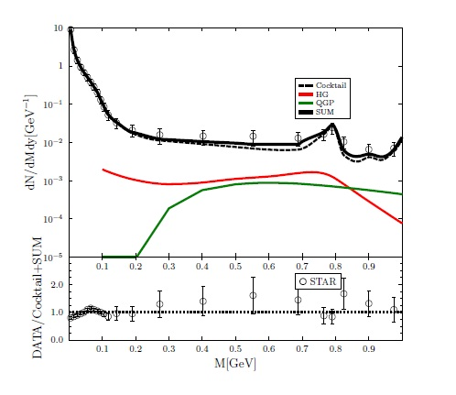
Dilepton Yields from Scenario I
Include quark meson interaction
State of art calculation
Have 20% more than just HG+QGP.
Hydro: He, Fries and Rapp, 2011.
STAR Data: QM11, J. Zhao; QM12, B. Huang
He, Fries and Rapp, priv. comm.

Slide 14
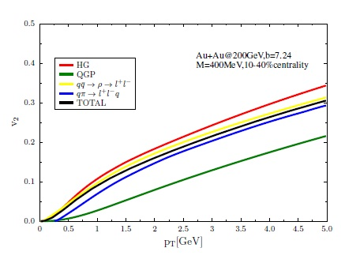
v2 from Scenario I
M=400 MeV
Dilepton from hadronization has large v2;
Total thermal v2 from scenario I very close to hadronic v2.

Slide 15
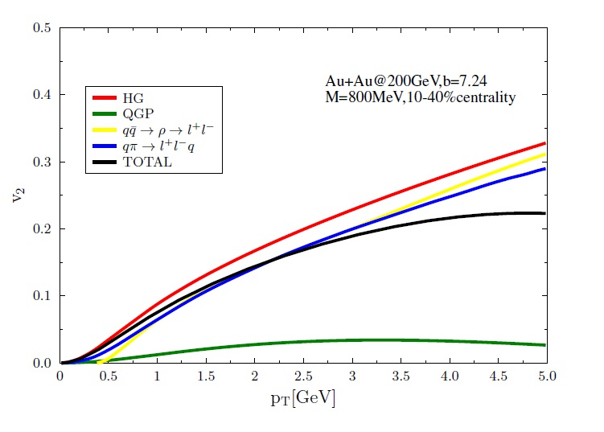
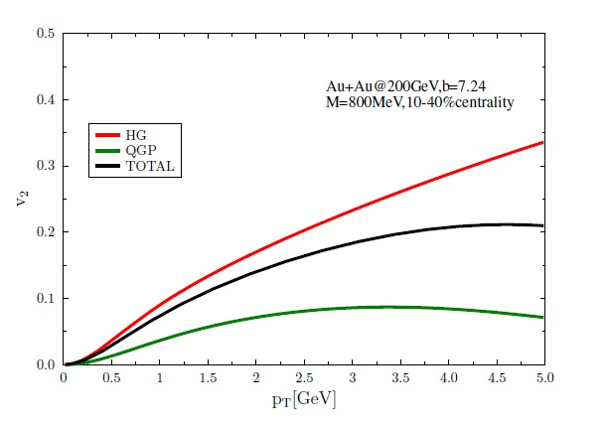
v2 from Scenario I
M=800 MeV
Total v2 is slightly
larger than if we
only considered
HG+QGP.
Compare to HG+QGP
He, Fries and Rapp

Slide 16
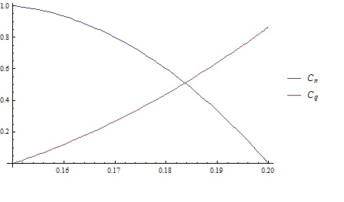
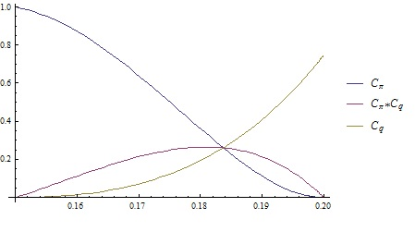
Another Possible Scenario (II)
Temperature | Ingredients | Dilepton Source
T>200MeV | QGP with thermal mass
150MeV<T<200MeV | QGP and HRG. | Quark meson interaction; Hadronic(RW) with weight;
T<150 | HRG. | Full Hadronic rate(RW).
Fraction of QGP and HG
Weight of interaction channels

Slide 17
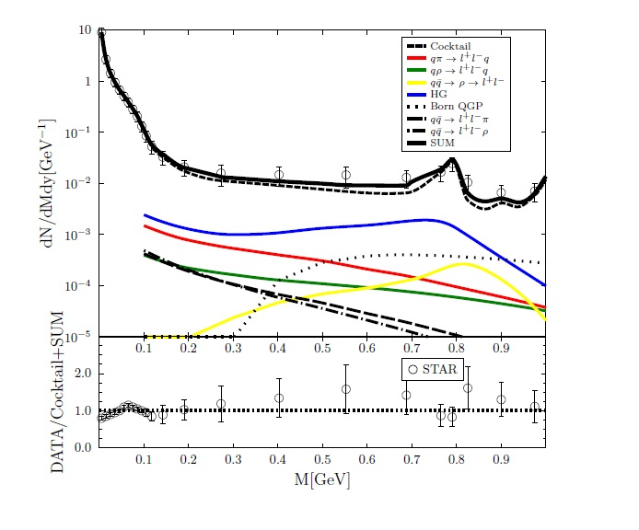
Dilepton Yields from Scenario II
Less yield than scenario I.
Quark meson interaction are less important than hadronic contribution.

Slide 18
Summary
First attempt to calculate dilepton production through quark hadron interaction during phase transition;
Calculations of dilepton yields in two different scenarios during crossover phase transition are carried out;
Dilepton spectrum and v2 are found to be modestly different from mixed phase results.

Slide 19
Thank You!
Acknowledgements
Dr. Ralf Rapp
Dr. Min He
J. Zhao, B. Huang……

Slide 20
Backup

Slide 21
Integrated v2

