Slide 1
The Thermal Photon Puzzle Experimental Issues
Axel Drees, April 20th, RIKEN-BNL Research Center
Introduction
Thermal Photons
High photon yield
Centrality dependence
Angular anisotropy
Theoretical Models
Thermal Photon Puzzle
B-fields and flowing glasma
Summary and Outlook

Slide 2
Thermal Radiation from Hot & Dense Matter
Black Body Radiation
Real or virtual photons
Spectrum and yield sensitive to temperature
Avg. inv. slope ∝ T, Yield ∝ T³
Space-time evolution of matter
collective motion → Doppler shift
→ anisotropy
Microscopic view of thermal radiation
e⁻
e⁺
γ∗
γ
γ
High yield → high T → early emission
Large Doppler shift → late emission
QGP: hadron gas:
photons low mass lepton pairs
g
q
π
π
q
γ
ρ
γ
Need realistic model simulation for rates and space-time evolution for quantitative comparison with data

Slide 3
Experimental Issue: Isolate Thermal Radiation
γ, γ* from A+A
Direct
Non-thermal
Thermal
Need to subtract decay and prompt contributions
Pre-equilibrium
$$π^{0}→γγ$$
$$η→γγ$$
Hadron Gas
“Prompt”
hard scattering
Quark-Gluon Plasma
Hadron Decays
1 10 10⁷ log t (fm/c)

Slide 4
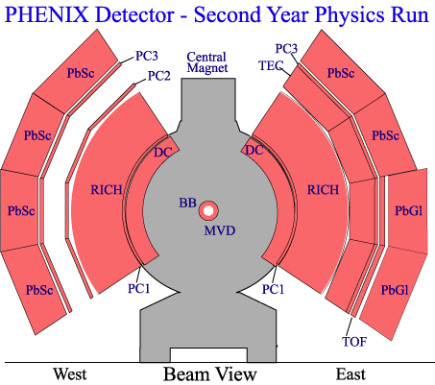
Thermal Radiation at RHIC Energies: PHENIX
e⁺e⁻ identification
Photons,
neutral pion
π⁰ → γ γ
E/p and RICH
Calorimeter
e⁺
γ
γ
γ
e⁻
HBD
DC
Photons
PC1
$$γ→e^{+}e^{−}$$
$$\lim_{m_{ee}→0}{{(γ}^{∗}→e^{+}e^{−} \text{)} }$$
magnetic field &
tracking detectors

Slide 5
Using γ∗ to Measure Direct Photons
Searches for thermal photons ongoing since late 1980’s at SPS
WA80 & successors, HELIOS, CERES …
Established mostly upper limits
Breack through at RHIC: Measuring direct photons via virtual photons
Method originally proposed by UA1 for prompt photons
Using virtual photons:
any process that radiates γ will also radiate γ∗
for m<<p_{T} γ∗ is “almost real”
extrapolate γ∗ → e+e- yield to m = 0 → direct γ yield
m > m_{π} removes 90% of hadron decay background
S/B improves by factor 10: 10% direct γ → 100% direct γ*

Slide 6
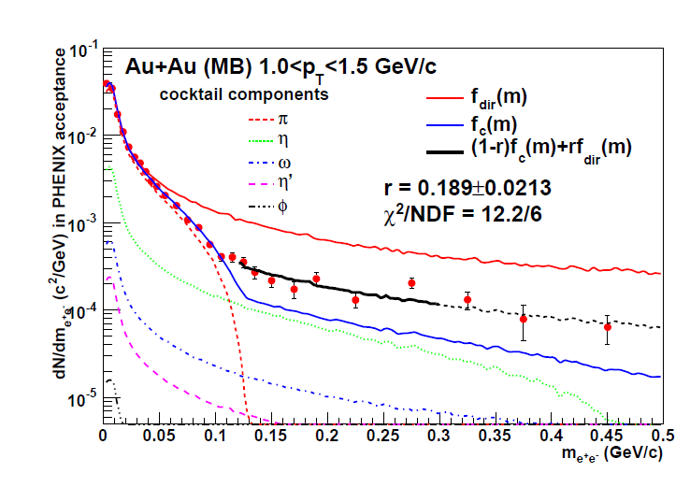
Fit e⁺e⁻ Mass Distribution to Extract the Direct Yield:
Example: one p_{T} bin for Au+Au collisions
1/m
Direct γ* yield fitted in range 120 to 300 MeV
Insensitive to π⁰ yield

Slide 7
Direct Photons from Virtual Photons
PHENIX Phys.Rev.C87 (2013) 054907
PHENIX Phys.Rev.Lett 104 (2010) 132301
2006 data
Prompt photon consistent with pQCD in p+p
Significant additional yield in Au+Au

Slide 8
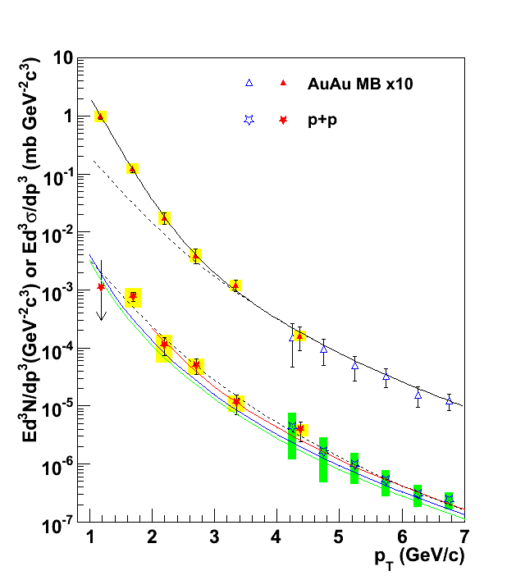
First Measurement of Thermal Radiation
Direct photons from real photons:
Measure inclusive photons
Subtract π⁰ and η decay photons at S/B < 1:10 for p_{T}<3 GeV
Direct photons from virtual photons:
Measure e⁺e⁻ pairs at m_{π} < m << p_{T}
Subtract η decays at S/B ~ 1:1
Extrapolate to mass 0
T ~ 220 MeV
γ* (e⁺e⁻)
→ m=0
First thermal photon measurement:
T_{ini} > 220 MeV > T_{C}
large photon yield!
γ
pQCD

Slide 9
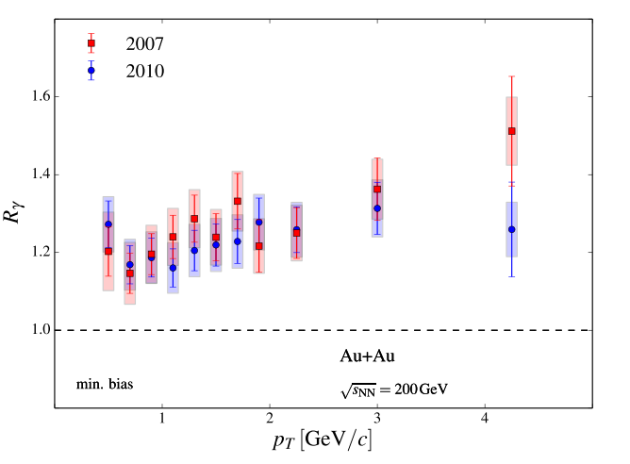
Direct Photons from Photon Conversions
Double ratio tagging method
Clean photon sample with photon conversion
Explicit cancelation of systematic uncertainties
measured raw yields
measured
raw yields
conditional
tagging efficiency
PHENIX arXiv:1405.3940
simulated based
On hadron data
Almost 20% direct photons!
Approx. independent of p_{T}
Extended range to 400 MeV

Slide 10
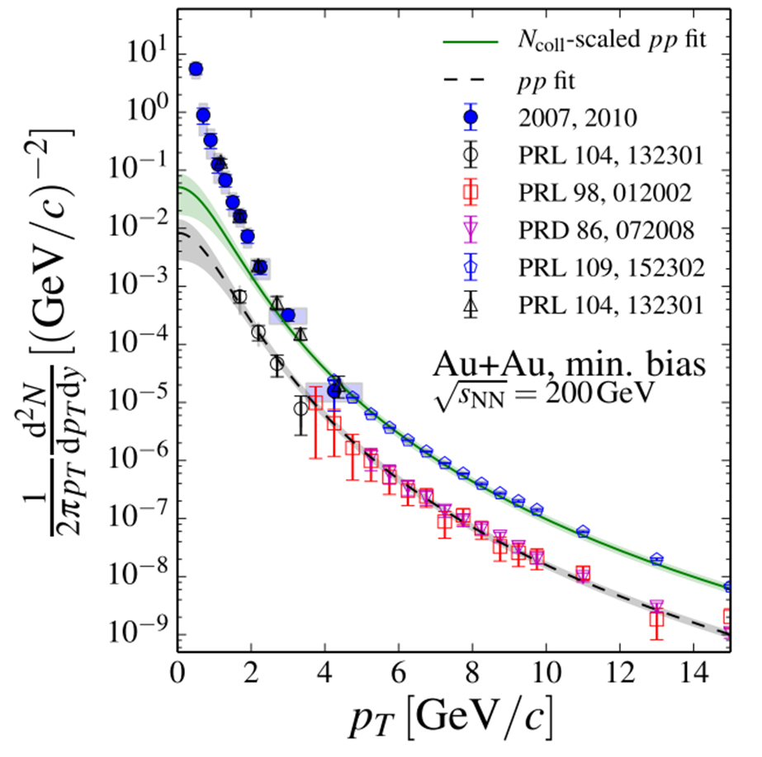
Direct Photons Au+Au Collisions
PhD thesis Bannier & Petti,
T_{eff} ~ 220 MeV
PHENIX arXiv:1405.3940
γ → e⁺e⁻
γ* (m→0)
γ
“pQCD-fit”

Slide 11
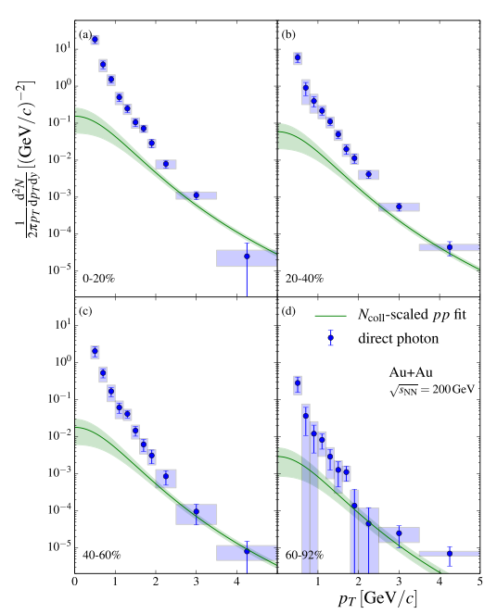
Centrality Dependence of Thermal Component
No significant change in shape
Inverse slope ~ const.
Fit range 0.6-2.0 GeV: ${Ae}^{{−p}_{T}/T_{eff}}$
Rapidly increasing yield with centrality like N_{part}^{α}
Data α = 1.48±0.08±0.04 ~ 3/2
Faster than volume ~ N_{part}
Faster than prompt component
N_{coll} ~ N_{part}^{4/3}
Slower than naïve expectation
Yield ~ N_{part}²

Slide 12
Collective Behavior: Elliptic Flow
out-of-plane
y
initial state of non-central Au+Au collision
spatial asymmetry
asymmetric pressure gradients
momentum anisotropy in final state
expressed as elliptic flow “v₂”
Au nucleus
in-plane
x
Au nucleus
z
Non-central Collisions
Thermal radiation emitted from moving matter → Doppler Shift
→ Anisotropy
red shift
blue shift

Slide 13
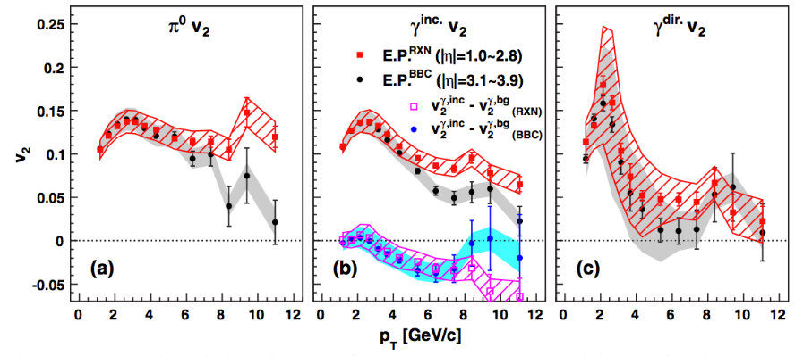
Thermal Photon Show Large Anisotropy
PHENIX Phys.Rev.Lett 109 (2012) 122302
R_{γ} (p_{T}) ~ constant > 1
At 2 GeV v₂^{inc} ~ v₂^{dec}
v₂^{dir} ~ v₂^{inc}
Large v₂~ 0.2 at 2 GeV/c
Insensitive to sys. uncertainty
IF there are direct photons

Slide 14
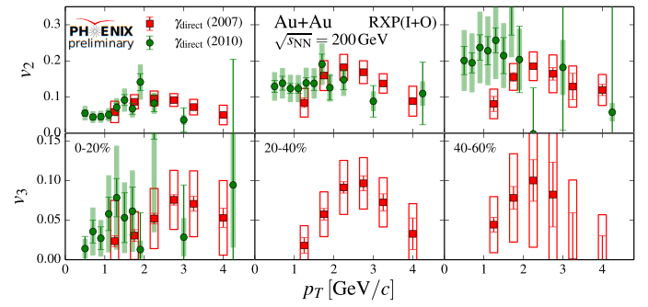
Thermal Photon Anisotropy Update
Two new independent analysis
Calorimeter measurement
photon conversions γ→e⁺e⁻
Consistent with published results
Large v₂~ 0.2 at 2 GeV/c
Indication for const. v₂ at low p_{T}
for v3 discussion see T.Sakaguchi’s talk

Slide 15
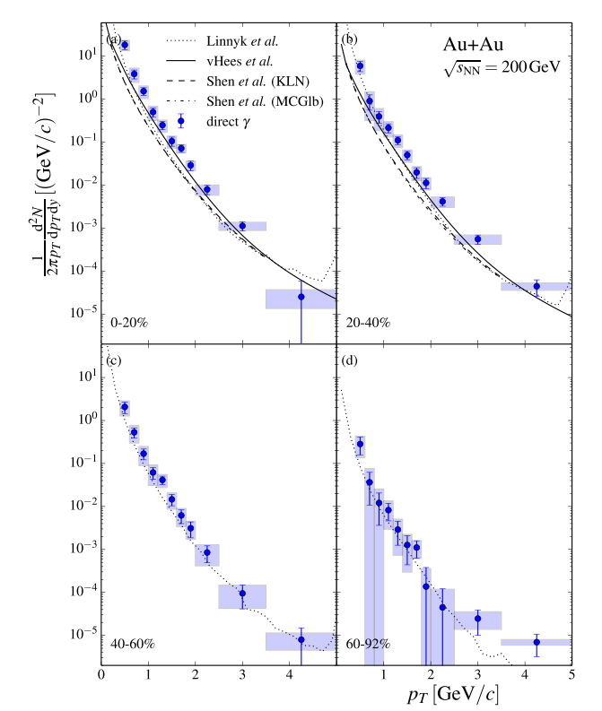
Theory Comparison: Thermal Photon Puzzle (I)
Transport model: Linnyk, Cassing, Bratkovskaya, PRC89 (2014) 0034908
Fireball model: van Hees, Gale, Rapp,
PRC84 (2011) 054906
Hydrodynamic model: Shen, Heinz, Paquet, Gale, PRC89 (2014) 044910
Reasonable agreement with:
T_{ini} = 300 to 600 MeV
Shape similar, but
yield is underestimated
Notes:
Hydrodynamical approach simulates a space-time evolution of the collisions, under the assumption of local conservation of energy and momentum. System evolves according to equation of motion of perfect relativisitic hydrodynamics with a set of initial condition (init T at thermalization time, equation-of-state and freeze-out condition).
Photon emits from volume cell by thermal rates calculated from relativistic kinetic theory.
No viscous hydro has been used before.
Shear viscosity to entropy ratio is small and viscous effects.

Slide 16
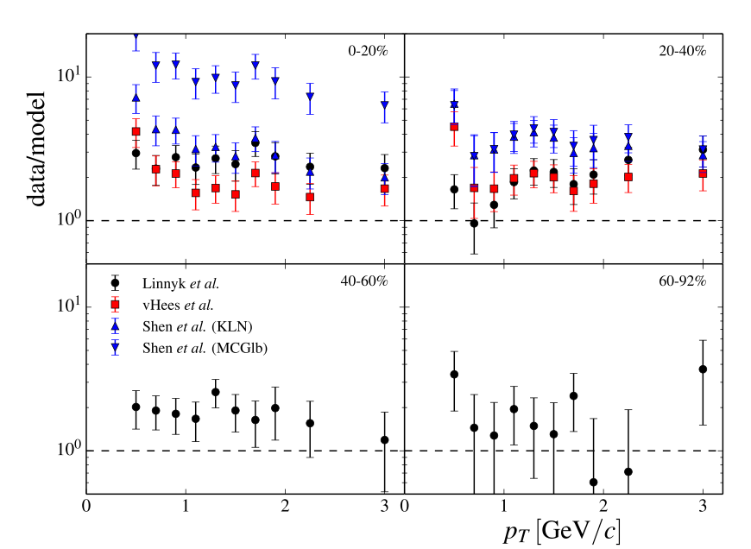
Theoretical Models Underestimate Yield
About factor of 2 at high pt – with large errors
Factor 5-10 at lower pt (central collisions)

Slide 17
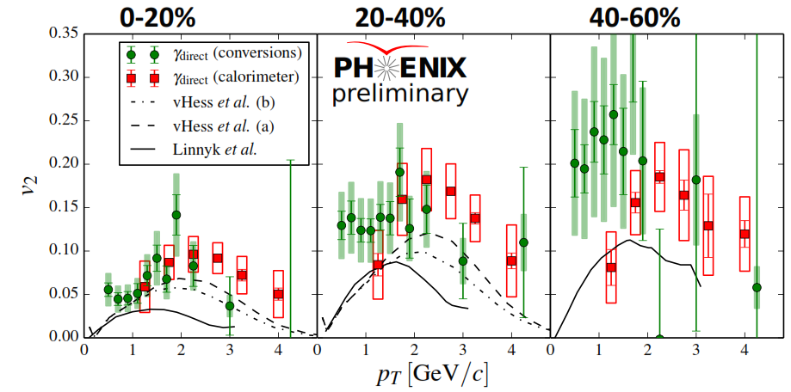
Theory Comparison: Thermal Photon Puzzle (II)
Models fail to describe simultaneously photon yield, T and v2!

Slide 18
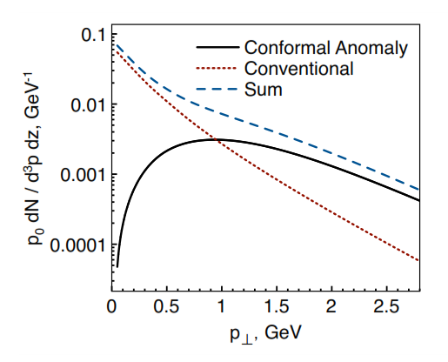
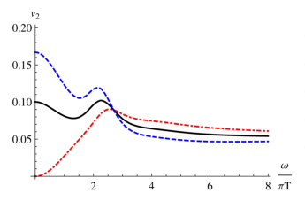
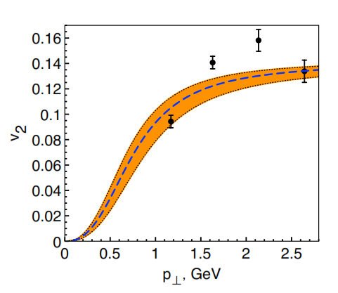
Large B-field Enhances Thermal Radiation
Basar, Kharzeev, Skokov PRL 109 (2012) 202303
Magnetic
B-field
Large magnetic field
Enhanced thermal emission
Anisotropy with respect to reaction plan
nucleus
+
in-plane
nucleus
+
x
z
B.Müller, S.Y.Wu, D.LYang PRD 89 (2014) 026013

Slide 19
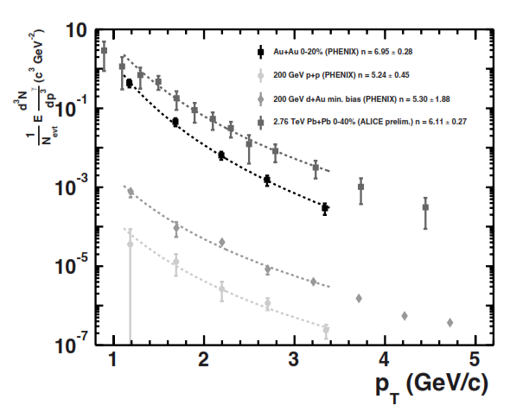
Radiation from Flowing Glasma
C.Klein-Bösing, McLerran, Phys. Lett.B734 (2014) 282
Geometrical scaling behavior of direct photon yield
Describes centrality dependence of Au+Au data
Describes pp, dAu, AuAu at RHIC
Describes scaling of spectra RHIC-LHC
Ideal fluid (hydrodynamic expansion) prior to thermal QPD may result in observed anisotropic “flow”

Slide 20
Flow vs B Field Effect
Look at different collision systems
Au+Au
central
U+U
central
Cu+Au
semi-central
B = 0
v₂ = 0
B = 0
v₂ ≠ 0
B ≠ 0
v₂ = 0
U+U and Cu+Au data sitting on tape waiting to be analysis

Slide 21
Summary and Outlook
Well established measurement of “thermal” photon in Au+Au at 200 GeV from PHENIX
Large yield above expected contribution from pQCD
Centrality dependence of yield ~ N_{part}^{3/2}
Large anisotropy v₂ with respect to reaction plan
Thermal photon puzzle
Models based on standard rates and time evolution fail to describe simultaneously photon yield, T and v2
New additional sources early in collision
Enhanced emission due to large B fields
Emission from flowing glasma state
Additional experimental measurements from RHIC
Vary collision geometry → U+U and Cu+Au
62.4 (and 39 GeV) Au+Au
New large Au+Au data samples to measure v_{n}

