Slide 1
Direct virtual photon production in Au+Au collision at 200 GeV at STAR
Bingchu Huang for the STAR collaboration
Brookhaven National Laboratory
Aug 21 2014

Slide 2
Outline
Motivation
eID and virtual photon extraction
Direct virtual photon production in Au+Au collisions at 200 GeV
Summary

Slide 3
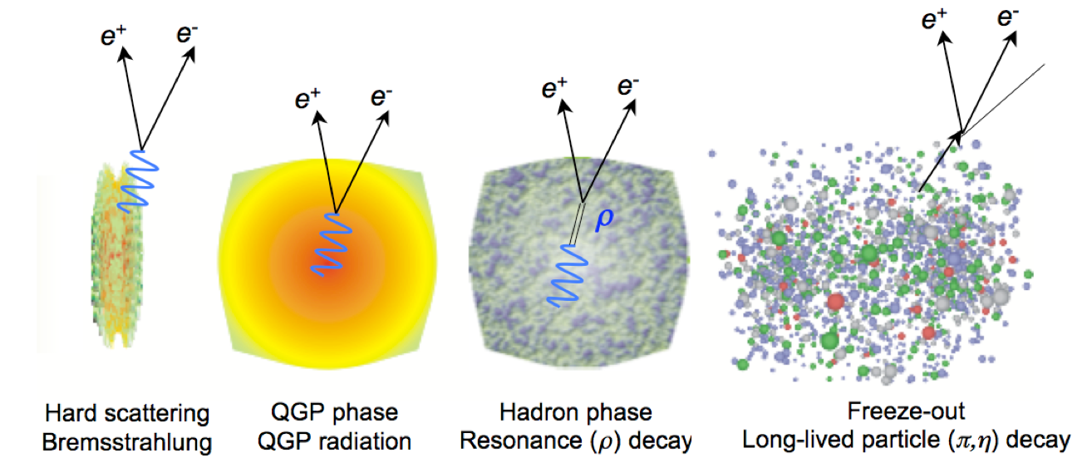
Motivation
Direct photon and virtual photon:
Created throughout evolution of system.
Very low cross-section with QCD medium.
Kinetic range reveals source of productions
High p_{T} (>5 GeV/c) --- from initial hard scattering.
Low p_{T} (1-5 GeV/c) --- from QGP.

Slide 4
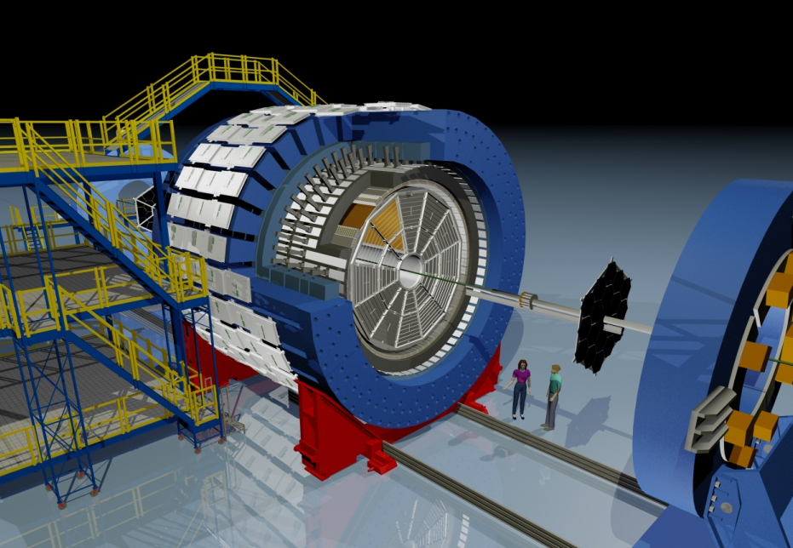
STAR detector
EEMC
Magnet
MTD
BEMC
TPC
TOF
BBC
HFT

Slide 5
Dataset and key detectors
Key detectors used in this analysis:
Time Projection Chamber:
|η| < 1 0<Φ<2π
Main tracking detector: track, momenta, ionization energy loss (dE/dx)
Time Of Flight:
|η| < 0.9 0<Φ<2π
Intrinsic timing resolution ~ 75 ps
Time-of-flight measurement
Improves PID
Barrel Electro-Magnetic Calorimeter:
|η| < 1 0<Φ<2π
Used for trigger and measure high-p_{T} processes
Type | Year | Min. Bias (0-80%) | EMC trigger (energy threshold 4.3GeV)
Au+Au 200 GeV | 2010 | 240M
 | 2011 | 490M | 39M
Combined 2010 and 2011 results.

Slide 6
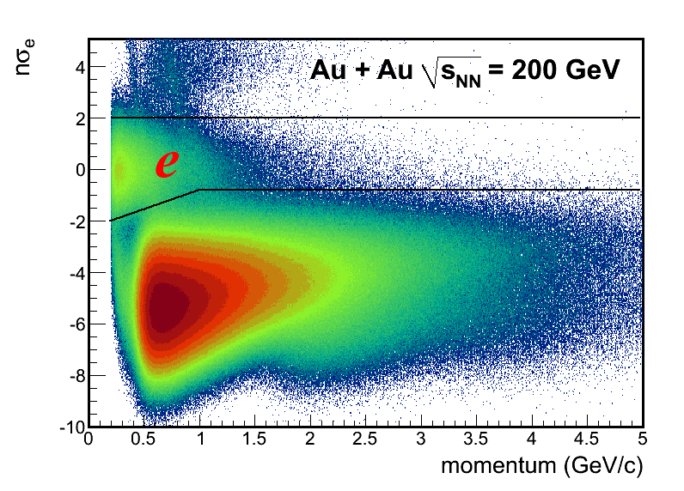
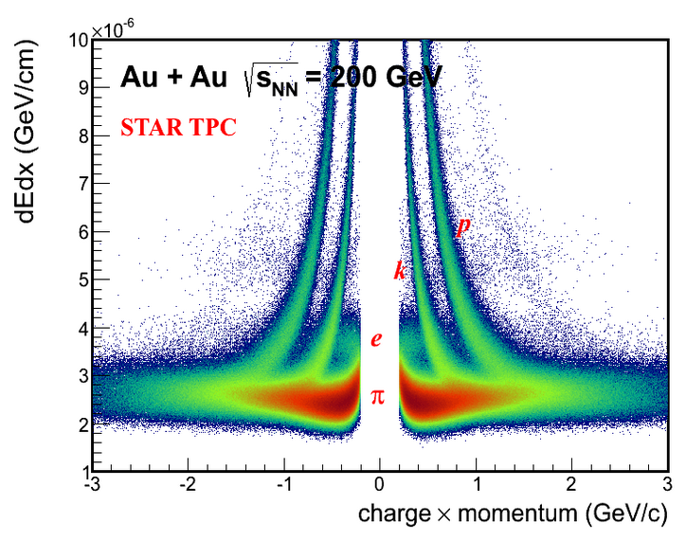
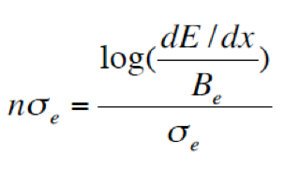
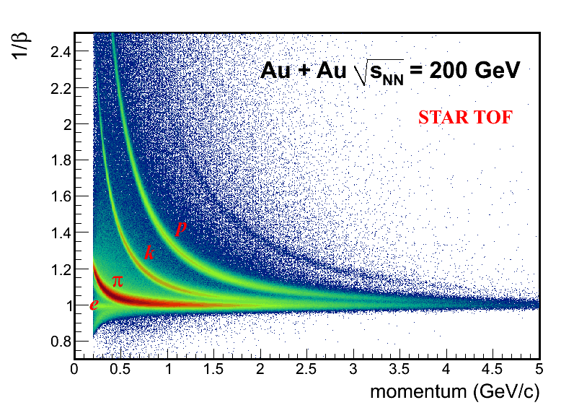
Electron identification (eID)
After βcut.
Collision system | Trigger | Momentum range | Purity
Au+Au 200GeV | Min.Bias | 0.2 – 2.0 GeV/c | ~95%
 | EMC trigger | 3.5 – 6.0 GeV/c | ~80%

Slide 7
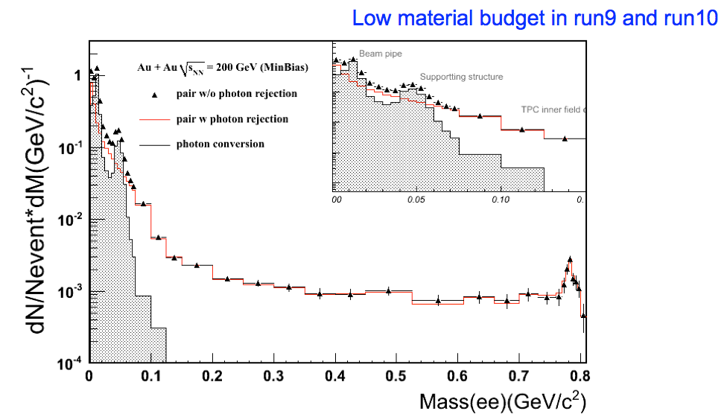
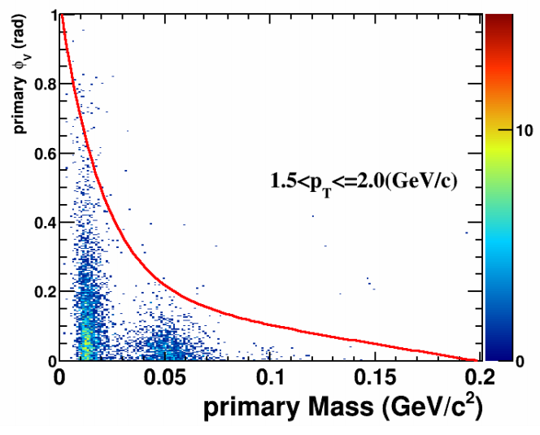
Photon Conversion Removal
GEANT
- Conversion electrons (~99%) are removed from signal pair reconstruction.

Slide 8
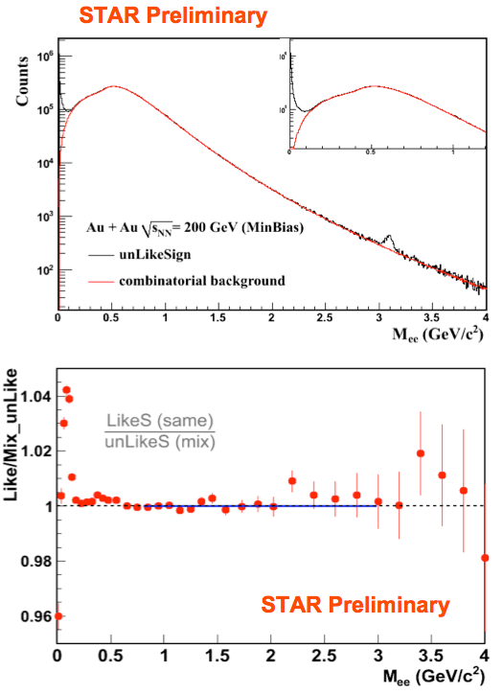
Background subtraction
Background sources
combinatorial background (non-physical)
correlated background
e.g. double Dalitz decay, jet correlation.
Background methods
mixed-event method: combinatorial only
improve statistics
used for correct unlike- and like-sign acceptance difference
like-sign method: combinatorial & correlated BG
pair cuts remove photon conversions

Slide 9
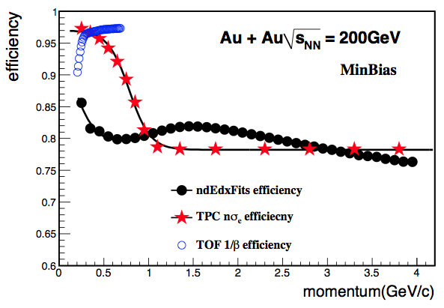
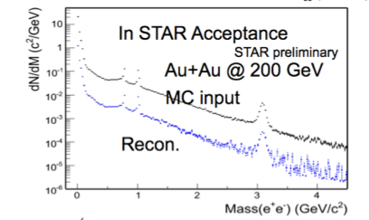
Efficiency correction
TPC Tracking efficiency
TOF acceptance * matching efficiency
PID efficiency (TPC dE/dx and TOF beta/BEMC)
Pair cut efficiency
physics acceptance:
p_{T}(e) > 0.2 GeV/c
|η(e)| < 1

Slide 10
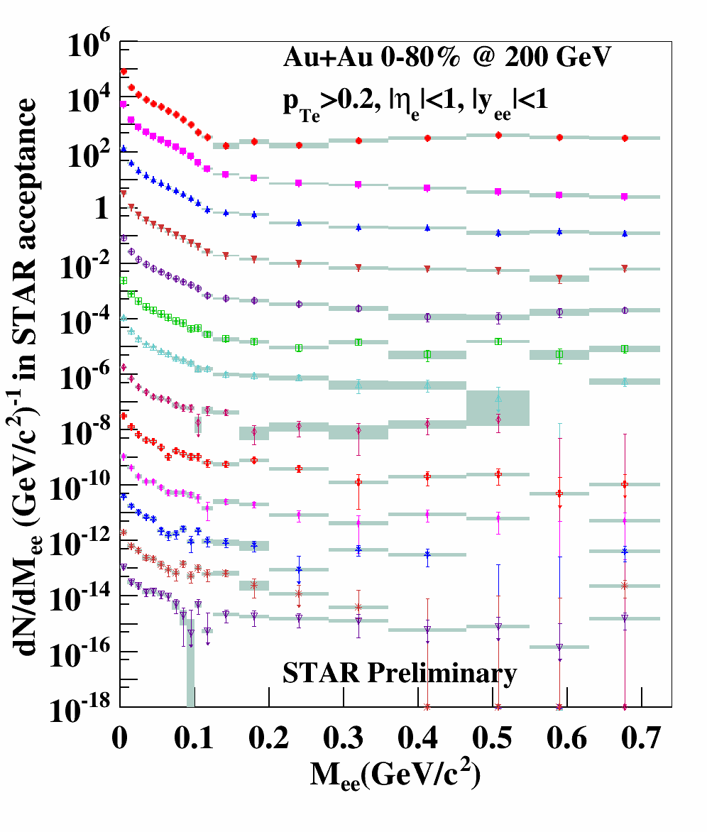
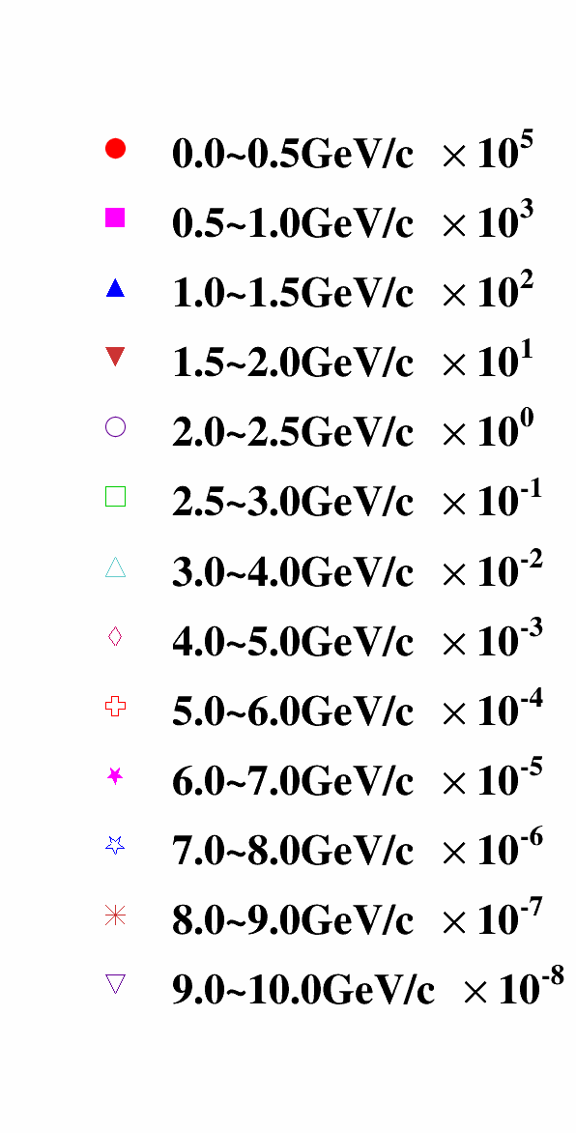
Low mass dielectron continuum
ee pair p_{T}
0-5 GeV/c
Run10+Run11 MB combined
5-10 GeV/c
Run11 EMC triggered data
The statistical and systematic uncertainties are shown by the bars and bands, respectively.

Slide 11
Signal extraction
PRC 81, 034911 (2010)

Slide 12
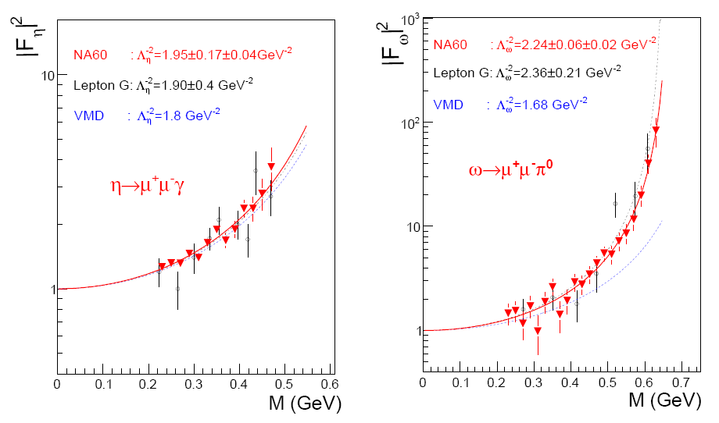
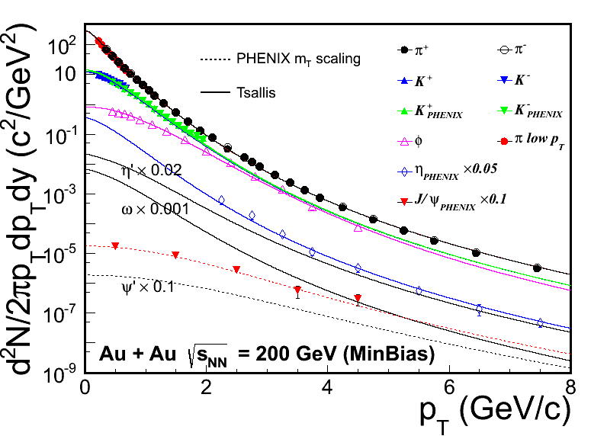
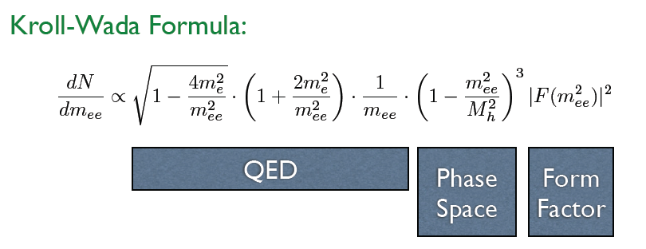
Cocktail simulation
NA60: PLB677 (2009) 260.
Flat rapidity (-1,1) , flat Φ (0, 2π)
p_{T}: Tsallis Blast wave functions.
N.M. Kroll, et al. Phys. Rev. 98, 1355 (1955).

Slide 13
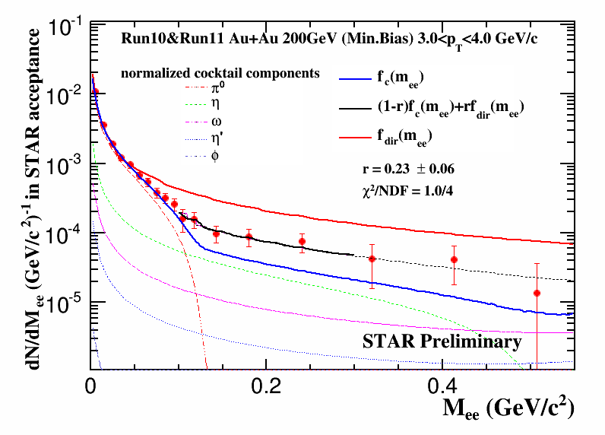
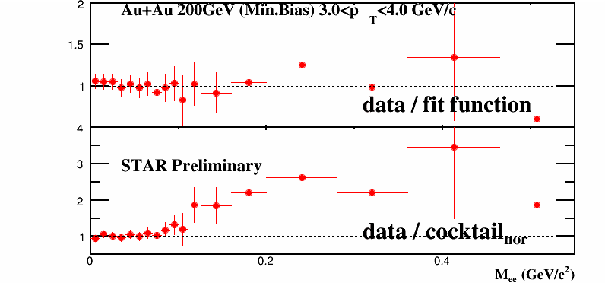
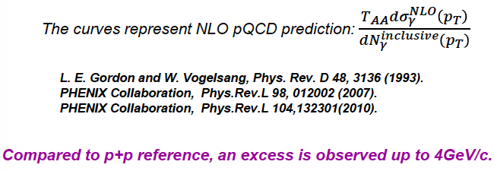
Fraction of direct virtual photon
fit range: 0.1-0.3 GeV/c²

Slide 14
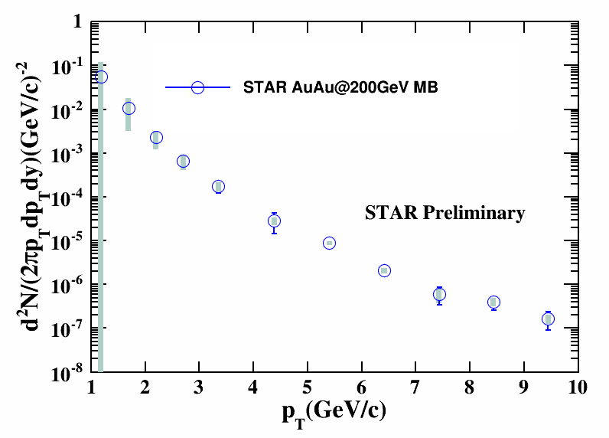
Direct virtual photon invariant yield
No η measurement at p_{T}<2 GeV/c. Most uncertainty comes from its yield.

Slide 15
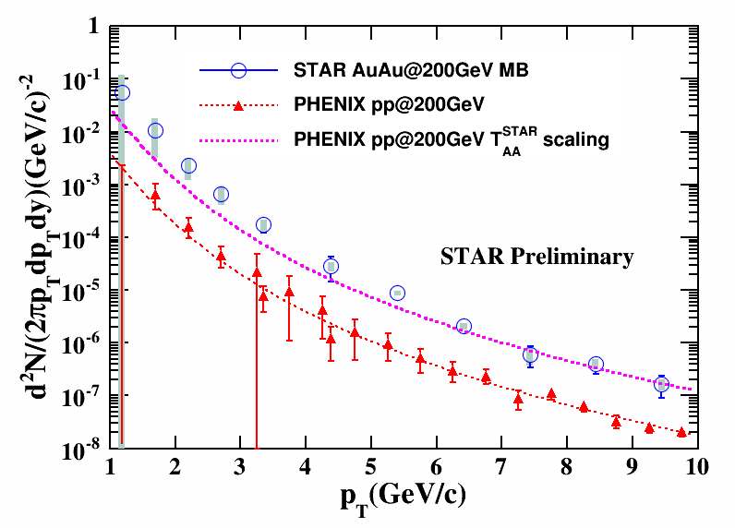
Comparison
In the high p_{T} range (5~10GeV/c):
the yield is consistent with a T_{AA} scaled fit function to PHENIX pp data.
[A. Adare et al. Phys.Rev.C.81:034911, (2010)]
[S.S. Adler et al. Phys.Rev.Lett., 98:012002, (2007)]
In the p_{T} range 1~5GeV/c:
Compared to the pp reference,
an excess is observed.

Slide 16
Theoretical calculation
Theoretical calculation including QGP, ρ, meson gas, and primordial production contributions is consistent with the invariant yield at 1<p_{T}<5 GeV/c within our uncertainty.
1. 0-20%: initial temperature about 445MeV at 0.17fm/c, fireball life time 15fm/c.
[Van Hees, Gale, and Rapp, Phys. Rev. C 84, 054906]

Slide 17
Summary
Measured direct virtual photon production in Au+Au collisions at 200 GeV at STAR.
An enhancement is observed for 1<p_{T}<5 GeV/c compared to T_{AA} scaled PHENIX p+p results.
A model including QGP, ρ meson, meson gas, and primordial productions is consistent with the enhancement.

