Slide 1
Dileptons and Photons at Collider Energies
K. Dusling, C.H. Lee and I. Zahed.
BNL14

Slide 2
Outline
Motivation
Rates,
Evolution
Experiments

Slide 3
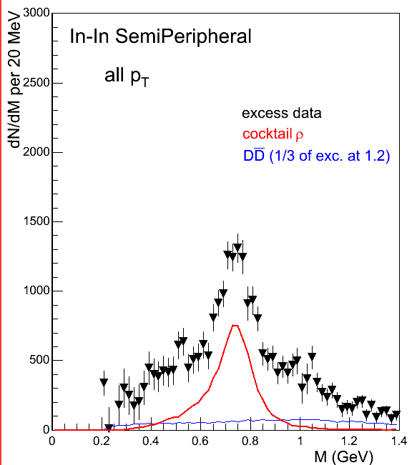
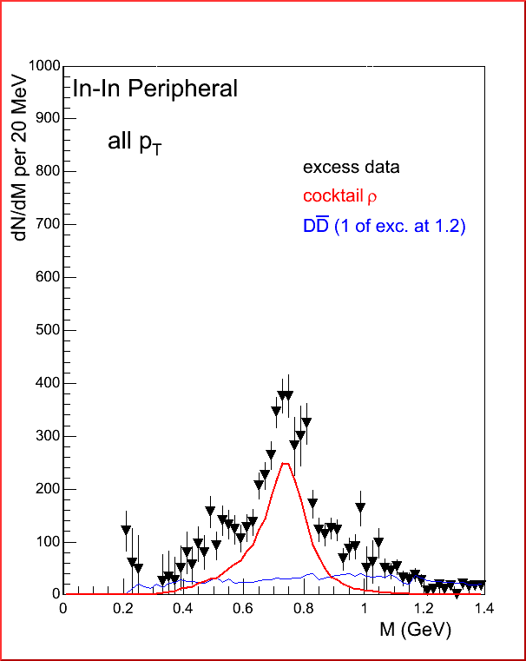
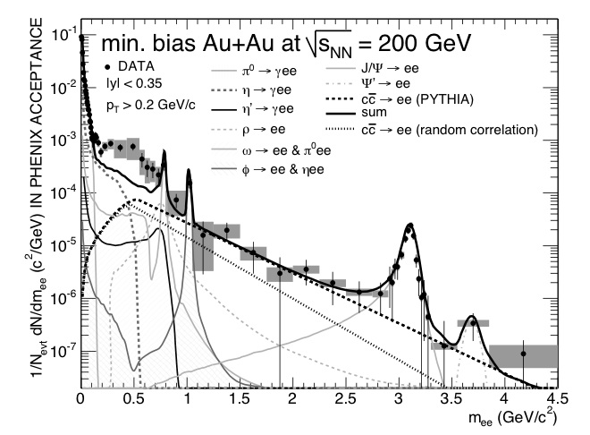
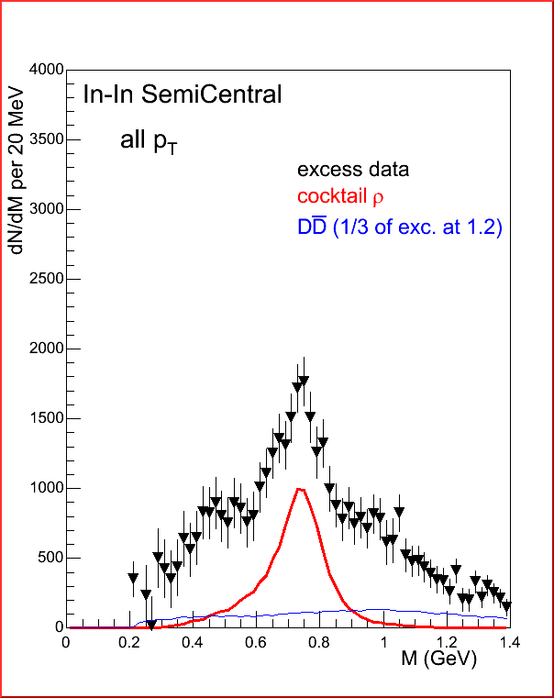
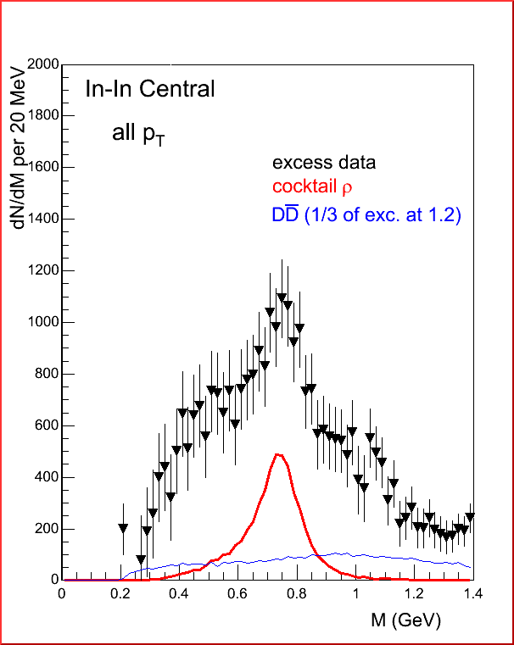
Na45: 95’
Phenix: 07’
Na60:03’
Star: 13’

Slide 4
Formally
acceptance
evolution
rate
time

Slide 5
Rates: Hadrons

Slide 6
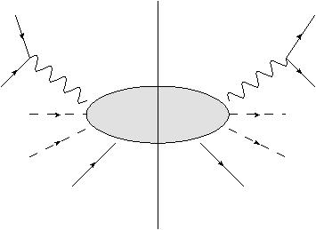
Equilibrium averaging

Slide 7
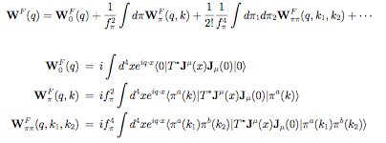
Hadronic Expansion
Notes:
As shown in Ref by McLerran the rate of dileptons per unit four volume is given as the
Thermal expectation value of the EM CC corr fn.
Various approaches differ in the way it is evaluated and approx.
Our approach is a virial expansion in meson and nucleon density
Similar in spirt to work by Huang--temperature expansion
Expand trace in terms of incoming pions and summing over disconnected pieces gives virial expansion

Slide 8
In Diagrams
Resonance Gas
1,2,3, …-Pi,
1,2,3-N
+ …
+ …

Slide 9
Vector-Axial Mixing: κ
κ
Chiral Limit and zero-mtm pion:
Notes:
Use of the CRF reduces the 1-pion piece to terms involving the vacuum vector and axial correlators which can be taken from data. We note that the the chrial limit and taking the pion to have zero momentum reduces the result to the order T2 result obtained by dey, eletsky and ioffe.

Slide 10
Data :
← e+e-
← τ Decay
.
Notes:
Vector correlator extracted by selecting events consisting only of an even number of pions.
Axial correlator from tau lepton decay into and odd number of pions

Slide 11
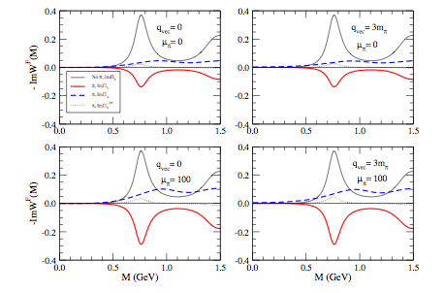
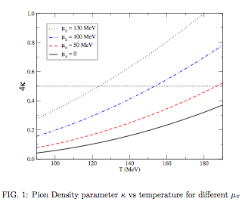
VA-Mixing explicitly
Dey, Eletsky, Ioffe 96

Slide 12
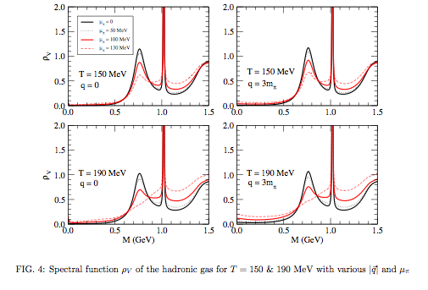
Vector Spectral Function

Slide 13
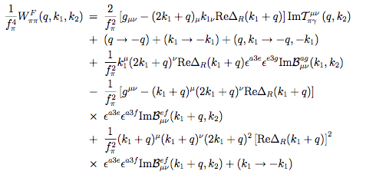
2-pion Final state:

Slide 14
Electric Conductivity:

Slide 15
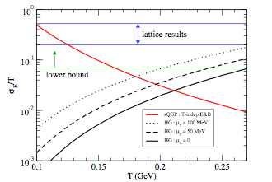
Hadronic vs Lattice:

Slide 16
Flavour Susceptibility:

Slide 17
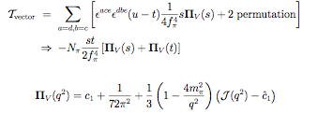
in details:

Slide 18
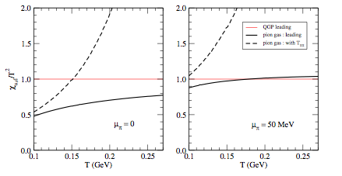
Flavour Susceptibility:

Slide 19
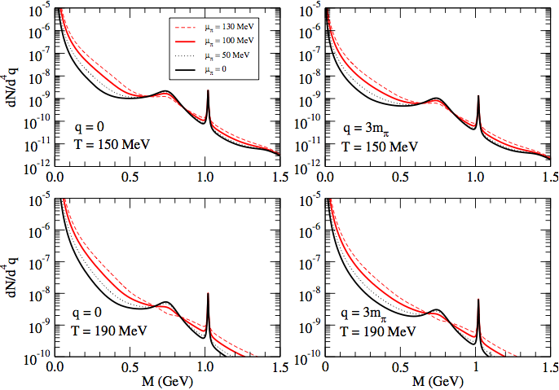
Rates

Slide 20
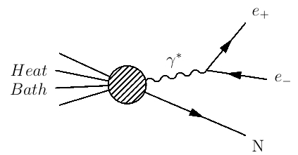
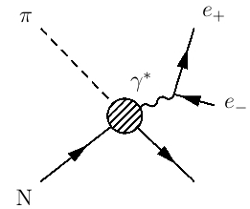
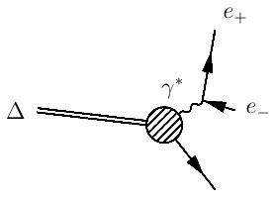
Rates: 1 Nucleon
=
+
1 Loop ChPT
N-Δ Transition
Notes:
The nucleon contribution is given by the spin-averaged forward Compton scattering amplitude on the nucleon with virtual photons. Only measured for q^2 less than or equal to zero. So at photon point use optical thm.
For off-shell photons must use chiral constraints.
Broken chiral symmetry dictates form of strong interaction lagrangia for spin 1/2 particles. Do one loop expansion in f_\pi. Add contribution of Delta to one loop results to take into account large conriubtion of Delta to Amplitude.

Slide 21
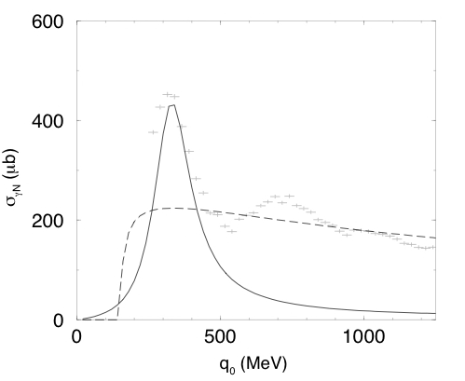
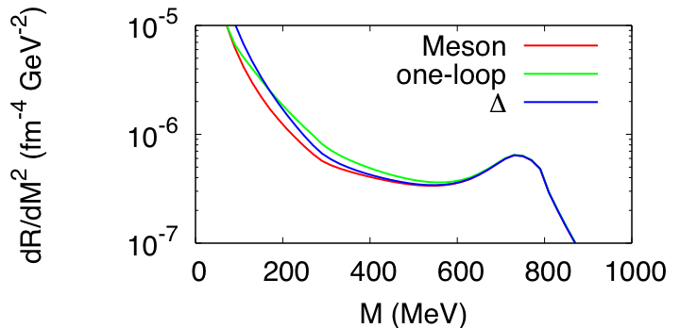
Input at the Photon Point
πN background
Δ
Notes:
Result for compton scattering on nucleon
Background pi N compton contribution (parameter free) And Delta contribution.
Reproduce photon rate fairly well so now can move to q^2 > 0.

Slide 22
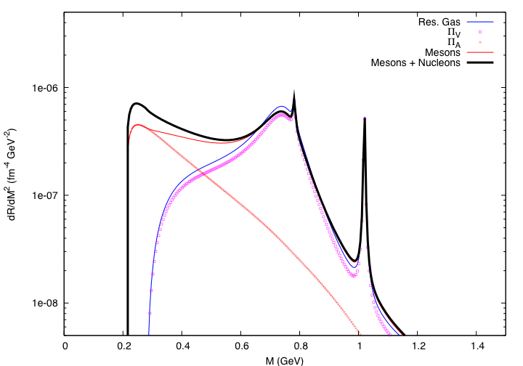
Typical Mixing in
a₁→πρ→a₁
T=150 MeV μb=225 MeV

Slide 23
Rates: sQGP

Slide 24
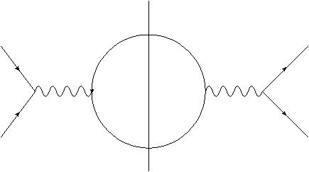
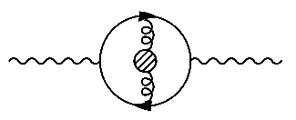
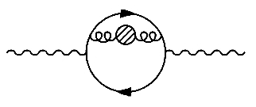
sQGP:
l+
l+
l-
l-
Hansson and Zahed 91’
Notes:
First contribution comes for born qqbar annihilation.
Also consider contribution to rates from chromoelectric, chromagnetic and correlations between static part of a4 gauge field. (time component of gluon field.)
Blob can mean either B^2, E^2 or A4^2
OPE used to evalute Im part of correlator
Nieve calculation: assume that the qqbar annihilation process that give rise to dileptons occur in the presence of a low mtm fluctuating background gluon field.
A constant potential a4 is the same as a an imaginary color chemical potential.
Fig. Soft gluon contribution to vector current

Slide 25
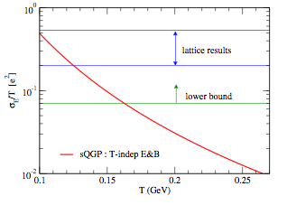
Electric Conductivity

Slide 26
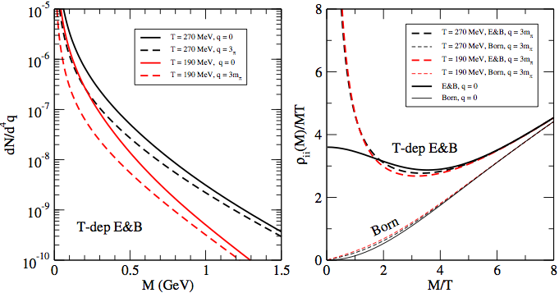
sQGP Rates

Slide 27
Evolution

Slide 28
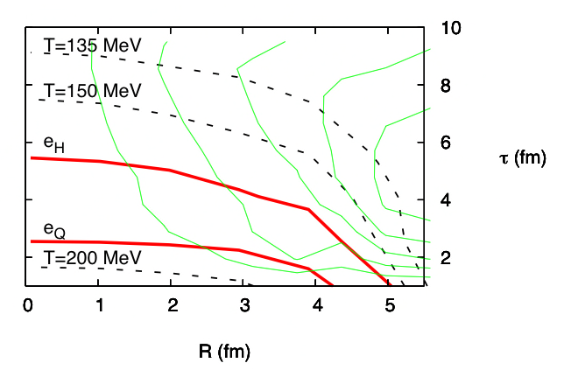
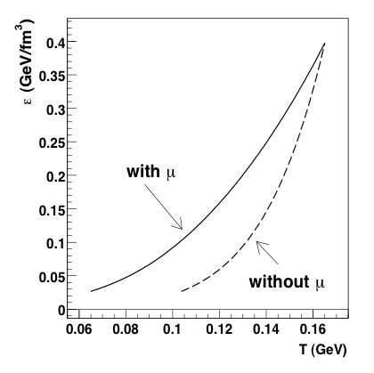
Sample hydro evolution
Faster cooling x higher rates: same

Slide 29
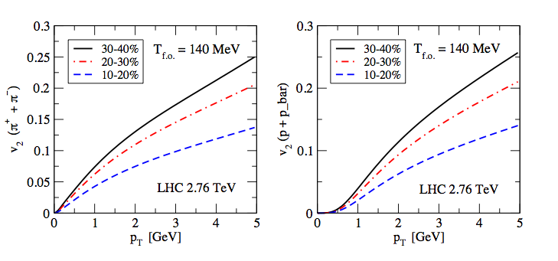
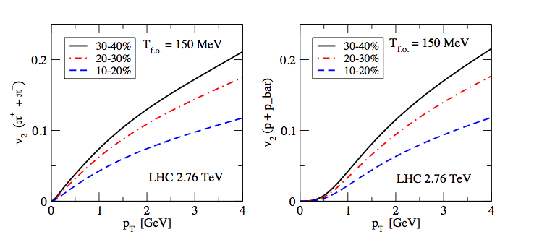
V2 Flow @ 2.76 TeV

Slide 30
Dileptons: NA60, Phenix, Star

Slide 31
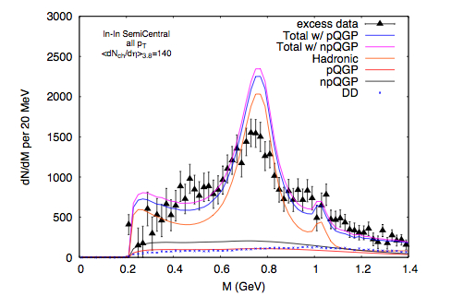
NA60 : dN/dη=140 95’

Slide 32
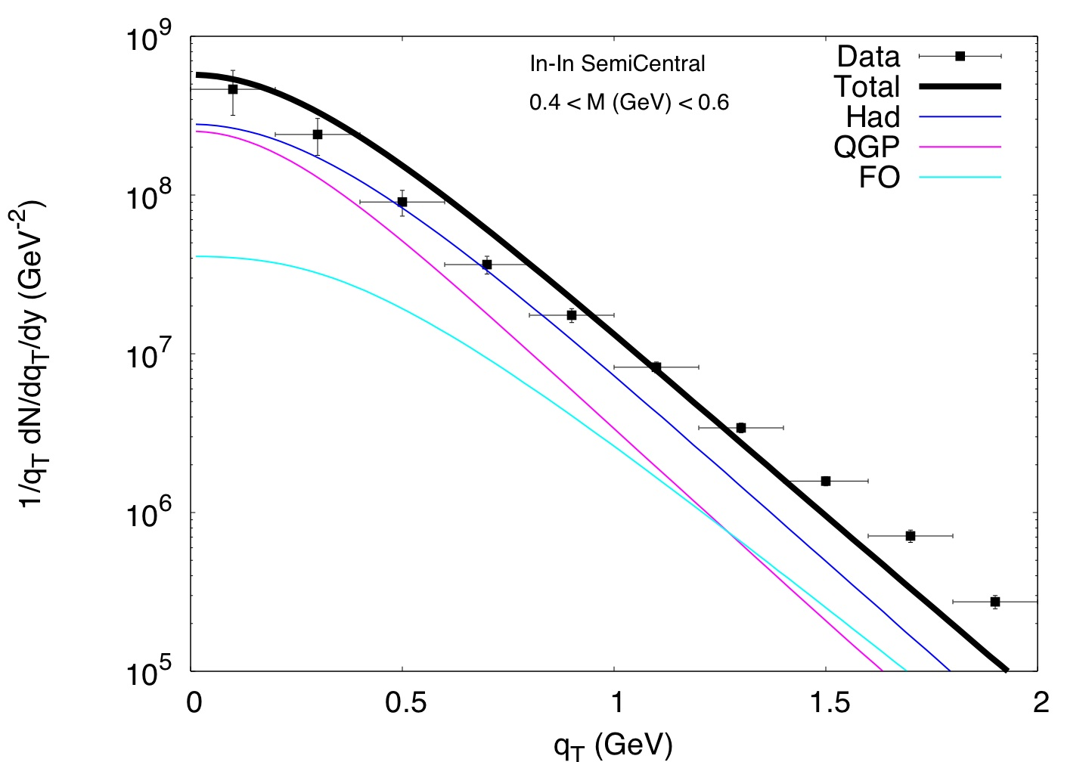
Pt Spectra: low

Slide 33
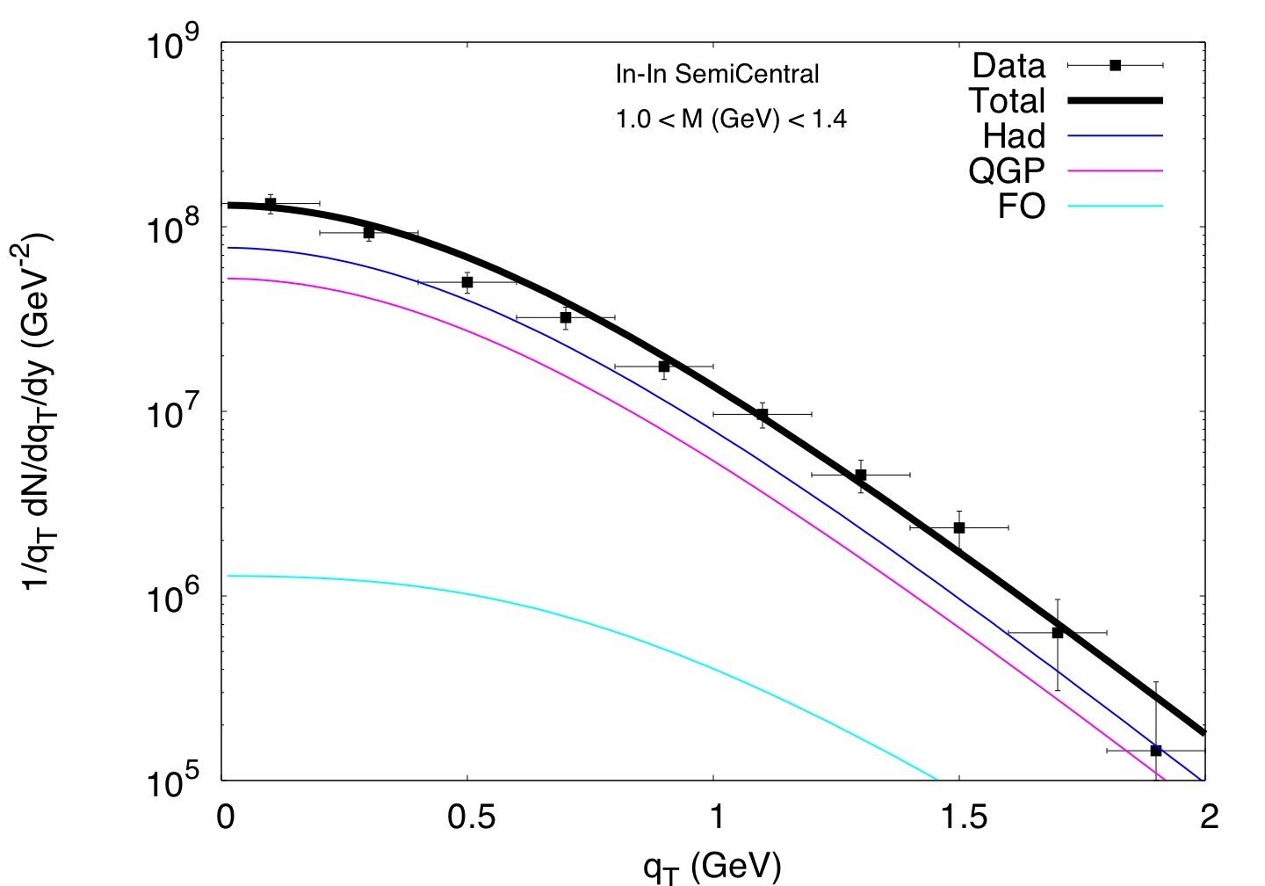
Pt Spectra: High

Slide 34
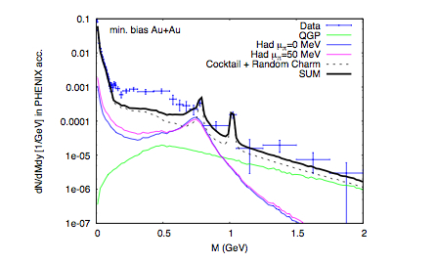
PHENIX

Slide 35
Beam Energy Scan: STAR 13’

Slide 36
Photons: WA90, PHENIX

Slide 37
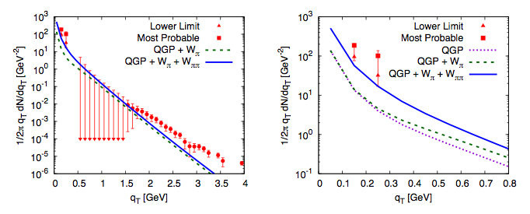
WA98
0<qT (GeV) <4
0<qT (GeV)<0.8

Slide 38
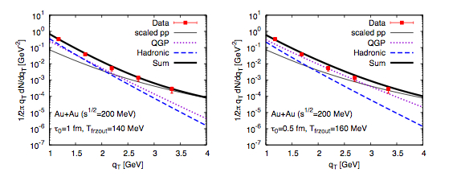
PHENIX
RHIC1
RHIC2

Slide 39
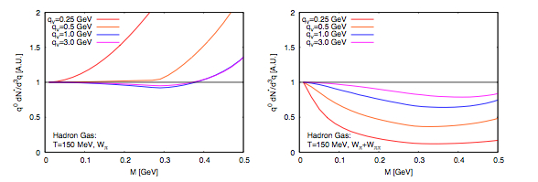
PHENIX extrapolation: γ
PHENIX: M<<qv
1
15% Systematics!

Slide 40
V2 PHENIX

Slide 41
Achievements
EM “OK”*
LxR “restored”
QGP “visible”
V2 “low”
(* π < < ρ)

