Slide 1
Photon and dilepton production in semi-QGP
Shu Lin
RIKEN BNL Research Center
Collaborators:
Photon/dilepton rate: Hidaka, SL, Satow, Skokov, Pisarski
Collinear photon rate: Hidaka, SL, Satow, Pisarski
Hadronic rate&hydrodynamics: Gales, Jeon, Paquet, Vujanovic
RBRC, Aug 22, 2014

Slide 2
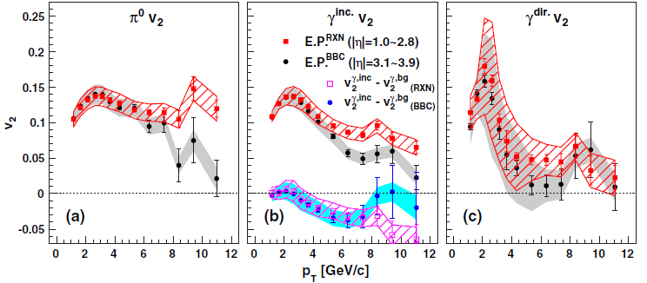
Motivation: Puzzle of photon v2
PHENIX, PRL 2012
v2 of photons comparable with v2 of pions at p_{T} < 4GeV
Many photons produced at early stage, expect less v2
Talk by A. Drees

Slide 3
Different sources of direct photon
Prompt photon (pQCD)
Pre-equilibrium photon?
Thermal photon: QGP phase + hadronic phase
Do we understand well photon rate in QGP phase?
What is known:
LO: Arnold, Moore and Yaffe JHEP 2001
NLO: Ghiglieri, Hong, Kurkela, Lu, Moore and Teaney, JHEP 2013
20% increase for phenomenologically interesting coupling
Any non-perturbative effect?

Slide 4
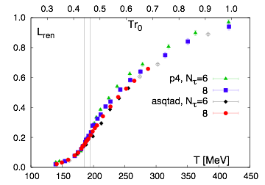
Polyakov loop in QCD
Semi-QGP in QCD, smooth rise of the loop
Hadronic
Semi-QGP
Complete-QGP
Bazavov et al, PRD 2009
loop
RHIC: 350 180 MeV
LHC: 450 180 MeV
T=0
T_{c}
2T_{c}

Slide 5
Effective matrix model
Polyakov loop
Non-perturbative
can be modeled by classical mean field
~ 1/g
Dumitru, Guo, Hidaka, Korthals Altes, Pisakrski, PRD 2011, 2012
high T limit
Q as imaginary chemical potential, reduces quark number density by the loop
Similar reduction for gluon number density

Slide 6
Reduction of d.o.f. & transports
QGP
Semi-QGP
quark
gluon
probe quark
less d.o.f. to scatter with
Suppression of energy loss & viscosity
Hidaka,Pisarski, PRD, 2008
SL, Pisarski, Skokov, PLB 2014

Slide 7
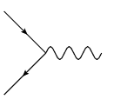
Enhanced dilepton production
a
$$q$$
$$\overline{q}$$
a
Suppression of dilepton rate due to reduced of quark number density? NO!
Boltzmann approximation
Dilepton rate ~
Effect of Q cancel out!
The effect of imaginary chemical potential cancels for a color singlet initial state.
Moreover, the rate is even enhanced beyond Boltzmann approximation!

Slide 8
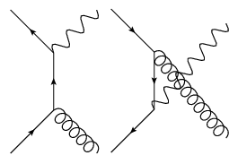
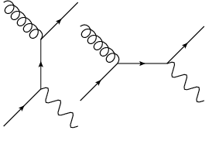
Suppressed photon production: 2→2 processes
Pair annihilation
Compton scattering
a
$$γ$$
a b
b
b
a
$$γ$$
a b
No cancellation!
Partial cancellation
Effect of imaginary chemical potential does not cancel out completely in the initial states.
Suppression of photon rate from 2 → 2 processes.

Slide 9
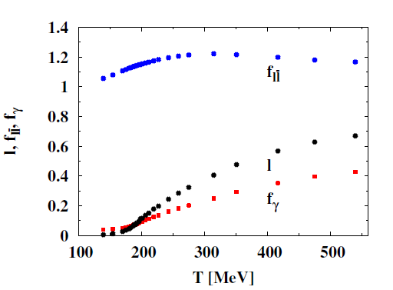
Modification factors of dilepton & photon rate
Dilepton rate
Photon rate
for leading log 2 →2 rate
above 1, non-monotonous in T
Dilepton in semi-QGP larger than QGP
See also talk by Zahed
loop
significantly below 1
Photon in semi-QGP much smaller than QGP

Slide 10
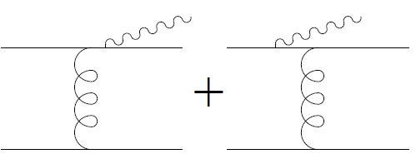
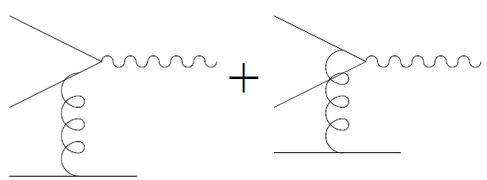
Suppression of collinear photon rate
bremsstrhalung
pair annihilation
Aurenche, Gelis, Zaraket, PRD 2000
Arnold, Moore, Yaffe, JHEP 2001/2002
Scattering with arbitrary number of soft gluons contributes at the same order
Soft gluons in QGP give additional Bose-Einstein enhancement
$$E\sim gT, \frac{1}{e^{E/T}−1}\sim \frac{1}{g}$$
In semi-QGP
$$E→E−i\left(Q_{a}−Q_{b}\right), \frac{1}{e^{(E−iQ_{a}+iQ_{b})/T−1}} \sim O(1)$$
Q ~ T hard, gluons soft only when a=b. Soft gluon density suppressed by 1/N

Slide 11
Suppression of collinear photon rate
bremsstrhalung
suppressed by loop
suppressed by 1/N
Hard quark suppressed by loop
Soft gluon density suppressed by 1/N
Additional 1/N suppression in collinear (LPM) rate
Quantitative study under way: leading order for 2 →2 rate plus collinear rate

Slide 12
Prompt photon
Prompt photon = hard scattering photon + collinear fragmentation photon
hard scattering photon sensitive to nuclear PDF
nPDF x nPDF ≠ pp scaled
Long emission time
fragmentation photon sensitive to fragmentation function
Klasen et al, JHEP 2013

Slide 13
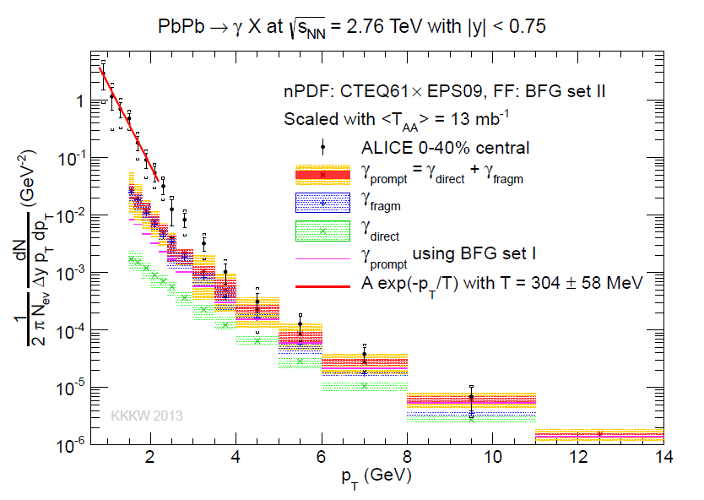
Prompt photon uncertainty large
direct (hard scattering)
Klasen et al, JHEP 2013

Slide 14
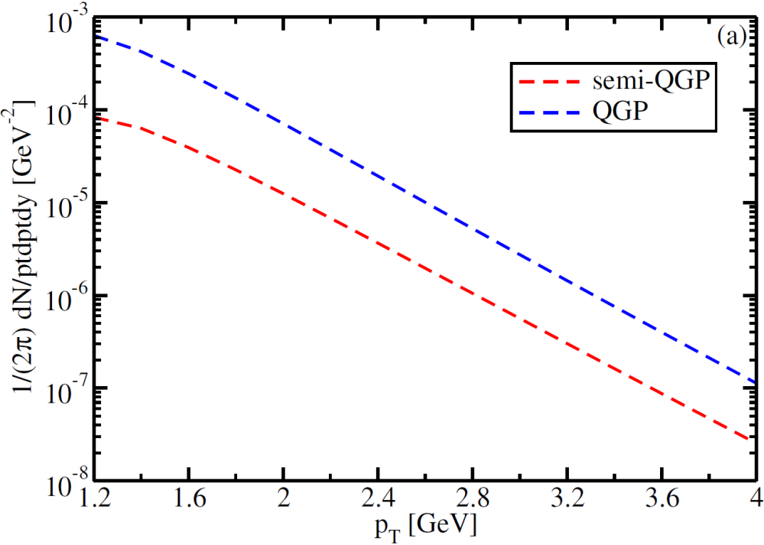
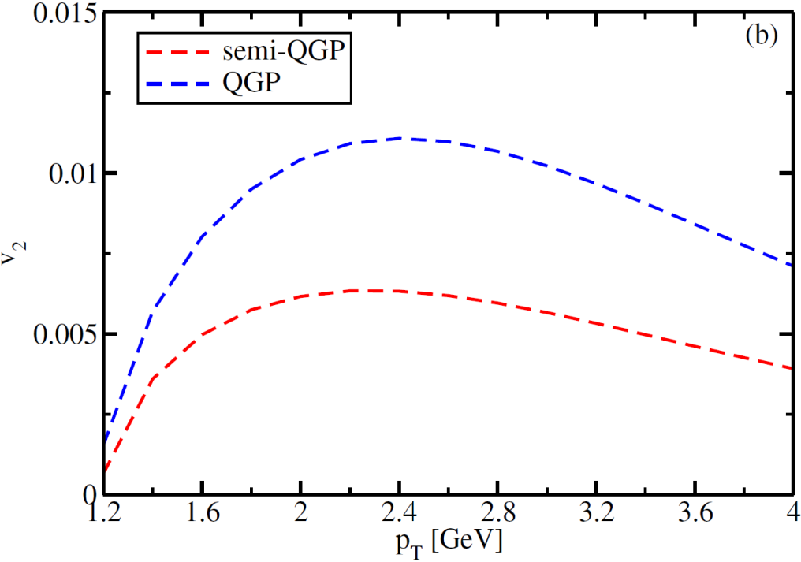
Photon (RHIC): strong suppression
Strong suppression in semi-QGP.
increases with T
less suppression at high T,
Photons produced at high T experience less v2.

Slide 15
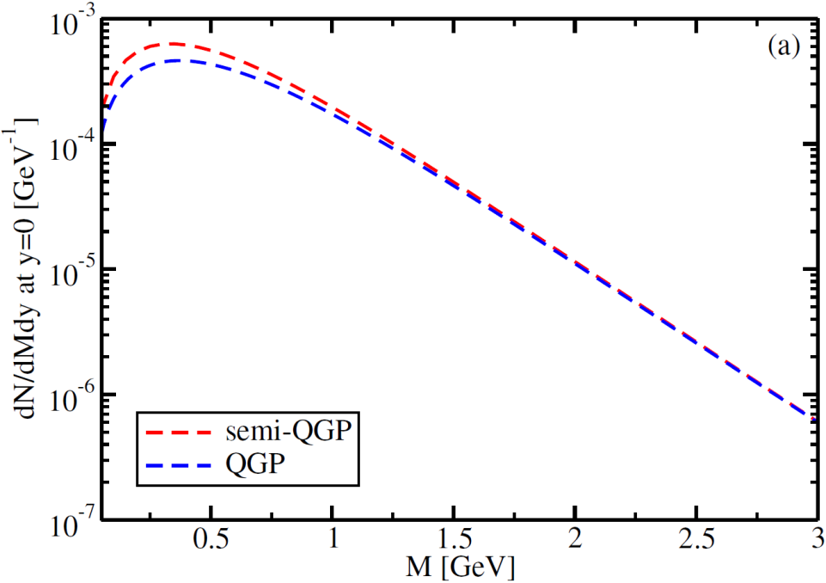
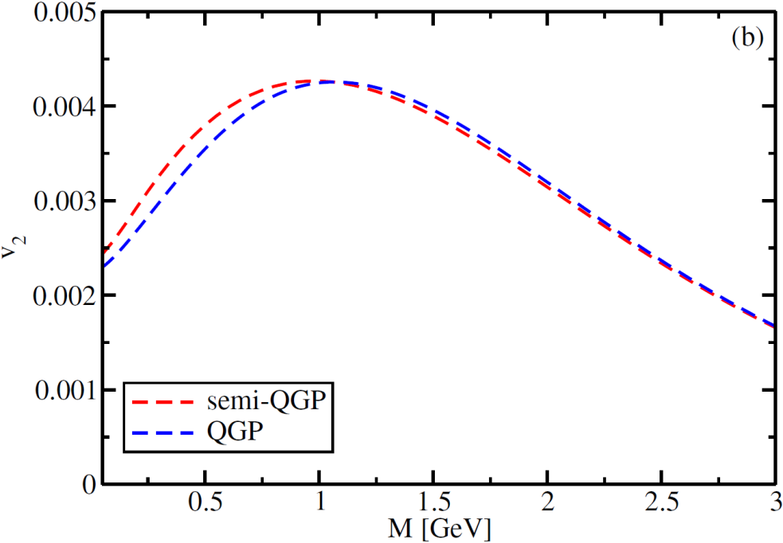
Dilepton (RHIC): no significant change
Modest enhancement in semi-QGP, no significant change to v2

Slide 16
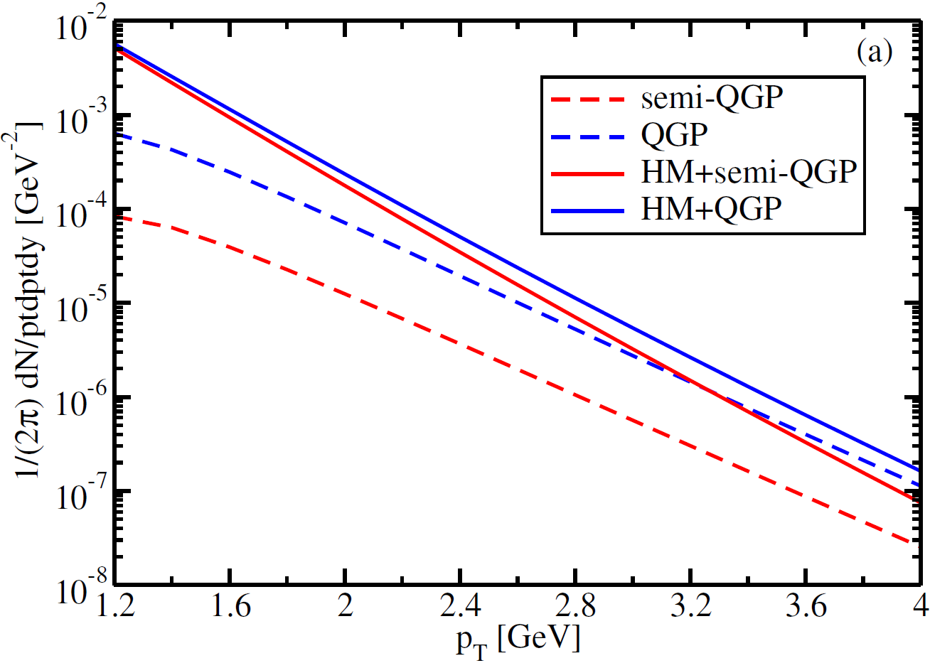
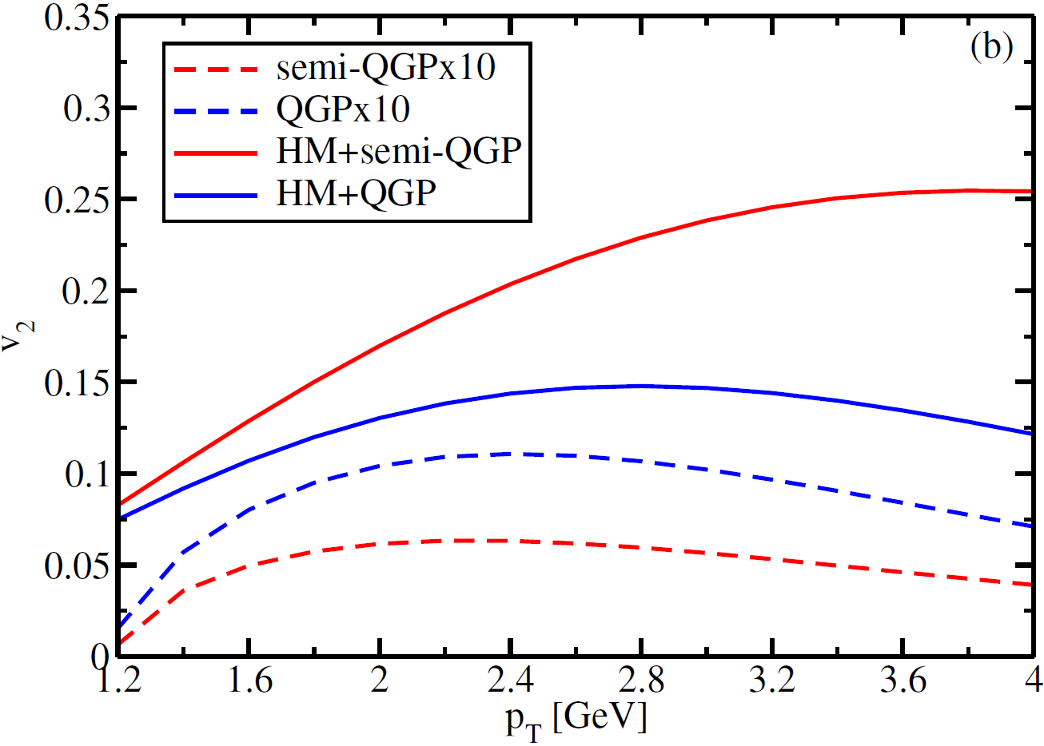
Photon (RHIC): QGP + hadronic matter
Semi-QGP suppresses significantly N_{QGP}, enhancing the overall v2
$${v2}_{QGP}<{v2}_{HM}$$
$$v2=\frac{{v2}_{QGP}∗N_{QGP}+{v2}_{HM}∗N_{HM}}{N_{QGP}+N_{HM}}$$
Model of semi-QGP works in the right direction for photon v2

Slide 17
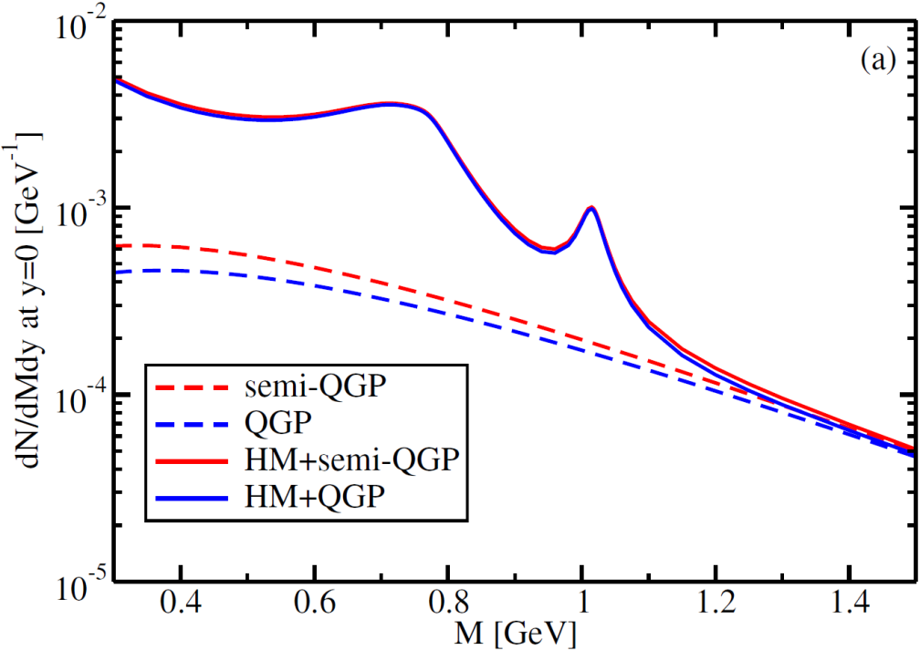
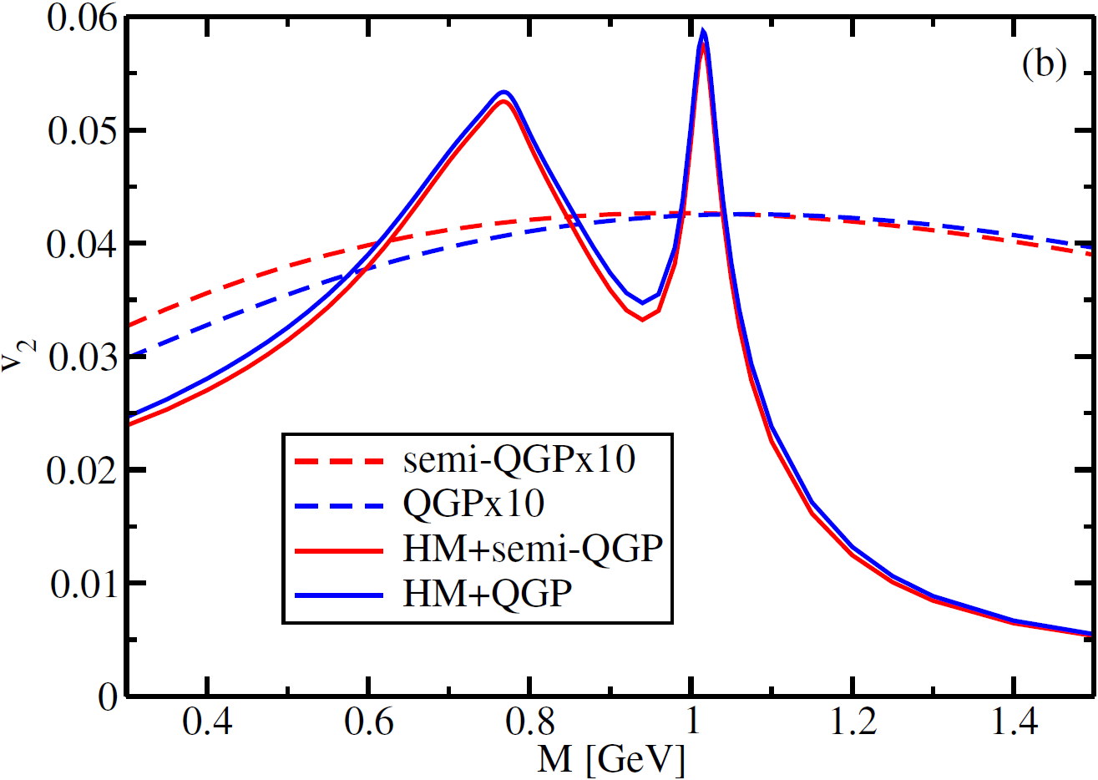
Dilepton (RHIC): QGP + hadronic matter
Semi-QGP enhances N_{QGP}, lowering the overall v2
$${v2}_{QGP}<{v2}_{HM}$$
$$v2=\frac{{v2}_{QGP}∗N_{QGP}+{v2}_{HM}∗N_{HM}}{N_{QGP}+N_{HM}}$$
Model of semi-QGP not in tension with available dielectron yield/v2

Slide 18
Thank you!

Slide 19
Medium dependence of fragmentation photon?
Long emission time
FF can be modified by:
Jet-photon conversion
Photon bremsstrahlung
Fries, Muller, Srivastava, PRL 2003
Zakharov, JETP Lett 2004

Slide 20
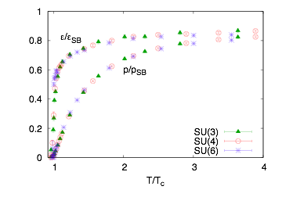
Scaling of thermodynamics in pure glue
e_{ideal}, p_{ideal} ~ N_{c}²-1
e and p approach
ideal gas limit slowly
N = 3, 4, 6
Boyd, Engels, Karsch, Laermann, Legeland, Luetgemeier, Petersson, NPB, 1996
Datta, Gupta, PRD, 2010

Slide 21
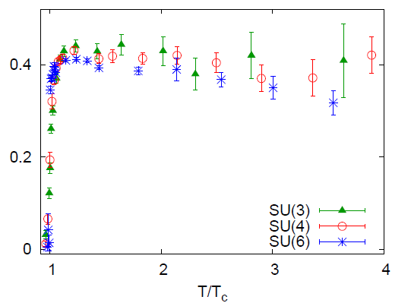
Scaling of thermodynamics in pure glue
trace anomaly normalized by number of d.o.f.
Datta, Gupta, PRD, 2010
semi-QGP
For N=3, T_{c} ~ 180 MeV
QGP at RHIC: 350 MeV 180 MeV
LHC: 450 MeV 180 MeV

Slide 22
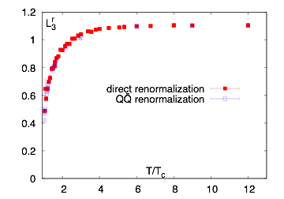
Polyakov loop in pure glue N=3
Semi-QGP in pure glue, smooth rise of the loop
Gupta, Hubner, Kaczmarek, PRD 2008
← Confined →← SemiQGP→ ← “Complete” QGP →
←1.0
<loop>
← ~ 0.4
T=0

Slide 23
Sources of photon and dilepton
Direct Photon: hadronic phase + QGP phase + prompt photon
low p_{T}
intermediate p_{T}
high p_{T}
Dilepton: hadronic phase + QGP phase
low p_{T}
high p_{T}
Expect reduced photon/dilepton rate in semi-QGP. Can help increase the weight of photon/dilepton from other sources.

