Slide 1
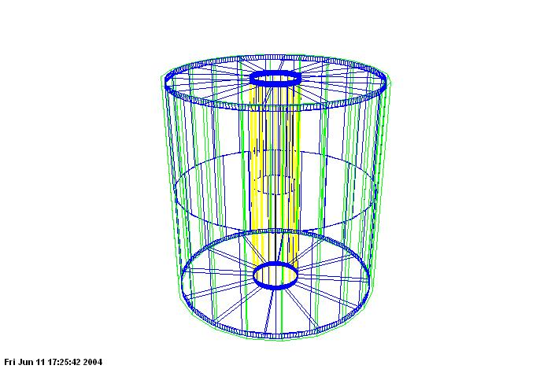
Virtual Monte Carlo and new geometry description in STAR
Maxim Potekhin
STAR Collaboration Meeting, BNL
July 17, 2004

Slide 2
Overview
What is Virtual Monte Carlo (VMC) and its origins? 
Why are we interested in VMC and alternative geometry models? 
Current status of the Star VMC and Detector Description project 
Plans for the VMC 

Slide 3
Geant 3 and 4 as precursors of the Virtual Monte Carlo (VMC)
Geant 3: still the mainstay of many simulation applications
Geant 4 gaining steam
Different language platforms and approaches (tracking and physics)
Each represents a fairly closed system:
  different geometry models
  lack of platform neutral geometry description
  no interchangeable components between the two
  difficulty of interfacing any other component such as a third party geometry manager
Transition from 3 to 4 inevitable but a major (and expensive) project for any collaboration
  geometry (re) definition a major problem (re-coding? conversion?)
  other infrastructure development

Slide 4
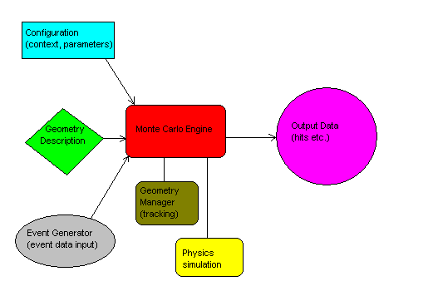
The VMC concept
Virtual Monte Carlo is based on the modular approach to the application design.
Individual components (in G3, G4) are identified and given appropriate interfaces.
The user code can be run, with minimal or no changes, with
different geometry management software,
different physics simulation etc.

Slide 5
What is the VMC, in practical terms?
In the narrow sense, as a software currently in existence, the VMC
is a set of ROOT classes meant to implement the design goals stated above. Large part of the code is dedicated to hiding the implementation detail of the concrete MC engine
has continuing support of the core ROOT development team
has been tested with at least two underlying simulators, Geant 3 and 4, and there is a promise of eventually supporting Fluka
Features the important option to use different geometry models:
  has a generalized geometry building and tracking interface similar to Geant 3
  does a good job of geometry encapsulation
  has been tested with an alternative geometry manager, based on the ROOT geometry system (often referred to as TGeo)
appears to fulfill the promise of having a single user application that would work with different underlying components

Slide 6
Our interest the VMC
the VMC is a hedge against our simulation framework becoming obsolete in terms of user expertise and platform change.
we want to increase transparency to the users, in part due to benefits of OO programming and the more familiar language platform (C++).
VMC can be seen as a bridge between Geant 3 and 4, and future MC platforms
Has the potential to become a long term MC solution for STAR, with a stable API, and a geometry description system that facilitates the ongoing detector development and upgrades

Slide 7
Our interest the VMC
it is a step to make the STAR software more robust by implementing a unified geometry description, i.e. finally establishing the SAME and CONSISTENT geometry in simulation and reconstruction (still an outstanding issue)
VMC offers the possibility of using an alternative geometry manager (TGeo), which opens the possibilities of:
  easier geometry navigation by the user, from C++ code
  consistent interface with reconstruction
  more flexible, and portable, geometry description: geometry persistent in ROOT files, XML (and its derivatives), possible CAD systems interface, various TGeo based interfaces, event displays
  more practical description of the “real” geometry, e.g. based on surveys; hence “better simulation”

Slide 8
The TGeo component and its role in VMC
the TGeo is a broad colloquial term used to describe a set of geometry related ROOT classes
it is feature-rich and allows one to build complex geometries
it is suitable for building a Geant-like application such as VMC
can be used in event displays and potentially offers sophisticated graphic functionality (confer recent Qt work by V.Fine)
can be considered “platform neutral” as it is not really tied to any particular application such as Geant, and can be productively used to navigate geometry in STAR reconstruction
an attractive component to have in any future simulation framework

Slide 9
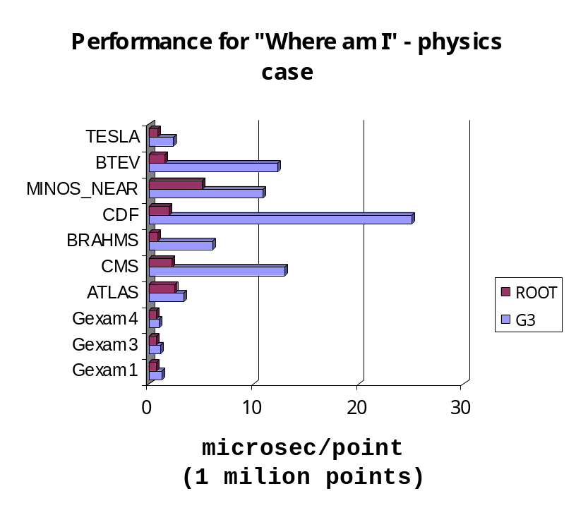
Our interest the VMC and TGeo
there is a potential of substantial performance gain (subject still open to testing, validation etc). Confer the following diagram from CHEP’03 (authors:René Brun, Andrei Gheata, Mihaela Gheata)

Slide 10
Current status of the STAR VMC project
the team: V.Fine, Y.Fisyak, V.Perevoztchikov, M.Potekhin
Accomplished steps:
  analysis of the existing VMC applications including ALICE
    possibility of software reuse considered
    an example of a large detector implementation
  initial design of core classes for STAR
  Geant 3 to ROOT geometry converter built into ST_geant_Maker (work in progress)

Slide 11
Current status of the STAR VMC project
Accomplished steps:
  validation of the ROOT geometry manager in the VMC context:
    same set of tracks injected into a realistic STAR geometry,
    regressions test: histograms of volumes and materials hits, track lengths in different volumes
    differences identified and mostly understood (work in progress)
    No “show stopper” problem with the TGeo geometry manager found so far
    Issues requiring close attention do exist (divisions, “many” etc)
  test application created
  unexpected benefit: validation of the actual STAR geometry (some bugs found and fixed)

Slide 12
Detector Description in STAR VMC
Detector Description is the method by which the detector geometry model is defined by the user. It can be a piece of Fortran code, a CAD system file, a piece C++ code, a XML file etc.
Now the Detector Description component should be viewed in a broader context of the VMC, as one of its components

Slide 13
Detector Description in the context of STAR VMC
What do we have now, and what can we hope to have in terms of tools and formats for the Detector Description in STAR?
  Backward compatibility and building a bridge between the old and new applications:
    the STAR software creates a Geant 3 based geometry model and exports it as a ZEBRA file
    existing g2root converter opens a possibility of reuse; reads ZEBRA and exports geometry as a C++ (cint) macro
    a new method in the St_geant_Maker does a similar conversion in memory
  Persistent feature of the ROOT geometry tested and used (geometry saved to, and reloaded from, .root files)

Slide 14
Detector Description
Directions for the Detector Description in STAR
  it appears likely that we shall use one (or all) of the following:
    C++ code with a proper API to interface the database
    A XML (or its derivative such as GDML etc), which would necessitate the creation of the parser
    geometry components obtained by conversion from Geant/Zebra
The beauty of VMC is that it allows us to do that!
We will try of course to find a uniform solution (XML solution being of particular interest)

Slide 15
Detector Description
Open issues in Detector Description:
Have to make a choice of a particular language (schema), such as GDML, AGDD etc
None of the existing parsers is useable right away in the TGeo context, so effectively this needs to be implemented almost from scratch
Separation of geometrical structure and the data component: current lack of a standard database interface in the existing implementations (will probably have to do it ourselves and/or establish a joint project with interested parties)

Slide 16
STAR VMC plans
Short term (2-10 weeks)
  finalize the design of the core VMC classes
  create a testbed application that would allow the development team to collaborate on the project
  build an interface with reconstruction (i.e. persist the MC data in the form that can be fed into reco)
Medium term (2-12 months)
  make a choice of the Detector Description and implement it
  build a fully functional VMC application prototype
  conduct physics tests
  work out integration with reco
Long term (12-18 months)
  have the STAR detector fully described within the new framework
  have the TGeo interfaced and used in reco
  phase out staf/gstar/starsim

