Slide 1
PP Physics Goals for RUN 15 and 16

Slide 2
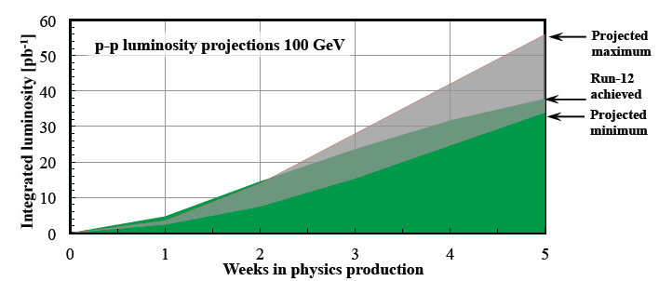
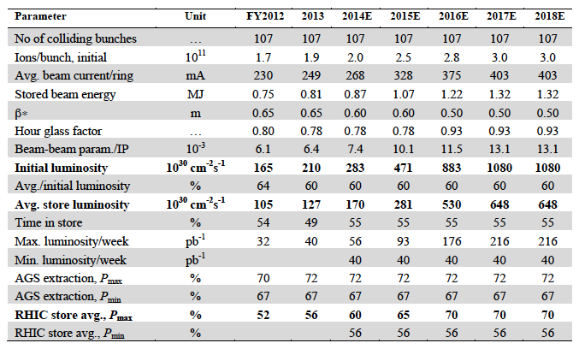
CAD Guidance
http://www.rhichome.bnl.gov/RHIC/Runs/RhicProjections.pdf
polarisation: 60%
250 GeV:
lets assume dynamic β*
works → can gain 2x
lumi per 2013 fill
impact of no 500 GeV running
between
2013 and 2016 unknown
Other Info:
Talk by Wolfram: http://www.star.bnl.gov/~eca/pp-pA-LoI/2014-0321%20p+p%20and%20p+Au%20in%202020+.pptx
Lumi-Document: http://www.star.bnl.gov/~eca/pp-pA-LoI/pp.pA.Lumi.2020+V2.docx

Slide 3
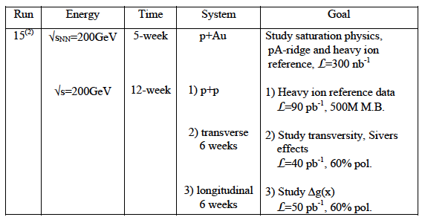
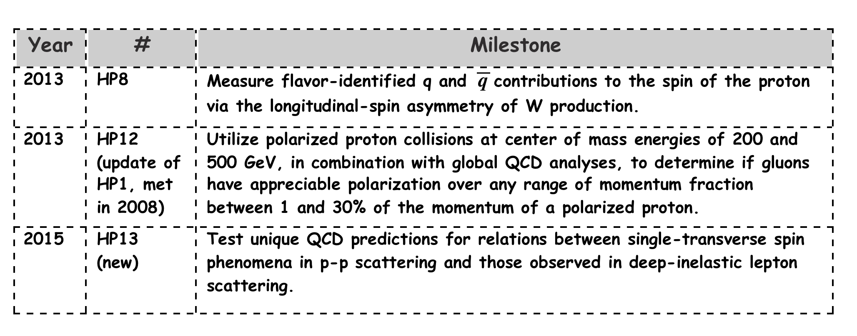
RHIC RUNNING AND PERFORMANCE MILESTONES
Run 9+11+12+13
Ws
Run 9+11+12+13+15
jets + di-jets
Run 15+16
and the nice results
from 11 & 12
Proposed
in 2014-2015
BUR

Slide 4
Important
Run-15 needs to provide comparison data for HFT program
MTD comparison data can also be collected during 500 GeV pp
Following Hardware needs to be in place
  FMS → refurbishment is going well
  Preshower → on track design finalized → presentations in pp-pA-LoI meetings
  pp2pp → Phase-II* funding and schedule on critical path

Slide 5
pp Run-15: GoAls
200 GeV longitudinal polarized pp
  increase statistics on A_{LL} jets and di-jets at mid rapidity
  explore A_{LL} in FMS
200 GeV transverse polarised pp
  understand the underlying physics of forward A_{N}
    direct γ A_{N}; A_{N} for diffractive and rapidity gap events
    improve statistics on A_{N}(π⁰,η) → reach high p_{t} with good statistics
    improve statistics on all mid-rapidity Sivers, IFF and Collins observables
    central and forward diffractive production in p^{(↑)}p, p^{(↑)}A
    elastic scattering in p^{(↑)}p^{(↑)}
200 GeV transverse polarised pA
  study saturation effects
  first measurement of g^{A}(x,Q²) and g^{A}(x,Q²,b) through direct photon and UPC J/Ψ
  unravel the underlying subprocess by measuring A_{N}(π⁰,γ)
  study GPDs trough exclusive J/Ψ
  AND
  much more

Slide 6
Run 16 possible Scenarios
22 weeks running
  suggestion split between AuAu → HFT, MTD
  transverse polarized pp running at 500 GeV
    Goal
      measure increase statistics for Sivers and Collins jet measurements in mid-rapidity
      measure sea-quark sivers, pin down TMD-evolution and try to resolve NSAC HP13
HOW?
  measure simultaneously A_{N} for γ, W^{+/-} Z⁰, DY
  DY and W^{+/-} Z⁰ give Q² evolution
  W^{+/-} give sea-quark sivers
  All three A_{N} for γ, W^{+/-} Z⁰, DY give sign change

Slide 7
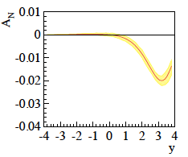
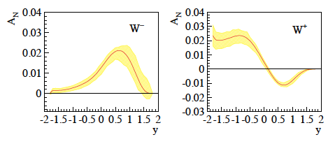
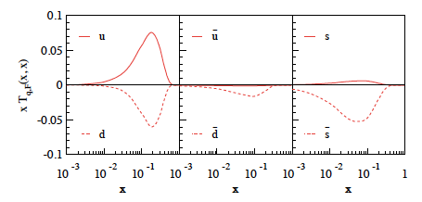
New Theory predictions
Z. Kang et al. arXiv:1401.5078v1
0 < p_{T} 3 GeV
4 < Q < 9 GeV
0 < p_{T} 1 GeV
Q² = 2.4 GeV²
despite fitted,
sea quarks completely
unconstrained
impacts A_{N}(W±, Z⁰)
new calculations for
A_{N}(γ) coming
and A_{N}(W±, Z⁰)
maximized sea-quarks

Slide 8
New Theory predictions
Z. Kang A_{N} (W^{+/-},Z⁰) accounting for sea quark uncertainties
0 < p_{T} 3 GeV
Huge uncertainties due to
unknown sea quark sivers fct.

Slide 9
Results from 2011 and projections
2011: recorded lumi 25 pb⁻¹ → prelim. plots also as fct. of p_{t}
900 pb⁻¹
delivered corresponds
to a Run-13 lumi with
dynamic β* squeeze

Slide 10
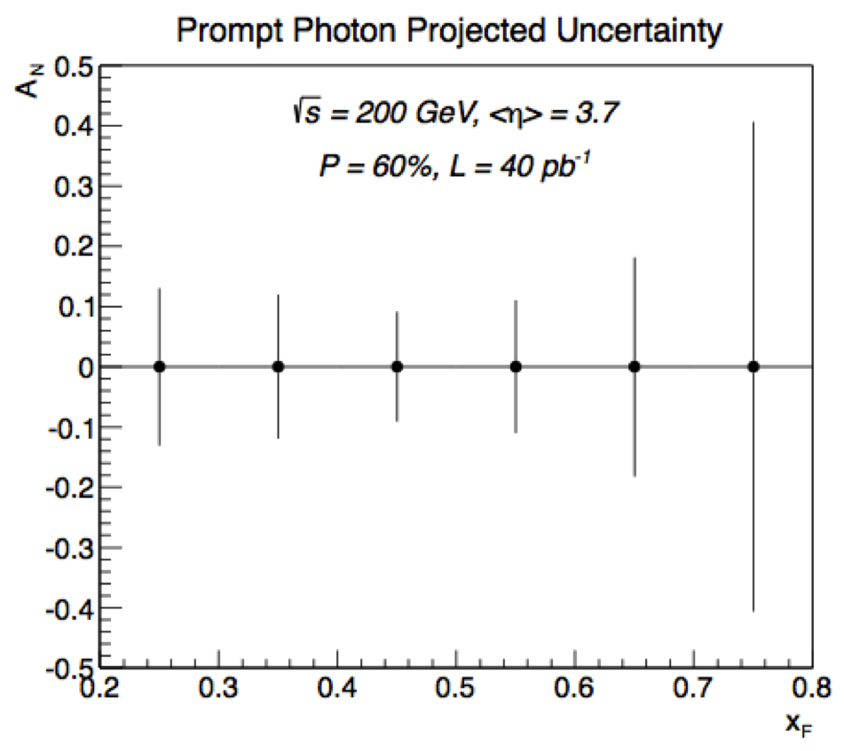
A_{n} direct Photon at 500 GeV
Proof of principle from Run-15 200 GeV data:
500 GeV: need to reach same high x_{f} as at 200 GeV
bigger background from merged π⁰
FMS Preshower need to help to separate merged π⁰ from single γ
Can be done
check out: https://drupal.star.bnl.gov/STAR/system/files/2014-04_11_FMS.preshower_0.pptx
new 200 and 500 GeV projections are ongoing
last years
BUR projection

Slide 11
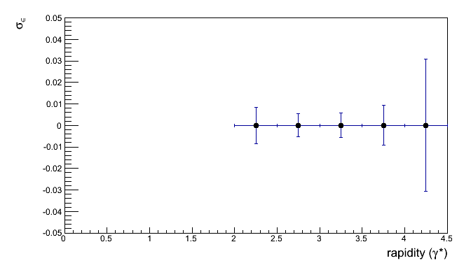
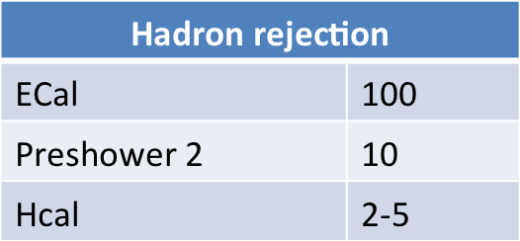
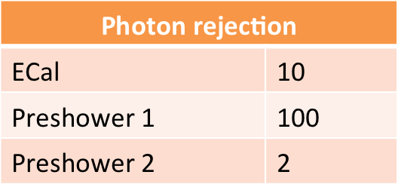
A_{n} DY
Details:
https://drupal.star.bnl.gov/STAR/system/files/2014-01-11_DrellYan.pptx
Requirements:
  Drell-Yan needs ~10⁷-10⁶ suppression of hadron pairs
    Forward rapidity naturally suppresses QCD background
    Track multiplicities are small with reasonable hadron rejection
    charge identification is mainly helping a small m_{inv}<2 GeV/c²
  Transverse asymmetries need h>2
  Background asymmetries a problem if S/B~1
  Mapping out 4< m_{inv}<9 GeV/c² needs a recorded lumi of 1 fb⁻¹
scales with 1/polarization !!!
L_{int} = 1fb⁻¹
rejections per track:
→ FMS
→ just building one
can be replaced by
postshower
→ use FMSPS technology
possible till run 16
tracking: → charge separation: 2

Slide 12
Summary
Run-15:
follow last years BUR
  of course improve plots, arguments and so on with
  what we have learned in the last year
Run-16:
transverse polarized pp at 500 GeV
  need delivered Lumi: > 700 pb⁻¹ but with cleaner TPC performance
  → less pile up
  → push CAD to make the dynamic β* squeeze working

Slide 13
BACKUP

Slide 14
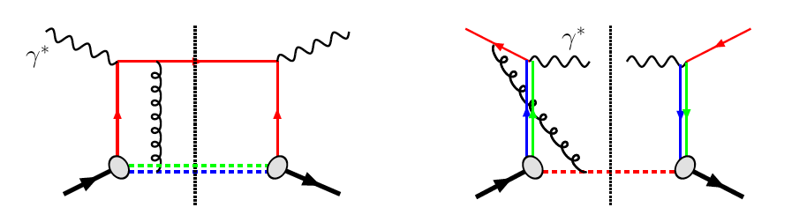
The famous sign change of the Sivers fct.
critical test for our understanding of TMD’s and TMD factorization
Twist-3 formalism predicts the same
DIS:
γq-scattering
attractive FSI
pp:
qqbar-anhilation
repulsive ISI
QCD:
Sivers_{DIS} = - Sivers_{DY} or Sivers_{W} or Sivers_{Z0}
A_{N}(direct photon) measures the sign change through Twist-3
All can be measured in one 500 GeV Run

Slide 15
Collected Luminosity with longitudinal Polarization
Year | √s [GeV] | Recorded PHENIX | Recorded STAR | Pol [%]
2002 (Run 2) | 200 | / | 0.3 pb⁻¹ | 15
2003 (Run 3) | 200 | 0.35 pb⁻¹ | 0.3 pb⁻¹ | 27
2004 (Run 4) | 200 | 0.12 pb⁻¹ | 0.4 pb⁻¹ | 40
2005 (Run 5) | 200 | 3.4 pb⁻¹ | 3.1 pb⁻¹ | 49
2006 (Run 6) | 200 | 7.5 pb⁻¹ | 6.8 pb⁻¹ | 57
2006 (Run 6) | 62.4 | 0.08 pb⁻¹ |  | 48
2009 (Run9) | 500 | 10 pb⁻¹ | 10 pb⁻¹ | 39
2009 (Run9) | 200 | 14 pb⁻¹ | 25 pb⁻¹ | 55
2011 (Run11) | 500 | 27.5 / 9.5pb⁻¹ | 12 pb⁻¹ | 48
2012 (Run12) | 500 | 30 / 15 pb⁻¹ | 82 pb⁻¹ | 50/54
2013 (Run13) | 500 | 156 / 77 pb⁻¹ | 300 pb⁻¹ | 50/54

Slide 16
Collected Luminosity with transverse Polarization
Year | √s [GeV] | Recorded PHENIX | Recorded STAR | Pol [%]
2001 (Run 2) | 200 | 0.15 pb⁻¹ | 0.15 pb⁻¹ | 15
2003 (Run 3) | 200 | / | 0.25 pb⁻¹ | 30
2005 (Run 5) | 200 | 0.16 pb⁻¹ | 0.1 pb⁻¹ | 47
2006 (Run 6) | 200 | 2.7 pb⁻¹ | 8.5 pb⁻¹ | 57
2006 (Run 6) | 62.4 | 0.02 pb⁻¹ |  | 53
2008 (Run8) | 200 | 5.2 pb⁻¹ | 7.8 pb⁻¹ | 45
2011 (Run11) | 500 | / | 25 pb⁻¹ | 48
2012 (Run12) | 200 | 9.2/4.3 pb⁻¹ | 22 pb⁻¹ | 61/58

Slide 17
Key measurements for polarized pp scattering
deliverables | observables | what we learn | requirements | comments/competition
HP13 (2015) Test unique QCD predictions for relations between single-transverse spin phenomena in p-p scattering and those observed in deep-inelastic lepton scattering. | A_{N} for γ , W^{+/-},Z⁰, DY | Do TMD factorization proofs hold. Are the assumptions of ISI and FSI color interactions in pQCD are attractive and repulsive, respectively correct | high luminosity trans pol pp at √s=500 GeV DY: needs instrumentation to suppress QCD backgr. by 10⁶ at 3<y<4 | A_{N} DY: >=2020 might be to late in view of COMPASS A_{N}W,Z: can be done earlier, i.e. 2016
HP13 (2015) and flavor separation | A_{N} for γ , charged identified(?) hadrons, jets and diffractive events in pp and pHe-3 | underlying subprocess causing the big A_{N} at high x_{f} and y | high luminosity trans pol pp at √s=200 GeV, (500 GeV jets ?) He-3: 2 more snakes; He-3 polarimetry; full Phase-II RP | the origin of the big A_{N} at high x_{f} and y is a legacy of pp and can only be solved in pp what are the minimal observables needed to separate different underlying subprocesses
transversity and collins FF | IFF and A_{UT} for collins observables, i.e. hadron in jet modulations A_{TT} for DY | TMD evolution and transversity at high x cleanest probe, sea quarks | high luminosity trans pol pp at √s=200 GeV & 500 GeV | how does our kinematic reach at high x compare with Jlab12 A_{TT} unique to RHIC
flavour separated helicity PDFs polarization dependent FF | A_{LL} for jets, di-jets, h/γ-jets at rapidities > 1 D_{LL} for hyperons | Δg(x) at small x Δs(x) and does polarization effect fragmentation | high luminosity long. pol pp at √s=500 GeV Forward instrumentation which allows to measure jets and hyperons. Instrumentation to measure the relative luminosity to very high precision | eRHIC will do this cleaner and with a wider kinematic coverage
Searches for a gluonic bound state in central exclusive diffraction in pp | PWA of the invariant mass spectrum in pp→p’M_{X}p’ in central exclusive production | can exotics, i.e. glue balls, be seen in pp | high luminosity pp at √s=200 GeV & 500 GeV full Phase-II RP | how does this program compare to Belle-II & PANDA

Slide 18
Key measurements for p↑A scattering
deliverables | observables | what we learn | requirements | comments/competition
DM8 (2012) determine low-x gluon densities via p(d) A | direct photon potentially correlations, i.e. photon-jet | initial state g(x) for AA-collisions | A-scan | LHC and inclusive DIS in eA eA: clean parton kinematics LHC wider/different kinematic reach; NA61
impact parameter dependent g(x,b) | c.s. as fct. of t for VM production in UPC (pA or AA) | initial state g(x,b) for AA-collisions | high luminosity, clean UPC trigger | LHC and exclusive VM production in eA eA: clean parton kinematics LHC wider/different kinematic reach
“saturation physics” | di-hadron correlations, γ-jet, h-jet & NLO DY, diffraction pT broadening for J/Ψ & DY -> Q_{s} | is the initial state for AA collisions saturated measurement of the different gluon distributions CNM vs. WW | capability to measure many observables precisely large rapidity coverage to very forward rapidities polarized pA A scan | complementary to eA, tests universality between pA and eA
CNM effects | R_{pA} for many different final states K⁰, p, K, D⁰, J/Ψ, .. as fct of rapidity and collision geometry | is fragmentation modified in CNM heavy quarks vs. light quarks in CNM | A scan to tag charm in forward direction → μ-vertex | separation of initial and final state effects only possible in eA
long range rapidty correlations “ridge” | two-particle correlation at large pseudo-rapidity Δη | do these correlations also exist in pA as in AA | tracking and calorimetry to very high rapidities | interesting to see the √s dependence of this effect compared to LHC
is GPD E_{g} different from zero | A_{UT} for J/Ψ through UPC Ap↑ | GPD E_{g} is responsible for L_{g}→ first glimpse |  | unique to RHIC till EIC turns on
underlying subprocess for A_{N}(π⁰) | A_{N} for π⁰ and γ | underlying subprocess for A_{N}(π⁰) sensitivity to Q_{s} | good π⁰ and γ reconstruction at forward rapidities | resolving a legacy in transversely polarized pp collisions

