Slide 1
Drell-Yan

Slide 2
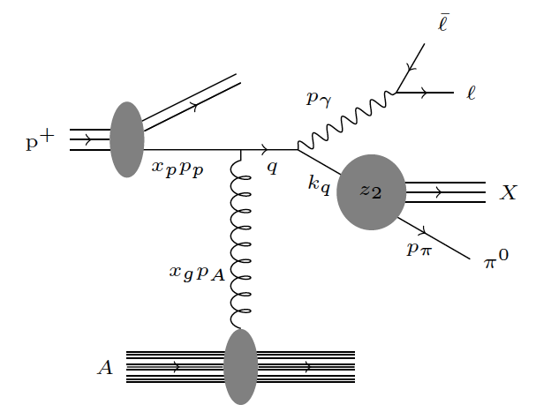
Anna’s calculations for correlation function DY+hadron are based on arXiv:1204.4861 and the following process
which is NLO to process a) so are b) and c)
see Anna’s paper arXiv:1008.2652

Slide 3
Questions to answer
what is the fraction of this process to the total DY cross section ant forward rapidities
how often do we have a hadron together with the DY lepton pair at forward rapidities for the LO process
What MC do we have available to answer this question

Slide 4
Existing MC
Pythia 6.4
can vary renormalisation /factorisation scale
have LO + NLO processes included (ISUB 1,15,30) see reference [Eic84] in Pythia
any PDF we want
NLO(Jianwei)
CTEQ6 PDFs (msbar)
calculates only c.s.
NLO(Ivan & Benwei)
CTEQ6 PDFs for different renormalization scale μ=Q,2Q,Q/2
seems nonsense see next slide
NLO(E866)
CTEQ6 PDFs or
MRST2001
calculates only c.s.
MCs inhand

Slide 5
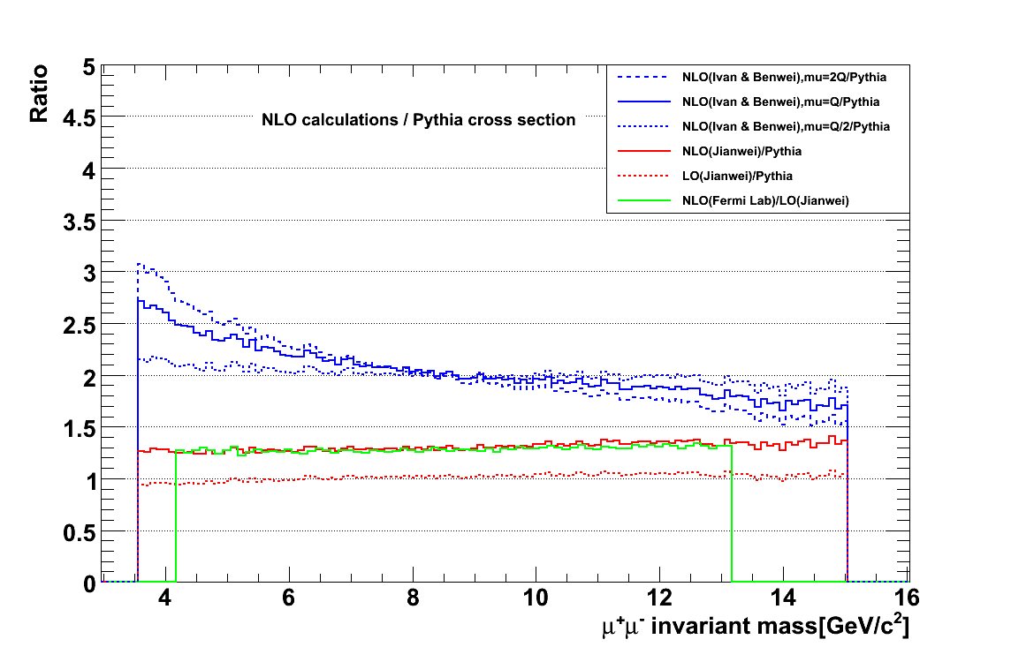
Ratio of (NLOs / Pythia cross section)
y=1.7

Slide 6
What to Do
repeat kinematic studies for 200 GeV
compare NLO pythia-DY with NLO-DY calculations
will the agreement be as good as for LO
NLO/LO = 1.25
forward rapidity intrinsic k_{t} is important
see how Anna’s cuts translate into star forward upgrade acceptance
can we see the NLO process → many LO DY pairs have an additional hadron (→ from target remnant)
can we suppress QCD backgrounds enough?
→ see some DY simulations for pp-500 GeV on the next slides.
….. and many more

Slide 7
A little bit about DY Parton Kinematics: 500 GeV
4 GeV < M_{inv} < 9 GeV

Slide 8
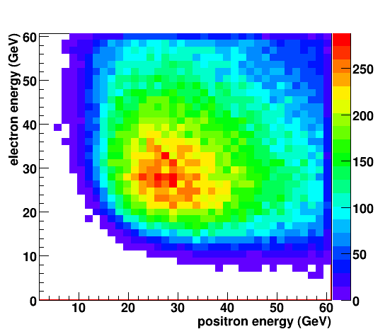
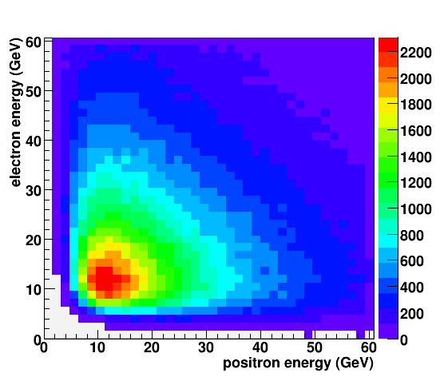
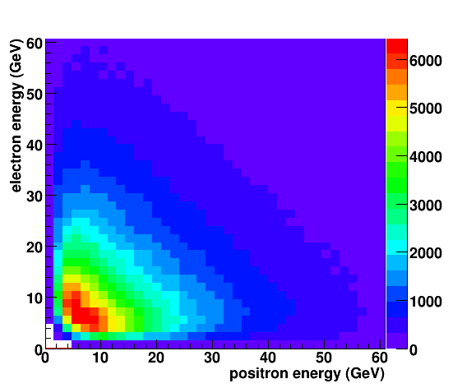
Drell-Yan lepton pairs
Leptons have high energy
Energies are very correlated

Slide 9
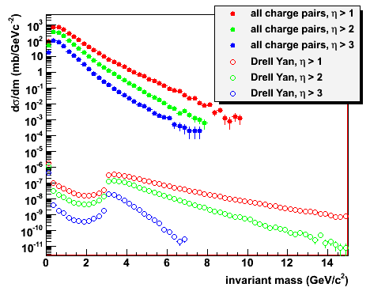
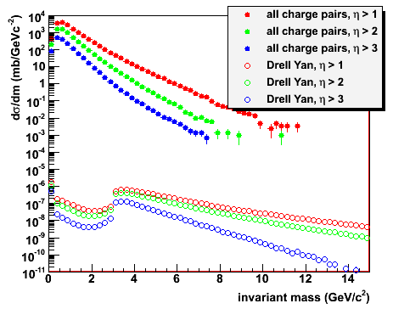
Backgrounds to DY production
Most dominat background sources
QCD 2→2
Heavy flavour
photon conversion in material
All charged particle pairs between J/Ψ and ϒ
Hadron suppression 10⁵-10⁶ needed at 500 GeV
Drell Yan signal reduced in 200 GeV forward
200 GeV
500 GeV

Slide 10
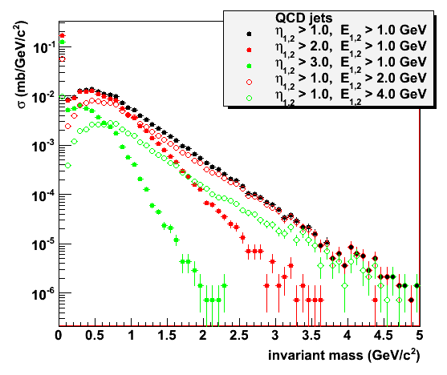
Background rejection
Electrons and positrons from hard QCD processes are uncorrelated
Opening angles are comparable to Drell Yan: detector acceptance
Lepton energies of Drell Yan decays are large
Energy cut removes QCD background at small m_{inv}
Large masses in QCD background favor mid-rapidity
Energy asymmetry has not been used yet

Slide 11
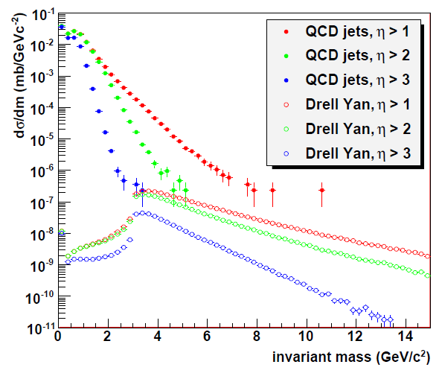
Drell-Yan at forward rapidities
Parametrized fast MC for detector smearing
Drell Yan signal
3 – 10 GeV/c²
Energy cut
E_{1,2} > 2 GeV
Forward rapidities
Effectively no background left
Statistically limited
Drell Yan for m_{inv} < 3 GeV/c² not physical (PYTHIA settings)
Oleg: HCal: 38%√E+3%
Ecal: 10%√E+1.5%

Slide 12
BACKUP

Slide 13
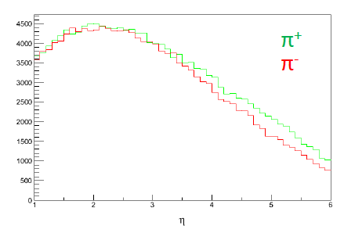
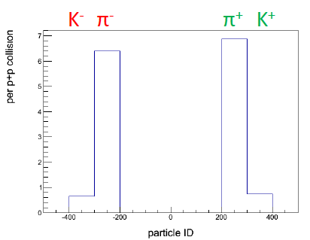
Do we need charge separation for DY?
QCD 2→2
No big difference between +/- hadrons
→ can live without charge sign discrimination
2 < η < 4.5
DY and background simulation working
as soon as upgrade detector performances are known
they can be integrated in the fast simulator
ultimately need full Geant simulation
framework can also be applied to pA

