Slide 1
Spin Patterns for Run-2015

Slide 2
Spin Pattern Considerations
For double helicity measurements:
Equal number of bunch crossings with same and opposite helicities
PHENIX needs even/odd cross checks
Abort gaps are aligned at PHENIX, STAR collides blue 1 with yellow 81
STAR wants different crossing pattern after abort gaps
Helicity states distributed equally over filled bunches
Change beam patterns from fill to fill, four basic beam patterns → eight different crossing patterns
Assumption: no empty bunches needed for e-lens

Slide 3
Basic Pattern with 24 Bunches
12 bunches possible, but very hard to equalize crossings for all requirements, i.e. to fulfill PHENIX even / odd
Use 24 bunches instead
based on 2012 and before
1
+
-
+
-
-
+
-
+
1
2
2
2
-
+
-
+
+
-
+
-
2
1
1
3
+
+
-
-
+
+
-
-
3
3
3
4
-
-
+
+
-
-
+
+
4
4
4
P1=B1xY3
P2=B2xY3
P3=B1xY4
P4=B2xY4
P5=B3xY1
P6=B4xY1
P7=B3xY2
P8=B4xY2
Combined crossing patterns

Slide 4
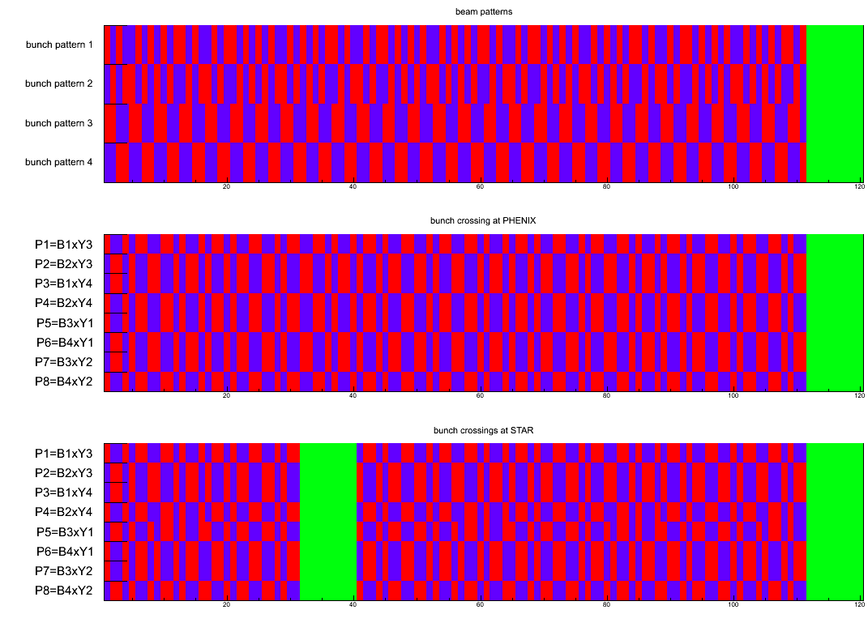

Slide 5
Bunch Crossings
based on 111 filled bunches
does not include short gaps for e-lens commissioning
 | STAR |  |  |  | PHENIX
 |  |  |  |  |  |  |  |  | even |  | odd
 | ++ | +- | -+ | -- | ++ | +- | -+ | -- | ++,-- | +-,-+ | ++,-- | +-,-+
P1=B1xY3 | 26 | 25 | 26 | 25 | 28 | 28 | 28 | 27 | 28 | 28 | 27 | 28
P2=B2xY3 | 26 | 25 | 26 | 25 | 28 | 27 | 28 | 28 | 28 | 28 | 28 | 27
P3=B1xY4 | 25 | 26 | 25 | 26 | 28 | 28 | 27 | 28 | 28 | 28 | 28 | 27
P4=B2xY4 | 25 | 26 | 25 | 26 | 27 | 28 | 28 | 28 | 28 | 28 | 27 | 28
P5=B3xY1 | 26 | 26 | 26 | 24 | 28 | 28 | 28 | 27 | 28 | 28 | 27 | 28
P6=B4xY1 | 26 | 24 | 26 | 26 | 28 | 27 | 28 | 28 | 28 | 28 | 28 | 27
P7=B3xY2 | 26 | 26 | 24 | 26 | 28 | 28 | 27 | 28 | 28 | 28 | 28 | 27
P8=B4xY2 | 24 | 26 | 26 | 26 | 27 | 28 | 28 | 28 | 28 | 28 | 27 | 28

Slide 6
What We HAD in 2012 and 2013

Slide 7
2013 What We Had
What else:
360 buckets, every 3rd filled
→ 120 bunches
aboard gaps aligned in PHENIX
anti-aligned in STAR
bunch 70/71 empty in blue
bunch 30/31 empty in yellow
(fixed for e-Lense)
4 spin patterns per beam
Blue:
1 ++--++--++--
2 --++--++--++
3 --++++----++++----++++
4 ++----++++----++++----
Yellow:
4 ++----++++----++++----
3 --++++----++++----++++
2 --++--++--++
1 ++--++--++--
we will collide
P21: B1xY3 P25: B3xY1
P22: B1xY4 P26: B3xY2
P23: B2xY3 P27: B4xY1
P24: B2xY4 P28: B4xY2
IP12 1-81
IP-10 1-41
IP-2 1-1
IP-8 1-1
IP-4 1-41
IP-6 1-81
blue clockwise
yellow counter clockwise

Slide 8
WHAT We HAD 2013 Spin Pattern
++--++--++|--++--++--|++--++--++|--++--++--|++--++--++|--++--++--|++--++--++|--++--++--|++--++--++|--++--++--|++--++--++|--++--++--|
1 5+6-
+55 -54
2 6+5-
+54 -55
3 5+6-
+55 -54
4 6+5-
+55 -54
10
20
30
40
50
60
70
80
90
100
110
120
--++--++--|++--++--++|--++--++--|++--++--++|--++--++--|++--++--++|--++--++--|++--++--++|--++--++--|++--++--++|--++--++--|++--++--++|
10
20
30
40
50
60
70
80
90
100
110
120
--++++----|++++----++|++----++++|----++++--|--++++----|++++----++|++----++++|----++++--|--++++----|++++----++|++----++++|----++++--|
10
20
30
40
50
60
70
80
90
100
110
120
++----++++|----++++--|--++++----|++++----++|++----++++|----++++--|--++++----|++++----++|++----++++|----++++--|--++++----|++++----++|
10
20
30
40
50
60
70
80
90
100
110
120
green bunches: empty bunches
--++++----|++++----++|++----++++|----++++--|--++++----|++++----++|++----++++|----++++--|--++++----|++++----++|++----++++|----++++--|
3 5+6-
4 6+5-
1 5+6-
2 6+5-
10
20
30
40
50
60
70
80
90
100
110
120
++----++++|----++++--|--++++----|++++----++|++----++++|----++++--|--++++----|++++----++|++----++++|----++++--|--++++----|++++----++|
10
20
30
40
50
60
70
80
90
100
110
120
++--++--++|--++--++--|++--++--++|--++--++--|++--++--++|--++--++--|++--++--++|--++--++--|++--++--++|--++--++--|++--++--++|--++--++--|
10
20
30
40
50
60
70
80
90
100
110
120
--++--++--|++--++--++|--++--++--|++--++--++|--++--++--|++--++--++|--++--++--|++--++--++|--++--++--|++--++--++|--++--++--|++--++--++|
10
20
30
40
50
60
70
80
90
100
110
120

Slide 9
2013 Continued WHAT WE HAD
P21: as example
40
Yellow
PHENIX
10
20
30
50
60
70
80
90
100
110
120
--++++----|++++----++|++----++++|----++++--|--++++----|++++----++|++----++++|----++++--|--++++----|++++----++|++----++++|----++++--|
++--++--++|--++--++--|++--++--++|--++--++--|++--++--++|--++--++--|++--++--++|--++--++--|++--++--++|--++--++--|++--++--++|--++--++--|
Blue
10
20
30
40
50
60
70
80
90
100
110
120
--++++----|++++----++|++----++++|----++++--|--++++----|++++----++|++----++++|----++++--|--++++----|++++----++|++----++++|----++++--|
Yellow
STAR
90
100
110
120
10
20
30
40
50
60
70
80
Dropped Bunches Colliding bunches
P21: Y3: 5+/6- B1: 5+/6- STAR: 100x100 PHENIX: 107x107
P22: Y4: 6+/5- B1: 5+/6- STAR: 100x100 PHENIX: 107x107
P23: Y3: 5+/6- B2: 6+/5- STAR: 100x100 PHENIX: 107x107
P24: Y4: 6+/5- B2: 6+/5- STAR: 100x100 PHENIX: 107x107
P25: Y1: 5+/6- B3: 5+/6- STAR: 100x100 PHENIX: 107x107
P26: Y2: 6+/5- B3: 5+/6- STAR: 100x100 PHENIX: 107x107
P27: Y1: 5+/6- B4: 6+/5- STAR: 100x100 PHENIX: 107x107
P28: Y2: 6+/5- B4: 6+/5- STAR: 100x100 PHENIX: 107x107
green bunches: empty bunches

Slide 10
2012 What WE HAD
4 spin patterns per beam
Blue:
1 +-+--+-++-+- also before 2012
2 -+-++-+--+-+ also before 2012
3 ++--++--++--
4 --++--++--++
Yellow:
1 ++--++--++-- also before 2012
2 --++--++--++ also before 2012
3 +-+--+-++-+-
4 -+-++-+--+-+
we did collide
P1: B1xY1 P5: B3xY3
P2: B2xY1 P6: B3xY4
P3: B1xY2 P7: B4:Y3
P4: B2xY2 P8: B4:Y4
attention: P7: 38/39 missing in yellow, 78/79 in blue
What else:
360 buckets, every 3rd filled
→ 120 bunches
aboard gaps aligned in PHENIX
anti-aligned in STAR
bunch 38/39 missing in blue
bunch 78/79 missing in yellow
IP12 1-81
IP-10 1-41
IP-2 1-1
IP-8 1-1
IP-4 1-41
IP-6 1-81
blue clockwise
yellow counter clockwise

Slide 11
WHAT We HAD 2012 Spin Pattern
+-+--+-++-|+--+-++-+-|-+-++-+--+|-++-+--+-+|+-+--+-++-|+--+-++-+-|-+-++-+--+|-++-+--+-+|+-+--+-++-|+--+-++-+-|-+-++-+--+|-++-+--+-+|
1
2
3
4
10
20
30
40
50
60
70
80
90
100
110
120
-+-++-+--+|-++-+--+-+|+-+--+-++-|+--+-++-+-|-+-++-+--+|-++-+--+-+|+-+--+-++-|+--+-++-+-|-+-++-+--+|-++-+--+-+|+-+--+-++-|+--+-++-+-|
10
20
30
40
50
60
70
80
90
100
110
120
++--++--++|--++--++--|++--++--++|--++--++--|++--++--++|--++--++--|++--++--++|--++--++--|++--++--++|--++--++--|++--++--++|--++--++--|
10
20
30
40
50
60
70
80
90
100
110
120
--++--++--|++--++--++|--++--++--|++--++--++|--++--++--|++--++--++|--++--++--|++--++--++|--++--++--|++--++--++|--++--++--|++--++--++|
10
20
30
40
50
60
70
80
90
100
110
120
++--++--++|--++--++--|++--++--++|--++--++--|++--++--++|--++--++--|++--++--++|--++--++--|++--++--++|--++--++--|++--++--++|--++--++--|
1
2
3
4
10
20
30
40
50
60
70
80
90
100
110
120
--++--++--|++--++--++|--++--++--|++--++--++|--++--++--|++--++--++|--++--++--|++--++--++|--++--++--|++--++--++|--++--++--|++--++--++|
10
20
30
40
50
60
70
80
90
100
110
120
+-+--+-++-|+--+-++-+-|-+-++-+--+|-++-+--+-+|+-+--+-++-|+--+-++-+-|-+-++-+--+|-++-+--+-+|+-+--+-++-|+--+-++-+-|-+-++-+--+|-++-+--+-+|
10
20
30
40
50
60
70
80
90
100
110
120
-+-++-+--+|-++-+--+-+|+-+--+-++-|+--+-++-+-|-+-++-+--+|-++-+--+-+|+-+--+-++-|+--+-++-+-|-+-++-+--+|-++-+--+-+|+-+--+-++-|+--+-++-+-|
10
20
30
40
50
60
70
80
90
100
110
120
green bunches: empty bunches

Slide 12
2012 Continued WHAT We HAD
P1: as example
++--++--++|--++--++--|++--++--++|--++--++--|++--++--++|--++--++--|++--++--++|--++--++--|++--++--++|--++--++--|++--++--++|--++--++--|
Yellow
PHENIX
10
20
30
40
50
60
70
80
90
100
110
120
+-+--+-++-|+--+-++-+-|-+-++-+--+|-++-+--+-+|+-+--+-++-|+--+-++-+-|-+-++-+--+|-++-+--+-+|+-+--+-++-|+--+-++-+-|-+-++-+--+|-++-+--+-+|
Blue
10
20
30
40
50
60
70
80
90
100
110
120
++--++--++|--++--++--|++--++--++|--++--++--|++--++--++|--++--++--|++--++--++|--++--++--|++--++--++|--++--++--|++--++--++|--++--++--|
Yellow
STAR
90
100
110
120
10
20
30
40
50
60
70
80
Dropped Bunches Colliding bunches
P1: Y: 5+/6- B: 6+/5- STAR: 102x102 PHENIX: 107x107
P2: Y: 5+/6- B: 5+/6- STAR: 102x102 PHENIX: 107x107
P3: Y: 6+/5- B: 6+/5- STAR: 102x102 PHENIX: 107x107
P4: Y: 6+/5- B: 5+/6- STAR: 102x102 PHENIX: 107x107
P5: Y: 6+/5- B: 5+/6- STAR: 102x102 PHENIX: 107x107
P6: Y: 5+/6- B: 5+/6- STAR: 102x102 PHENIX: 107x107
P7: Y: 7+/4- B: 6+/5- STAR: 100x100 PHENIX: 107x107 ← Pattern had a bug
P8: Y: 5+/6- B: 6+/5- STAR: 102x102 PHENIX: 107x107
green bunches: empty bunches

