Slide 1
A Pre-shower for the FMS

Slide 2
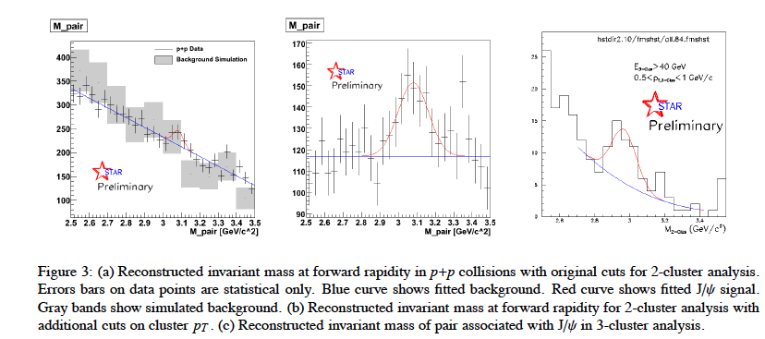
Physics Objectives
Improve lepton-photon-hadron separation in the FMS to do
Some examples
  J/Ψ physics in pAu and pp at forward rapidities
  current status from chris perkins from run-08

Slide 3
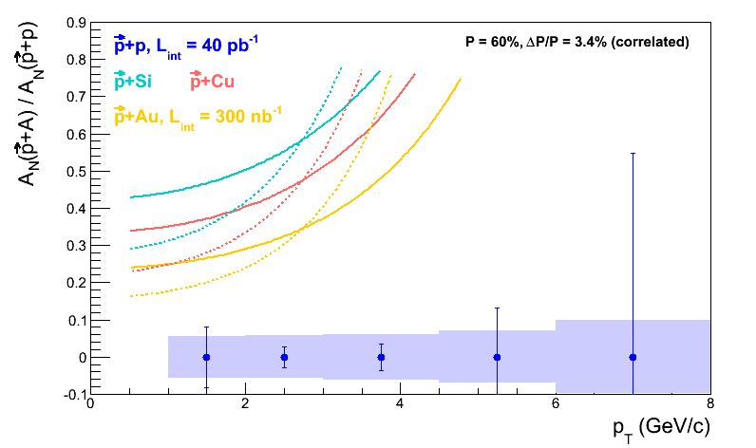
Physics Objectives
Direct photon physics in pp and pA
  to study A_{N} in transversely polarised pp and pA
    Sivers fct contribution to A_{N}
    see Yuri’s odderon model for the underlying process of A_{N} has any bearing on what is going on. → A_{N}=0
    example on what can be done: π⁰ A_{N} in pp and pA

Slide 4
Geant Model for A_{n}DY for Run-13
use A_{N}DY design as inspiration
for FMS preshower

Slide 5
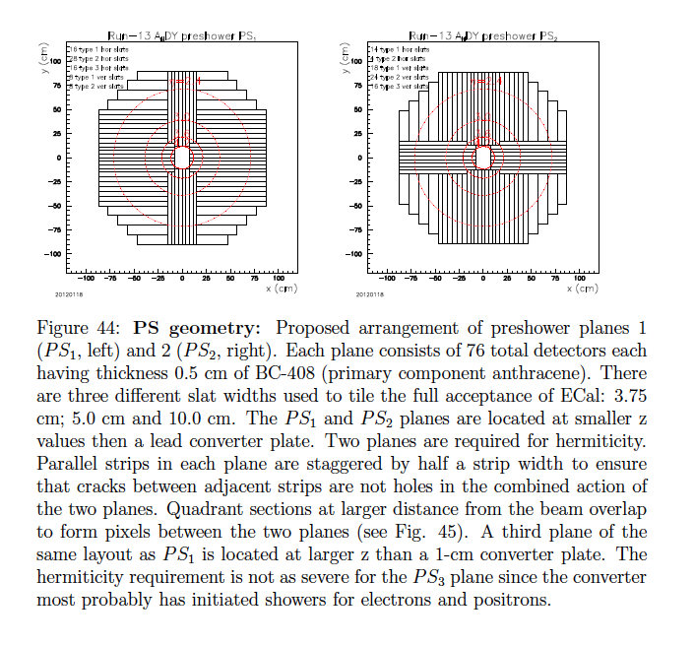

Slide 6
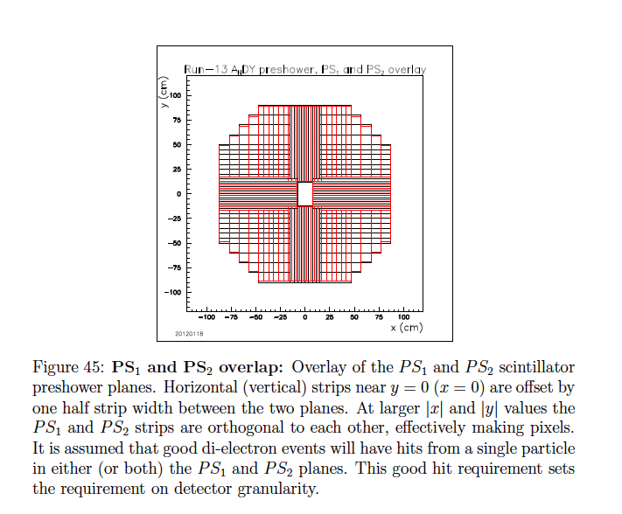
Readout-Concept:
The total of 228 strips from the three planes will
be read out by eight 32-channel QT boards, leaving
28 spare channels. The detectors are readout by
XP-2972 photomultiplier tubes at their ends distant
from the beam. Each XP-2972 is powered by a
Cockcroft-Walton base. The XP-2972 tubes
and CW bases were purchased for AGS/E-864
and 400 sets have been loaned
to ANDY.

Slide 7
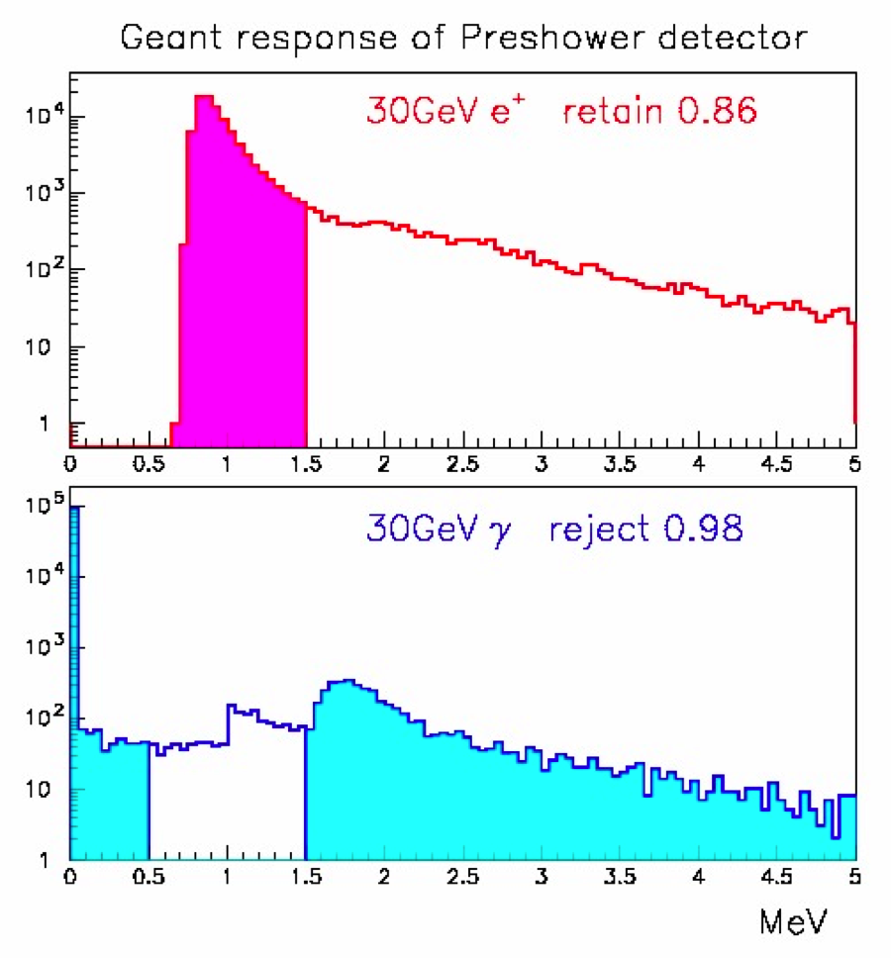
Single particle GEANT study
Preshower 1 : photon rejection
GEANT simulation of a pre-shower detector made of 0.5cm thick plastic scintillation counter. Responses for 30GeV electrons and photons are simulated. A cut of 0.5MeV < dE < 1.5MeV will retain 86% of electrons, while rejecting 98% photons including ones converted to e+e- pairs in beam pipe and preshower detector itself.
Retain 86% electrons (and charged hadrons)
Reject 98% photons

Slide 8
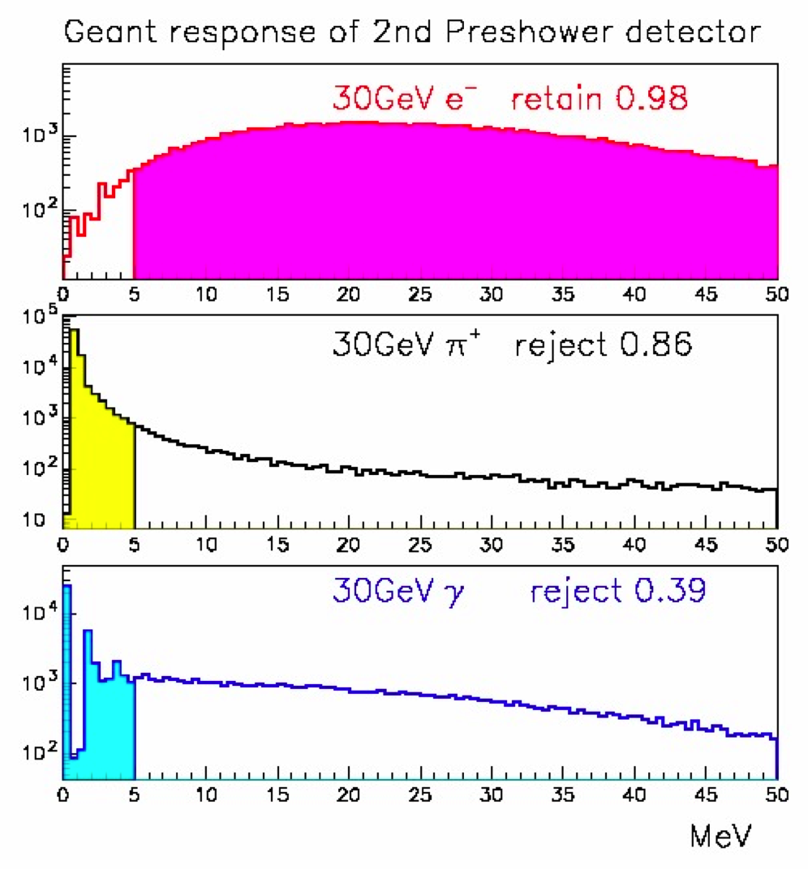
Single particle GEANT study
Preshower 2 : hadron/photon rejection
GEANT simulation of 2nd pre-shower detector made of 0.5cm thick plastic scintillation counter placed after 1cm Pb converter. Responses for 30GeV electrons, charged pion and photons are simulated. A cut of energy deposit in the 2nd pre-shower above 5MeV will retain 98% of electrons, while rejecting 85% of pions and 39% of photons.
Retain 98% electrons
Reject 85% hadrons
Reject 39% photons

Slide 9

Study BY Len on IMPACT ON FMS photon reconstruction
SET-UP used:
Use FCS simulation using only the clusters and tracks within the FMS geometry at 200 GeV.
Photon reconstruction efficiency (~100%) and π⁰-ϒ separation are comparable under 80 GeV for the FMS and the FCS EMCal.
Energy resolution is better for the FCS. This has not been adjusted for the current estimate because the AN measurement is not very sensitive to the smearing in energy scale.
The charged track detection efficiency is set at 86%, per Akio’s study of the FMS pre-shower model, which showed that the first layer can be used to accept 98% of the photons and reject 86% of the charged hadrons.

Slide 10
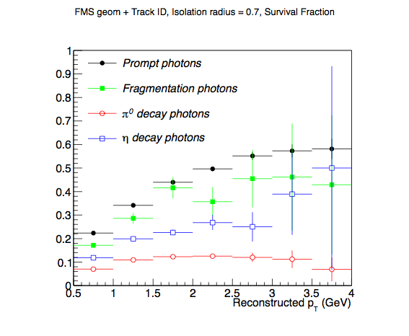
FMS + Charged Track Isolation Cut
In addition to the isolation cut (r = 0.7), all photon pairs are examined (including photons outside the cone) to reject π⁰ and η.

Slide 11
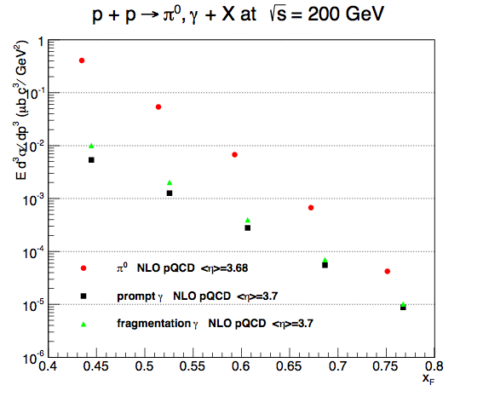
NLO pQCD Cross-sections
Use calculations by Werner at <η> ~ 3.7 that were produced for a previous analysis.

Slide 12
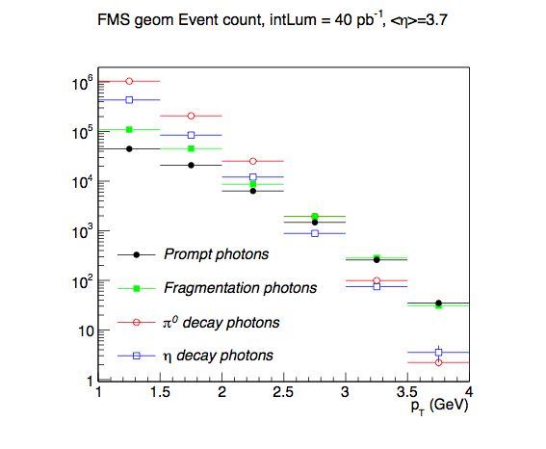
Event Count with ∫L = 40 pb⁻¹
Event count after the isolation cut was applied, based on the pQCD X-sections, π⁰ and η decay toy MC, and the full simulation isolation cuts.

Slide 13
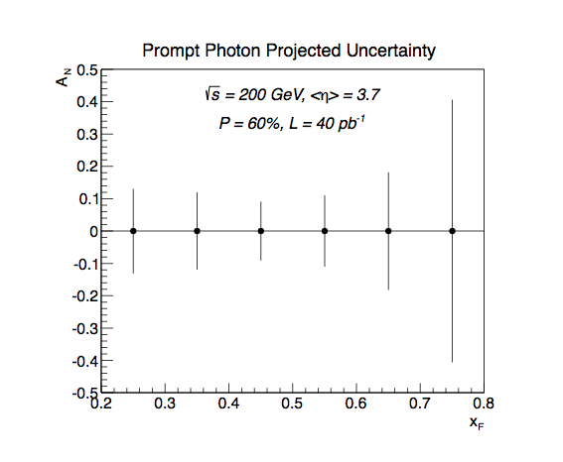
AN Uncertainty Projection
Prompt = Direct - Fragmentation photons. The uncertainty in fragmentation photon AN was set by hand at 5%, as a rough guess.

Slide 15
what do we mean by “Direct”….
proton – proton:
Au – Au or d-Au
(1)
(2)
(3)
(4)
(5)
γ
“Fragmentation”
much better called internal bremsstrahlung
Induced
De-excitation
for excited
states
Prompt
Fragmentation
(6)
Thermal Radiation
QGP / Hadron Gas
π⁰
EM & Weak Decay

Slide 16
What is in Pythia 6.4
Processes included which would fall under prompt (1)
  14: qqbar → gγ
  18: qqbar → γγ (19: qqbar → γZ⁰ 20: qqbar → γW⁺
  29: qg → qγ
  114: gg → γγ
  115: gg → gγ (106: gg → J/Psiγ 116: gg → Z⁰γ )
  initial and final internal bremsstrahlung (g and γ) (3)
    Pythia manual section 2.2
  Process 3 and 4 are for sure not in pythia
  I’m still checking 5
  the decay of resonances like the π⁰ is of course in pythia

