Slide 1
More ideas on what could cause the “relative Lumi problem”
  Longitudinal polarization profile
    First look to data in Run-9 by Sasha for 250 GeV
    Dima had a first look for Run-11 250 GeV running
    → ZDC and BBC sample differently along the length of the bunch

Slide 2
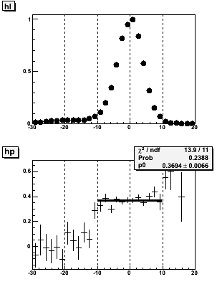
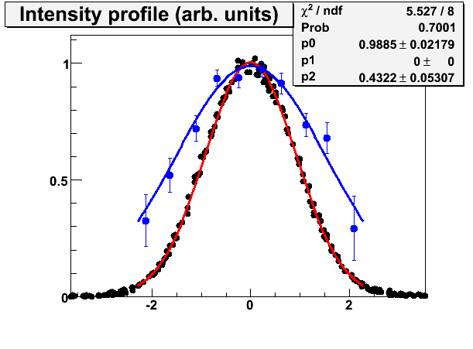
Transverse Longitudinal
Profile
Fill 10490 Yellow1 (250 GeV) 2009
Intensity
Polarization
Intensity profile
Transverse Polarization profile
Known effect
No hint for longitudinal polarization profile in 2009

Slide 3
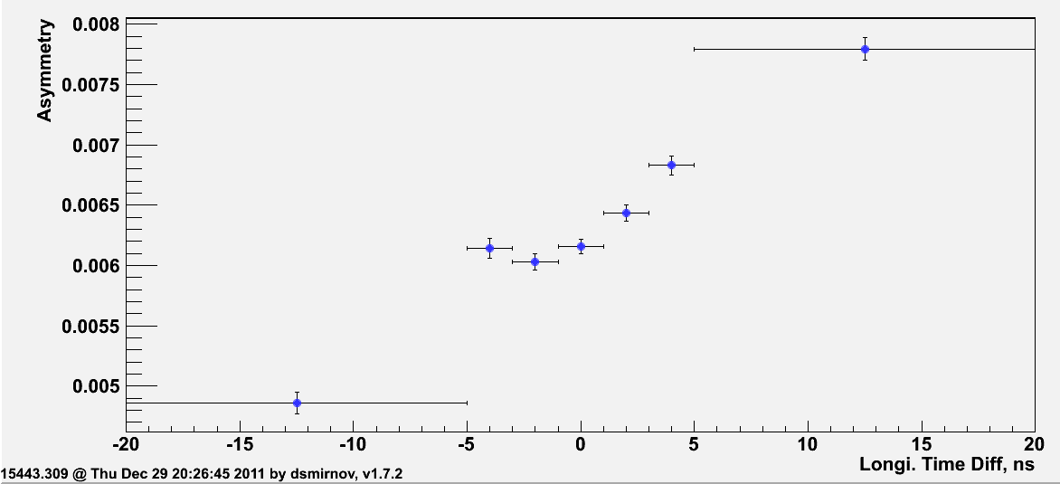
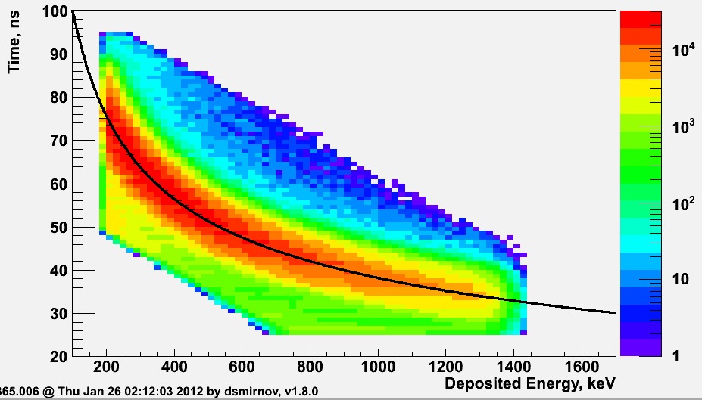
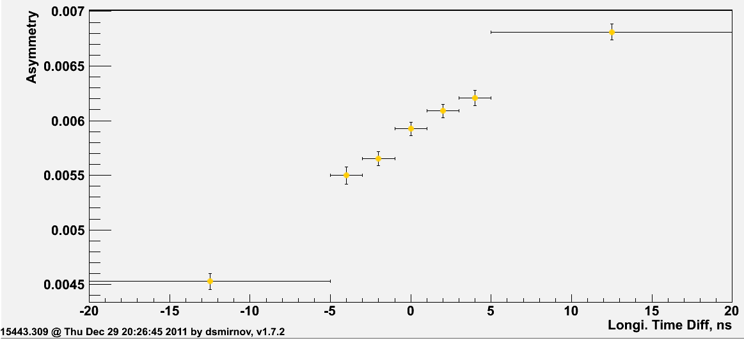
2011: Longitudinal Profile at 250 GeV
Combined 8 fills declared by Haixin and Mei to have the same machine settings
15365, 15366, 15368, 15372, 15376, 15378, 15380, 15386, 15390, 15393, 15399, 15425, 15427, 15435, 15436, 15438, 15443
Blue Beam
Maybe there is some hint for a
longitudinal profile.
BUT need still to study in much
more detail background
Fraction in carbon sample
Yellow Beam
Background

Slide 4
A_{LL} due to real physics asymmetry in ZDC
  HERMES has measured a A_{LL} in elastic diffractive ρ production
  ep→e’p’ρ or single diffractive ep→e’ρY
  Double-spin Asymmetries in the Cross Section of Diffractive rho⁰ and phi Production
  at Intermediate Energies A. Airapetian et al, Eur. Phys. J. C 29, 171 - 179 (2003) hep-ex/0302012

Slide 5
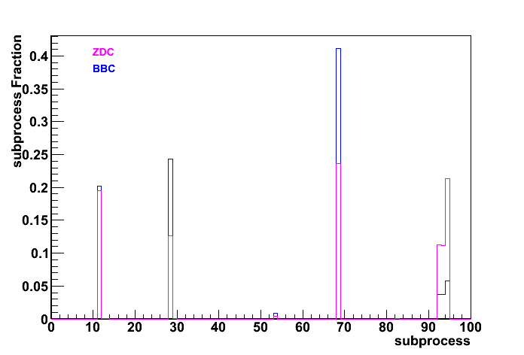
What are the dominating sub-processes in ZDC & BBC
PYTHIA 6.4: TUNE-4 C_{kin}(3) = 1.GeV, PARP(91) = 0.5
no full detector simulation done yet, only acceptances.
Diffractive processes contribute 20% to ZDC event sample and only 5% to BBC
event sample, if there is an asymmetry in pp like in ep this would explain some part
of the difference measured between ZDC and BBC.

