Slide 1
A summary on Polarisation in Run-12 100GeV and first results for 250 geV
E.C. Aschenauer
presenting the work done by Alan, anders, Bill and Dima

Slide 2
Run 12 pC polarimeters

Slide 3
Run 12 pC polarimeters
Known complications:
100 GeV:
noise due to pickup especially at injection less significant at flat top
method to correct for it was developed by Dima and Bill and implemented
shown data have this correction included
noise was correlated to stochastic cooling sitting before / after the polarimeters
B2D is a test polarimeter → new detector types
255 GeV
noise is gone → most likely due to grounding improvements and removing of antennas at the polarimeters and the stochastic cooling
polarimeters not yet normalized to jet, need 10 long fills at least
normalization is polarimeter dependent
ratios like Y1D to Y2U need not to be 1 at the moment

Slide 4
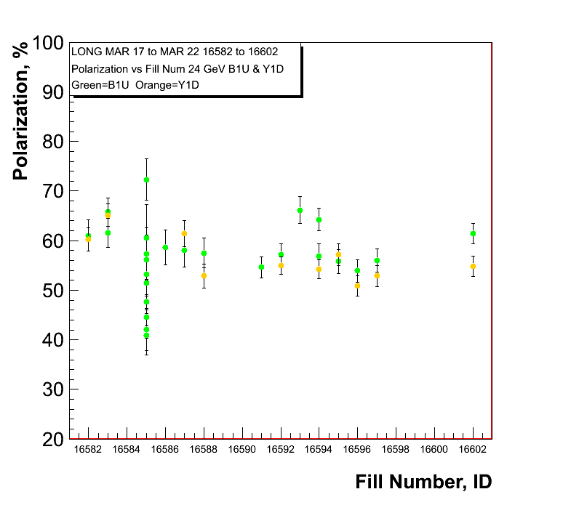
255 GeV Results
polarisation at injection
Blue and Yellow
Caveat:
pC numbers not normalized
to jet

Slide 5
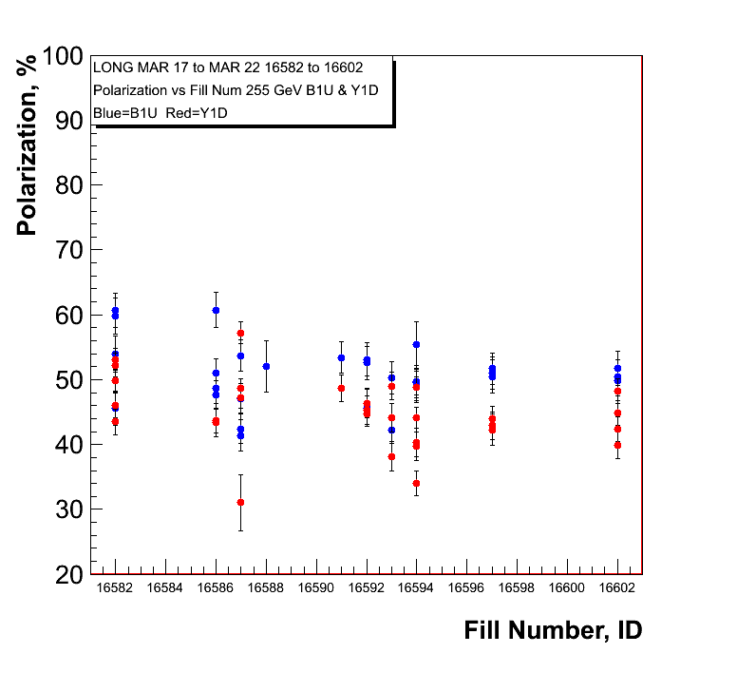
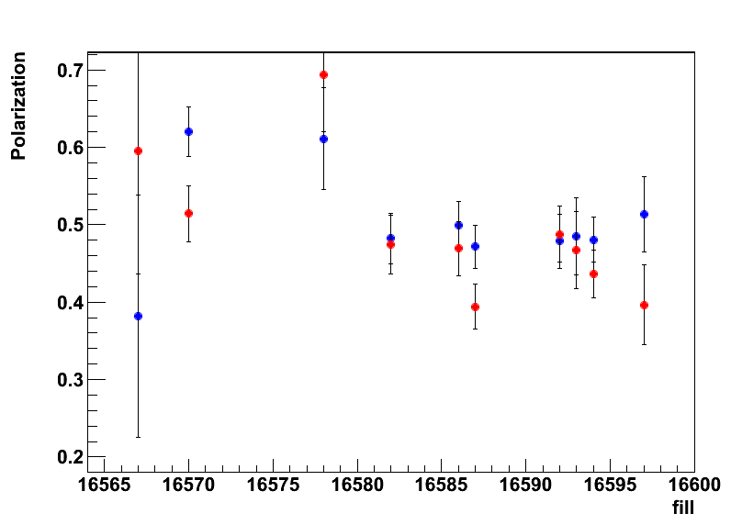
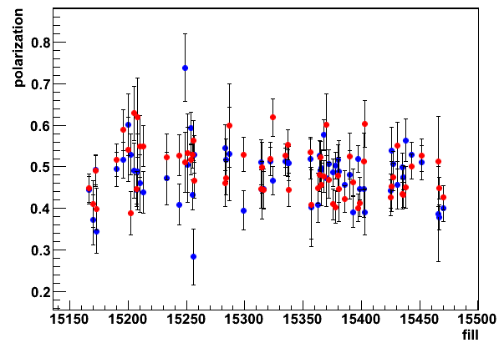
255 GeV Results
polarisation at flat top
Blue and Yellow
H-Jet
H-Jet Run-11
→ longitudinal

Slide 6
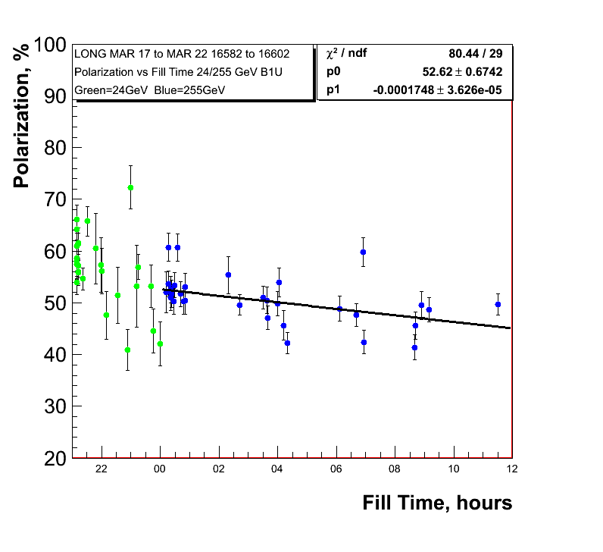
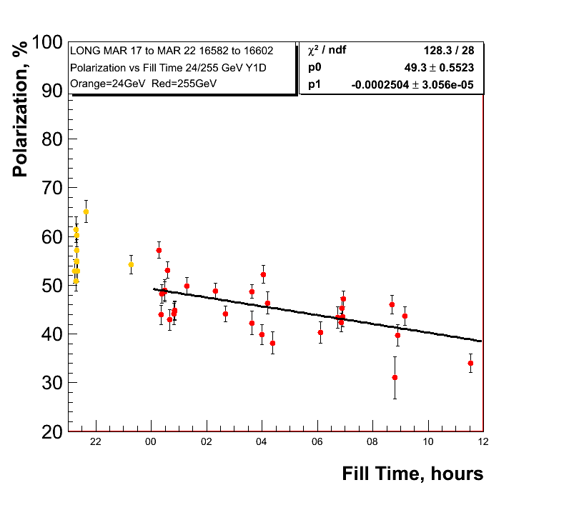
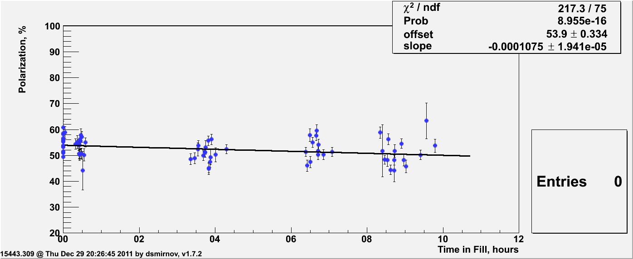
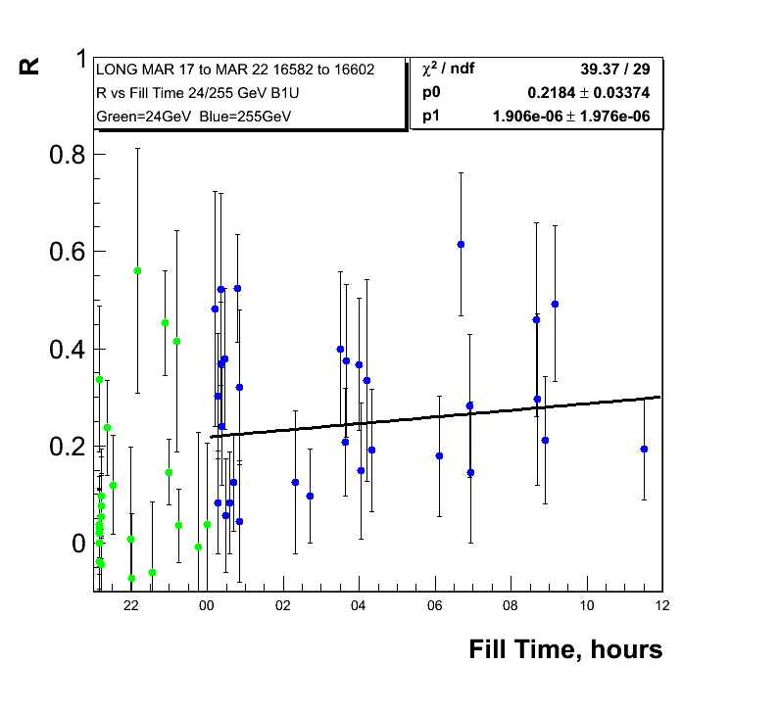
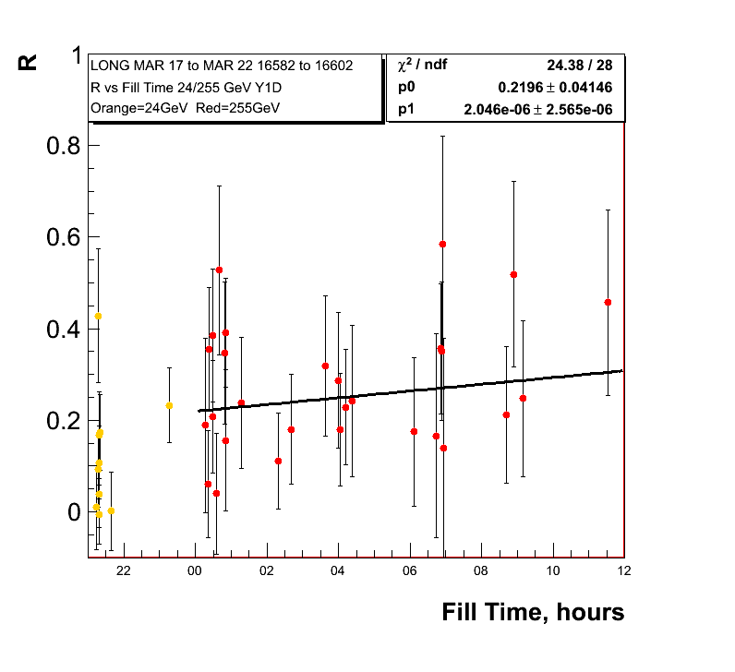
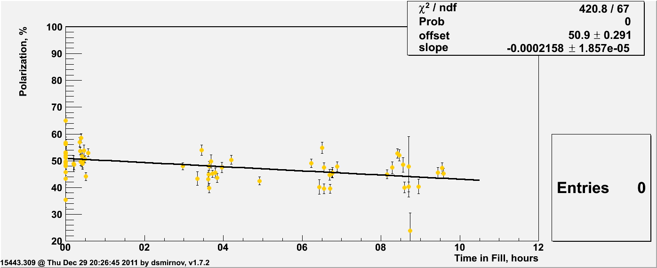
255 GeV Results
0.62%±0.13/hour
0.9%±0.11/hour
Polarisation
lifetime very
similar run-11
and run-12 so
255 GeV did not
do the trick
Run-11
0.39%±0.07/hour
Run-11
0.78%±0.07/hour

Slide 7
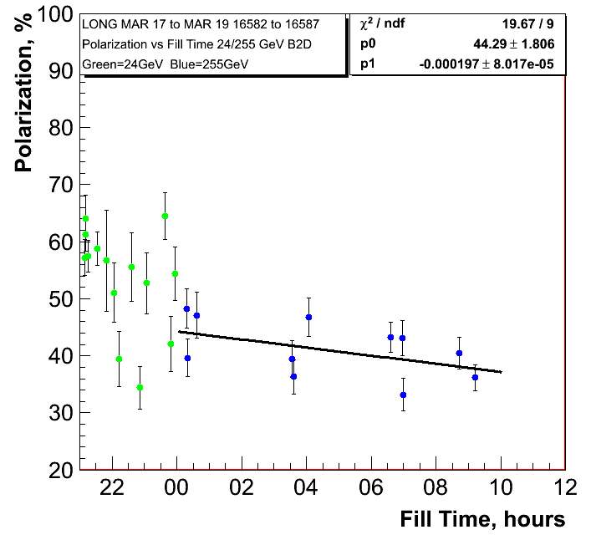
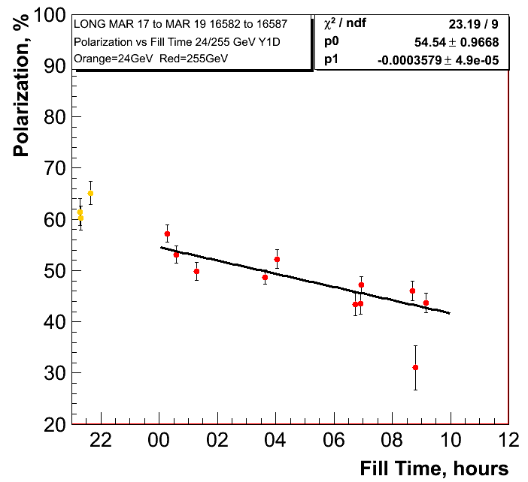
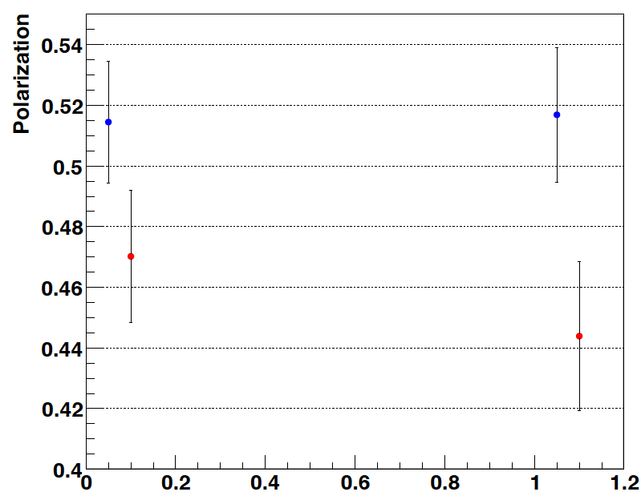
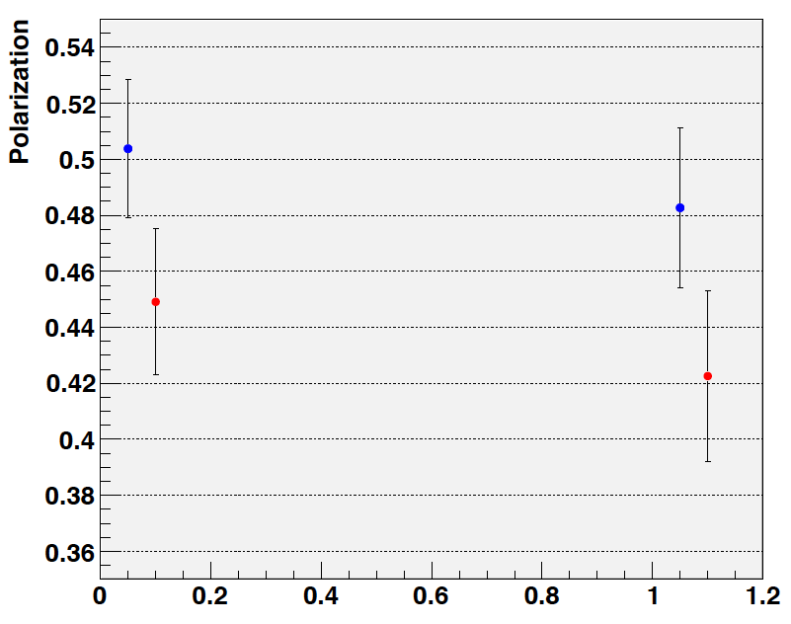
255 GeV Results
0.71%±0.28/hour
1.288%±0.18/hour
H-Jet:
Fills: 16570-16592
trans + longitudinal
H-Jet:
Fills: 16586-16592
longitudinal

Slide 8
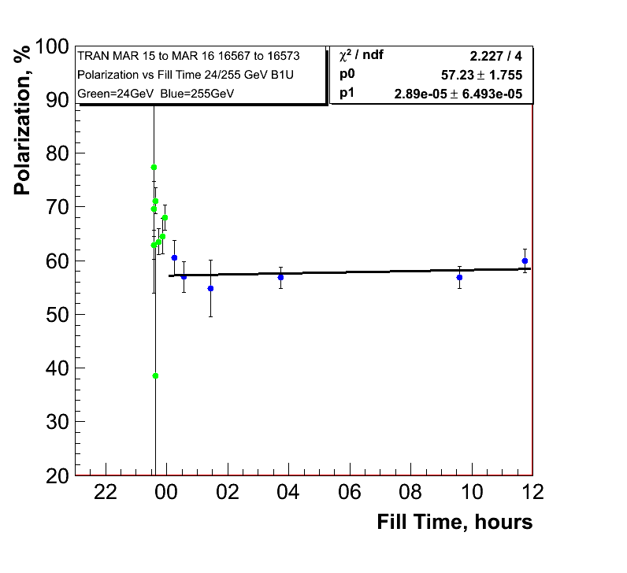
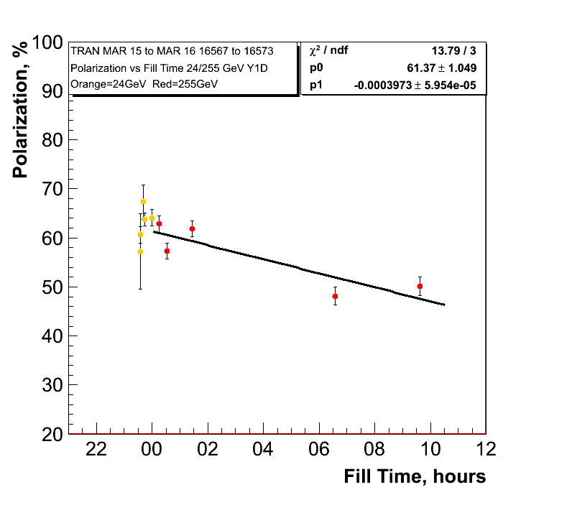
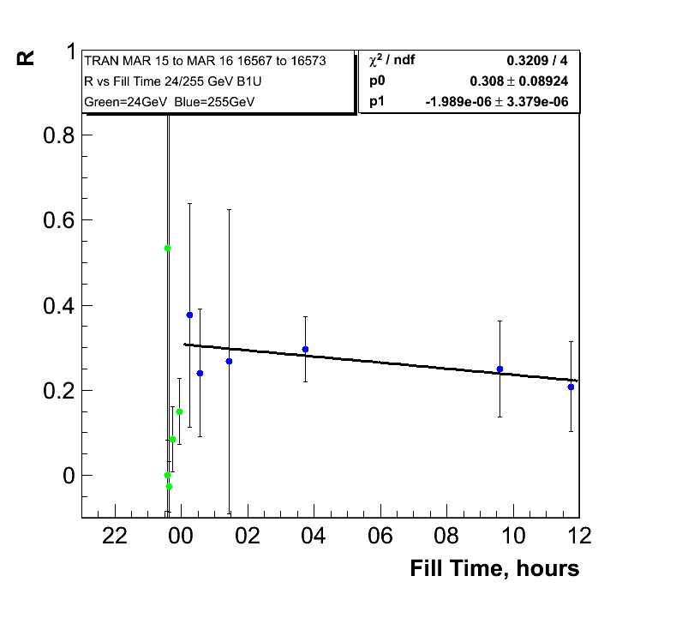
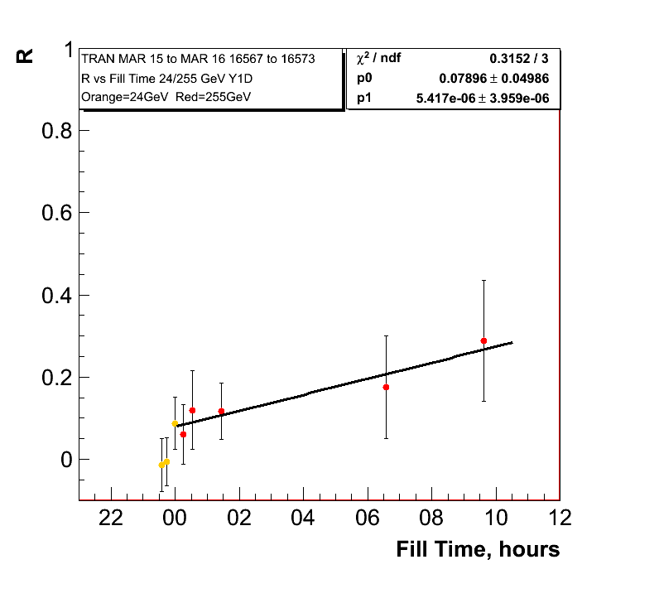
255 GeV Results Transverse Fills
0.10%±0.23/hour
Polarisation
lifetime in
yellow very
similar to
longitudinal
255 GeV fills
1.4%±0.21/hour

Slide 9
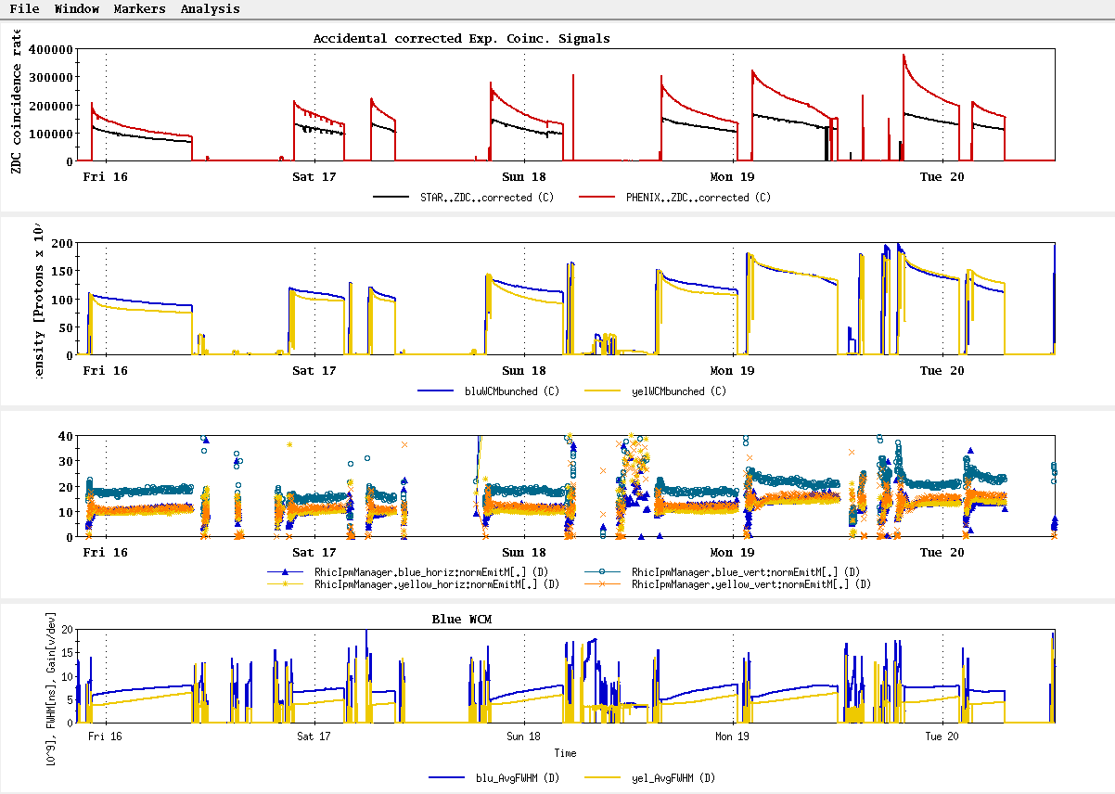
History
~L_{store avg} Goal

Slide 10
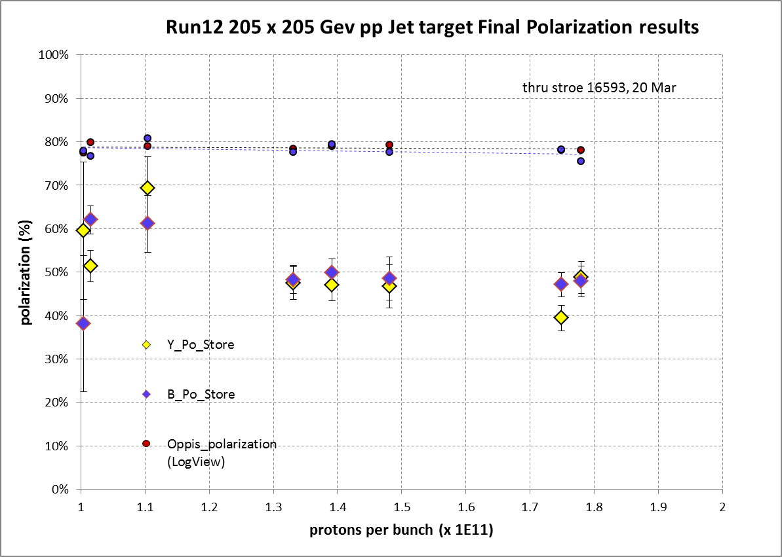
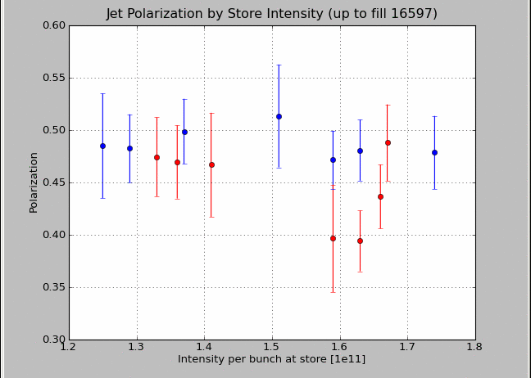
Intensity Dependence of Polarisation
transverse
longitudinal
longitudinal

Slide 11
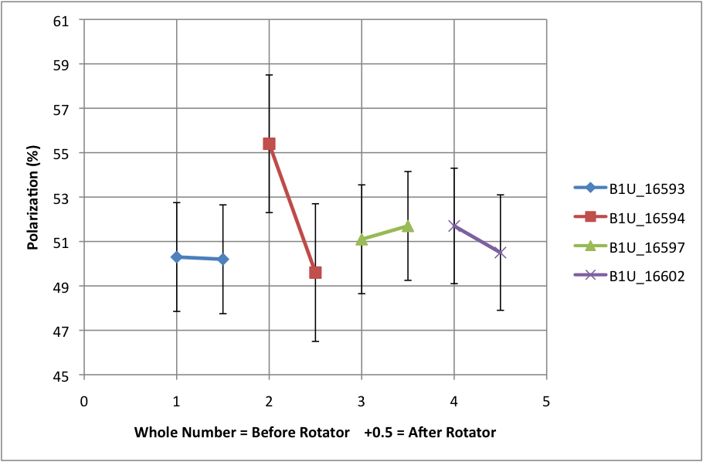
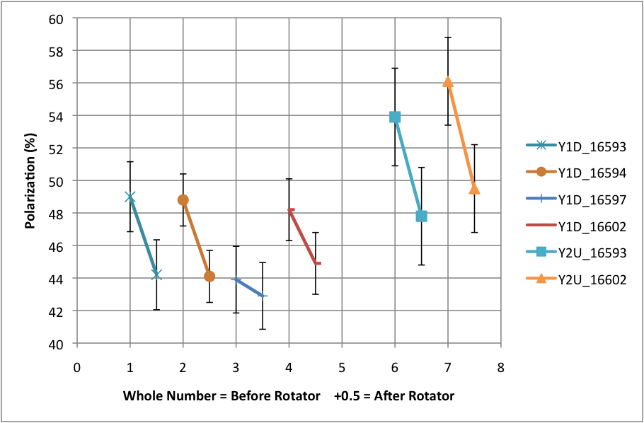
Polarisation loss through rotator ramp
Blue Beam
Shown are the polarisation
measurements before and
after the rotator ramp
at 255 GeV
Yellow Beam

Slide 12
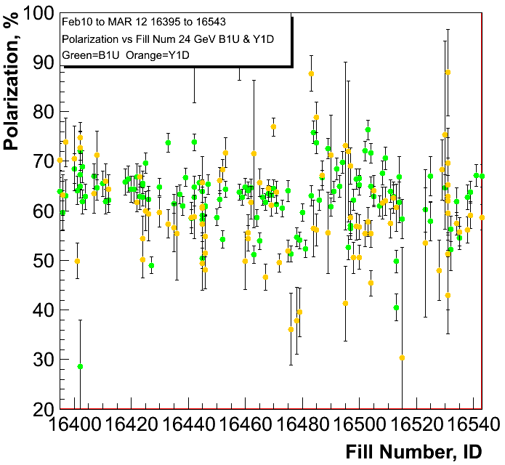
100 geV Results
polarisation at injection
Blue and Yellow
Caveat:
only first round of cleaning
up noise in polarimeters
was done
pC numbers not normalized
to jet

Slide 13
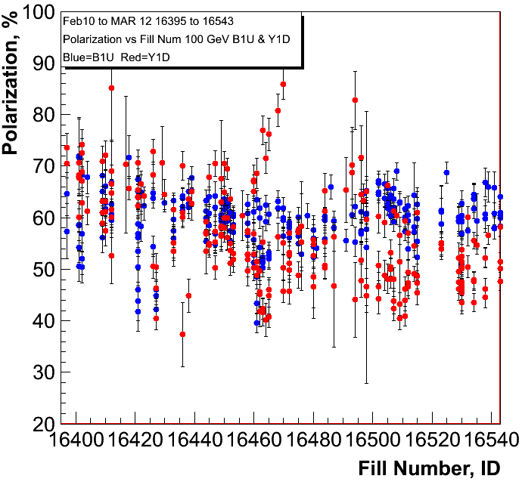
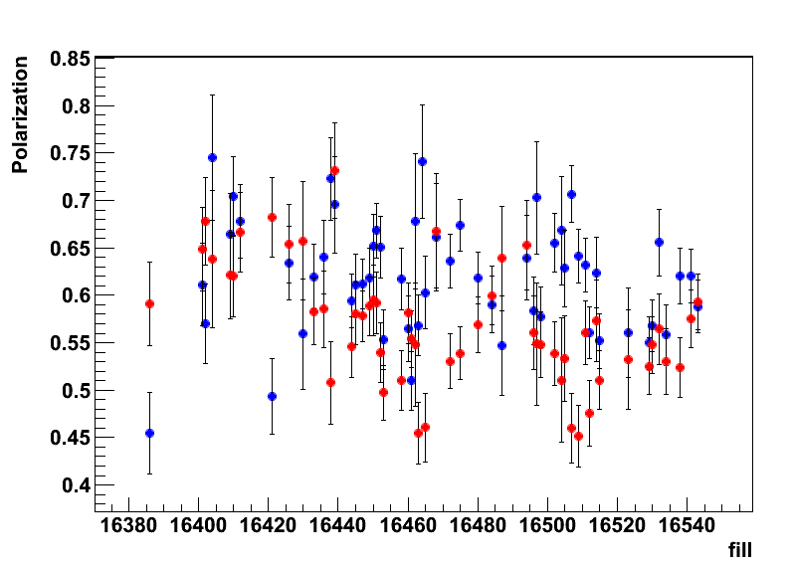
100 geV Results
polarisation at flat top
Blue and Yellow
H-JET

Slide 14
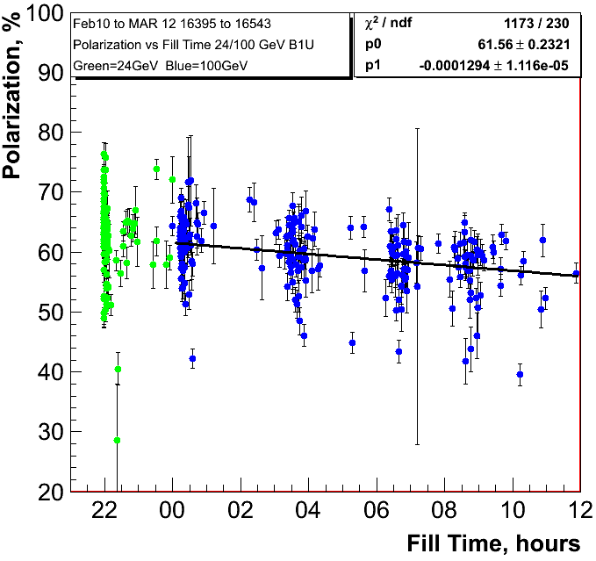
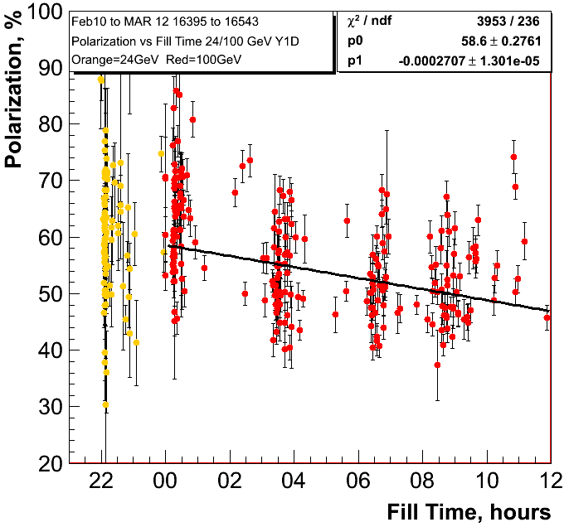
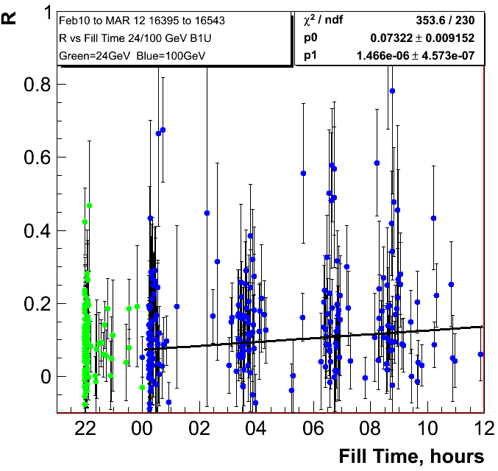
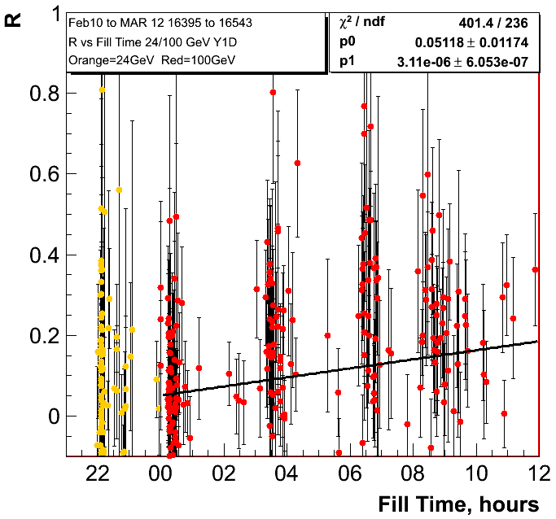
0.47%±0.040/hour
0.97%±0.047/hour

Slide 15
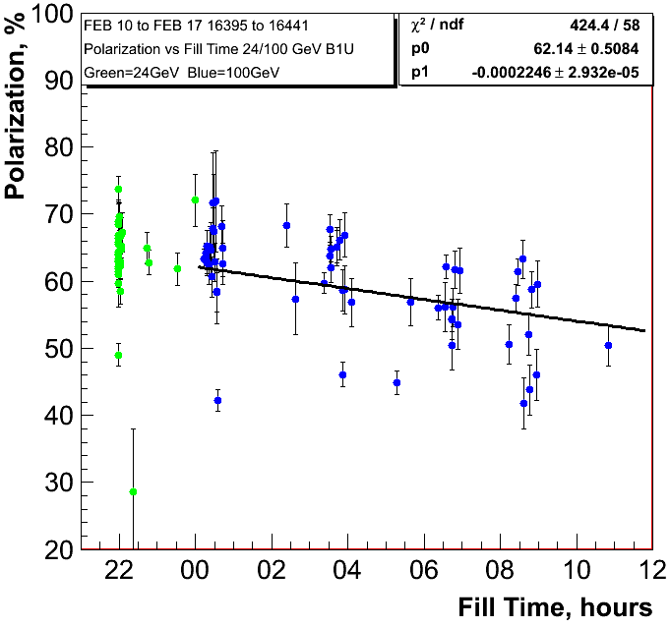
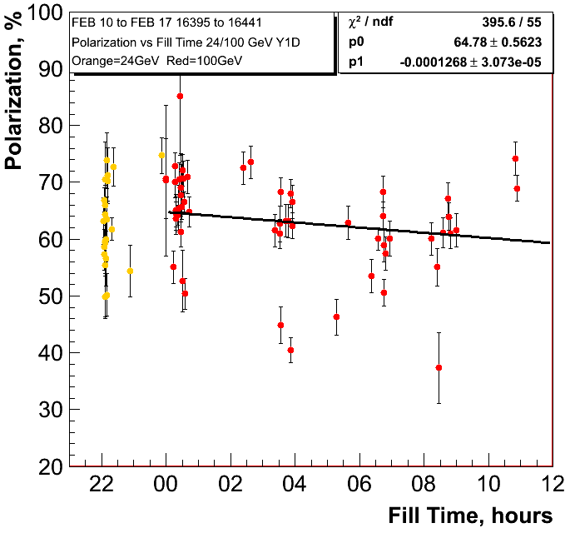
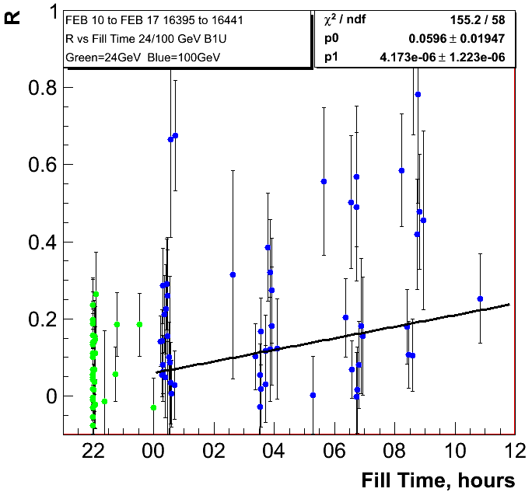
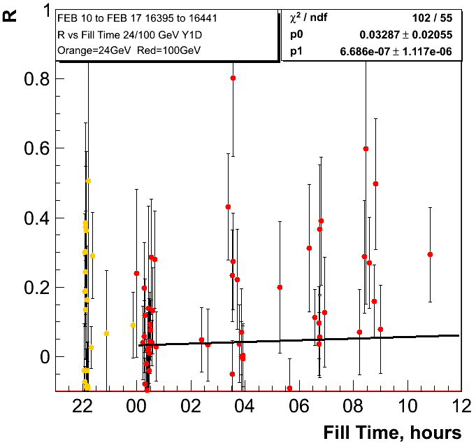
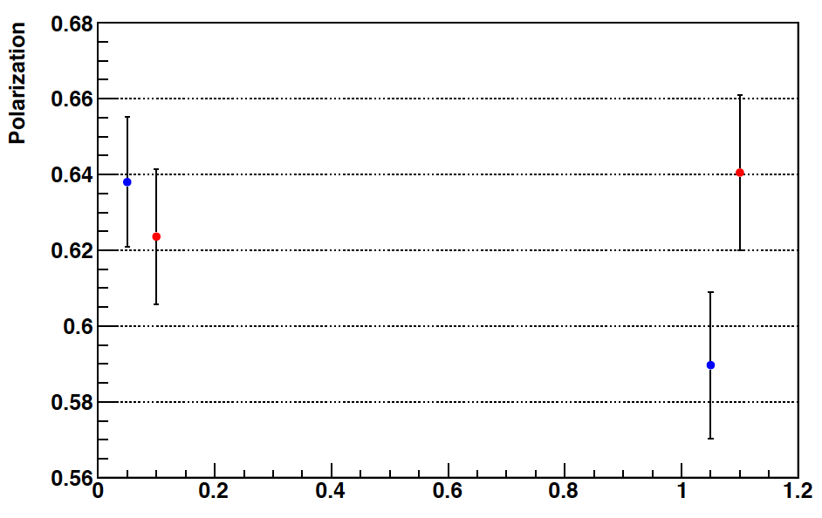
0.80%±0.11/hour
0.46%±0.11/hour
H-Jet
Fills: 16386-16439

Slide 16
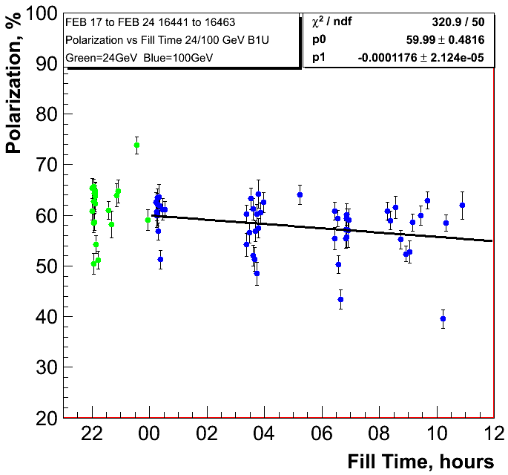
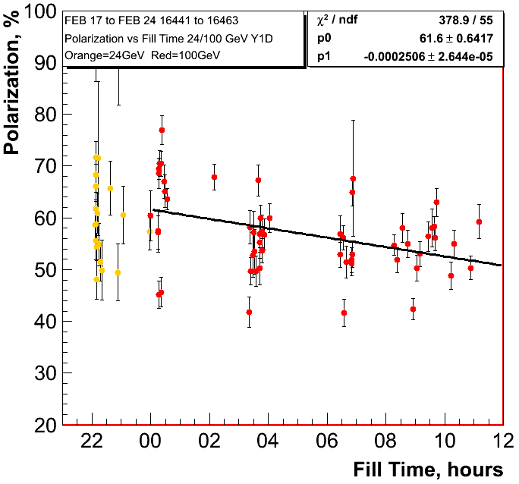
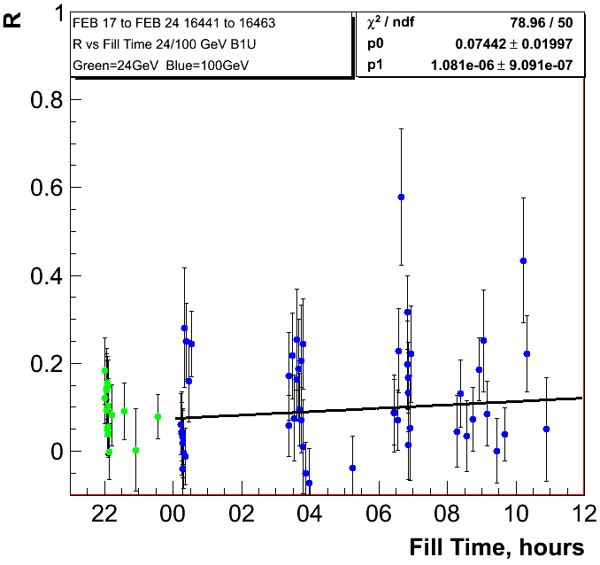
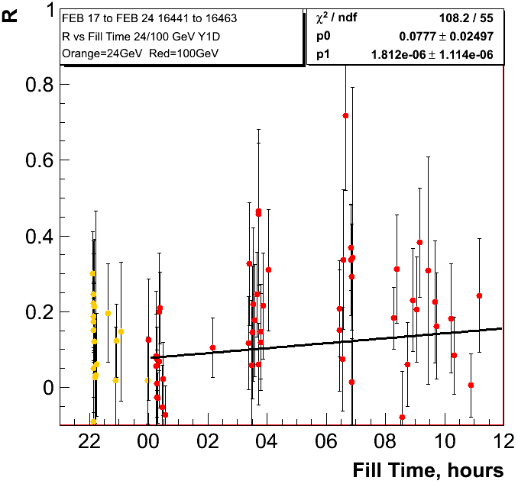
0.42%±0.08/hour
0.90%±0.095/hour

Slide 17
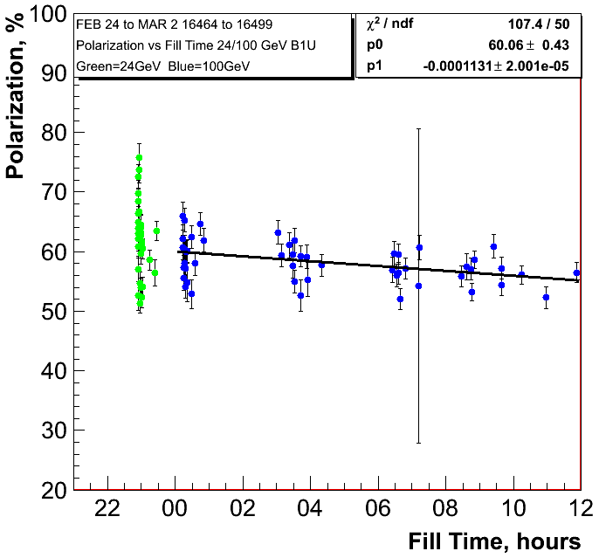
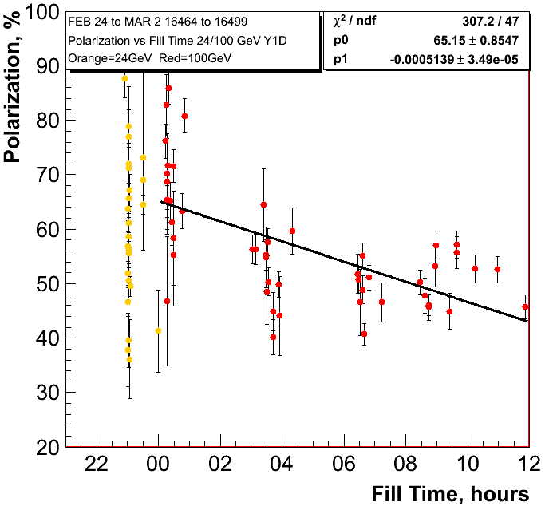
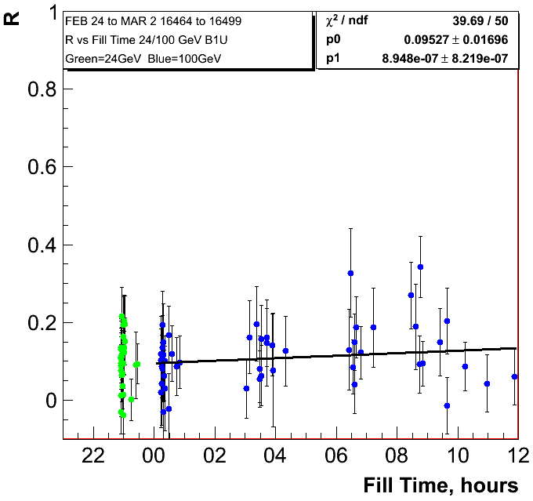
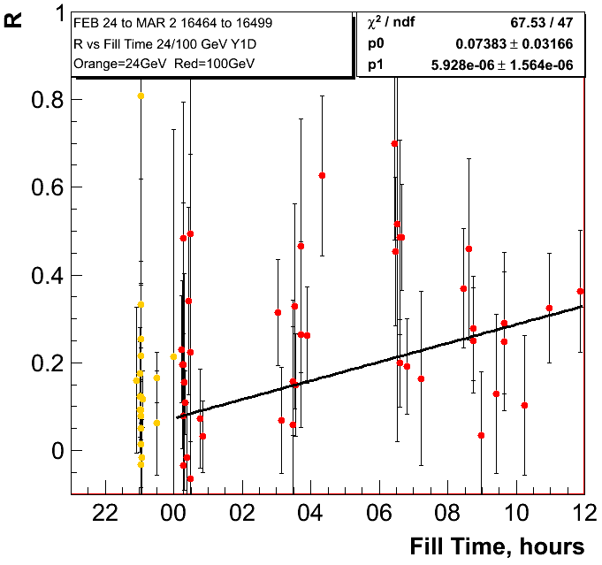
0.41%±0.07/hour
1.85%±0.13/hour

Slide 18
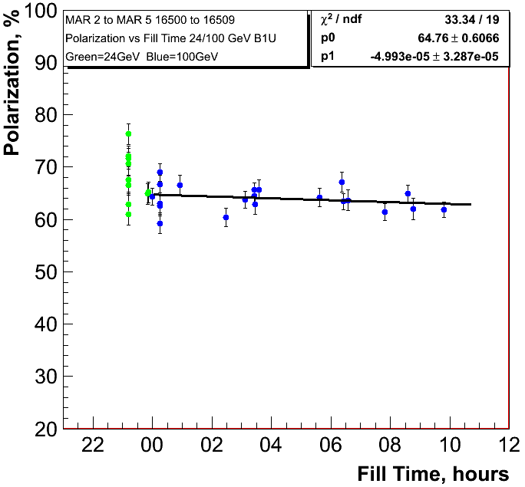
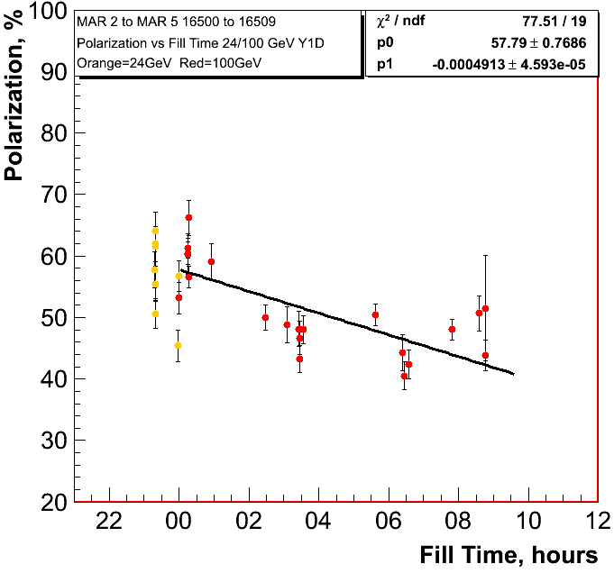
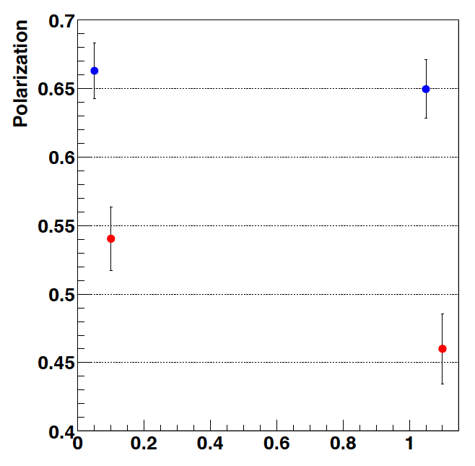
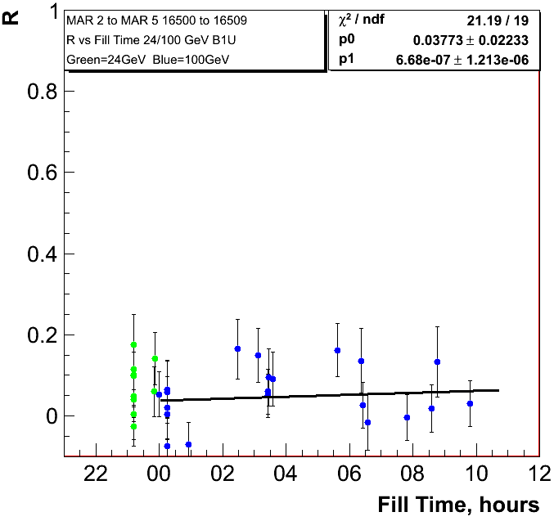
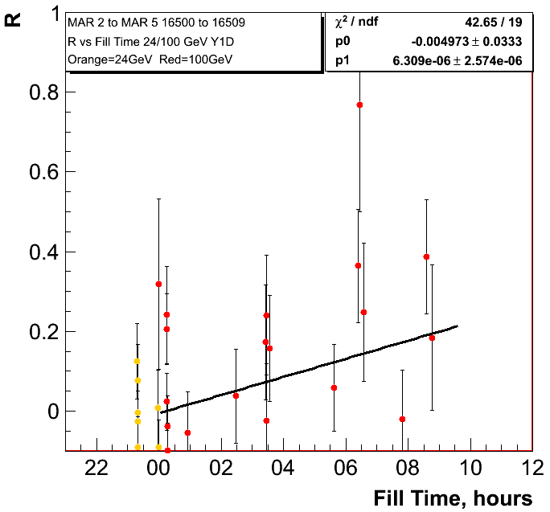
0.18%±0.118/hour
1.77%±0.17/hour
H-Jet
Fills: 16502-16511

Slide 19
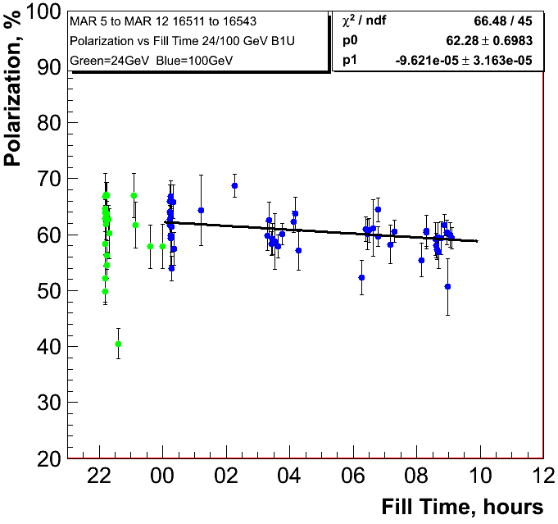
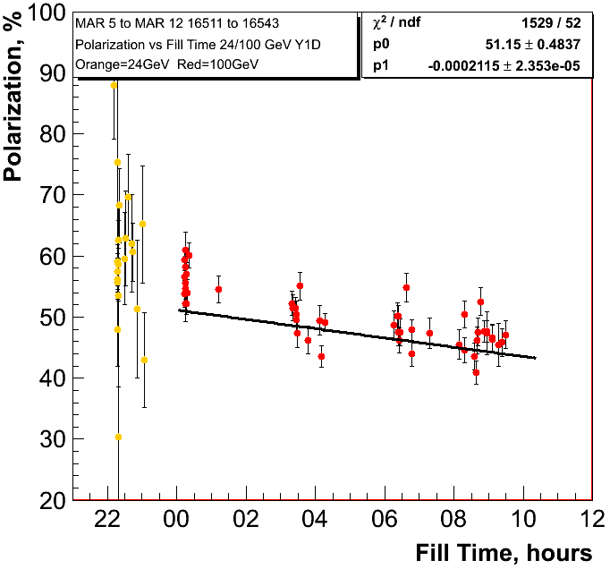
0.35%±0.11/hour
0.76%±0.08/hour

Slide 20
Summary
100 GeV:
main loss in polarisation through decay in fill
polarisation decay varies from week to week for the two beams
jet and pC polarimeters consistent observing the same trends
255 GeV:
the polarisation loss through decay in fill and on the ramp
jet and pC polarimeters consistent observing the same trends
observed polarisation consistent with 2011 average
polarisation decay in fill “comparable” to 2011

