Slide 1

The beauty of electroweak physics at star
E.C. Aschenauer
for the STAR Collaboration
arXiv:1501.01220

Slide 2
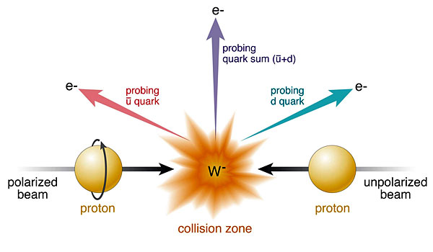
W Production Basics
Ws naturally separate quark flavors
rapidity: sea vs. valence quarks
Ws are maximally parity violating
→ Ws couple only to one parton helicity
Complementary to SIDIS:
very high Q²-scale 6400 GeV²
extremely clean theoretically
No Fragmentation function
stringent test on theory approach
for SIDIS
UNIVERSALITY of PDFs

Slide 3
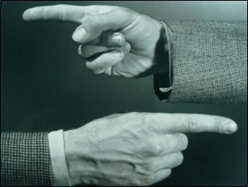
The Helicity structure of the proton
Jaffe-Manohar Spin Sum Rule:

Slide 4
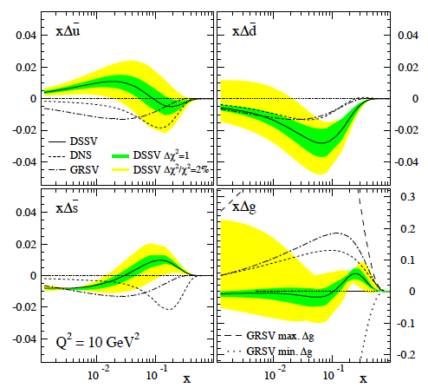
Polarized quark distributions
Why is separating quark flavors important?
the nuclear structure is encoded in PDF
understand dynamics of the quark-antiquark fluctuations
flavor asymmetry in the light quark sea in the proton
unpolarized: ubar ≠ dbar polarized case ?
sea-quark polarizations critical for quark contribution to spin
Drop of integral due to shape of polarized sea
quark PDFs at low x
→ forced by 3F-D constrain in PDF fits

Slide 5
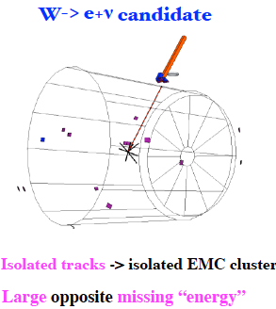
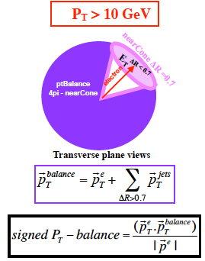
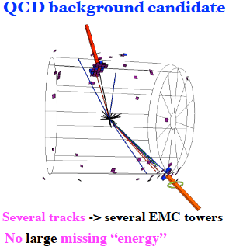
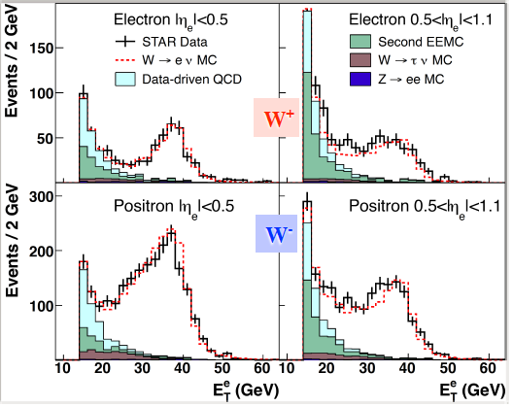
W selection
Primary Background:
QCD processes where fragments of a jet satisfy candidate e+/- isolation cuts while all other jets escape detection outside the acceptance.
Electroweak Background:
W→ τ ν Z→e+e-
MC embedded in zero bias events
Forward rapidity (1<η_{e}<1.4 ) W selection uses similar technique as mid rapidity and background estimation improves using additional Endcap Shower Maximum Detector

Slide 6
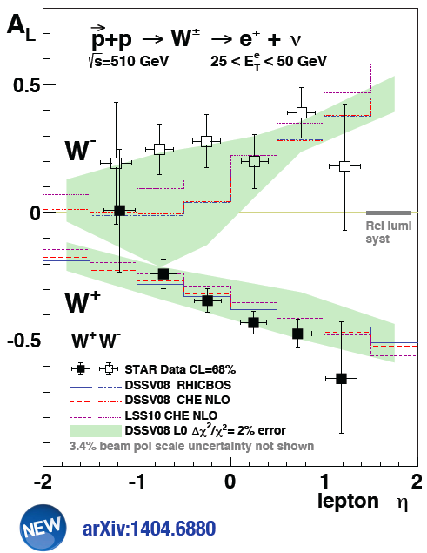
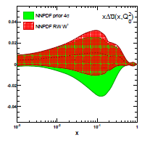


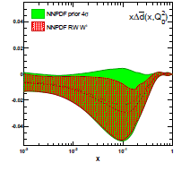
Current W-Results
RHIC data already indicate
polarized:
arXiv:1406.5539

Slide 7
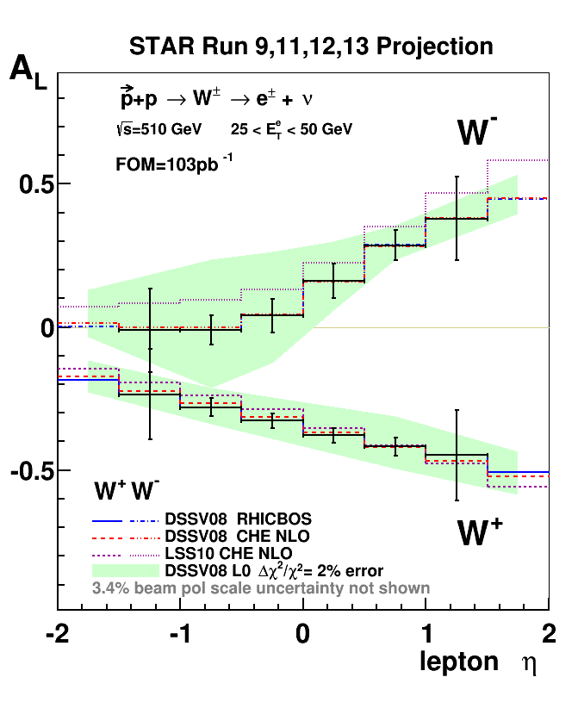
If the run-13 data are fully analyzed
pseudo-data randomized around DSSV
uncertainties correspond to 2009-2013
STAR W±-data will be a
strong constraint for
and
L_{int}=716 pb⁻¹ (delivered)

Slide 8
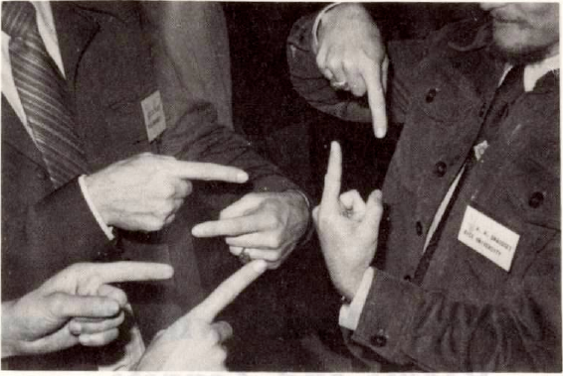

Transverse SPin Structure
using spin to unravel
the secrets / dynamics of QCD
Resolving the new spin puzzle
of the 21st century
The legacy of transverse polarized pp:
What causes A_{N} at forward rapidities?

Slide 9
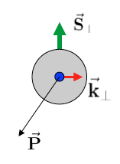
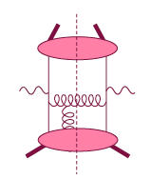
Initial State: TMDs vs. Twist-3
Intermediate Q_{T}
Q>>Q_{T}/p_{T}>>Λ_{QCD}
Transverse
momentum
dependent
Q>>Q_{T}>=Λ_{QCD}
Q>>p_{T}
Collinear/
twist-3
Q,Q_{T}>>Λ_{QCD}
p_{T}~Q
Efremov, Teryaev;
Qiu, Sterman
or
Twist-3 FF
Sivers fct.
Q_{T}/P_{T}
Λ_{QCD}
<<
Q_{T}/P_{T}
<<
Q
Need 2 scales
Q² and p_{t}
Remember pp:
several observables one scale
Exception:
DY, W/Z-production
Need only 1 scale
Q² or p_{t}
But
should be of reasonable size
should be applicable to
pp observables
A_{N}(π⁰/γ/jet)
related through

Slide 10
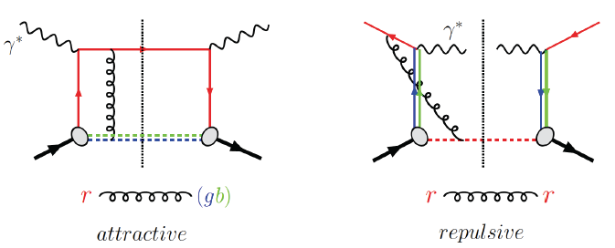
Visualize Color interactions in QCD.
Measure non-universality of sivers-function
DIS:
γq-scattering
attractive FSI
pp:
qqbar-anhilation
repulsive ISI
QCD:
Critical test of factorization in QCD
no sign change
→ need to rethink QCD factorization
Sivers_{DIS} = - (Sivers_{DY} or Sivers_{W} or Sivers_{Z0})
A_{N}(direct photon) measures the sign change in the Twist-3 formalism
All three observables can be approached
at 500 GeV at RHIC

Slide 11
How to study TMDs in p+P
Initial State
Final State
A_{N} as function of rapidity, E_{T},
p_{T} and x_{F} for inclusive jets,
direct photons
A_{N} for heavy flavour → gluon
A_{N} as a function of rapidity,
p_{T} for W^{+/-}, Z⁰, DY
A_{UT} as a function of the azimuthal
dependence of the correlated hadron
pair on the spin of the parent quark
(transversity x interference FF)
Azimuthal dependences of hadrons within
a jet (transversity x Collins FF)
A_{N} as function of rapidity, p_{T} and x_{F} for
inclusive identified hadrons
(transversity x Twist-3 FF)
TMD, TWIST-3, Collinear
All possible explanations for the underlying
physics of the forward A_{N}

Slide 12
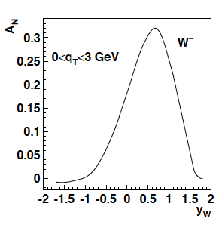
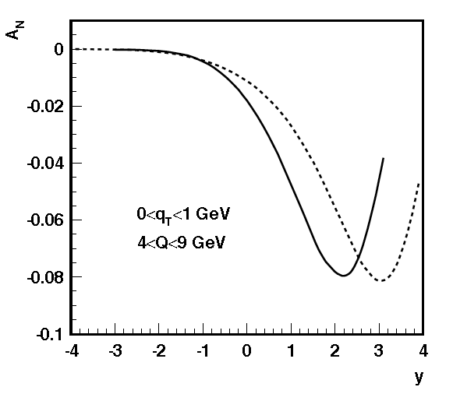
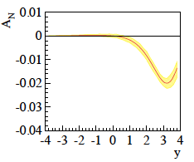
Surprise: TMD evolution
Z.-B. Kang & J.-W. Qui arXiv:0903.3629
Z. Kang: original paper arXiv:1401.5078
before evolution
after evolution
much stronger than
any other known
evolution effects
needs input from
data to constrain
non-perturbative
part in TMD evolution
current data extremely limited
further constraints
cannot come from fixed
target SIDIS
→ too small lever arm in
Q² & p_{t}
NOTE:
the same evolution applies
to TMD FFs, i.e. Collins
and to e⁺e⁻,
SIDIS → eRHIC
÷ ~10
TMD evolution can be tested at RHIC
→ Measure A_{N} through DY and W/Z
Z.-B. Kang & J.-W. Qui Phys.Rev.D81:054020,2010
Z. Kang et al. arXiv:1401.5078
before evolution
after evolution
DY
500 GeV
÷ ~4
200 GeV
4 < Q < 9 GeV
0 < q_{T} <1 GeV

Slide 13
What else Can we learn
What is the sea-quark Sivers fct.?
  W’s ideal → rapidity dependence of A_{N} separates quarks from antiquarks
  no constraint from existing SIDIS data
Z. Kang A_{N} (W^{+/-},Z⁰) accounting for sea quark uncertainties through positivity bounds
all plots after evolution (arXiv:1401.5078)

Slide 14
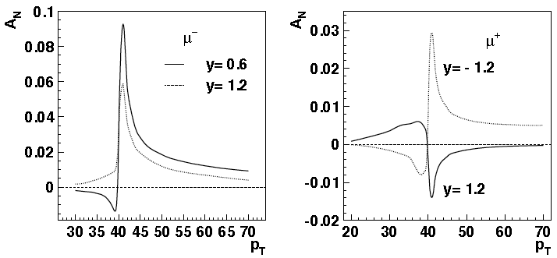
Analysis Technique for A_{n} W
Need to reconstruct W kinematics as lepton asymmetry is suppressed and
the kinematic dependences are difficult to resolve
→ resolution effects and statistics
Apply analysis technique developed at the Tevatron and used at LHC
i.e. CDF PRD 70, 032004 (2004)
Philosophy:
W → l+ν as ν is not seen
→ reconstruct W kinematics through lepton and recoil

Slide 15
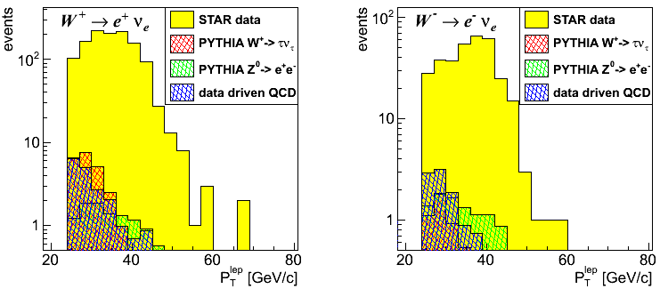
STAR: A_{N}^{W}
Analysis Strategy to fully reconstruct Ws:
Follow the analysis steps of the A_{L}
→ W candidate selection via high p_{t} lepton
Data set: 2011 transverse 500 GeV data (25 pb⁻¹)
In transverse plane:
Recoil reconstructed using tracks and towers:
Part of the recoil not within STAR acceptance
→ correction through MC (Pythia)
→ MC-correction

Slide 16
STAR: A_{N}^{W}
W Rapidity reconstruction:
W longitudinal momentum (along z) can be calculated from the invariant mass:
Neutrino longitudinal momentum component from quadratic equation
GOOD data/MC agreement
Systematics determined through a MC challenge method
input asymmetries from arXiv:1401.5078 and reconstruct it back

Slide 17
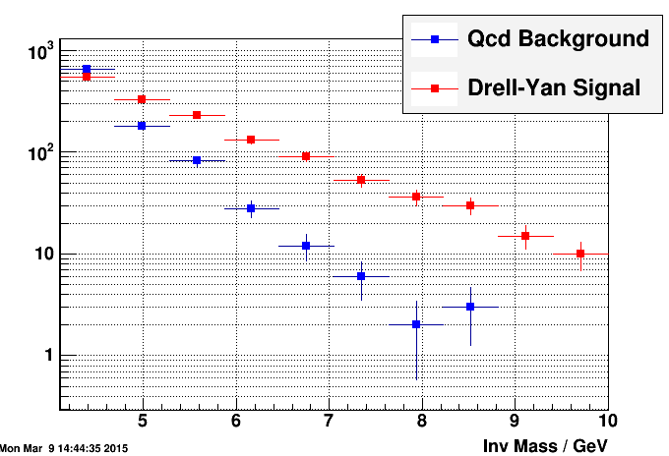
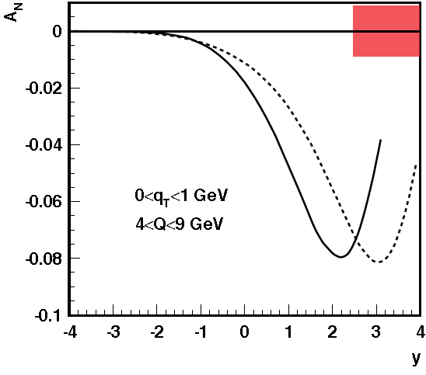
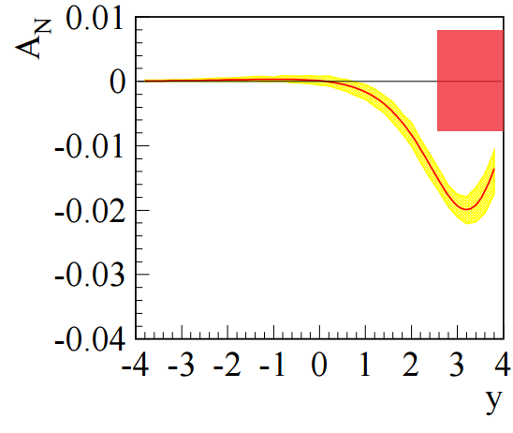
What can we DO in RUN-17
Assumptions:
integrated delivered luminosity of 400 pb⁻¹
7 weeks transversely polarized p+p at 510 GeV
electron lenses are operational and dynamic β-squeeze is used
throughout the fill
  smoothed lumi-decay during fills
  reduced pileup effects in TPC → high W reconstruction efficiency
Measuring the sign change through DY
STAR has investigated in detail the option
FMS & Pre- and Post-shower
Results for a run-17
Will provide data to constrain TMD evolution
sea-quark Sivers fct
test sign-change if TMD evolution ÷ ~5 or less

Slide 18
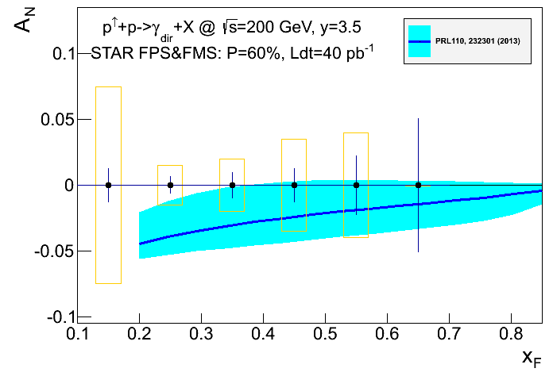
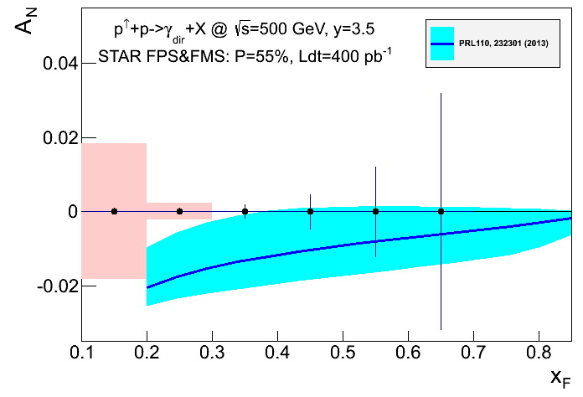
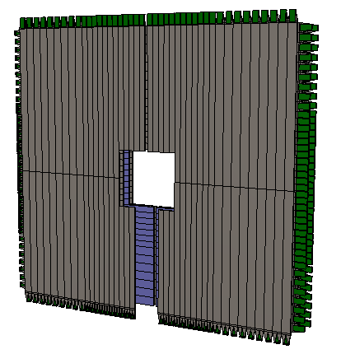
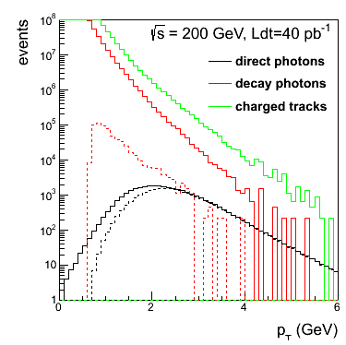
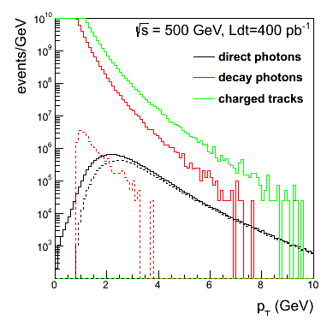
Complementary Channel
STAR FMS-PreShower:
3 layer preshower in front of the FMS,
distinguish photons, electrons/positrons
and charged hadrons → installed for RUN-15
Note:
similar capabilities with
PHENIX MPC-EX
A_{N} for direct photon production:
sensitive to sign change, but in TWIST-3 formalism
not sensitive to TMD evolution
no sensitivity to sea-quarks; mainly u_{v} and d_{v} at high x
collinear objects but more complicated evolutions than DGLAP
indirect constraint on Sivers fct.
Not a replacement for A_{N}(W^{+/-}, Z⁰, DY) measurement
but an important complementary piece in the puzzle

Slide 19
STAR possibilities
 | A_{N}(W^{+/-},Z⁰) | A_{N}(DY) | A_{N}(γ)
sensitive to sign change through TMDs | yes | yes | no
sensitive to sign change through Twist-3 T_{q,F}(x,x) | no | no | yes
sensitive to TMD evolution | yes | yes | no
sensitive to sea-quark Sivers fct. | yes | yes | no
need detector upgrades | no | yes FMS postshower | no
biggest experimental challenge | integrated luminosity | background suppression & integrated luminosity | ---------
A_{N}(DY,W^{+/-},Z⁰,γ) clean and proven probes sensitive to all questions
in a timely way without the need for upgrades

Slide 20
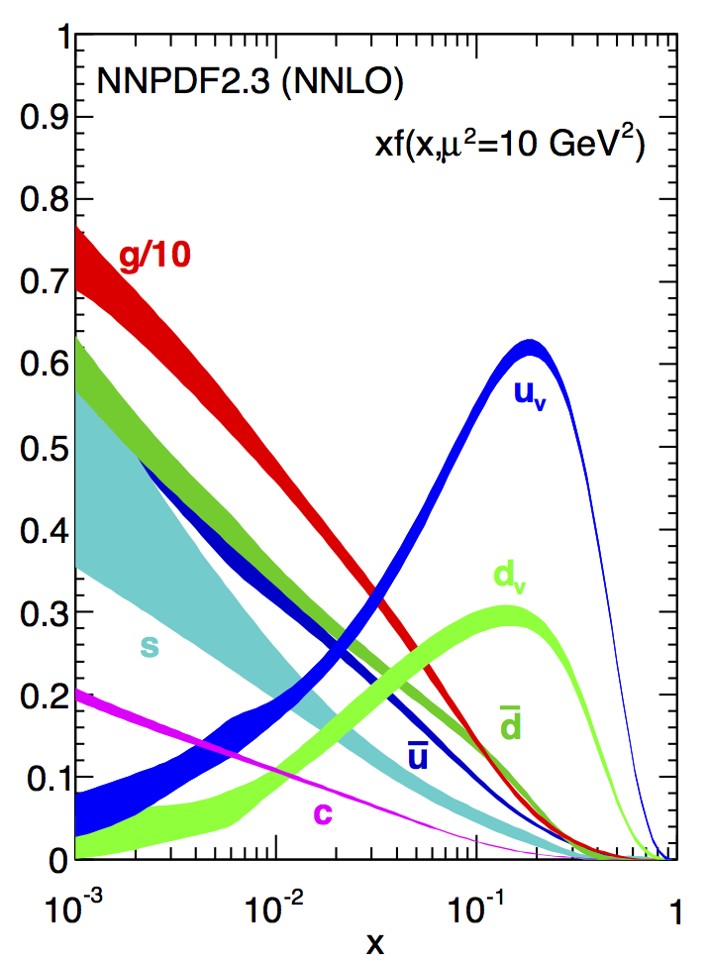
Are sea quarks flavor-symmetric?
at which x-range are
sea quarks flavor symmetric ?
High precision high-x PDFs
critical for searches at
high masses at the LHC
RHIC
mid-rapidity jet cross sections
→ high x gluons (200 GeV)
W⁺/W⁻: u, d, ubar, dbar PDFs

Slide 21
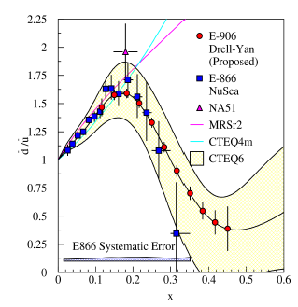
unpolarized W+/W- ratios
What will we learn?
  d-bar/u-bar in PDFs
LHC coverage: ~10⁻³ < x < 10⁻¹
RHIC coverage: x > ~10⁻¹
LO:
Current data: E866/NuSea (Drell-Yan)
  included in all NLO global PDF fits
Unpolarized asymmetries:
Quantitative calculation of Pauli blocking does not explain ratio

Slide 22
The unpolarized W+/W- cross section ratio
What we measure
N_{obs} = observed W events
N_{bkg} = background events
ε = efficiency
Same selection as for A_{N}
Background estimated in the same way
W boson kinematics are reconstructed in the same way
  We do not care of the polarization direction in measuring RW
  We could add the STAR 2012 data at √s= 510 GeV
  and will add run 13
Data sample
pp – run11 transverse @ √s=500 GeV Integrated Luminosity ~25 pb⁻¹
pp – run12 long @ √s=510 GeV Integrated luminosity: ~ 77 pb⁻¹
Total Int. lumi: 102 pb⁻¹

Slide 23
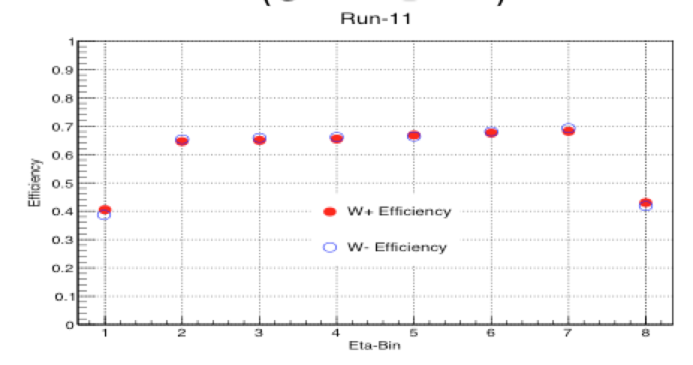
Efficiency Study
Uncertainties calculated binomially (not visible)
The efficiency depends very little on
the charge
it plays negligible role in this
measurement
The efficiency depends on the period
Run 12 less efficient than run 11 because of the lower reconstruction efficiency at higher rates due to pile up effects in the TPC

Slide 24

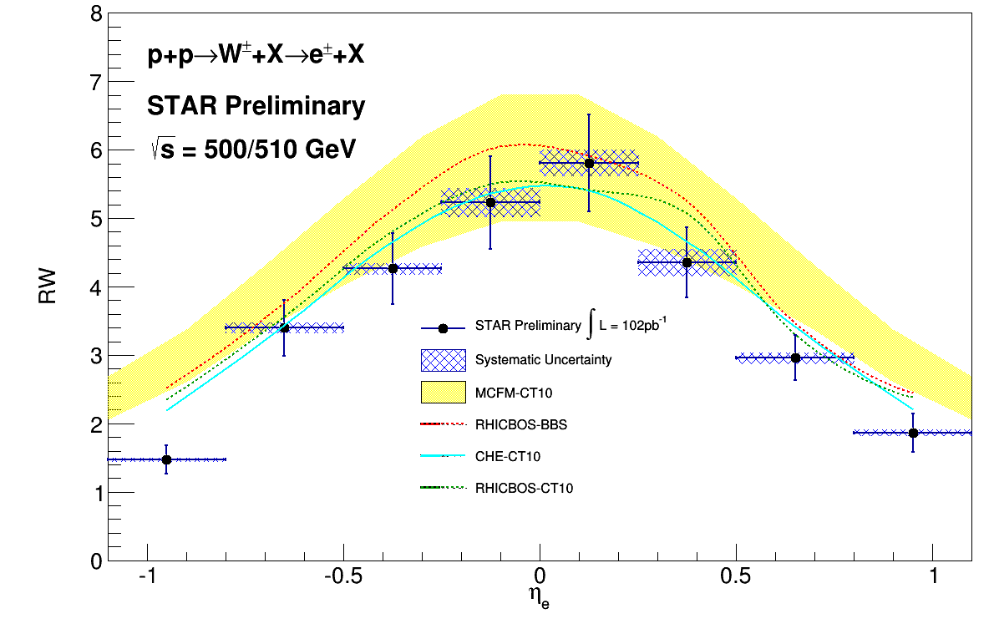
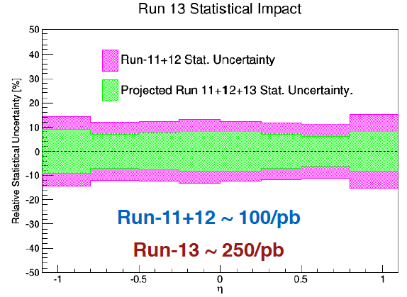
W+/W- ratio as fct. of lepton rapitity
Collected Lumi = 102 pb⁻¹
  Systematics much smaller than statistical uncertainties
σ(W⁺) / σ(W⁻)
Systematic uncertainties (blue shades) from background subtraction:
QCD background varied the normalization bin to: [15;17] and [15;21]
  Z⁰ -> ee background vary the normalization to STAR lumi +/- 13%

Slide 25
W+/W- vs boson rapidity
Why to use fully reconstructed Ws for charge ratio:
no smearing in x compared to “lepton asymmetry”
access to higher x compared to “lepton asymmetry”
Cross check of CDF measurements
Follow the same procedure to reconstruct W kinematics as for A_{N}
Preliminary
Stat. errors
Blue points: After background subtraction
Impact of background subtraction smaller than statistical uncertainties
Collected Lumi = 102 pb⁻¹
The Correction factor
Is not charge-dependent
does not impact the W+/W- ratios !
Is not interaction-rate dependent
→ we can combine different run periods

Slide 26
Systematics for W reconstruction
Systematics on background subtraction (as for the decay lepton)
Systematics on the reconstruction smearing
  Calculate the ratio with generated pure MC
  Calculated the ratio with reconstructed MC after all the analysis
  Assign the difference as systematic uncertainty
Relative Systematics

Slide 27
W⁺/W⁻ as function of boson rapidity
σ(W⁺) / σ(W⁻)
Total systematic uncertainty accounts for
Syst. from background subtraction
Syst. from W reconstruction

Slide 28
Summary
EW observables, W, Z⁰ and DY, ideal tools to study the proton structure
STAR the ideal detector to address several important physics questions
through EW observables
the sea quark helicity structure
the sea quark sivers fct. and its evolution
the unpolarized quark structure at high x
the comparison between PDFs extracted from SIDIS and EW measurements
extremely critical to verify the theoretical approach for SIDIS
→ EIC: SIDIS the golden tool to extract proton structure

Slide 29
BACKUP

