Slide 1
pp and pA for 2014 BUR

Slide 2
Executive Summary 2015
Charge from Berndt Müller: Prepare for 15 or 22 cryo-weeks scenarios at √s=200 GeV
15 cryo-weeks
  Up to 11 physics weeks of p+A or 11 physics of p+p
  too short for 2 species, not clear to me what it will be
22 cryo-weeks
  11 physics weeks of p+A and 5/6 weeks of p+p
  Transverse pp and pA because FMS and Roman Pots will be installed
  pp still HI reference data: need to see what is needed in detail

Slide 3
Run 15 goals
In Run 12, we sampled 22 pb⁻¹ at 61/58% polarization over ~5 weeks with >70% data-taking efficiency
In Run 15, we plan to sample 40 pb⁻¹ at ~60% polarization over 5 weeks
Higher FOM in Run 15 will hopefully come from:
  Higher luminosity from electron lensing (2x)
    need still to commission the e-Lens nothing done till now in Run-13
  there is the hope of higher polarization from the new polarized ion source (+5% at source and +4% at RHIC), have not seen anything from it in Run-13
  maybe some improved data-taking efficiency

Slide 4
Physics Motivations p^{(↑)}p and p^{(↑)}A
p^{(↑)}p
  increase statistics for classical observables sensitive to sivers and transversity
    iff, A_{N}(jet+hadron), A_{N}(direct photon), A_{N}(jet), A_{N, ….}
  elastic scattering in p^{(↑)}p
    RP would detect the protons scattered under small angles
  central diffraction to study exotic particle production
    RP would detect the protons scattered under small angles and veto the break up of the nucleus
transverse polarized p^{(↑)}p and p^{(↑)}A
  A_{N} for in exclusive J/Ψ in UPC in polarised p↑p or p↑A collisions to constrain GPD E_{g}
    RP will tag the protons (p↑p case) and act as the ZDC as a veto for the A-beam (p↑A)
  to study saturation arXiv:1106.1375
  to understand the underlying sub-processes for A_{N} arXiv:1201.5890
  A_{N} in forward diffractive physics → underlying sub-processes for A_{N}
    RP would detect the protons scattered under small angles and veto the break up of the nucleus

Slide 5
Physics Motivations for pA
standard R_{pA} and comparison data for AA in mid rapidity
  Charm with HFT + MTD
Study of saturation
  forward diffractive production in pA
  di-hadron correlation, hadron-jet, photon-jet
  J_{dA}
  p_{t}-broadening for J/Ψ, Υ, DY(?)
need lepton/photon separation → preshower in front of FMS
  provides also further hadron suppression

Slide 6
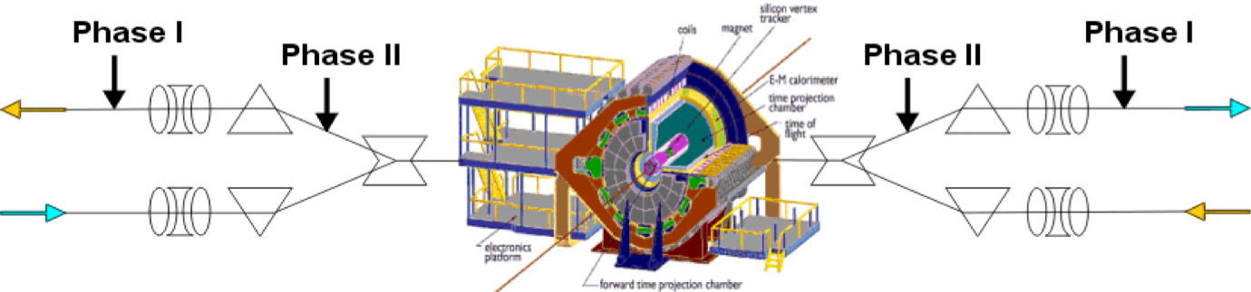
Forward Proton Tagging at STAR/RHIC
at 55-58m
at 15-17m
Roman Pots to measure forward scattered ps in diffractive processes
Staged implementation to cover wide kinematic coverage
Phase I (Installed): for low-t coverage
Phase II (planned) : for higher-t coverage, new RPs, reinstall old ones at old place
Phase II* (planned) : for higher-t coverage, re-use RP from Phase I
full coverage in φ not possible due to machine constraints
No dedicated running needed any more
→ 250 GeV to 100 GeV
scale t-range by 0.16

Slide 7
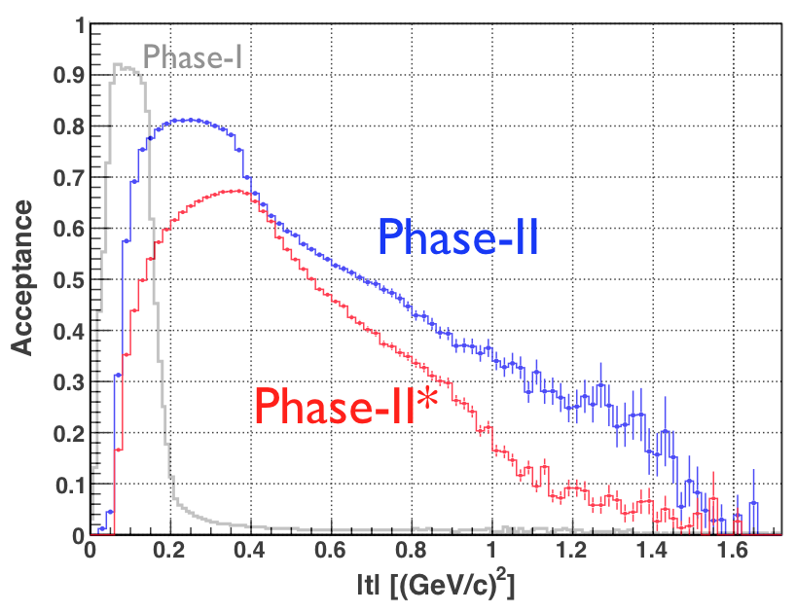
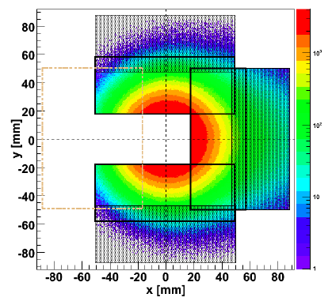
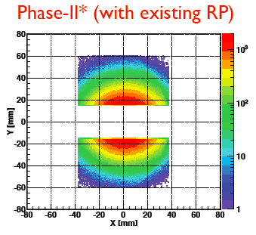
Forward Proton Tagging at STAR/RHIC
J.H. Lee
Phase-II

Slide 8

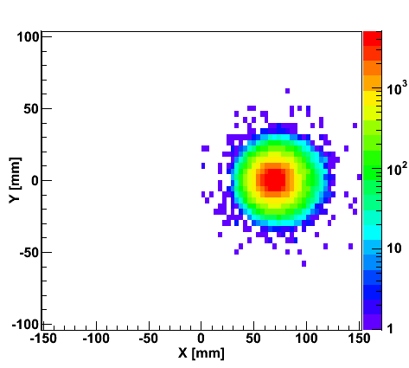
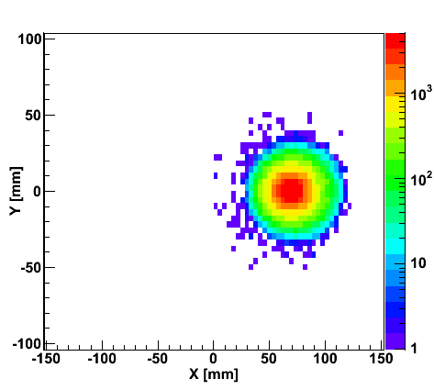
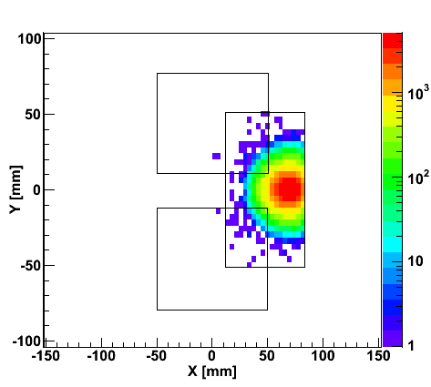
“Spectator” proton from deuteron with the current RHIC optics
generated
Passed DX aperture
Accepted in RP
Rigidity (d:p =2:1)
The same RP configuration with the current RHIC optics (at z ~ 15m between DX and D0)
Detector size and position can be optimized for optimal acceptance

Slide 9
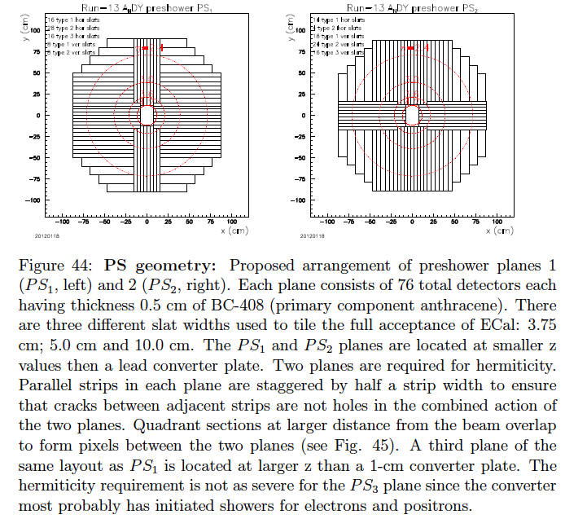
Preshower in front of FMS

Slide 10
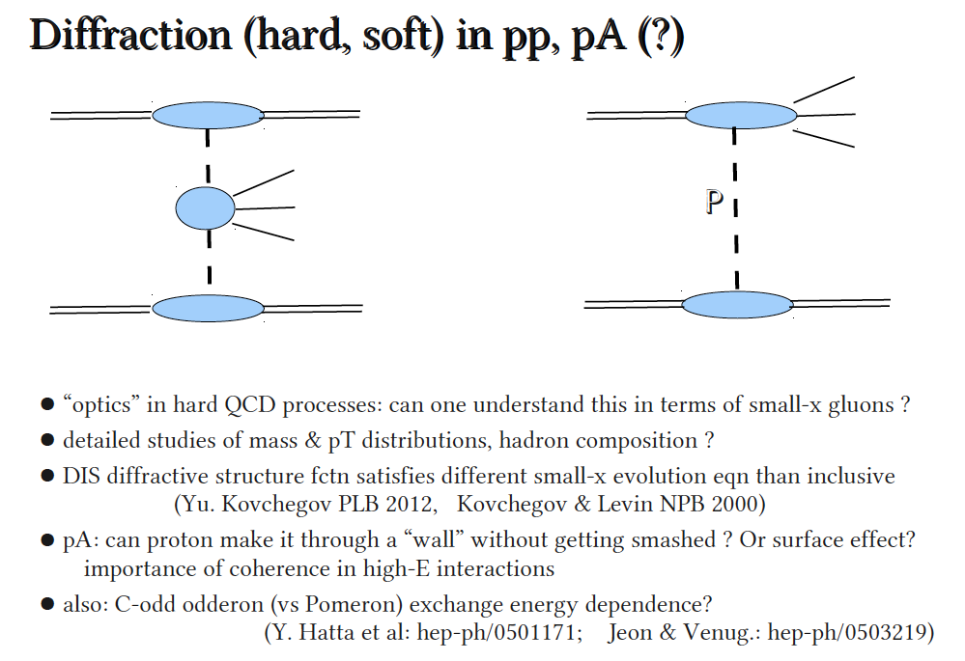
Diffractive Physics
Adrian Dumitru
To be sure it was diffraction need to make sure p and/or A are intact

Slide 11
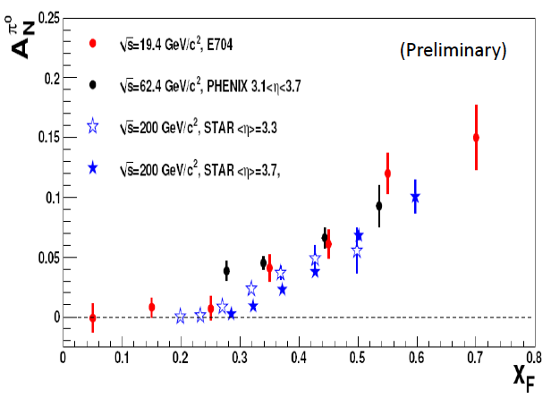
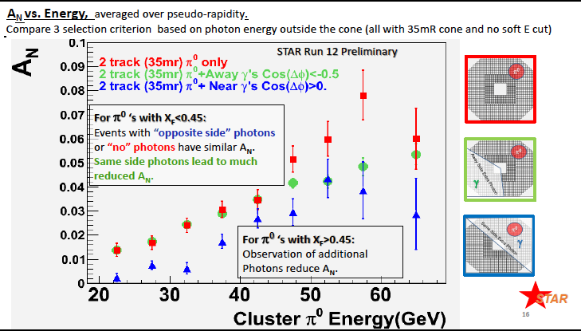
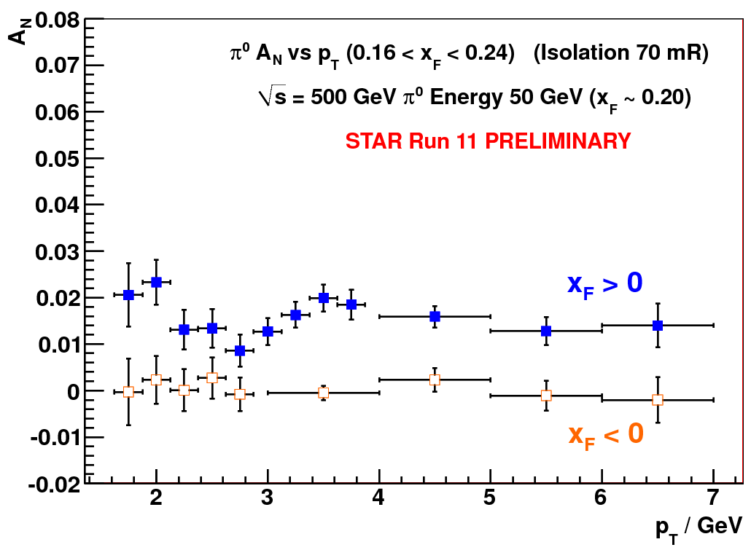
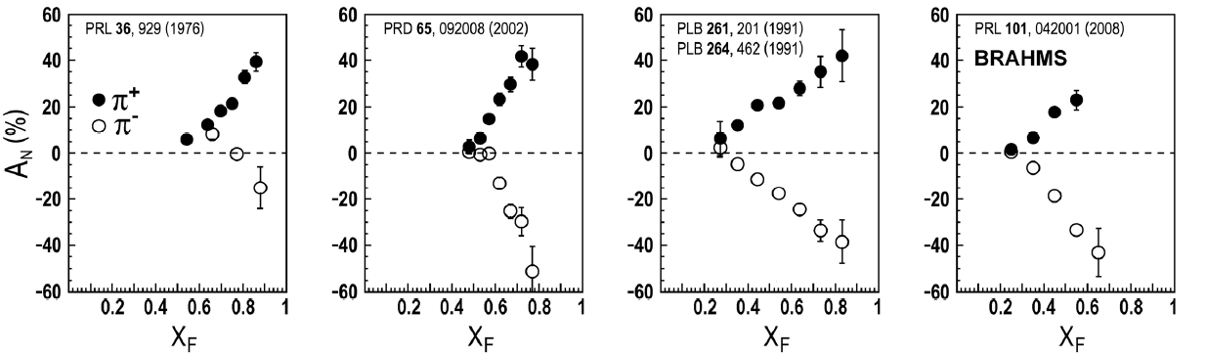
Long standing puzzle in forward physics: large A_{N} at high √s
Big single spin asymmetries in p↑p !!
Naive pQCD (in a collinear picture)
predicts A_{N} ~ a_{s}m_{q}/sqrt(s) ~ 0
Do they survive at high √s ? YES
Is observed p_{t} dependence as expected
from p-QCD? NO
Surprise: A_{N} bigger for more isolated events
What is the underlying process?
Sivers / Twist-3 or Collins or ..
till now only hints
Left
Right
Bigger asymmetries for isolated events
→
Measure A_{N} for diffractive and rapidity gap events
ANL ZGS
√s=4.9 GeV
BNL AGS
√s=6.6 GeV
FNAL
√s=19.4 GeV
BRAHMS@RHIC
√s=62.4 GeV

Slide 12
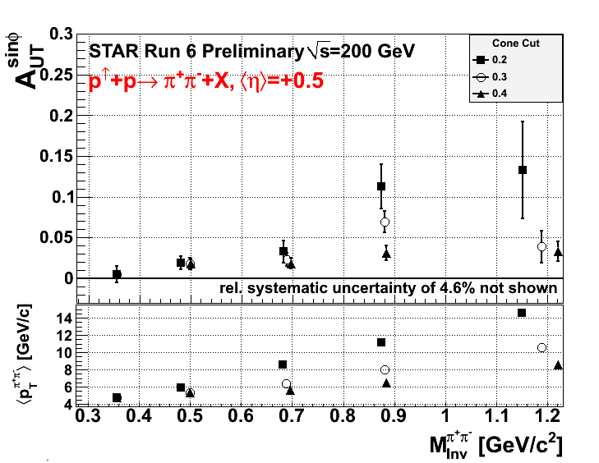
Interference Fragmentation Function
Measure pair transverse momentum p_{T} and invariant mass M
Correlations describe product of transversity h(x) and Interference Fragmentation Function
IFF will help constrain h(x) at higher x than competing measurements
First significant non-zero transverse spin asymmetry measured at mid-rapidity at STAR

Slide 13
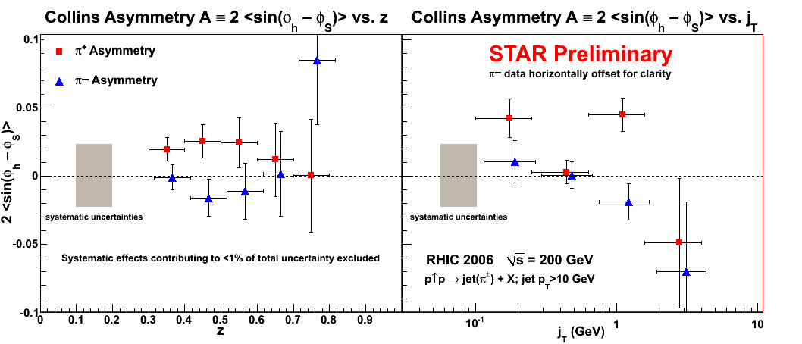
Collins Asymmetry
Leading charged pions inside jets
Correlations between azimuthal distribution of pions and spin orientation of proton
Sensitive to transversity h(x) and Collins Fragmentation Function ΔD(z)

Slide 14
A_{N} in p↑A or Shooting Spin Through CGC
Yuri Kovchegov et al.
strong suppression of odderon STSA in nuclei.
Q_{s}=1GeV
r=1fm
Very unique RHIC possibility p↑A
Synergy between CGC based
theory and transverse spin physics
A_{N}(direct photon) = 0
r=1.4fm
r=2fm
The asymmetry is larger for peripheral collisions,
and is dominated by edge effects.
x_{f}=0.7
x_{f}=0.9
x_{f}=0.9
cut on
large b
x_{f}=0.7
x_{f}=0.6
x_{f}=0.6
x_{f}=0.5
x_{f}=0.5

Slide 15
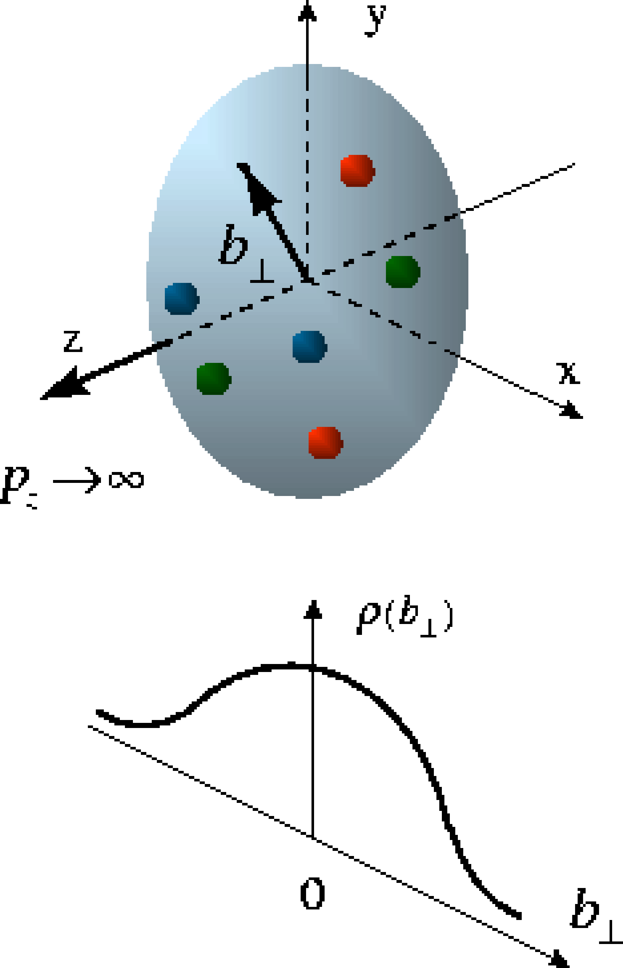
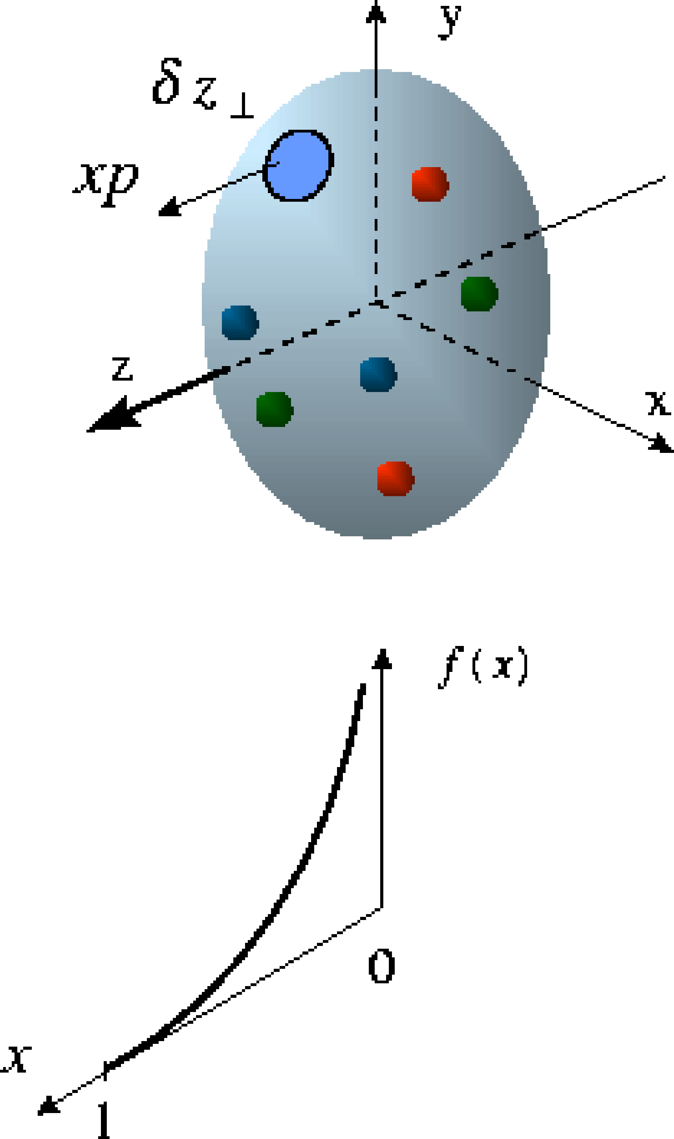
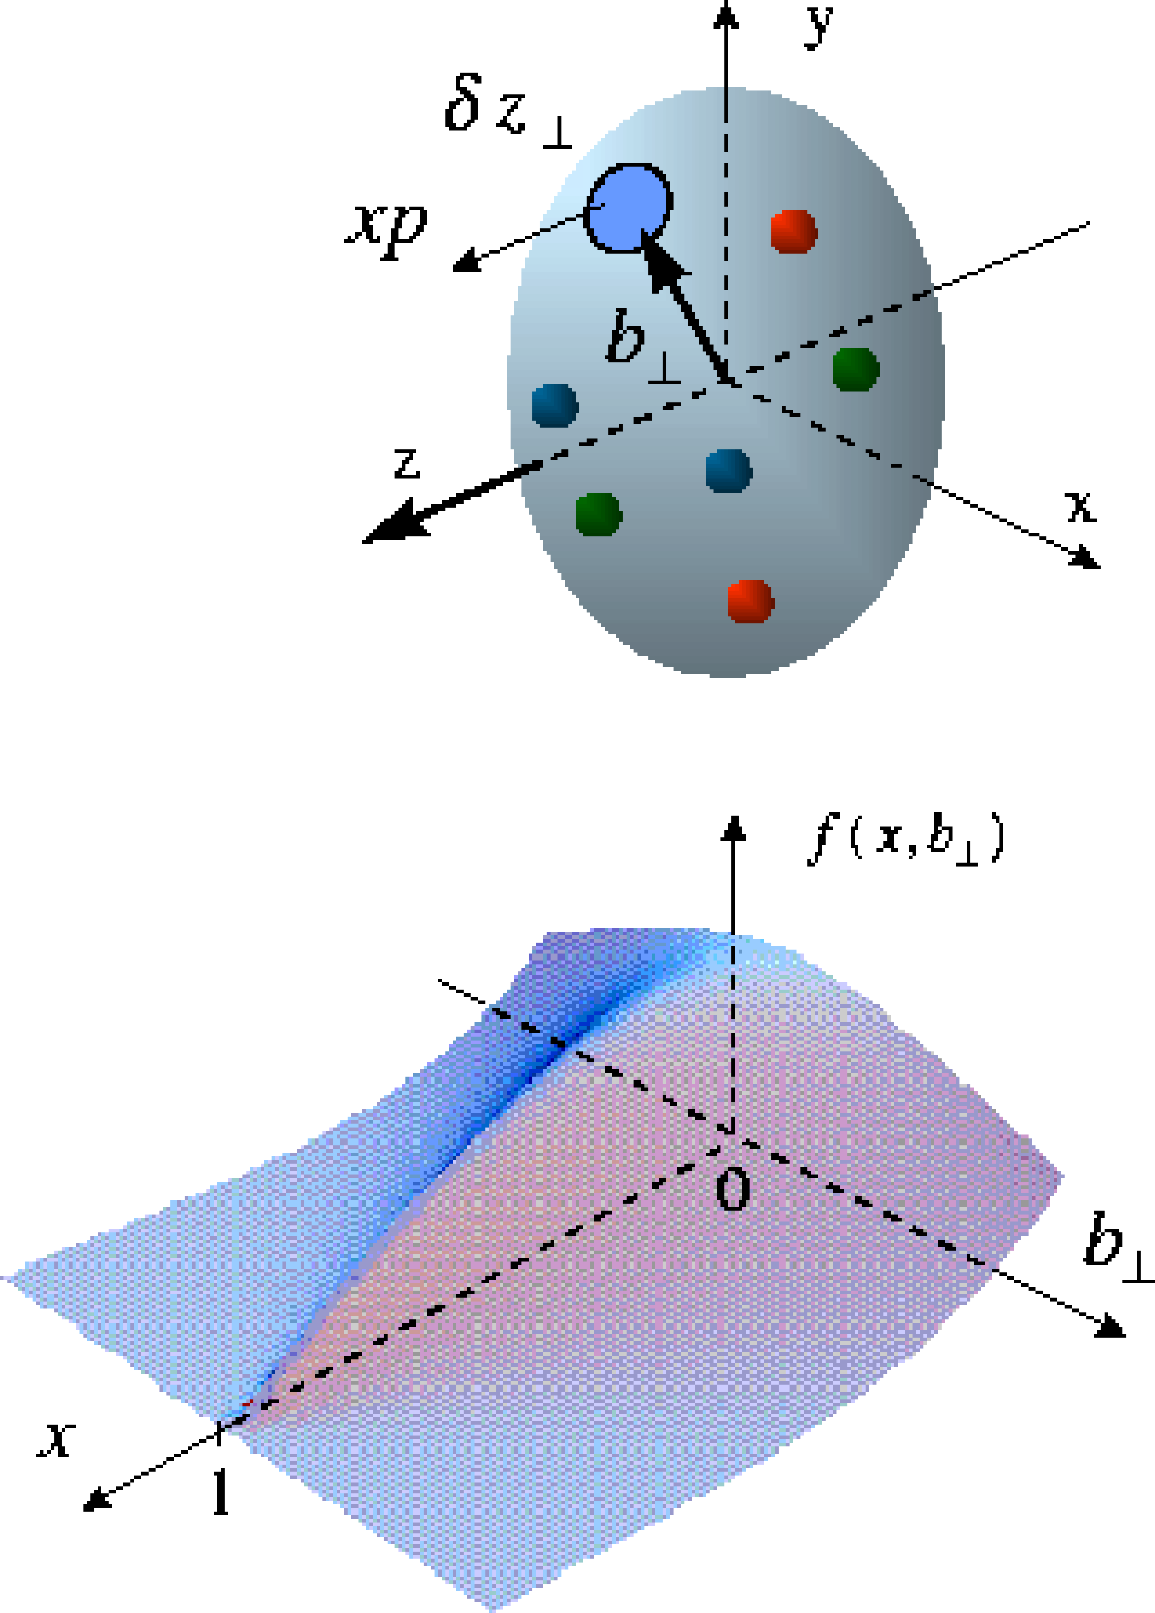
Beyond form factors and quark distributions
Generalized Parton Distributions → 2d+1 proton imaging
Proton form factors, transverse charge & current densities
Structure functions,
quark longitudinal
momentum & helicity
distributions
Correlated quark momentum
and helicity distributions in
transverse space - GPDs
X. Ji, D. Mueller, A. Radyushkin (1994-1997)

Slide 16
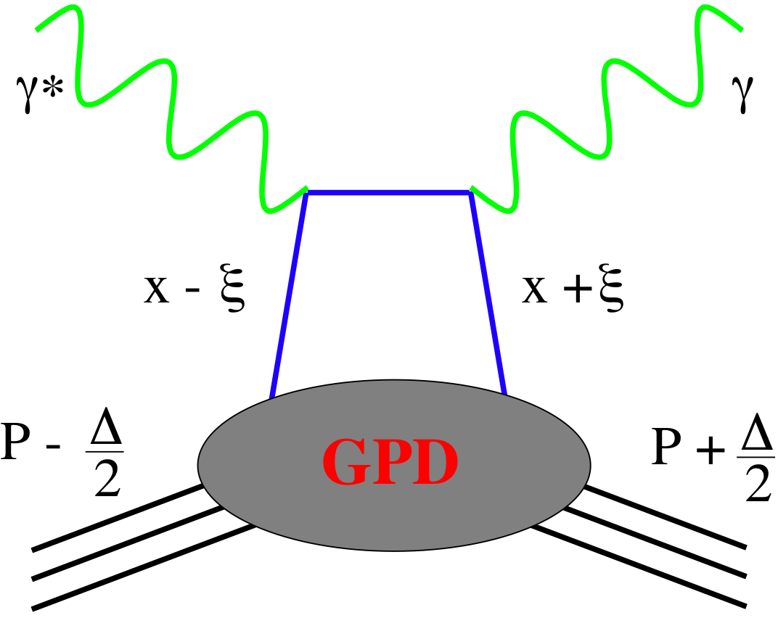
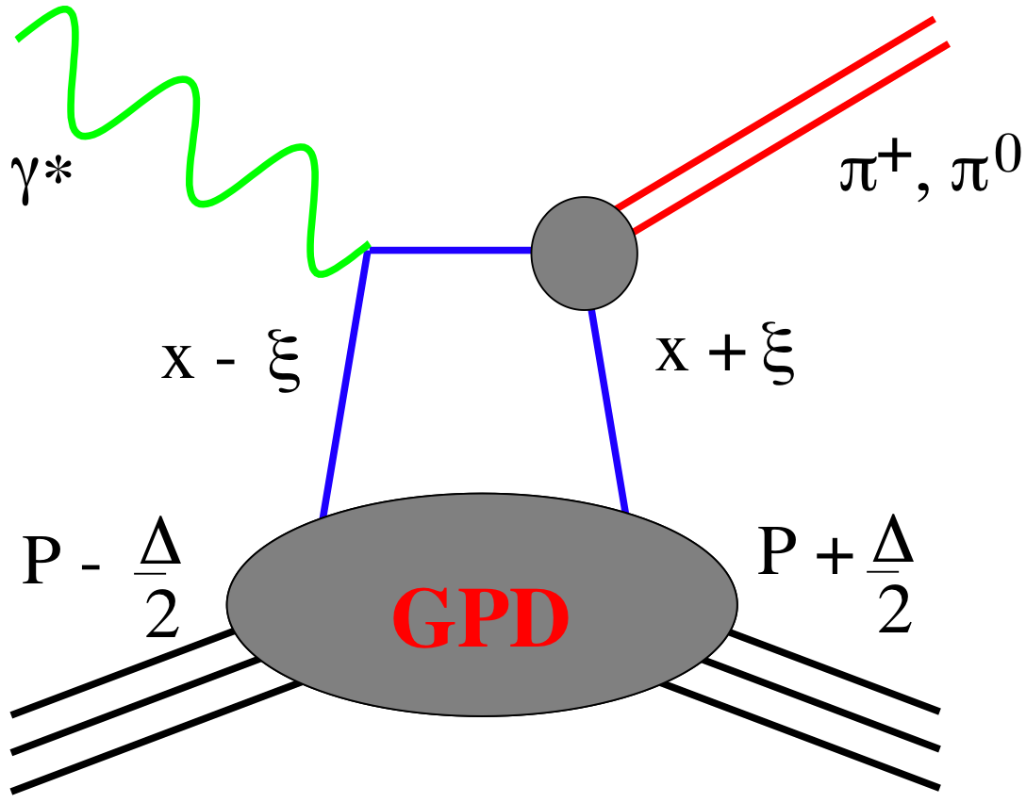
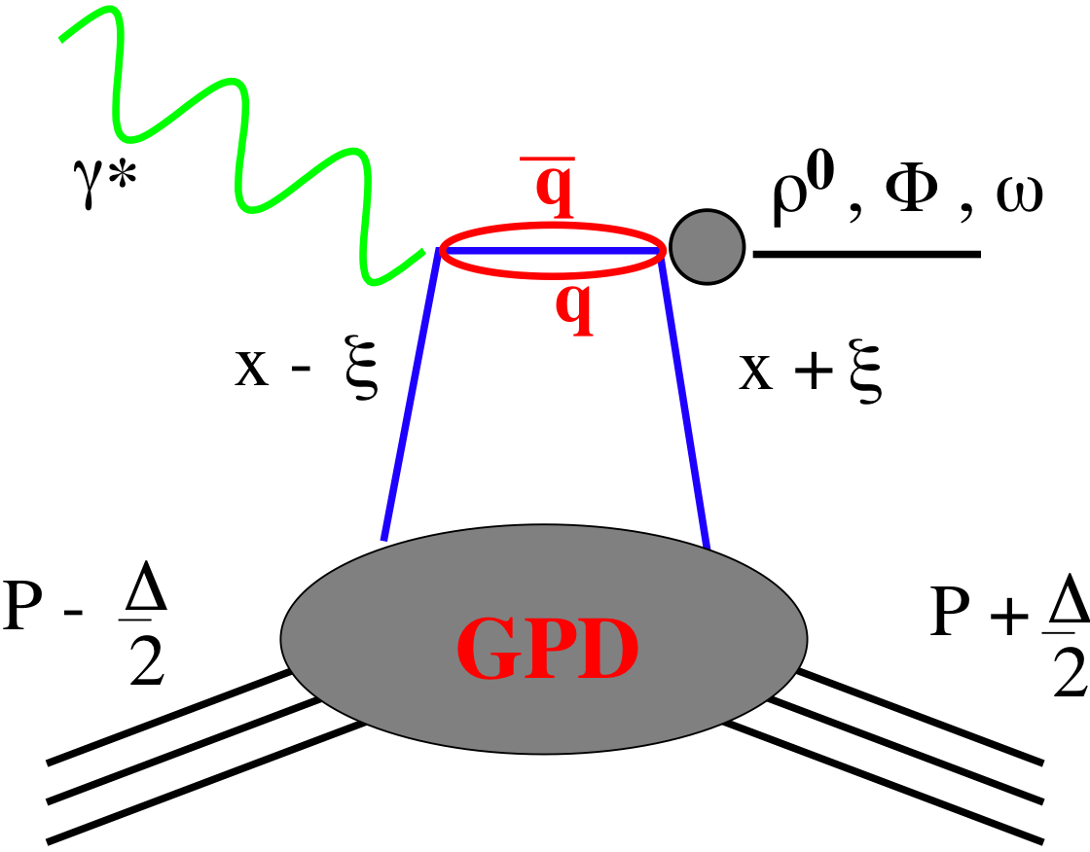
GPDs Introduction
How are GPDs characterized?
unpolarized polarized
conserve nucleon helicity
flip nucleon helicity
not accessible in DIS
quantum numbers of final state select different GPD
A_{UT} in exclusive J/Ψ production sensitive to
GPD E for gluons
GPD E responsible for orbital angular momentum L_{g}
DVCS
pseudo-scaler mesons
vector mesons
π⁰ | 2Δu+Δd
η | 2Δu−Δd
ρ⁰ | 2u+d, 9g/4
ω | 2u−d, 3g/4
φ | s, g
ρ⁺ | u−d
J/ψ | g
Q²= 2E_{e}E_{e}’(1-cosθ_{e’})
x_{B} = Q²/2Mν ν=E_{e}-E_{e’}
x+ξ, x-ξ long. mom. fract.
t = (p-p’)²
ξ ≅ x_{B}/(2-x_{B})

Slide 17
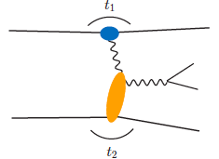
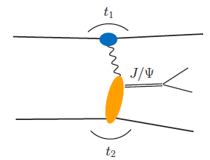
From pp to γp: UPC
Get quasi-real photon from one proton
Ensure dominance of g from one identified proton
by selecting very small t₁, while t₂ of “typical hadronic size”
small t₁ ←→ large impact parameter b (UPC)
Final state lepton pair ←→ timelike compton scattering
timelike Compton scattering: detailed access to GPDs
including E^{q;g} if have transv. target pol.
Challenging to suppress all backgrounds
Final state lepton pair not from γ* but from J/ψ
  Done already in AuAu
  Estimates for J/ψ (hep-ph/0310223)
basically no background
transverse target spin asymmetry → calculable with GPDs
information on helicity-flip distribution E for gluons
golden measurement for eRHIC
Work in collaboration with Jakub Wagner, Dieter Mueller, Markus Diehl

Slide 18
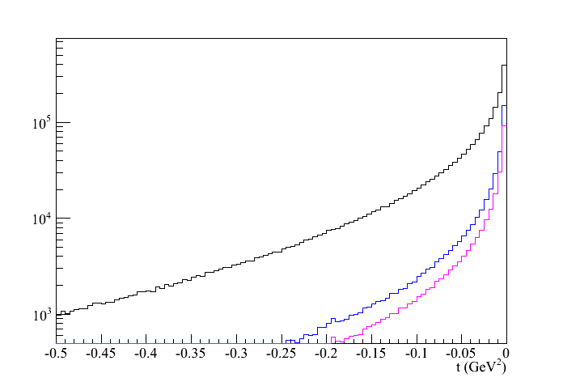
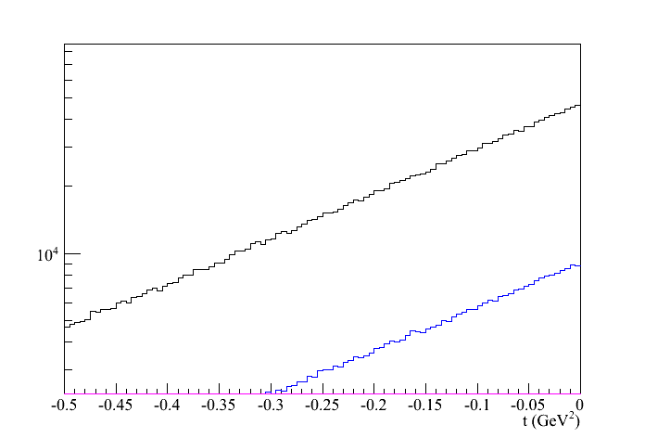
500 GeV pp: UPC kinematics
Beam: t₁
kinematics of proton 1 and 2
target: t₂
Adding cut by cut:
leptons without cuts
lepton-2: -1 < η < 2
lepton 1 and 2: -1 < η < 2
RP@500GeV: -0.8<t<-0.1
→ 200 J/Ψ in 100 pb⁻¹

Slide 19
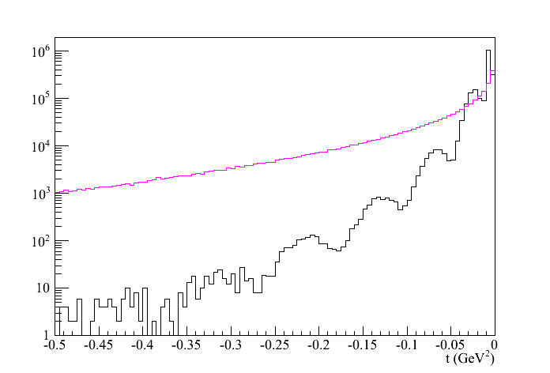
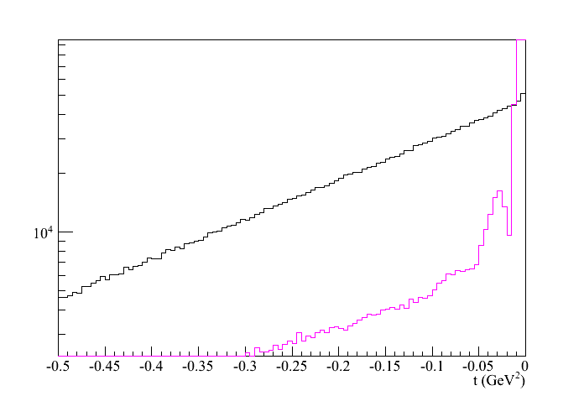
200 GeV pAu: UPC kinematics
t-distribution for γ emitted by p or Au
Au
Au’
Beam: t₁
p
p’
p: t_{γ}
p
p’
Au
Au’
Au: t_{γ}
t-distribution for target being p or Au
target: t₂
pA Philosophy:
veto p/n from A by no hit in
RP and ZDC t₁>-0.016
detect p’ in RP -0.2<t₂<-0.016
→ 155800 J/Ψ in 100 pb⁻¹
t_{p’}
t_{Au’}

Slide 20
BACKUP

Slide 21
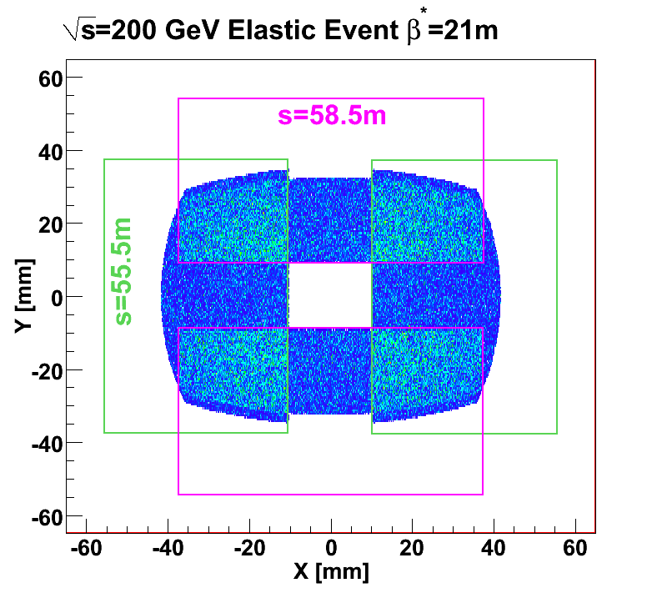
Roman Pots at STAR (Phase I)
Phase I: 8 Roman pots at ±55.5, ±58.5m from the IP
Require special beam tune :large β* (21m for √s=200 GeV) for minimal angular divergence
Successful run in 2009: Analysis in progress focusing on small-t processes (0.002<|t|<0.03 GeV²)
Beam transport simulation using Hector

Slide 22
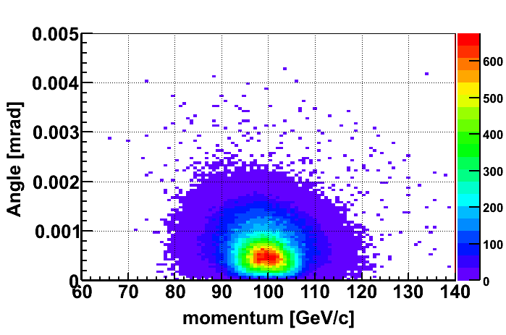
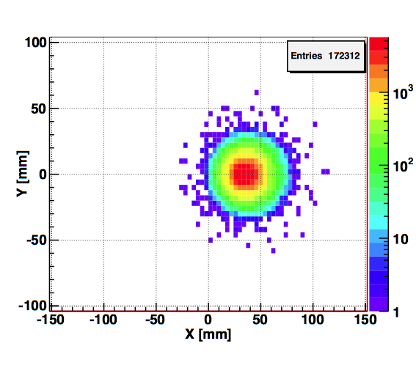
Spectator proton from ³He with the current RHIC optics
Momentum smearing mainly due
to Fermi motion + Lorentz boost
Angle <~3mrad (>99.9%)
Angle [rad]
Study: JH Lee
generated
Passed DX aperture
Accepted in RP
The same RP configuration with the current RHIC optics (at z ~ 15m between DX-D0)
Acceptance ~ 92%

