Slide 1
Roman Pots at STAR

Slide 2
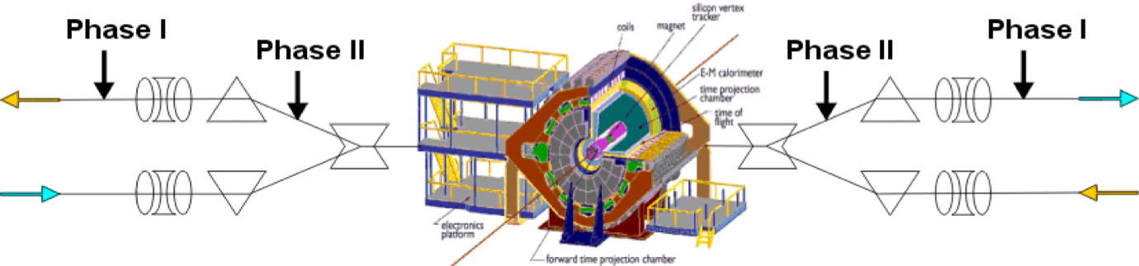
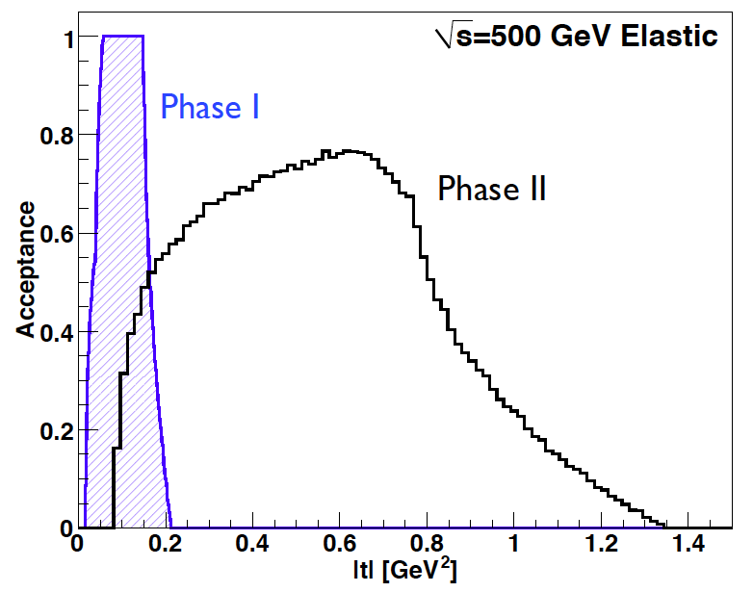
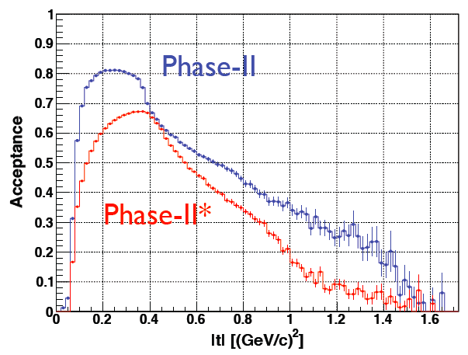
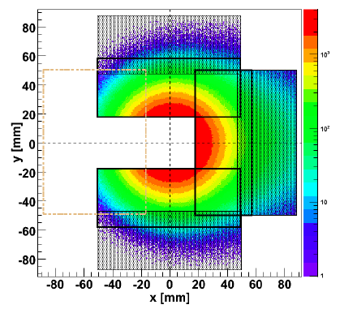
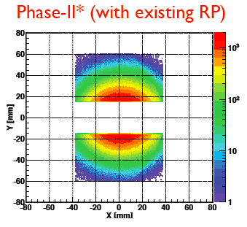
Forward Proton Tagging at STAR/RHIC
at 55-58m
at 15-17m
J.H. Lee
Roman Pots to measure forward scattered ps in diffractive processes
Staged implementation to cover wide kinematic coverage
Phase I (Installed): for low-t coverage
Phase II (planned) : for higher-t coverage, new RPs, reinstall old ones at old place
Phase II* (planned) : for higher-t coverage, re-use RP from Phase I
full coverage in φ not possible due to machine constraints
No dedicated running needed any more
→ 250 GeV to 100 GeV
scale t-range by 0.16

Slide 3
Physics Motivations for Phase-II RP@STAR
elastic scattering in p^{(↑)}p
  RP would detect the protons scattered under small angles
central and forward diffractive production in p^{(↑)}p, p^{(↑)}A
  to study saturation
  to understand the underlying sub-processes for A_{N}
  to study exotic particle production
    RP would detect the protons scattered under small angles and veto the break up of the nucleus
A_{N} for in exclusive J/Ψ in UPC in polarised p↑p or p↑A collisions to constrain GPD E_{g}
  RP will tag the protons (p↑p case) and act as the ZDC as a veto for the A-beam (p↑A)
physics with polarized He-3
  RP would tag the spectator protons to ensure we scatter on the neutron

Slide 4
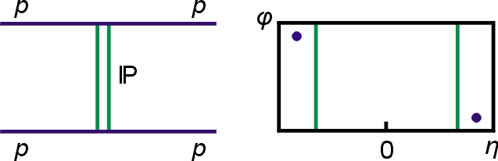
Elastic Scattering
We will measure spin-dependent (helicity structure) in elastic proton-proton scattering in largely unexplored region of √s and –t, probing large distance QCD (Pomeron, Odderon)
√s = 200 GeV: Small |t|-region 0.02 < -t < 0.2 (GeV/c)^{2,} s_{tot}, B, ds/dt, A_{N}(t), A_{NN}(t)
√s = 500 GeV: Medium |t|-region 0.02 < -t < 1.3 (GeV/c)²; diffractive minimum (peaks and bumps, Odderon) and their spin dependence, B(t), ds/dt, A_{N}(t), A_{NN}(t)
Then there is a comparison of the dip shape between pp and ppbar and its dependence on √s, also tests Odderon hypothesis

Slide 5
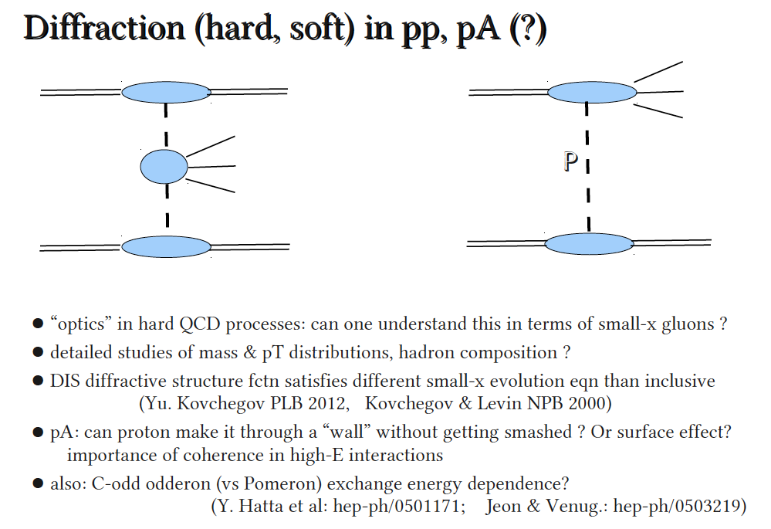
Diffractive Physics
Adrian Dumitru
To be sure it was diffraction need to make sure p and/or A are intact

Slide 6
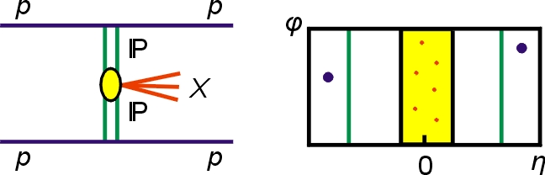
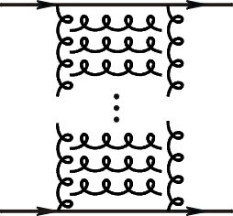
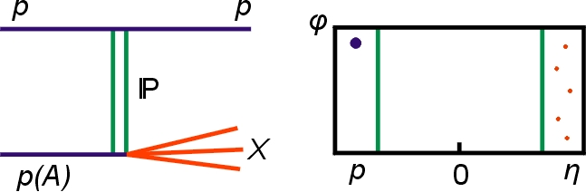
Processes with Tagged Forward Protons
QCD color singlet exchange: C=+1(IP), C=-1(Ο)
Discovery Physics
p + p → p + p elastic
p + p → p + X + p
diffractive X= particles, glueballs
pQCD Picture
Gluonic exchanges
p + p → p + X SDD
Notes:
6

Slide 7
Central Exclusive Production Process in DPE
p₁p₂→p_{1’}M_{X}p₂
p
p
For each proton vertex one has
t four-momentum transfer
ξ = Δp/p
M_{X}=√(ξ₁ξ₂s) invariant mass
M_{x}
We expect that because of the constraints provided by the double Pomeron interaction, glueballs, hybrids, and other states coupling preferentially to gluons, will be produced with much reduced backgrounds compared to standard hadronic production processes.
Exclusive process with “small” momentum transfer:
-t₁(p₁→p₁’) and -t₂(p₂ →p₂’)
M_{X} is centrally produced, nearly at rest, through DPE process
In pQCD, Pomeron is considered to be made of two gluons: natural place to look for gluon bound state
M_{X}(~1 – 3 GeV/c²) →π⁺π⁻, π⁺π⁻π⁺π⁻, Κ⁺Κ⁻,...
Lattice cal.: Lightest glueball M(0⁺⁺)=1.5-1.7 GeV/c² (PRD73 2006)
Search for glueball (gg) candidates in M_{x}

Slide 8
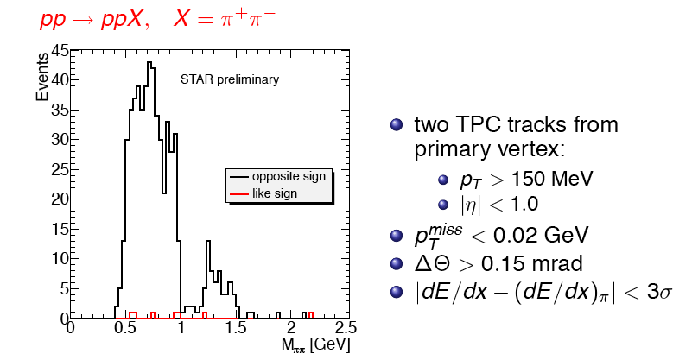
Run 2009 – proof of principle:
Tagging forward proton is crucial
Note small like sign background after momentum conservation cut

Slide 9
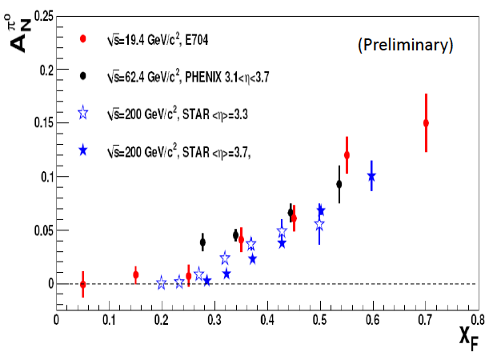
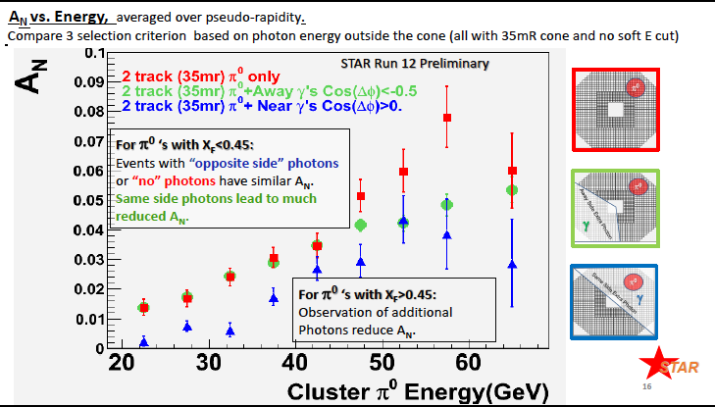
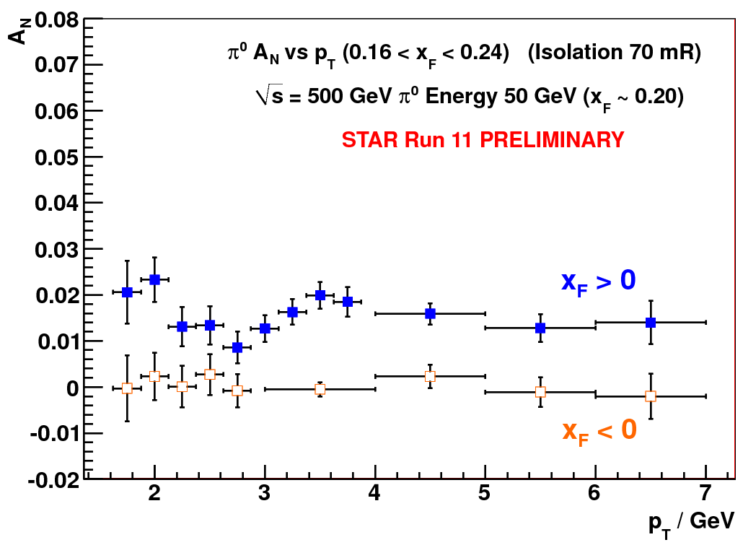
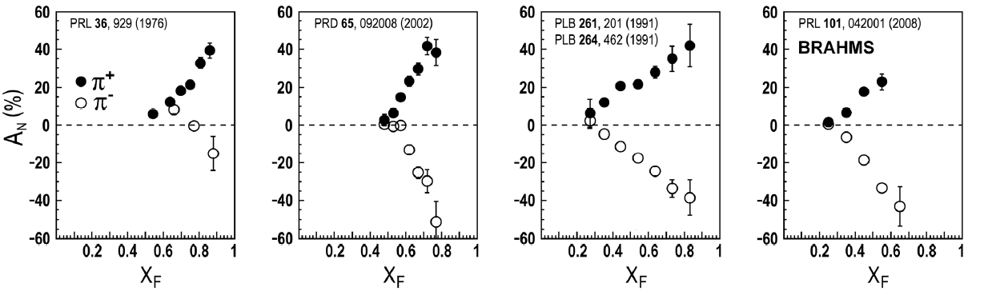
Long standing puzzle in forward physics: large A_{N} at high √s
Big single spin asymmetries in p↑p !!
Naive pQCD (in a collinear picture)
predicts A_{N} ~ a_{s}m_{q}/sqrt(s) ~ 0
Do they survive at high √s ? YES
Is observed p_{t} dependence as expected
from p-QCD? NO
Surprise: A_{N} bigger for more isolated events
What is the underlying process?
Sivers / Twist-3 or Collins or ..
till now only hints
Left
Right
Bigger asymmetries for isolated events
→
Measure A_{N} for diffractive and rapidity gap events
ANL ZGS
√s=4.9 GeV
BNL AGS
√s=6.6 GeV
FNAL
√s=19.4 GeV
BRAHMS@RHIC
√s=62.4 GeV

Slide 10
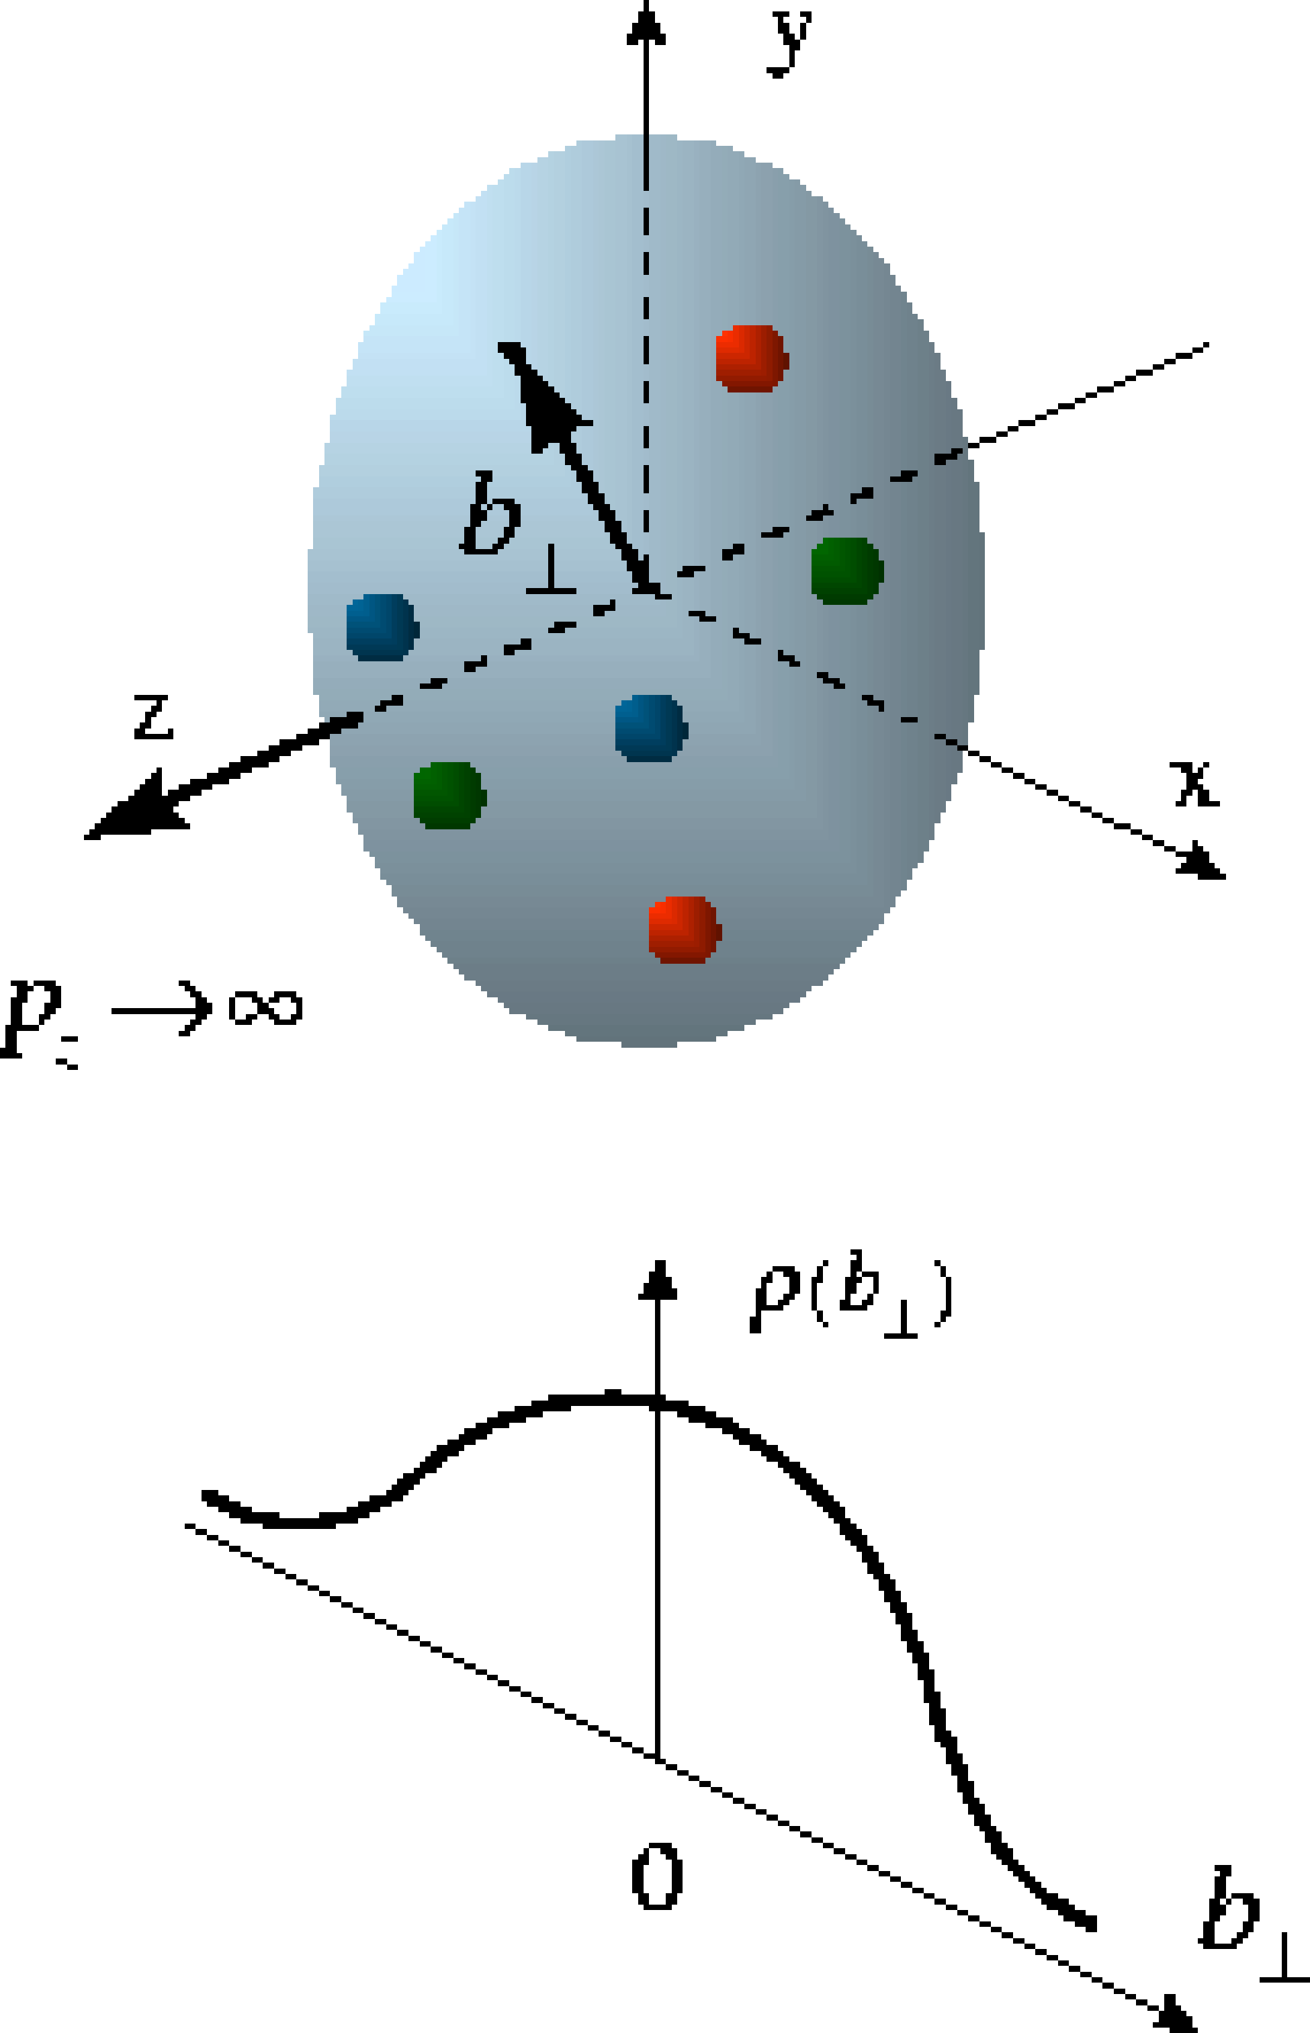
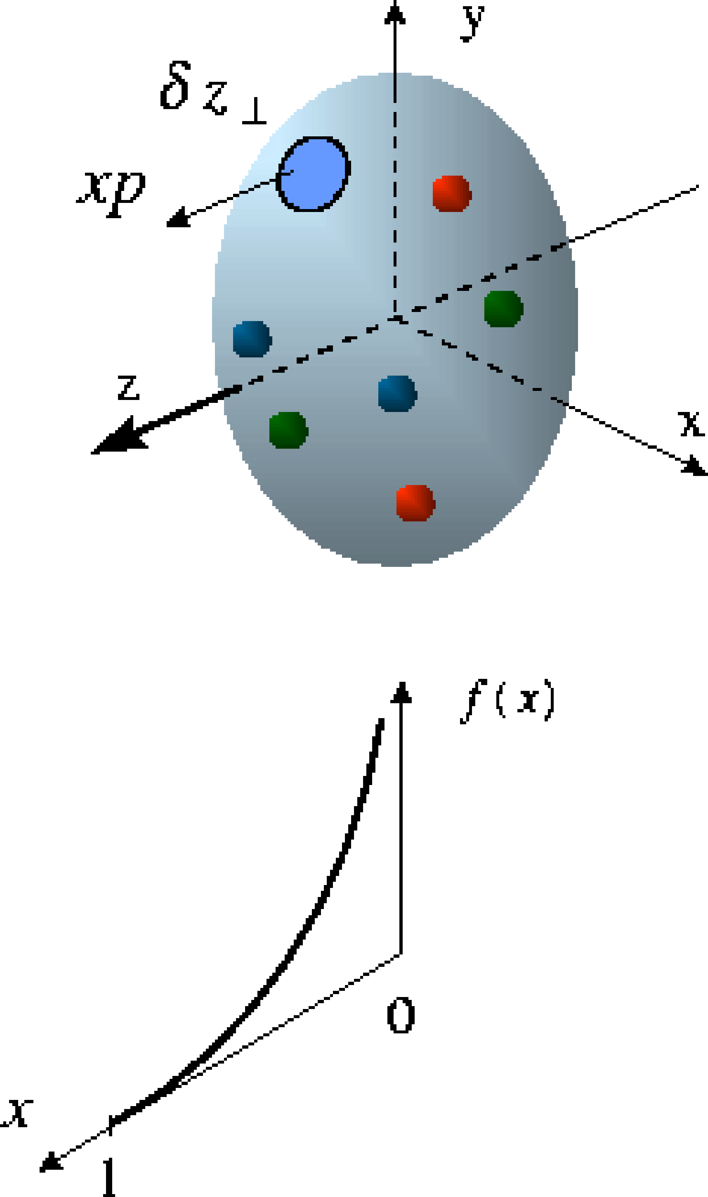
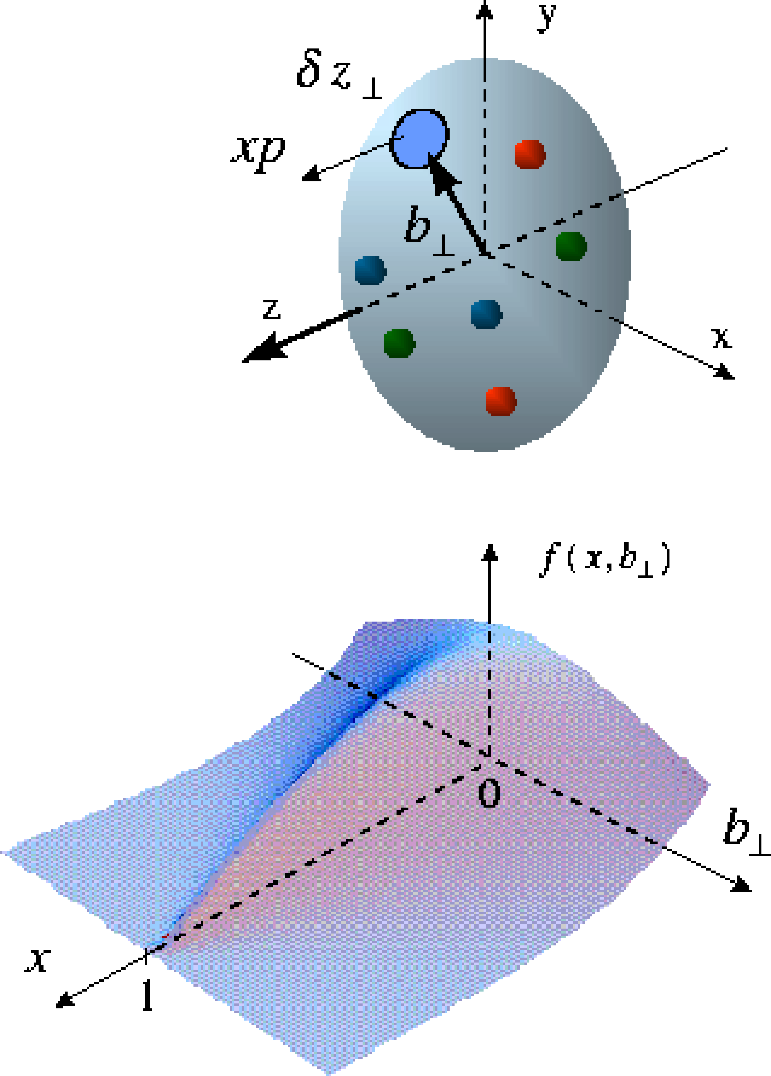
Beyond form factors and quark distributions
Generalized Parton Distributions → 2d+1 proton imaging
Proton form factors, transverse charge & current densities
Structure functions,
quark longitudinal
momentum & helicity
distributions
Correlated quark momentum
and helicity distributions in
transverse space - GPDs
X. Ji, D. Mueller, A. Radyushkin (1994-1997)

Slide 11
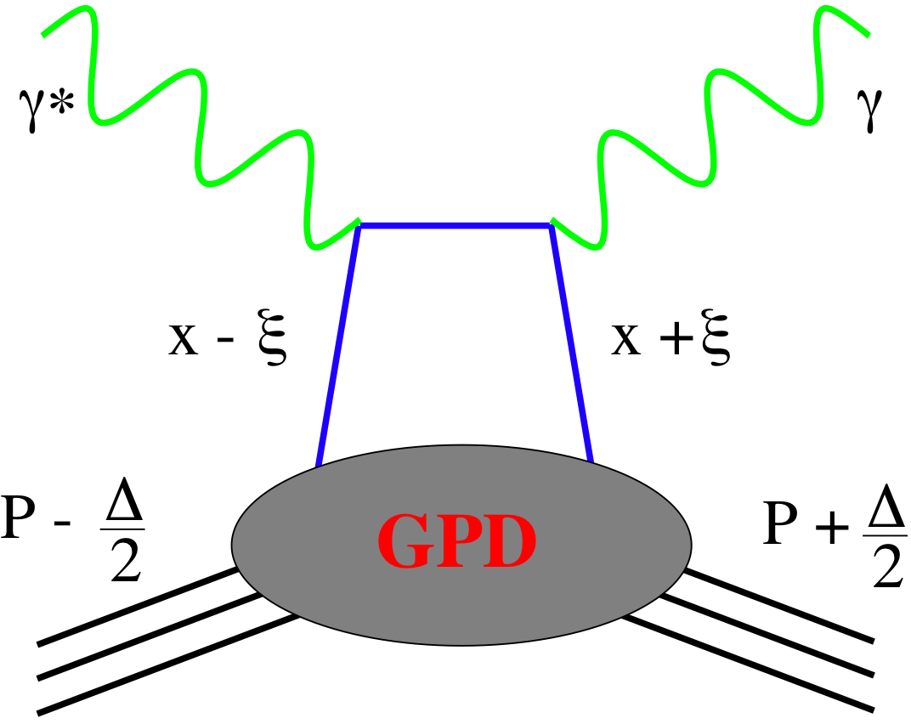
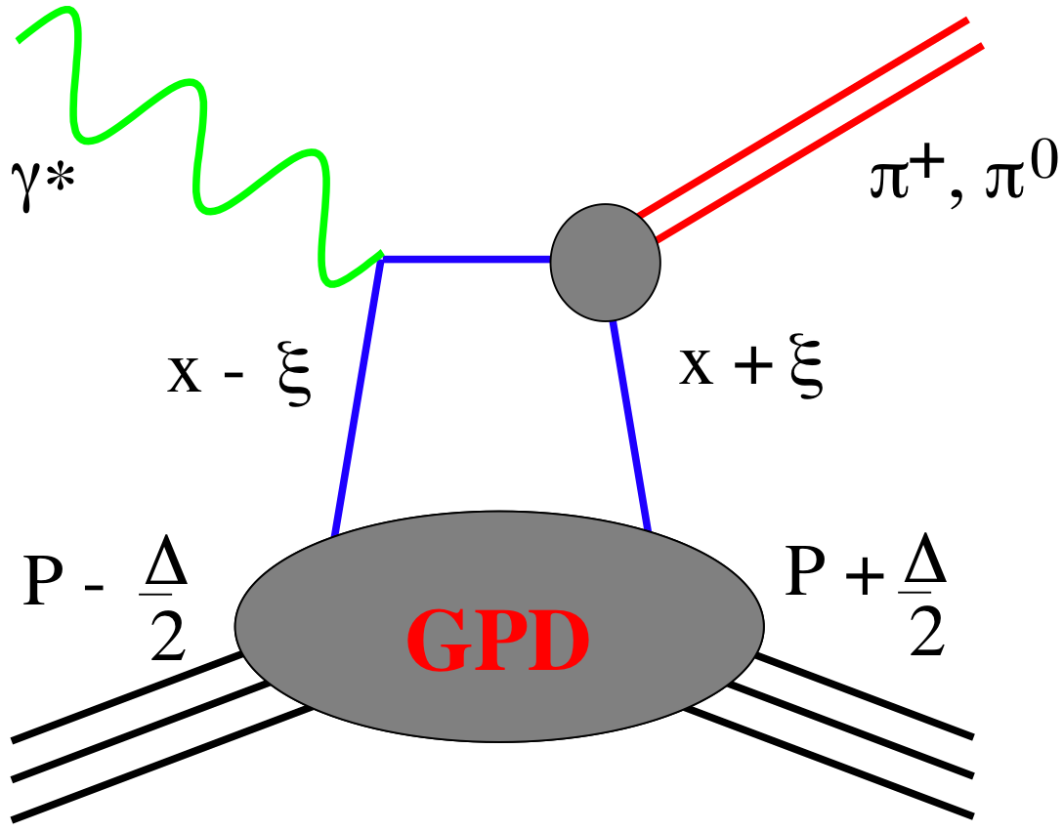
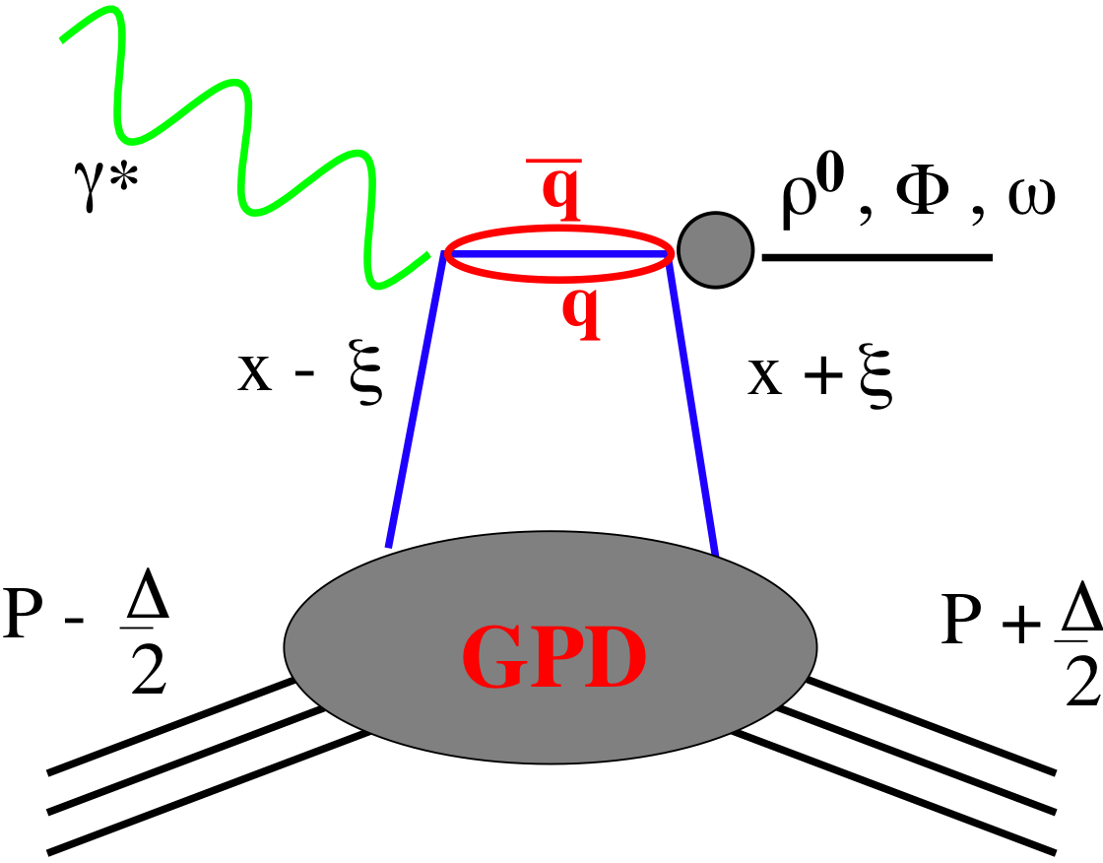
GPDs Introduction
How are GPDs characterized?
unpolarized polarized
conserve nucleon helicity
flip nucleon helicity
not accessible in DIS
quantum numbers of final state select different GPD
A_{UT} in exclusive J/Ψ production sensitive to
GPD E for gluons
GPD E responsible for orbital angular momentum L_{g}
DVCS
pseudo-scaler mesons
vector mesons
π⁰ | 2Δu+Δd
η | 2Δu−Δd
ρ⁰ | 2u+d, 9g/4
ω | 2u−d, 3g/4
φ | s, g
ρ⁺ | u−d
J/ψ | g
Q²= 2E_{e}E_{e}’(1-cosθ_{e’})
x_{B} = Q²/2Mν ν=E_{e}-E_{e’}
x+ξ, x-ξ long. mom. fract.
t = (p-p’)²
ξ ≅ x_{B}/(2-x_{B})

Slide 12
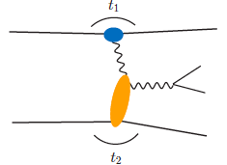
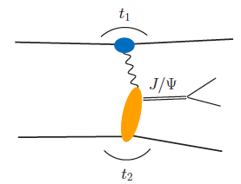
From pp to γp: UPC
Get quasi-real photon from one proton
Ensure dominance of g from one identified proton
by selecting very small t₁, while t₂ of “typical hadronic size”
small t₁ ←→ large impact parameter b (UPC)
Final state lepton pair ←→ timelike compton scattering
timelike Compton scattering: detailed access to GPDs
including E^{q;g} if have transv. target pol.
Challenging to suppress all backgrounds
Final state lepton pair not from γ* but from J/ψ
  Done already in AuAu
  Estimates for J/ψ (hep-ph/0310223)
basically no background
transverse target spin asymmetry → calculable with GPDs
information on helicity-flip distribution E for gluons
golden measurement for eRHIC
Work in collaboration with Jakub Wagner, Dieter Mueller, Markus Diehl

Slide 13
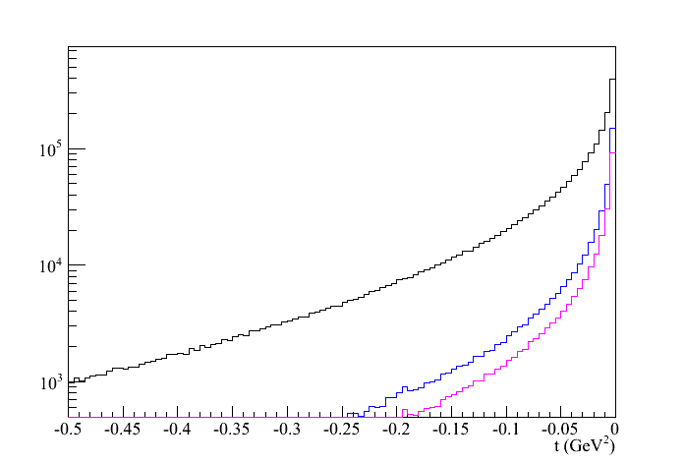
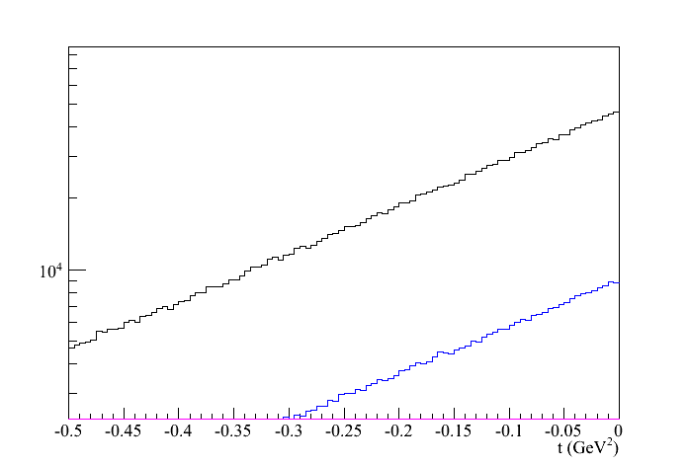
500 GeV pp: UPC kinematics
Beam: t₁
kinematics of proton 1 and 2
target: t₂
Adding cut by cut:
leptons without cuts
lepton-2: -1 < η < 2
lepton 1 and 2: -1 < η < 2
RP@500GeV: -0.8<t<-0.1
→ 200 J/Ψ in 100 pb⁻¹

Slide 14
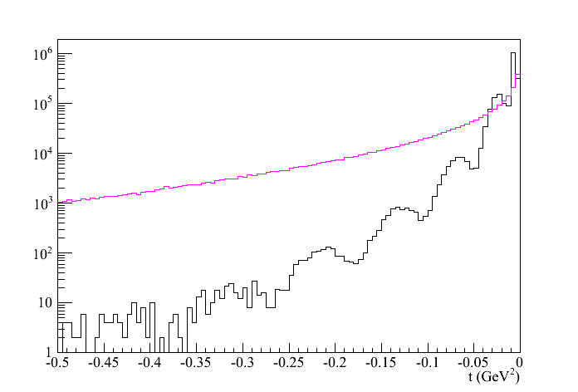
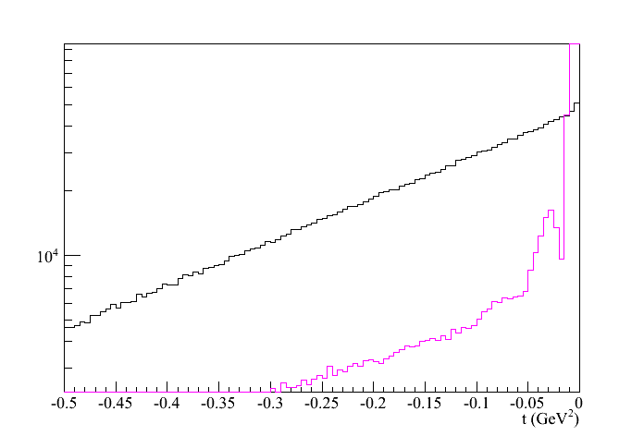
200 GeV pAu: UPC kinematics
t-distribution for γ emitted by p or Au
Au
Au’
Beam: t₁
p
p’
p: t_{γ}
p
p’
Au
Au’
Au: t_{γ}
t-distribution for target being p or Au
target: t₂
pA Philosophy:
veto p/n from A by no hit in
RP and ZDC t₁>-0.016
detect p’ in RP -0.2<t₂<-0.016
→ 155800 J/Ψ in 100 pb⁻¹
t_{p’}
t_{Au’}

Slide 15
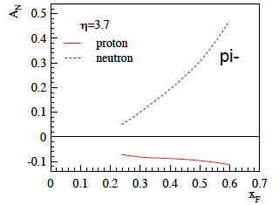
What pHe3 can teach us
Polarized He-3 is an effective neutron target → d-quark target
  Polarized protons are an effective u-quark target
Therefore combining pp and pHe3 data will allow a full
quark flavor separation u, d, ubar, dbar
Two physics trusts for a polarized pHe3 program:
Measuring the sea quark helicity distributions through W-production
  Access to Δdbar
  Caveat maximum beam energy for He-3: 166 GeV
    Need increased luminosity (e-Lens) to compensate for lower W-cross section
Measuring single spin asymmetries A_{N} for pion production and Drell-Yan
  expectations for A_{N} (pions)
    similar effect for π± (π⁰ unchanged)
³He: helpful input for understanding
of transverse spin phenomena
Critical to tag spectator protons from 3He with roman pots

Slide 16
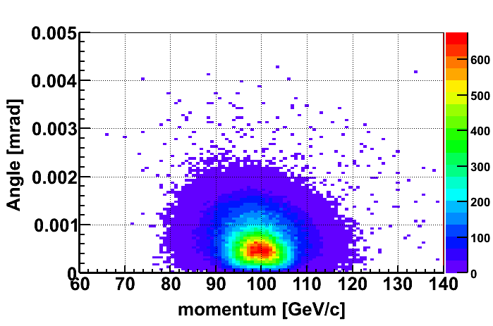
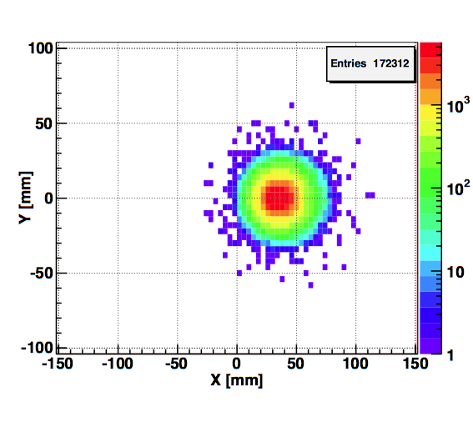
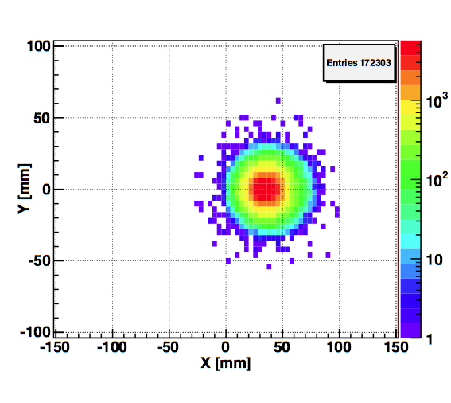
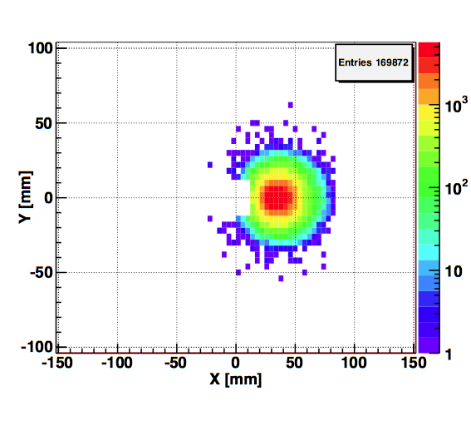
Spectator proton from ³He with the current RHIC optics
Momentum smearing mainly due
to Fermi motion + Lorentz boost
Angle <~3mrad (>99.9%)
Angle [rad]
Study: JH Lee
generated
Passed DX aperture
Accepted in RP
The same RP configuration with the current RHIC optics (at z ~ 15m between DX-D0)
Acceptance ~ 98%

Slide 17
Resources Required (2009 est.)
Phase II Capital exp, cont. and overhead included
RP and detectors' cost | $500,170
Roman Pot Stations | $230,974
Si readout and Si | $269,196
Si Readout | $102,630
Si sensors | $166,566
C-AD cost (DX-D0 and controls) | $307,230
Total incl. cont. and overhead | $807,400
The manpower form BNL STAR support group:
  6 months of mechanical designer to adopt Roman Pot stations design to fit DX-D0
  vacuum chamber and larger size of Roman Pots.
  One month of electrical engineering of design and one month for layout of Si readout
  board, which is based on APV chip, used by FGT and ST.
  6 man months Roman Pot station mechanical assembly
C-AD manpower - integrated over number of tasks:
  9 man months - slow controlls
  10 man months - DX-D0 design/installation, RP installation, etc…

Slide 18
Can we move faster?
PHASE IIA as presented in June, 2012
No major funding increase is expected in the next couple of years – this is most likely reality.
We do have existing Roman Pot system, which would be a good starting point – use existing RPs
So to get started PHASE IIA would require only design and procurement of DX – D0 vacuum chambers – about $250k (all in C-AD).
The design of PHASE IIA will accommodate PHASE II as designed originally.
Start engineering now – possible to install for Run 14.

Slide 19
Resources Required for Phase IIA (2009 est.)
Phase IIA Capital exp, cont. and overhead included
RP and detectors' cost | $100,000
Roman Pot Stations (my estimate, stand mods, etc.) was$ 230k | $100,000
Si readout and Si | $0
Si Readout | $0
Si sensors | $0
C-AD cost (DX-D0 and controls) | ~ $200,000
Total incl. cont. and overhead | ~ $300,000
The manpower form BNL STAR support group: minimal, cabling…
C-AD manpower - integrated over number of tasks:
  9 man months - slow controlls
  10 man months - DX-D0 design/installation, RP installation, etc…
To get the updated cost we need full engineering at C-AD to understand the details and the manpower requirements. Major issue will be shielding, which will need to be taken apart partially and reassembled.
Need to start now=> request from STAR needs to be made

Slide 20
BACKUP

Slide 21
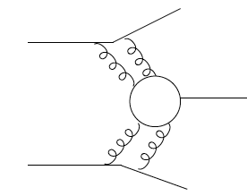
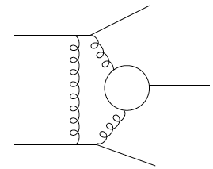
Central Exclusive Production in DPE
Method is complementary to:
GLUEX experiment (2015)
PANDA experiment (>2015)
COMPASS experiment (taking data)
In the double Pomeron exchange process each proton “emits” a Pomeron and the two Pomerons interact producing a massive system M_{X}
where M_{X} = π⁺ π⁻, χ_{c}( χ_{b}), qq(jets), H(Higgs boson), gg(glueballs)
The massive system could form resonances. We expect that because of the constraints provided by the double Pomeron interaction, glueballs, hybrids, and other states coupling preferentially to gluons, will be produced with much reduced backgrounds compared to standard hadronic production processes.
p
p
For each proton vertex one has
t four-momentum transfer
ξ = Δp/p
M_{X}=√ξ₁ξ₂s invariant mass
M_{x}
Notes:
21
21

Slide 22
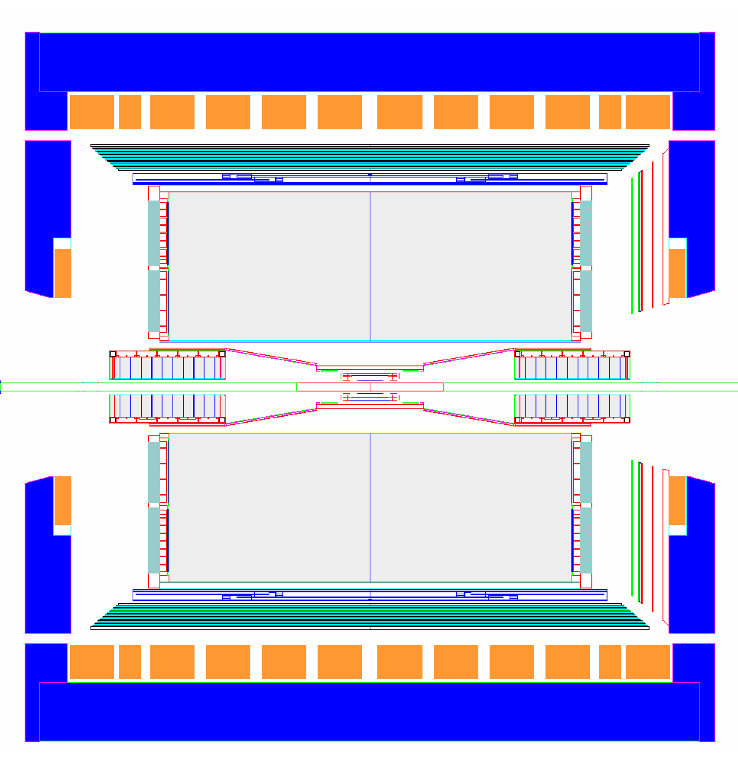
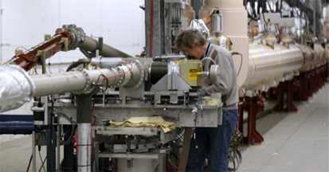
Implementation at STAR + pp2ppp
Need detectors to measure forward protons: t - four-momentum transfer,
ξ = Δp/p, M_{X} invariant mass and;
Detector with good acceptance and particle ID to measure central system
Roman Pot (RP) detectors to measure forward protons
Staged implementation for wide kinematic coverage
Phase I, present- low-t coverage
Phase II, future- higher-t coverage, large data samples
Notes:
22

Slide 23
COST
Engineering estimates and direct quotes for all major purchases

Slide 24
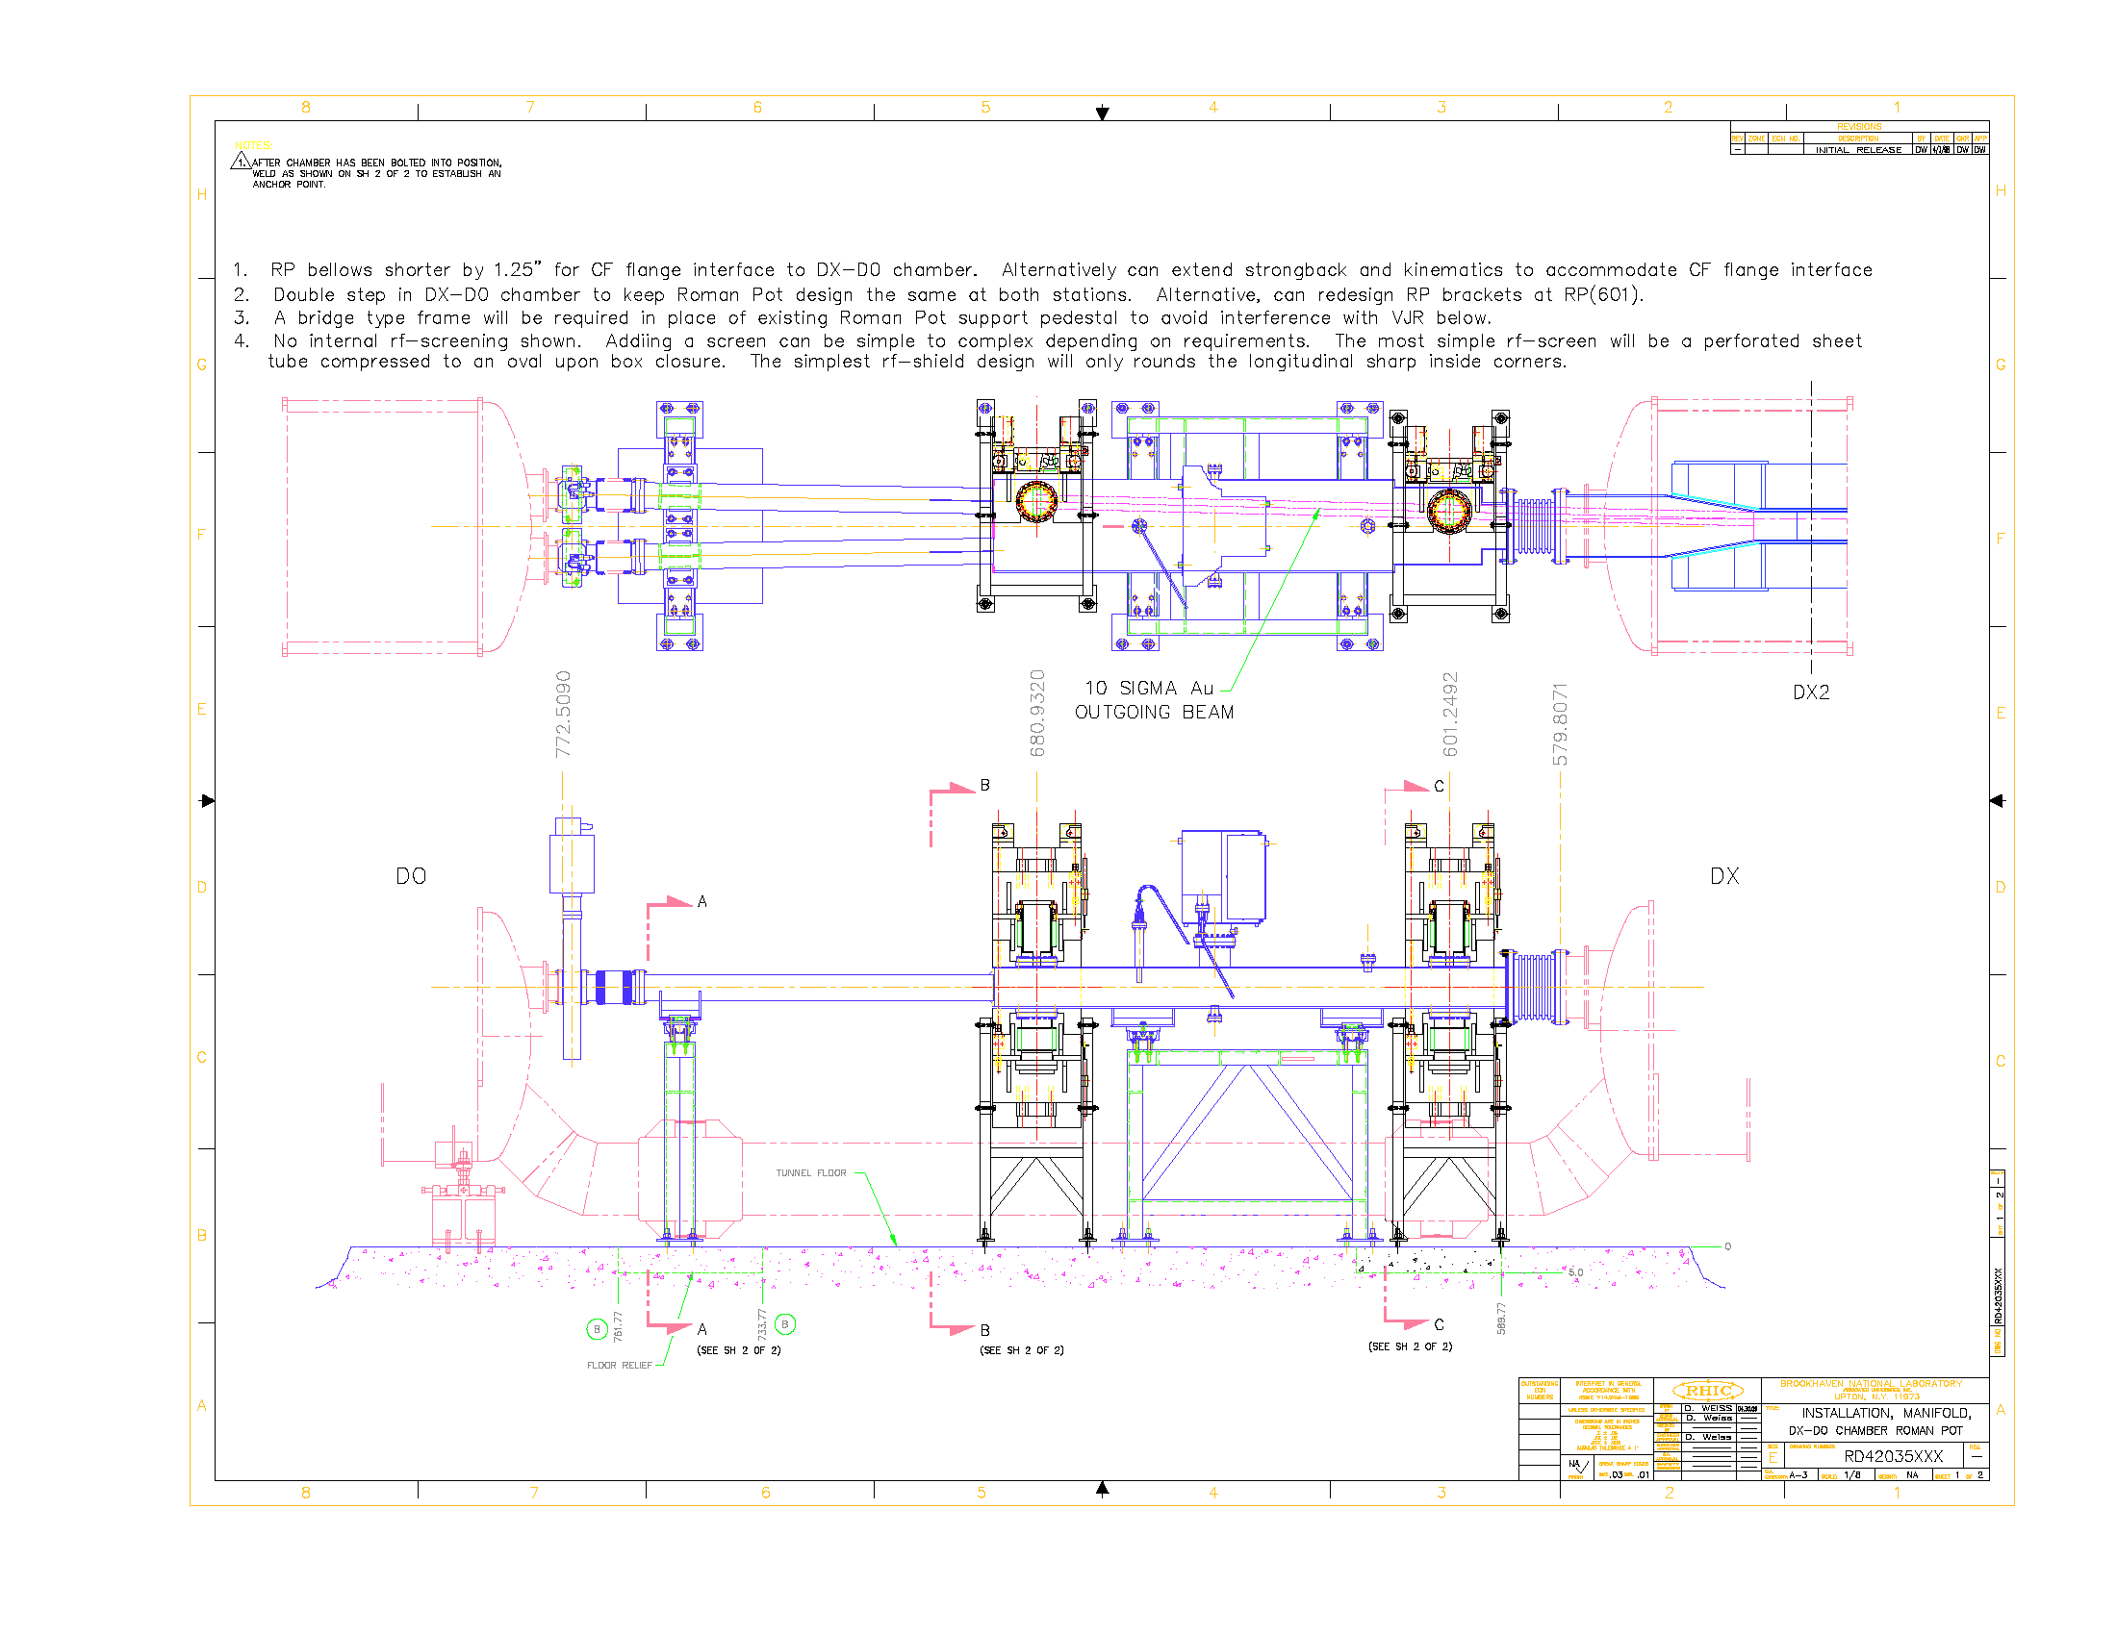
Advanced Conceptual Design Exists

Slide 25
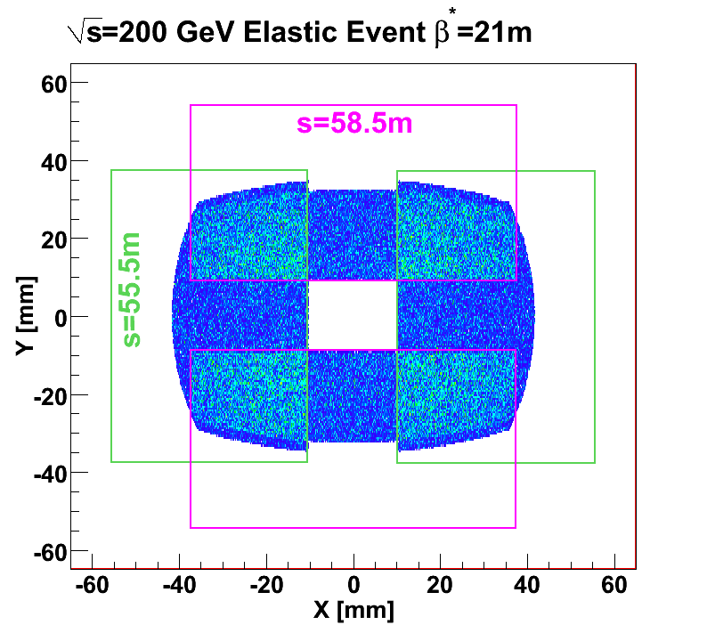
Roman Pots at STAR (Phase I)
Phase I: 8 Roman pots at ±55.5, ±58.5m from the IP
Require special beam tune :large β* (21m for √s=200 GeV) for minimal angular divergence
Successful run in 2009: Analysis in progress focusing on small-t processes
(0.002<|t|<0.03 GeV²)
Beam transport simulation using Hector

Slide 26

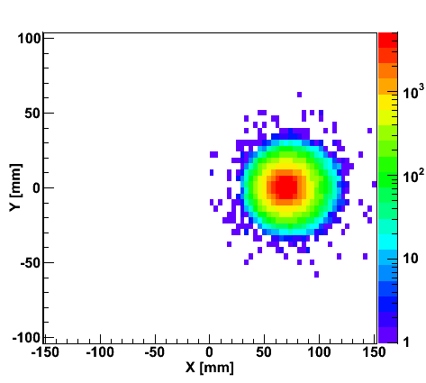
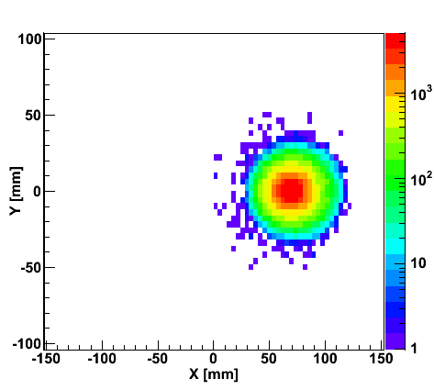
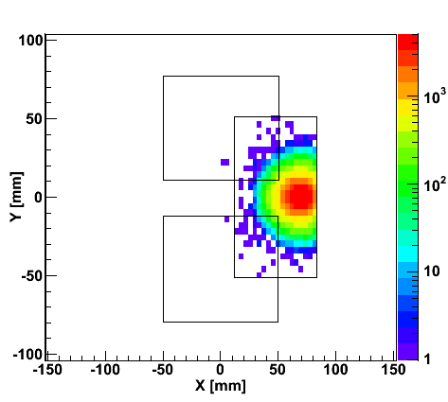
“Spectator” proton from deuteron with the current RHIC optics
generated
Passed DX aperture
Accepted in RP
Rigidity (d:p =2:1)
The same RP configuration with the current RHIC optics (at z ~ 15m between DX and D0)
Detector size and position can be optimized for optimal acceptance

Slide 27
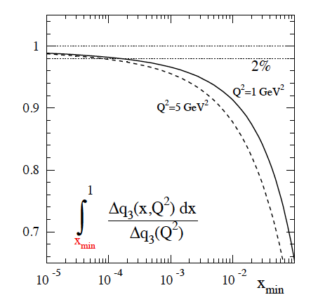
eRHIC: polarized eHe3 scattering
Future:
  Polarized electron – proton and electron – He3 scattering
  allows for a test of the best know Sum Rule in QCD
  The Bjoerken Sum Rule
Currently measured to 10%
Calculated in pQCD
g₁^{p} and g₁^{n}:
polarized structure functions
EIC could provide a 1-2%
measurement, if beam polarization
Is measured to 1-2%

