Slide 1
The RHIC Spin Plan
Cold QCD Physics
E.C. Aschenauer
Recent Documents:
Spin WP for Tribble committee: arXiv:1304.0079
LEP Spin WP: arXiv:1501.01220
STAR and PHENIX pp & pA LoIs:
https://indico.bnl.gov/conferenceDisplay.py?confId=764

Slide 2
What should be covered
No charge from DOE yet
→ I was charged to develop the charge for the document
→ First ideas after some exchange with Berndt
Run-2017 needs to be included again → STAR only
pp and pA @ 200 GeV during the sPHENIX period
list opportunities for running beyond / different to sPHENIX period
  cannot be the motivation for upgrades
time line: end of the year 2015
  it is critical to have as much look to 2015 data as possible
Common physics section with focus what is unique to STAR/
(f)sPHENIX
→ realization plans specific to both experiments

Slide 3
2017: the Sivers fct.
 | A_{N}(W^{+/-},Z⁰) | A_{N}(DY) | A_{N}(γ)
sensitive to sign change in TMD formalism | yes | yes | no
sensitive to sign change in Twist-3 formalism | no | no | yes
sensitive to TMD evolution | yes | yes | no
sensitive to sea-quark Sivers fct. | yes η dependence of A_{N}(W) | yes | no
need detector upgrades | no | yes FMS postshower | no
biggest experimental challenge | integrated luminosity | background suppression & integrated luminosity | ---------
A_{N}(DY,W^{+/-},Z⁰,γ) clean and proven probes sensitive to all questions
in a timely way without the need for major upgrades

Slide 4
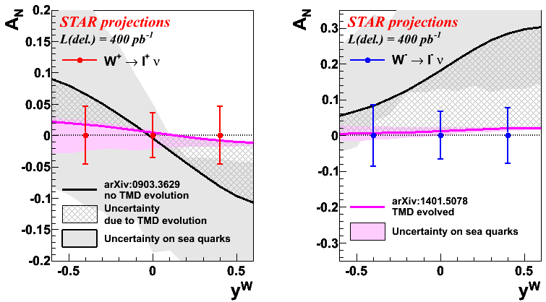
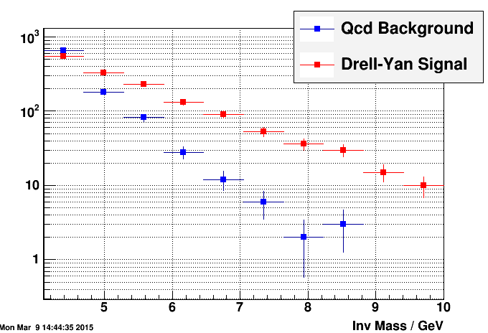
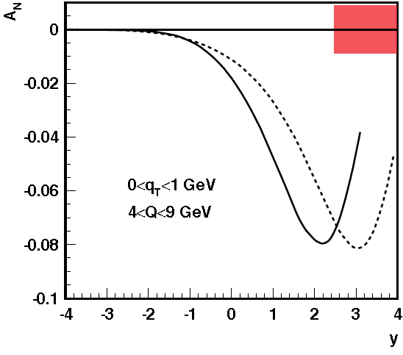
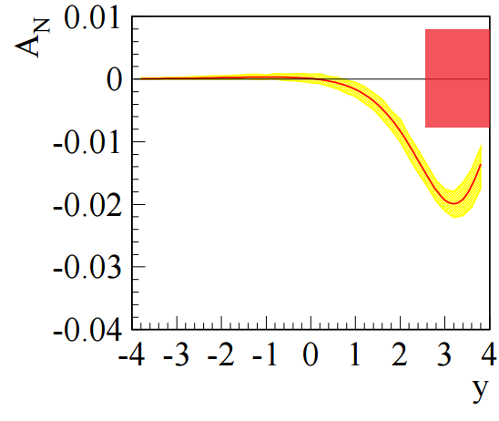
What can Be Done in RUN-17
Assumptions:
integrated delivered luminosity of 400 pb⁻¹
7 weeks transversely polarized p+p at 510 GeV
electron lenses are operational and dynamic β-squeeze is used through the fill
  smoothed lumi-decay during fills
  reduced pileup effects in TPC → high W reconstruction efficiency
Measuring the sign change through DY
STAR has investigated in detail the option
FMS & a Pre- and Post-shower (new)
→ QCD-bckgrd suppression of 10⁶-10⁷ reached
Results for a run-17
Will provide data to constrain TMD evolution
sea-quark Sivers fct
test sign-change if TMD evolution ÷ ~5 or less

Slide 5
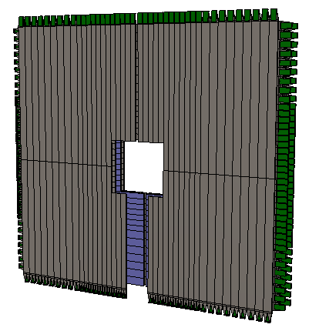
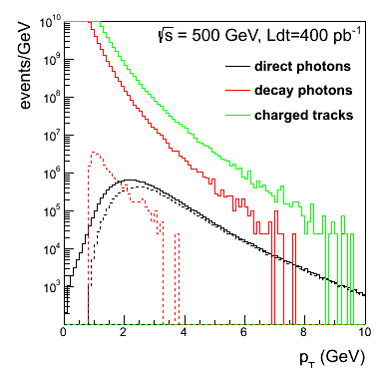
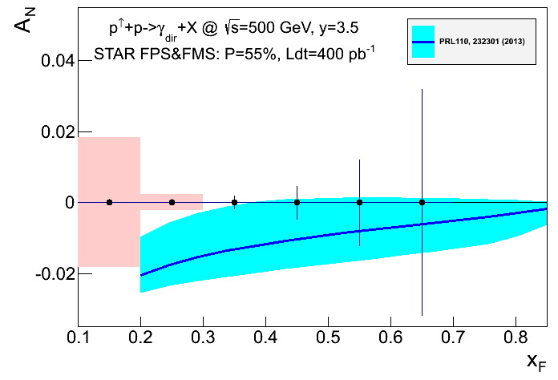
Complementary Channel: A_{N}(γ)
STAR FMS-PreShower:
3 layer preshower in front of the FMS,
distinguish photons, electrons/positrons
and charged hadrons
→ successfully operated in 2015
A_{N} for direct photons: sensitive to sign change in TWIST-3 formalism
Not a replacement for A_{N}(W^{+/-}, Z⁰, DY) measurement
but an important complementary piece in the puzzle

Slide 6
pA at RHIC
separate initial from final state effects at a kinematics
where the bulk of the matter sits
A-scan unique to RHIC
Critical Questions:
What are the dynamics of partons at very small and very large momentum
fraction (x) in nuclei.
What are the pQCD mechanisms that cause energy loss of partons in CNM?
What are the detailed hadronization mechanisms and time scales and how
are they modified in the nuclear environment?

Slide 7
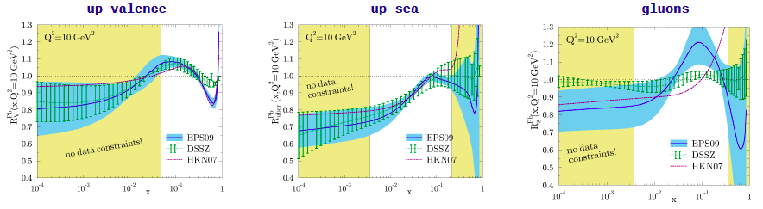
nuclear PDFs
Current situation: before LHC-data are included
H. Paukkunen, DIS-2014
DGLAP: predicts Q² but no A-dependence and x-dependence
Saturation models: predicts A-dependence and x-dependence but not Q²
Need: Q² lever-arm → LHC-RHIC A-scan: RHIC
Observables:
direct photon: R_{pA}
Di-hadron correlation measurements
A_{N}^{pA}/A_{N}^{pp}
UPC pA: g(x,Q²,b) → 2020++ lumi
Direct-photon Jet correlations
R_{pA} for DY
2015 pA-Run
no separation of initial &
final state effects
FCS + FTS → 2020+

Slide 8
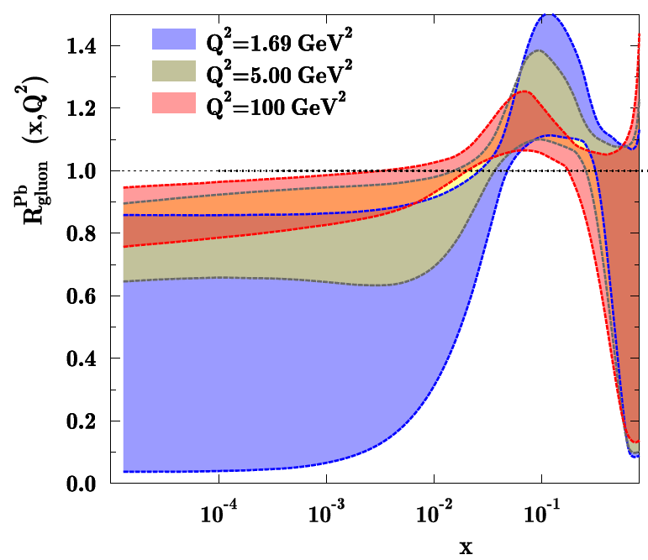
Nuclear PDFs
Important: p_{t}² ←→ Q² DY: M² ←→ Q²
Q² for measurements at STAR Q²>5 GeV, i.e. direct photon
Q² for DY: 16 GeV²
impact on precision EPS estimate < 10% statistical uncertainty
all LHC probes at very high Q² → small effects
99% of all h± have p_{t} < 2 GeV/c
“Bulk Matter” → x < 0.01

Slide 9
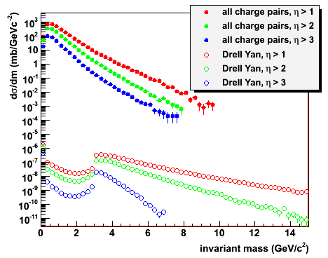
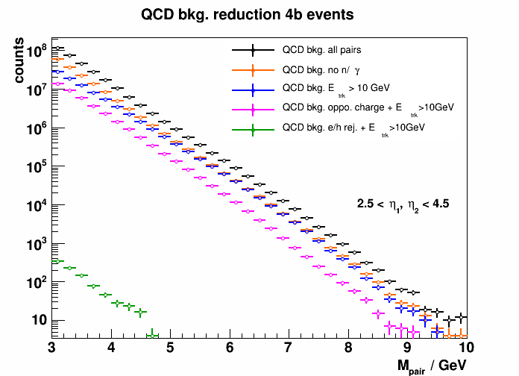
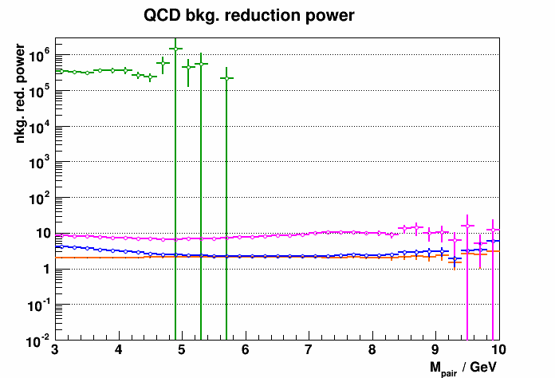
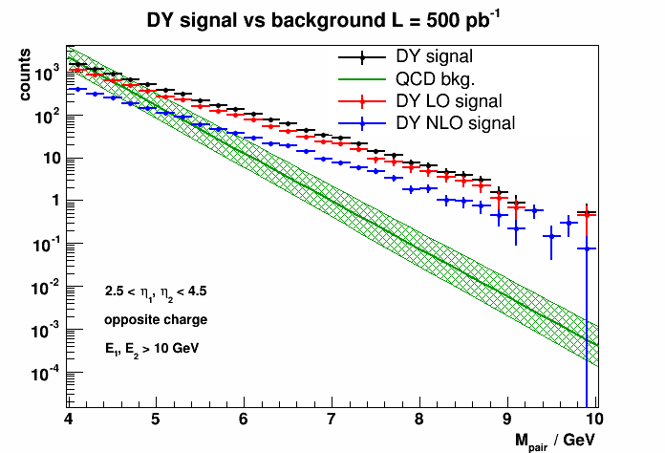
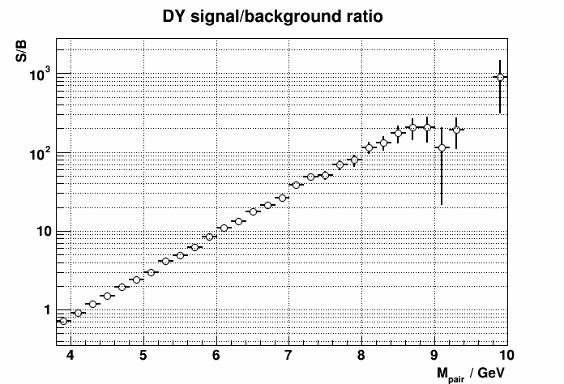
2020+: Dy in pA
Physics
Access to sea and valence quarks in nuclei
DY-h correlations → saturation Stasto et al. arXiv 1204.4861
very challenging
need big bkg. suppression
FCS + FTS
2.5 pb⁻¹ p+Au
200 GeV pp
Other possible channels, but no or limited event by event parton kinematic access
direct photon R_{pA} → first measurement in 2015, but no A-scan
Jet (di-jet) R_{pA}, → high scale → small effects in nPDF
2.5<η<4.0
2.5<η<4.0

Slide 10
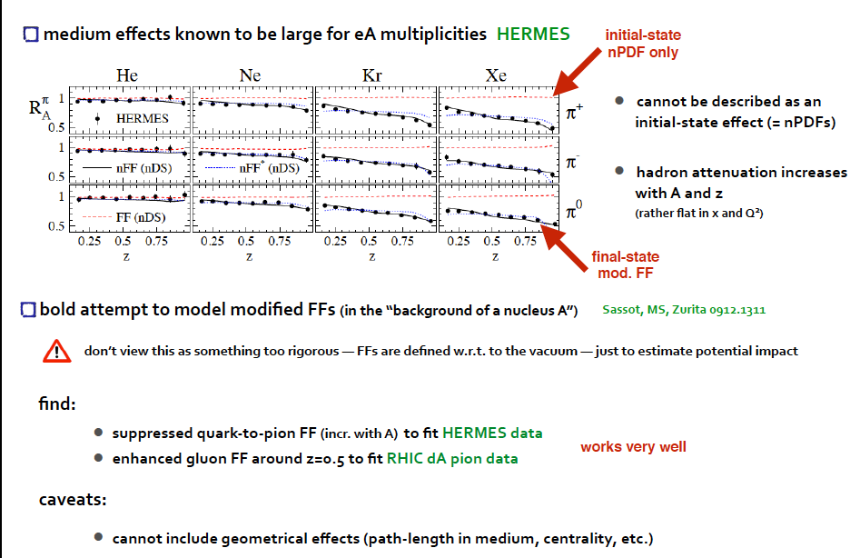
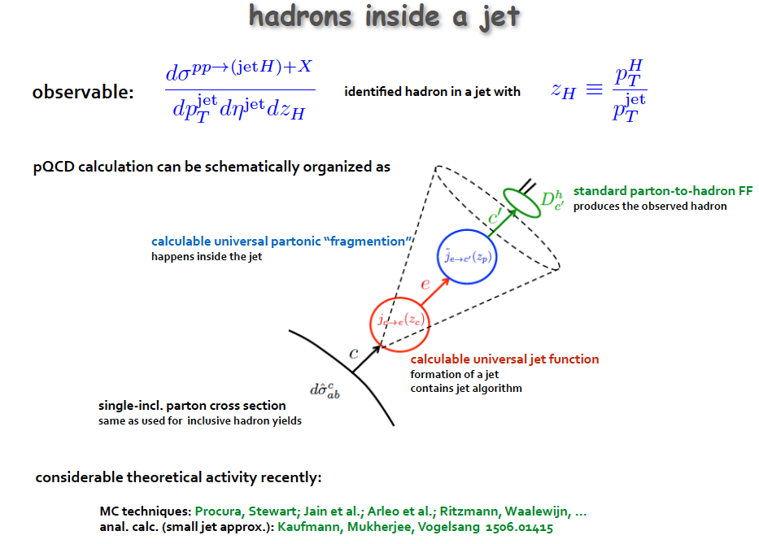
Final State Effects → FF

Slide 11
Jets+π^{+/-} to access Collins FF
dependence of the Collins FF on pion transverse momentum (j_{T})
first results in pp at 200 & 500 GeV
took first p↑A data in 2015
Transversity =
p_{proton}
Use the same technique in pp and pAu ignoring polarization effects
unpolarized FF
completely unique to STAR because of its PID capabilities

Slide 12
pp at RHIC
Critical Questions:
What is the nature of the spin of the proton?
How do quarks and gluons hadronize into final-state particles?
How can we describe the multidimensional landscape of nucleons?

Slide 13
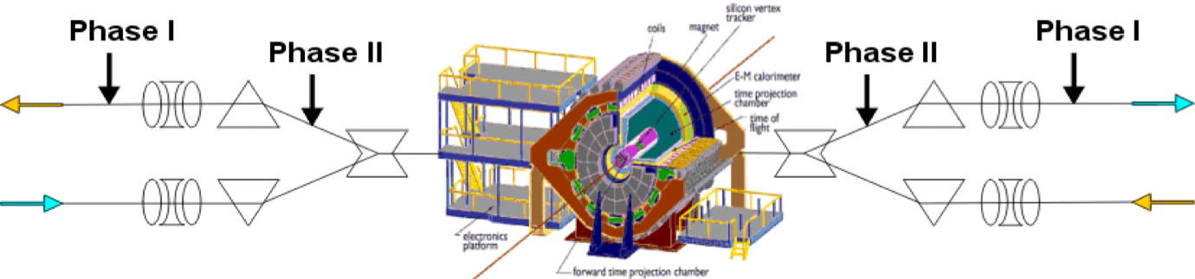
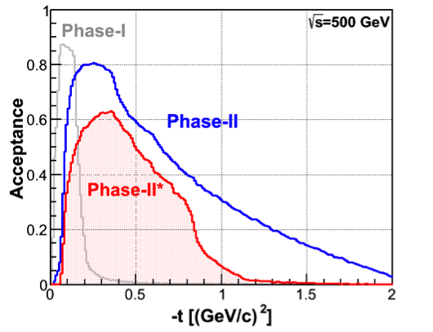
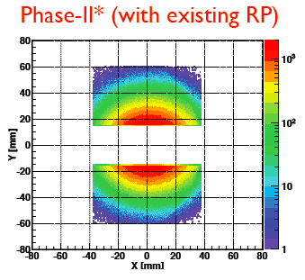
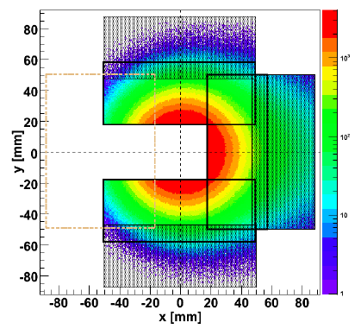
Forward Proton Tagging Upgrade
at 55-58m
at 15-17m
Opens a window to new observables at RHIC
Diffraction
Followed PAC recommendation and found a solution to run pp2pp@STAR with
std. physics data taking → No special β* running any more
should cover wide range in t → RPs at 15m & 17m
Staged implementation
  Phase I (in 2009): low-t coverage
  Phase II (installed 2015) : for larger-t coverage
  1st step reuse Phase I RP at new location only in y
  full phase-II: new bigger acceptance RPs & add RP in x-direction
    full coverage in φ not possible due to machine constraints
  → 250 GeV to 100 GeV scale t-range by 0.16
Good acceptance also for spectator protons from
deuterium and He-3 collisions
Phase-II: 1st step
1st step
2015
full Phase-II

Slide 14
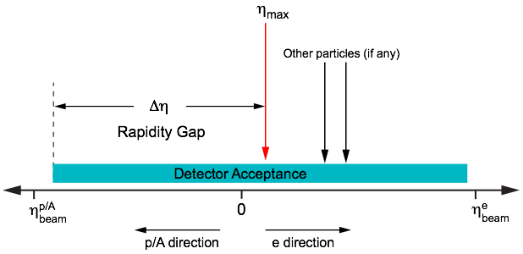
What do we know about diffraction
Diffractive events are characterized by a large rapidity gap
and
the exchange of a color neutral particle (pomeron)
Spin asymmetries open a new window to study the nature of diffraction
What is a pomeron really
Can we see odderons
Absolutely unique to RHIC
The diffractive processes occur in pp, pA, AA, ep, and eA
High sensitivity to gluon density: σ~[g(x,Q²)]² due to color-neutral exchange
→ golden channel at EIC to probe saturation
→ fraction of diffractive events goes from 15% (ep) to 30% (eA)
→ same is predicted for pA
Only known process where spatial gluon distributions can be extracted

Slide 15
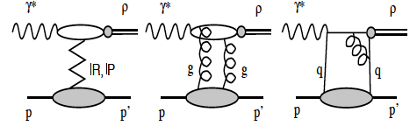
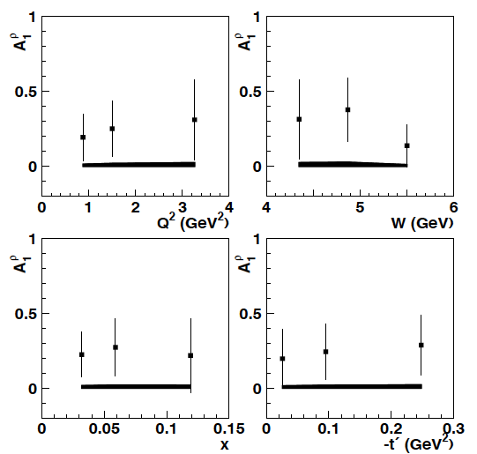
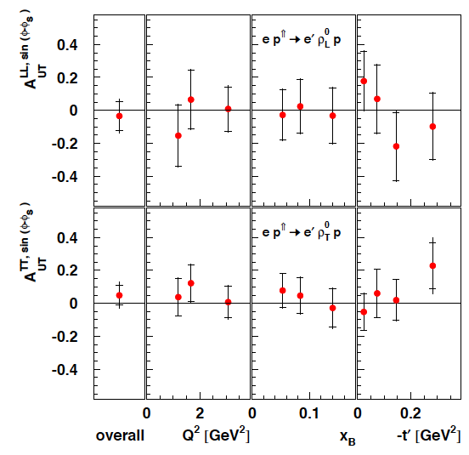
Diffraction and Spin
Pomeron (2g) vacuum quantum numbers → spin Asymmetries should be zero
only experiment which could measure diffractive spin asymmetries
HERMES
longitudinal DSA
transverse SSA
Is the underlying process for A_{N} at forward rapidities
single diffraction with the polarized proton breaking up
→ A_{N} measured requiring a proton in the yellow beam RP
hep-ex/0302012
arXiv:0906.5160

Slide 16
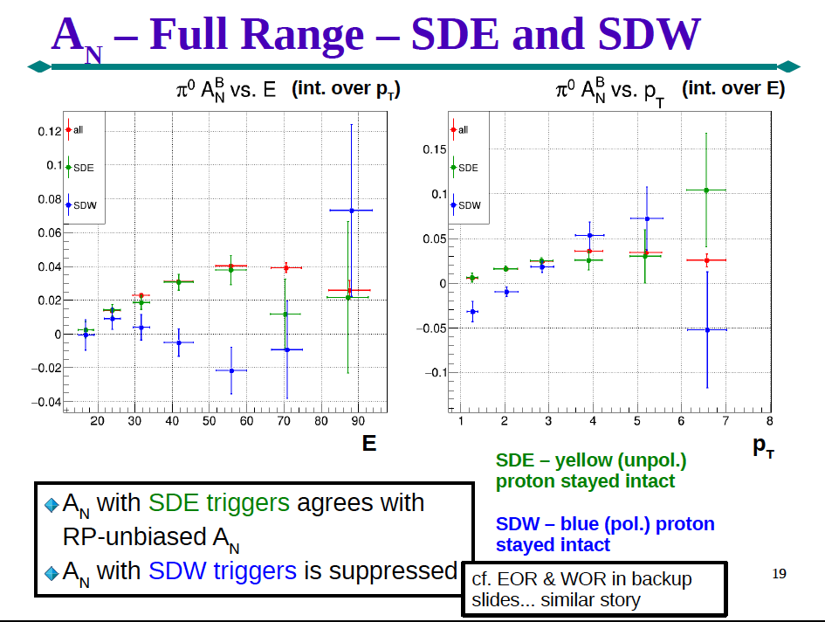
Very Preliminary results from run-15
thanks
Ch, Dilks

Slide 17
forward Upgrades my guess: due to financial constraints there will be only one upgrade at best

Slide 18
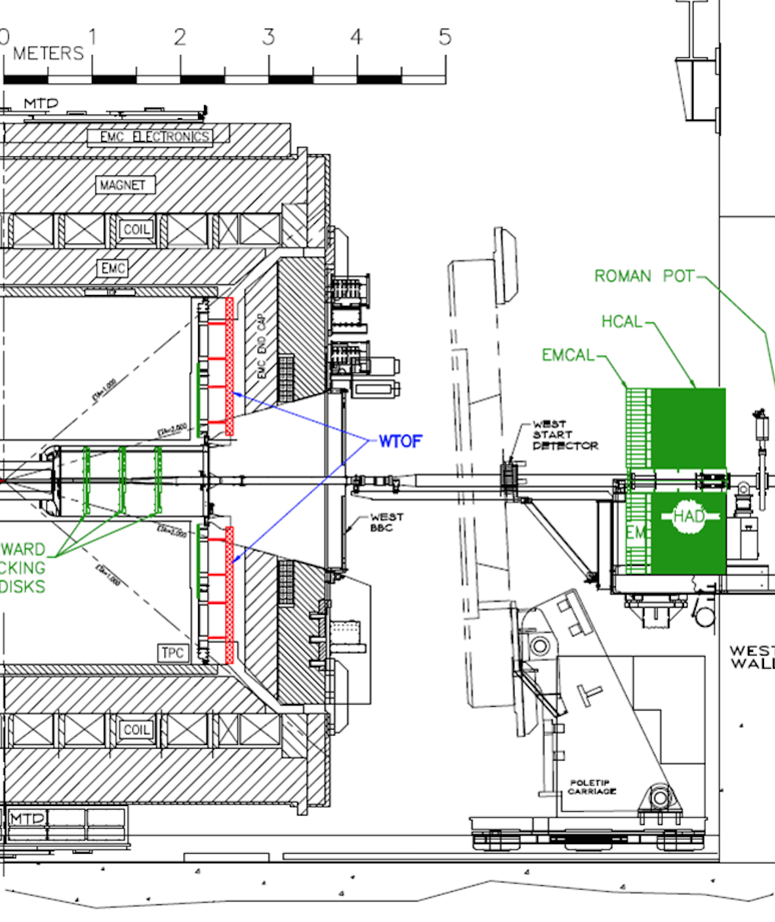
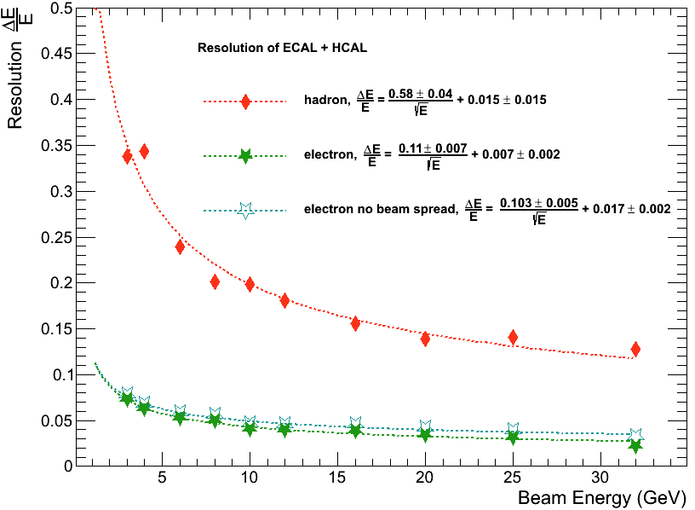
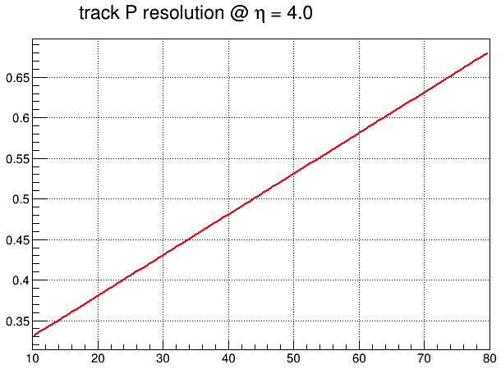
STAR FORward Upgrades for 2020+
ECal:
Tungsten-Powder-Scintillating-fiber
2.3 cm Moliere Radius, Tower-size: 2.5x2.5x17 cm³
23 X_{o}
HCal:
Lead and Scintillator tiles, Tower size of 10x10x81 cm³
4 interaction length
Latest Test-Beam results:
Tracking:
Silicon mini-strip detector
3-4 disks at z ~70 to 140 cm
Each disk has wedges
covering full 2π range in ϕ
and 2.5-4 in η
other options still
under study

Slide 19
Alternative Solution for STAR forward upgrade
Several detectors become available after 2016
forward Ecal: restack PHENIX barrel Ecal
  needs new electronics current one integrates over 3 bunches
  magnetic shielding for PMTs
forward Tracker: reuse fFTX
  can we sign change in STAR with it
forward Hcal: reuse E864 HCal
  needs readout electronics
  the need for pixelisation needs to be demonstrated
all of this would need detailed studies to verify the ideas are viable

Slide 20
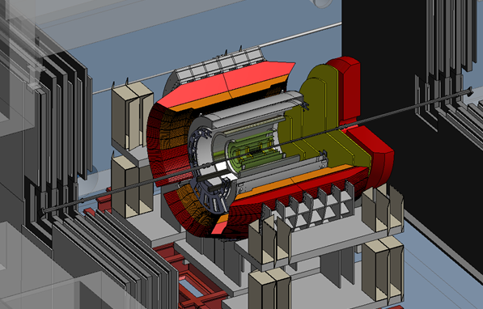
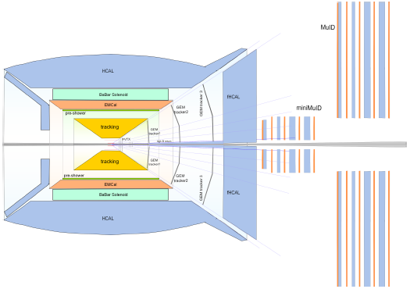
fsPHENIX Upgrade
sPHENIX + fsPHENIX
Evolve sPHENIX with forward instrumentation for p+p/p+A physics:
GEM tracking chambers
Hadronic Calorimetry
Reconfigure existing FVTX and MuID

Slide 21
Further opportunitis at 500 GeV polarized pp

Slide 22
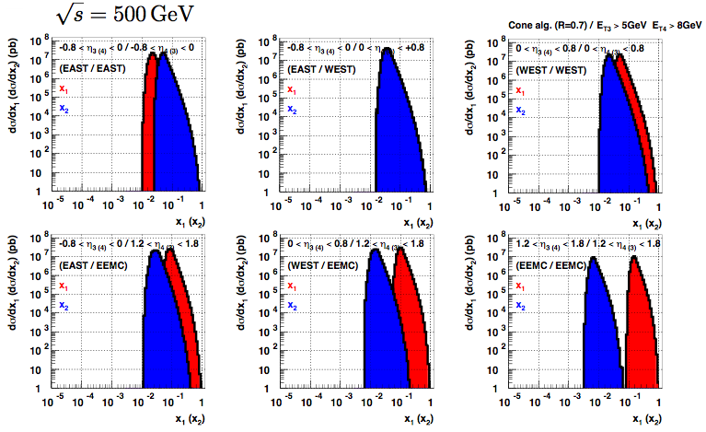
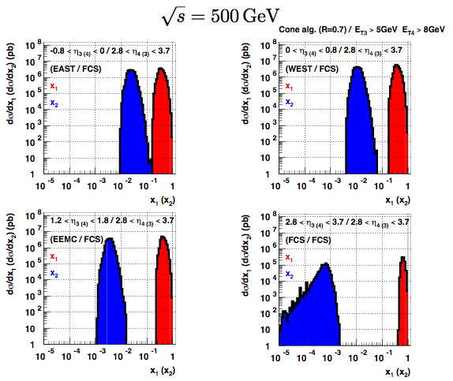
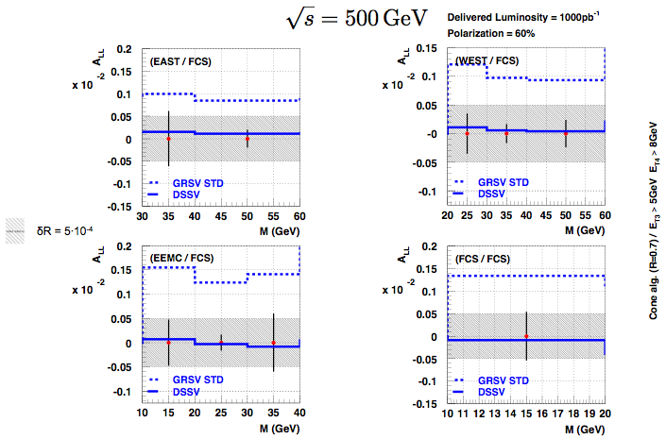
2020+: Going to lower x
510 GeV & Di-Jets: constrain the shape of Δg(x,Q²) only in LO → go to lower x:
Utilize FCS + FTS: x: 0.005 → 0.001
This will be the measurement to constrain Δg(x,Q²) at lowest x
before eRHIC comes online
L < 0
L ~ 0
L > 0

Slide 23
Why are TMDs interesting
Transverse momentum dependent parton distribution functions
→ initial state effects
important in calculating cross-sections in a range of processes
provide a way to image the proton in transverse and longitudinal momentum space (2+1d)
provide access to spin-orbit correlations
provide constrains to quark-gluon-quark correlations
are important to describe the gluon distribution at low-x → CGC
the most popular explanation for the large A_{N} seen in transverse p+p
of special interest: The Sivers function,
it describes the correlation of the parton transverse momentum with
the transverse spin of the nucleon.
Transverse momentum dependent fragmentation functions
final state effects
describe a correlation of the transverse spin of a fragmenting quark and the transverse momentum of a hadron
→ Collins FF

Slide 24
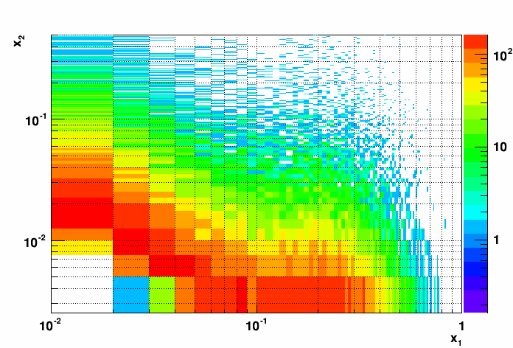
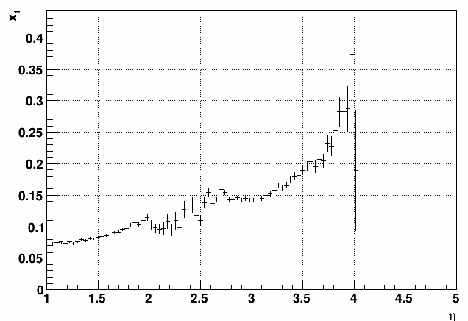
Transverse Spin Physics at the end of the Decade
Bring mid rapidity observables (jets, IFF, ..) to high rapidities → high x
Needs:
forward upgrade (FCS + FTS) & 500 GeV & delivered luminosity: 1fb⁻¹
Address the following questions:
measure tensor charge → connection to lattice
difference between δq(x) and Δq(x) allows to study orbital angular momentum
in wave fct.
is the Soffer bound violated
Cuts: 2.8 <η< 3.5 and jet p_{t} > 3 GeV

Slide 25
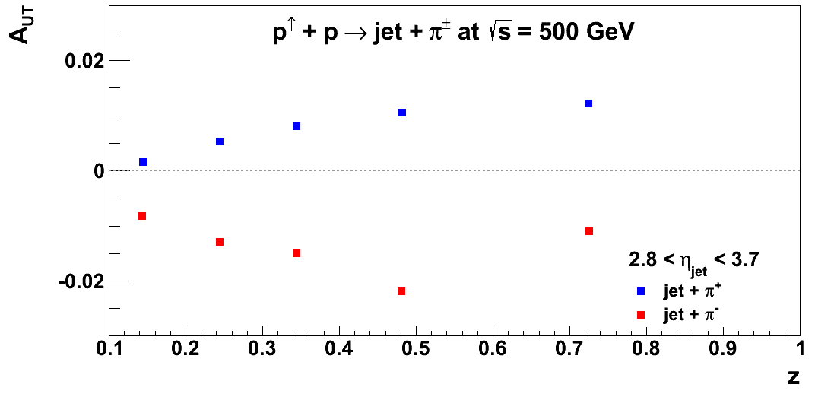
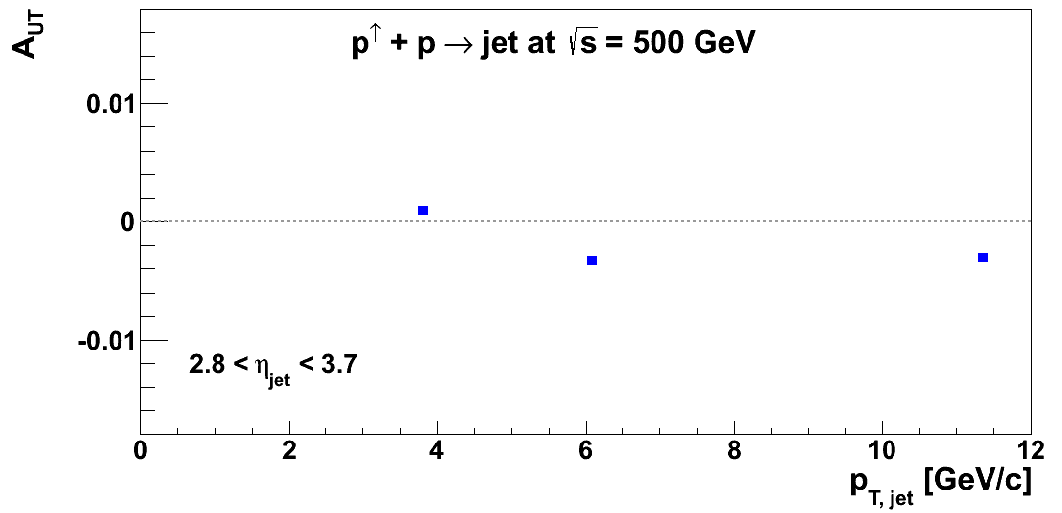
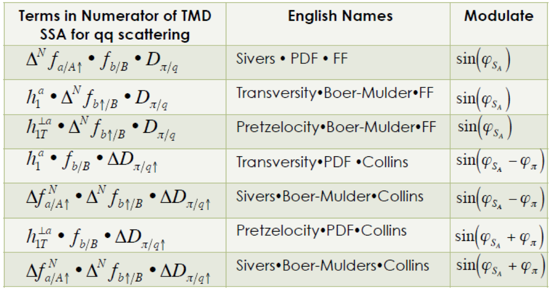
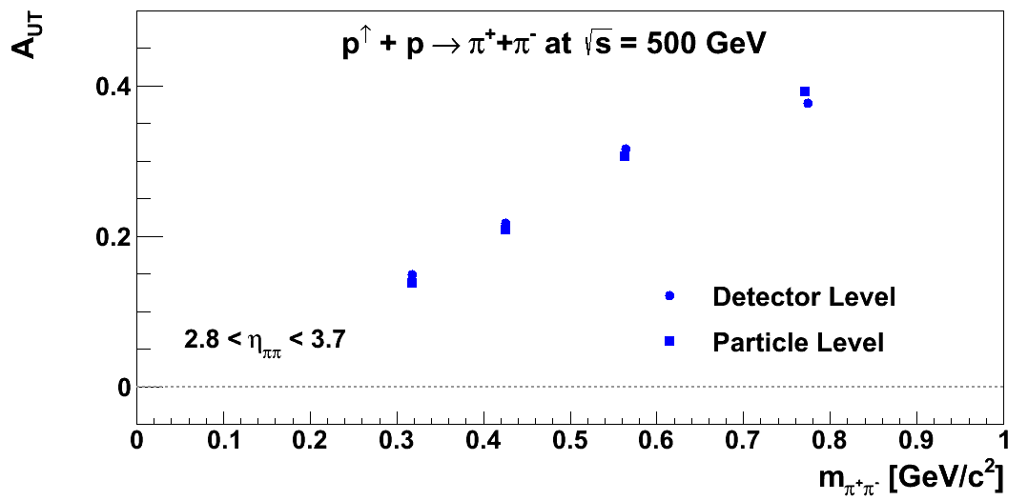
Transverse Spin Physics at the end of the Decade
Cuts: 2.8 <η< 3.5 and jet p_{t} > 3 GeV
Simulations:
TPPMC: transverse MC with hard
interaction from PYTHIA
Detector: fast smearing, based on
GEANT responses
Only poster-child measurements shown
more observables, i.e. di-jets,… are possible together with
new forward detector systems and high luminosity will allow to address
different TMDs
Sivers x PDF x FF:
Transversity x PDF x Collins:
Transversity • Boer-Mulders • FF
Pretzelocity • Boer-Mulders • FF
Sivers • Boer-Mulders • Collins
Transversity x IFF:

Slide 26
Summary
Several new and unique to STAR physics opportunities
  many physics opportunities are possible with minor or no upgrades
    RP phase II
    post-shower to FMS
  the nPDF DY measurement requires upgrades in the forward direction
    need to see this measurement could be done with the pre-shower + FMS+post-shower setup
  the 500 GeV physics topics require the forward upgrade
    jets need the Ecal + Hcal combination
Need to come to grips what we want to do and take decisions and not keep all options always open

Slide 27
ADDITIONAL Material

Slide 28
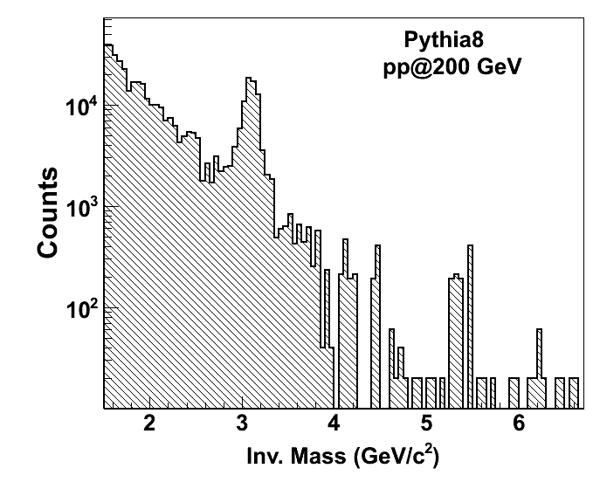
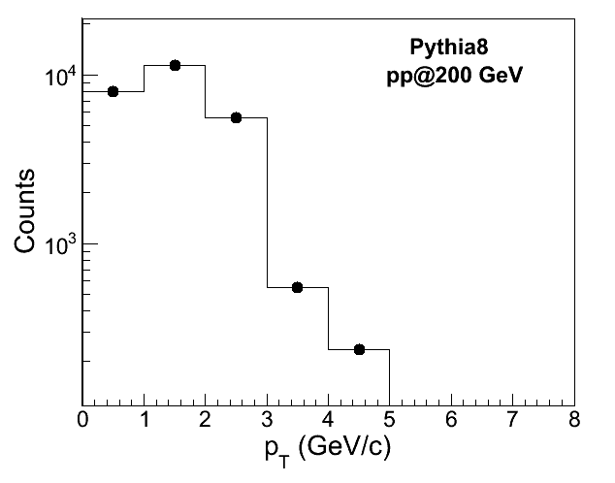
Energy Loss in cold nuclear matter
R_{pA} of J/Ψ as function of η sensitive to:
initial conditions (nPDF, saturation)
energy loss mechanism
2020+: FCS + FTS provide new detector capabilities
to measure J/Ψ at 2.5 < η < 4.0
→ clean J/Ψ signal & good stat till 5 GeV
F. Arleo and S. Peigné, JHEP 03 (2013) 122

Slide 29
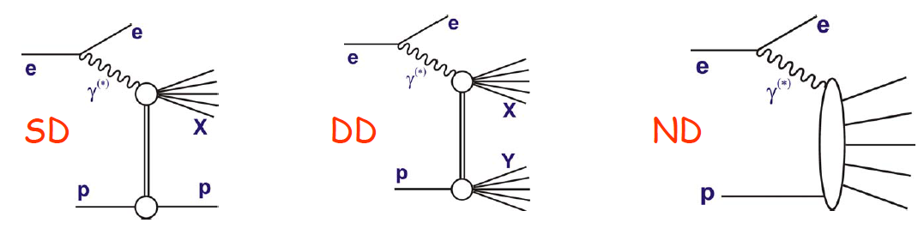
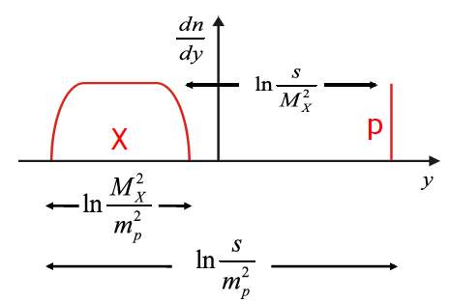
What do we know about diffraction
… but how to specify the difference between diffractive and non-diffractive processes?…
… nature gives smooth transitions between these processes
Definitions in terms of hadron-level observables …
For SD can be done in terms of a leading proton
More general definition to accommodate DD
…can be applied to any diff or non-diff final state …
Order all final state particles in rapidity
Define two systems, X and Y, separated by the
largest rapidity gap between neighboring particles.

Slide 30
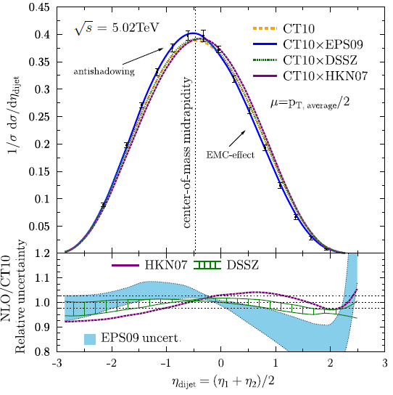
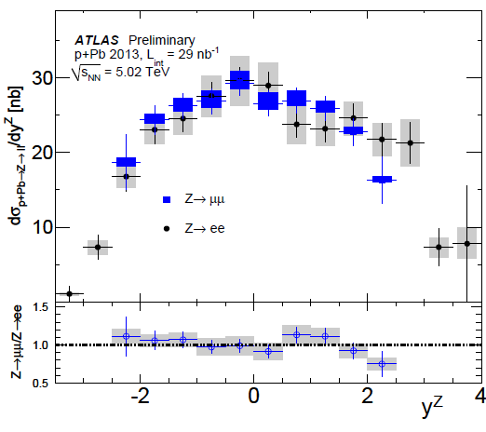
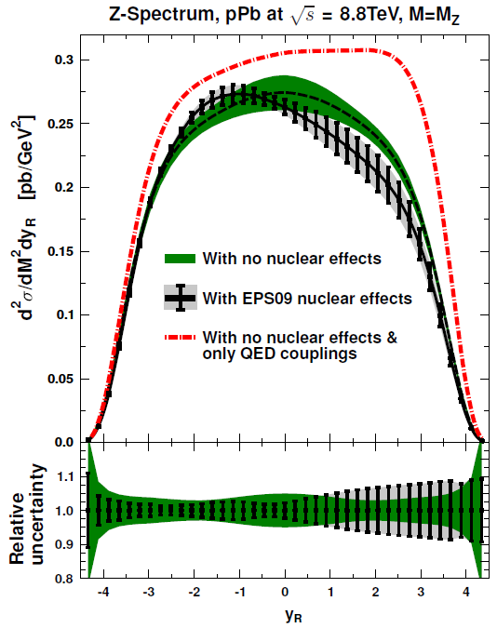
Constraints on nPDFs from the LHC
Existing CMS p+Pb dijet measurements can discriminate between different nPDFs.
Future results for photons, W^{+/-}, and Z bosons in p+Pb collisions will constrain nPDFs at a large scale.
ATLAS-CONF-2014-20
JHEP 1310 (2013) 213
JHEP 1103 (2011) 071
LHC data will provide significant new constraints on nPDFs.
CMS PAS HIN-13-007

Slide 31
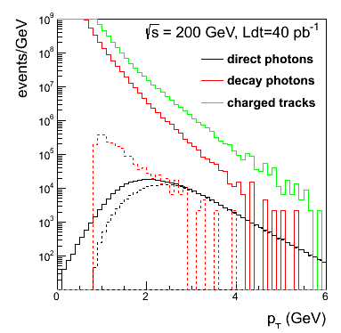
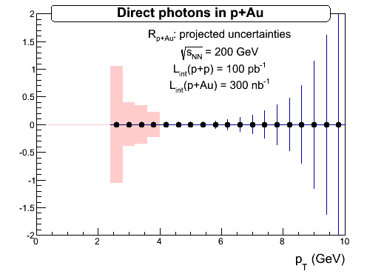
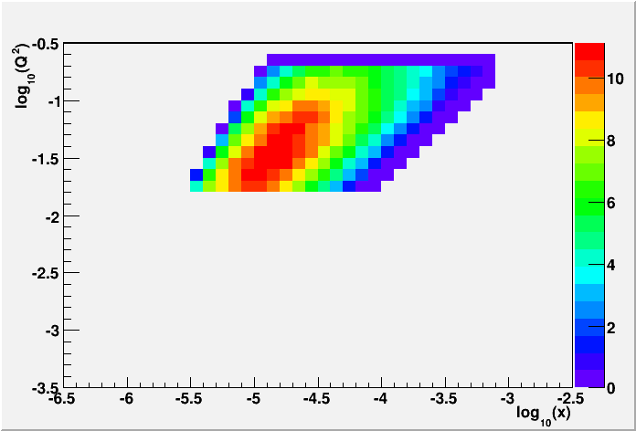
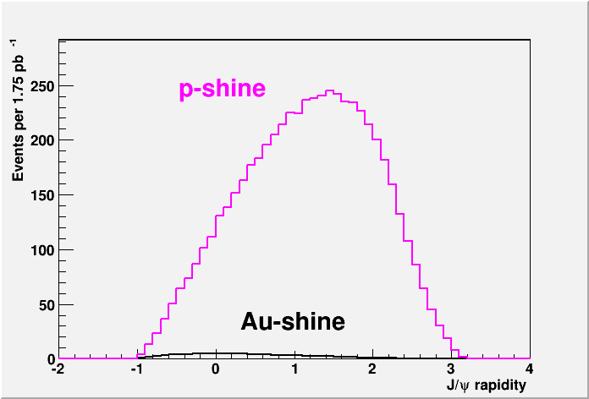

STAR: nuclear PDFs
Direct Photon R_{pAu}:
p+p
2015
required: FPS + FMS
2020+ UPC: “proton-shine”-case:
Requires: RP-II* and 2.5 pb⁻¹ p+Au
Fourier transform of σ vs. t
→ g(x,Q²,b)

