Slide 1

eRHIC
IR- and Detector Design
Considerations

Slide 2
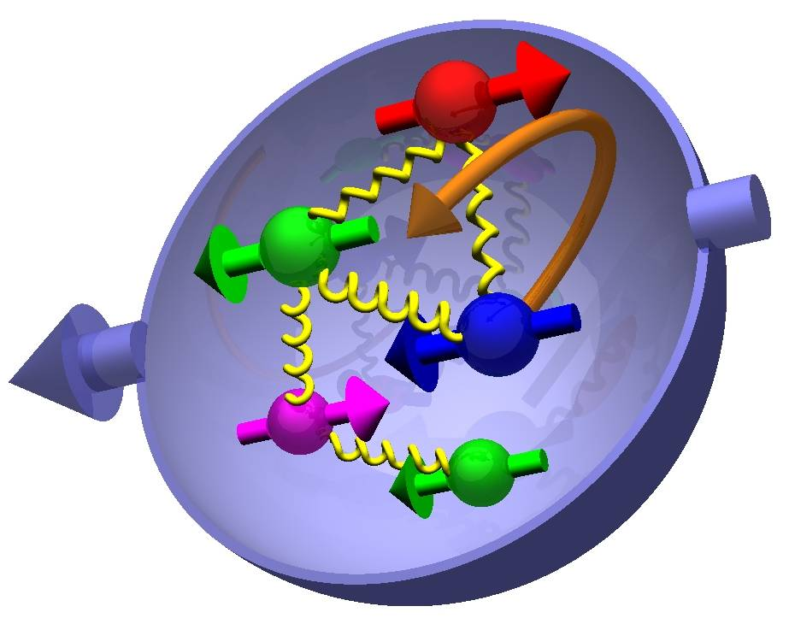
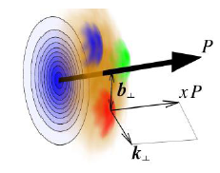

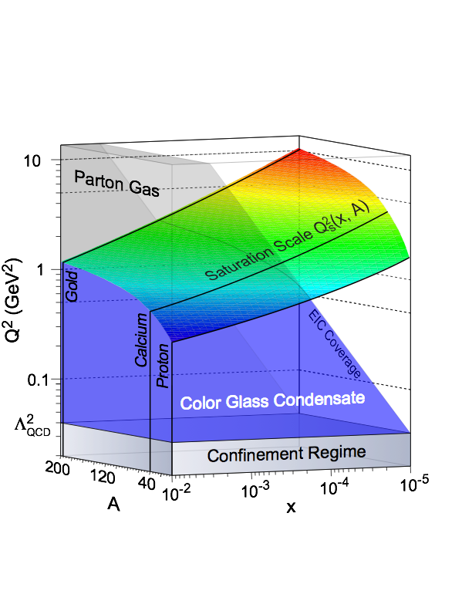
Most Compelling Physics Questions
spin physics
imaging
what is the polarization of gluons at
small x where they are most abundant
what is the spatial distribution of
quarks and gluons in nucleons/nuclei
Question to answer
What fraction of this program
can be addressed by eSTAR?
Need to simulate the golden measurements
in eSTAR
what is the flavor decomposition of
the polarized sea depending on x
understand deep aspects of gauge
theories revealed by k_{T} dep. distr’n
determine quark and gluon contributions
to the proton spin at last
possible window to
orbital angular momentum
physics of strong color fields
quantitatively probe the universality of
strong color fields in AA, pA, and eA
understand in detail the transition to the non-linear
regime of strong gluon fields and the physics of saturation
how do hard probes in eA interact with the medium

Slide 3
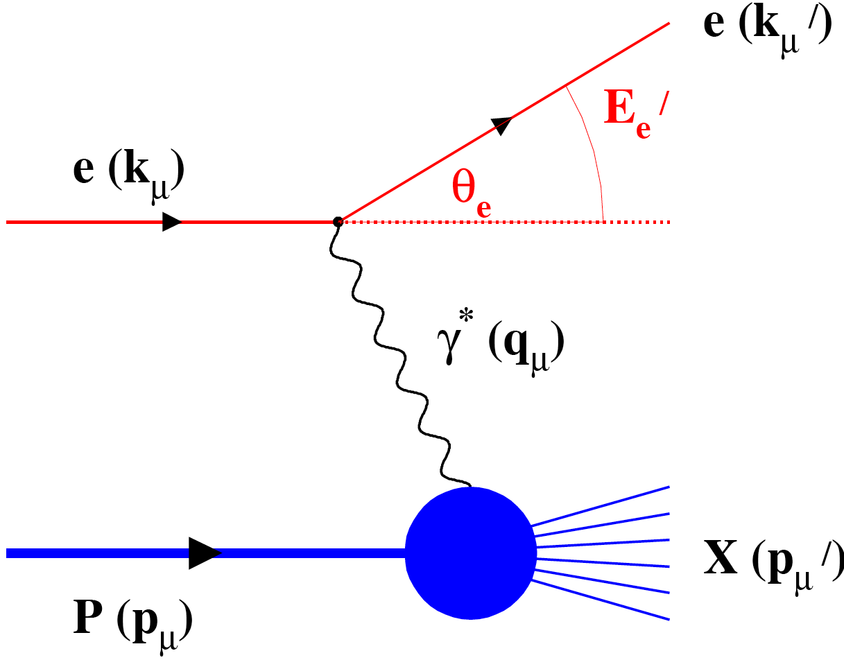
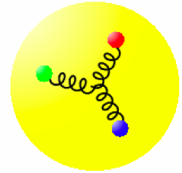
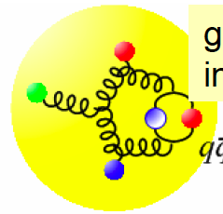
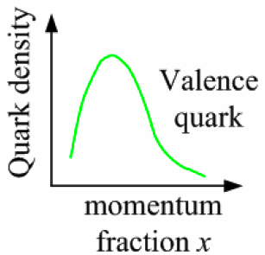
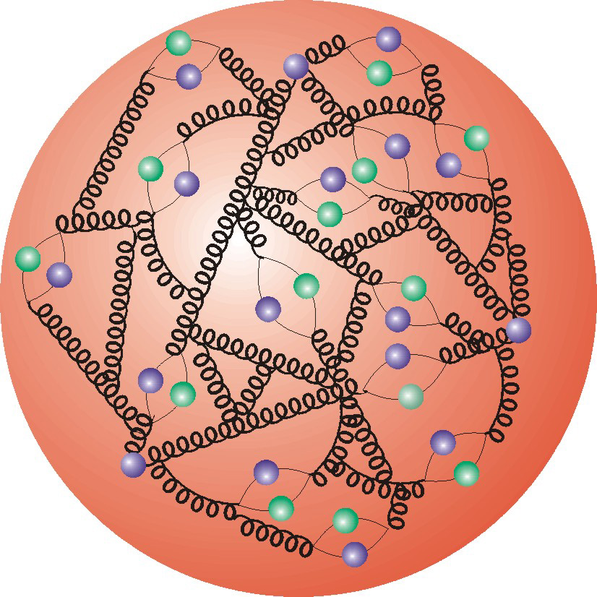
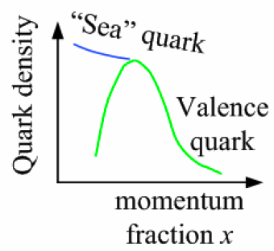
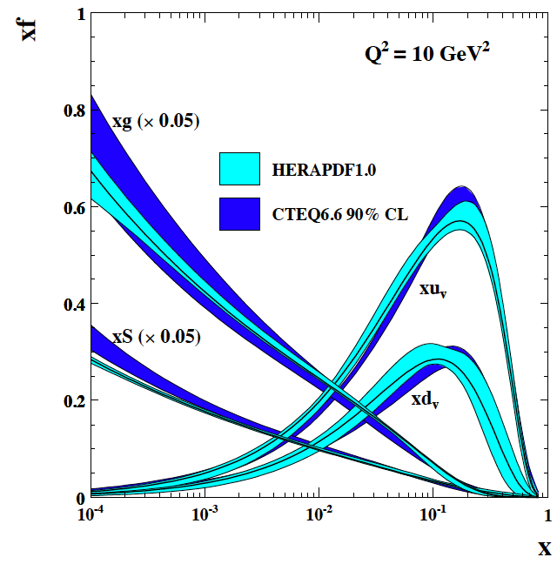
How to see the gluons: Deep Inelastic Scattering
Kinematics:
Measure of resolution power
Measure of inelasticity
Measure of momentum fraction of struck quark
Gluon splits
into quarks
Quark splits
into gluon
splits
into quarks …
10⁻¹⁶m
10⁻¹⁹m
higher √s
increases resolution

Slide 4
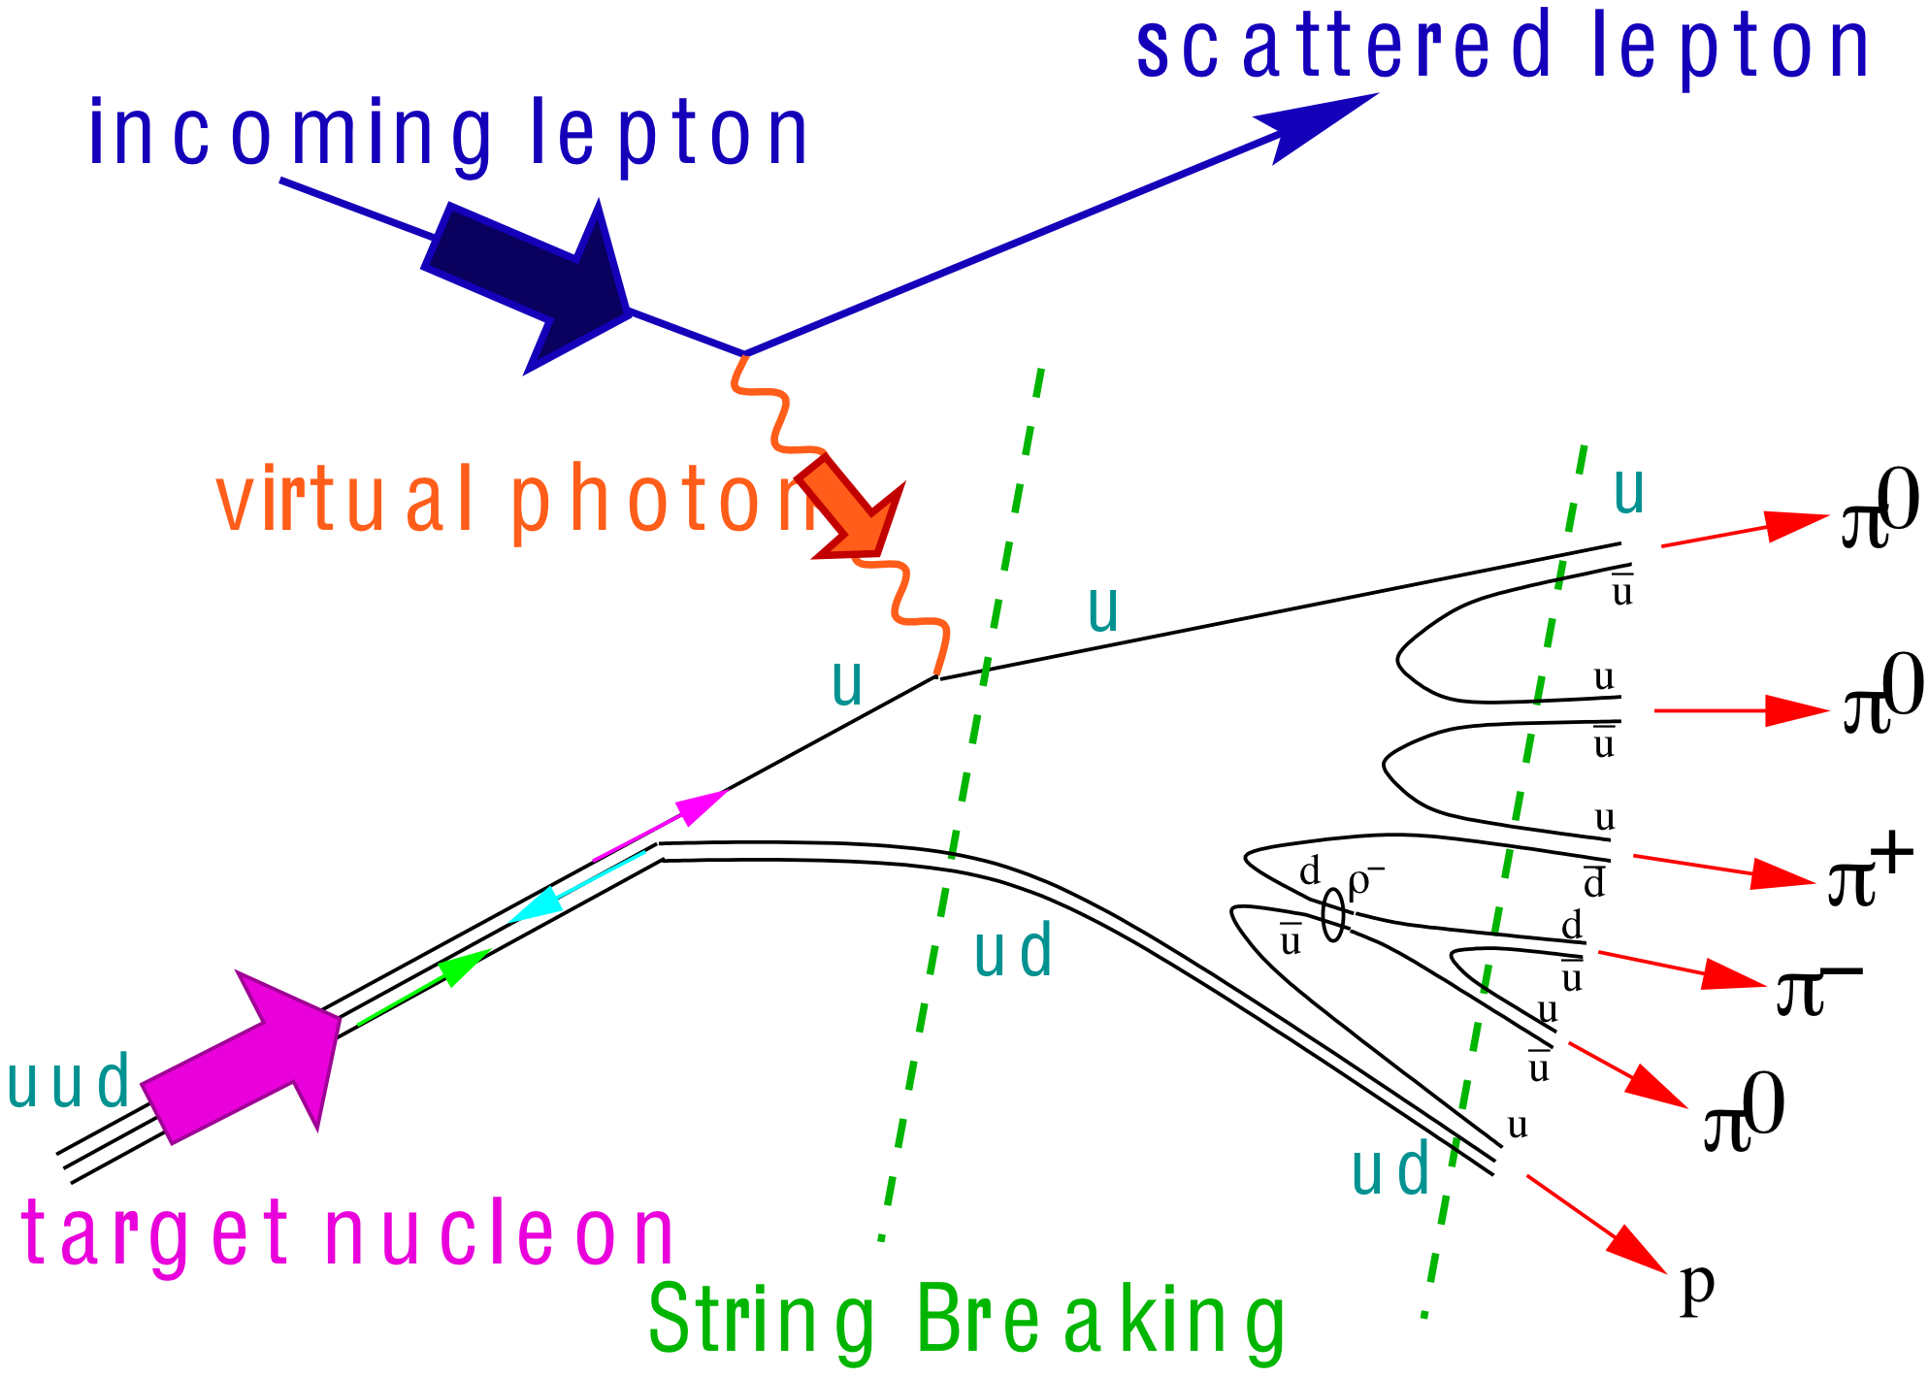
What needs to be covered
e’
e
γ, π,J/Ψ
γ_{L}*
(Q²)
x+ξ
x-ξ
~
~
H, H, E, E (x,ξ,t)
p
p’
t
Inclusive Reactions:
Momentum/energy and angular resolution of e’ critical
Very good electron id
Moderate luminosity >10³² cm⁻¹ s⁻¹
Need low x ~10⁻⁴ → high √s (Saturation and spin physics)
Semi-inclusive Reactions:
Excellent particle ID: π,K,p separation over a wide range in η
full Φ-coverage around γ*
Excellent vertex resolution → Charm, bottom identification
high luminosity >10³³ cm⁻¹ s⁻¹ (5d binning (x,Q²,z, p_{t},Φ))
Need low x ~10⁻⁴ → high √s
Exclusive Reactions:
Exclusivity → high rapidity coverage → rapidity gap events
high resolution in t → Roman pots
high luminosity >10³³ cm⁻¹ s⁻¹ (4d binning (x,Q²,t,Φ))

Slide 5
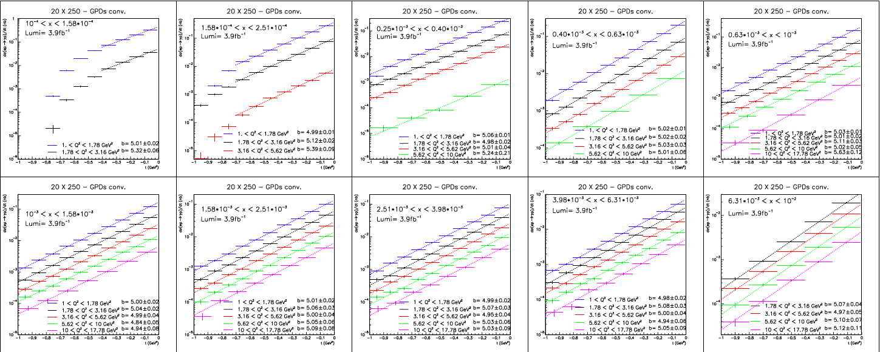
DVCS at eRHIC
Goal: Cover wide range in t → Fourier transform
→ impact parameter space b PDFs
e’
e
γ
γ_{L}*
(Q²)
x+ξ
x-ξ
DVCS cross section in bins of Q², x and t
GPD H
Simulations by S.Fazio
~
~
H, H, E, E (x,ξ,t)
p
p’
t

Slide 6
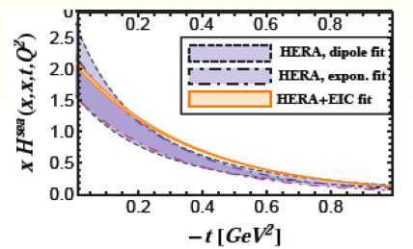
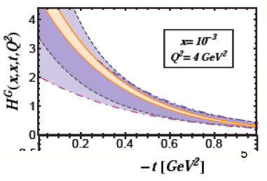
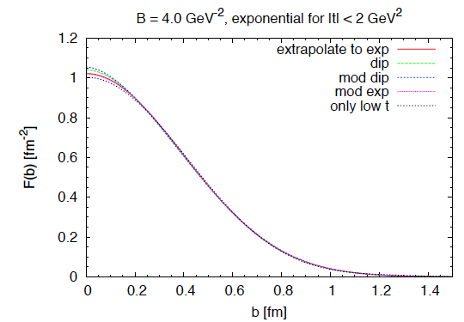
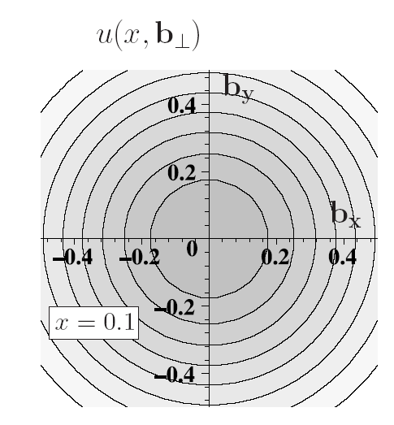
DVCS at eRHIC
Global Fit to extract GPDs by D. Mueller and K. Kumerički
eRHIC will allow to
constrain GPDs
and to get impact
parameter dependent
PDFs

Slide 7
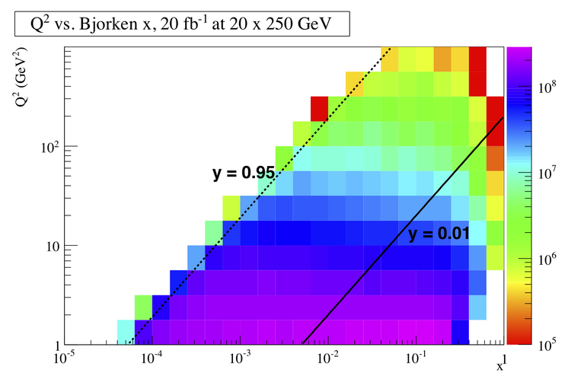
DIS Kinematics
Potential limitations in kinematic coverage:
high y limited by
radiative corrections
can be suppressed by
by requiring hadronic
activity
y=0.85
HERA
y>0.005
y=0.05
Strong x-Q² correlation
  high x → high Q²
  low x → low Q²
low y limited by resolution for e’
→ use hadron method, needs rapidity
coverage

Slide 8
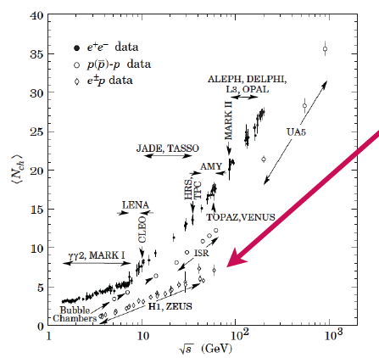
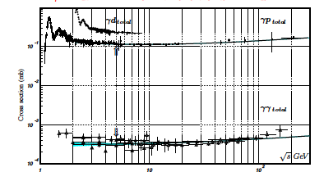
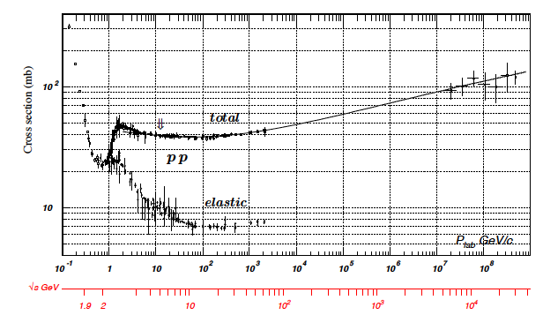
Some thought about rates
low multiplicity
4-6 √s = 40-65 GeV
N_{ch} (ep) ~ N_{ch} (eA) < N_{ch}(pA)
→ no occupancy problem
Cross section:
Pythia σ_{ep}: 0.030 – 0.060 mb
Luminosity: 10³⁴ cm⁻¹ s⁻¹ ⁼ 10⁷ mb⁻¹ s⁻¹
Interaction rate:
300 -600 kHz

Slide 9
What do we know about the scattered lepton
cuts: Q²>0.1GeV² && 0.01<y<0.9

Slide 10
Kinematics of semi-inclusive hadrons
PIONS:
cuts: Q2>1GeV² && 0.01<y<0.9 && 0.1<z<0.9
With increasing
lepton energy
hadrons are boosted
in electron beam
Direction
Much more plots
at
http://www.phenix.bnl.gov/
WWW/publish/elke/
EIC/KINEMATIC-PLOTS

Slide 11
Kinematics of exclusive hadrons
J/Ψ→e⁺+e⁻:
No cuts
With increasing
lepton energy
decay products are
boosted
in electron beam
direction

Slide 12
DVCS: ep → e’p’γ
cuts: Q2>1.0GeV² && 0.01<y<0.9
&& Eγ>1GeV
With increasing
lepton energy
real photon is
boosted even more
in electron beam
direction

Slide 13
Required Lepton-Hadron Separation
Need very good e-PID for
high Q² events at 5x100
and for low to high Q²
events at 20x250

Slide 14
Additional consideration for Detector Design
Challenge:
  need to cover wide range in beam energies
  lepton: 5 - 30 GeV; hadron (p/Au) 100–250 GeV / 25–100 GeV
  Electron beam → synchrotron radiation
Resolution in x, Q² dominated how well the scattered
lepton is measured
DIS:
  with increasing center-of-mass energy lepton goes more and more in original beam direction
  high Q² events go into central detector
  low Q2 events have small scattering angle and close to original beam energy
  need low forward electron tagger for low Q² events
  low-mass high resolution trackers over wide angular acceptance
Very high luminosity 10³⁴ cm⁻¹s⁻¹
  will be systematic limited basically in every measurement
  needs a lot of care to account for this in the design

Slide 15
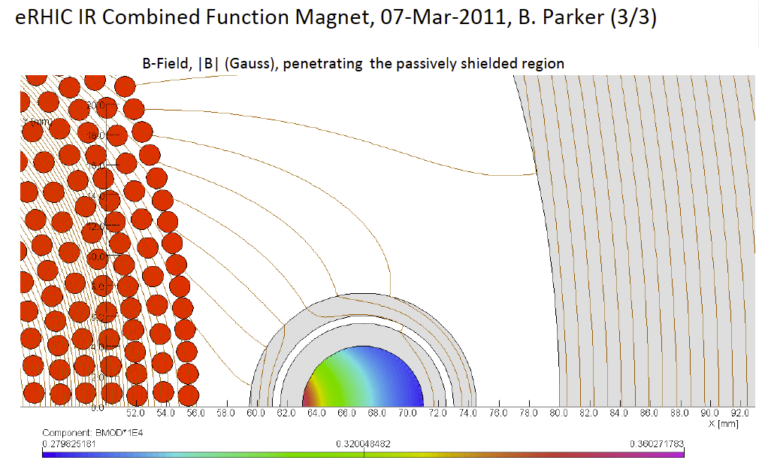
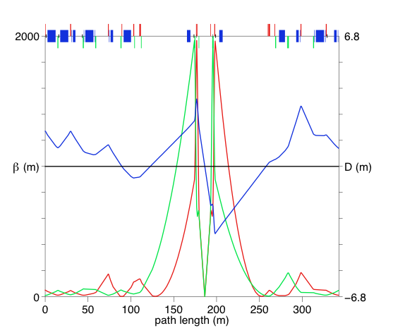
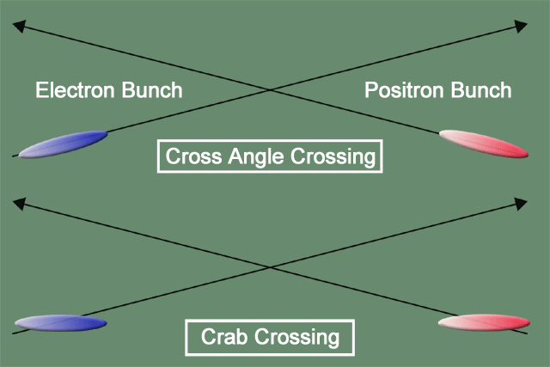
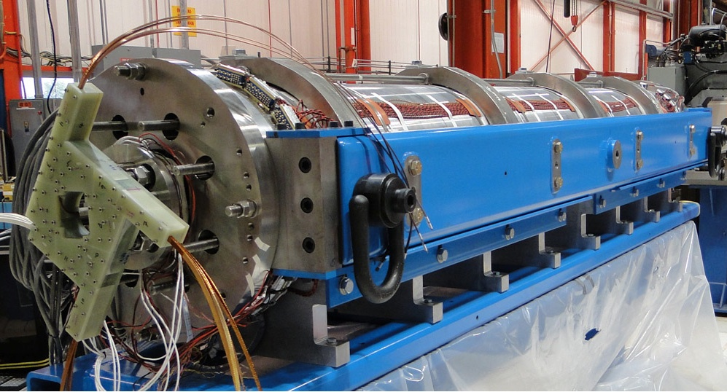
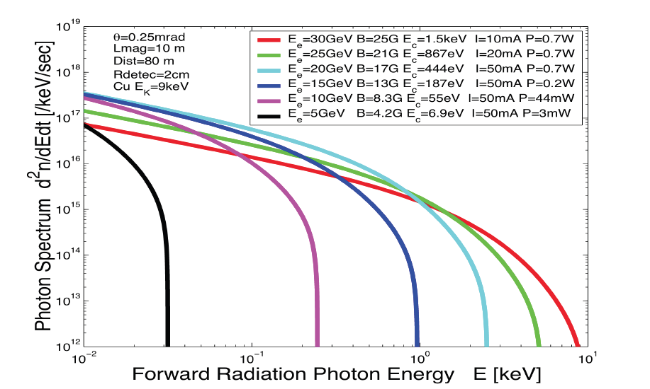
eRHIC high-luminosity IR with β*=5 cm
© D.Trbojevic, B.Parker, S. Tepikian, J. Beebe-Wang
p
Proton beam lattice
G.Ambrosio et al., IPAC’10
Question to answer
How does this design need to be adapted for eSTAR?
ATTENTION:
eRHIC clock will be changing to 75ns
e
Nb₃Sn
200 T/m
eRHIC - Geometry high-lumi IR with β*=5 cm, l*=4.5 m
and 10 mrad crossing angle → this is required for 10³⁴ cm⁻² s⁻¹
10 mrad crossing angle and crab-crossing
High gradient (200 T/m) large aperture Nb₃Sn focusing magnets
Arranged free-field electron pass through the hadron triplet magnets
Integration with the detector: efficient separation and registration of low angle collision products
Gentle bending of the electrons to avoid SR impact in the detector

Slide 16
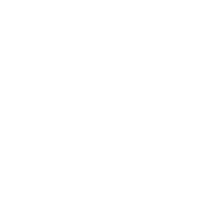
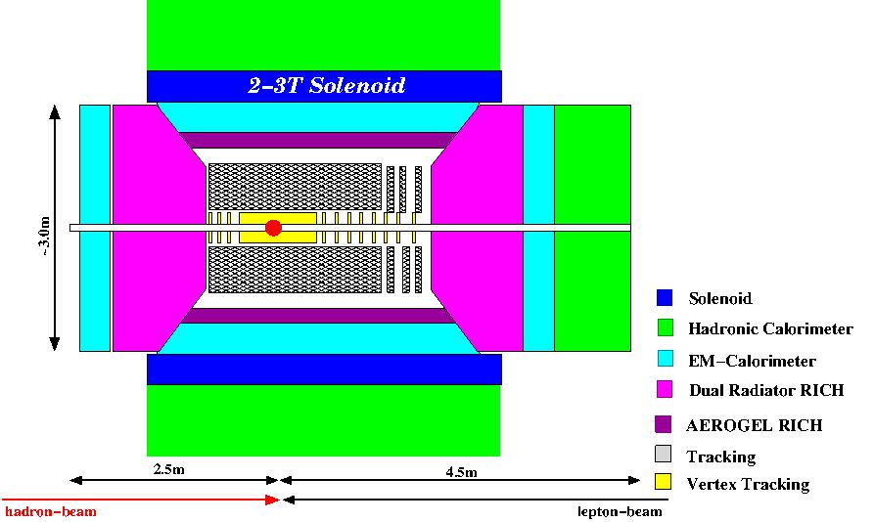
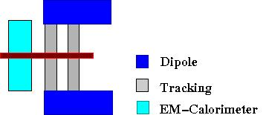
Emerging Detector Concept
Backward Spectrometer
For very low Q²-electrons:
detector currently modeled in
FAIRRoot
important for Detector R&D and
physics capabilities
high acceptance -5 < η < 5 central detector
good PID (π,K,p and lepton) and vertex resolution (< 5μm)
tracking and calorimeter coverage the same → good momentum resolution, lepton PID
low material density → minimal multiple scattering and brems-strahlung
very forward electron and proton/neutron detection → maybe dipole spectrometers

Slide 17
Detector technology concepts
Si-Vertex
  MAPS technology from IPHC ala STAR, CBM, Alice, …
    Barrel:
    4 double sided layers @ 3. 5.5 8. 15. cm 10 sectors in Φ
    chip 20mm x 30mm ---> 1cm 300 pixel pitch 33 micron dual readout, one column 60 μs readout time
    Forward Disks:
    4 single sided disks spaced in z starting from 20cm
    Radial extension 3 (19 μm pixel) to 12 cm (75 μm pixel), dual sided readout
Barrel Tracking
  Preferred technology TPC (alternative GEM-Barrel tracker Mass???)
    Low mass, PID e/h via dE/dx
Forward tracking
  GEM-Trackers
Forward/Backward RICH-Detectors
  Momenta to be covered: 0.5-80 GeV for 2<|y|<5
  Technology:
    Dual Radiator (HERMES, LHCb) Aerogel+Gas (C₄F₁₀ or C₄F₈O)
  Photondetector: low sensitivity to magnetic field

Slide 18
Detector technology concepts
Barrel PID-Detectors
  Momenta to be covered 0.5-10 GeV for -2<y<2
  Technology:
    Aerogel Proximity focusing RICH
    DIRC (remember p_{max} < 4 GeV)
ECal:
  Backward/Barrel:
    PbW-crystal calorimeter → great resolution, small Molière radius → electron-ID: e/p, measure lepton via Ecal, important for DVCS
  Forward:
    Less demanding: sampling calorimeter
Preshower
  Si-W technology as proposed for PHENIX MPCEX
    Do we need a preshower if we have tracking and a PbW-calo
Hcal/μ-Detectors
  Not obvious they are really needed
Luminosity monitor, electron and hadron polarimeters

Slide 19
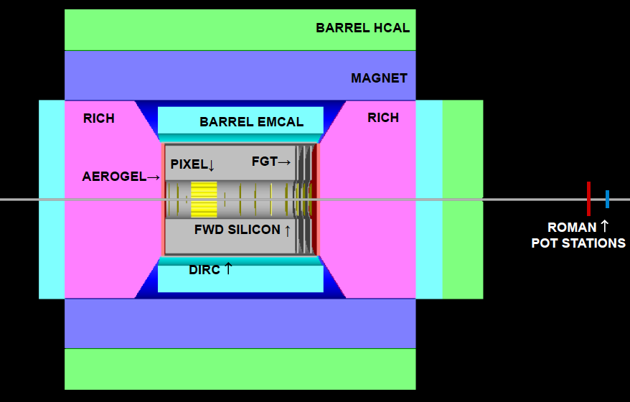
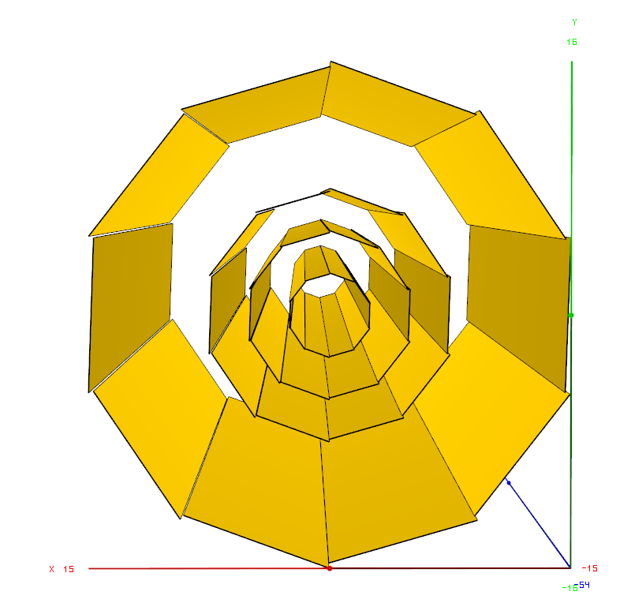
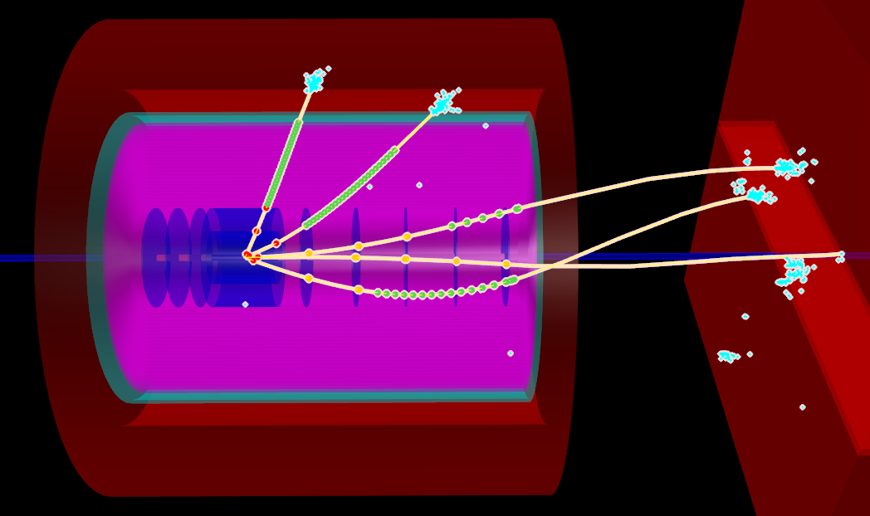
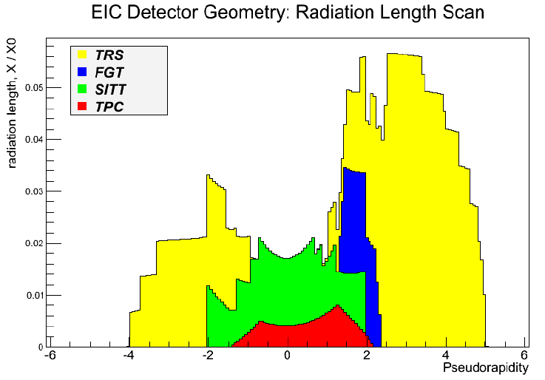
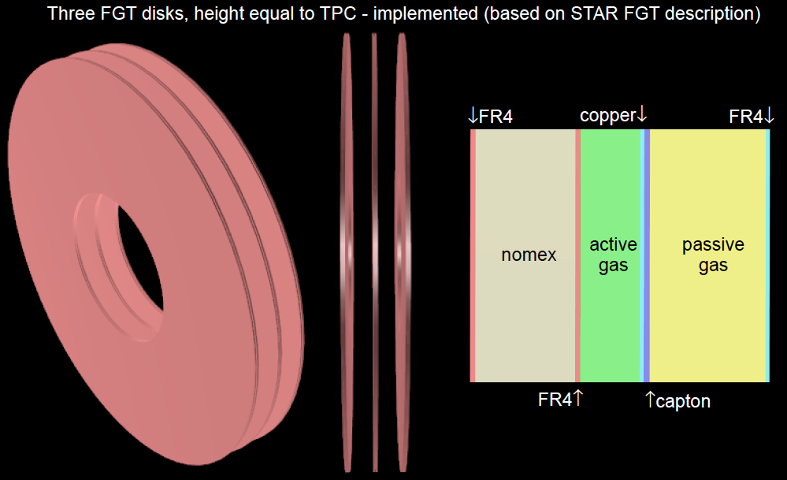
Simulation well ahead
Pythia-event

Slide 20
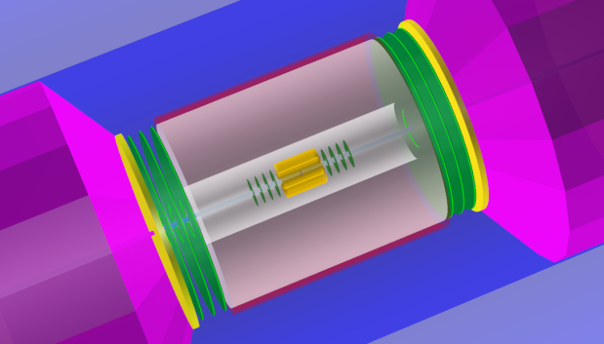
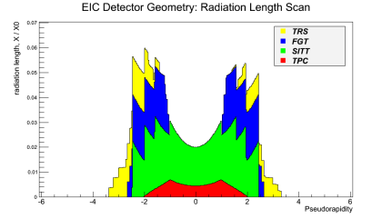
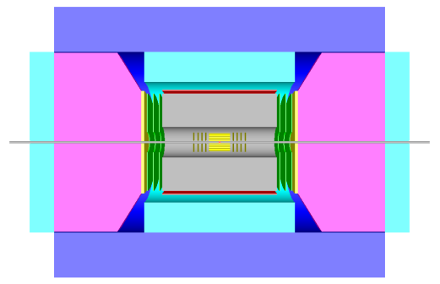
Symmetric version with improved detector model
All FairRoot simulations
done by Yulia Zoulkarneev
FairRoot has also a fast
smearing generator, which
is based on the actual
material budget

Slide 21
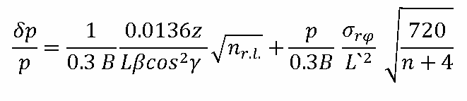
2nd Framework: Fast Smearing Generator
Generic:
  Layers of “Logical” detectors with smearing and acceptance functions
  RICH (Mis)-PID matrix ala HERMES
  Crystal Ball function for Bremsstrahlung tails
Specific:
ZEUS
EMCal "0.18*sqrt(E)"
STAR
EMCal "0.015*E+0.14*sqrt(E)"
HCal "0.35*sqrt(E)"
Tracking "0.0085*p+0.0025*p*p"
Polar Angle "0.0005*p+0.003"
Tracking "0.005*p+0.004*p*p"
Polar Angle "√(0.0003*0.0003+(0.0009/p,2)^2)/√(sin(θ))"

Slide 22
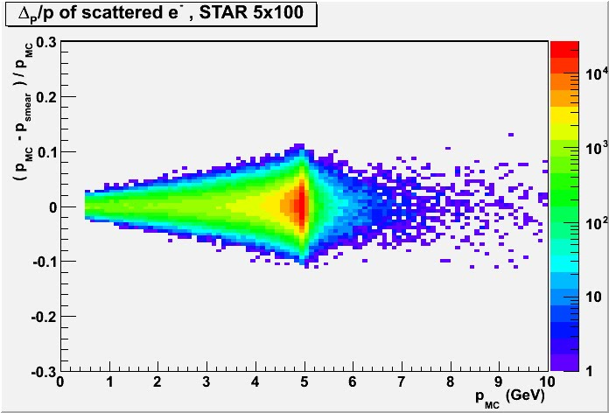
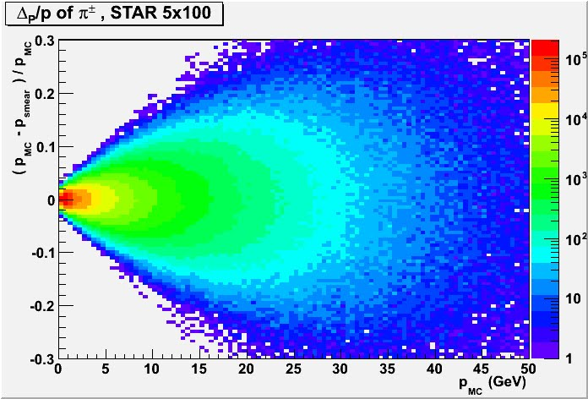
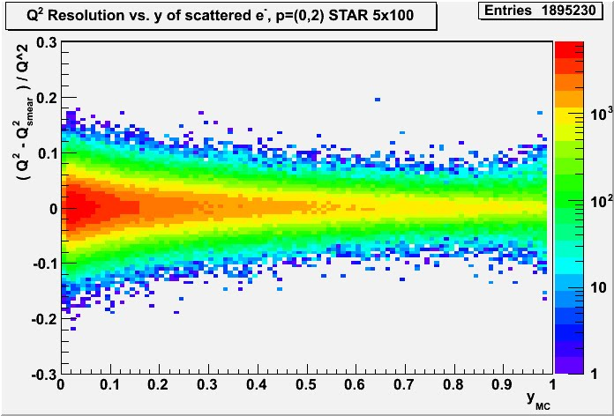
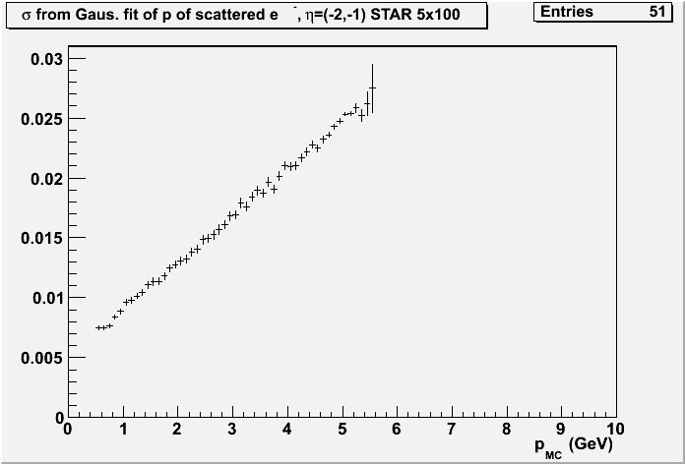

Slide 23
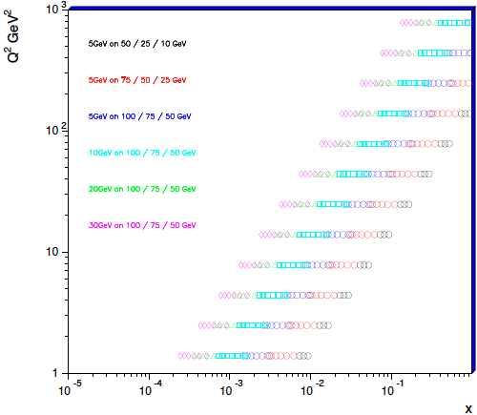
Inclusive Structure functions in eA or why momentum resolutions are important
How to extract F_{L}:
Measure σ_{r} at different √s → vary y
  → F_{L} slope of σ_{r} vs y
  F₂ intercept of σ_{r} vs y with y-axis
Issues:
Lever arm in y
Value of y
  At low y: detector resolution for e’
  At high y: radiative corrections and
  charge symmetric background
Need to combine bins according to the detector resolution
Final y-range needs full MC study

Slide 24
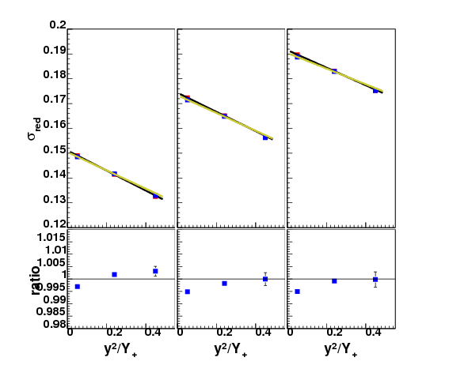
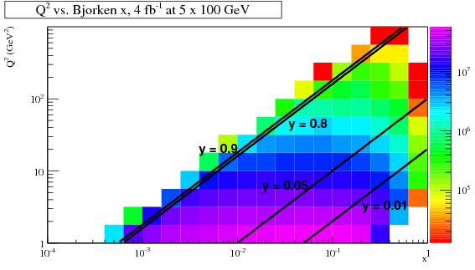
Golden Measurement for Tracking F_{L}
1 GeV < Q² < 1.78GeV
and
3 x points below 10⁻³
no detector effects
with detector smearing

Slide 25
Inclusive Structure functions in eA or why momentum resolutions are important
Good momentum resolution
critical for F_{L}
Systematic uncertainties equally
critical for F_{L}
F2 small effects from either
momentum resolution or/and
systematic uncertainties

Slide 26
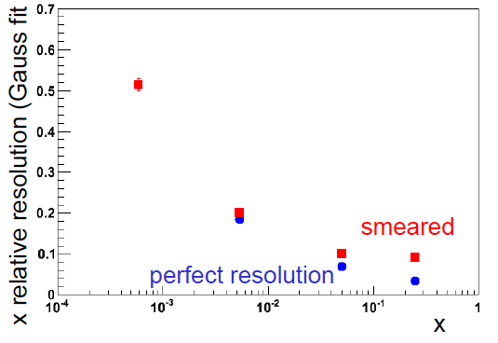

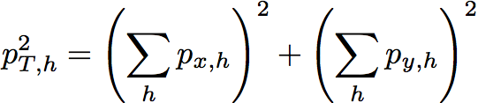
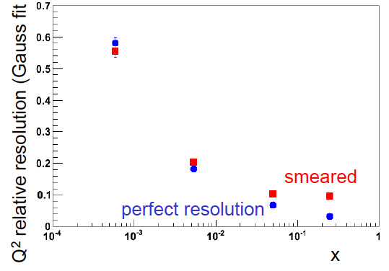



How well does the hadron method work for CC
Jacquet-Blondel method: hadronic final state
  assumption hadrons which escape E=p_{z}
  Needed at low y to compensate bad scattered lepton reconstruction
First look with smearing ala STAR
This is plots have all y
Reason for bad resolution at low x
Need more studies for NC, but all software in place to do

Slide 27
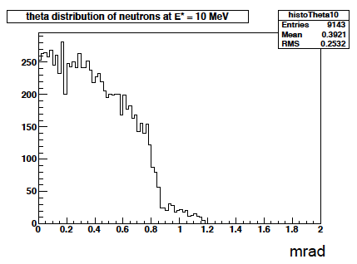
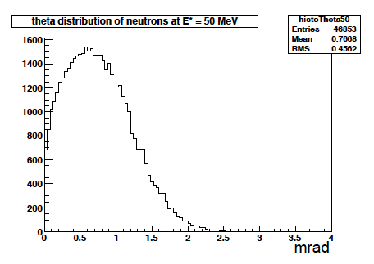
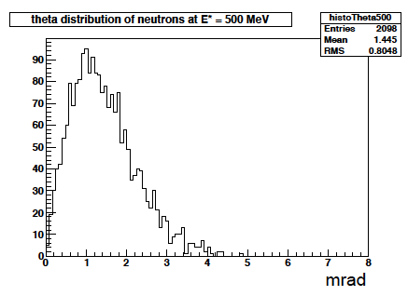
Kinematics of Breakup Neutrons
Results from GEMINI++ for 50 GeV Au
Results:
With an aperture of ±3 mrad we are in relative good shape
• enough “detection” power for t > 0.025 GeV²
• below t ~ 0.02 GeV² we have to look into photon detection
‣ Is it needed?
Question:
For some physics rejection power for incoherent is needed ~10⁴
→ How efficient can the ZDCs be made?
by Thomas Ullrich
+/-5mrad acceptance seems sufficient

Slide 28


Diffractive Physics: p’ kinematics
Diffraction:
t=(p4-p2)² = 2[(mp^{in}.mp^{out})-(E^{in}E^{out} - pz^{in}pz^{out})]
→ “ Roman Pots” acceptance studies see later
?
5x50
p’
5x100
5x250
Simulations by J.H Lee

Slide 29




proton distribution in y vs x at s=20 m
without quadrupole aperture limit
25x250
5x50
with quadrupole aperture limit
25x250
5x50

Slide 30




Accepted in“Roman Pot”(example) at s=20m
25x250
5x50
25x250
5x50
Generated
Quad aperture limited
RP (at 20m) accepted

Slide 31
and Summary
Dedicated detector is essential to do the full eRHIC physics program
  essential to form a eRHIC community with new groups
IR and detector design need to go hand in hand
  Need to look into this for eSTAR
The eRHIC-TF has developed many tools, which could be shared
  Maybe some of the results on the requirements for different physics coming from the eRHIC-TF can be used how to upgrade STAR → eSTAR
what is the cost for a new detector?
  How can the new detector be staged with the staging of the machine
  How do the cost of eSTAR upgrades compare with a new detector taking also the physics capabilities into account

Slide 32
BACKUP

Slide 33
Questions to be answered
H1 and Zeus have been asymmetric detectors (IR not in the center), is this a good idea for the eRHIC detector
What material budget can we tolerate?
What momentum/energy resolution can we tolerate?
What is the vertex-resolution?
What is the optimum coverage of barrel in rapidity (1, 1.5 or 2)
Can we track from the insight out (occupancy in MAPS, resolution mismatch MAPS – TPC)
Can we make a projective ECal in the barrel with the changing kinematics for different beam energy combinations
…………

Slide 34


Combined function magnet with zero field for electron passage Brett Parker-March-2011-BNL
40 cm
Protons/ions enter with offset 22 mm
22 mm
5.4 E-04 T
4.5 cm
2.432 T
0.28 T
0.36 T

Slide 35

Integration into Machine: IR-Design
Outgoing electron direction currently under detailed design
detect low Q² scattered leptons
want to use the vertical bend to separate very low-Θ e’ from beam-electrons
can make bend faster for outgoing beam → faster separation
for 0.1º<Θ<1º will add calorimetry after the main detector
space for
low-Θ e-tagger

Slide 36

The Pillars of the eRHIC Physics program
spin Physics
Hadronisation
Electro Weak
physics of
strong color
fields
3D Imiging
Wide physics program with high requirements on detector and machine performance

Slide 37



Position resolution vs. B-field
electrons: P > 0.5 GeV, 3%X_{o}
4

Slide 38
Deep Inelastic Scattering
Kinematics:
Measure of resolution power
Measure of inelasticity
Measure of momentum fraction of struck quark
e-
p/A
0º 180º
Challenge:
need to cover wide range in beam energies
lepton: 5 - 30 GeV
hadron (p/Au) 100 – 325 GeV / 25 – 130 GeV
Resolution in x, Q² dominated how well the scattered lepton is measured
low momentum: Multiple scattering → low material
high momentum: position resolution from tracking detector
all momenta: Brems-strahlung → low material

Slide 39


How to detect coherent/in-coherent events in ep/A ?
e+p/A → e’+p’/A’ + γ / J/ψ / ρ / φ / jet
Challenges to detect p’/A’
  Beam angular divergence limits smallest outgoing Θ_{min} for p/A that can be measured
  Can measure the nucleus if it is separated from the beam in Si (Roman Pot) “beamline” detectors
    p_{Tmin} ~ p_{z}^{A} θ_{min}
      For beam energies = 100 GeV/n and θ_{min} = 0.1 mrad
  Large momentum kicks, much larger
  than binding energy (~8 MeV)
    For large A, coherently diffractive nucleus
    cannot be separated from beamline
    without breaking up
    → break up neutron detection
    → veto incoherent events
incoherent dominates at a t at 1/e
of coherent cross section
→ p_{t} << p_{tmin}
p_{t}=√t

Slide 40




How to detect coherent/in-coherent events in ep/A ?
Rely on rapidity gap method
  simulations look good
  clear difference between DIS and
  diffractive events
  high eff. high purity
  possible with gap alone
    ~1% contamination
    ~80% efficiency
  depends critical on detector
  hermeticity
    However, reduce the acceptance by 1 or 2 units of rapidity and these values drop significantly
  improve further by veto on
  breakup of nuclei (DIS)
Very critical
  mandatory to detect nuclear
  fragments from breakup
  n: Zero-Degree calorimeter
  p, A frag: Forward Spectrometer
Efficiency
Purity
Rapidity
Rapidity

Slide 41




Latest beam optics for outgoing nominal protons
Beam transport using Hector:
studies by JH
outgoing protons with 20% momentum loss

Slide 42
Kinematics of semi-inclusive hadrons
KAONS:
cuts: Q2>1GeV² && 0.01<y<0.9 && 0.1<z<0.9

Slide 43
Kinematics of scat. electron
cuts: Q2>1GeV² && 0.01<y<0.9

Slide 44
Kinematics of scat. electron
cuts: Q2>0.1GeV² && 0.01<y<0.9

Slide 45

Golden Measurements: Physics of strong color fields
Science Deliverable | Basic Measurement | Detector Requirements | Machine Requirements
integrated gluon distributions nuclear wave fct. saturation, Q_{s} | inclusive DIS F_{2,L} | → very good electron ID very good momentum and angular resolution for e’ | need to reach x~10⁻⁴ large x,Q² coverage → medium lumi highest √s
k_{T}-dependent gluons; gluon correlations non-linear QCD evolution/universality | semi-inclusive DIS di-hadron correlations | very similar to inclusive DIS excellent particle ID → wide coverage range in η | need to reach x~10⁻⁴ large x,Q² coverage → medium lumi highest √s
transport coefficients in cold nuclear matter parton energy loss; shower evolution energy loss mechanism | semi-inclusive DIS; light and heavy hadrons (c,b), Jets | → very good electron ID very good momentum and angular resolution for e’ → excellent particle ID excellent vertex resolution | large x,Q² coverage multi-dim binning → medium - high lumi low - high √s

Slide 46

Golden Measurements: Spin Physics
Science Deliverable | Basic Measurement | Detector Requirements | Machine Requirements
spin structure at small x contribution of Δg, ΔΣ to spin sum rule | inclusive DIS | → very good electron ID very good momentum and angular resolution for e’ | need to reach x=10⁻⁴ large x,Q² coverage about 10fb⁻¹ medium lumi high √s
full flavor separation in large x,Q² range strangeness, s(x)-s(x) polarized sea | semi-inclusive DIS | very similar to inclusive DIS excellent particle ID separate π, K, p over a wide range in η | need to reach x=10⁻⁴ large x,Q² coverage polarized ³He beam medium lumi high √s
electroweak probes of proton structure flavor separation electroweak parameters | very high Q² hadronic final state | very good coverage for hadronic final state → kinematic from q-jet | 20x250 to 30x325 positron beam polarized ³He beam high lumi highest √s

Slide 47
Golden Measurements: 3D-Imaging in b_{T} / k_{T}
Science Deliverable | Basic Measurement | Detector Requirements | Machine Requirements
Sivers + unpol PDF valence, sea quarks & gluons quantum interference multiparton correlations spin-orbit correlations & role of OAM matching low-high p_{T} | semi-inclusive DIS transverse nucl. pol. di-hadron/(di-jets) heavy-flavor production | → very good electron ID very good momentum and angular resolution for e’ excellent particle ID separate π, K, p over a wide range in η full Φ-coverage around γ* excellent vertex res. | large x,Q² coverage 5D binning high lumi low - high √s
chiral odd fcts. valence, sea quarks & gluons transversity & IFF Collins-FF Boer-Mulders fct. | semi-inclusive DIS | as above | as above
quark and gluon imaging via GPDs in b_{T}-space access to L_{q} and L_{g} | exclusive DIS DVCS, J/Ψ, ρ, Φ | → very good electron ID very good momentum and angular resolution for e’ → exclusivity and high resolution in t → Roman pots | large x,Q²,t coverage 4D binning polarized beams high lumi low - high √s

Slide 48

What can PHENIX and STAR do?
MPC 3.1 < | η | < 3.9
2.5º < Θ < 5.2º
Muon Arms 1.2 < | η | < 2.4
South: 12º < Θ < 37º
North: 10º < Θ < 37º
Central Arms | η | < 0.35
60º < Θ < 110º
scattered lepton can only be
detected at mid-rapidity
| η | < 0.35 very high Q²
no acceptance for TMD/GPD
physics
small acceptance for semi-inclusive
physics
PHENIX:
in its current incarnation it is not suited
for eRHIC physics
p/A
e-

Slide 49



The New PheniX Spectrometer
Design completely driven by AA, dA and pp physics program
p/A
e-
What can be done:
inclusive physics → reasonable coverage for scattered lepton
  but need to close the gap between 1<η<2
  high mass tracking → Q² – x resolution
semi-inclusive physics
  no PID in central detector and hadron beam direction
  will loose significant part of the physics program
exclusive physics program
  limited acceptance for coherent physics
    but need to add roman pots
  design is not suited for rapidity gap events
Design not compatible with most of the eRHIC physics program

Slide 50

STAR Experiment as of 2014
MRPC ToF Barrel
MTD
EMC Barrel
EMC End Cap
FMS
BBC
FPD
TPC
Roman Pots
Phase 2
computing
DAQ1000
COMPLETE
Trigger and DAQ
Upgrades
FGT
HFT
Ongoing
R&D

Slide 51




eRHIC phase 1: kinematic range
5 GeV e + 50 GeV/nucleon
5 GeV e + 325 GeV/nucleon
Inclusive physics
  “Forward” (-2.5 <~ η < -1) electron acceptance essential to span deep-inelastic (DIS) regime
semi-inclusive physics
  need to investigate how well PID coverage is matched to SIDIS kinematics
  Both backward and forward hadron coverage valuable for SIDIS
exclusive physics program
  Need forward proton and expanded photon detection (→DVCS)
    Roman pots (also valuable for spectator proton tagging in e+³He)
  EM calorimetry for -4 < η < -1
  rapidity gap event acceptance needs to be checked
DIS region
TPC+
BEMC+TOF
Missing today
EEMC+FGT
SIDIS region
Missing today
Missing today

Slide 52

Evolving from STAR into eSTAR
proton
nucleus/electron
Lepton Beam Direction:
ToF: π, K identification, t₀, electron
ECal: electrons and photons
GCT:
a compact tracker with enhanced electron capability
Combine high-threshold (gas) Cherenkov with TPC(-like) tracking
Hadron Beam Direction:
optimized for p+A and transverse spin physics
  Charged-particle tracking
  e/h and γ/π⁰ discrimination
  Baryon/meson separation
What is the momentum resolution at forward rapidity (B=0.5T too low?)
~ 6 GEM disks
Tracking: 2.5 < η < 4
FMS
FHC
ToF
ECal
TPC i.s.
GCT
W powder HCal
TPC i.s.
Preshower
1/2” Pb radiator
Shower “max”
RICH
Baryon/meson separation
Design closer to eRHIC physics program needs
But: need to simulate golden measurements to understand the details
EIC Generic Detector R&D Panel:
GCT: LOI toward multi-institution R&D effort
HCal: R&D proposal

Slide 53
The Physics we want to study
What is the role of gluons and gluon self-interactions in nucleons and nuclei?
  Observables in eA / ep:
    elastic/diffractive events: rapidity gap events, elastic VM production, DVCS
    inclusive events: structure functions F₂^{A}, F_{L}^{A}, F_{2c}^{A}, F_{Lc}^{A}, F₂^{p}, F_{L}^{p},………
What is the internal landscape of the nucleons?
  What is the nature of the spin of the proton?
    Observables in ep
      inclusive & semi-inclusive events: Asymmetries → polarized cross-sections,
      inclusive events: electroweak Asymmetries (γ-Z interference, W^{+/-})
  What is the three-dimensional spatial landscape of nucleons?
    Observables in ep/eA
      semi-inclusive events: single spin asymmetries (TMDs)
      elastic/diffractive events: cross sections, SSA of exclusive VM, PS and DVCS (GPDs)
What governs the transition of quarks and gluons into pions and nucleons?
  Observables in ep / eA
    semi-inclusive events: cross sections, R_{eA}, azimuthal distributions, jets

Slide 54






What will the current PheniX see
p_{e}: 0-1 GeV
p_{e}: 1-2 GeV
p_{e}: 2-3 GeV
p_{e}: 3-4 GeV
4x100
Current PheniX detector
not really useable for
DIS
acceptance not matched to DIS kinematics
4x100
4x100

Slide 55






What can we detect
p_{e}: 0-1 GeV
p_{e}: 1-2 GeV
p_{e}: 2-3 GeV
p_{e}: 3-4 GeV
No dependence on hadron beam energy
Q²>0.1GeV²
4GeV → >5º
10GeV → >2º
20GeV → >1º
New PheniX has close to full coverage for scattered lepton
4x50
Forward upgrade
identified hadrons
5 GeVx50GeV
4x100
20 GeV x 250 GeV
central arm
unidentified
North μ arm
only muons

Slide 56
Processes used to study the Physics
exclusive /diffractive
reactions
ep/A → e’p’/A’VM
semi-inclusive
reactions
ep/A→ e’πX
inclusive
reactions
ep/A → e’X
electro-weak
reactions
Close to 4π
acceptance
Excellent
electron
identification
Background
suppression
good jet
identification
PID:
to identify
Hadrons
Detect
outgoing
scattered
proton
excellent
absolute
and/or
relative
luminosity
Detect
very low Q²
electron
very precise
polarization
measurement
high demands on
momentum and/or
energy resolution
good vertex
resolution

Slide 57
February 12, 2011, IP configuration for eRHIC
1.045 m
1.719 m
1.95 m
5.475 m
1.1m
1.057 m
p_{c}/2.5
1.902 m
D=120 mm
θ=10 mrad
θ=4 mrad
1.9 cm (p_{o}/2.5)
ZDC
4.50 m
θ=10 mrad
IP
2
4
6
8
10
12
14
16
Combined function:
1.6 m, 2.230 T, -109 T/m
Θ=4 mrad
beam
neutrons
D=120 mm

Slide 58

Design Nikolai Smirnov, CDF (BaBar) magnet
Magnet, R=1.5 m,
dZ=2.4 m
B-field = 1.4 T
4 layers of Si-vertex
detector
“small “, low diffusion,
fast TPC (~ 25 pad rows)
With “HBD performance”
Aerogel Ch. D.
EMCAL
HCAL + Muon Detector
2 layers of MicroPattern Gas Det R position = 64, 100 cm

Slide 59
Design Nikolai Smirnov, CDF (BaBar) magnet II
Magnet, R=1.5 m,
dZ=2.4 m
B-field = 1.4 T
4 layers of Si-vertex detector
“small” low diffusion,
fast TPC
(~ 25 pad rows)
“HBD”; CF4 Ch. D.
Aerogel Ch. D.
EMCAL
HCAL + Muon Detector
2 layers of MicroPattern Gas Det R position = 64, 100 cm

Slide 60
Kinematics of scat. electron
cuts: Q2>0.1GeV² && 0.01<y<0.9

Slide 61
Kinematics of semi-inclusive hadrons
PROTONS:
cuts: Q2>1GeV² && 0.01<y<0.9 && 0.1<z<0.9

Slide 62
Kinematics of exclusive hadrons
J/ψ → e^{+/-}/ μ^{+/-}:
no cuts

Slide 63
Deep Inelastic Scattering
Kinematics:
Measure of resolution power
Measure of inelasticity
Measure of momentum fraction of struck quark
Inclusive events:
e+p/A → e’+X
detect only the scattered lepton in the detector
Semi-inclusive events:
e+p/A → e’+h(π,K,p,jet)+X
detect the scattered lepton in coincidence with identified hadrons/jets in
the detector

Slide 64

Probing Gluonic Structure of Nuclear Forces
Basic Idea:
Exclusive diffractive VM production
eA → e’A’V
dσ_{A}/dt → F_{g}(b)
Promising method to measure gluon form
factor in nuclei
→ long wavelength gluons (small t)
Raju: E*=-t/2m_{N}
Experimental Requirement:
Photo-production c.s. large &
|t| ~ p_{t}²(VM)
J/Ψ easy to detect for |η| < 2 well
separated from background
Crucial: detecting breakup of nuclei
Need e’ to measure t for Q²>10⁻³ GeV²
somewhat shaky region

Slide 65
Magnetic Field: Super simple resolution estimates
Multiple scattering contribution:
Intrinsic contribution (first term):
z = charge of particle
L = total track length through detector (m)
γ= angle of incidence w.r.t. normal of detector plane
n_{r.l.} = number of radiation lengths in detector
msc
B=central field (T)
σ_{rφ}=position resolution (m)
L’=length of transverse path through field (m)
N=number of measurements
intr
Assumptions:
  circular detectors around interaction point
  n_{r.l.} = 0.03 (from Hall D CDC)

Slide 66


“Easier” Solenoid Field – 2T vs. 4T?
p = 50 GeV
p = 5 GeV
B=2T
B=4T
Intrinsic contribution ~ 1/B
Multiple scattering contribution ~ 1/B

Slide 67


Multiple scattering contribution
p = 50 GeV
p = 5 GeV
Multiple scattering contribution dominant at small angles (due to B_{T} term in denominator) and small momenta

Slide 68


δp/p angular dependence
p = 50 GeV
p = 5 GeV
Can improve resolution at forward angles by offsetting IP

Slide 69


Solenoid and Dipole field
p = 50 GeV
p = 5 GeV
As expected, substantially improves resolutions at small angles

Slide 70
Magnetic Field Considerations
Solenoid Fields – Overview:
Experiment | Central Field | Length | Inner Diameter
ZEUS | 1.8 T | 2.8 m | 0.86 m
H1 | 1.2T | 5.0 m | 5.8 m
BABAR | 1.5T | 3.46 m | 1.4 m
BELLE | 1.5T | 3.0 m | 1.7 m
GlueX | 2.0T | 3.5 m | 1.85 m
ATLAS | 2.0T | 5.3 m | 2.44 m
CMS | 4.0T | 13.0 m | 5.9 m
PANDA^{(*design)} | 2.0T | 2.75m | 1.62 m
CLAS12^{(*design)} | 5.0T | 1.19 m | 0.96 m
Suggest 4-5m long Solenoid with diameter ~3m and B-Field of ~3T
need dipoles in forward direction for particles
with very small scattering angle

Slide 71

Some Info on RadCors
Inclusive cross section
  σ_{tot} = σ_{ela} + σ_{qela} + σ_{inel +} σ_{v}
    for all parts photons can be radiated from the incoming and outgoing lepton, high Z-material Compton peak.
      radiation is proportional to Z² of target, like bremsstrahlung
      radiation is proportional to 1/m² of radiating particle
  elastic:
  quasi-elastic: scattering on proton of nuclei
    proton stays intact
    nuclei breaks up
  two photon exchange? Interference terms?
initial
final
vacuum loops

Slide 72
Why are RadCor important?
Modify kinematics → Q²:
  initial state: E’_{beam} = E_{beam} – E_{γ}
    photon goes along the beam line
  final state: E’_{out} = E_{out} – E_{γ}
    photon goes somewhere in Calo
RadCor and detector smearing don’t factorize
  need to have RadCor implemented in MC to unfold effects on kinematics
  unfolding in bins
    N_{true}=N_{meas}-N_{bckg}
events
smeared into
acceptance

Slide 73
Technology choices and needed R&D
Some thoughts about technologies
  LHC trackers have all to much radiation length
    GEM trackers and ILC Si detectors would be much better
  Forward calorimeters small moliere radius → PbWO₄
    especially important for hadron direction → DVCS
    Preshower: γ −π⁰ separation → Si-WO
  Central calorimeter
    needs to be compact with a pointing geometry
Needed R&D
  low mass trackers
  compact and wide momentum covering PID
  compact calorimetry for inside solenoid
  ion polarimetry → currently at best 5% systematic uncertainty at RHIC

Slide 74
STAR → eSTAR
Optimizing STAR for e+p and e+A collisions from 5+50 to 5+325 GeV
Inclusive scattering over the entire deep-inelastic region
  Key measurements
    F_{L} in e+p and e+A: direct measure of gluon densities in nucleons and nuclei
    g₁ in e+p and e+³He: nucleon spin structure
    F₂^{A}/F₂^{d}: parton distributions in nuclei (including gluons via Q² evolution)
  Need electron detection, ID, and triggering over -2.5 <~ η < -1
    Combined mini-TPC/threshold gas Cherekov detector
Semi-inclusive deep-inelastic scattering over a broad (x,Q²) domain
  Key measurements
    Flavor-separated helicity distributions, including strangeness
    Collins, Sivers, Boer-Mulders, and other transverse spin distributions
    Flavor-separated parton distributions in nuclei, including strangeness
    Parton energy loss in cold nuclear matter
  Need hadron detection and identification beyond the TPC/EEMC
    Extend TOF to cover -2 < η < -1
    GEM disks (from forward instrumentation upgrade) plus hadronic calorimetry in the region 2 < η < 3
Deeply-virtual Compton scattering
  Key measurement
    GPDs
  Need forward proton and expanded photon detection
    Roman pots (also valuable for spectator proton tagging in e+³He)
    EM calorimetry for -4 < η < -1

Slide 75


Detection efficiency of Breakup Neutrons
Results:
With an aperture of ±3 mrad we are in relative good
shape even for 50 GeV Au beams
• enough “detection” power for t > 0.025 GeV²
• below t ~ 0.02 GeV² we have to look into photon detection
‣ Is it needed?
Assumptions:
• Gemini++ is correct, was verified by SMM
• E* ~ -t/2mN
• Can we make a ZDC 100% (>99.9999%) efficient
‣ do we understand neutron detection on the 10⁻⁴ level?

Slide 76


First Model of eRHIC Detector
Si-Vertex
as Zeus
Central Tracker
as BaBar
Traditional
Drift-Chambers
better GEM-Tracker
Hadronic
Calorimeter
Dual-Radiator
RICH
as LHCb /
HERMES
EM-Calorimeter
PbGl
High Threshold
Cerenkov
fast trigger on e’
e/h separation
DIRC: not shown because of cut;
modeled following Babar
no hadronic calorimeter and μ-ID jet
  CALIC technology combines μID with HCAL

Slide 77
Deep Inelastic Scattering
Kinematics:
e’
Measure of resolution power
e
γ
γ_{L}*
(Q²)
x+ξ
x-ξ
Measure of inelasticity
~
~
H, H, E, E (x,ξ,t)
p
p’
Measure of momentum fraction of struck quark
t
Exclusive events:
e+p/A → e’+p’/A’+γ / J/ψ / ρ / φ
detect all event products in the detector
Special sub-event category rapidity gap events
e+p/A → e’+γ / J/ψ / ρ / φ / jet
don’t detect p’ → HERA: 20% non-exclusive event contamination
missing mass technique as for fixed target does not work → resolution

