Slide 1
Collected Luminosity with transverse Polarization
Year | √s [GeV] | Recorded PHENIX | Recorded STAR | Pol [%]
2001 (Run 2) | 200 | 0.15 pb⁻¹ | 0.15 pb⁻¹ | 15
2003 (Run 3) | 200 | / | 0.25 pb⁻¹ | 30
2005 (Run 5) | 200 | 0.16 pb⁻¹ | 0.1 pb⁻¹ | 47
2006 (Run 6) | 200 | 2.7 pb⁻¹ | 8.5 pb⁻¹ | 57
2006 (Run 6) | 62.4 | 0.02 pb⁻¹ |  | 53
2008 (Run8) | 200 | 5.2 pb⁻¹ | 7.8 pb⁻¹ | 45
2011 (Run11) | 500 | / | 25 pb⁻¹ | ~50
a sampled 16 pb⁻¹ in Run-12 would allow to study different
observables, which can distinguish Sivers from transversity x Collins
contribution to A_{N} with a high statistics dataset
and resolve a theory puzzles

Slide 2
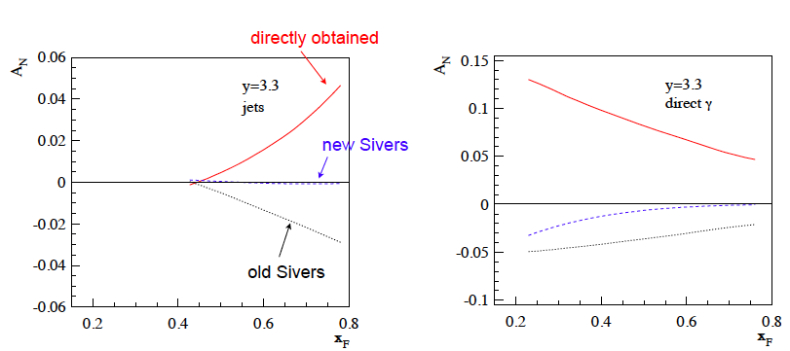
Theory Puzzle: TMD vs. Twist-3
A_{N} for jets and/or direct photon will resolve things
arXiv:1103.1591
Directly obtained: twist-3 extraction from π⁰ A_{N}
New Sivers: extracted in TMD formalism new SIDIS-data; Anselmino 2009
Old Sivers: earlier extraction in TMD formalism from SIDIS-data; Anselmino 2005

Slide 3
What to measure at 200 GeV p↑p
SIVERS
Transversity x Collins
A_{N} for jets in FMS
A_{N} for direct photons in FMS
A_{N} for J/ψ do we see
the same as PHENIX
π^{+/-}π⁰ azimuthal distribution in jets
mid to forward rapidity
Interference fragmentation function
→ mid to forward rapidity
A_{N} for π⁰ and η in FMS with increased p_{t} coverage
Combined with 2011 transverse 500 GeV data
Powerful dataset to attack A_{N} mystery

Slide 4
Some Projections for how well we will do
Statistical error estimate shown is for
20 pb⁻¹ and 60% polarisation,
→ 16pb⁻¹ therefore error bars projected
to be ~10% larger than shown.

Slide 5
BACKUP

Slide 6
Spin-Dependent Fragmentation
Collins fragmentation function
J. C. Collins, Nucl. Phys. B396, (1993) 161
h
_


quark
quark
h
Interference fragmentation function H₁<(z,M²_{ππ} )
J. Collins, S.Heppelmann, G. Ladinsky, Nuclear Physics B, 420 (1994) 565
h₁
h₂
Quark spin
Perfectly matched to large acceptance of STAR
_


quark
quark
h₂
h₁

Slide 7
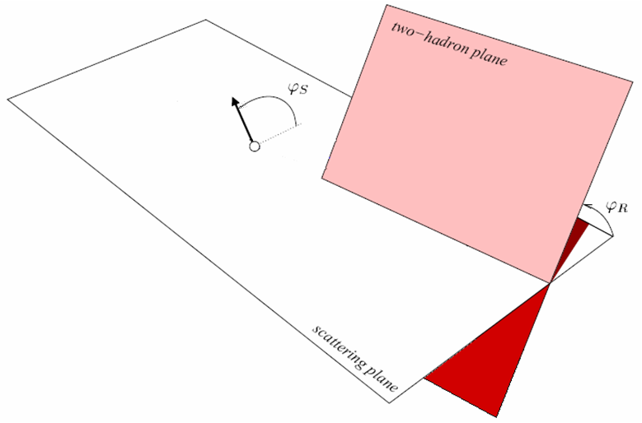
IFF Definitions
Bacchetta and Radici, PRD70, 094032 (2004)

Slide 8
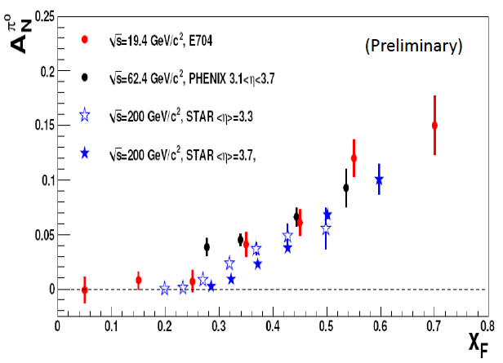
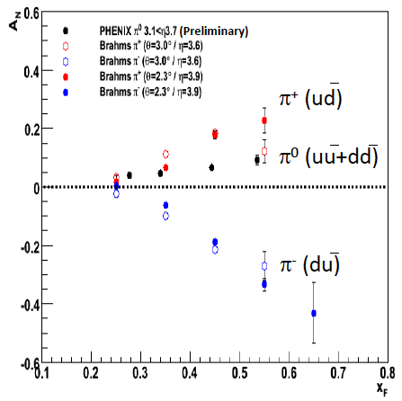
What is seen at RHIC
No strong dependence on s from 19.4 to 200 GeV
Spread probably due to different acceptance in pseudorapidity and/or p_{T}
x_{F} ~ <z>P_{jet}/P_{L} ~ x : shape induced by shape of Collins/Sivers
Sign also consistent with Sivers and/or Transversity x Collins

Slide 9
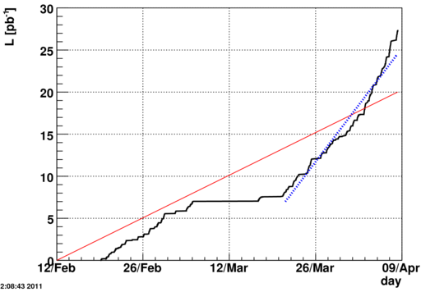
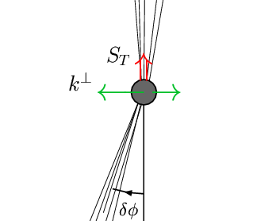
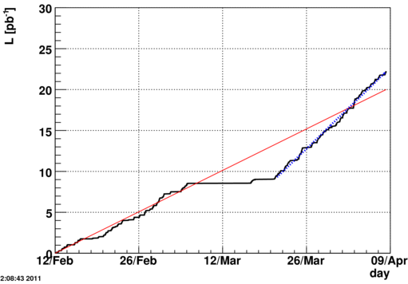
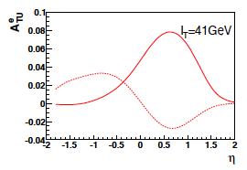
STAR: Upcoming physics topics
Sampled Luminosity for STAR FY11 pp 500 Transverse data set
Forward Meson Spectrometer
With projection
Goal = 20 pb⁻¹
Final = ~ 27.4 pb⁻¹
~137%
Nice data set to study
A_{N} – jet: → Sivers fct.
A_{N} for single lepton from W^{+/-}:
Sign change in Sivers fct. compared to SIDIS
A_{N} for dijets: Sivers fct. via back to back
imbalance of 2 jets
Calorimeter High Tower
With projection
Goal = 20 pb⁻¹
Final = ~ 22.2 pb⁻¹
~111%
Analysis to be done by:
Thomas P Burton
Alan Dion
Salvatore Fazio
William B. Schmidke
Dimitri Smirnov
e+
e-

Slide 10
Collected Luminosity with longitudinal Polarization
Year | √s [GeV] | Recorded PHENIX | Recorded STAR | Pol [%]
2002 (Run 2) | 200 | / | 0.3 pb⁻¹ | 15
2003 (Run 3) | 200 | 0.35 pb⁻¹ | 0.3 pb⁻¹ | 27
2004 (Run 4) | 200 | 0.12 pb⁻¹ | 0.4 pb⁻¹ | 40
2005 (Run 5) | 200 | 3.4 pb⁻¹ | 3.1 pb⁻¹ | 49
2006 (Run 6) | 200 | 7.5 pb⁻¹ | 6.8 pb⁻¹ | 57
2006 (Run 6) | 62.4 | 0.08 pb⁻¹ |  | 48
2009 (Run9) | 500 | 14 pb⁻¹ | 10 pb⁻¹ | 39
2009 (Run9) | 200 | 16 pb⁻¹ | 25 pb⁻¹ | 55
2011 (Run11) | 500 | 27.5 / 9.5pb⁻¹ | 12 pb⁻¹ | ~50%

