Slide 1

A possible Design for a forward RICH

Slide 2
A RICH @ STAR
Main physics interests
  Flavour separation for transverse asymmetries
  Spin transfer measurements
  eRHIC: hadrons at high rapidity for 5 GeV x 100 GeV
Important Considerations
  Momentum resolution → Talk by Anselm
  Space constrains
  Needed momentum coverage
  Impact of fringe magnetic field on photon detector

Slide 3
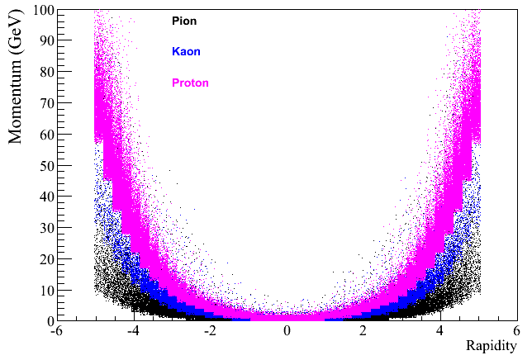
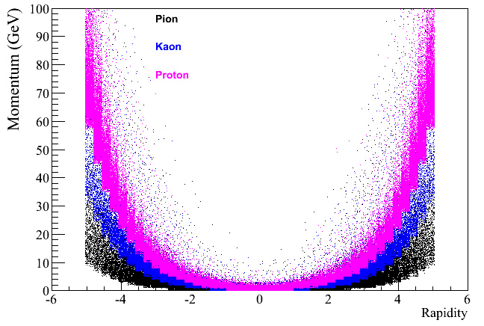
Needed Momentum Coverage
100GeV x 100GeV
250GeV x 250GeV
Momentum Coverage needed:
1-100 GeV
In general needs are very
similar to RICH detectors in
fixed target experiments or
forward spectrometers
Decadal Plan:
concentrate on 2<rapidiy<4

Slide 4
THE FAMILY OF RICH COUNTERS
With focalization
Extended radiator
(gas)
the only approach
at high momenta
(p > 5-6 GeV/c)
EXAMPLES: SELEX,
OMEGA, DELPHI, SLD-CRID, HeraB,
HERMES, COMPASS, LHCb
Proximity focusing
thin radiator
(liquid, solid)
Effective at low
momenta
(p < 5-6 GeV/c)
EXAMPLES: STAR,
ALICE HMPID,
CLEO III
DIRC (Detection of Internally Reflected Cherenkov light)
Quartz as radiator and as light guide
Effective at low momenta
(p < 5-6 GeV/c)
The only existing DIRC was in
operation at BABAR
PANDA is planning two

Slide 5
RICH Design Equations
Cherenkov threshold equation: cos θ_{c}= 1/βn
All light is emitted at a fixed Cherenkov angle to the direction of flight of a particle
θ_{c}=√(2δ-1/γ²) δ=n-1 radiator index of refraction
γ particle velocity
N_{pe}=N₀Lθ_{c}² L radiator length
N₀ figure of merit
Transforming that light to the focal plane of a mirror transforms a ring in angle space to a ring in coordinates
R=Fθ_{c} F mirror focal length
Single photon counting - statistics really applies (no charge sharing)
σ_{<R>}=σ_{R}/√(N_{PE)} σ_{R} photon pixel resolution
Isochronous - all photons reach the focal plane at the same time

Slide 6
SINGLE PHOTON DETECTORS
the requests:
QE: high QE (above standard PMT photocathodes having peak-values of 20-25 %)
r: rate capabilities (> 100 kHz/ mm²)
t: time resolution below 100 ps
B: insensitivity to high magnetic fields (B=1T and more)
$: reasonable costs to make large systems affordable
L: Large area and wide angular acceptance of each single sensor
the approaches:
Poly- and nano-crystalline diamond-based photocathodes (QE)
Photocathodes based on C nanotubes (QE)
Hybrid avalanche photodiodes HAPD (B)
Si photomultipliers (QE,r,t,B)
Microchannel plate (MCP) PMTs (B,t)
Micro Pattern Gas Detectors (MPGD) + CsI (r, B, $)
Large, wide aperture (hybride) PMTs (L)
promising
for a far
future
astroparticle experiments

Slide 7
SINGLE PHOTON DETECTORS
single photon detectors :
the CENTRAL QUESTION since the beginning of the RICH era
3 groups (with examples, not exhaustive lists)
Vacuum based PDs
PMTS (SELEX, Hermes, BaBar DIRC)
MAPMTs (HeraB, COMPASS RICH-1 upgrade)
  Flat pannels (various test beams, proposed for CBM)
Hybride PMTs (LHCb)
MCP-PMT (all the studies for the high time resolution applications)
Gaseous PDs
Organic vapours - in practice only TMAE and TEA (Delphi, OMEGA, SLD CRID, CLEO III)
Solid photocathodes and open geometry (HADES, COMPASS, ALICE, JLAB-HALL A)
Solid photocathodes and closed geometries (PHENIX HBD, even if w/o imaging)
Si PDs
Silicon PMs (only tests till now)

Slide 8
LARGE SENSITIVE AREAS ↔ GASEOUS PDs
photoconverting vapours are no longer in use, a part CLEO III
(rates ! time resolution !)
the present is represented by MWPC (open geometry!) with CsI
  the first prove (in experiments !) that coupling solid photocathodes and gaseous detectors works
  Severe recovery time (~ 1 d) after detector trips ion feedback →
  Aging CsI ion
  Moderate gain: < 10⁵ (effective gain: <1/2) bombardment
The way to the future: ion blocking geometries
  GEM/THGEM allow for multistage detectors
    With THGEMs: High overall gain ↔ pe det. efficiency!
    Good ion blocking (up to IFB at a few % level)
    MHSP: IFB at 10⁻⁴ level
      opening the way to the physicists’ dream (Philosopher’s Stone):
      Gaseous detectors with solid photocathodes for visible light
    (this is for far future)
  PHENIX HBD – first application
  noise performance: pedestal rms 0.15 fC or 0.2 p.e. at a gain of 5000,
  but several pe/channel
  Photon detector – 1 m²

Slide 9
RADIATOR MATERIALS
the “low momentum” domain <10 GeV/c: Aerogel vs quartz
  Aerogel
    Separation up to higher momenta (but Rayleight, transmission …)
    Lower density → smaller perturbation of particle trajectories, limited number of photons (variable index of refraction to partially overcome)
    Progresses in aerogel production
  Quartz
    θ saturation at lower momenta (but removing chromaticity…)
    high density → large number of photons, trajectory perturbation
    excellent transparency, excellent mechanical characteristics →
    detectors of the DIRC family
the “high momentum” domain > 10 GeV/c: gas radiators
    low density gasses for the highest momenta or the best resolutions (NA62)
    Still a major role played by C-F gasses; availability of C₄F₁₀ …
    Gas systems for purity (transparency) and pressure control

Slide 10
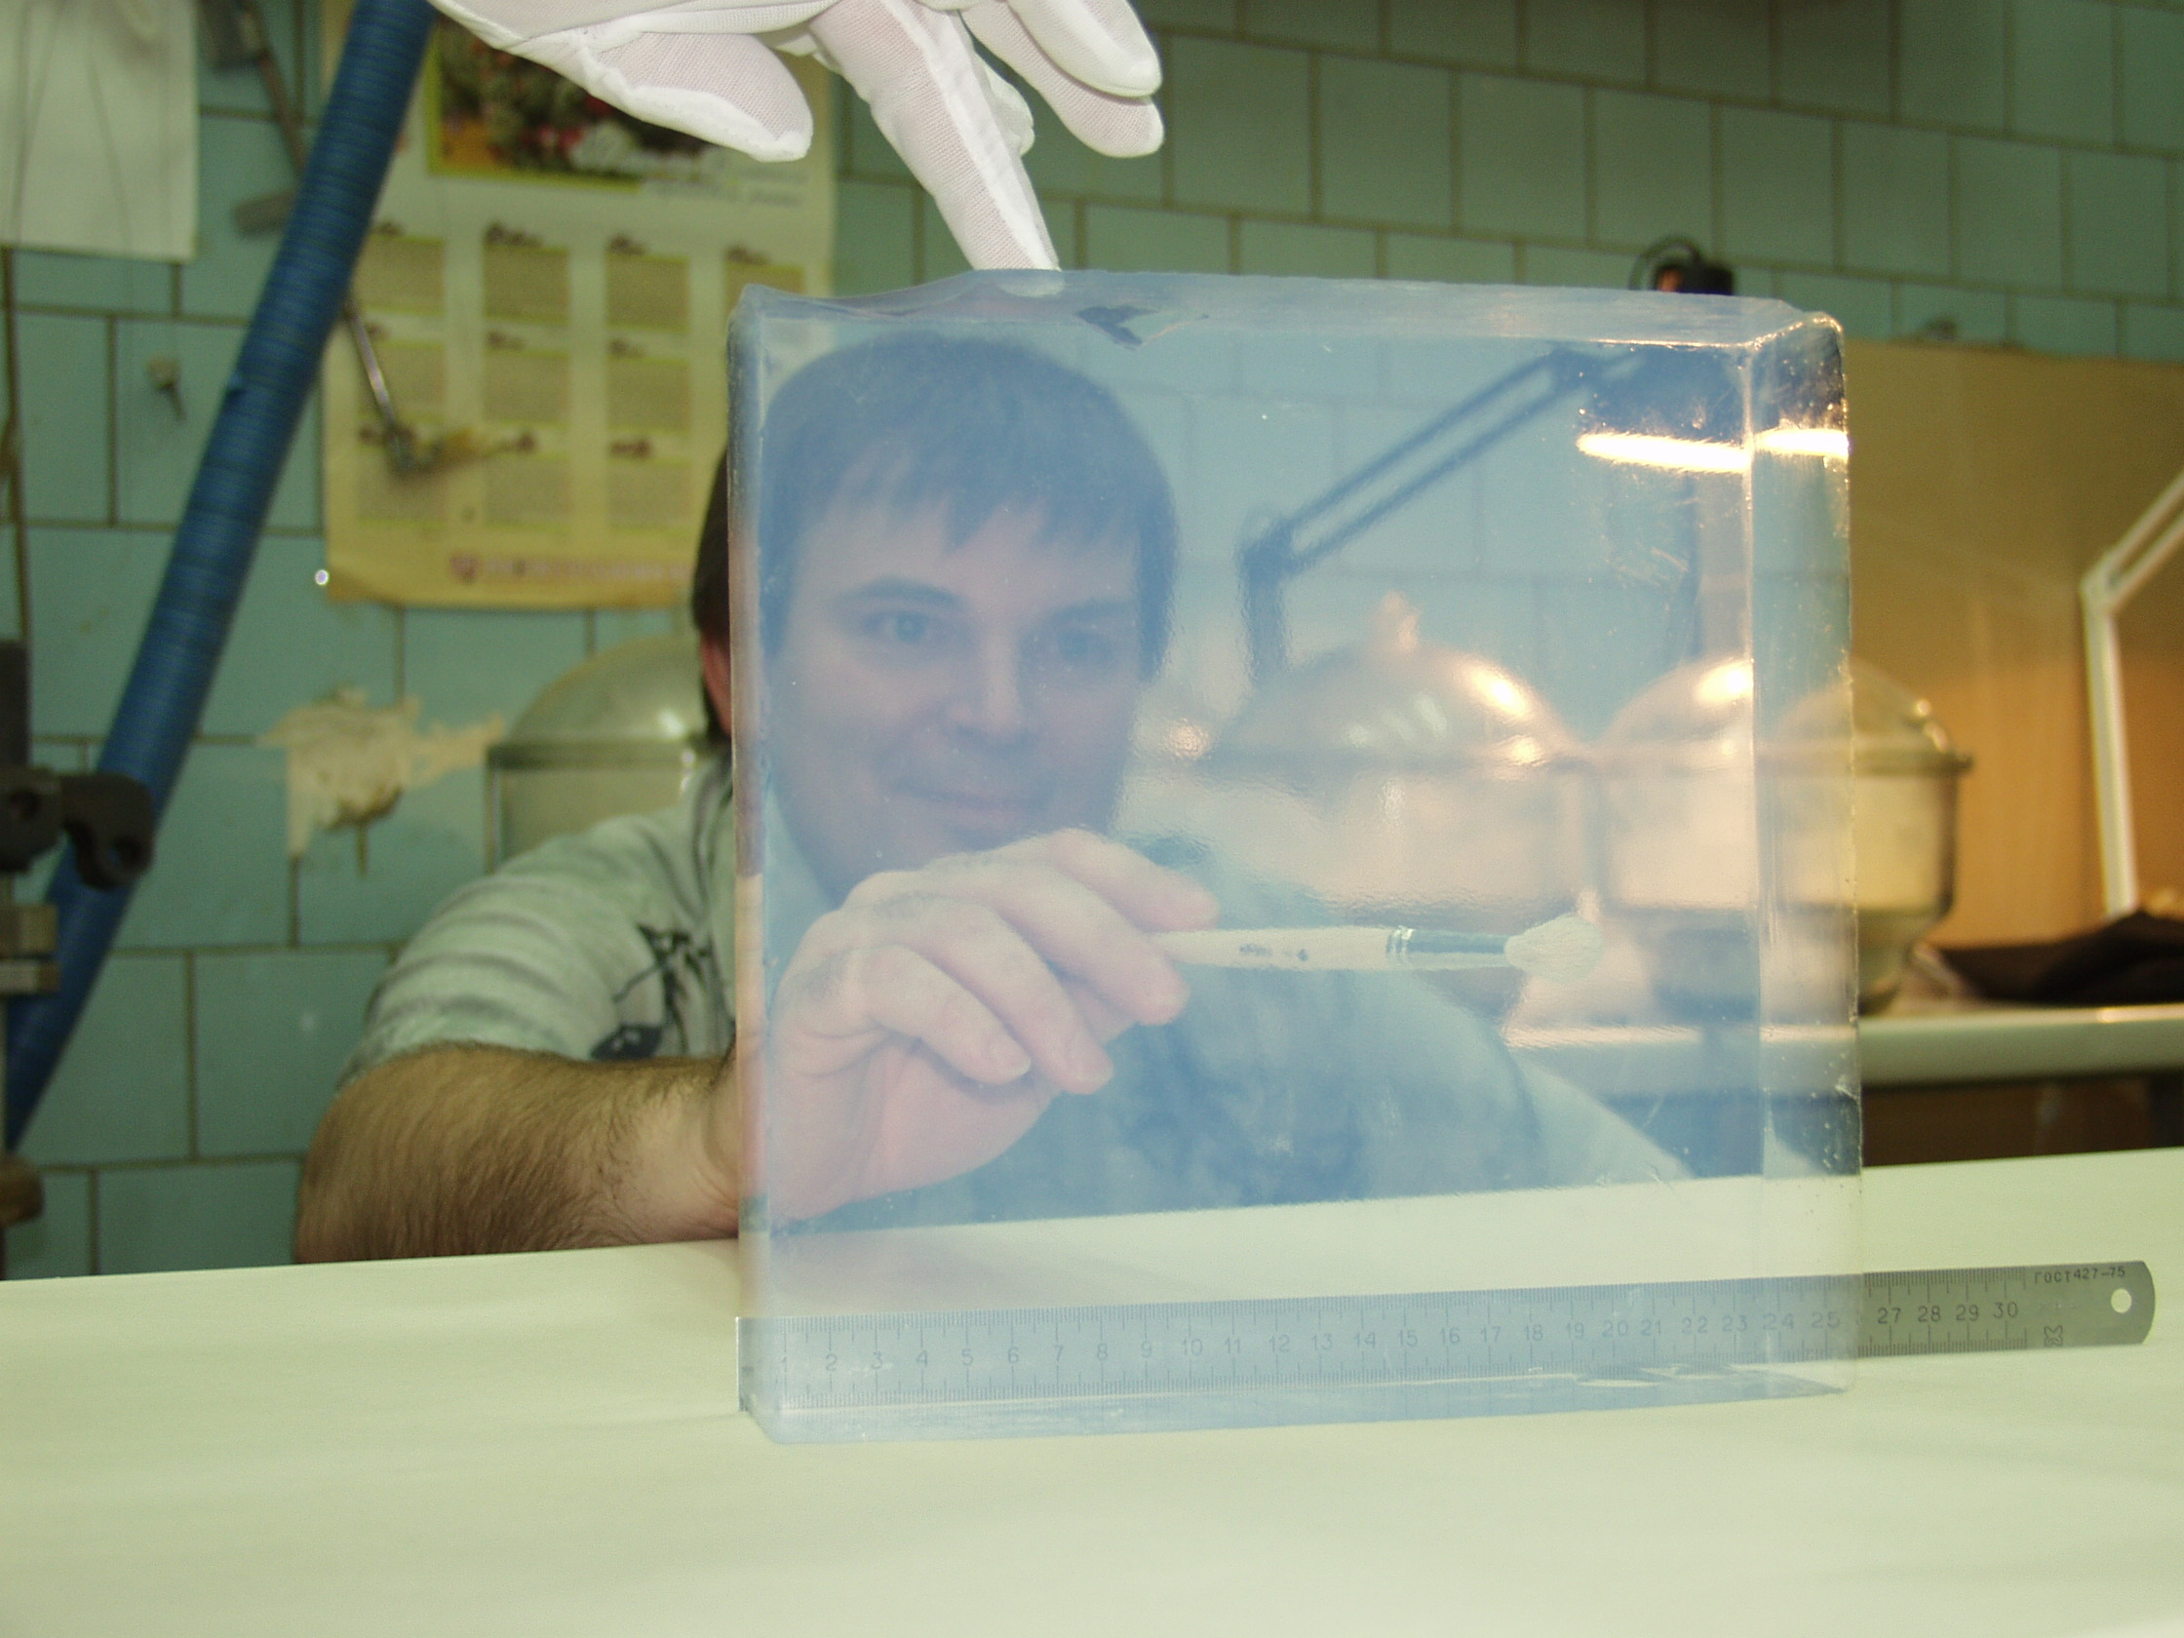
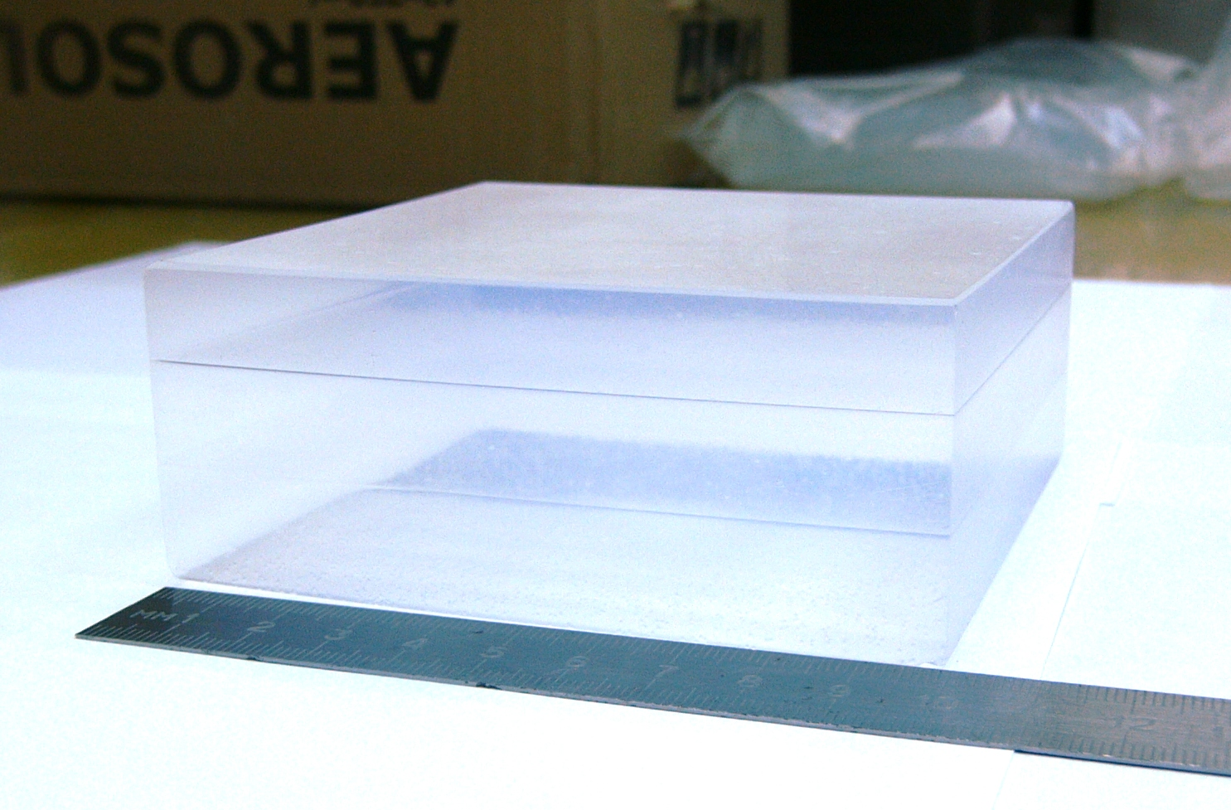
AEROGEL NEWS I
News from NOVOSIBIRSK
PRODUCTION STATUS
~2000 liters have been produced for KEDR ASHIPH detector, n=1.05
blocks 20020050 mm have been produced for LHCb RICH, n=1.03
~200 blocks 11511525 mm have been produced for AMS RICH, n=1.05
n=1.13 aerogel for SND ASHIPH detector
n=1.008 aerogel for the DIRAC
3-4 layers focusing aerogel
High optical parameters (Lsc≥43mm at 400 nm)
Precise dimensions (<0.2 mm)

Slide 11
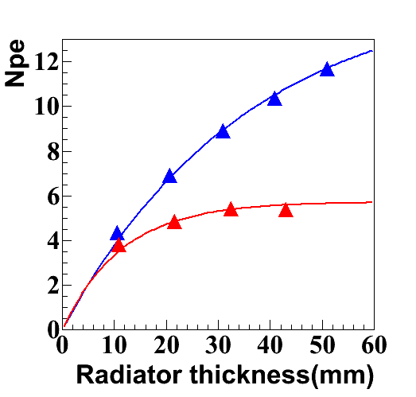
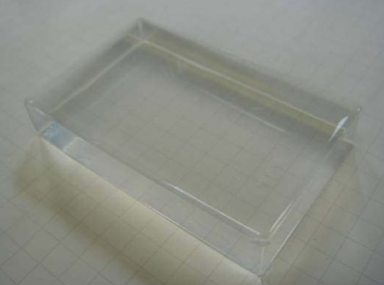
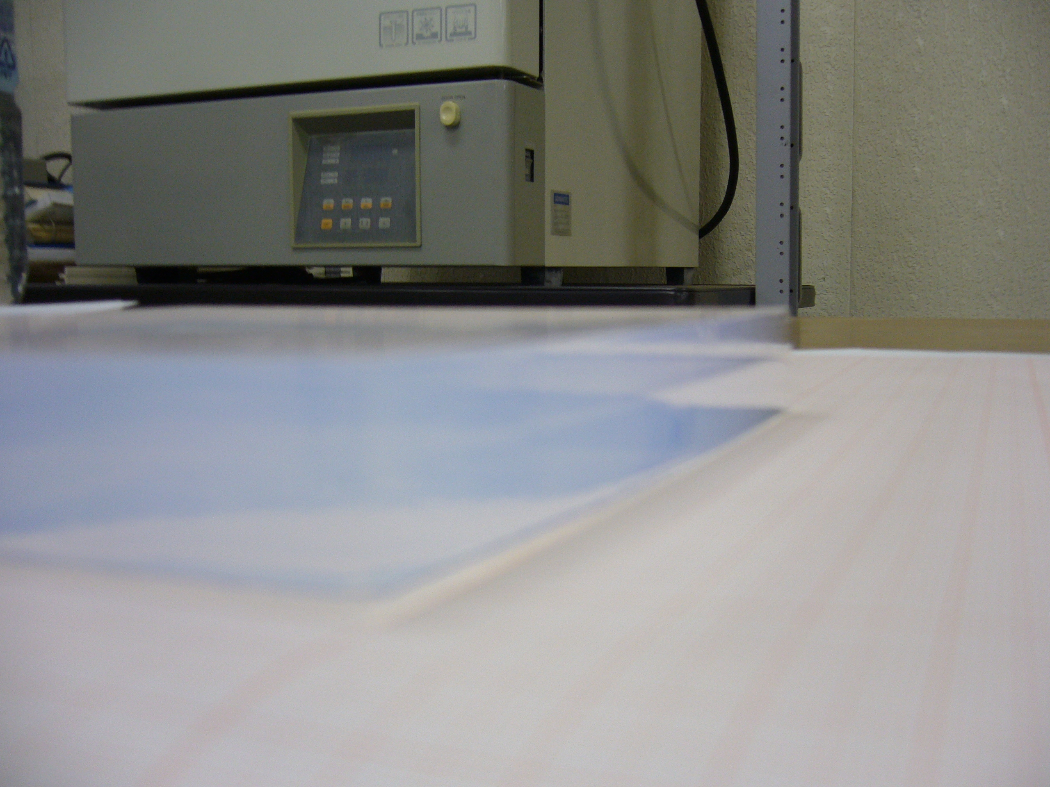
AEROGEL NEWS II
News from JAPAN
3rd generation:2002- A-RICH for Belle
upgrade (new solvent)
Home made !
largely improved transparency
very good homogeneity both density and chemical comp.
2-layer samples
4th generation:
high density aerogel
prototype result with
3 GeV/c pions
2005 sample
2001 sample
n~1.050
transmission length: 18mm at 400nm
photon yield is not limited by radiator transparency up to ~50mm
n = 1.22
n = 1.045
n = 1.050
60x35x10mm³
160mm
transmission length(400nm): 46mm

Slide 12
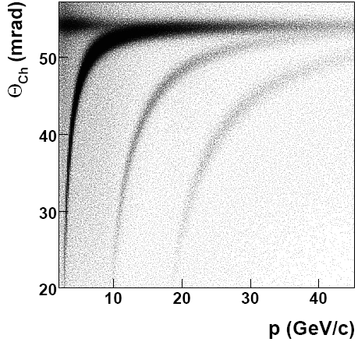
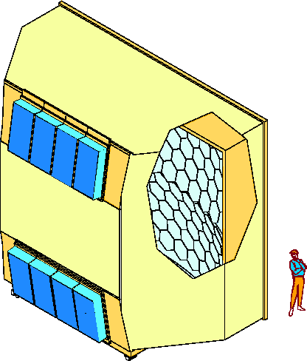
COMPASS RICH-1
Single Radiator: C₄F₁₀
3 m
6 m
in operation
at COMPASS
since 2001
PERFORMANCES:
photons / ring
(β ≈ 1, complete ring in
acceptance) : 14
σ_{θ-ph} (β ≈ 1) : 1.2 mrad
σ_{ring} (β ≈ 1) : 0.6 mrad
2σ π/K separation @ 43 GeV/c
PID efficiency > 95%
(θ _{particle} > 30 mrad)
vessel
π
K
mirror
wall
5 m
photon
detectors:
CsI MWPC
p
radiator:
C₄F₁₀

Slide 13
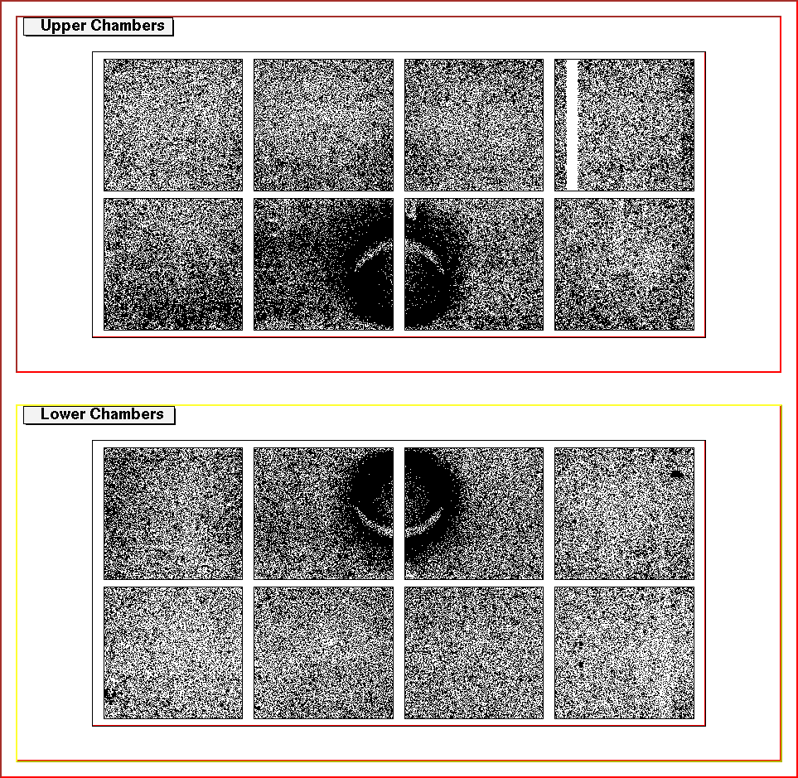
COMPASS RICH-1 – UPGRADE 1/2
Large uncorrelated background
in the forward direction
(μ beam halo)
UPGRADE
overlap
of event
images

Slide 14
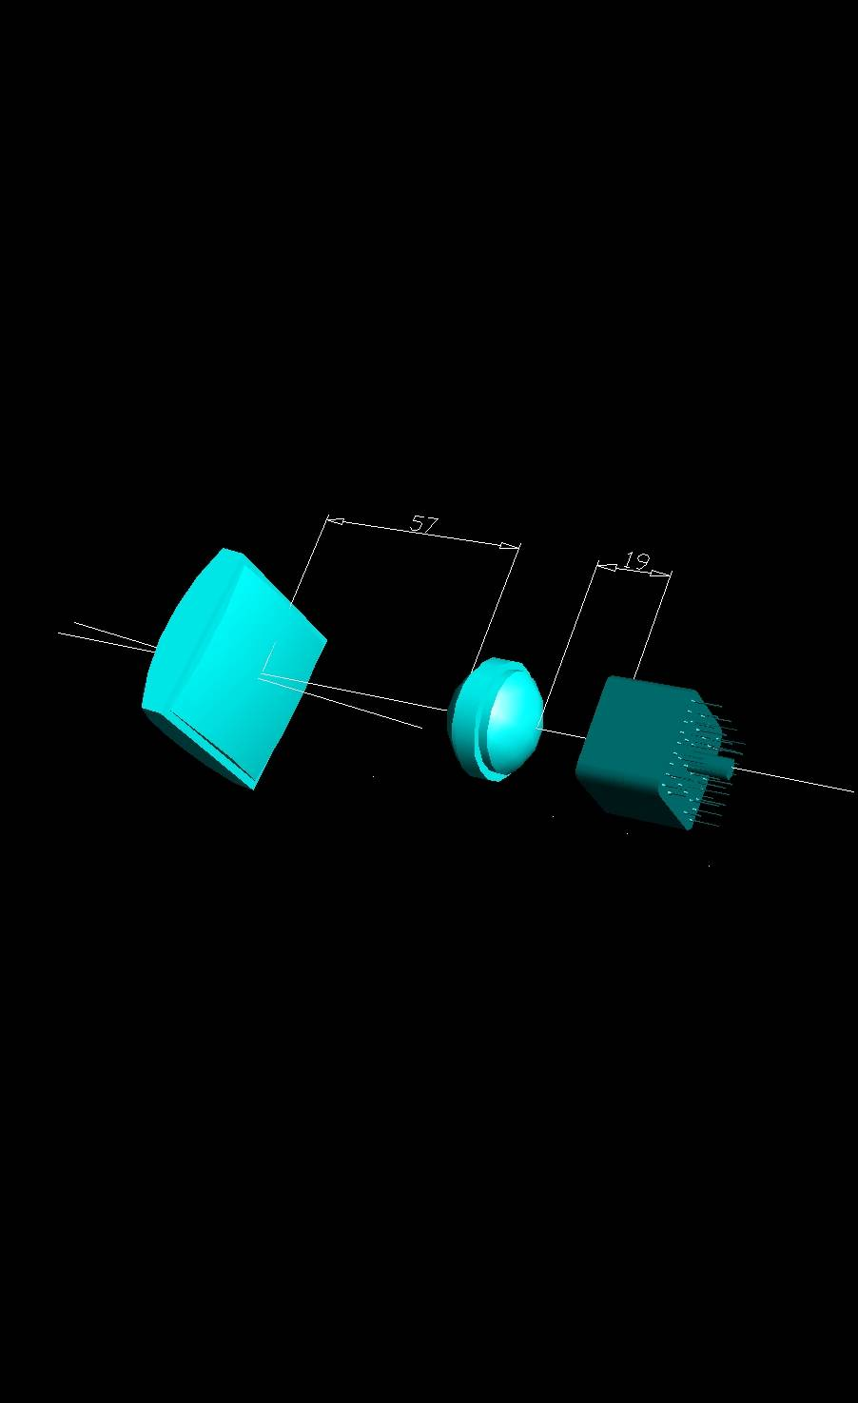
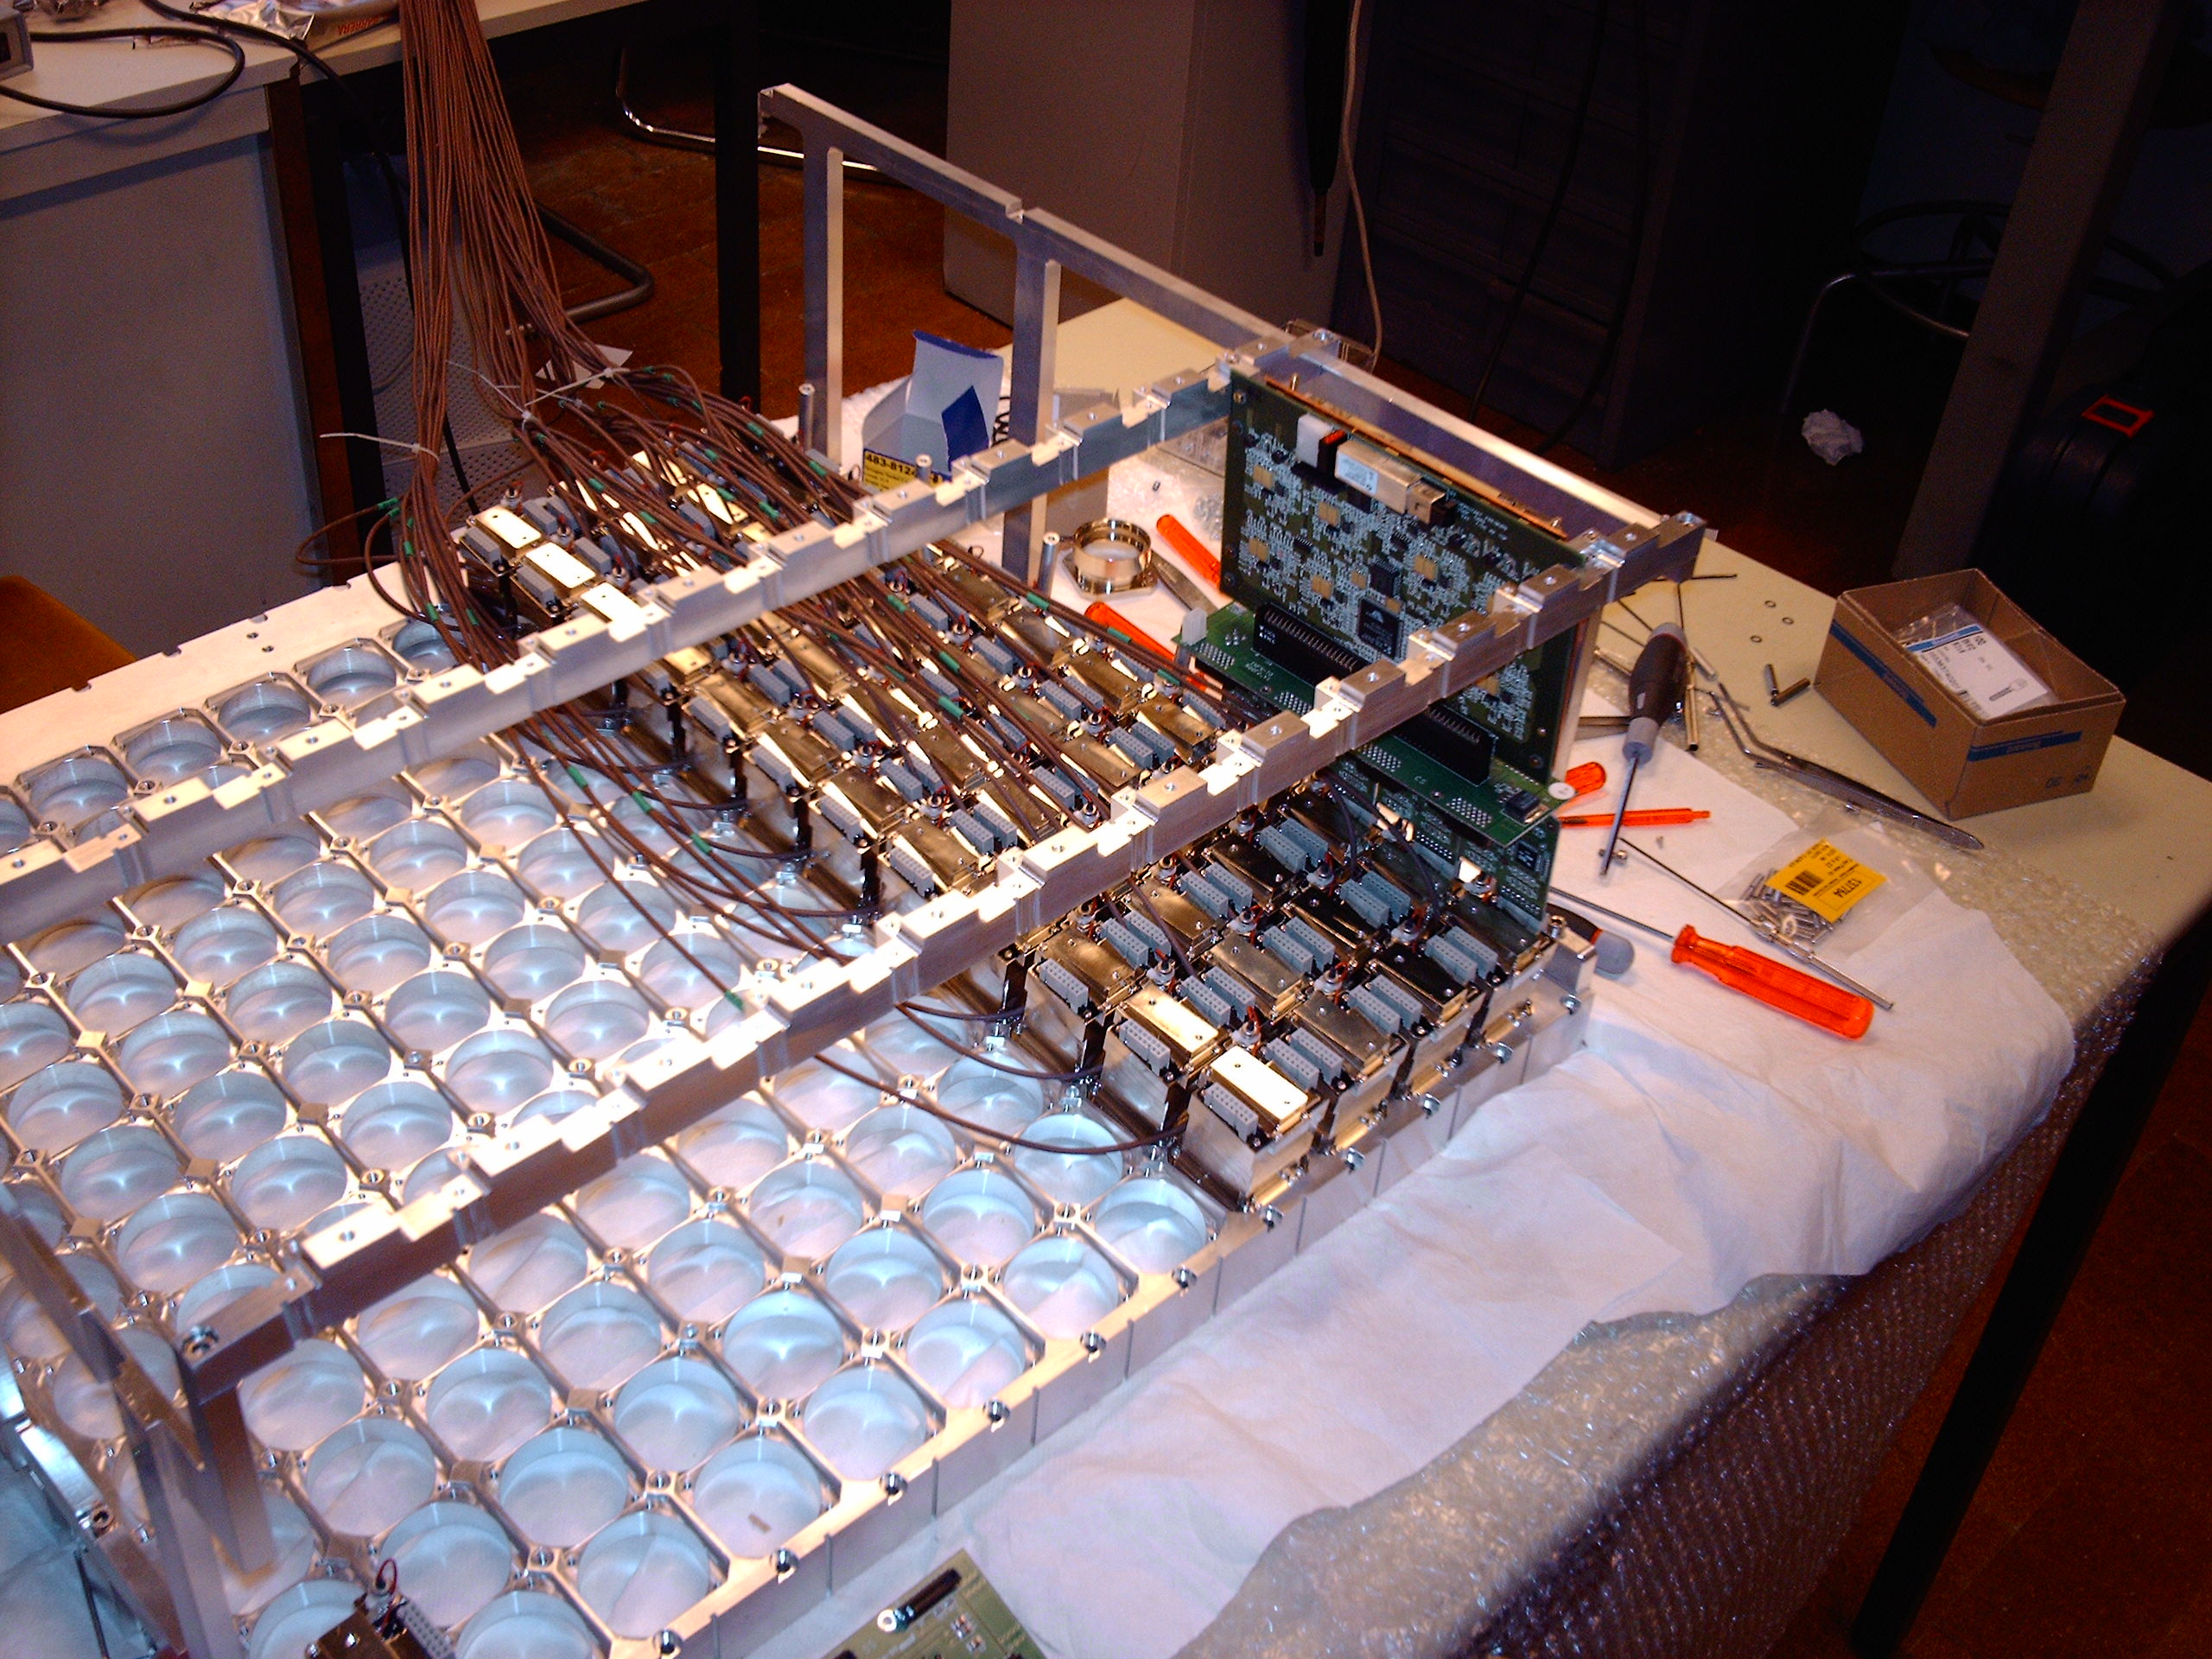
COMPASS RICH-1 – UPGRADE 1/2
photons
field lens
Technical data
Hamamatsu 16 anode PMTs
(R7600 – UV extended glass)
quartz optics
surface ratio 1:7 ($ !)
wide angular acc. (± 9.5 degrees)
high sensitivity pre-amplifier
fast, high time resolution digital electronics
dead zone: 2% even with 46 mm pitch
About performance
photons / ring (β ≈ 1, complete ring
in acceptance) : 56
time resolution better than 1 ns
σ_{θ-ph} (β ≈ 1) : 2 mrad
σ_{ring} (β ≈ 1) : 0.3 mrad
2σ π/K separation @ 55 GeV/c
PID efficiency > 95% (also < 30 mrad)
concentrator
MAPMT
online event
display

Slide 15
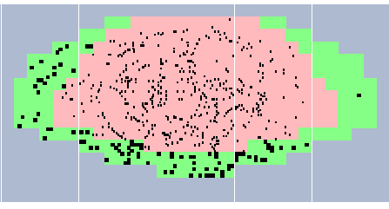
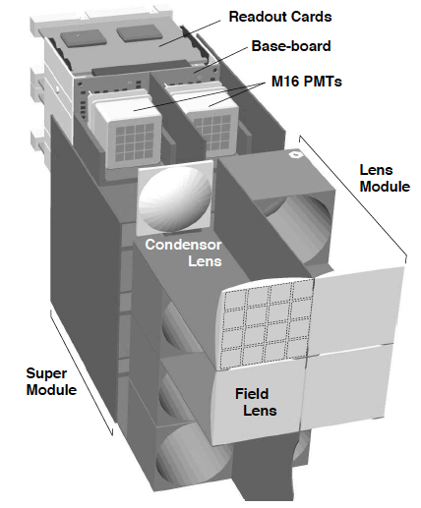
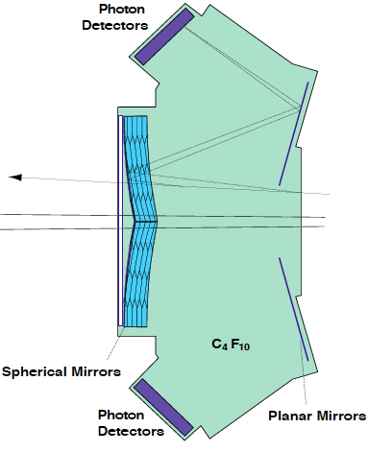
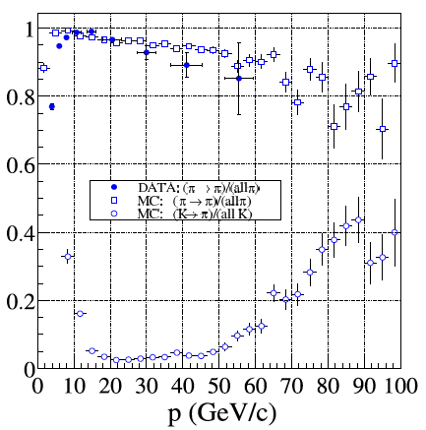
HERA-B Photon Detector
4 m
10 m
Used a lens system to increase active to dead area of photon detector

Slide 16
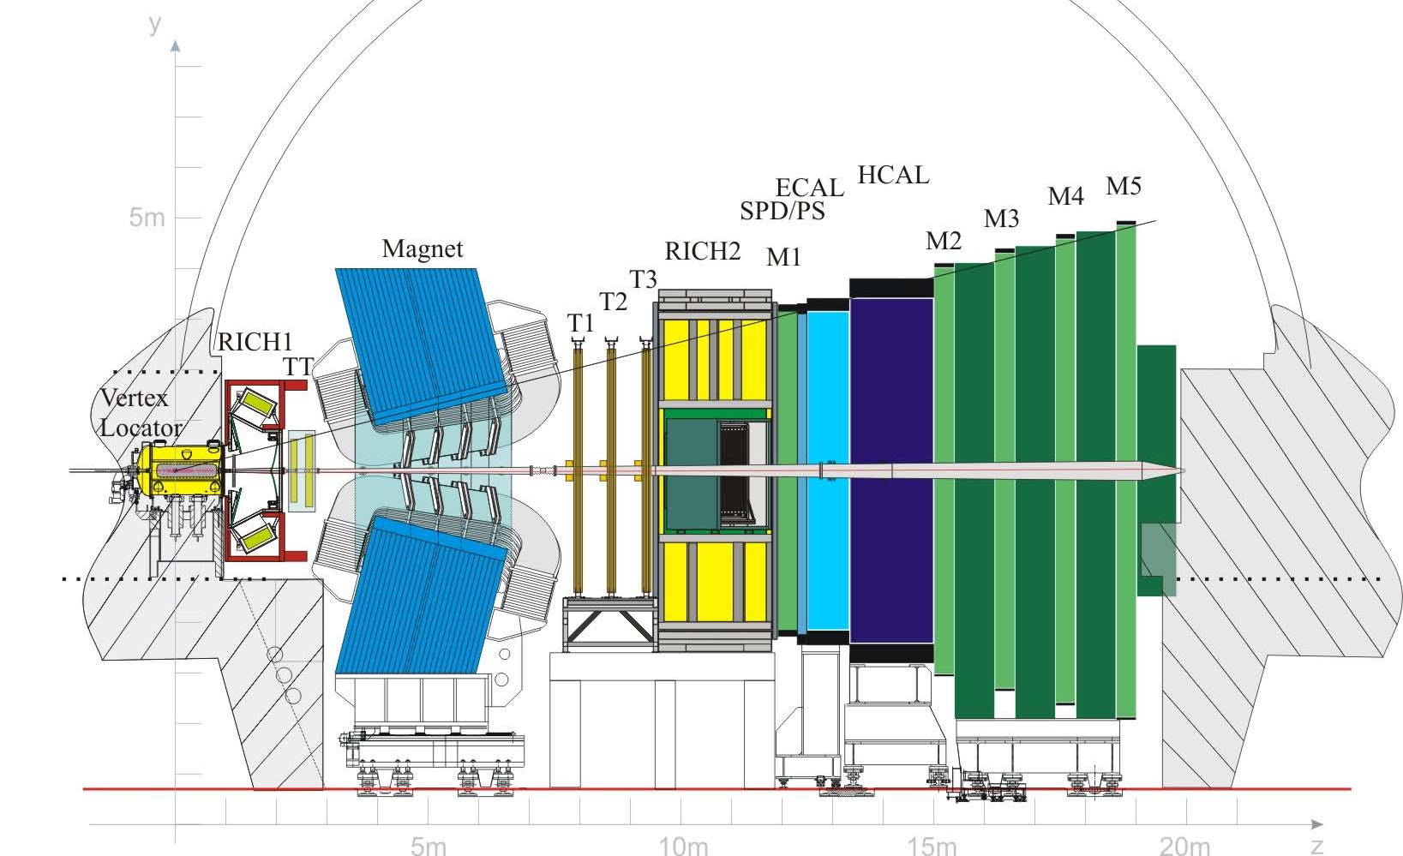
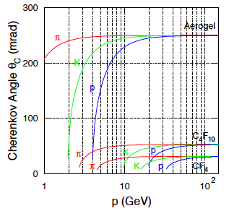
Most Relevant RICH Design for STAR
LHC-b: 2 RICHs with 3 radiators

Slide 17
LHC-b: 2 RICHs with 3 radiators
RICH-1 (modern HERMES RICH) RICH-2
2<p<60 GeV 17<p<100 GeV
25-300 mrad 10-120 mrad
5cm Aerogel (n=1.030) ~200 cm CF₄ (n=1.0005)
85 cm C₄F₁₀ (n=1.0014)

Slide 18
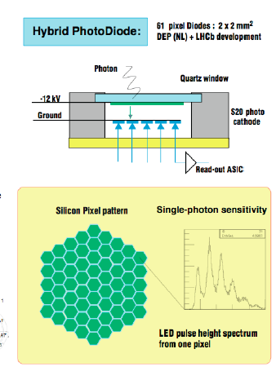
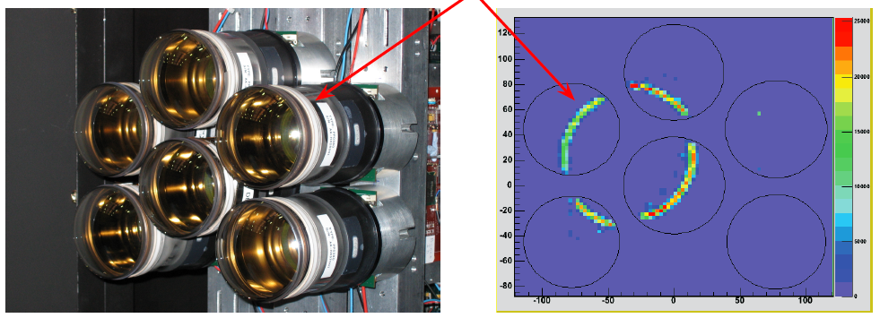
LHC-b HPD based Photondetector
3 m² area have been equipped with photodetectors providing:
Single Photon Sensitivity (200 - 600nm)
2.5 x 2.5 mm2 granularity
Fast readout (40 MHz)
Active-area fraction > 70%
Hybrid Photo Diodes (HPD)
  168 HPDs RICH1
  262 HPDs RICH2
340 k channels

Slide 19
LHC-b HPD based Photondetector
HPD combines vacuum photo-cathode technology with solid state technology
Photoelectron, released from a photo-cathode, is accelerating by an applied 20kV voltage onto silicon detector. Then it creates ~3000-5000 electron-hole pairs.
The light pattern incident on the photo-cathode is imaged onto silicon matrix.
No dead regions
30% QE at 200 nm
Fast signal (rise-fall times of a few ns) and negligeable jitter
(<1 ns)

Slide 20
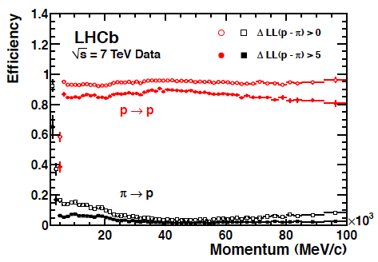
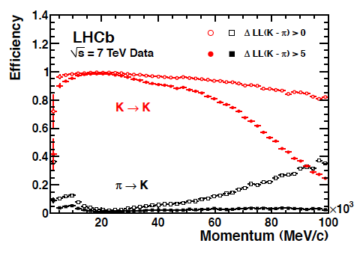
LHC-b RICH performance
Stunning performance → For Details
https://twiki.cern.ch/twiki/bin/view/LHCb/LHCbRICH

Slide 21
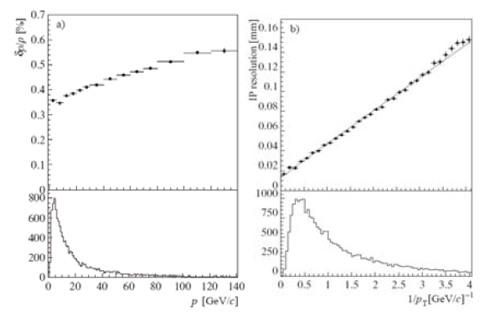
Summary
The RICH-1 concept of LHC-b is ready to go for STAR and eRHIC-detector without enormous R&D
If we drop the Aerogel there could be interesting R&D for the photon detector by making it a GEM
  No sensitivity to magnetic field
  An R&D discussed in the LoI proposal for EIC
  https://wiki.bnl.gov/conferences/index.php/EIC_R%25D
So if we decide a RICH is important for the pp physics program there are good designs available we can rely on
For eRHIC a RICH in forward and backward direction is a must
Most critical momentum resolution θ_{c}=√(2δ-1/γ²)
LHC-b
momentum resolution

Slide 22
BACKUP

Slide 23
TECHNOLOGICAL ASPECTS
Radiator materials
  aerogel material (BELLE upgrade, super B factory)
    radiation hardness of fused silica (future DIRCs in PANDA)
    gas systems (C-F gasses: DIRAC, LHCb)
Mirrors & optics
    construction of light mirrors (LHCb)
    Mirror reflectivity (MAGIC)
    Mirror alignment monitoring (COMPASS, LHCb)
    Mirror alignment adjustment (COMPASS)
    (Dichroic) mirrors for focusing DIRC and TOP approaches
Electronics
    Self-triggered read-out electronics (CBM)
    Fast electronics (COMPASS)

Slide 24
Needed Momentum Coverage

Slide 25
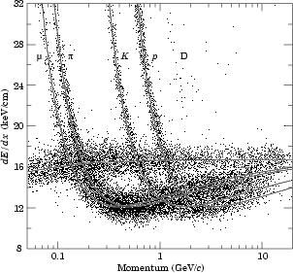
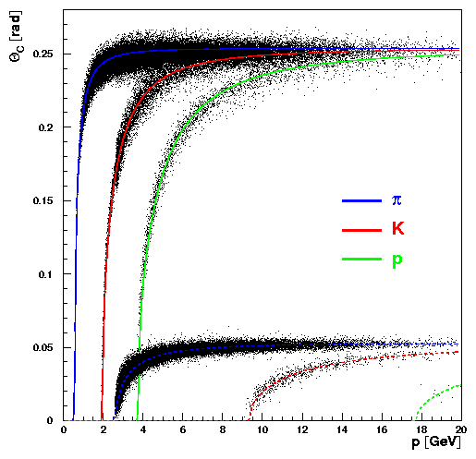
What is the best Detector concept
Cerenkov Radiation
Aerogel; n=1.03
e
C₄F₁₀; n=1.0014
Energy loss dE/dx
Too small p lever arm
Match radiator and lepton p-range
Transition Radiation:
sensitive to particle γ (γ>1000)
Talk by M. Hartig on the ALICE TRD project

Slide 26
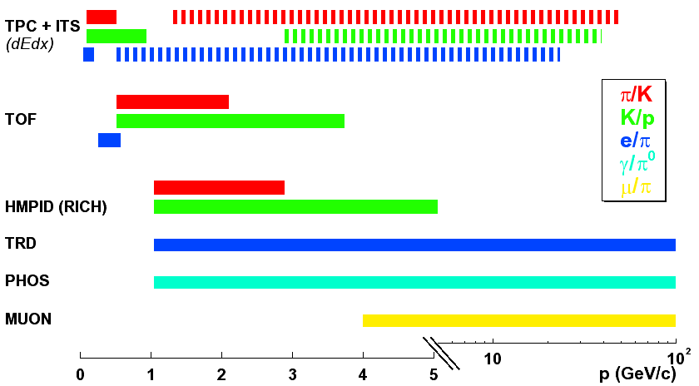
ALICE Experiment: PID Capabilities
(relativistic rise)
TPC: σ(dE/dx) = 5.5(pp) – 6.5(Pb-Pb) %
TOF: σ < 100 ps
TRD: π suppression ≈ 10⁻² @ 90% e-efficiency

Slide 27
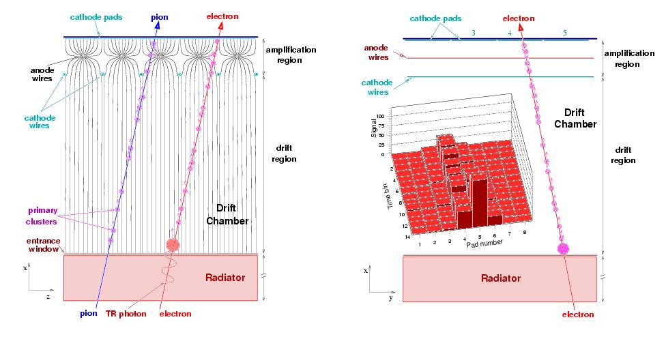
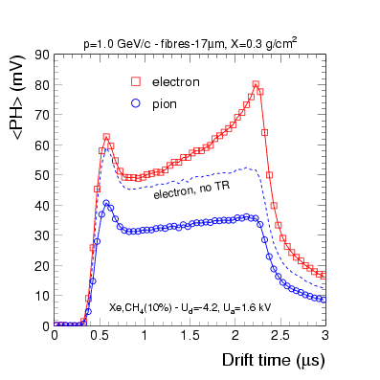
Transition Radiation Detector
Schematic View
Radiator:
  irregular structure
  - Polypropylen fibers
  - Rohacel foam (frame)
  4.8 cm thick
  self supporting
Gas:
  Xe/CO₂ 85/15 %
Drift region:
  3 cm length
  700 V/cm
  75 μm CuBe wires
Amplification region:
  W-Au-plated wires 25 μm
  gain ~ 10000
Readout:
  cathode pads
  8 mm (bending plane)
  70 mm in z/beam-direction
  10 MHz

Slide 28
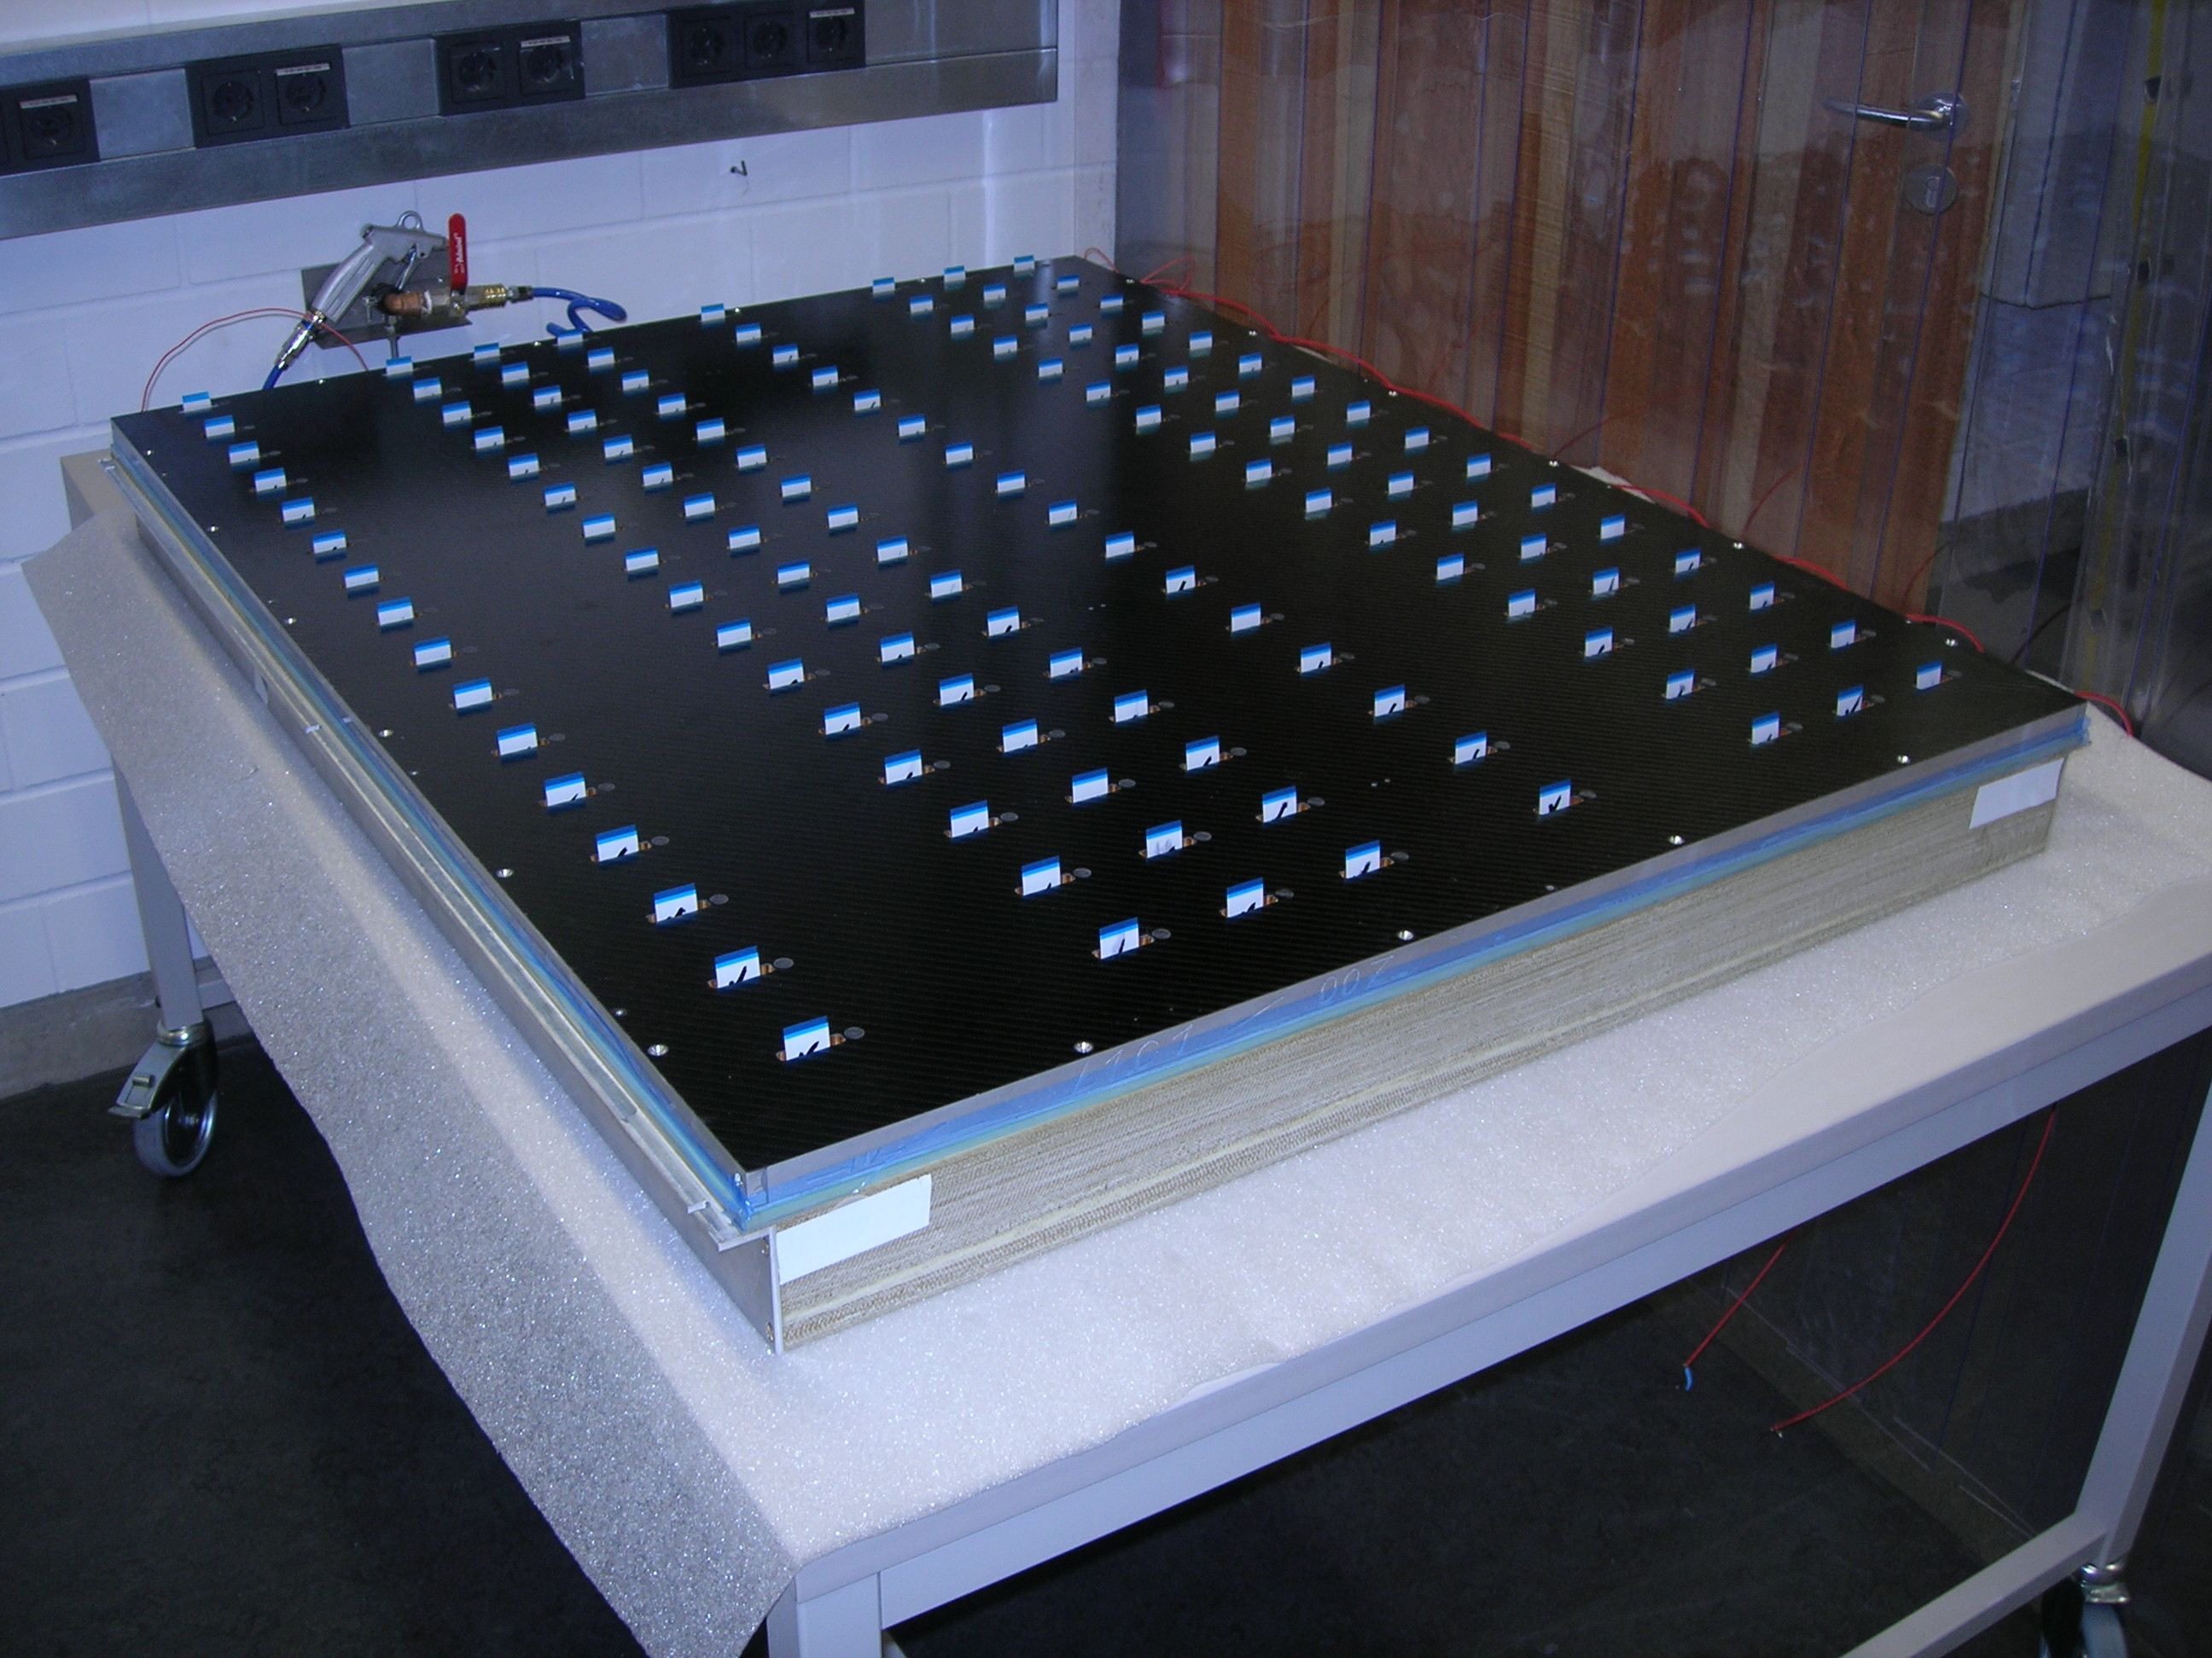
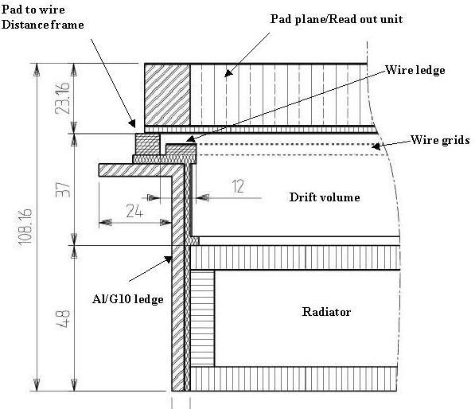
Transition Radiation Detector
Design
Large area chambers (1-1,7 m²)
-> need high rigidity
Low rad. length (15%Xo)
-> low Z, low mass material

Slide 29
Electron Identification Performance
Result of Test Beam Data
Typical signal of single particle
LQ Method:
Likelihood with total charge
LQX Method:
total charge + position of max. cluster
PID with neural network
e/π-discrimination < 10⁻²
  For 90% e-efficiency

Slide 30
Offline Tracking Performance
Efficiency and Resolution for Pb+Pb
Efficiency:
high software track-finding
efficiency
lower combined track efficiency
(geometrical acceptance, particle
decay )
Efficiency independent of track
multiplicity
dN_{ch}/dy = 6000
Momentum resolution:
long lever arm ITS + TPC +TRD
(4cm <r<370cm)
resolution better for low
multiplicity (p+p)
δpt/pt ≤ 5 % at 100 GeV/c and
B = 0.5 T

