Slide 1
Physics opportunities having Roman Pots @ STAR

Slide 2
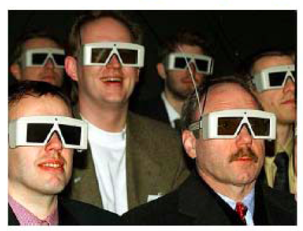
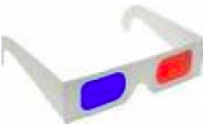
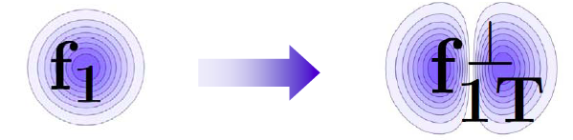
Quantum tomography of the nucleon
Join the real
3D experience !!
TMDs
GPDs
2D+1 picture in momentum space
transverse momentum
dependent distributions
2D+1 picture in coordinate space
  generalized parton distributions
  → exclusive reaction like DVCS
Quarks
unpolarised polarised

Slide 3
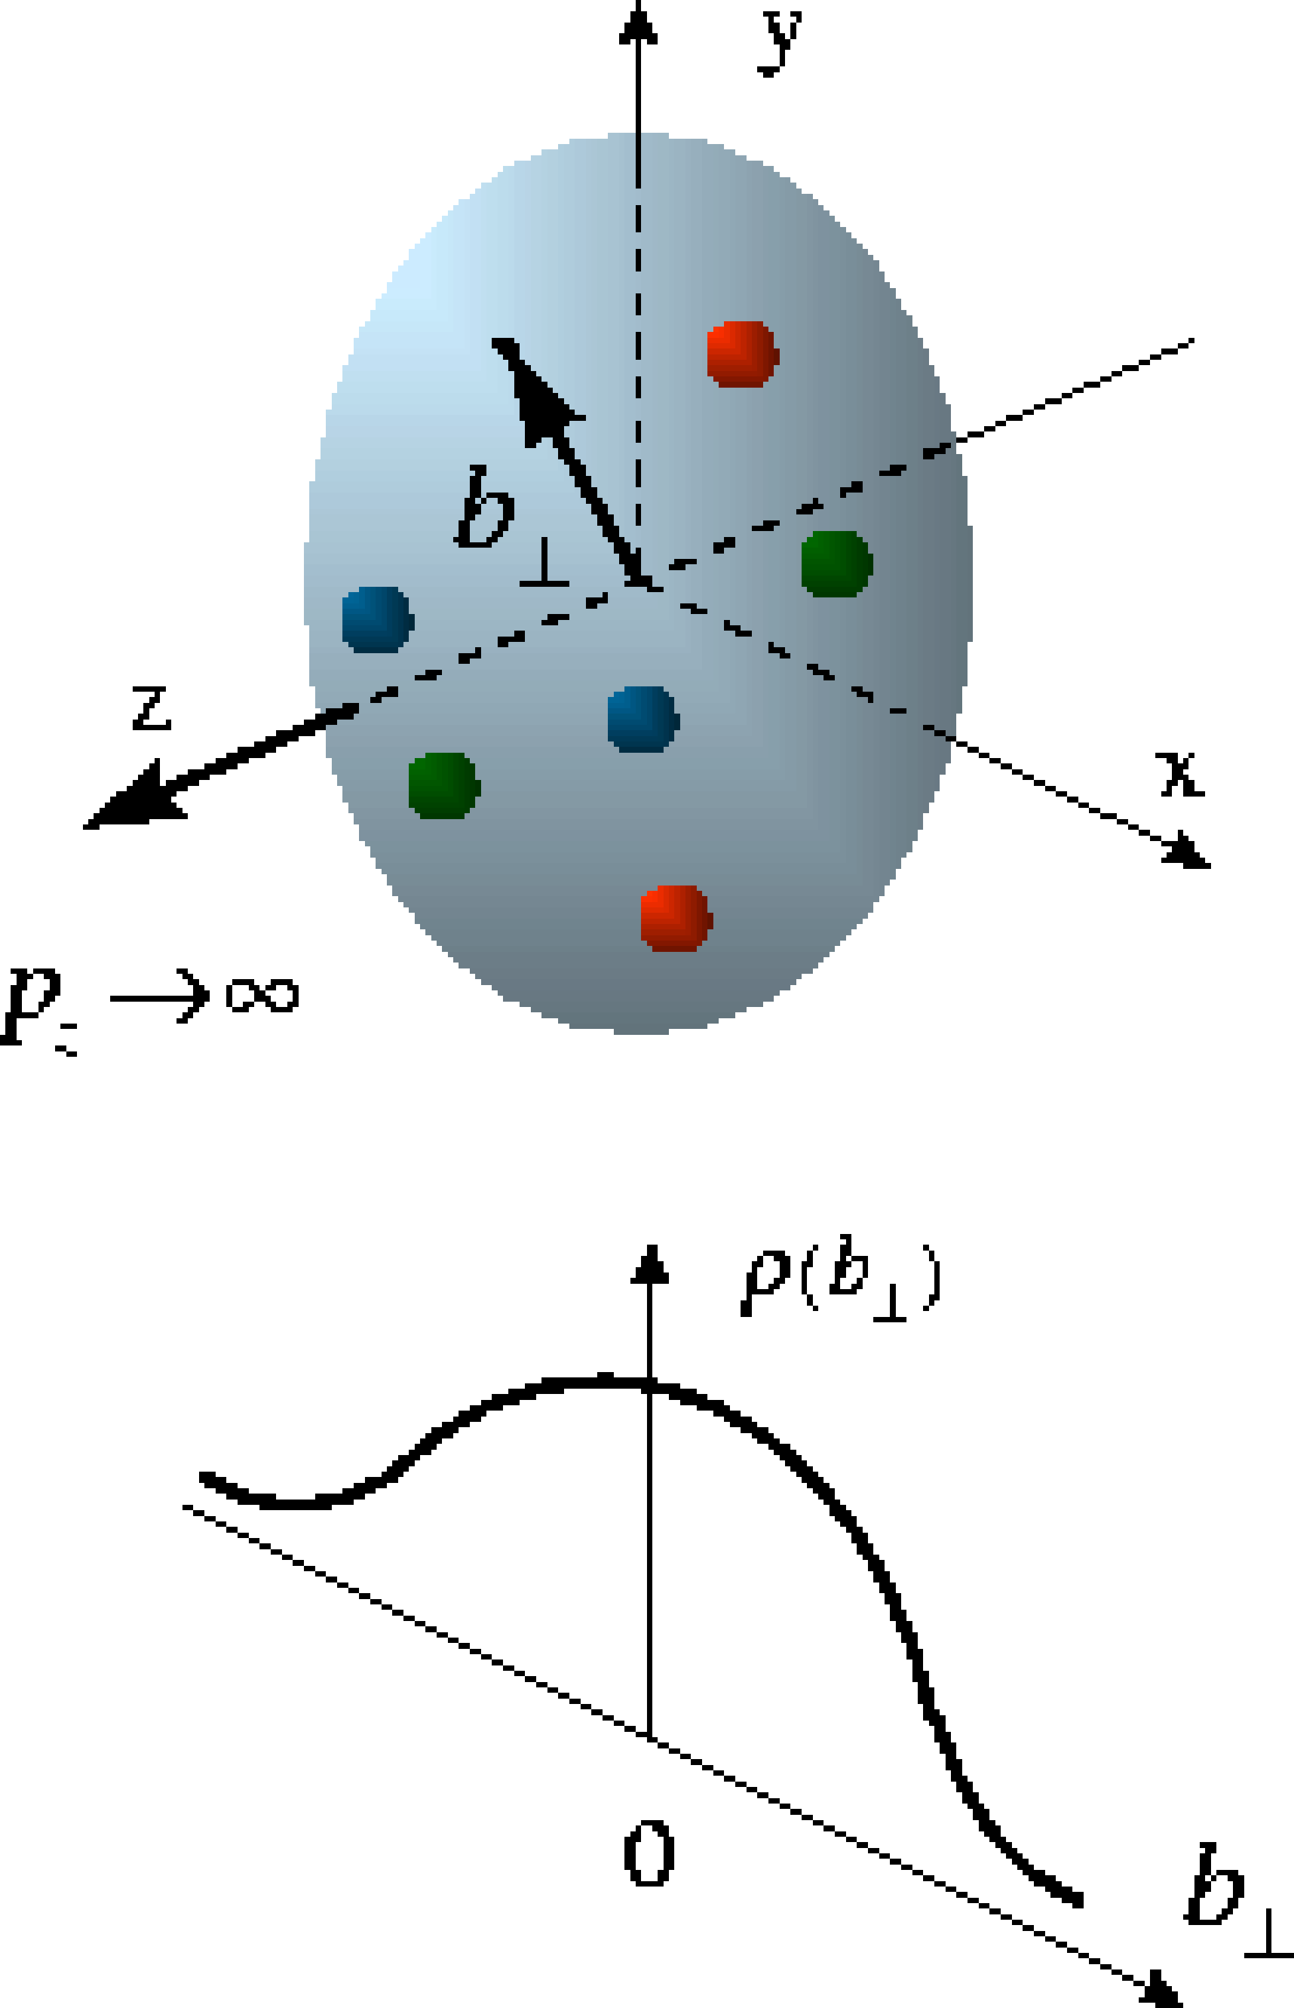
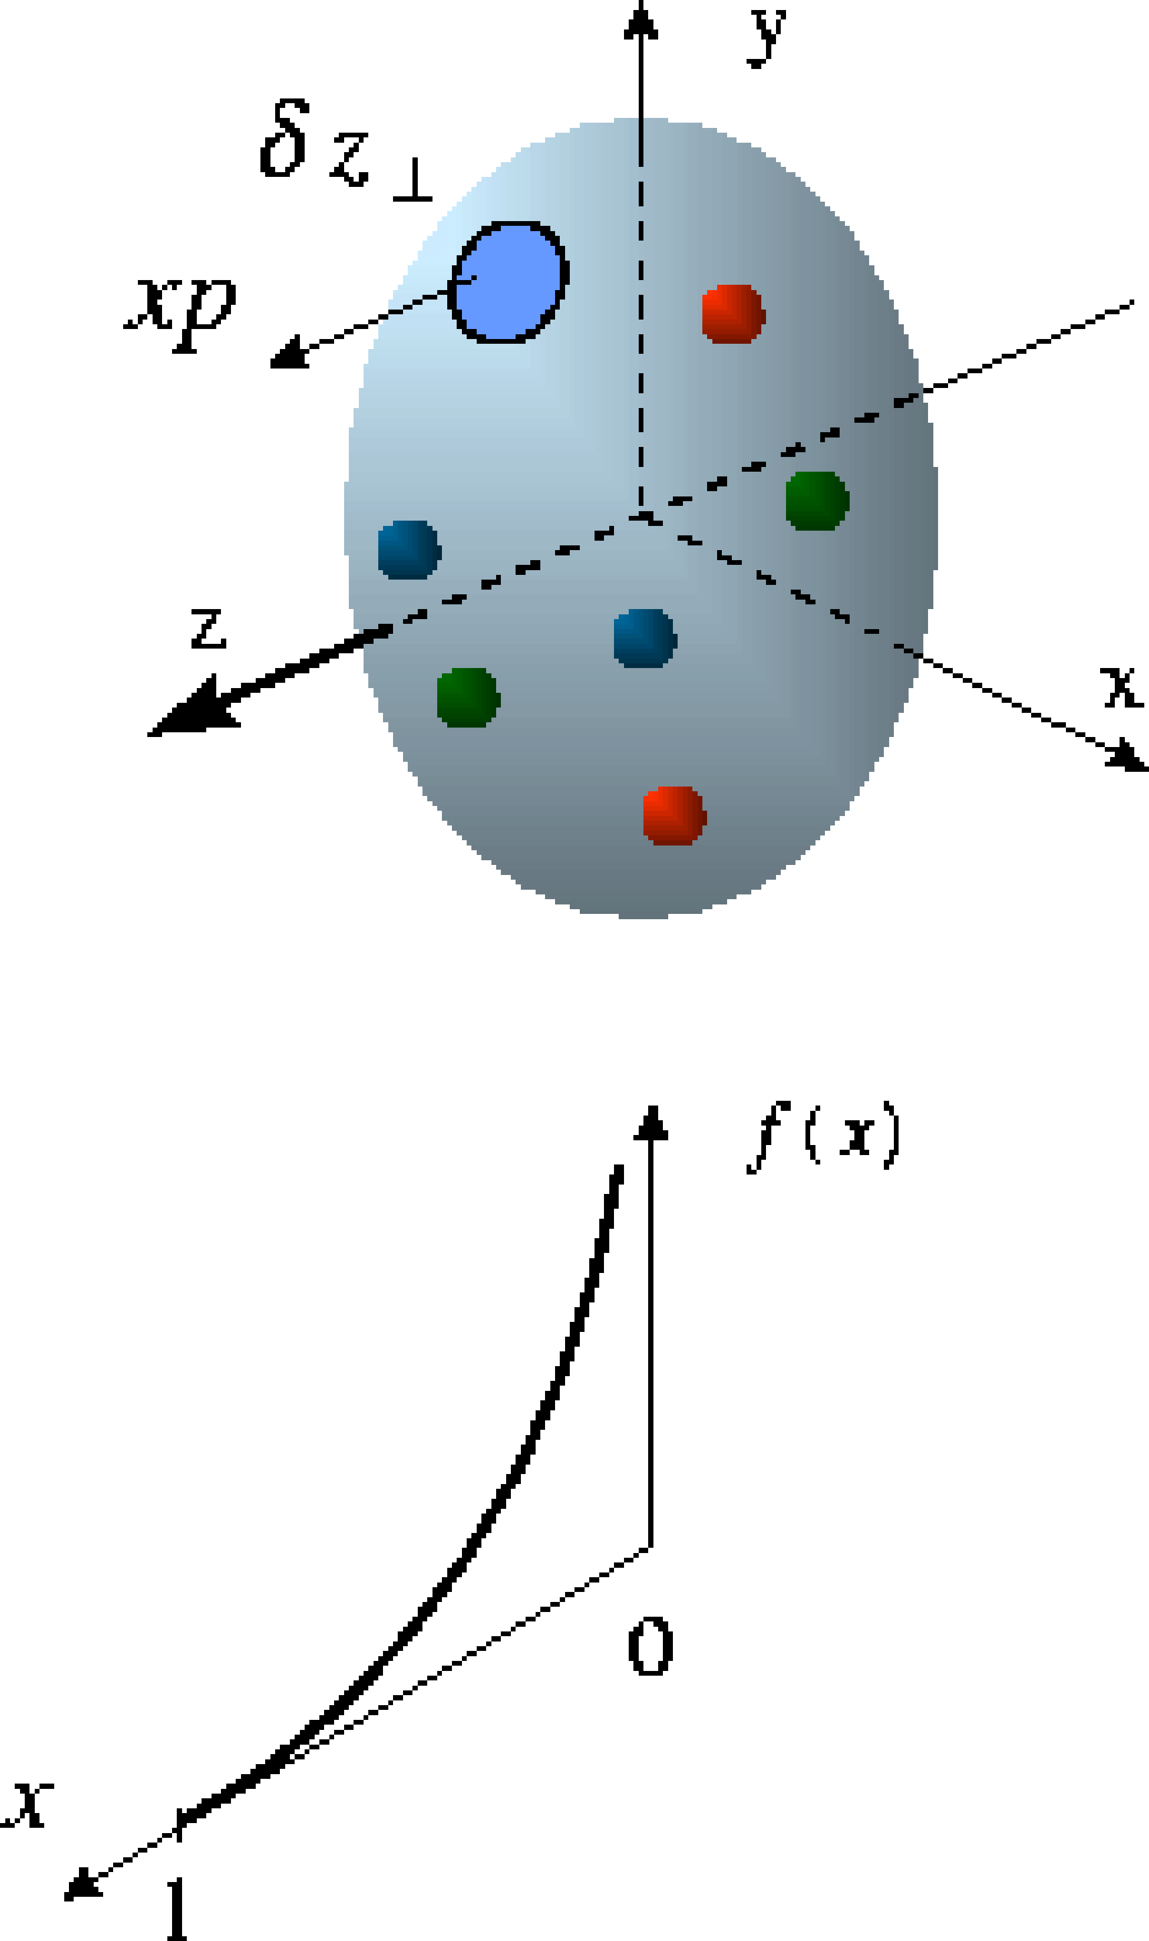
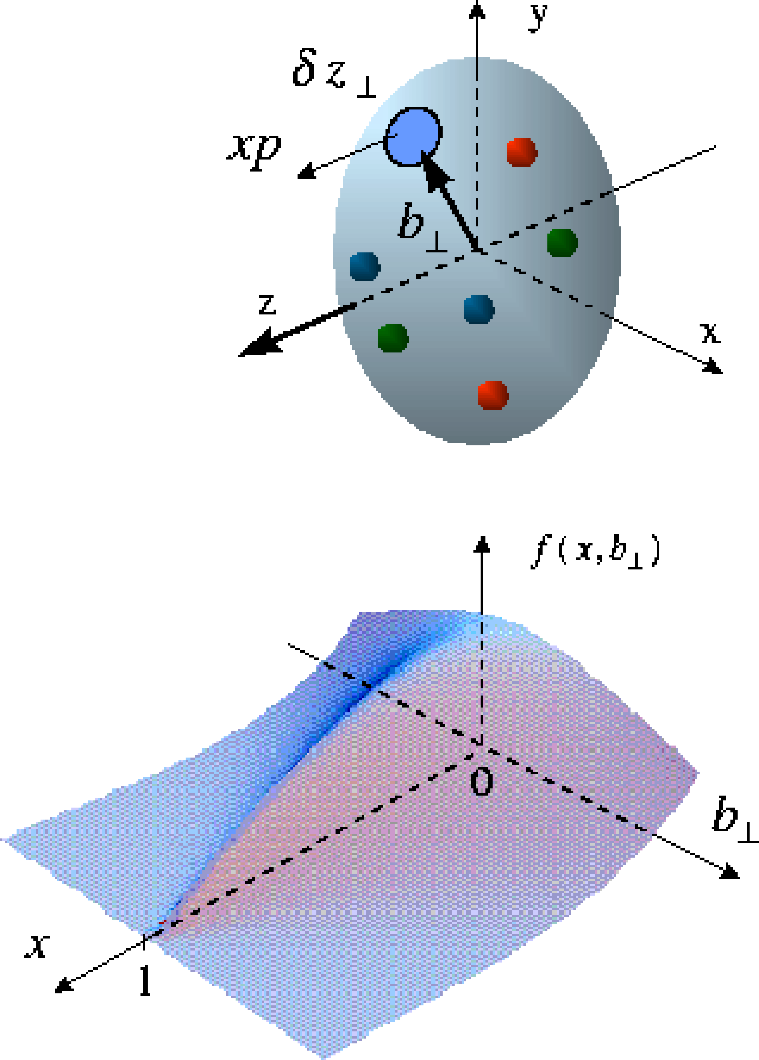
Beyond form factors and quark distributions
Generalized Parton Distributions
X. Ji, D. Mueller, A. Radyushkin (1994-1997)
Proton form factors, transverse charge & current densities
Structure functions,
quark longitudinal
momentum & helicity
distributions
Correlated quark momentum
and helicity distributions in
transverse space - GPDs

Slide 4
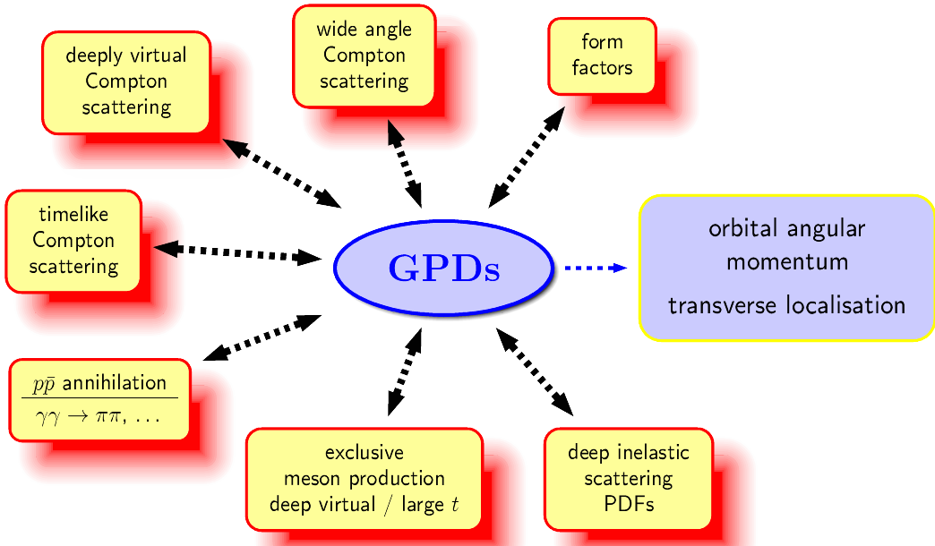
The Hunt for Lq
Study of hard exclusive processes
allows to access
a new class of PDFs
Generalized Parton Distributions
possible way to access
orbital angular momentum
DIS: ~0.3
Spin Sum Rule in PRF:
exclusive:
all reaction products are detected
missing energy (ΔE) and
missing Mass (M_{x}) = 0

Slide 5
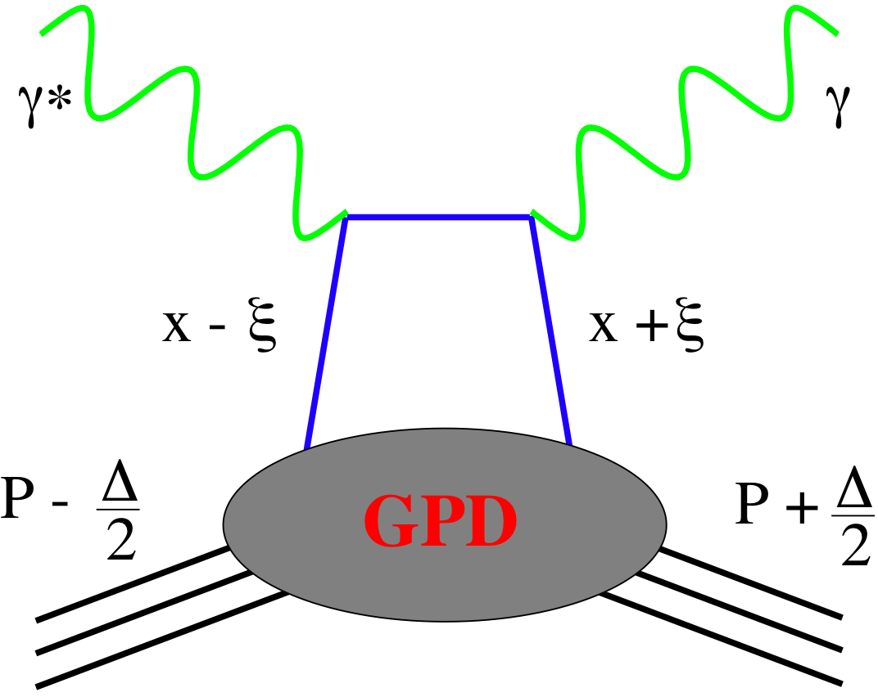
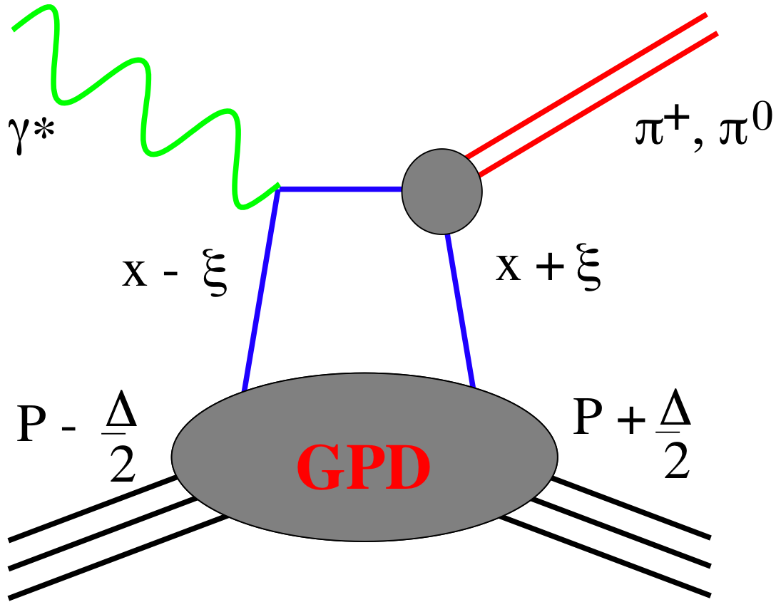
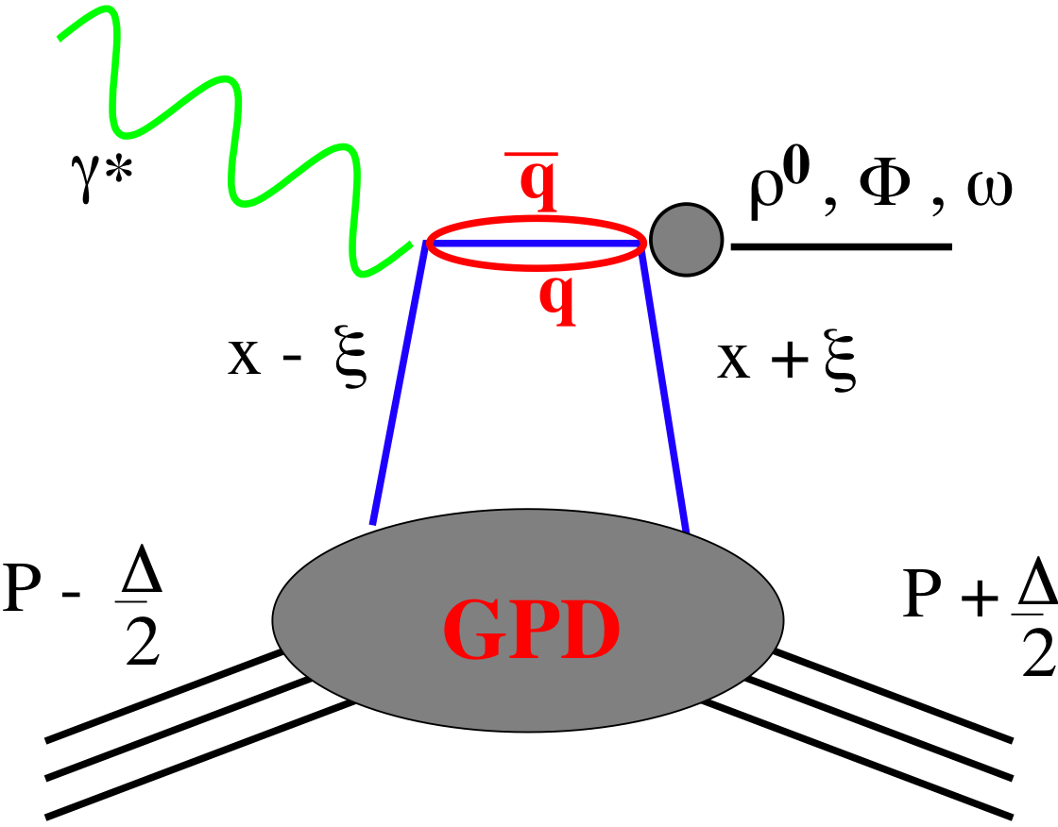
GPDs Introduction
How are GPDs characterized?
unpolarized polarized
conserve nucleon helicity
flip nucleon helicity
not accessible in DIS
quantum numbers of final state select different GPD
DVCS
pseudo-scaler mesons
vector mesons
π⁰ | 2Δu+Δd
η | 2Δu−Δd
ρ⁰ | 2u+d, 9g/4
ω | 2u−d, 3g/4
φ | s, g
ρ⁺ | u−d
J/ψ | g
Q²= 2E_{e}E_{e}’(1-cosθ_{e’})
x_{B} = Q²/2Mν ν=E_{e}-E_{e’}
x+ξ, x-ξ long. mom. fract.
t = (p-p’)²
ξ ≅ x_{B}/(2-x_{B})

Slide 6
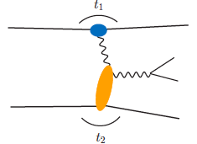
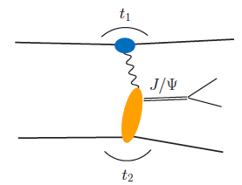
From pp to γ p/A
Get quasi-real photon from one proton
Ensure dominance of g from one identified proton
by selecting very small t₁, while t₂ of “typical hadronic
size”
small t₁ ←→ large impact parameter b (UPC)
Final state lepton pair ←→ timelike compton scattering
timelike Compton scattering: detailed access to GPDs
including E^{q/g} if have transv. target pol.
Challenging to suppress all backgrounds
Final state lepton pair not from γ* but from J/ψ
  Done already in AuAu
  Estimates for J/ψ (hep-ph/0310223)
transverse target spin asymmetry → calculable with GPDs
information on helicity-flip distribution E for gluons
golden measurement for eRHIC
Z²
A²
Gain in statistics doing polarized p↑A
Work in collaboration with Jakub Wagner, Dieter Mueller, Markus Diehl

Slide 7
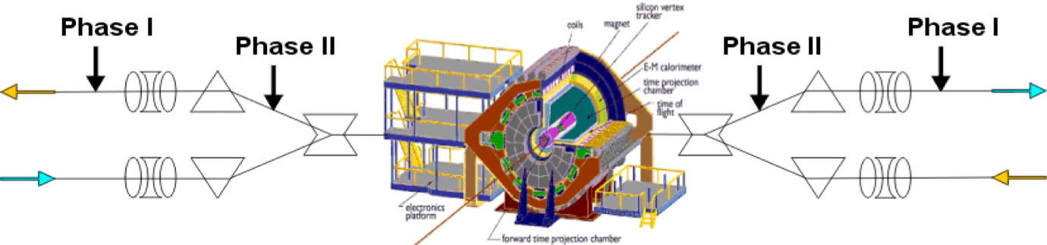
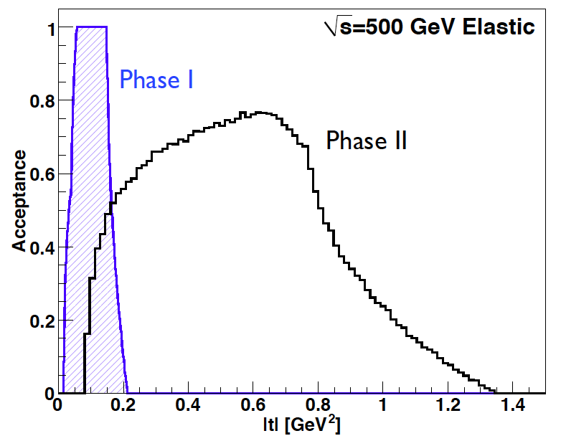
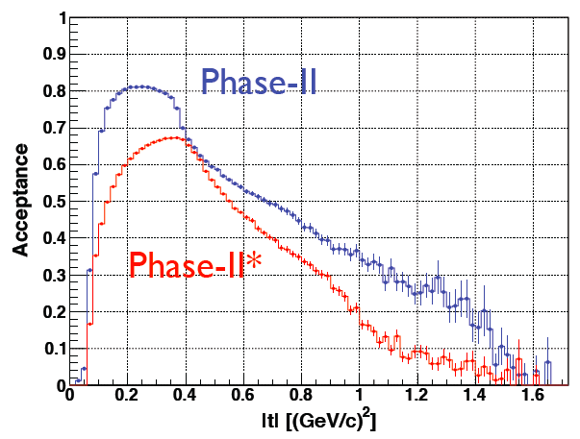
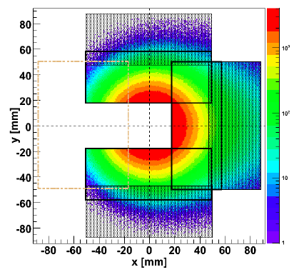
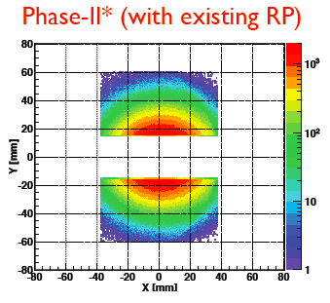
Forward Proton Tagging at STAR/RHIC
at 55-58m
at 15-17m
J.H. Lee
Roman Pot detectors to measure forward scattered protons in diffractive processes
Staged implementation to cover wide kinematic coverage
Phase I (Installed): for low-t coverage
Phase II (planned) : for higher-t coverage
    8(12) Roman Pots at ±15 and ±17m
    2π coverage in φ will be limited due to
    machine constraint (incoming beam)
No special β* running needed any more
→ 250 GeV to 100 GeV
scale t-range by 0.16

Slide 8
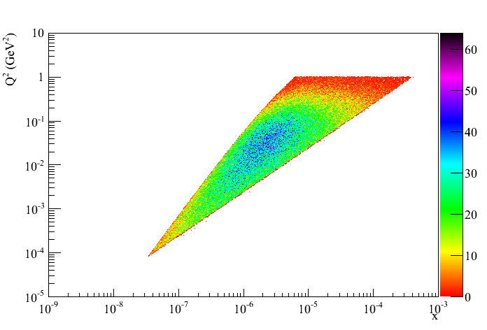
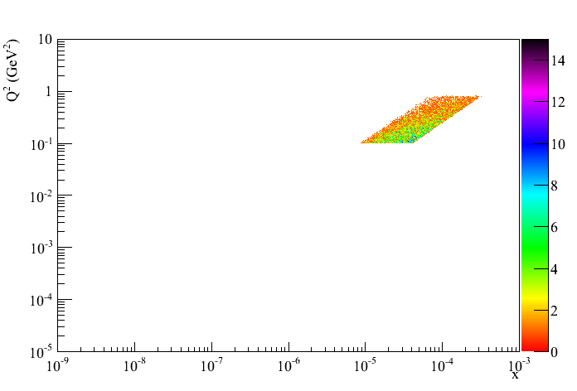
500 GeV pp: UPC kinematics
no cuts
Adding cut by cut:
leptons without cuts
μ₂: -1 < η < 2
μ₁ and μ₂: -1 < η < 2
-0.8<t₁<-0.1 and -0.8<t₂<-0.1
all cuts

Slide 9
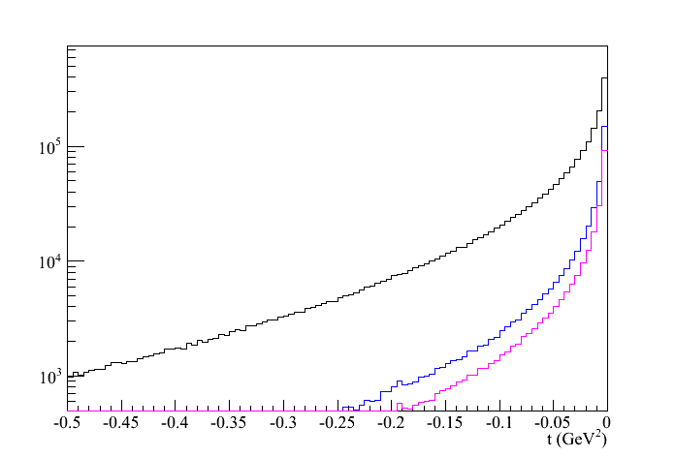
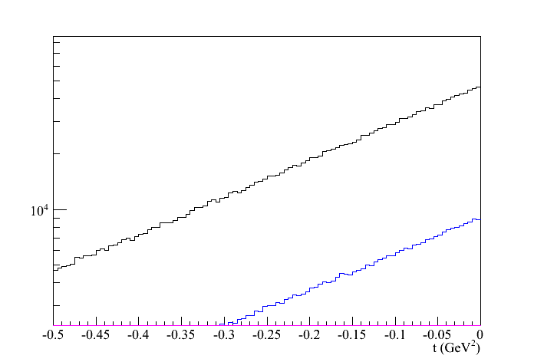
500 GeV pp: UPC kinematics
Beam: t₁
kinematics of proton 1 and 2
target: t₂
Adding cut by cut:
leptons without cuts
μ₂: -1 < η < 2
μ₁ and μ₂: -1 < η < 2
-0.8<t₁<-0.1 and -0.8<t₂<-0.1

Slide 10
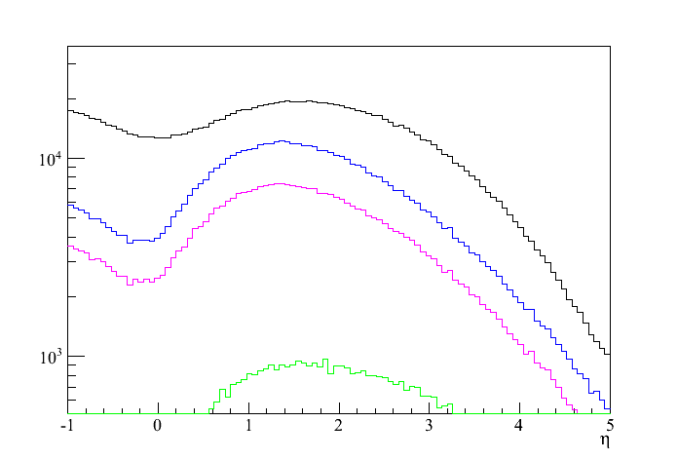
500 GeV pp: Decay kinematics
all cuts
Using SARTRE:
Cross section 500 GeV: 6.9 nb
200 GeV: 1.1 nb
in agreement with theoretical calculations
500 GeV: → 1600 J/Ψ in 290 pb⁻¹
550 J/Ψ in 100 pb⁻¹
200 GeV: → 3650 J/Ψ in 1800 pb⁻¹
200 J/Ψ in 100 pb⁻¹
no trigger efficiencies or detector effects
included yet
need more statistics → p↑Au
Adding cut by cut:
leptons without cuts
μ₂: -1 < η < 2
μ₁ and μ₂: -1 < η < 2
-0.8<t₁<-0.1 and -0.8<t₂<-0.1
J/Ψ reconstructed through
e+e- and/or μ+μ- channels

Slide 11
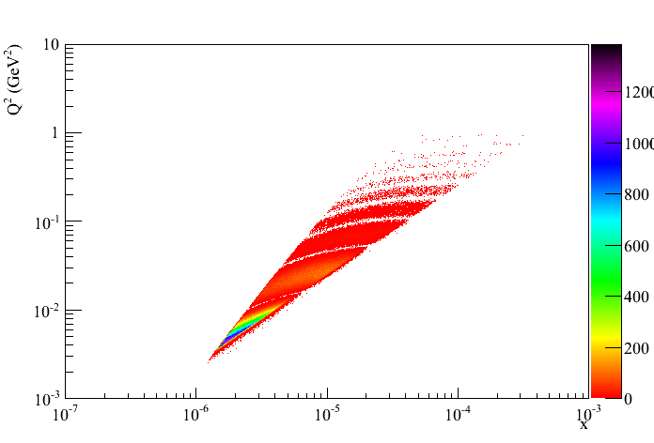
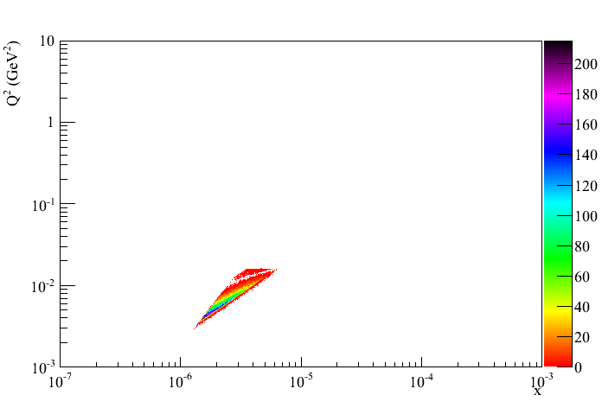
200 GeV pAu: UPC kinematics
Au
Au’
no cuts
p
p’
Adding cut by cut:
leptons without cuts
μ₂: -1 < η < 2
μ₁ and μ₂: -1 < η < 2
t₁>-0.016 and -0.2<t₂<-0.016
all cuts

Slide 12
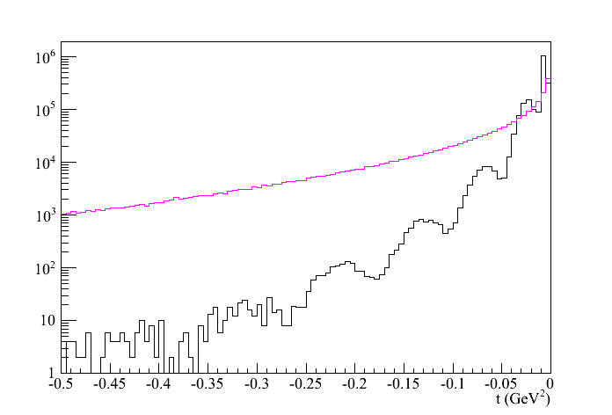
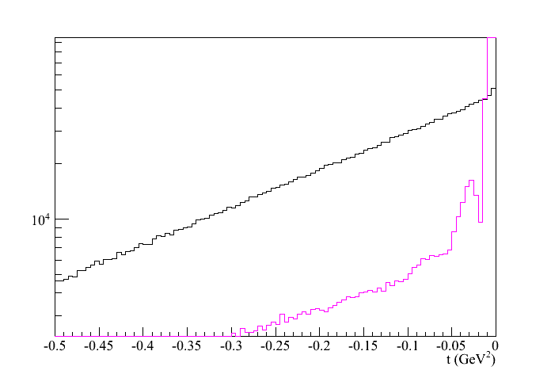
200 GeV pAu: UPC kinematics
Beam: t₁
p: t_{γ}
kinematics of proton 1 and 2
Au: t_{γ}
target: t₂
t_{p’}
t_{Au’}

Slide 13
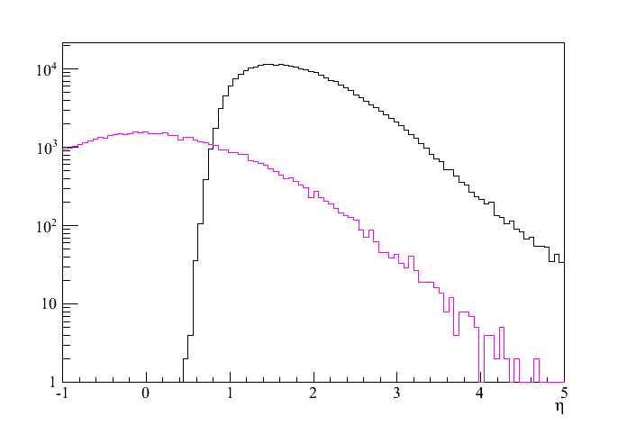
200 GeV pAu: Decay kinematics
all cuts
Au
Au’
p
p’
magenta
p
p’
black
Au
Au’
Using SARTRE:
Cross section 200 GeV: 38.5 nb
200 GeV: 1.6 10³ nb
in agreement with theoretical calculations
200 GeV: → 5450 J/Ψ in 51 pb⁻¹
11000 J/Ψ in 100 pb⁻¹
200 GeV: → 1558 J/Ψ in 1.2 pb⁻¹
155800 J/Ψ in 100 pb⁻¹
no trigger efficiencies or detector effects
included yet
Caveat: Q²-distribution for Au (=t₁)
needs to be extended in MC
→ more statistics 38.5 nb → ~10³ nb
Adding cut by cut:
leptons without cuts
μ₂: -1 < η < 2
μ₁ and μ₂: -1 < η < 2
t₁>-0.016 and -0.2<t₂<-0.016
J/Ψ reconstructed through
e+e- and/or μ+μ- channels

Slide 14
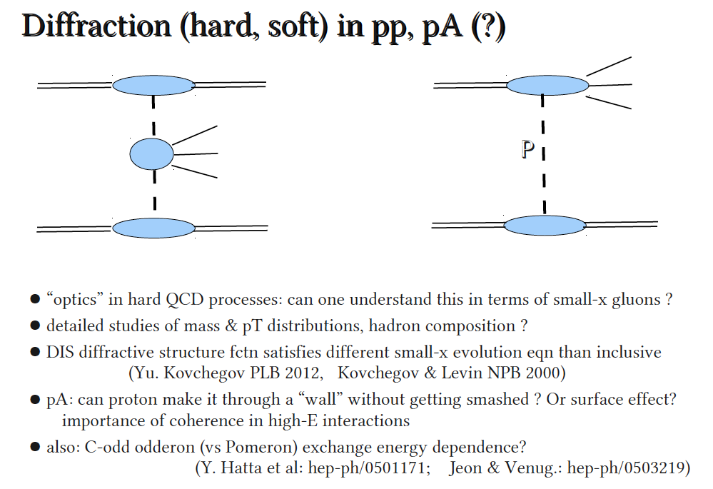
Diffractive Physics
Adrian Dumitru

Slide 15
More insights to the proton
Transversity distribution function δq(x)
Correlation between and
Single Spin Asymmetries
Unpolarized distribution function q(x), G(x)
beyond collinear picture
Explore spin orbit correlations
Helicity distribution function Δq(x), ΔG(x)
Boer-Mulders distribution function
Correlation between and
Sivers distribution function
Correlation between and

Slide 16
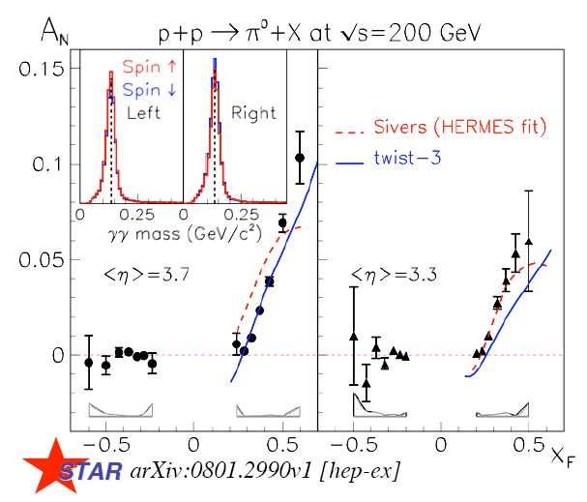
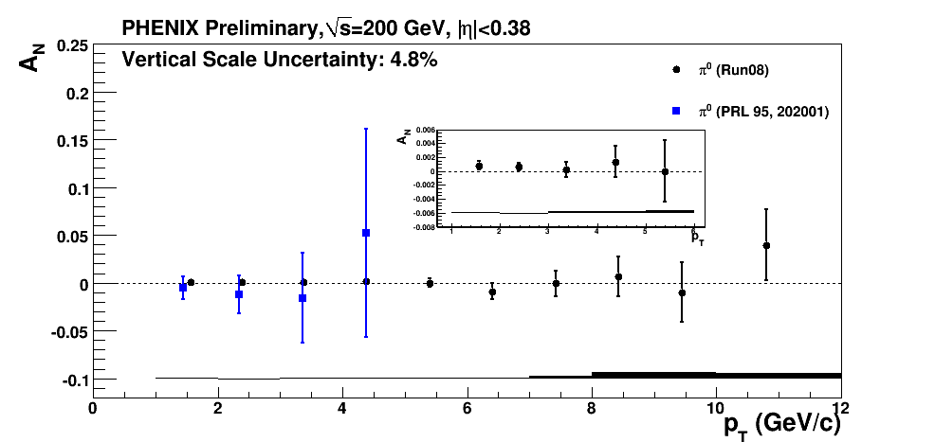
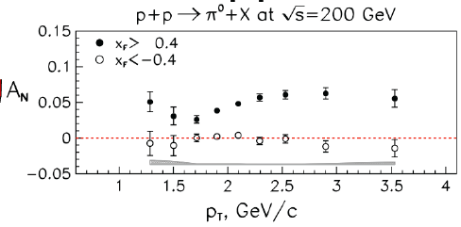
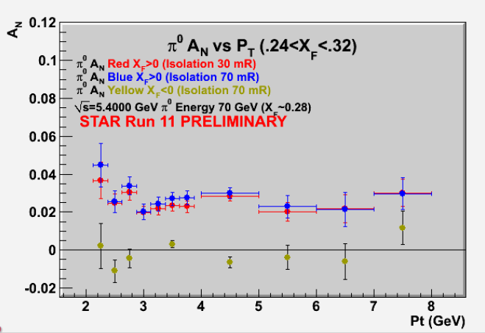
Transverse Polarization Effects @ RHIC
Left
-Right
Phys. Rev. Lett. 101 (2008) 222001
midrapidity: maybe gluon Sivers????
PHENIX
Questions from last page
What is the underlying process?
Sivers / Twist-3 or Collins or ..
no answer yet
Do they survive at high √s ? ✔
Is p_{t} dependence as expected from p-QCD? NO

Slide 17
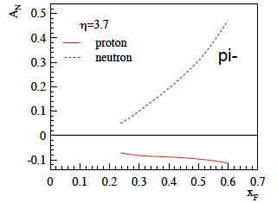
What pHe3 can teach us
Polarized He-3 is an effective neutron target → d-quark target
  Polarized protons are an effective u-quark target
Therefore combining pp and pHe3 data will allow a full
quark flavor separation u, d, ubar, dbar
Two physics trusts for a polarized pHe3 program:
Measuring the sea quark helicity distributions through W-production
  Access to Δdbar
  Caveat maximum beam energy for He-3: 166 GeV
    Need increased luminosity to compensate for lower W-cross section
Measuring single spin asymmetries A_{N} for pion production and Drell-Yan
  expectations for A_{N} (pions)
    similar effect for π± (π⁰ unchanged)
³He: helpful input for understanding
of transverse spin phenomena
Critical to tag spectator protons from 3He with roman pots

Slide 18

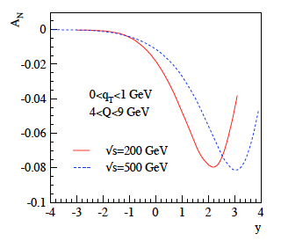
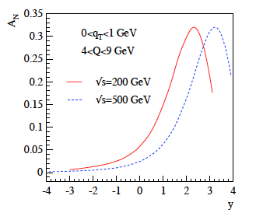
The long term future future of pp@RHIC
A_{N} in ³He-proton collisions
Sivers fcts. for u and d quarks opposite in sign and slightly larger for d quarks
expectations for Drell Yan
Z. Kang @ 2010 Iowa RSC meeting
u <-> d isospin rotation leads to different signs for A_{N} for protons and neutrons
asymmetries for neutrons are larger (due to electric charges)
proton
neutron
expectations for A_{N} (pions)
similar effect for π± (π⁰ unchanged)
this time computed within twist-3 formalism
here, effect due to favored/unfavored fragmentation
3He: helpful input for understanding
of transverse spin phenomena

Slide 19
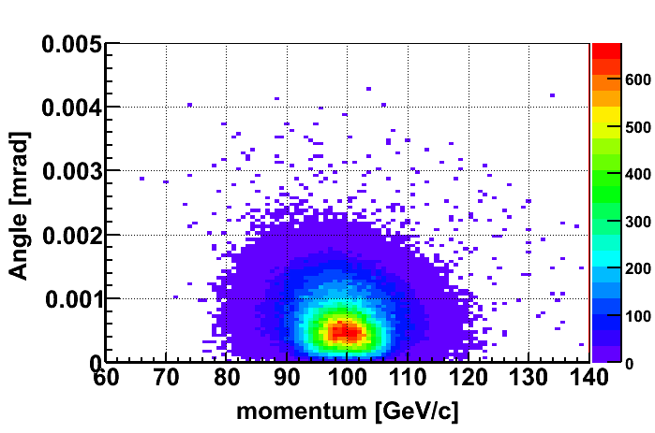
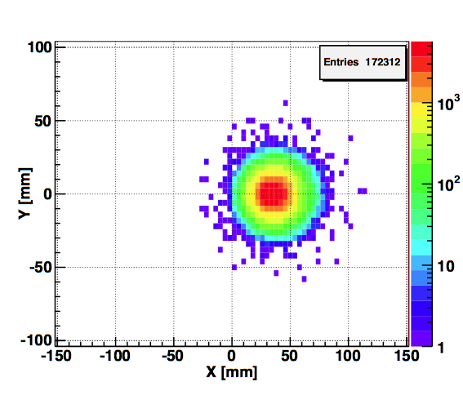
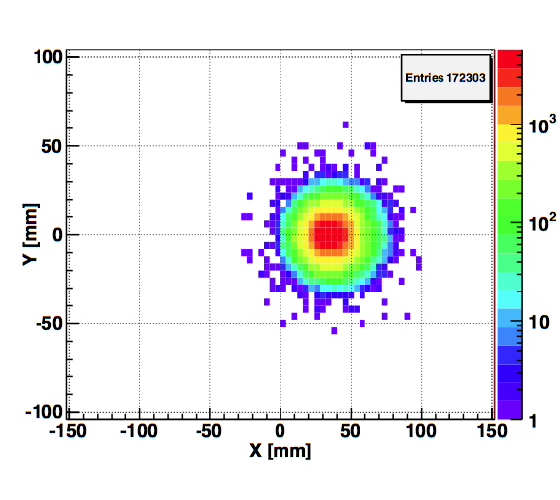
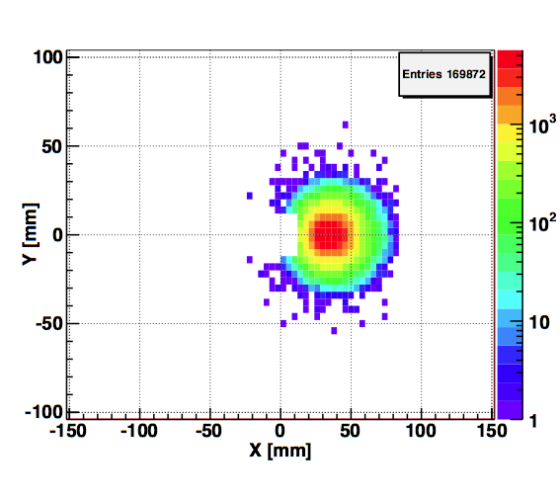
Spectator proton from ³He with the current RHIC optics
Momentum smearing mainly due
to Fermi motion + Lorentz boost
Angle <~3mrad (>99.9%)
Angle [rad]
Study: JH Lee
generated
Passed DX aperture
Accepted in RP
The same RP configuration with the current RHIC optics (at z ~ 15m between DX-D0)
Acceptance ~ 98%

Slide 20
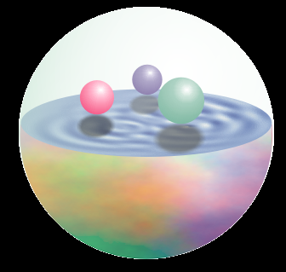
Δq: W Production Basics
Since W is maximally parity violating
→ W’s couple only to one parton helicity
large Δu and Δd result in large asymmetries.
u
No Fragmentation !
d
Similar expression for W⁻ to get Δ and Δd…

Slide 21
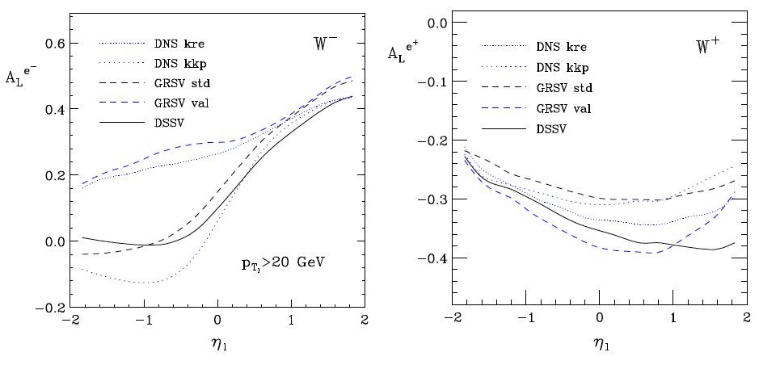
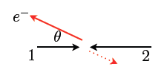
expectations for A_{L}^{e} in pp collisions
de Florian, Vogelsang
t large
u large
t large
u large
strong sensitivity to
limited sensitivity to

Slide 22
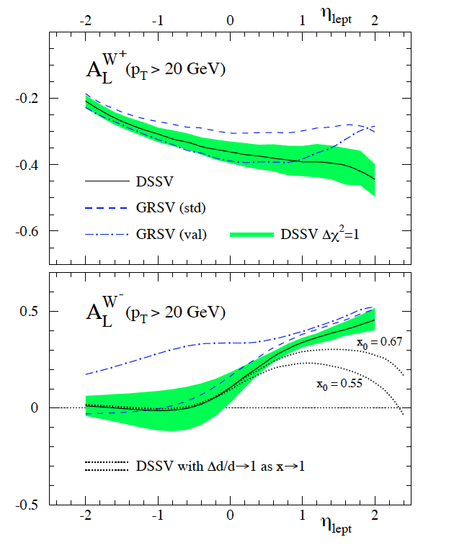
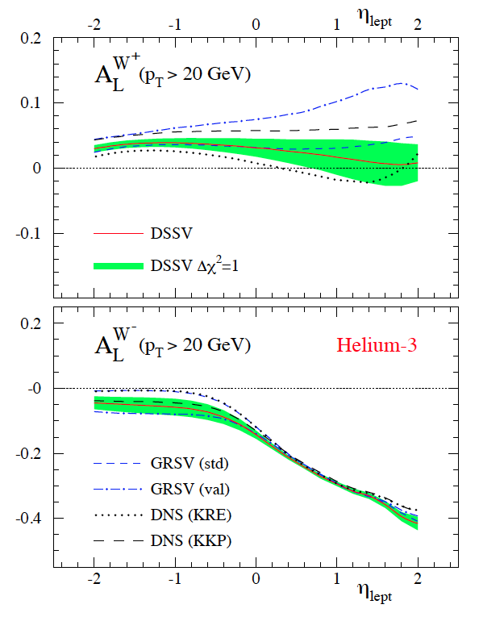
A_{L}^{W}: Future Possibilities
Can we increase p-beam energy?
  325 GeV: factor 2 in σ_{W}
  access to lower x for Δg(x)
Increased beam-energy and polarized He-3 beam → full flavor separation
A_{L}^{W}: pp @ 500 GeV
A_{L}^{W}: He3-p @ 432 GeV
phase 2 of pp2pp@STAR can separate scattering on n or p

Slide 23
Critical √s of W cross section
Main issues:
Quench performance of magnets (DX, arc dipoles and quads, IR quads)
Crossing angles at IPs and luminosity
Polarization
Current feed-throughs
Power supplies and transformers
Dump kicker (strength, pre-fires)
Reliability generally reduced at higher energies
Report: W. MacKay BNL C-A/AP/422
estimated # of training quenches
polarised He-Beams
  had a a workshop to discuss possibilities
  https://indico.bnl.gov/conferenceDisplay.py?confId=405
  no show stoppers, but need additional snakes in RHIC
increase luminosity of RHIC
Conclusion:
10% increase to 275 GeV feasible with current magnets
about 20 DX, 10 other training quenches, more cooling at some current leads
Requires some hardware upgrades (power supplies)
Effect on polarization still needs study
Energies >275 GeV require too many training quenches
hundreds of arc dipole training quenches alone for 325 GeV

Slide 24
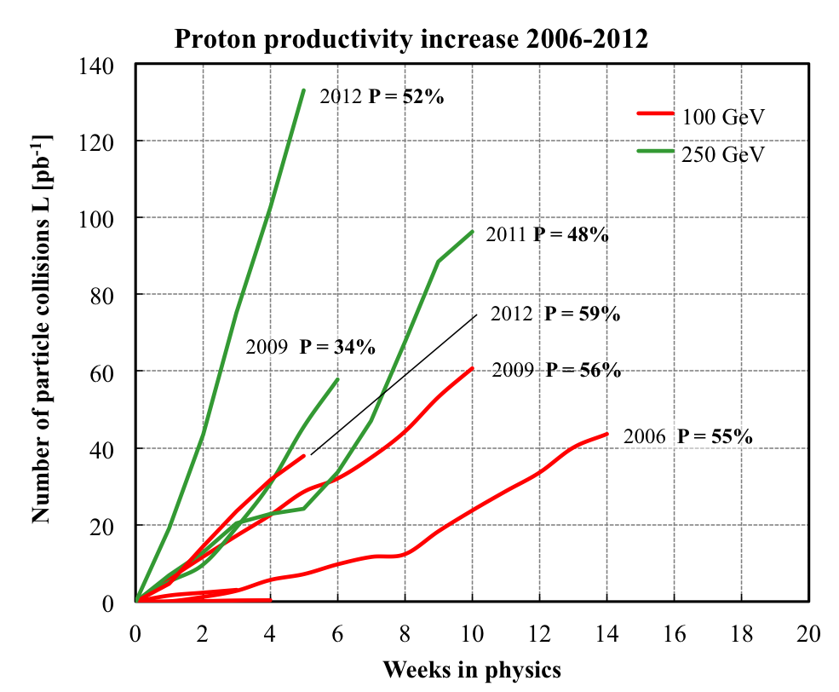
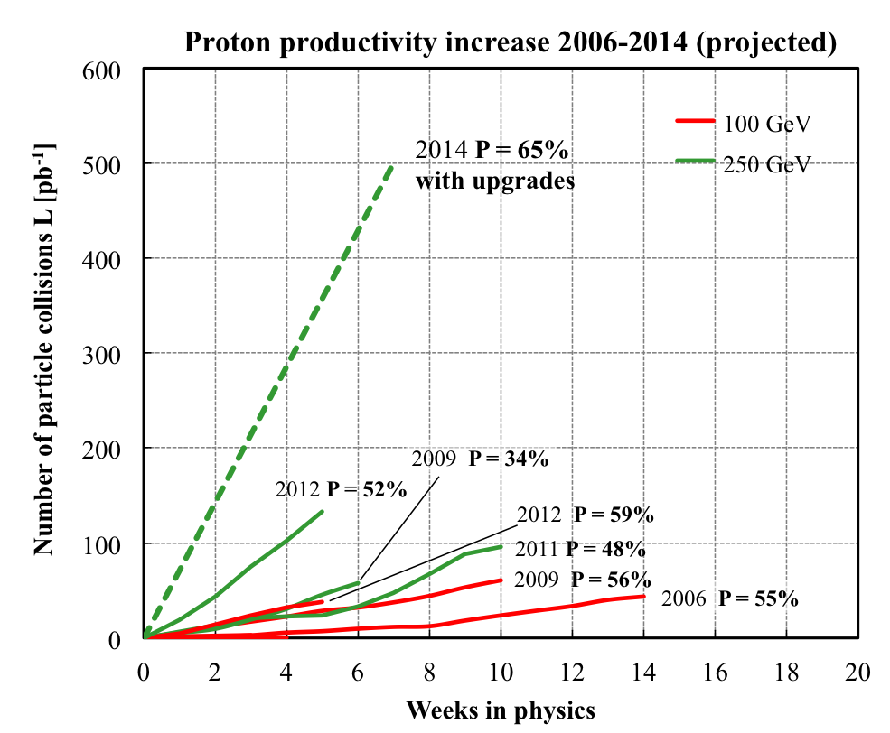
RHIC polarised p+p performance
2012:
golden year for polarized
proton operation
100 GeV:
new records for L_{peak}, L_{avg}, P
255 GeV:
new records for L_{peak}, L_{avg}, P
highest E for pol. p beam
L_{avg}: +15%
P_{avg}: +8%
What will come:
increased Luminosity and
polarization through
OPPIS new polarized source
Electron lenses to
compensate beam-beam
effects
many smaller incremental
improvements
will make luminosity
hungry processes,
i.e. DY, easier accessible

Slide 25
Summary
An enormous amount of physics
which needs RP@STAR
it is a secret to me why we don’t do this upgrade

