Slide 1
Diffraction why is it interesting?
E.C. Aschenauer

Slide 2
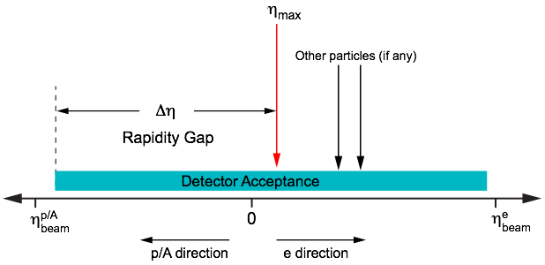
What do we know about diffraction
Diffractive events are characterized by a large rapidity gap
and
the exchange of a color neutral particle (pomeron)
The diffractive processes occur in pp, pA, AA, ep, and eA
High sensitivity to gluon density: σ~[g(x,Q²)]² due to color-neutral exchange
→ golden channel at EIC to probe saturation
→ fraction of diffractive events goes from 15% (ep) to 30% (eA)
→ same is predicted for pA
Only known process where spatial gluon distributions of nuclei can be extracted

Slide 3
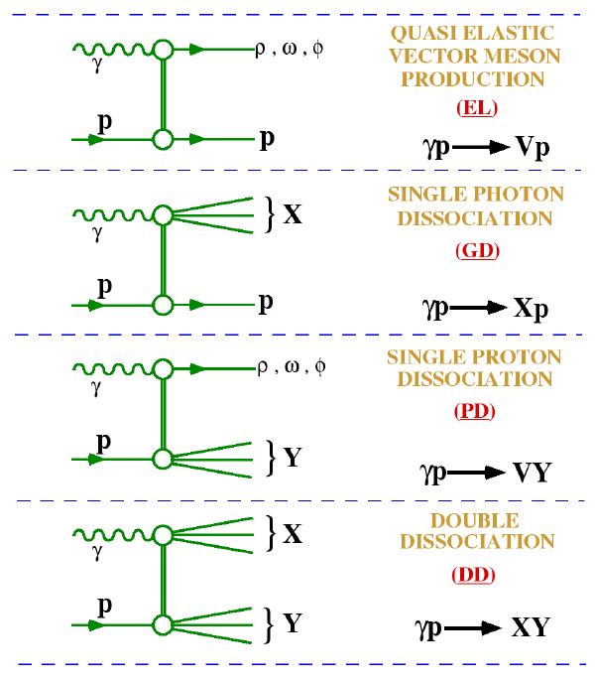
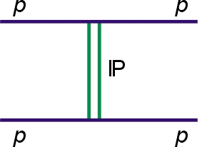
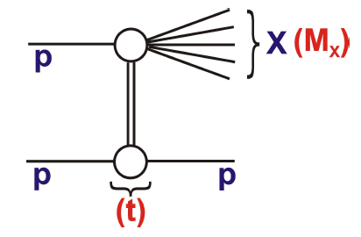
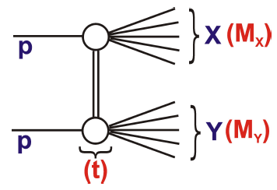
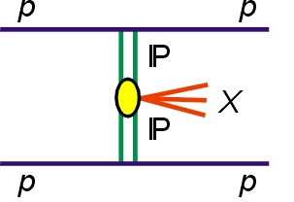
What do we know about diffraction
DIS
Hadron+Hadron
elastic
p + p → p + p
single dissociation (SD)
p + p → X + p
p + p → p + Y
double dissociation (DD)
p + p → X + Y
Favorable kinematics to study
photon dissociation
double pomeron exchange (DPE)
p + p → p + p + X

Slide 4
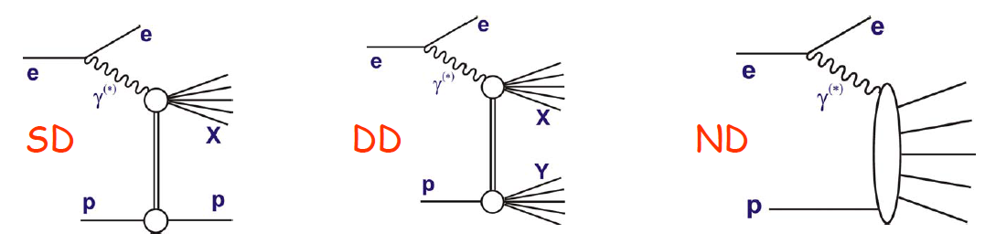
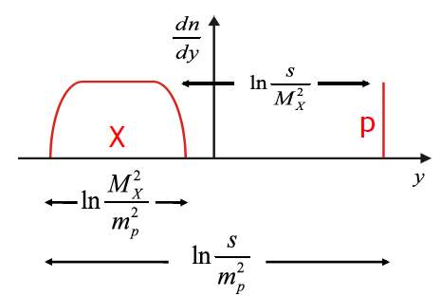
What do we know about diffraction
… but how to specify the difference between diffractive and non-diffractive processes?…
… nature gives smooth transitions between these processes
Definitions in terms of hadron-level observables …
For SD can be done in terms of a leading proton
More general definition to accommodate DD
…can be applied to any diff or non-diff final state …
Order all final state particles in rapidity
Define two systems, X and Y, separated by the
largest rapidity gap between neighboring particles.

Slide 5
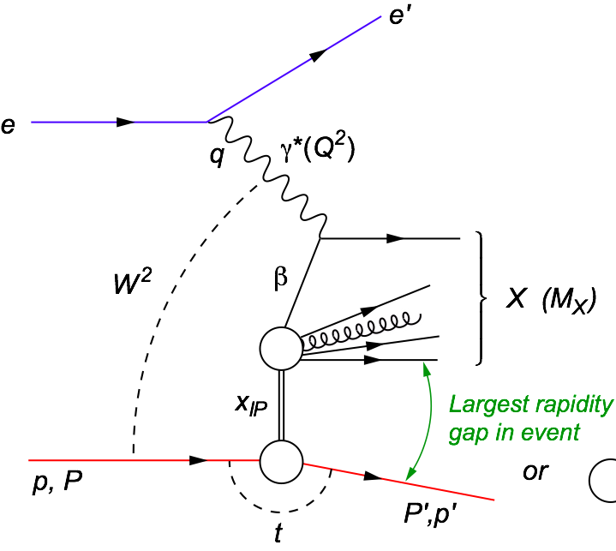
Hard Diffraction Kinematics
e+p
p+p
t = (p-p’)²
β = x/xIP is the momentum fraction of the struck parton w.r.t. the Pomeron
xIP = ζ = x/β = M_{x}²/W:
momentum fraction of the
exchanged object w.r.t. the hadron
know exact kinematics from
scattered lepton
→ factorization is proven
t = (p-p’)²
ζ = M_{x}²/W:
momentum fraction of the exchanged object w.r.t. the hadron
exact kinematics not known
→ factorization is violated

Slide 6
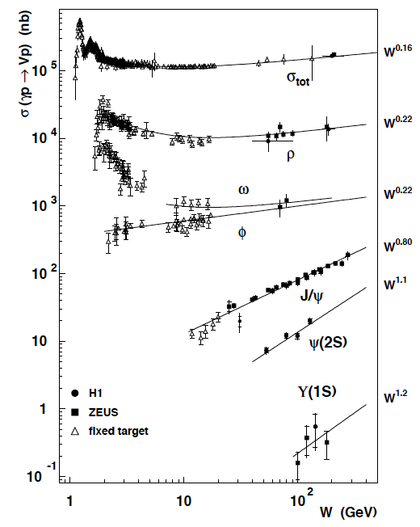
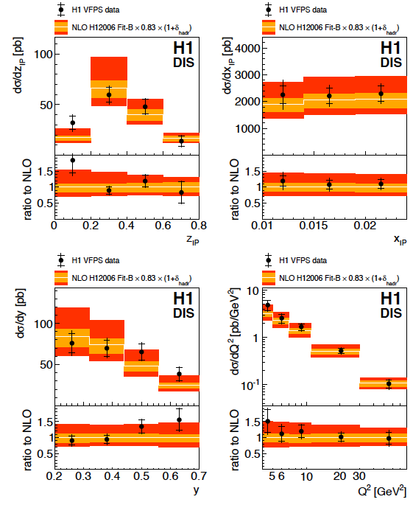
HERA and Tevatron results
VM
Di-jet
Excellent summary
arXiv:1308.3368

Slide 7
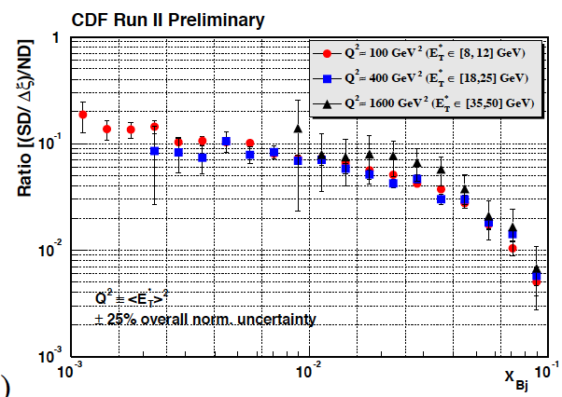
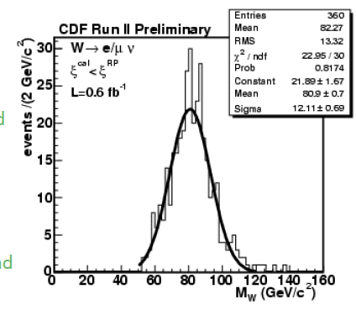
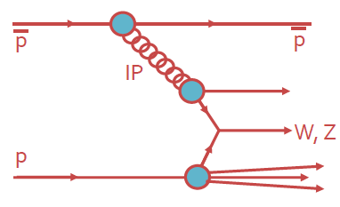
HERA and Tevatron results
Di-jets
No results from LHC shown, because this would be a 3h talk
Diffractive W/Z production probes the
quark content of the Pomeron

Slide 8

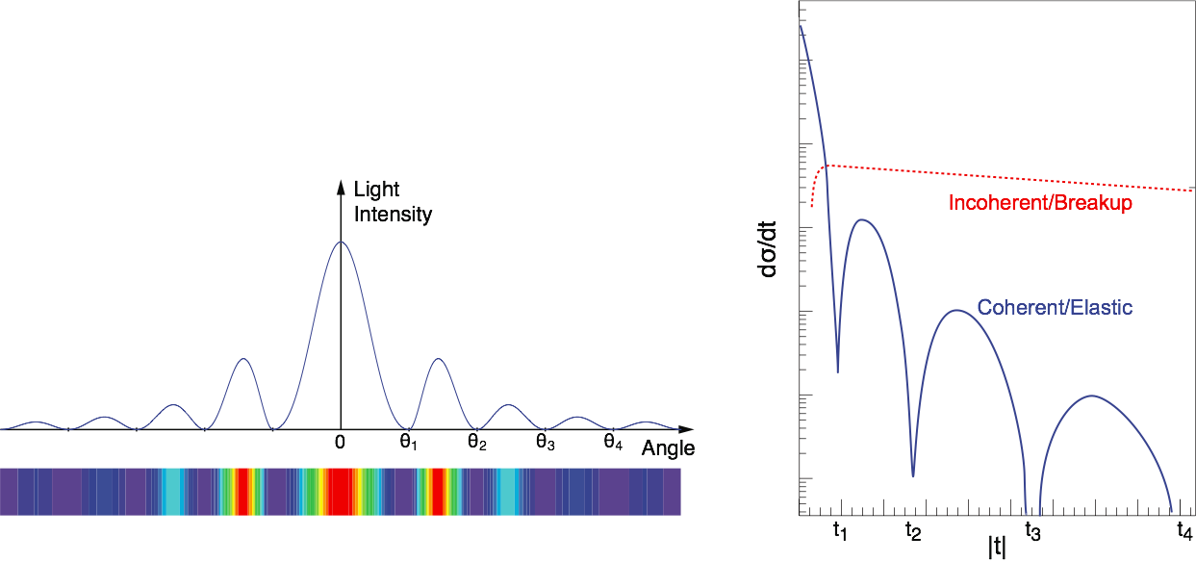
Diffractive Events in eA
Diffraction Analogy: plane monochromatic wave incident on a circular screen of radius R
2 Types: Coherent (A stays intact) & Incoherent (A breaks up)
Experimental challenging to identify
  Rapidity gap ⇒ hermetic detector
  Breakup needs to be detected ⇒ n and γ in Zero Degree Calorimeter, spectator tagging (Roman Pots)
Notes:
HERA: σdiff/σtot ~ 15%

Slide 9
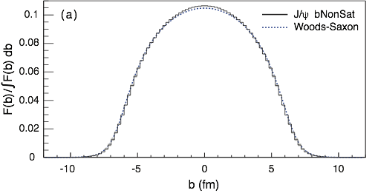
eRHIC: Spatial Gluon Distribution from dσ/dt
Diffractive vector meson production:
e + Au → e′ + Au′ + J/ψ, φ, ρ
Momentum transfer t = |pAu-pAu′|² conjugate to bT
Fourier Transform
PRC 87 (2013) 024913
Converges to input F(b) rapidly: |t| < 0.1 almost enough
Recover accurately any input distribution used in model used to generate pseudo-data (here Wood-Saxon)
  Systematic measurement requires ∫Ldt >> 1 fb⁻¹/A
  dσ/dt: diffractive pattern known from wave optics
  φ sensitive to saturation effects, smaller J/ψ shows no effect
  J/ψ perfectly suited to extract source distribution
Notes:
spin-dependent gluon distribution

Slide 10
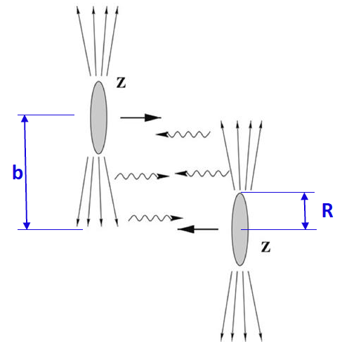
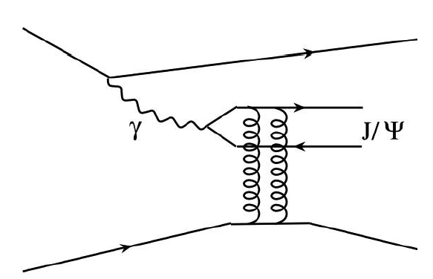
RHIC as γA collider: UPC
Ultra-peripheral (UPC) collisions: b > 2R
→ hadronic interactions strongly suppressed
High photon flux ~ Z²
→ well described in Weizsäcker-Williams approximation
→ high σ for -induced reactions
e.g. exclusive vector meson production
Coherent vector meson production:
• photon couples coherently to all nucleons
• ↑ p_{T} ~ 1/R_{A} ~ 60 MeV/c
• no neutron emission in ~80% of cases
Incoherent vector meson production:
• photon couples to a single nucleon
• ↑ p_{T} ~ 1/R_{p} ~ 450 MeV/c
• target nucleus normally breaks up

Slide 11
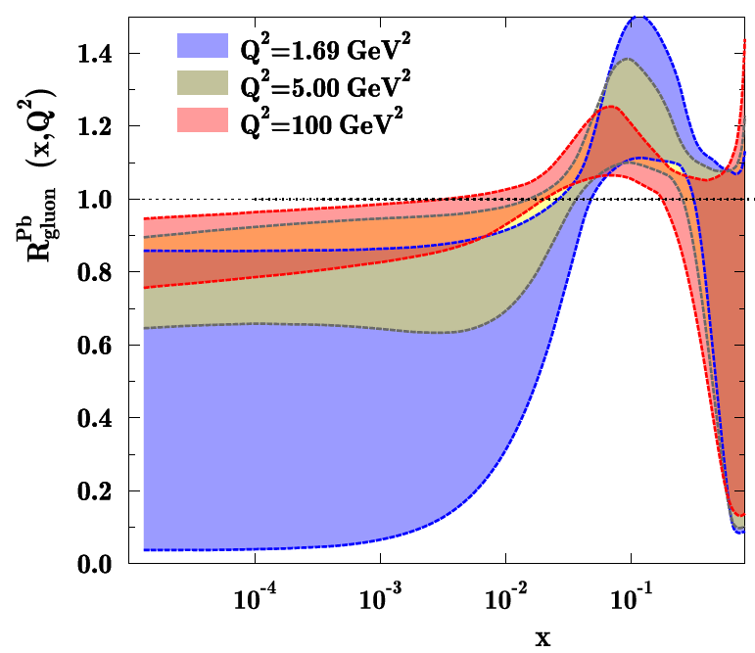
Why UPC at STAR
Quarkonia photoproduction allows to study the gluon density G(x,Q²) in A
as well as G(x,Q², b_{T})
LO pQCD: forward coherent photoproduction cross section is proportional to the squared gluon density
Quarkonium photoproduction in UPC is a direct tool to measure nuclear gluon shadowing
Important: p_{t}² ←→ Q²
Q² for measurements at STAR Q²>5 GeV, i.e. direct photon
Q² for J/Ψ: 2.5 GeV²
→ impact on precision EPS estimate < 10% statistical uncertainty

Slide 12
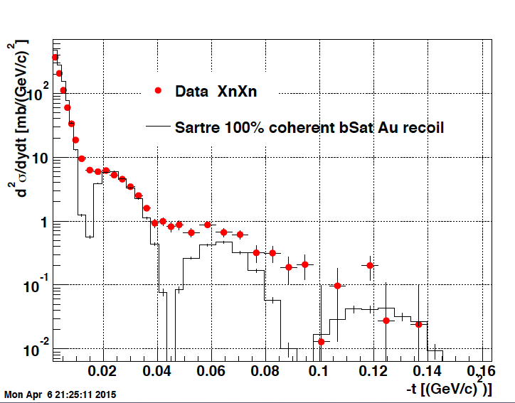
UPC at STAR
R. Debbe
2 tracks in STAR and one neutron in each ZDC Au+Au → n+n+e+e-
no attempt for a Fourier transform of σ vs. t has been made
→ g(x,Q²,b)

Slide 13
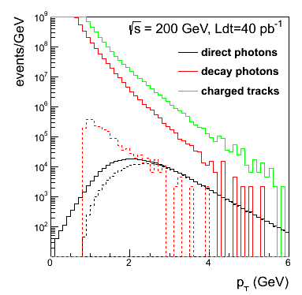
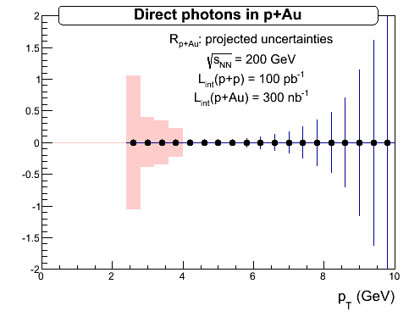
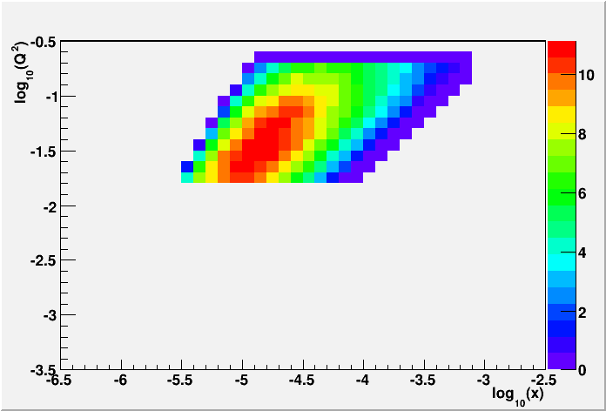
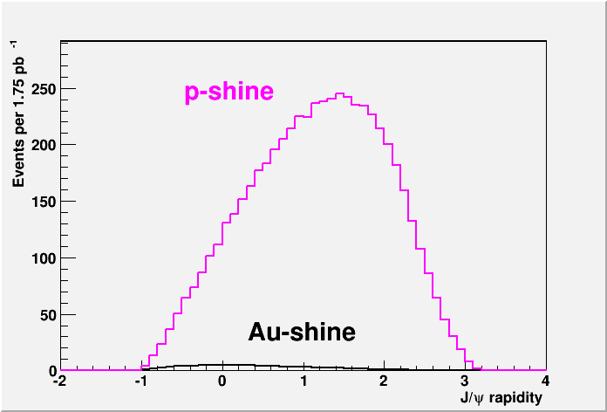
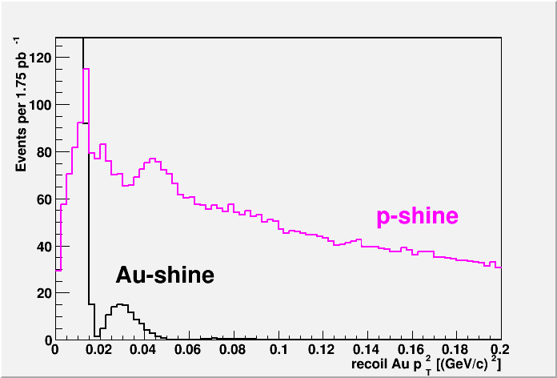
STAR: nuclear PDFs
Direct Photon R_{pAu}:
p+p
2015
required: FPS + FMS
2020+ UPC: “proton-shine”-case:
Requires: RP-II* and 2.5 pb⁻¹ p+Au
Fourier transform of σ vs. t
→ g(x,Q²,b)

Slide 14
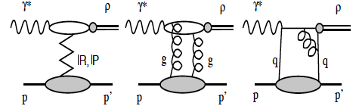
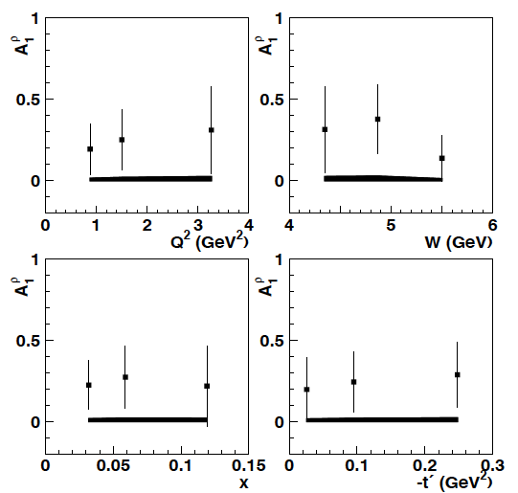
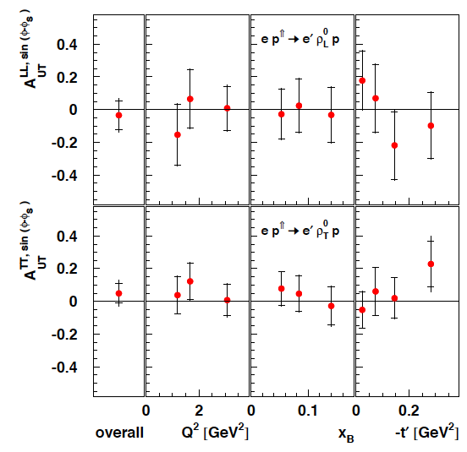
Diffraction and Spin
Pomeron (2g) vacuum quantum numbers → spin Asymmetries should be zero
only experiment which could measure diffractive spin asymmetries
HERMES
longitudinal DSA
transverse SSA
Is the underlying process for A_{N}
single diffraction with the polarized proton breaking up
→ A_{N} measured requiring a proton in the yellow beam RP
hep-ex/0302012
arXiv:0906.5160

Slide 15
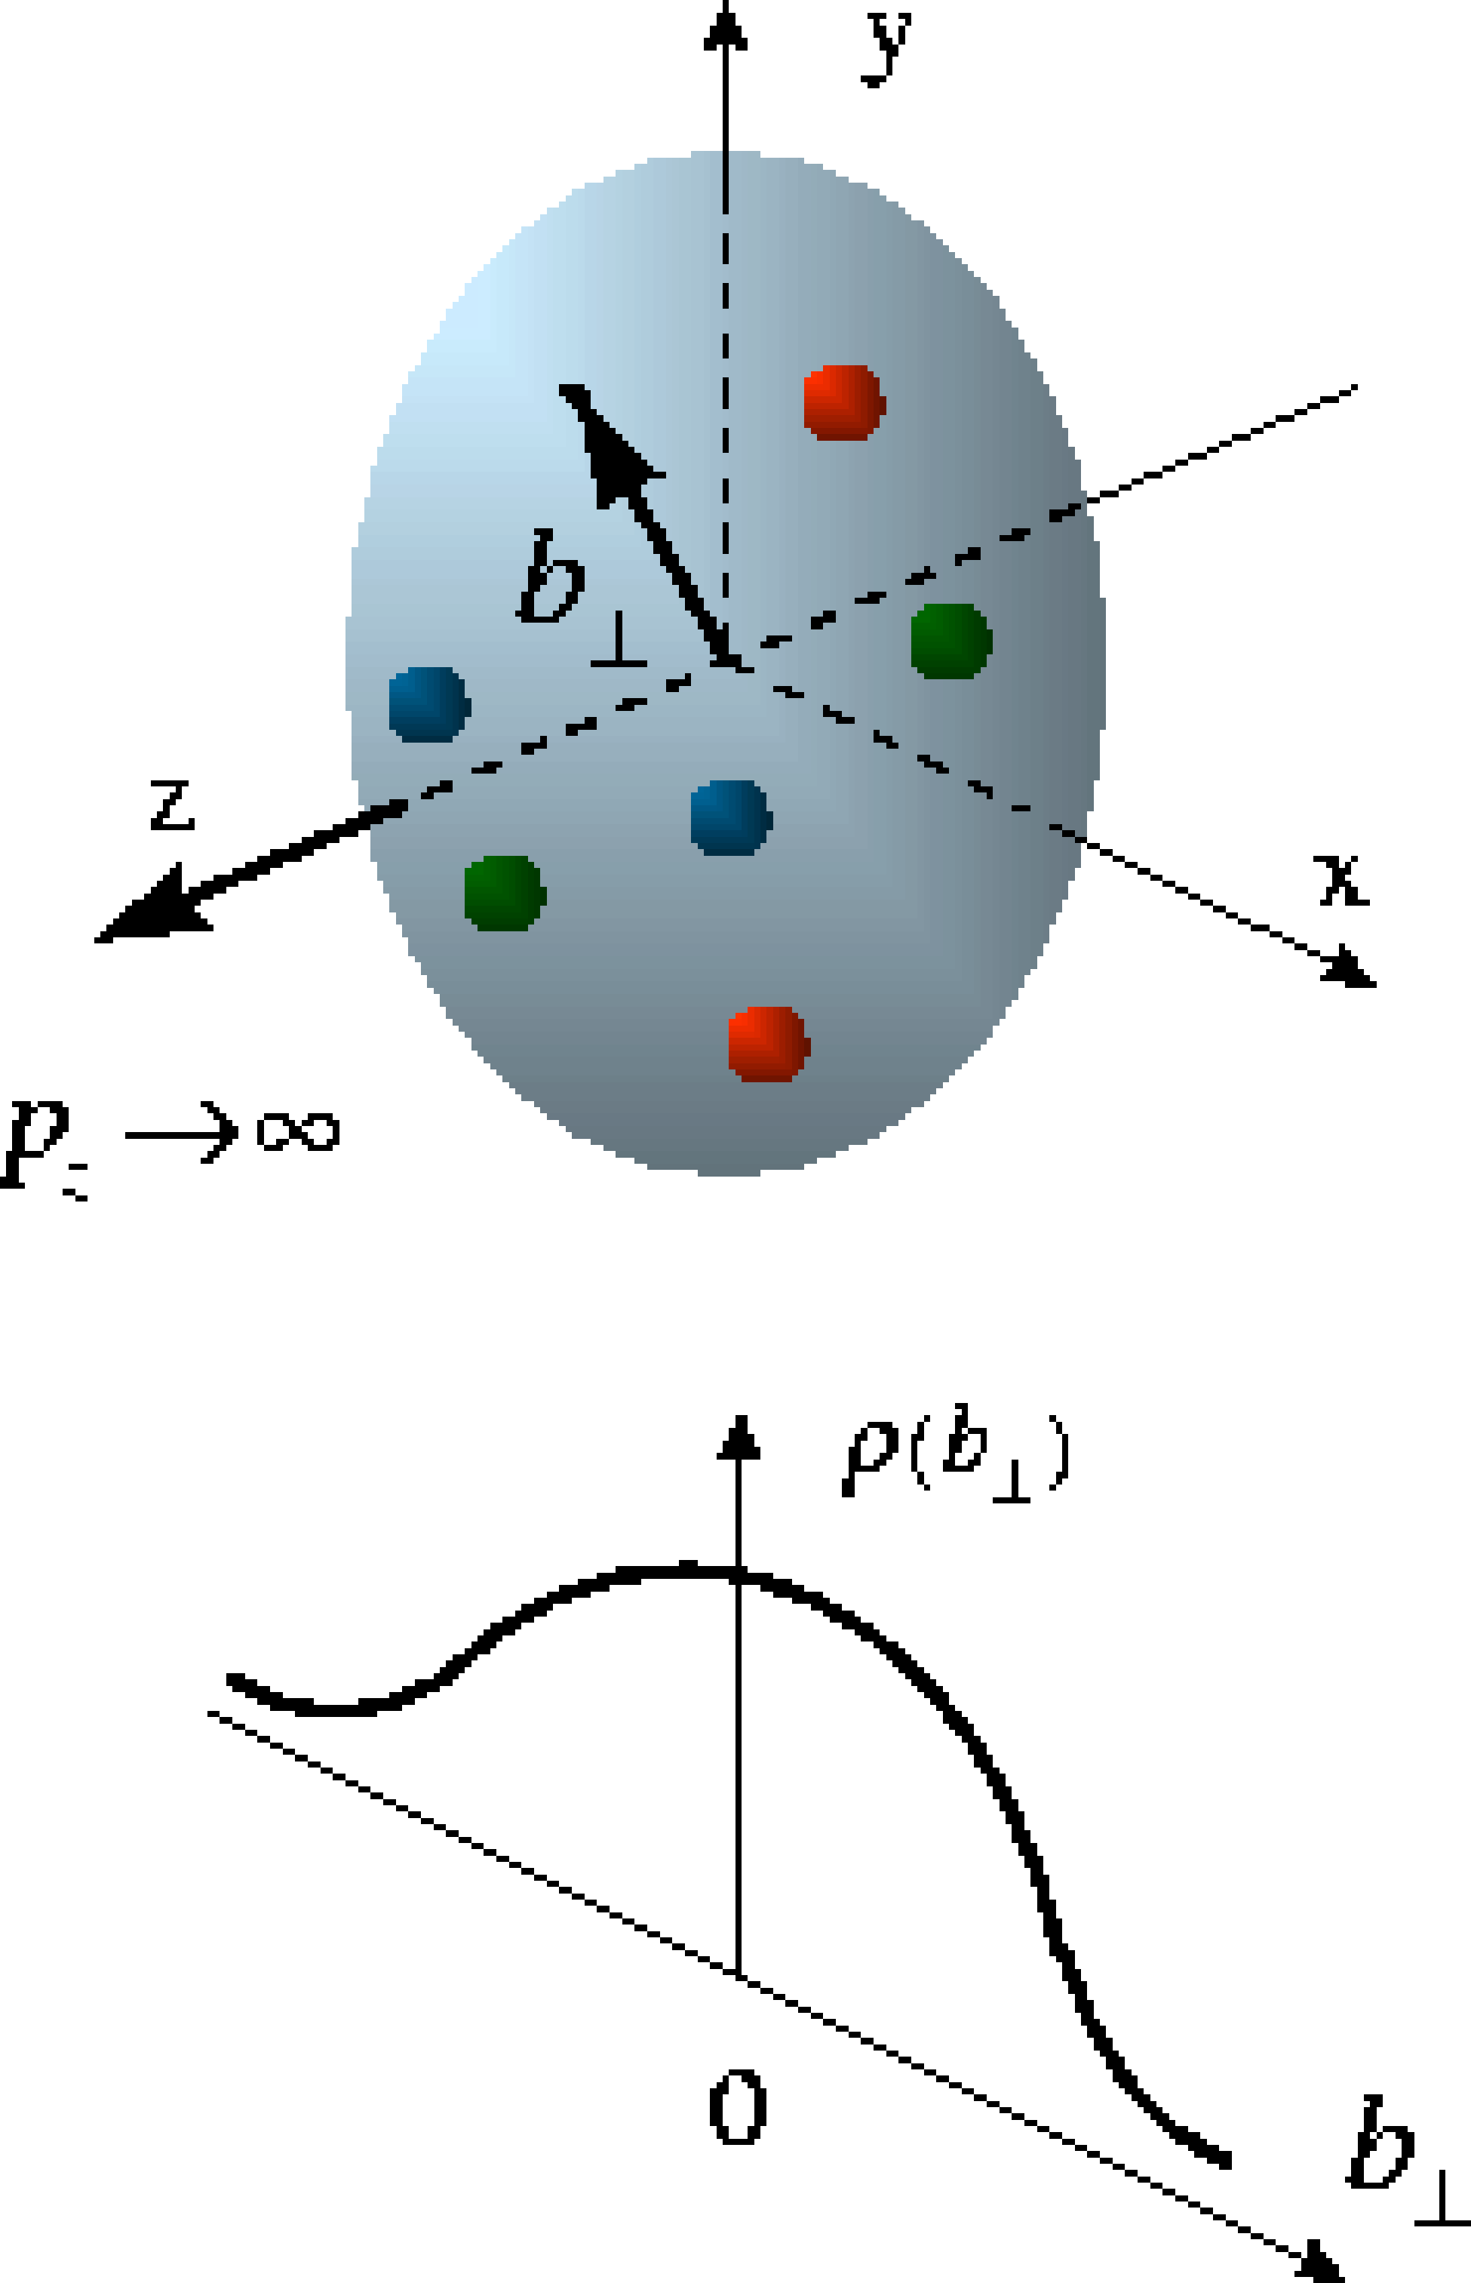
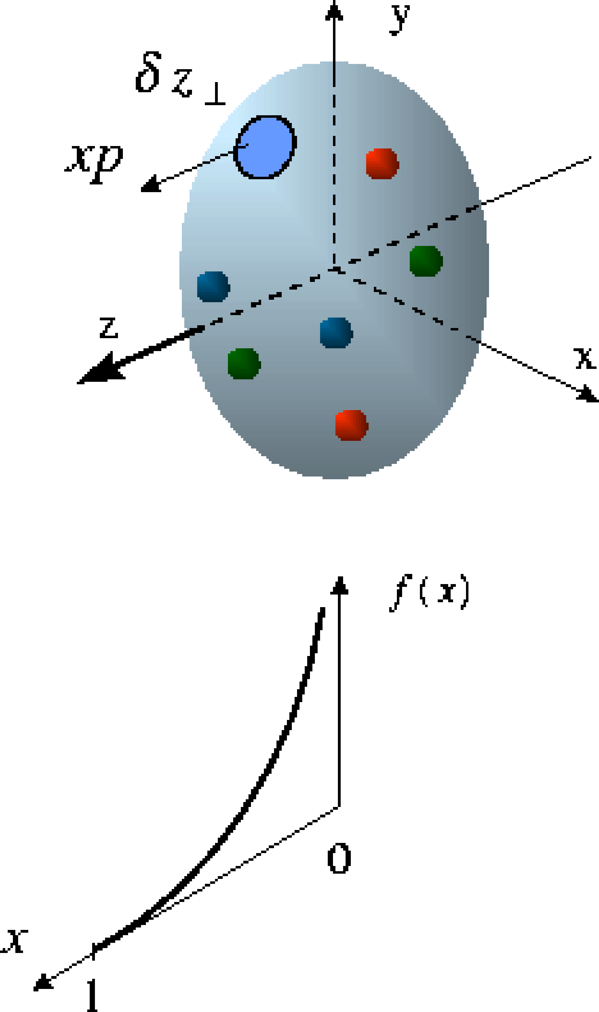
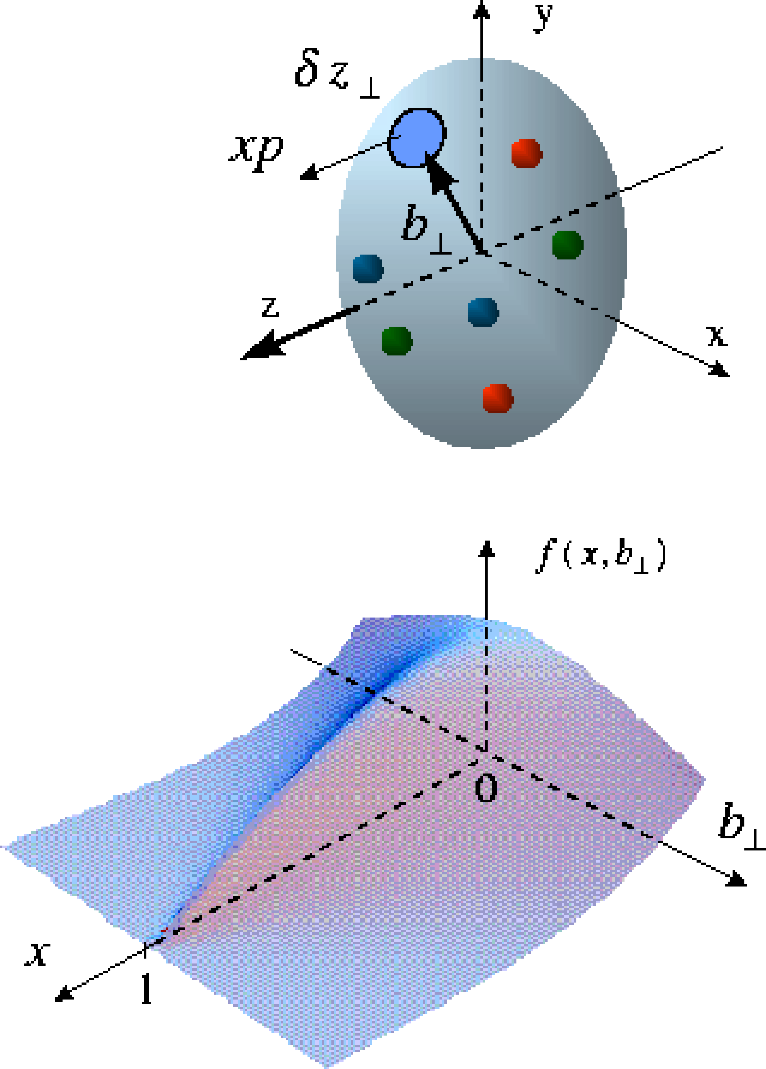
Beyond form factors and PDFs
Generalized Parton Distributions
X. Ji, D. Mueller, A. Radyushkin (1994-1997)
Proton form factors, transverse charge & current densities
Structure functions,
quark longitudinal
momentum & helicity
distributions
Correlated quark momentum
and helicity distributions in
transverse space - GPDs
the way to 3d imaging of the proton and the orbital angular momentum L_{q} & L_{g}
Constrained through exclusive reactions

Slide 16
Generalized Parton Distributions
the way to 3d imaging of the proton and the orbital angular momentum L_{q} & L_{g}
Measure them through exclusive reactions
golden channel: DVCS
e’
γ
e
γ_{L}*
(Q²)
x+ξ
x-ξ
~
~
p
H, H, E, E (x,ξ,t)
p’
t
Spin-Sum-Rule in PRF:
from g₁
GPDs:
Correlated quark momentum
and helicity distributions in
transverse space
responsible for orbital angular momentum

Slide 17
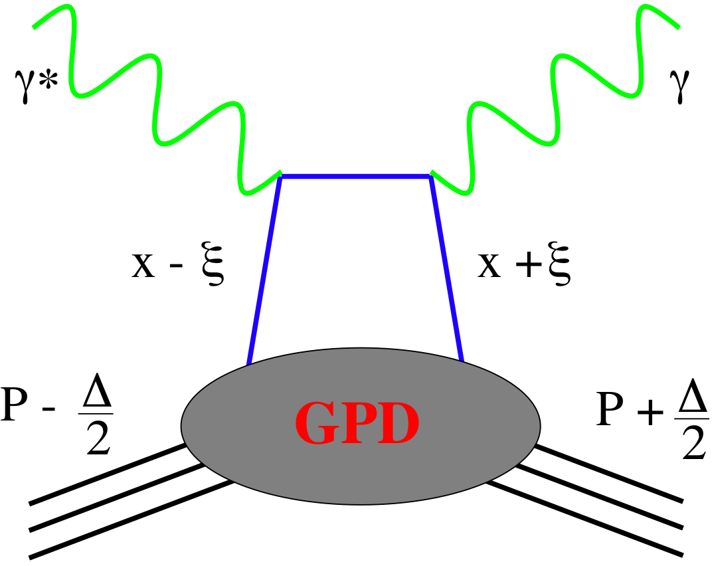
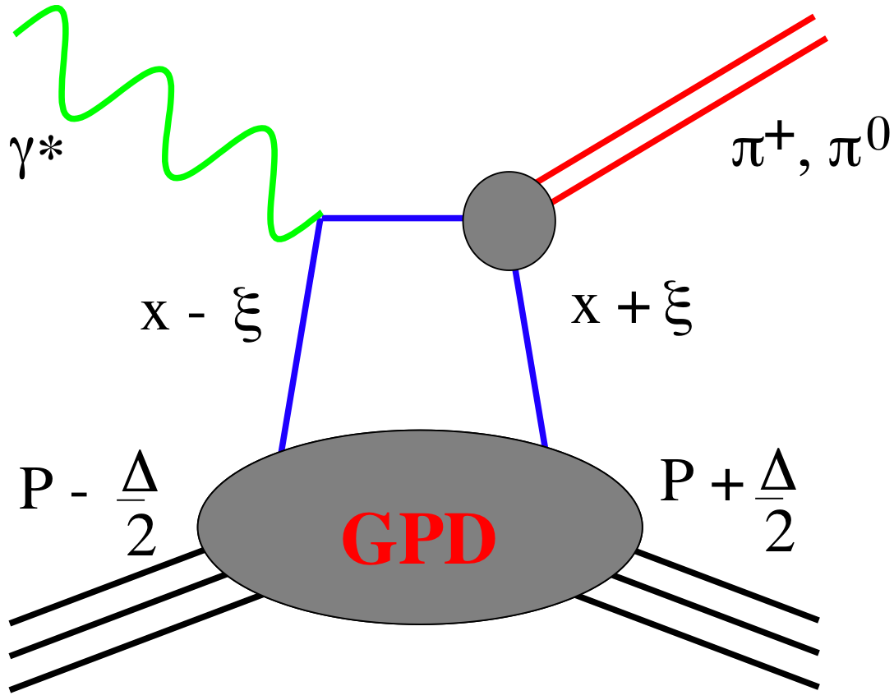
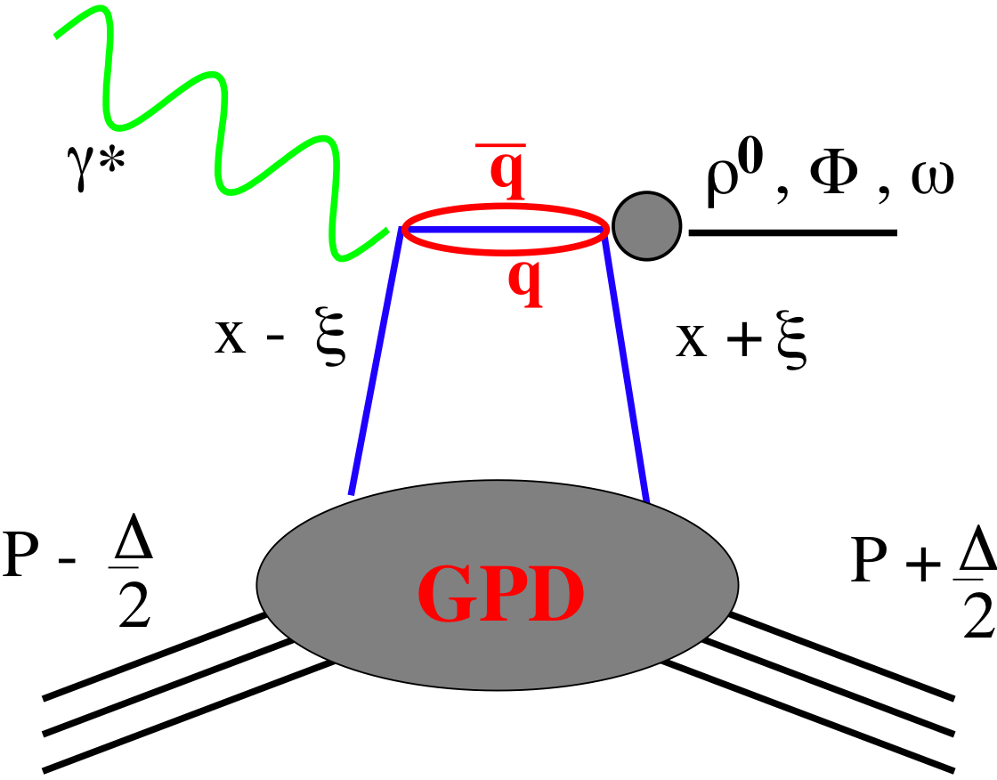
GPDs Introduction
How are GPDs characterized?
unpolarized polarized
conserve nucleon helicity
flip nucleon helicity
not accessible in DIS
quantum numbers of final state select different GPD
DVCS
pseudo-scaler mesons
vector mesons
π⁰ | 2Δu+Δd
η | 2Δu−Δd
ρ⁰ | 2u+d, 9g/4
ω | 2u-d, 3g/4
φ | s, g
ρ⁺ | u-d
J/ψ | g
Q²= 2E_{e}E_{e}’(1-cosθ_{e’})
x_{B} = Q²/2Mν ν=E_{e}-E_{e’}
x+ξ, x-ξ long. mom. fract.
t = (p-p’)²
ξ ≅ x_{B}/(2-x_{B})

Slide 18
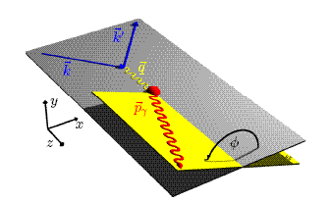
DVCS ASYMMETRIES
→ different charges: e⁺ e⁻ (only @HERA!):
~
Δσ_{C} ~ cosφ ∙Re{ H + ξH +… }
H
→ polarization observables:
~
Δσ_{LU} ~ sinφ∙Im{H + ξH + kE}
H
Δσ_{UT}
~
~
Δσ_{UL} ~ sinφ∙Im{H + ξH + …}
H
beam target
Δσ_{UT} ~ sinφ∙Im{k(H - E) + … }
H, E
ξ = x_{B}/(2-x_{B} ) k = t/4M²
kinematically suppressed

Slide 19
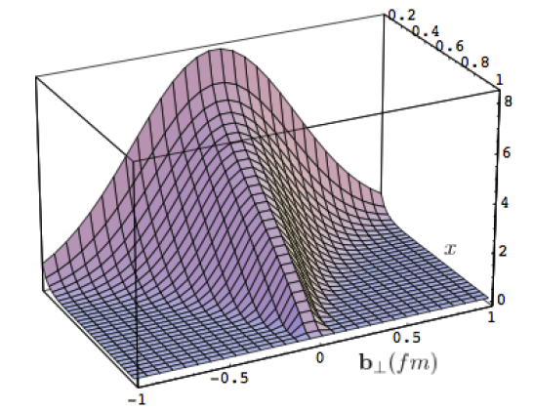
What can we learn
Model of a quark GPD
x
b_{T} (fm)
b_{T} decreasing as a function of x
eRHIC
Valence (high x) quarks at the center → small b_{T}
Sea (small x) quarks at the perifery → high b_{T}
GLUONS ???

Slide 20
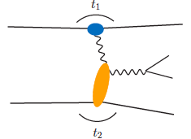
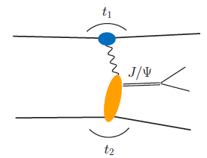
UPC in polarized pp↑ or Ap↑
p
p’
Get quasi-real photon from one proton
Ensure dominance of g from one identified proton
by selecting very small t₁, while t₂ of “typical hadronic
size”
small t₁ ←→ large impact parameter b (UPC)
Two possibilities:
Final state lepton pair ←→ timelike compton scattering
timelike Compton scattering: detailed access to GPDs
including E^{q/g} if have transv. target pol.
Challenging to suppress all backgrounds
p
p’
Au
Au’
Final state lepton pair not from γ* but from J/ψ
  Done already in AuAu
  Estimates for J/ψ (hep-ph/0310223)
transverse target spin asymmetry
→ calculable with GPDs
information on helicity-flip distribution E for gluons
golden measurement for eRHIC
Z²
p
p’
polarized p↑A: gain in statistics ~ Z²

Slide 21
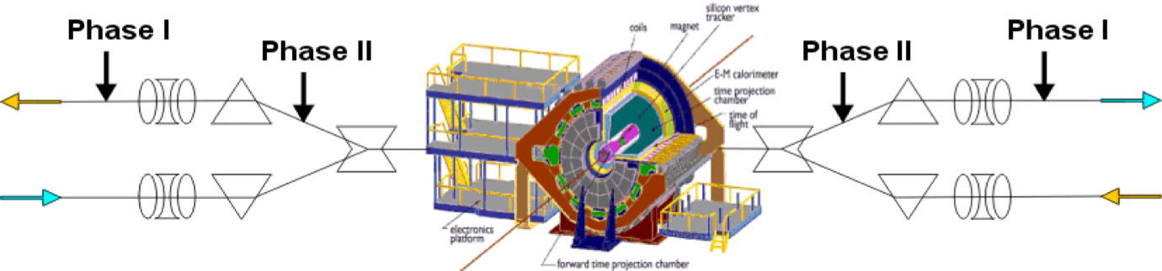
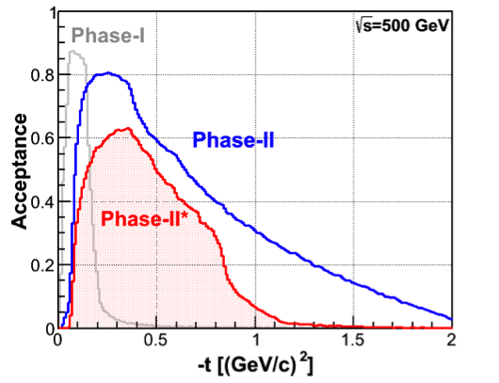
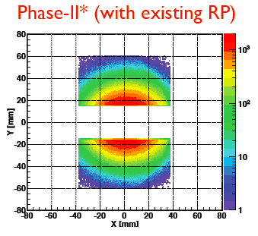
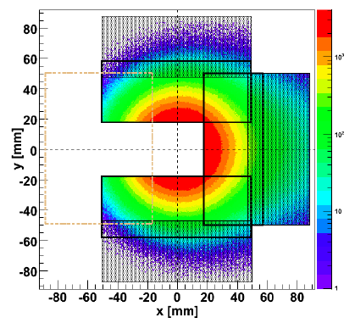
Forward Proton Tagging Upgrade
at 55-58m
at 15-17m
Follow PAC recommendation to develop a solution to run pp2pp@STAR with
std. physics data taking → No special β* running any more
should cover wide range in t → RPs at 15m & 17m
Staged implementation
  Phase I (currently installed): low-t coverage
  Phase II (proposed) : for larger-t coverage
  1st step reuse Phase I RP at new location only in y
  full phase-II: new bigger acceptance RPs & add RP in x-direction
    full coverage in φ not possible due to machine constraints
Good acceptance also for spectator protons from
deuterium and He-3 collisions
Phase-II: 1st step
1st step
full Phase-II

Slide 22
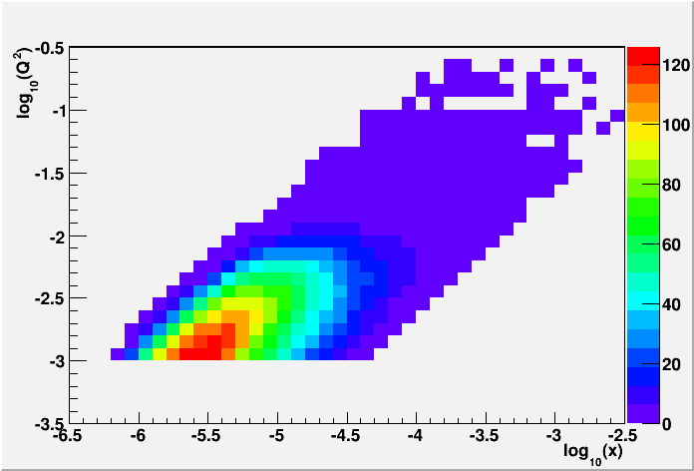
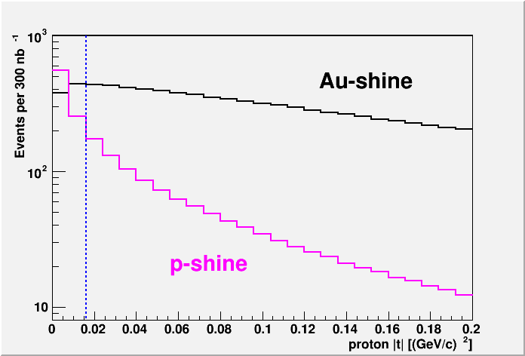
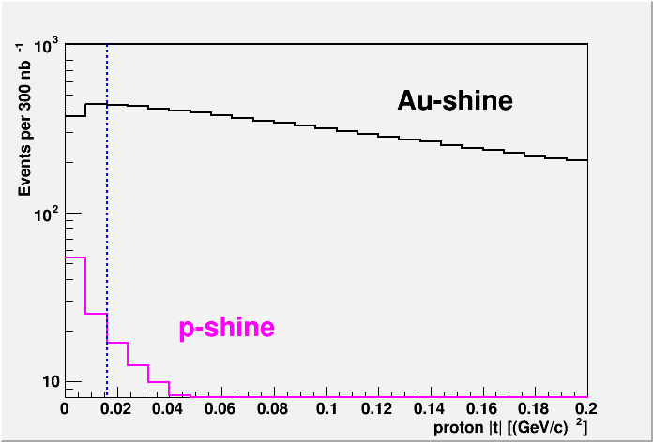
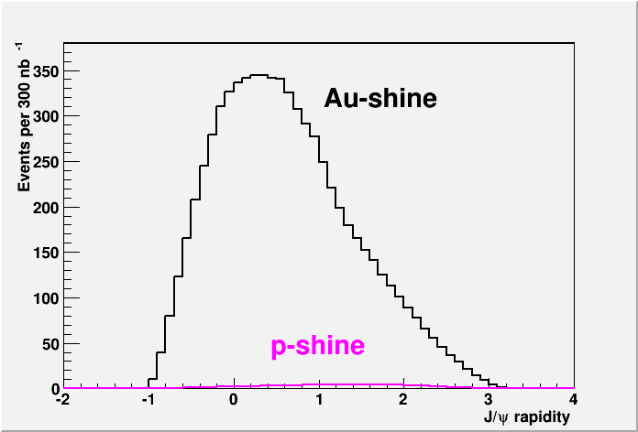
From ep tO pp to γ p/A
UPC in p+Au:
Required:
2015 p+A 300 nb⁻¹
RP-Phase II*
Cuts:
no hit in the RP phasing the Au-beam (-t > -0.016 GeV²) or in the ZDC
detecting the scattered proton in the RP (-0.016 > -t > -0.2 GeV²)
both J/ψ decay leptons are in -1 < η < 4
cut on the p_{t}² of the scattered Au, calculated as the p_{t}² of the vector sum
of the proton measured in the RP and the J/ψ to be less then 0.02 GeV²
→ 7k J/ψ

Slide 23
Summary
Diffractive physics provides one of the most versatile tools to study QCD
both in DIS and in hadron+hadron collisions
collected plenty of data in 2015 to study
is origin of A_{N} of diffractive nature
Is the GPD E_{g} non-zero
g(x,Q²) for nuclei
  possibly as fct. of b_{T}
  → can we see saturation through σ_{pA} / σ_{pp} for diffractive events
…….

