Slide 1
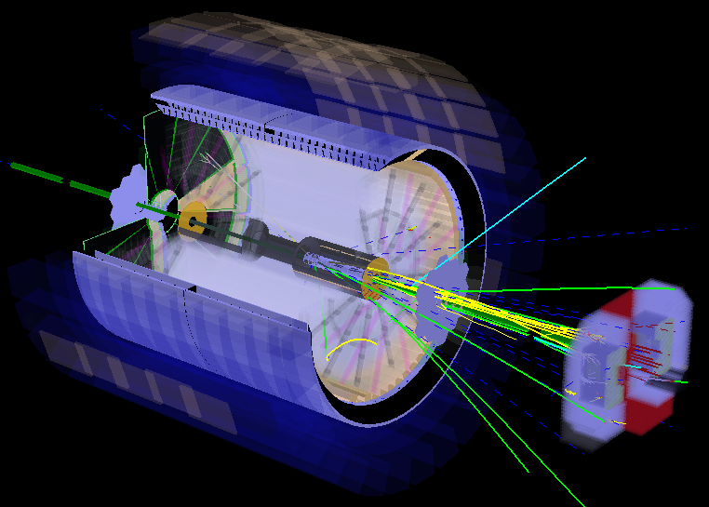
STAR’s polarized p+p and p+A program for the next years
E.C. Aschenauer
https://drupal.star.bnl.gov/STAR/starnotes/public/sn0605

Slide 2
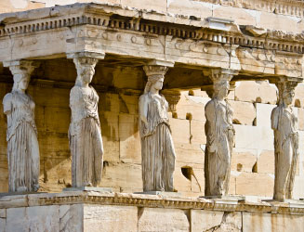
The Pillars of the STAR p+p & p+A Physics program
How do quarks and
gluons hadronize
into final state
particles?
What is the nature
of the spin of the
proton?
How can we describe
the multidimensional
landscape of nucleons
and nuclei?
What is the nature of
the initial state in
nuclear collisions?
Needs a multiyear program to answer these questions

Slide 3
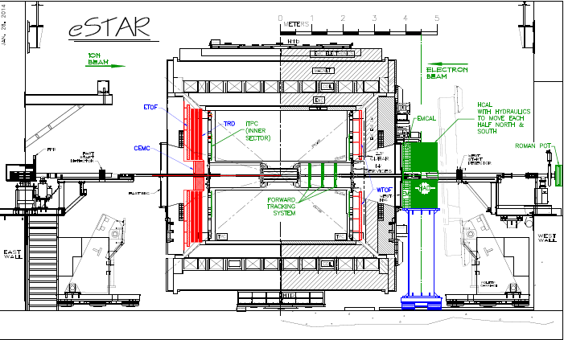
STAR’s p+p & p+A Timeline
2015
2016
≧2020-2023
≧ 2025
Upgrades:
FMS-Preshower
RP Phase-II*
Run:
p+p 200 GeV
longitudinal &
transverse
p↑+Au 200 GeV
transverse
Goal:
Δg(x,Q²)
transverse spin
structure of the p
Search for exotics
GPD E_{g}
nPDF: g(x,Q²)
Saturation
eSTAR@eRHIC
Upgrades:
FMS-Postshower
Run:
p+p 510 GeV
transverse
Goal:
Sea-quark Sivers fct.
Sivers fct. sign change
through TMDs & Twist-3
Upgrades:
Forward Ecal+Hcal
Forward tracker
RP full Phase II
Run:
p+p 510 GeV
longitudinal & transverse
p↑+A (C, Cu, Au) 200 GeV
transverse
Goal:
Δg(x,Q²) @ low x
transverse spin structure of the proton
Search for exotics
nPDF: g(x,Q²), q(x,Q²)
Saturation
energy loss in cold
nuclear matter
https://drupal.star.bnl.gov/
STAR/starnotes/public/sn0592

Slide 4
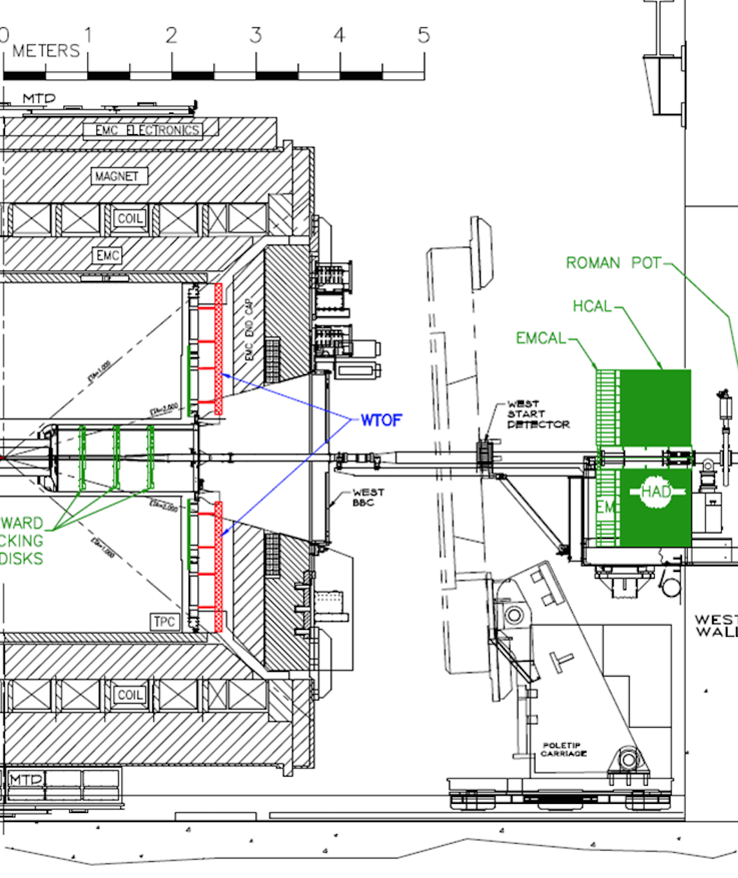
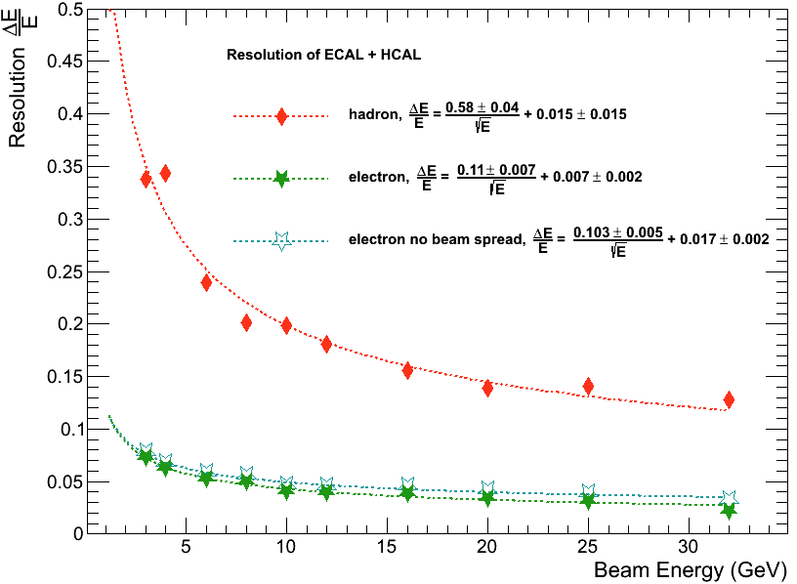
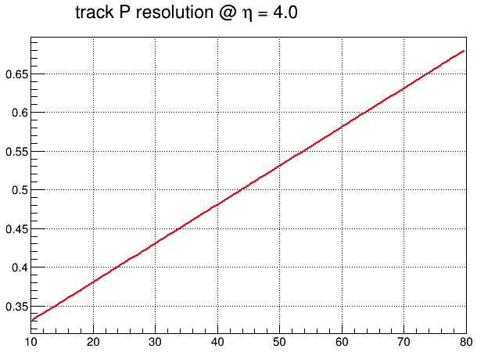
STAR FORward Upgrades for 2020+
ECal:
Tungsten-Powder-Scintillating-fiber
2.3 cm Moliere Radius, Tower-size: 2.5x2.5x17 cm³
23 X_{o}
HCal:
Lead and Scintillator tiles, Tower size of 10x10x81 cm³
4 interaction length
Latest Test-Beam results:
Tracking:
Silicon mini-strip detector
3-4 disks at z ~70 to 140 cm
Each disk has wedges
covering full 2π range in ϕ
and 2.5-4 in η
other options still
under study

Slide 5

Helicity Structure
Contribution to proton spin to date: MISS at least 50%
Can quarks and gluons explain it all ? → No orbital angular momentum

Slide 6
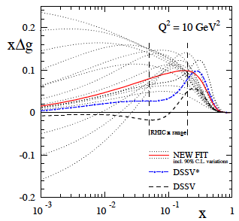
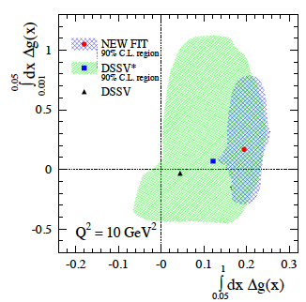
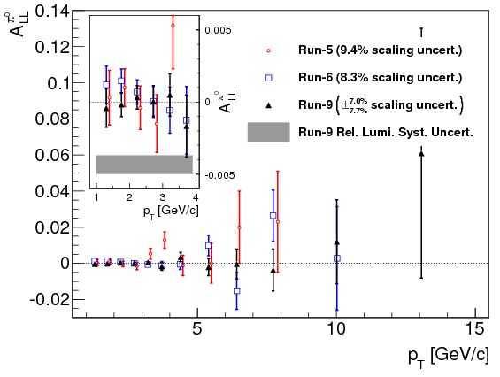
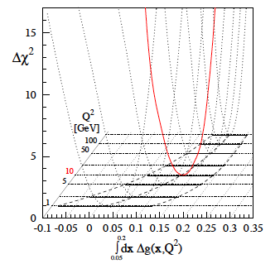
High Precision 2009 RHIC DATA→∫Δg(x)
Getting significantly closer to understand the gluon contribution to the proton spin
BUT
need to reduce low-x (<10⁻²) uncertainties for ∫Δg(x)
DSSV: arXiv:0904.3821
DSSV*: DSSV + all new (SI)DIS
DSSV: DSSV* & RHIC 2009
arXiv:1405.5134
strong constrain on
first
completely consistent with
DSSV* in 90% C.L.
can be accessed
through jets/di-jets
at √s=500 GeV and
forward rapidity η > 1
QCD
fit
arXiv: 1404.4293
First time a significant
non-zero Δg(x)
arXiv:1402.6296

Slide 7
After RUNs 2009 to 2015 are analyzed
Inclusive Jet @ |η| < 1:
x-range:
200 GeV: 0.05 – 0.2 (1)
500 GeV: 0.005 – 0.2 (1)
Di-Jets: constrain the shape
of Δg(x,Q²)
factor ~2 reduction in ∫Δg(x,Q²) in the
200 GeV x-range
Δχ²=2%

Slide 8
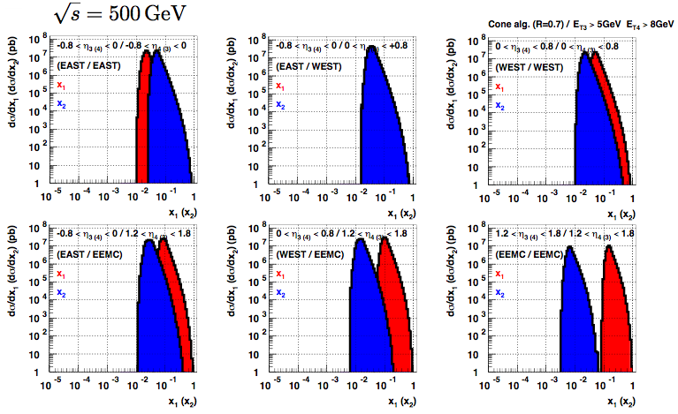
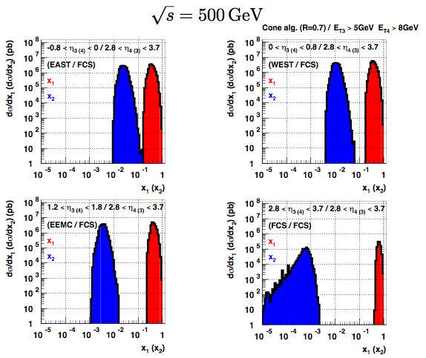
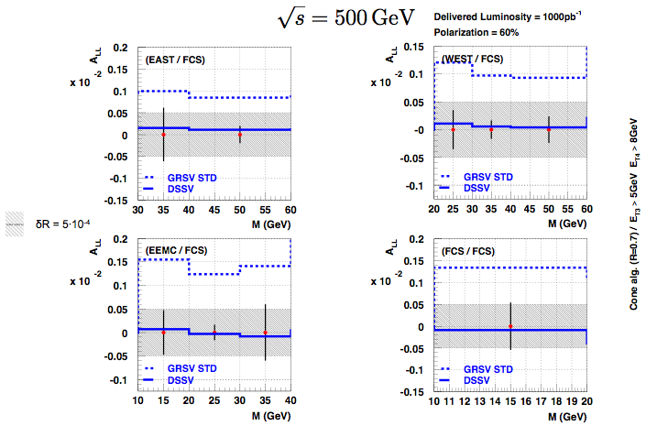
2020+: Going to lower x
510 GeV Di-Jets: constrain the shape of Δg(x,Q²) and go to lower x:
Utilize FCS + FTS: x: 0.005 → 0.001
This will be the measurement to constrain Δg(x,Q²) at lowest x
before eRHIC comes online

Slide 9
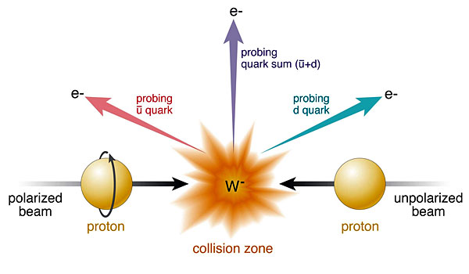
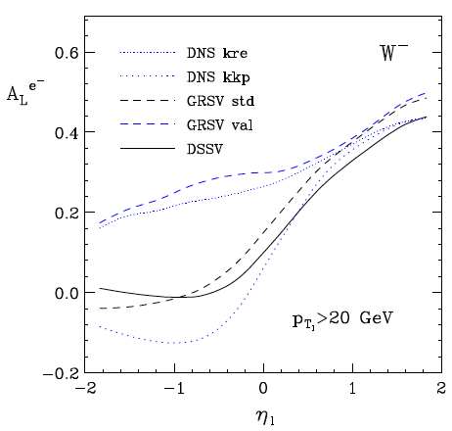
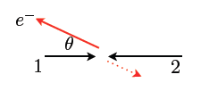
Δq: W Production Basics
Since W is maximally parity violating
→ W’s couple only to one parton helicity
large Δu and Δd result in large asymmetries.
Complementary to SIDIS:
very high Q2-scale
extremely clean theoretically
No Fragmentation function
backward
forward
x₁ small
t large
x₁ large
u large

Slide 10
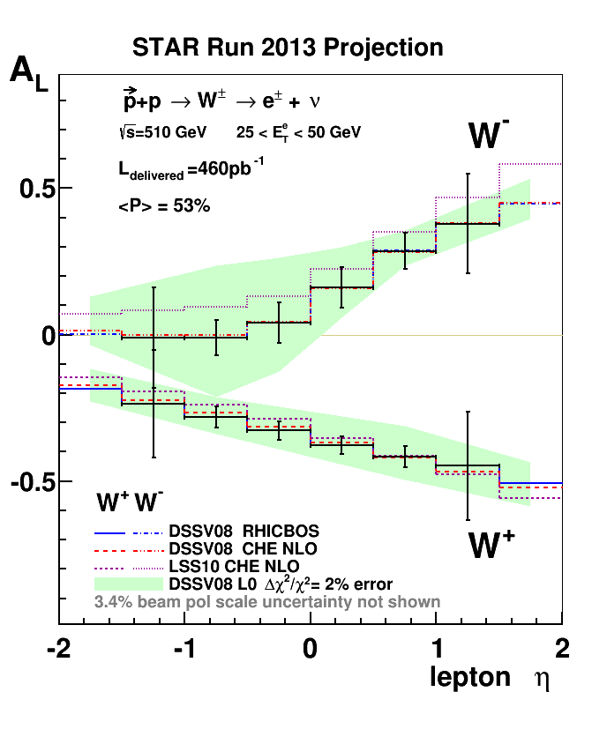
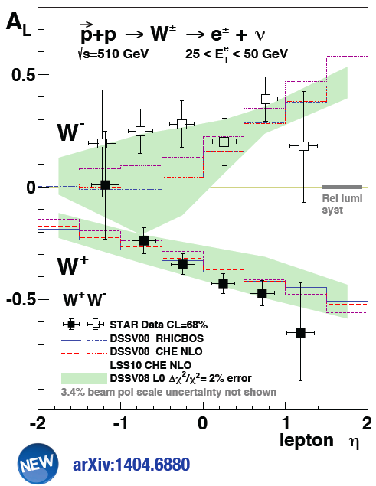
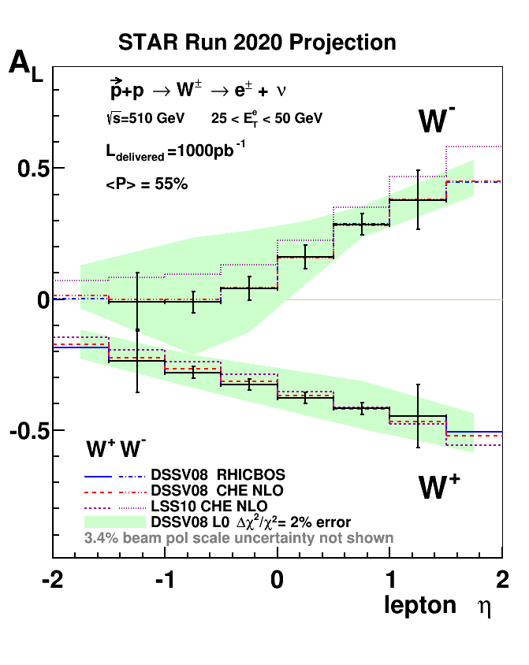

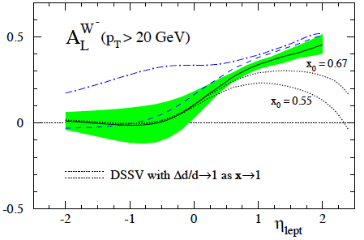
Current W-Results and The Future
Theoretically cleanest way to constrain Δq(x,Q²) at medium/high x
no target mass & higher twist corrections or FF uncertainties
as in SIDIS
potential to check
the concept of
helicity retention
Δd → 1 as x → 1

Slide 11
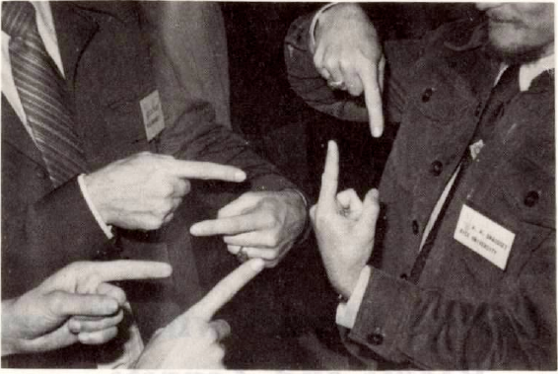
Transverse SPin Structure

Slide 12
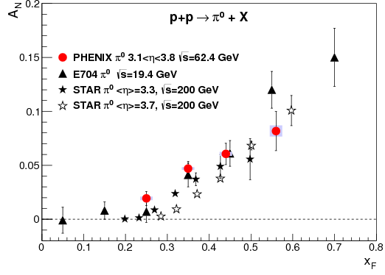
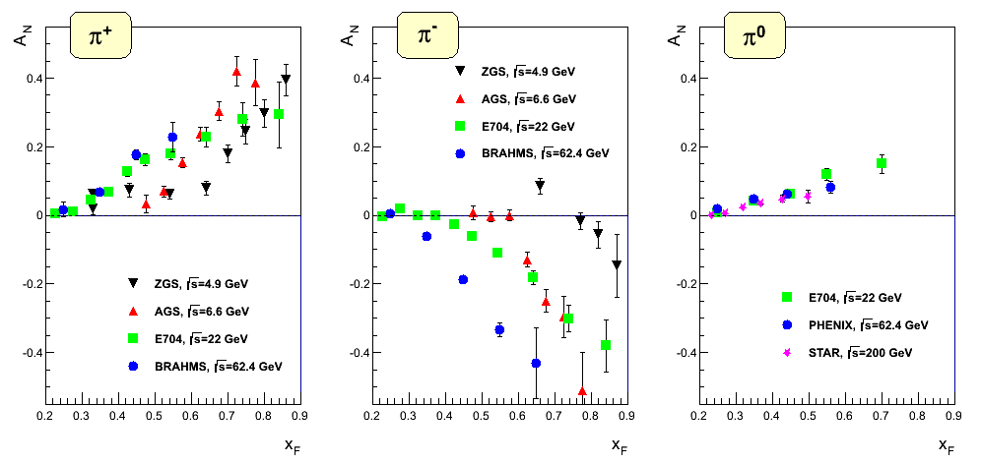
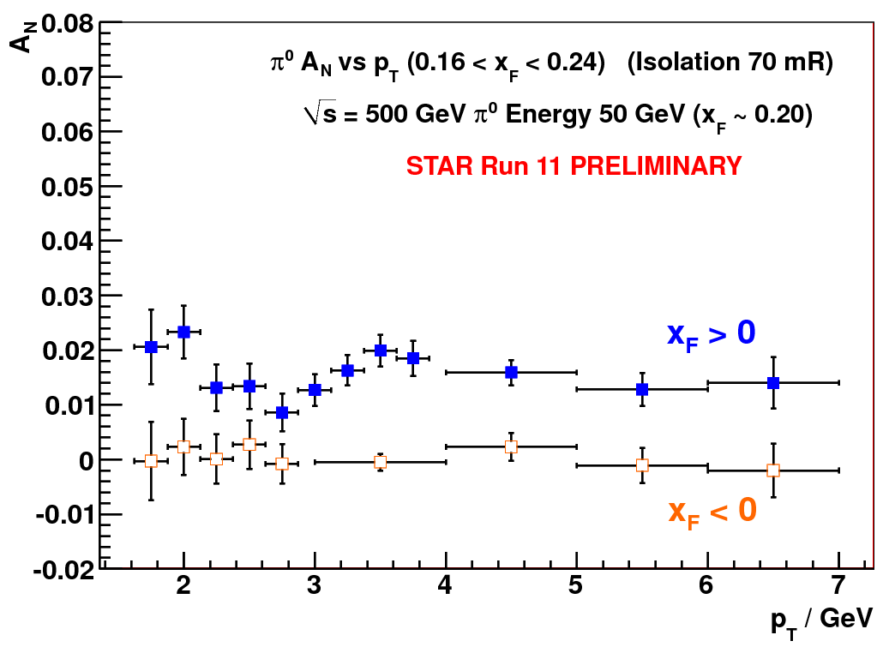
New puzzles in forward physics: large A_{N} at high √s
Big single spin asymmetries in pp !!
Naive pQCD (in a collinear picture)
predicts A_{N} ~ α_{s}m_{q}/sqrt(s) ~ 0
Do they survive at high √s ? YES
Is observed p_{t} dependence as naively
expected from p-QCD? NO
What is the underlying process?
Sivers / Twist-3 or Collins or ..
many new results
Left
Right

Slide 13
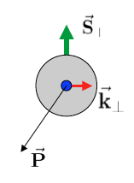
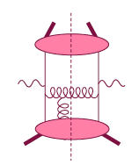
Theory: TMDs vs. Twist-3
Intermediate Q_{T}
Q>>Q_{T}/p_{T}>>Λ_{QCD}
Transverse
momentum
dependent
Q>>Q_{T}>=Λ_{QCD}
Q>>p_{T}
Collinear/
twist-3
Q,Q_{T}>>Λ_{QCD}
p_{T}~Q
Efremov, Teryaev;
Qiu, Sterman
Sivers fct.
Q_{T}/P_{T}
Λ_{QCD}
<
Q_{T}/P_{T}
<<
Q
Need 2 scales
Q² and p_{t}
Remember pp:
most observables one scale
Exception:
DY, W/Z-production
Need only 1 scale
Q² or p_{t}
But
should be of reasonable size
should be applicable to
most pp observables
A_{N}(π⁰/γ/jet)
  Sivers and twist-3 are correlated

Slide 14
A_{N}: How to get to THE underlying Physics
Goal: measure less inclusive
SIVERS/Twist-3
Collins Mechanism
Rapidity dependence of
A_{N} for π⁰ and eta with increased p_{t} coverage
A_{N} for jets, direct photons
A_{N} for heavy flavour → gluon
A_{N} for W^{+/-}, Z⁰
asymmetry in jet fragmentation
  π^{+/-}π⁰ azimuthal distribution in jets
  Interference fragmentation function
S_{P}
S_{P}
k_{T,q}
p
p
p
p
Sensitive to proton spin –
parton transverse motion correlations
not universal between SIDIS & pp
S_{q}
k_{T,π}
Sensitive to transversity
universal between SIDIS & pp & e+e-

Slide 15
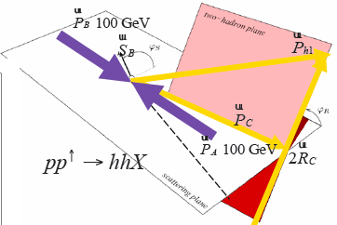
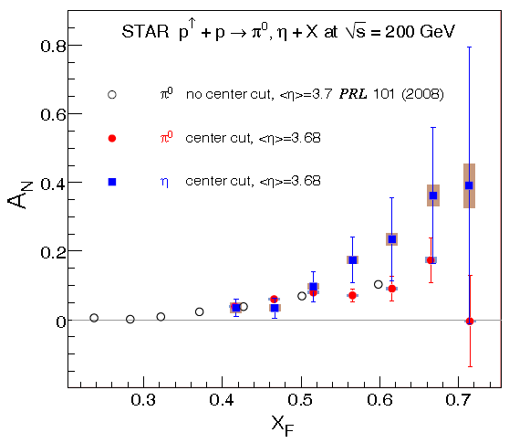
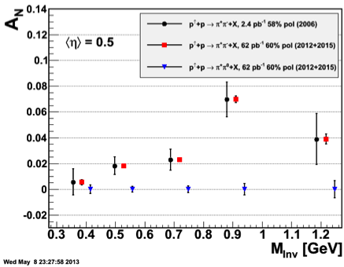
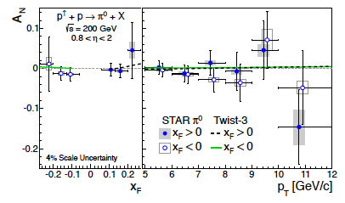
Results for different channels and rapidity
A_{N} π⁰ and eta at different η:
PRD86 (2012) 051101
arXiv:1309.1800
IFF the only non zero
transverse single spin
asymmetry at mid rapidity

Slide 16
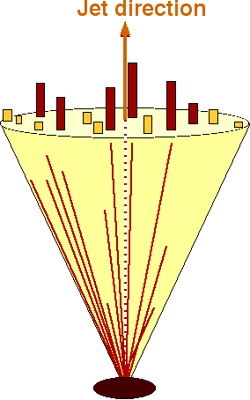
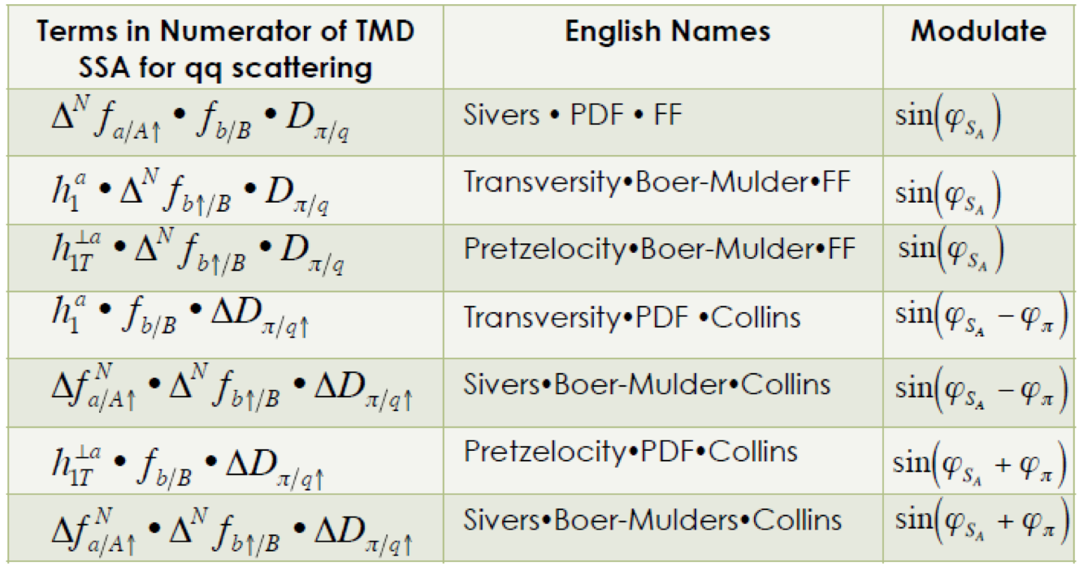
Transverse PHYSICS through jets
STAR: Jets reconstructed with Anti-k_{t} algorithm
Data jets MC jets
pbeam
S⊥
ΦS
Detector
GEANT
Asymmetry moments sensitive to various contributions
(analogous moments sensitive to gluon scattering)
A_{UT} – Transverse single-spin asymmetry (also written A_{N})
pπ
π⁺
e⁺
π⁰
π⁻
jT
Φh
Particle
e⁻
–pbeam
Κ⁰
PYTHIA
PJET
F. Yuan, PRL 100, 032003 (2008)
D’Alesio et al., PRD 83, 034021 (2011)
Parton
Transversity • Boer-Mulders • FF
Use PYTHIA + GEANT to quantify detector response
Trigger Bias (bias for specific processes)
Reconstruction smearing/bias (unfolding)
Reconstruction of partonic variables, parton matching
Underlying event/pileup effects
Pretzelocity • Boer-Mulders • FF
Sivers • Boer-Mulders • Collins

Slide 17

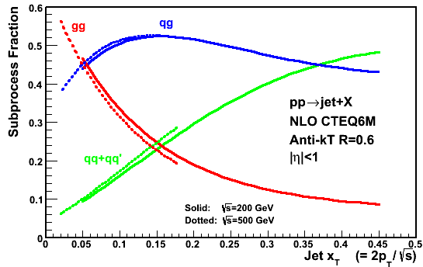
Sivers Through Jets
Asymmetries shown as function of particle-jet p_{T}
Corresponding parton-jet p_{T} lower by 0.6-1.4 GeV
Horizontal errors include uncertainties from statistics, calorimeter gains, efficiencies, track momentum, and tracking efficiency
No sign of sizable azimuthal asymmetry in jet production at √s = 500 GeV
Consistent with expectation from inclusive jets, di-jets, and neutral pions at √s = 200 GeV
Notes:
----- Meeting Notes (9/26/13 11:10) -----
specify p_T range on left-hand plot
specify eta range

Slide 18

The legacy of transverse polarised pp
Resolving the new spin puzzle for the 21st century
What causes A_{N} at forward rapidities?

Slide 19

A_{N} for different # photons in EM-Jets
1-photon events, which include a large π⁰ contribution in this analysis, are similar to 2-photon events
Three-photon jet-like events have a clear non-zero asymmetry, but substantially smaller than that for isolated π⁰’s
A_{N} decreases as the event complexity increases (i.e.,the "jettiness”
A_{N} for #photons >5 is similar to that for #photons = 5
The RP phase-II will be the key detector component to investigate
A_{N} for π⁰ is dominated by hard diffraction
p↑+p → π⁰+ p’+p’ or p↑+p → π⁰+ p’+X
Jettier events
Several Asymmetries for jettier events are very small
these dependences raise serious questions how much of the large forward π⁰ A_{N} comes from 2 → 2 parton scattering

Slide 20
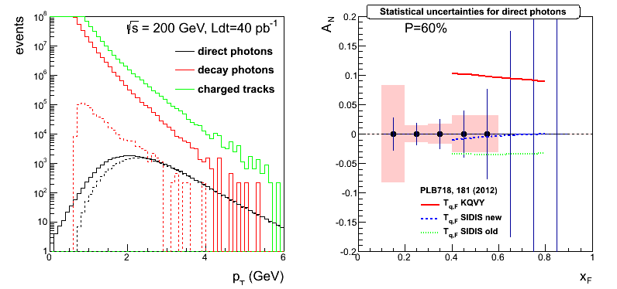
2015 and 2016 Highlights
200 GeV:
factor 2 increase in luminosity for all mid- and forward observables
to TMDs and Twist-3 observables
new dectector capabilities FMS-Preshower
A_{N} direct photon → Sivers fct.
500 GeV:
factor 13 increase in luminosity for all mid- and forward observables
to TMDs and Twist-3 observables

Slide 21
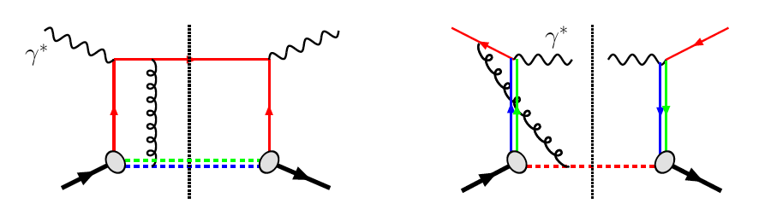
The famous sign change of the Sivers fct.
critical test for our understanding of TMD’s and TMD factorization
Twist-3 formalism predicts the same
DIS:
γq-scattering
attractive FSI
pp:
qqbar-anhilation
repulsive ISI
QCD:
Sivers_{DIS} = - (Sivers_{DY} or Sivers_{W} or Sivers_{Z0})
A_{N}(direct photon) measures the sign change through Twist-3
A_{N}(DY) and A_{N}(W^{+/-},Z⁰) will test also TMD evolution
All three observables can be attacked in
one 500 GeV Run by STAR

Slide 22
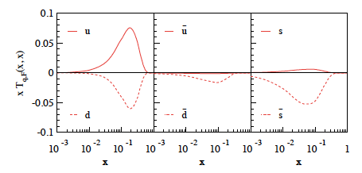
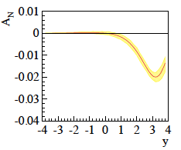
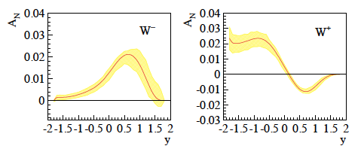
New Theory predictions
Z. Kang et al. arXiv:1401.5078v1
Q² = 2.4 GeV²
despite fitted,
sea quarks unconstrained
impacts A_{N}(W±, Z⁰)
new calculations for
A_{N}(γ) coming
and A_{N}(W±, Z⁰)
maximized sea-quarks
Remember: p_{t} <<Q → advantage for Ws: 0< p_{t} < 15 GeV and nice overlap in x
with SIDIS-Sivers measurements
Q ~ 80 GeV
0 < p_{T} < 3 GeV
4 < Q < 9 GeV
0 < p_{T} < 1 GeV
Z. Kang A_{N} (W^{+/-},Z⁰) accounting for sea quark uncertainties
using positivity bound as limit

Slide 23
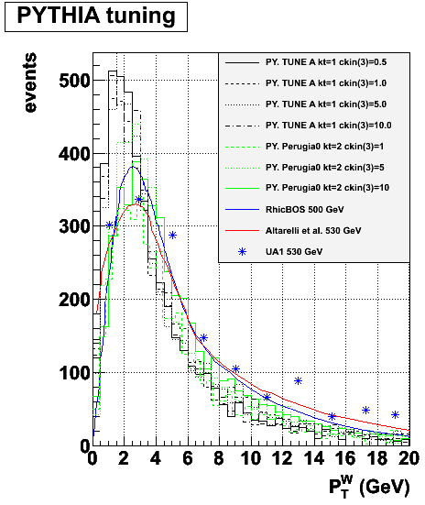
STAR: A_{N}^{W}
Analysis Strategy to fully reconstruct Ws:
Follow the analysis steps of the A_{L}
→ W candidate selection via high p_{t} lepton
Data set 2011 transverse 500 GeV data set (25 pb⁻¹)
In transverse plane:
Recoil reconstructed using tracks and towers:
Part of the recoil not within STAR acceptance
→ correction through MC (Pythia)
W Rapidity reconstruction:
W longitudinal momentum (along z) can be calculated from the invariant mass:
Neutrino longitudinal momentum component from quadratic equation

Slide 24
A_{N}(W^{+/-},Z⁰) Results from 2011
2011: recorded lumi 25 pb⁻¹

Slide 25
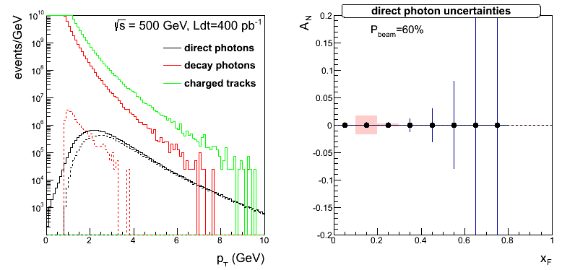
A_{N}(W^{+/-},Z⁰) from Run 2016
2016: possible recorded lumi as big as 900 pb⁻¹
A_{N}(W^{+/-},Z⁰):
will be able to constrain sea quark Sivers
and
make a statement on the sign change
A_{N}(γ) up to x_{F} of 0.6
A_{N}(DY) simulations still ongoing

Slide 26
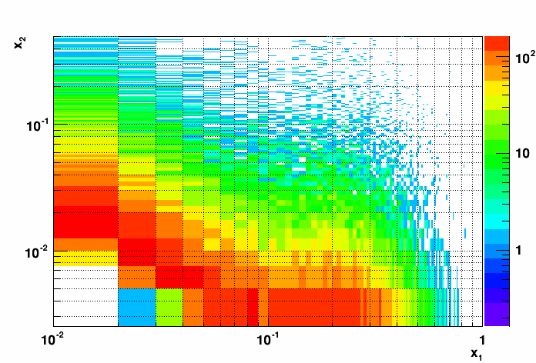
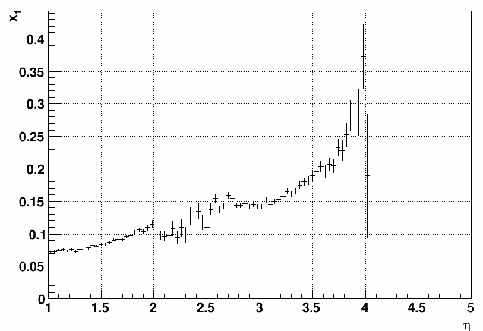
Transverse Spin Physics at the end of the Decade
Bring mid rapidity observables (jets, IFF, ..) to high rapidities → high x
Needs:
forward upgrade (FCS + FTS) & 500 GeV & delivered luminosity: 1fb⁻¹
Address the following questions:
measure tensor charge → connection to lattice
difference between δq(x) and Δq(x) allows to study orbital angular momentum
in wave fct.
is the Soffer bound violated
Cuts: 2.8 <η< 3.5 and jet p_{t} > 3 GeV

Slide 27
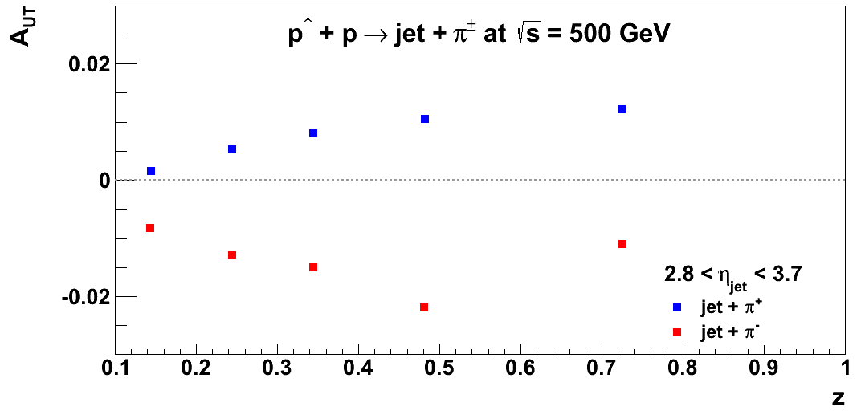
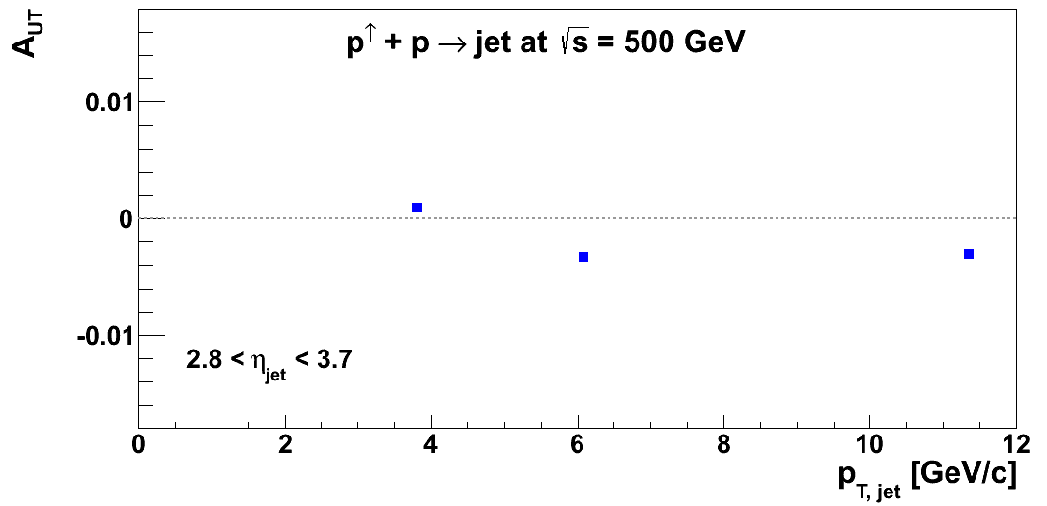
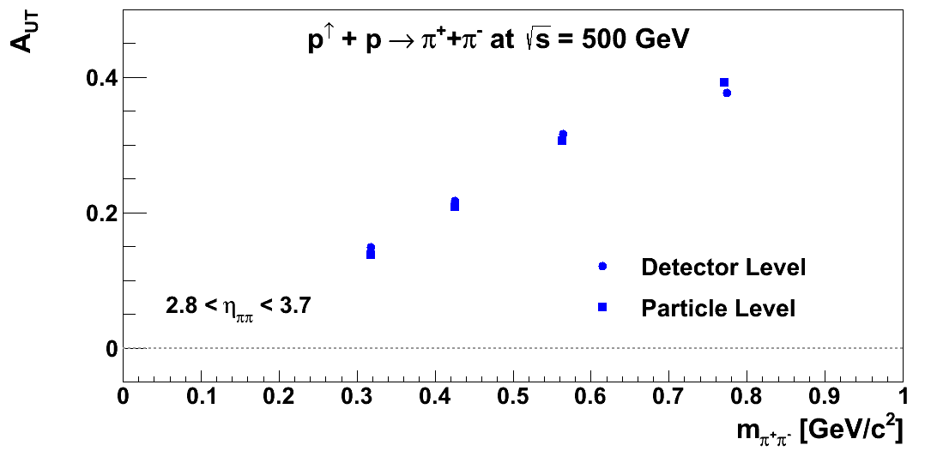
Transverse Spin Physics at the end of the Decade
Cuts: 2.8 <η< 3.5 and jet p_{t} > 3 GeV
Simulations:
TPPMC: transverse MC with hard
interaction from PYTHIA
Detector: fast smearing, based on
GEANT responses
Only poster-child measurements shown
more observables, i.e. di-jets,… are possible together with
new forward detector systems and high luminosity will allow to address
different TMDs
Sivers x PDF x FF:
Transversity x PDF x Collins:
Transversity • Boer-Mulders • FF
Pretzelocity • Boer-Mulders • FF
Sivers • Boer-Mulders • Collins
Transversity x IFF:

Slide 28
STAR transverse polarized pp program
wealth of high precision data for wide range of observables
to test universality and factorization of TMDs
to constrain the evolution of TMDs
to gain new insights in QCD dynamics
→ spin dependence of diffraction

Slide 29
The beauty of RHIC
mix and match beams as one likes
polarised p↑A (Au, C, Cu, …)
Critical Questions:
What are the dynamics of partons at very small and very large momentum
fraction (x) in nuclei, and at high gluon-density.
What are the nonlinear evolution effects (i.e. saturation)?
What are the pQCD mechanisms that cause energy loss of partons in CNM,
and is this intimately related to transverse momentum broadening?
What are the detailed hadronization mechanisms and time scales and
how are they modified in the nuclear environment?

Slide 30
STAR’s p+p & p+A Timeline
2015
2016
≧2020-2023
≧ 2025
Upgrades:
FMS-Preshower
RP Phase-II*
Run:
p+p 200 GeV
longitudinal &
transverse
p↑+Au 200 GeV
transverse
Goal:
Δg(x,Q²)
transverse spin
structure of the p
Search for exotics
GPD E_{g}
nPDF: g(x,Q²)
Saturation
eSTAR@eRHIC
Upgrades:
FMS-Postshower
Run:
p+p 510 GeV
transverse
Goal:
Sea-quark Sivers fct.
Sivers fct. sign change
through TMDs & Twist-3
Upgrades:
Forward Ecal+Hcal
Forward tracker
RP full Phase II
Run:
p+p 510 GeV
longitudinal & transverse
p↑+A (C, Cu, Au) 200 GeV
transverse
Goal:
Δg(x,Q²) @ low x
transverse spin structure of the proton
Search for exotics
nPDF: g(x,Q²), q(x,Q²)
Saturation
energy loss in cold
nuclear matter
https://drupal.star.bnl.gov/
STAR/starnotes/public/sn0592

Slide 31
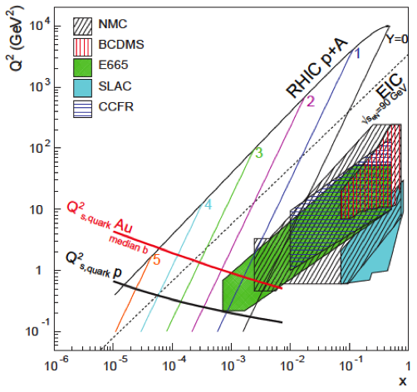
Do Gluons Saturate
Gluon density dominates at x<0.1
Rapid rise in gluons described naturally by linear pQCD evolution equations
This rise cannot increase forever - limits on the cross-section
  → non-linear pQCD evolution equations provide a natural way to tame this growth and lead to a saturation of gluons, characterised by the saturation scale Q²_{s}(x)
Notes:
Counter-intuitively the best way is through an EM process: DIS
y = inelasticity = fraction of the incoming electron energy carried by photon in the rest frame of the nucleon
The structure function F2 is sensitive to the sum of quark and anti-quark momentum distribution in the nucleon.
The apparent scaling of the data with Q2 at large x in early DIS data from SLAC was termed “Bjorken scaling” and motivated the parton model.
In the parton model, FL = 0, while in QCD, it is directly proportional to the gluon structure function, FL(x,Q2) ~ aS xG(x,Q2), at low x.
DGLAP: fixed x -> evolution along Q2
sigma (gamma N) = sig_T + sig_L
sig_L ~ FL
sig_tot ~ F2/Q^2
\frac{d^2 \sigma^{ep \rightarrow eX}}{dx dQ^2} = \frac{4 \pi \alpha^2_{e.m.}}{xQ^4} \left[ \left(1-y+\frac{y^2}{2} \right ) F_2(x,Q^2) - \frac{y^2}{2} F_L(x,Q^2) \right]

Slide 32
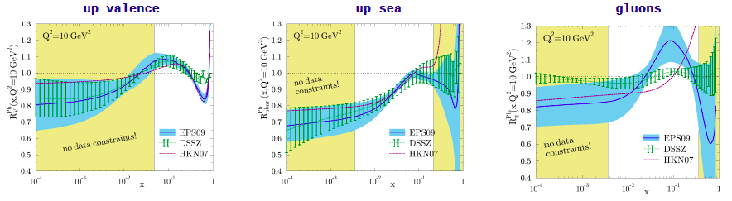
nuclear PDFs
Current situation: before LHC EW-data are included
H. Paukkunen, DIS-2014
DGLAP: predicts Q² but no A-dependence and x-dependence
Saturation models: predicts A-dependence and x-dependence but not Q²
Need: Q² lever-arm → LHC-RHIC A-scan: RHIC
Observables addressed :
UPC pA: g(x,Q²,b)
direct photon: R_{pA}
Di-hadron correlation measurements
A_{N}^{pA}/A_{N}^{pp}
Direct-photon Jet correlations
R_{pA} for DY
FCS + FTS → 2020+

Slide 33
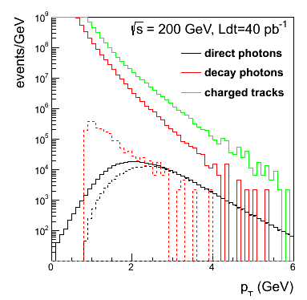
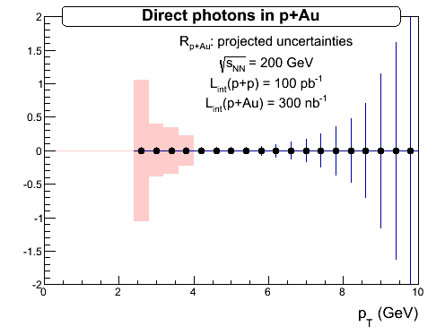
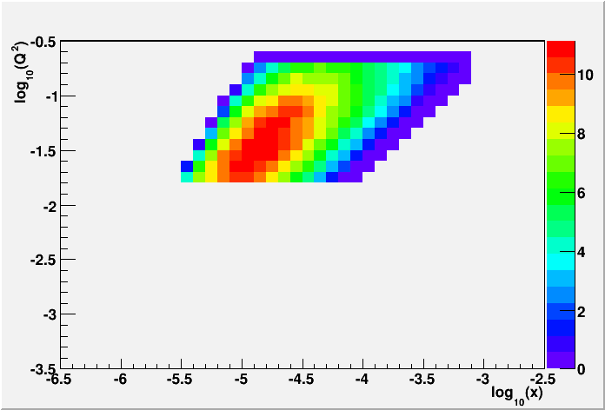


nuclear PDFs
Direct Photon R_{pAu}:
p+p
2015
required: FPS + FMS
2020+ UPC: “proton-shine”-case:
Requires: RP-II* and 2.5 pb⁻¹ p+Au
Fourier transform of σ vs. t
→ g(x,Q²,b)

Slide 34





2020+: Dy in pA
Physics
Access to sea and valence quarks in nuclei
DY-h correlations → saturation Stasto et al. arXiv 1204.4861
very challenging
need big bkg. suppression
FCS + FTS
2.5 pb⁻¹ p+Au
200 GeV pp
2.5<η<4.0
2.5<η<4.0

Slide 35



Correlations: Di-Hadron and γ-Jet
2015 pAu:
answer the underlying mechanism leading to di-hadron correlations
move the cut on trigger hadron to higher values to move out of
saturation regime
η > 3 π⁰ cross section ~1/p_{T}⁶ → same statistical accuracy for p_{T}^{trig}>3 GeV
a factor 11
arXiv:1009.6123
two-pion production in d+A collisions through
the double-interaction mechanism
PRL 97, 152302
2020+ pA runs:
A-scan to scan saturation scale and new channel: γ-jet correlation
Cuts:
|ϕ_{γ}-ϕ_{jet}|>2π/3
0.5<p_{T}^{γ}<p_{T}^{je}t<2. 2.8<η<3.7
pT>4.5 (3.2) GeV/c in 500 (200) GeV
photon isolation
signal-to-background 3:1
Statistics:
1.2 million with 500 pb⁻¹ at √s=500 GeV.
100k with 500 pb⁻¹ (2.5pb⁻¹) p+p (p+Au)
at √s_{NN}=200 GeV..
0.001<x<0.005

Slide 36

A_{N} in p↑A or Shooting Spin Through CGC
Y. Kovchegov & M.D. Siever arXiv:1201.5890.
strong suppression of odderon STSA in nuclei.
Q_{s}=1GeV
Very unique RHIC possibility p↑A
Synergy between CGC based
theory and transverse spin physics
A_{N}(direct photon) = 0
The asymmetry is larger for
peripheral collisions
r=1fm
r=1.4fm
r=2fm
π⁰
STAR: projection for upcoming pA run
Curves: Feng & Kang arXiv:1106.1375
solid: Q_{s}^{p} = 1 GeV
dashed: Q_{s}^{p} = 0.5 GeV
first measurement p+Au 2015
A-scan 2020+

Slide 37


Energy Loss in cold nuclear matter
R_{pA} of J/Ψ as function of η sensitive to:
initial conditions (nPDF, saturation)
energy loss mechanism
2020+: FCS + FTS provide new detector capabilities
to measure J/Ψ at 2.5 < η < 4.0
→ clean J/Ψ signal & good stat till 5 GeV
F. Arleo and S. Peigné, JHEP 03 (2013) 122

Slide 38






Summary
ΔG
Σ_{q}L_{q}
L_{g}
Σ_{q}Δq
STAR’s p+p and p+A Program:
unique science program that addresses
important open questions in cold nuclear matter,
uniquely tied to a polarized p+p/p+A-collider
never been measured before & never without
Σ_{q}L_{q}
δq
δq
Σ_{q}Δq
ΔG
L_{g}
Due to time reasons please look for:
details of the individual measurements
and
more key physics topics, i.e. search for exotics, GPD E_{g} in backup and STAR’s pp-pA-LoI
https://drupal.star.bnl.gov/STAR/starnotes/public/sn0605

Slide 39
THANK YOU to my fellow members of the pp-pA-LoI writing group
E. Aschenauer, J. Drachenberg, C. Gagliardi,, H.Z. Huang, J.H. Lee, S. Mioduzewski, J. Seger, E. Sichtermann, B. Surrow, A. Vossen, Q.H. Xu, Z.Y Ye and the indispensable help from:
Yuxi Pan (UCLA), Oleg Eyser (BNL), Akio Ogawa (BNL), Thomas Burton (BNL),
Nihar R. Sahoo (TAMU), Oleg Tsai (UCLA), Ramiro Debbe (BNL), William Schmidke (BNL), Tobias Toll (BNL), Tom Burton (BNL), Xuan Li (Temple), Fuqiang Wang (Purdue), Li Yi (Purdue), Wolfram Fischer (CAD/BNL), and Alexander Kiselev (BNL).

Slide 40
ADDITIONAL Material

Slide 41




THE Beauty of Colliders: Kinematic Coverage
novel electroweak
probe
Q²=6400 GeV²
0.05<x<0.4
Evolution

Slide 42


After RUNs 2009 to 2015 are analyzed
Inclusive Jet @ |η| < 1:
factor 2 reduction in ∫Δg(x,Q²)
Run-15 200 GeV Di-Jets: constrain the shape of Δg(x,Q²)

Slide 43




Forward Proton Tagging Upgrade
at 55-58m
at 15-17m
Follow PAC recommendation to develop a solution to run pp2pp@STAR with
std. physics data taking → No special β* running any more
should cover wide range in t → RPs at 15m & 17m
Staged implementation
  Phase I (currently installed): low-t coverage
  Phase II (proposed) : for larger-t coverage
  1st step reuse Phase I RP at new location only in y
  full phase-II: new bigger acceptance RPs & add RP in x-direction
    full coverage in φ not possible due to machine constraints
Good acceptance also for spectator protons from
deuterium and He-3 collisions
Phase-II: 1st step
1st step
full Phase-II

Slide 44




Processes with Tagged Forward Protons
QCD color singlet exchange: C=+1(IP), C=-1(Ο)
Discovery Physics
p + p → p + p elastic
p + p → p + X + p
diffractive X= particles, glueballs
pQCD Picture
Gluonic exchanges
p + p → p + X SDD
Notes:
44

Slide 45


Central Exclusive Production in DPE
Method is complementary to:
GLUEX experiment (2015)
PANDA experiment (>2015)
COMPASS experiment (taking data)
In the double Pomeron exchange process each proton “emits” a Pomeron and the two Pomerons interact producing a massive system M_{X}
where M_{X} = π⁺ π⁻, χ_{c}( χ_{b}), qq(jets), H(Higgs boson), gg(glueballs)
The massive system could form resonances. We expect that because of the constraints provided by the double Pomeron interaction, glueballs, hybrids, and other states coupling preferentially to gluons, will be produced with much reduced backgrounds compared to standard hadronic production processes.
p
p
For each proton vertex one has
t four-momentum transfer
ξ = Δp/p
M_{X}=√ξ₁ξ₂s invariant mass
M_{x}
Notes:
45
45

Slide 46





Search for Exotics
200 GeV:
500 GeV:
Estimated accepted phase-space
distributions of invariant mass M_{X}
decaying into π⁺π⁻, π⁺π⁻π⁺π⁻ (hatched)
and K⁺K⁻ (cross-hatched) from 25M
DPE events simulated in at
√s = 500 GeV with Phase II set-up.
2009: p+p→p’+M_{x}(π+π−)+p’
500 GeV

Slide 47




“Spectator” proton from deuteron with the current RHIC optics
Study: JH Lee
generated
Passed DX aperture
Accepted in RP
Rigidity (d:p =2:1)
The same RP configuration with the current RHIC optics (at z ~ 15m between DX and D0)
needs full PHASE-II RP

Slide 48



Spectator proton from ³He with the current RHIC optics
Momentum smearing mainly due
to Fermi motion + Lorentz boost
Angle [rad]
Study: JH Lee
generated
Passed DX aperture
Accepted in RP
The same RP configuration with the current RHIC optics (at z ~ 15m between DX-D0)
Acceptance ~ 92% with full PHASE-II RP

Slide 49

Generalized Parton Distributions
the way to 3d imaging of the proton and the orbital angular momentum L_{q} & L_{g}
Measure them through exclusive reactions
golden channel: DVCS
e’
γ
e
γ_{L}*
(Q²)
x+ξ
x-ξ
~
~
p
H, H, E, E (x,ξ,t)
p’
t
Spin-Sum-Rule in PRF:
from g₁
GPDs:
Correlated quark momentum
and helicity distributions in
transverse space
responsible for orbital angular momentum

Slide 50


From ep tO pp to γ p/A
Get quasi-real photon from one proton
Ensure dominance of g from one identified proton
by selecting very small t₁, while t₂ of “typical hadronic
size”
small t₁ ←→ large impact parameter b (UPC)
Final state lepton pair ←→ timelike compton scattering
timelike Compton scattering: detailed access to GPDs
including E^{q/g} if have transv. target pol.
Challenging to suppress all backgrounds
Final state lepton pair not from γ* but from J/ψ
  Done already in AuAu
  Estimates for J/ψ (hep-ph/0310223)
transverse target spin asymmetry → calculable with GPDs
information on helicity-flip distribution E for gluons
golden measurement for eRHIC
Z²
A²
Gain in statistics doing polarized p↑A

Slide 51




From ep tO pp to γ p/A
UPC in p+Au:
Required:
2015 p+A 300 nb⁻¹
RP-Phase II*
Cuts:
no hit in the RP phasing the Au-beam (-t > -0.016 GeV²) or in the ZDC
detecting the scattered proton in the RP (-0.016 > -t > -0.2 GeV²)
both J/ψ decay leptons are in -1 < h < 4
cut on the pt² of the scattered Au, calculated as the pt² of the vector sum
of the proton measured in the RP and the J/ψ to be less then 0.02 GeV²
→ 7k J/ψ

Slide 52
Transverse PHYSICS: What else do we know
Collins / Transversity:
  conserve universality in hadron hadron interactions
  FF_{unf} = - FF_{fav} and δu ~ -2δd
  evolve ala DGLAP, but soft because no gluon contribution (i.e. non-singlet)
Sivers, Boer Mulders, ….
  do not conserve universality in hadron hadron interactions
  k_{t} evolution → can be strong
    till now most predictions did not account for evolution
  FF should behave as DSS, but with k_{t} dependence unknown till today
  u and d Sivers fct. opposite sign d >~ u
  Sivers and twist-3 are correlated
    global fits find sign mismatch, possible explanations,
    like node in k_{t} or x don’t work

Slide 53
Collins AsymmetrY
Increased gluonic subprocesses at √s = 500 GeV lead to expectation of small Collins asymmetry until larger z
D’Alesio et al.
Present data do not have sufficient statistics at high-z
to observe Collins asymmetry of order 1%
→ 2016 Run
Notes:
[Anselm]
mention (maybe verbally) connection between jT and k\perp
----- Meeting Notes (9/26/13 11:10) -----
highlight z-ranges

Slide 54
Collins like AsymmetrY
Maximized contribution
for √s = 500 GeV
D’Alesio et al.
Model predictions shown for “maximized” effect,
saturated to positivity bound
Until now, Collins-like asymmetries completely unconstrained
→ Sensitive to linearly polarized gluons

Slide 55
A_{N} vs. EM-Jet Energy
π⁰-Jets –
2γ-EM-Jets with
m_{γγ} <0.3 and Z_{γγ} <0.8
2γ-EM-Jets (η +continuum) – with m_{γγ} > 0.3
EM-Jets –
with no. photons >2
Isolated π⁰’s have large asymmetries consistent with previous observation (CIPANP-2012 Steven Heppelmann)
https://indico.triumf.ca/contributionDisplay.pycontribId=349&sessionId=44&confId=1383
Asymmetries for jettier events are much smaller

Slide 56
A_{N} correlated with midrapidity activities
Near and away side
BEMC
EEMC
FMS
2.6<η<4.2
1 < η < 2.
-1 < η < 1
forward EMJets
central EMJets
Uncorrelated
central EM-Jet
Correlated
central EM-Jet
Midrapidity EM Jets
Jet algorithm : anti-k_{T}, R = 0.7
p_{T}^{EM-Jet} > 2.0 GeV/c, -1.0<η^{EM-Jet}<2.0
Inputs for central EMJets : towers from BEMC and EEMC
Leading central EM-Jets : Jet with highest p_{T}
Case-I : having no central jet
Case-II : having a central jet

Slide 57
A_{N} for Forward jet with near and away in Φ central jet
Uncorrelated central EM-Jet is separated out

Slide 58
A_{N} for correlated central jets and no central jet cases
≈√
Asymmetries for the forward isolated π⁰ are low when there is a correlated
away-side jet.

Slide 59
A_{N} for with and without a central EM-Jet
0.06
An EM-jet in the central rapidity region reduces the asymmetries for the forward isolated π⁰

Slide 60




Hints for Gluon Sivers /Twist-3
Mid Rapidity A_{N}(π⁰) dominated by gg and qg
PHENIX 200 GeV
no hint of a
non-zero
A_{N}(π⁰), A_{N}(J/Ψ)
and
A_{N}(μ)
gluon Sivers ~ 0
Twist-3 gg correlator ~0 ?
Forward Rapidity A_{N}(μ) dominated by
gg through D-production:
arXiv:1312.1995
Forward Rapidity A_{N}(J/Ψ) only gg:

Slide 61
Collected Luminosity with longitudinal Polarization
Year | √s [GeV] | Recorded PHENIX | Recorded STAR | Pol [%]
2002 (Run 2) | 200 | / | 0.3 pb⁻¹ | 15
2003 (Run 3) | 200 | 0.35 pb⁻¹ | 0.3 pb⁻¹ | 27
2004 (Run 4) | 200 | 0.12 pb⁻¹ | 0.4 pb⁻¹ | 40
2005 (Run 5) | 200 | 3.4 pb⁻¹ | 3.1 pb⁻¹ | 49
2006 (Run 6) | 200 | 7.5 pb⁻¹ | 6.8 pb⁻¹ | 57
2006 (Run 6) | 62.4 | 0.08 pb⁻¹ |  | 48
2009 (Run9) | 500 | 10 pb⁻¹ | 10 pb⁻¹ | 39
2009 (Run9) | 200 | 14 pb⁻¹ | 25 pb⁻¹ | 55
2011 (Run11) | 500 | 27.5 / 9.5pb⁻¹ | 12 pb⁻¹ | 48
2012 (Run12) | 500 | 30 / 15 pb⁻¹ | 82 pb⁻¹ | 50/54

Slide 62
Collected Luminosity with transverse Polarization
Year | √s [GeV] | Recorded PHENIX | Recorded STAR | Pol [%]
2001 (Run 2) | 200 | 0.15 pb⁻¹ | 0.15 pb⁻¹ | 15
2003 (Run 3) | 200 | / | 0.25 pb⁻¹ | 30
2005 (Run 5) | 200 | 0.16 pb⁻¹ | 0.1 pb⁻¹ | 47
2006 (Run 6) | 200 | 2.7 pb⁻¹ | 8.5 pb⁻¹ | 57
2006 (Run 6) | 62.4 | 0.02 pb⁻¹ |  | 53
2008 (Run8) | 200 | 5.2 pb⁻¹ | 7.8 pb⁻¹ | 45
2011 (Run11) | 500 | / | 25 pb⁻¹ | 48
2012 (Run12) | 200 | 9.2/4.3 pb⁻¹ | 22 pb⁻¹ | 61/58

Slide 63

RHIC polarised p+p performance
2013:
golden year for polarized
proton operation
2012: 100 GeV:
new records for L_{peak}, L_{avg}, P
2012 & 2013: 255 GeV:
new records for L_{peak}, L_{avg}, P
highest E for pol. p beam
2015++ P: 60%
with upgrades
What will come:
increased Luminosity and
polarization through
OPPIS new polarized source
Electron lenses to
compensate beam-beam
effects
many smaller incremental
improvements
will make luminosity hungry processes,
i.e. DY, easier accessible

Slide 64




Correlation p_{T} – x and √s
contributing sub-processes:
changing vs p_{T} and rapidity
low p_{T} → low x
  scale uncertainty
high √s → low x
forward rapidity → low x
2-2.5 GeV/c
4-5 GeV/c
9-12 GeV/c
2-2.5 GeV/c
4-5 GeV/c
9-12 GeV/c
η=3.3, √s=200 GeV

Slide 65




π⁰-Cross Sections
√s=62 GeV (PRD79, 012003)
√s=200 GeV (PRD76, 051106)
√s=500 GeV (Preliminary)
PRL 97, 152302
arXiv: 1309.1800
Data compared to NLO pQCD calculations:
√s=62 GeV calculations may need inclusion of NLL (effects of threshold logarithms)
√s=200 and 500 GeV: NLO agrees with data within ~30%
good agreement also for η>1
Input to qcd fits of gluon fragmentation functions → DSS

Slide 66




Jet-Cross Sections
√s=200 GeV inclusive jets
√s=200 GeV Di-jets
√s=500 GeV Di-jets
Data compared to NLO pQCD calculations:
Inclusive jet and di-jet cross section results in
p+p collisions are consistent with NLO pQCD calculations
after Had+UE corrections

Slide 67
Summary
RHIC SPIN Program:
unique science program that addresses
all important open questions in spin physics
uniquely tied to a polarized pp-collider
never been measured before & never without
ΔG
Σ_{q}L_{q}
L_{g}
Σ_{q}Δq
Longitudinal Spin Physics:
first non-zero Δg(x,Q²)
Ws: unique data set to constrain Δq for sea
and test SiDIS formalism for Δq
Σ_{q}L_{q}
δq
δq
Σ_{q}Δq
ΔG
Transverse Spin Physics:
wealth of data and more to come
  to constrain IFF, Transversity and Collins FF
  200 GeV and 500 GeV data → evolution
  to constrain Sivers/Twist-3 → universality breaking
Excellent Outlook to constrain sea-quark Sivers, “Sivers sign-change”
through A_{N}(DY, W^{+/-},Z⁰, γ) → TMD evolution
A_{N} at high x_{F}
  A_{N} decreases as the event complexity increases(i.e., the "jettiness”)
  Isolated π⁰ asymmetries are smaller when there is a correlated EM-jet at mid-rapidity.
Both of these dependences raise serious questions
how much of the large forward π⁰ A_{N} comes from 2 → 2 parton scattering.
L_{g}

