Slide 1
Forward Tracking upgrade
What should it do / What is it
with significant important contributions from
Thomas Burton and Oleg Eyser

Slide 2
The STAR Forward Upgrade

Slide 3
What are open physics questions
Cold nuclear matter
  can we unambiguously determine the suppression in R_{dA} at forward rapidity is caused either by saturation effects or by multiple scattering + energy loss (i.e. arXiv:1112.6021)
  p_{t} broadening in DY and J/Ψ-production is sensitive to the saturation scale in some models (B.K. and X.W.)
  SSA sensitive to Q_{s} in p↑A
Observables:
  Drell-Yan, J/Ψ
    tracking: charge sign, e-PID, background suppression (conversions)
  correlation measurements: γ-jet, hadron-jet, ….
    tracking: momentum → need to check Hcal vs tracking performance
  direct photon
    tracking: background rejection
  Inclusive pions → A_{N}
    tracking: momentum

Slide 4
What are open physics questions
polarised proton-proton / proton-nucleus
  What is the underlying subprocess of the measured A_{N}
    Sivers vs. Collins vs. hard diffraction vs. ????
      Yuri and Feng & Kang → A_{N} in p↑A
    Sign change of Sivers fct. in DY/W/Z-production vs. SIDIS
  Constrain generalized parton distribution E_{g} via J/Ψ production in p↑A via UPC
  helicity structure of the proton:
    ΔG at low x → forward rapidity
    Δs via hyperons
Observables:
  Drell-Yan, J/Ψ
    tracking: charge sign, e-PID, background suppression (conversions)
  jets, “hadrons in jets”, direct photons
    tracking: momentum, PID, background rejection
Is there any AA physics topics, which need forward acceptance

Slide 5
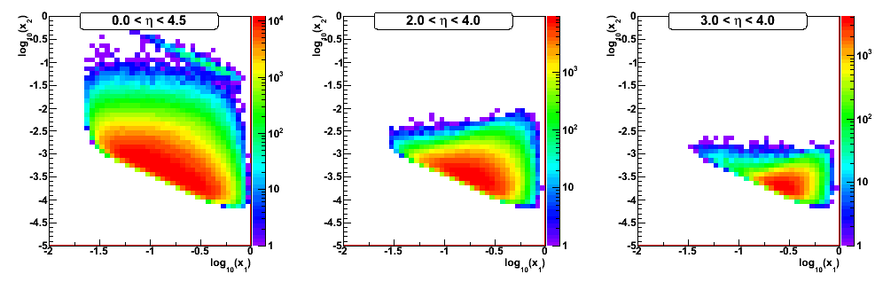
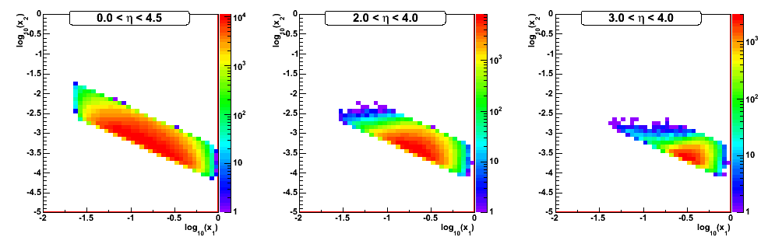
A little bit about DY Parton Kinematics
4 GeV < M_{inv} < 9 GeV

Slide 6

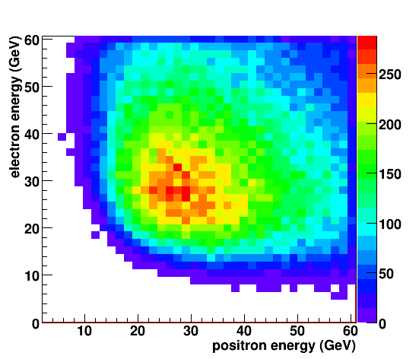

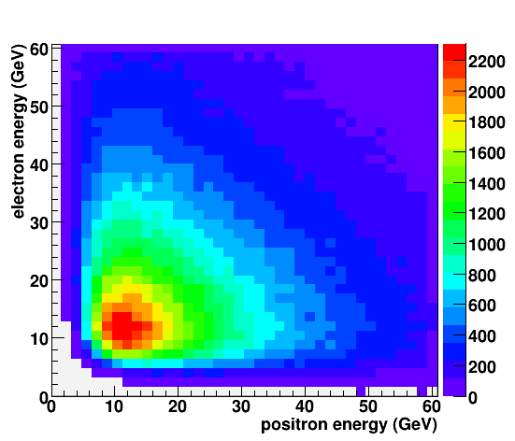
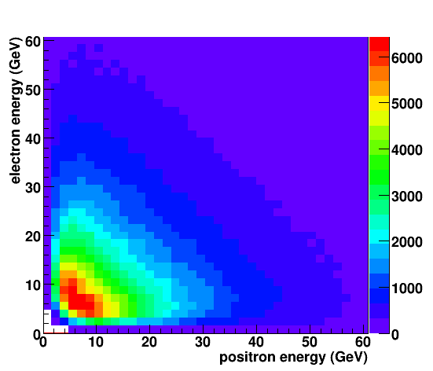

Drell-Yan lepton pairs
Leptons have high energy
Energies are very correlated

Slide 7
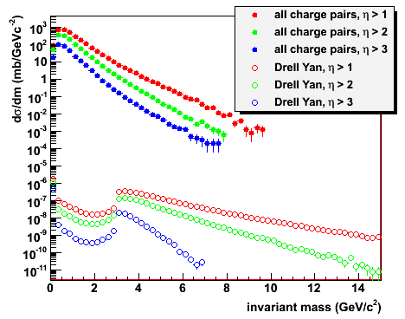
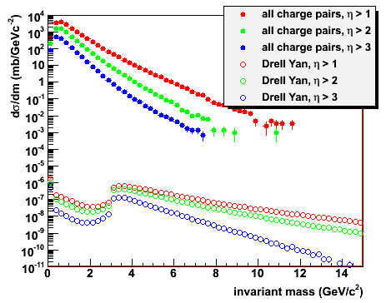
Backgrounds to DY production
Most dominat background sources
  QCD 2→2
  Heavy flavour
  photon conversion in material
All charged particle pairs between J/Ψ and ϒ
Hadron suppression 10⁵-10⁶ needed at 500 GeV
  Drell Yan signal reduced in 200 GeV forward
200 GeV
500 GeV

Slide 8
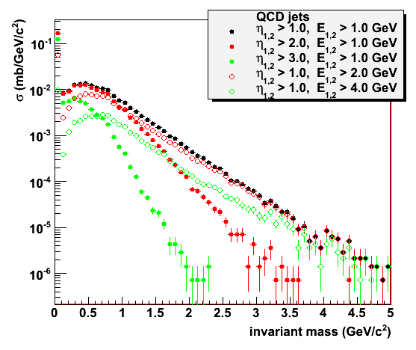
Background rejection
Electrons and positrons from hard QCD processes are uncorrelated
  Opening angles are comparable to Drell Yan: detector acceptance
  Lepton energies of
  Drell Yan decays are
  large
  Energy cut removes
  QCD background at
  small m_{inv}
  Large masses in QCD
  background favor
  mid-rapidity
  Energy asymmetry has
  not been used yet

Slide 9
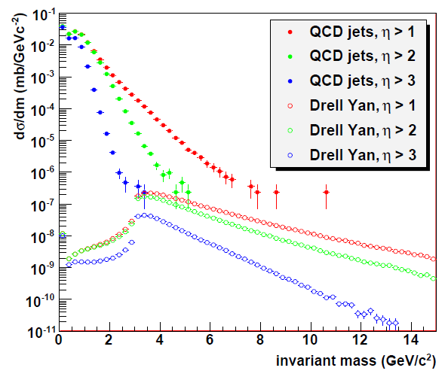
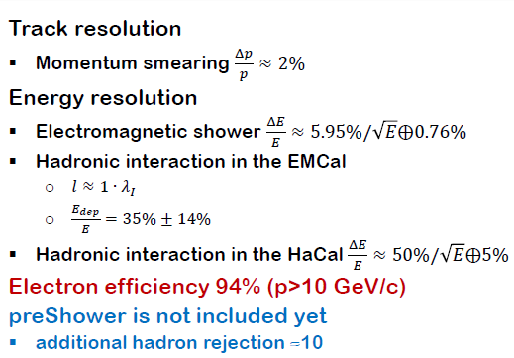
Drell-Yan at forward rapidities
Parametrized fast
MC for detector
smearing
Drell Yan signal
  3 – 10 GeV/c²
Energy cut
  E_{1,2} > 2 GeV
Forward rapidities
  Effectively no
  background left
  Statistically limited
  Drell Yan
  for m_{inv} < 3 GeV/c² not physical (PYTHIA settings)
Oleg: HCal: 38%√E+3%
Ecal: 10%√E+1.5%

Slide 10
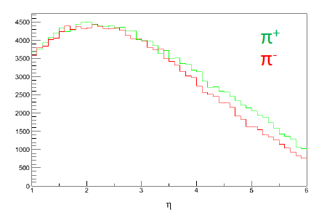
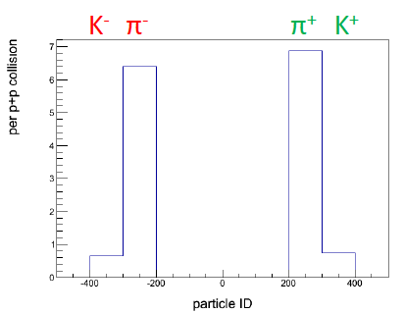
Do we need charge separation for DY?
QCD 2→2
No big difference between +/- hadrons
→ can live without charge sign discrimination
2 < η < 4.5
DY and background simulation working
as soon as upgrade detector performances are known
they can be integrated in the fast simulator
ultimately need full Geant simulation
framework can also be applied to pA

Slide 11
Possible technologies and other Questions
need a technology with absolutely minimal R&D → manpower
  tap into LHC technologies
need to keep price reasonable
what radiation length can we tolerate
  if needs to be low → only gaseous detectors are possible
Need to determine from physics:
  rapidity range: we need momentum reconstruction
  rapidity range: charge determination is enough
  rapidty range: with other requirements on tracking
Final FGT performance
  sufficient for, jets or other observables in the endcap ?
    if yes ☺
    if no need to fix FGT performance

Slide 12
Gaseous Detectors in the current LHC experiments
 | Vertex | Inner Tracker | PID/ photo- det. | EM CALO | HAD CALO | MUON Track | MUON Trigger
ATLAS | - | TRT (straws) | - | - | - | MDT (drift tubes), CSC | RPC, TGC (thin gap chambers)
CMS | - |  | - | - | - | Drift Tubes, CSC | RPC, CSC
TOTEM | - | GEM | - | - | - | - | -
LHCb | - | Straw Tubes | - | - | - | MWPC | MWPC, GEM
ALICE | - | TPC (MWPC) | TOF(MRPC), RICH pad chamber, TRD (MWPC) | - | - | Muon pad chambers | RPC

Slide 13
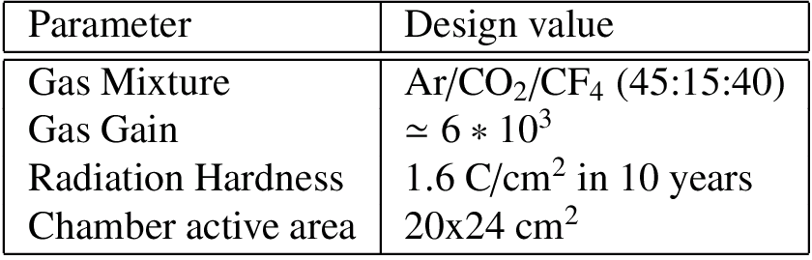
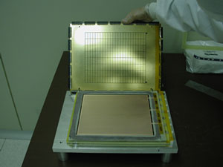
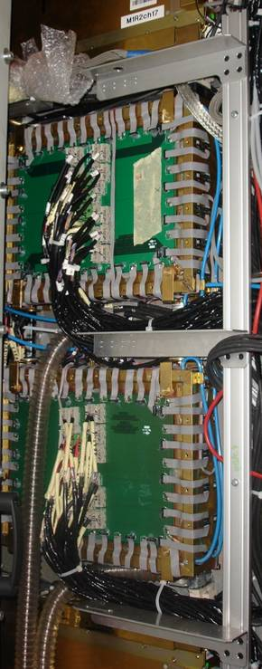
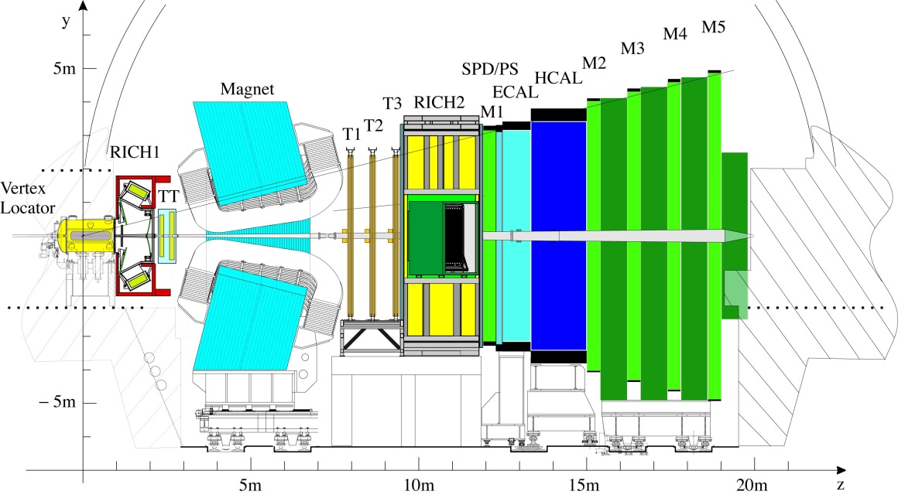
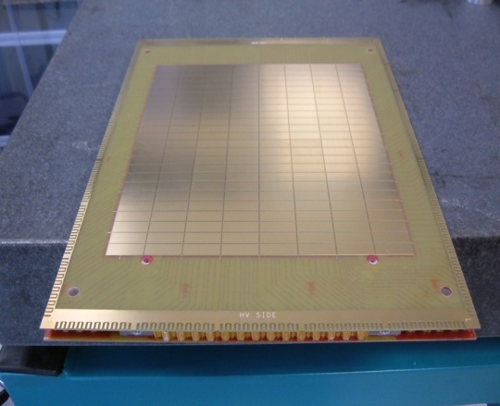
GEMs @ LHCb
GEMs for LHCb L0 Muon Trigger:
Operating since LHC startup
Rate up to 500 kHz/cm²
Efficiency ≥ 98% in 25ns window (using OR)
Time resolution 4.5 ns (rms)
Rad-hard up to integrated charge of
≥ 2 C/cm² (15 LHCb years)
20x24 cm² GEM module
12 Double Triple-GEMs in front of calorimeter; total area 0.6 m²
Double
3-GEMs
Readout: 1cm × 2.5 cm pads

Slide 14
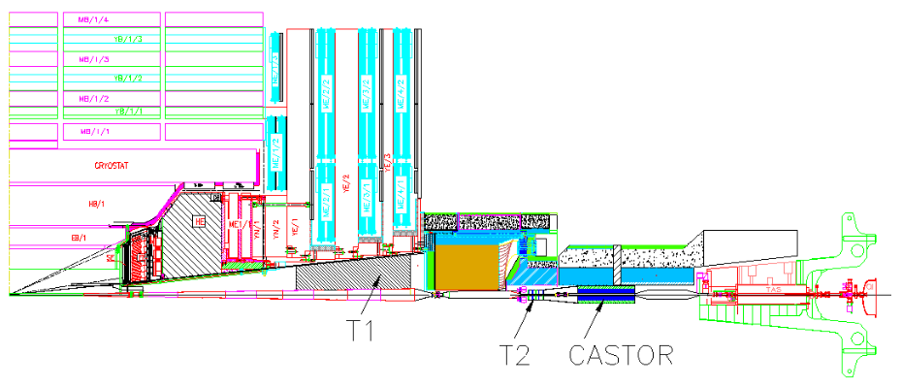
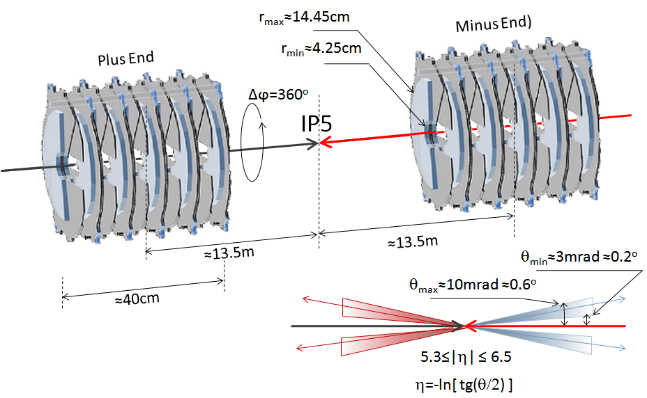

GEMs @ TOTEM
E. Oliveri (INFN Pisa), 3rd CMS GEM Upgrade Workshop, April 2012
T1, T2:
Charged Particles
in Inelastic Events
CMS
Triple-GEM Telescope T2:
very forward at
5.3 ≤ |η| ≤ 6.5
CSCs 3.1≤ |η| ≤ 4.7:
About 99.5% of all non- diffractive minimum bias events and 84% of all diffractive events have charged particles within the acceptance of the TOTEM detectors,T1 and T2.
360º ϕ coverage
Readout Granularity:
  δ r ≈ 400mm [pitch]
  δϕ = 2.9º [pitch]
4 quarters with 10 detectors aligned each

Slide 15
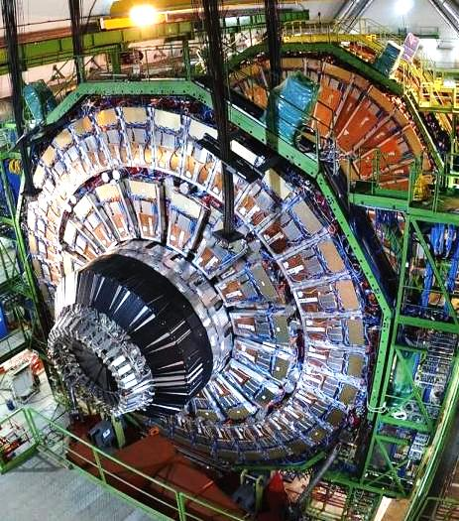
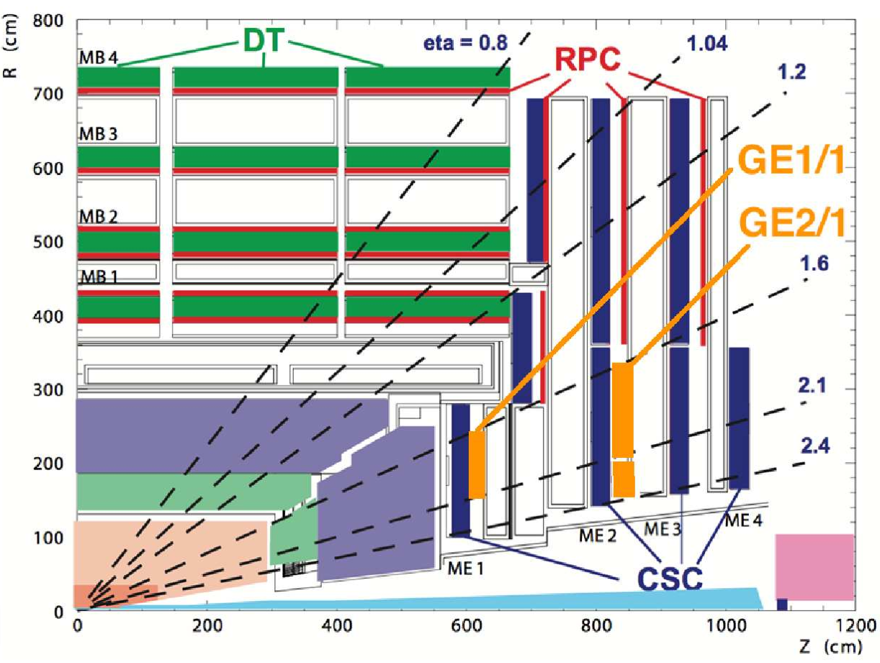
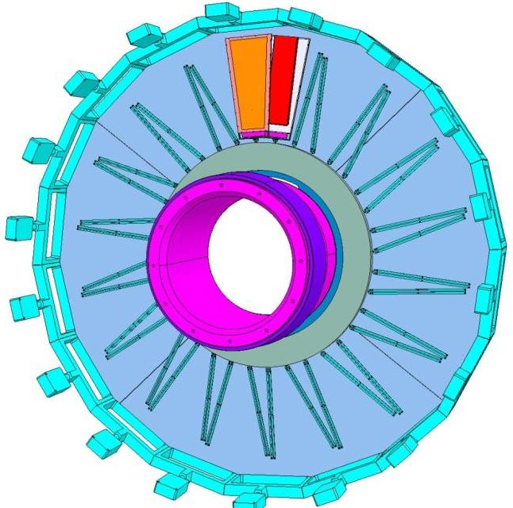
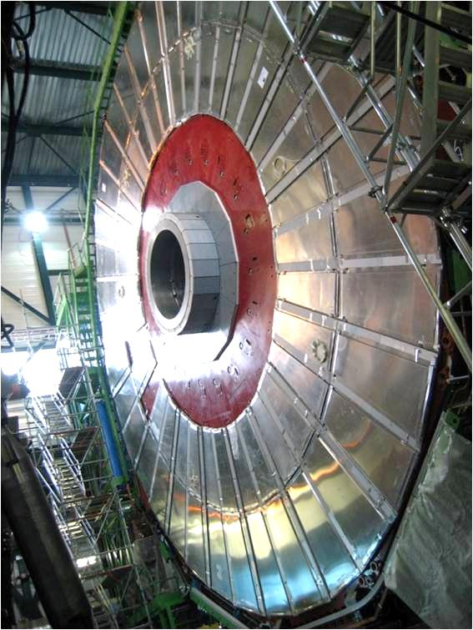
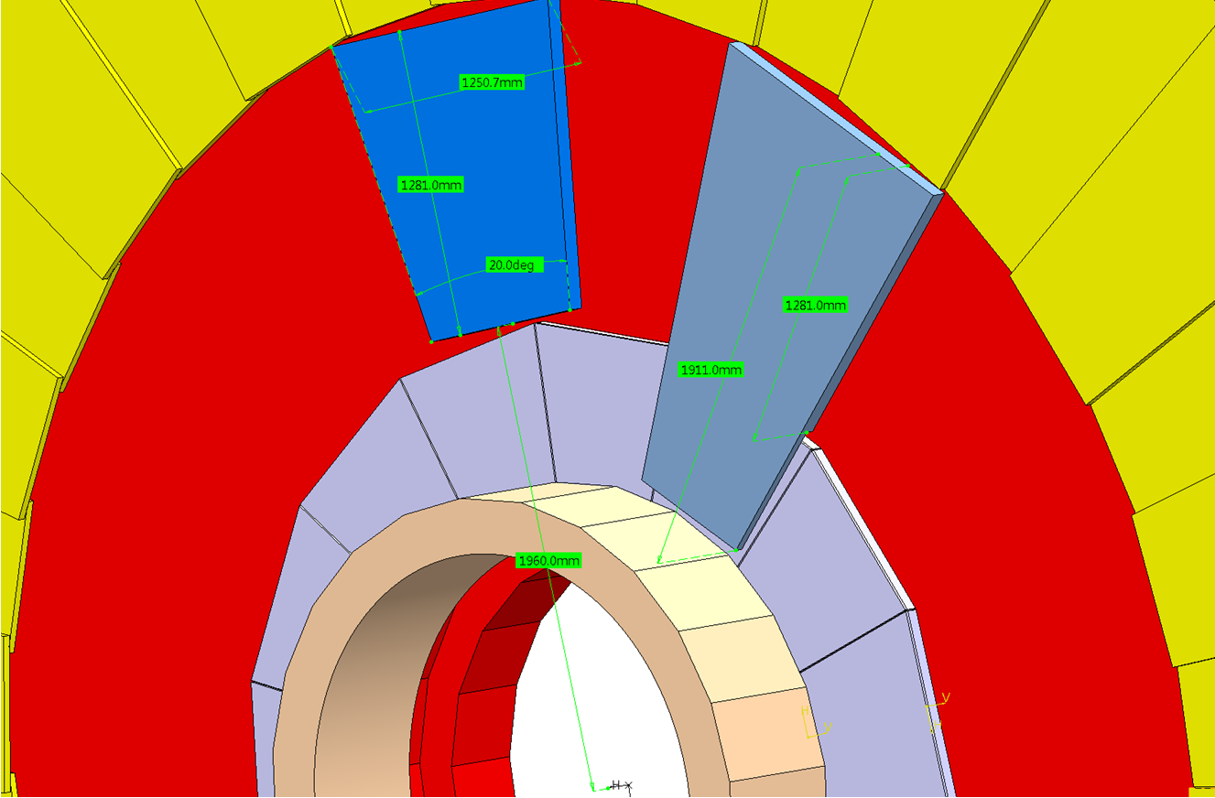
GEM Endcap Chambers
The currently un-instrumented high-η RPC region of the muon endcaps presents an opportunity for instrumentation with a detector technology that could sustain the radiation environment long-term and be suitable for operation at the LHC and its future upgrades into Phase II: GEM Detectors
GE1/1 in YE1 nose
GE3/1
GE4/1
GE2/1 on
back of YE1

Slide 16
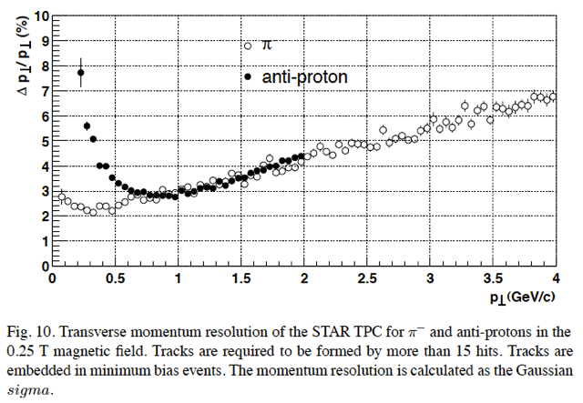
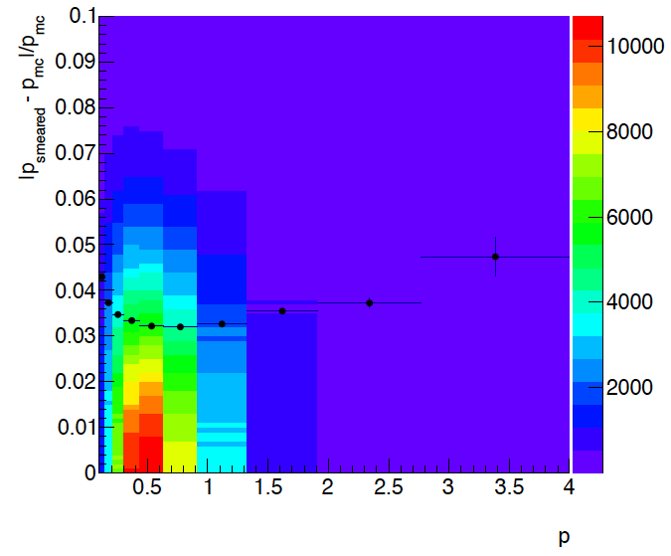
Some Simulation results
Used fast smearing simulator
  multiple scattering and momentum scattering included according to PDG
  check at central region → looks okay
-1< η <1
assumed 0.05 radiation lengths

Slide 17
What was modeled
Magnetic field: Solenoid with 0.5 Tesla
“Central” +/-1
  TPC-like:
    45 fit points; 0.03 radiation length, position resolution: 80 μ
“Forward” 1-3
  GEM-like:
    6 planes; 0.03 radiation length, position resolution: 80 μ
“Far Forward” 3-4.5
  Si-Pixel-like:
    12 planes; 0.03 radiation length, position resolution: 20 μ

Slide 18
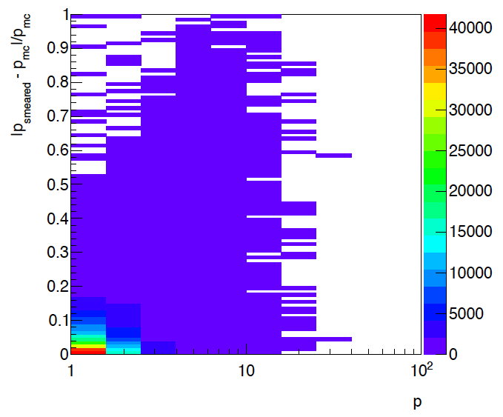
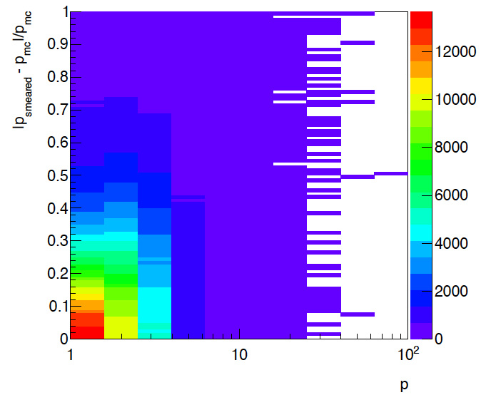
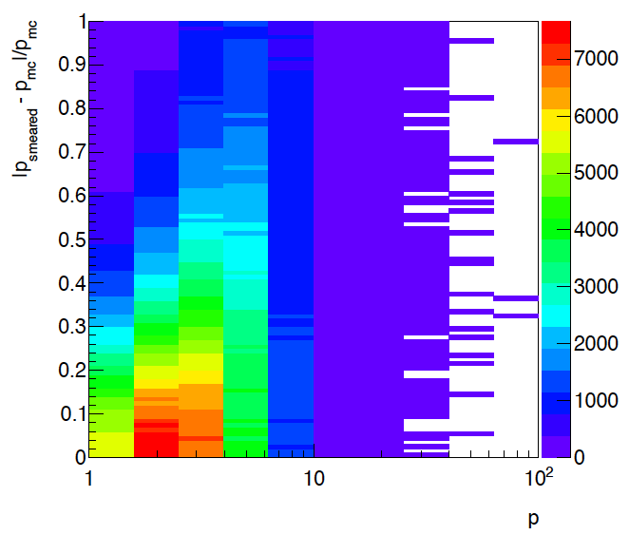
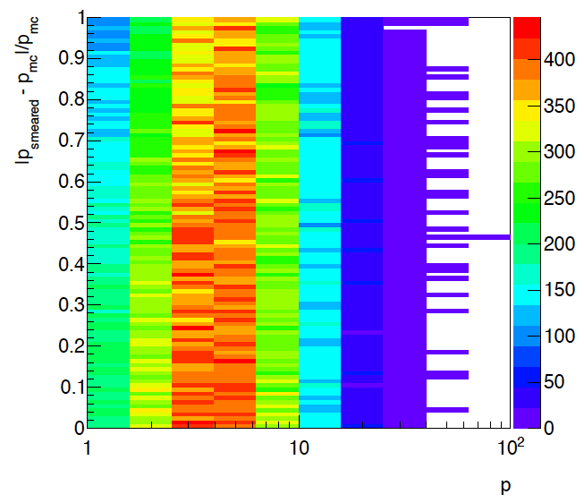
What can we expect in the forward η
Above η>2.5 resolution detoriates so much, can get at maximum charge of particle
0.5<η<1.5
1.5<η<2.5
2.5<η<3.5
3.5<η<4.5

Slide 19
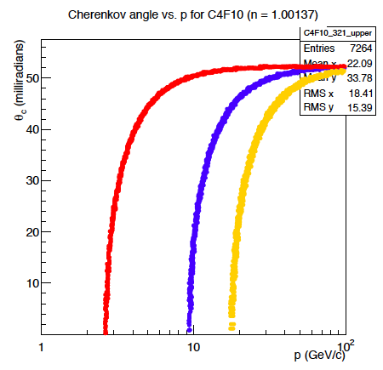
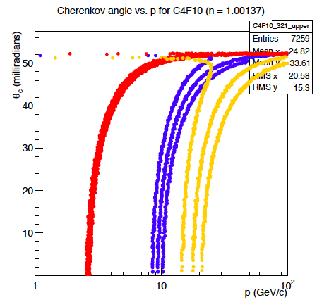
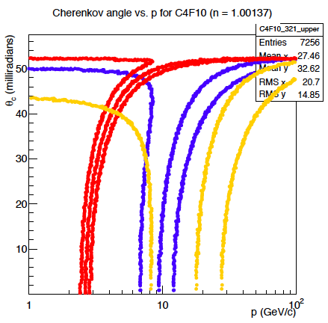
Cerenkov and momentum resolution
δp/p<0.1%
δp/p< 1.0%
δp/p< 3.0%
π
Κ
p
Lets forget about a RICH
and update our default upgrade figure
Of course also a threshold Cerenkov is affected by this momentum effects
So for the forward PID the questions is, which rapidity range we want to
cover.

Slide 20
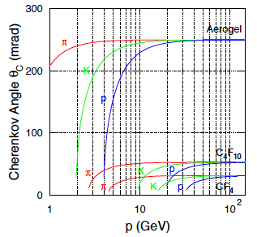
Summary
Momentum reconstruction with tracking η>2.5 is not possible
  is the charge enough for the physics we want to do
PID based on a RICH impossible
  threshold Cerenkov is possible for η<2.5, if radiator has low refractive index → high K, p threshold
    CF₄: n=1.0005 (π > 4 GeV)
  Material impact on Calorimeters needs to be simulated
If we want good momentum resolution
and π, K, p separation
till a rapidity of 4 need a dipole magnet
check old proposal from
Les, Hank and Akio
major effort
unusable for eSTAR

Slide 21
BACKUP

Slide 22
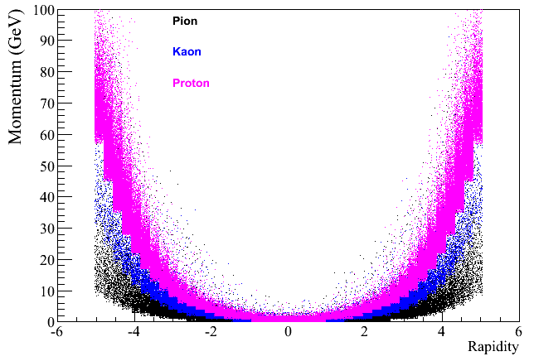
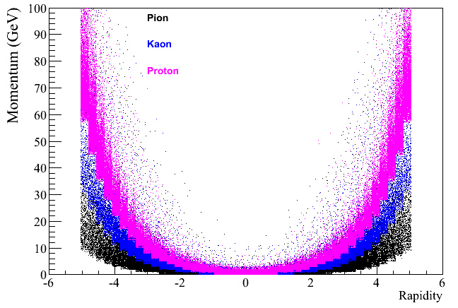
Needed Momentum Coverage
100GeV x 100GeV
250GeV x 250GeV
Max. Momentum Coverage needed:
1-100 GeV
In general needs are
dual radiator cernekov
to separate π, p, K
Decadal Plan:
concentrate on 2<rapidiy<4

Slide 23
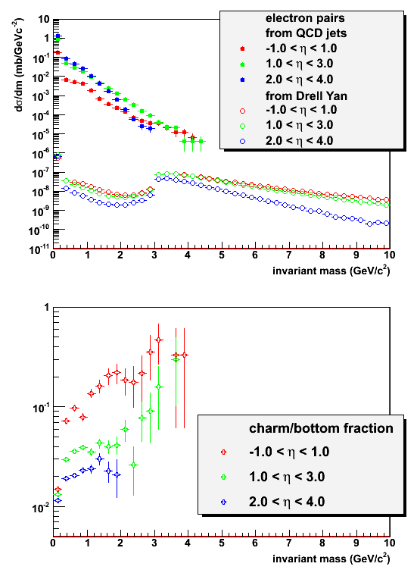
Heavy flavor contributions
More low mass heavy flavor in forward directions
Charm & bottom contributions increase with m_{inv}
Comparison at m_{inv} < 3 GeV/c² needs more studies
  See previous slide
  Smaller energy cut

Slide 24
Tools/MCs to study this questions
polarised pp
  developed MC generator for transverse physics TPPMC (Tom Burton)
    sivers and collins asymmetries already included
    IFF and DY/ W A_{N} need to be still included
    Details: http://drupal.star.bnl.gov/STAR/system/files/burtonAnalysisMeeting20110418.pdf
AA, p(d)A, pp
  MC generator SARTRE (Tobias Toll, Thomas Ullrich) to simulate UPC
    Details: http://drupal.star.bnl.gov/STAR/system/files/StarUPC.pdf
  pA/eA including non-saturation cold nuclear matter physics (L. Zheng)
    based on dpmjet → nucleus geometry via wood-saxon, break up fully simulated
    eA: replaced phojet (only very low Q²) by pythia6.4 ( all Q²) and included LHAPDF → nPDFs as well as Salgado-Wiedemann energy loss model
    currently working on extension to pA; DPMJET-III works for pA
ep/eA
  have MC generators for all physics topics discussed for an EIC
  have been heavily for the EIC white paper and by ePHENIX
Fast smearing generator
  tool to smear generator particle responses in p and energy and to include PID responses, “detectors” can be flexible defined in the acceptance

Slide 25
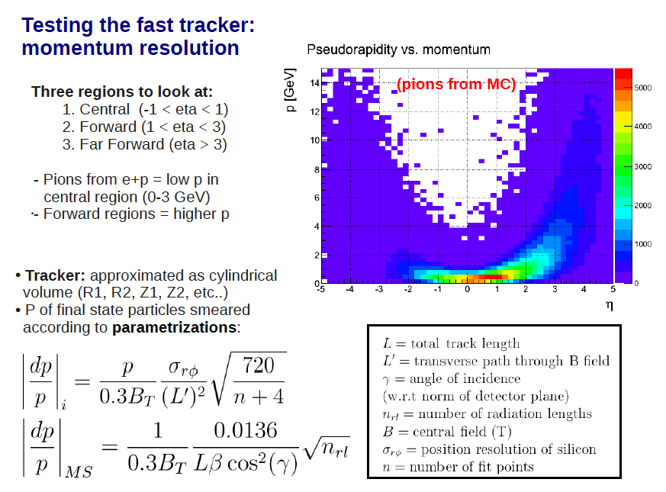
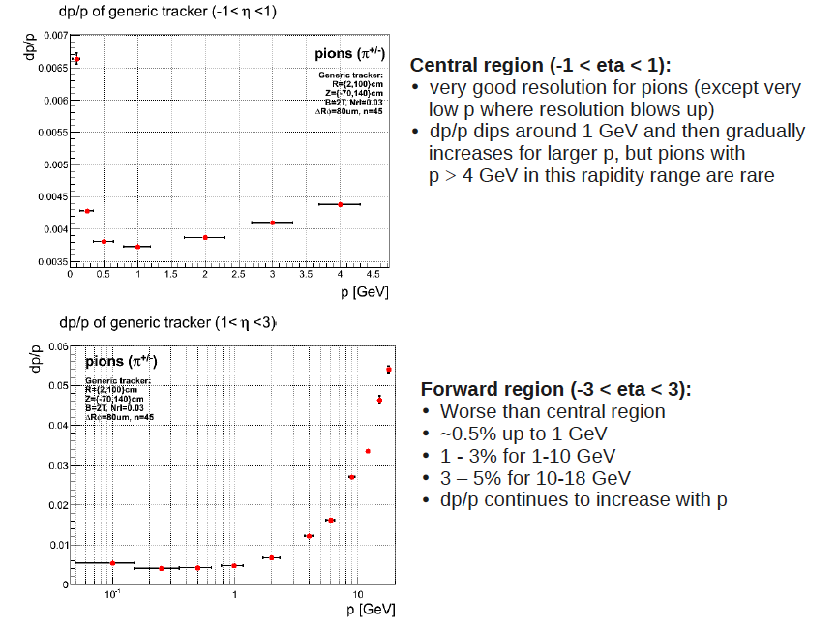
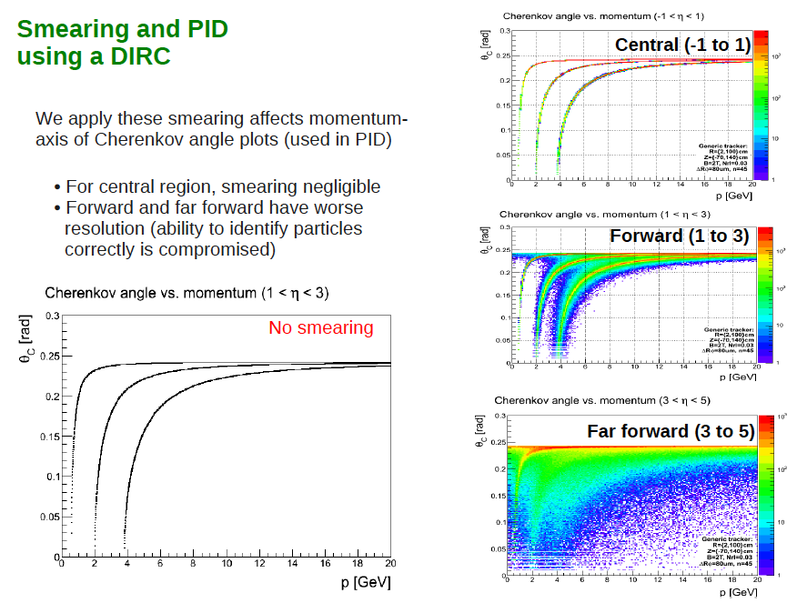
RICH a possibility for (e)STAR
At UCLA we discussed a RICH in the forward direction, BUT what does the not to great momentum resolution do to the π, K, p identification
Aerogel RICH
RICH in the forward direction of STAR
seems super difficult, because of expected
momentum resolution

Slide 26
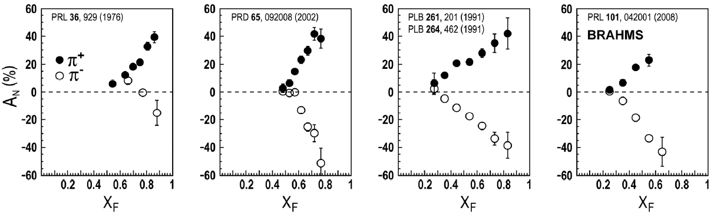
Transverse single-spin asymmetries
ANL ZGS
√s=4.9 GeV
BNL AGS
√s=6.6 GeV
FNAL
√s=19.4 GeV
BRAHMS@RHIC
√s=62.4 GeV
π⁰
Big single spin asymmetries in pp !!
Naive pQCD (in a collinear picture)
predicts A_{N} ~ α_{s}m_{q}/sqrt(s) ~ 0
What is the underlying process?
Sivers / Twist-3 or Collins or ..
Do they survive at high √s ?
Is p_{t} dependence as expected from p-QCD?
left
right

Slide 27
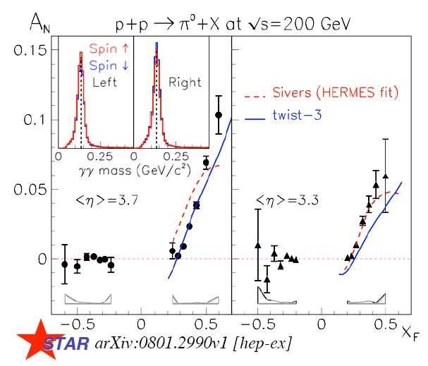
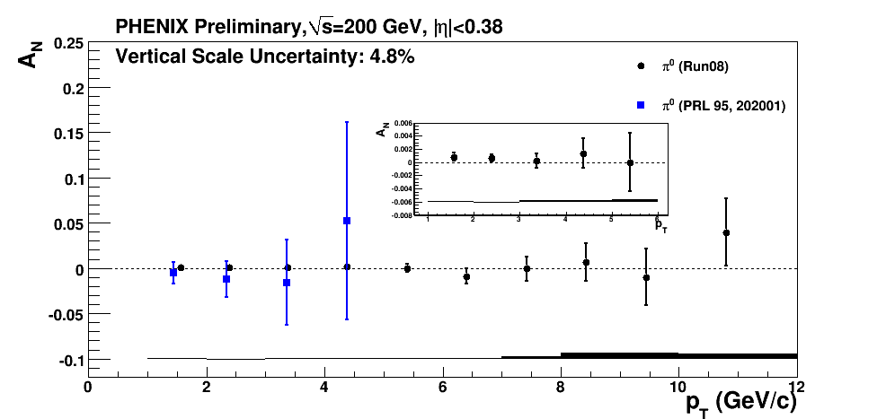
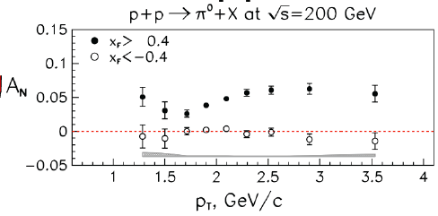
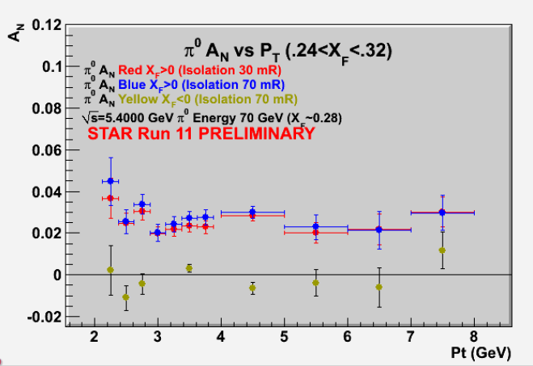
Transverse Polarization Effects @ RHIC
Left
-Right
Phys. Rev. Lett. 101 (2008) 222001
midrapidity: maybe gluon Sivers????
PHENIX
Questions from last page
What is the underlying process?
Sivers / Twist-3 or Collins or ..
no answer yet
Do they survive at high √s ? ✔
Is p_{t} dependence as expected from p-QCD? NO

Slide 28
What else do we know
Collins / Transversity:
  conserve universality in hadron hadron interactions
  FF_{unf} = - FF_{fav} and δu ~ -2δd
  evolve ala DGLAB, but soft because no gluon contribution (i.e. non-singlet)
Sivers, Boer Mulders, ….
  do not conserve universality in hadron hadron interactions
  k_{t} evolution → can be strong
    till now predictions did not account for evolution
  FF should behave as DSS, but with k_{t} dependence unknown till today
  u and d Sivers fct. opposite sign d >~ u
  Sivers and twist-3 are correlated
    global fits find sign mismatch, possible explanations, like node in k_{t} or x don’t work

Slide 29
What does the MC say?
Collins Result with all positivity bounds maxed out
How can the Sivers asymmetry be so small
Following plots were done with:
Q² > 1
p + p √s = 500 GeV
Sivers at positivity bound
No fragmentation/transversity/Collins
Look at pz > 0 partons (forward η)
No parton showers (ISR/FSR off)
Integrated over p_{T}
Sivers Result with all positivity bounds maxed out

Slide 30
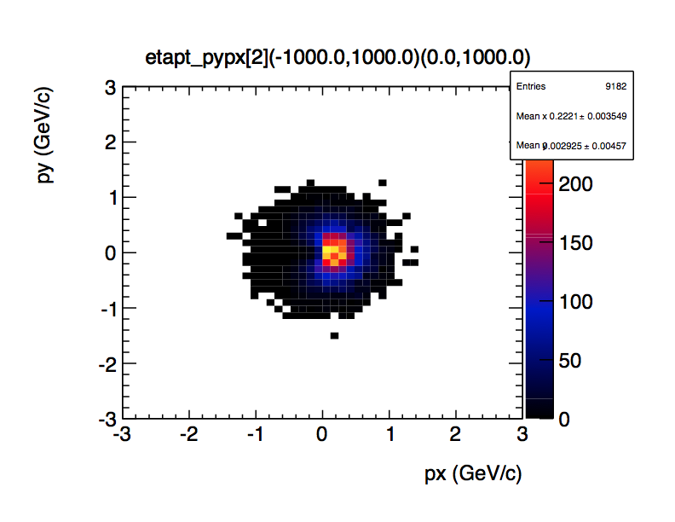
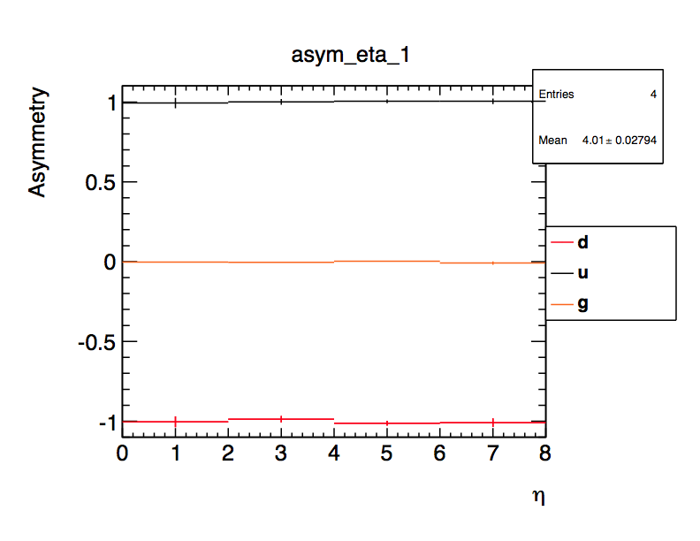
Weight counts using Sivers function to give phi modulation
incident up quarks, at forward η
w = 1 + sivers/unpol*(px/pt)
PYTHIA Gaussian primordial kT width = 0.5
(amplitude * spin factor)
Compute simple left-right asymmetry: recovers input
30

Slide 31
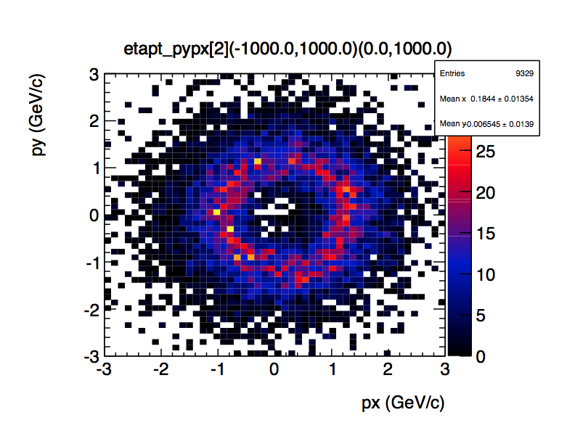
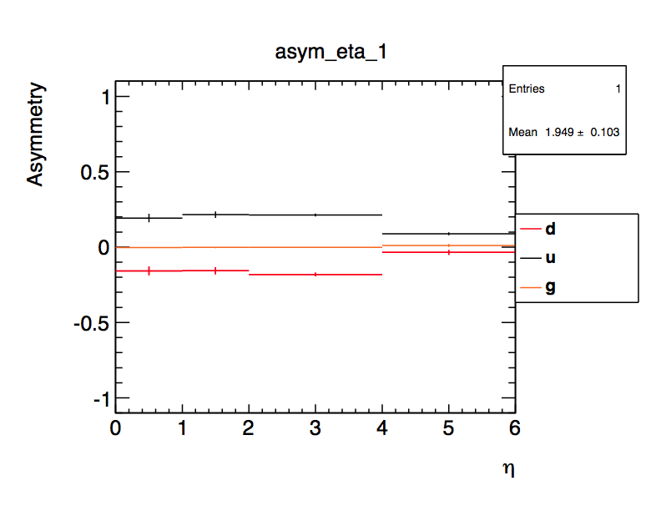
Weight counts using Sivers
function to give phi modulation
Use same weighting for parton after scattering (no fragmentation)
py-px distribution “blows up” because of pT kick from hard interaction
Offset from 0 due to asymmetry
Left-right asymmetry: watered down in scattering because hard pT >> intrinsic kT

Slide 32
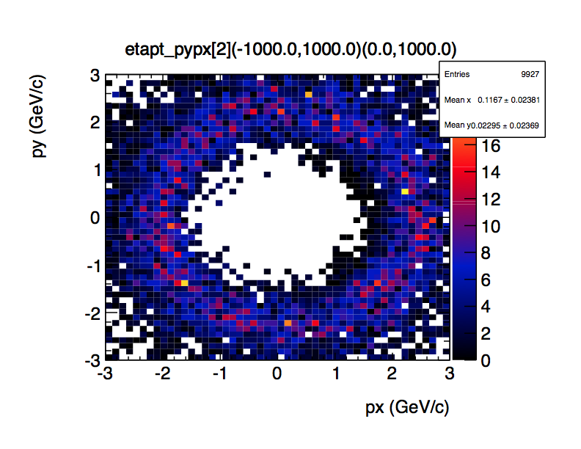

See this more if we increase Q²min from 1 to 4:
~5% vs 15% for up

Slide 33


Conversely, if Q²min == 1 and
increase intrinsic kT width to 1,
asymmetry is less watered down:
30% vs. 15% for u
So …
100% asymmetry in up quarks is significantly reduced in scattered
q once account for high-pT hard interaction
Final asymmetry even smaller due to
    Opposite signs of u and d partially cancel
    Gluons, with no asymmetry
    Fragmentation further washes out partonic asymmetry
RESULT: Sivers small, at least in the kinematics Tom has looked at here

Slide 34
We need to analyze 200/500 GeV p↑p
SIVERS
Transversity x Collins
A_{N} for jets in FMS
A_{N} for direct photons in FMS
A_{N} for J/ψ do we see
the same as PHENIX
A_{N} for heavy flavour → gluon
π^{+/-}π⁰ azimuthal distribution in jets
mid to forward rapidity
→ see Alan’s talk in April @ Spin PWG
Interference fragmentation function
→ mid to forward rapidity
A_{N} for π⁰ and η in FMS with increased p_{t} coverage
Combined with 2011 transverse 500 GeV data
and 2012 transverse 200 GeV data
Powerful dataset to attack A_{N} mystery
and it will help us to optimize forward upgrade

Slide 35



The famous sign change of the Sivers fct.
Intermediate Q_{T}
Q>>Q_{T}/p_{T}>>Λ_{QCD}
Transverse
momentum
dependent
Q>>Q_{T}>=Λ_{QCD}
Q>>p_{T}
Collinear/
twist-3
Q,Q_{T}>>Λ_{QCD}
p_{T}~Q
Efremov, Teryaev;
Qiu, Sterman
Sivers fct.
Q_{T}/P_{T}
Λ_{QCD}
<<
Q_{T}/P_{T}
<<
Q
critical test for our understanding of TMD’s and TMD factorization
QCD:
DIS: attractive
FSI
Drell-Yan: repulsive
ISI
Sivers_{DIS} = - Sivers_{DY} / Sivers_{W}

Slide 36



Collision Energy Dependence of Drell Yan Production
Comments…
partonic luminosities increase with √s
net result is that DY grows with √s
largest √s probes lowest x
⇒ Consider large-x_{F} DY at √s=500 GeV
Prediction of
A_{N} using TMDs
Sivers fct
based on fit to
HERMES & COMPASS
Kang & Qiu PRD 81 (2010) 054020

Slide 37

The polarized DY caveat
Caveat: k_{t} evolution of TMDs
  First results from evolution workshop at Jlab
  http://www.jlab.org/conferences/qcd2012/program.html
Need to see how things develop but if this effect remains A_{N}^{DY} is immeasurable

Slide 38

Reconstruction of W – The A_{TU} asymmetry
A. Metz and J. Zhou -> arXiv:1006.3097v1 [hep-ph]
l± asymmetry very small and in a tiny range of P_{T} (?)
Measurement eager of statistics
pp -> l± X
pp -> l± X
W-asymmetry can be 4 times
larger than lepton one
Reconstructing the W is a big advantage for the TSA measurement (A_{TU}^{W}).
Direct reconstruction of W in the rest-frame not possible: Ignorance of P_{z}(n) -> ignorance of P_{z}(W)
Method used at Fermilab [Phys.Rev.Lett. 73 (1994) 2296-2300]
M_{W} not know in each event… but follows the Breit-Wigner distribution and > M_{T}
Assigning a M_{W} leads to: 2 possible solutions for P_{z}(ν) -> P_{z}(W)-> cos(θ) and φ
Collins-Soper frame -> both solutions for P_{z}(W) uniquely determine |cos(θ)| and φ
MC grid is used to select the most probable solution on event-by-event basis:
  Create 4-dimensional phase-space (η of W, lepton, neutrino and jet)
  Two P_{z}(ν) choices -> two different phase-space locations
  Choose the P_{z}(ν) which falls in the most populated bin of the grid
  Correct solution is selected in ~80% of events
Notes:
Τηετα is the neutrino angle in the Collins-Soper frame

Slide 39


Solid line: reconstructed cos(θ)
Dashed line: generated cos(θ)
Good agreement for Tevatron energies
cos(θ) is shown for different bins of P_{T}(W)
The pink elephant in the room is
what are the evolution effects for A_{N}^{DY}
[J. Strologlas, FERMILAB-THESIS-2002-47]
Will apply the method to STAR

Slide 40

What pHe³ can teach us
Polarized He-3 is an effective neutron target → d-quark target
  Polarized protons are an effective u-quark target
Therefore combining pp and pHe3 data will allow a full
quark flavor separation u, d, ubar, dbar
Two physics trusts for a polarized pHe3 program:
Measuring the sea quark helicity distributions through W-production
  Access to Δdbar
  Caveat maximum beam energy for He-3: 166 GeV
    Need increased luminosity to compensate for lower W-cross section
Measuring single spin asymmetries A_{N} for pion production and Drell-Yan
  expectations for A_{N} (pions)
    similar effect for π± (π⁰ unchanged)
³He: helpful input for understanding
of transverse spin phenomena
Critical to tag spectator protons from 3He with roman pots

Slide 41




Spectator proton from ³He with the current RHIC optics
Momentum smearing mainly due
to Fermi motion + Lorentz boost
Angle <~3mrad (>99.9%)
Angle [rad]
generated
Passed DX aperture
Accepted in RP
The same RP configuration with the current RHIC optics (at z ~ 15m between DX-D0)
Acceptance ~ 98%

Slide 42




Quantum phase-space tomography of the nucleon
Wigner Distribution
W(x,r,k_{t})
Join the real
3D experience !!
TMDs
GPDs
3D picture in momentum space 3D picture in coordinate space
  transverse momentum generalized parton distributions
  dependent distributions → exclusive reaction like DVCS
Quarks
unpolarised polarised

Slide 43



Beyond form factors and quark distributions
Generalized Parton Distributions
X. Ji, D. Mueller, A. Radyushkin (1994-1997)
Proton form factors, transverse charge & current densities
Structure functions,
quark longitudinal
momentum & helicity
distributions
Correlated quark momentum
and helicity distributions in
transverse space - GPDs

Slide 44

The Hunt for Lq
Study of hard exclusive processes
allows to access
a new class of PDFs
Generalized Parton Distributions
possible way to access
orbital angular momentum
DIS: ~0.3
Spin Sum Rule in PRF:
exclusive:
all reaction products are detected
missing energy (ΔE) and
missing Mass (M_{x}) = 0

Slide 45



GPDs Introduction
How are GPDs characterized?
unpolarized polarized
conserve nucleon helicity
flip nucleon helicity
not accessible in DIS
quantum numbers of final state select different GPD
DVCS
pseudo-scaler mesons
vector mesons
π⁰ | 2Δu+Δd
η | 2Δu−Δd
ρ⁰ | 2u+d, 9g/4
ω | 2u−d, 3g/4
φ | s, g
ρ⁺ | u−d
J/ψ | g
Q²= 2E_{e}E_{e}’(1-cosθ_{e’})
x_{B} = Q²/2Mν ν=E_{e}-E_{e’}
x+ξ, x-ξ long. mom. fract.
t = (p-p’)²
ξ ≅ x_{B}/(2-x_{B})

Slide 46


From pp to γp
Get quasi-real photon from one proton
Ensure dominance of g from one identified proton
by selecting very small t₁, while t₂ of “typical hadronic size”
small t₁ ←→ large impact parameter b (UPC)
Final state lepton pair ←→ timelike compton scattering
timelike Compton scattering: detailed access to GPDs
including E^{q;g} if have transv. target pol.
Challenging to suppress all backgrounds
Final state lepton pair not from γ* but from J/ψ
  Done already in AuAu
  Estimates for J/ψ (hep-ph/0310223)
transverse target spin asymmetry → calculable with GPDs
information on helicity-flip distribution E for gluons
golden measurement for eRHIC
Z²
A²
Work in collaboration with Jakub Wagner, Dieter Mueller, Markus Diehl

Slide 47



Forward Proton Tagging at STAR/RHIC
at 55-58m
at 15-17m
J.H. Lee
Roman Pot detectors to measure forward scattered protons in diffractive processes
Staged implementation to cover wide kinematic coverage
Phase I (Installed): for low-t coverage
Phase II (planned) : for higher-t coverage
    8(12) Roman Pots at ±15 and ±17m
    2π coverage in φ will be limited due to
    machine constraint (incoming beam)
No special β* running needed any more
→ 250 GeV to 100 GeV
scale t-range by 0.16

Slide 48


500 GeV pp: UPC kinematics
no cuts
Adding cut by cut:
leptons without cuts
μ₂: -1 < η < 2
μ₁ and μ₂: -1 < η < 2
-0.8<t₁<-0.1 and -0.8<t₂<-0.1
all cuts

Slide 49


500 GeV pp: UPC kinematics
Beam: t₁
kinematics of proton 1 and 2
target: t₂
Adding cut by cut:
leptons without cuts
μ₂: -1 < η < 2
μ₁ and μ₂: -1 < η < 2
-0.8<t₁<-0.1 and -0.8<t₂<-0.1

Slide 50

500 GeV pp: Decay kinematics
all cuts
Using SARTRE:
Cross section 500 GeV: 6.9 nb
200 GeV: 1.1 nb
in agreement with theoretical calculations
500 GeV: → 1600 J/Ψ in 290 pb⁻¹
550 J/Ψ in 100 pb⁻¹
200 GeV: → 3650 J/Ψ in 1800 pb⁻¹
200 J/Ψ in 100 pb⁻¹
no trigger efficiencies or detector effects
included yet
need more statistics → p↑Au
Adding cut by cut:
leptons without cuts
μ₂: -1 < η < 2
μ₁ and μ₂: -1 < η < 2
-0.8<t₁<-0.1 and -0.8<t₂<-0.1
J/Ψ reconstructed through
e+e- and/or μ+μ- channels

Slide 51


200 GeV pAu: UPC kinematics
Au
Au’
no cuts
p
p’
Adding cut by cut:
leptons without cuts
μ₂: -1 < η < 2
μ₁ and μ₂: -1 < η < 2
t₁>-0.016 and -0.2<t₂<-0.016
all cuts

Slide 52


200 GeV pAu: UPC kinematics
Beam: t₁
p: t_{γ}
kinematics of proton 1 and 2
Au: t_{γ}
target: t₂
t_{p’}
t_{Au’}

Slide 53

200 GeV pAu: Decay kinematics
all cuts
Au
Au’
p
p’
magenta
p
p’
black
Au
Au’
Using SARTRE:
Cross section 200 GeV: 38.5 nb
200 GeV: 1.6 10³ nb
in agreement with theoretical calculations
200 GeV: → 5450 J/Ψ in 51 pb⁻¹
11000 J/Ψ in 100 pb⁻¹
200 GeV: → 1558 J/Ψ in 1.2 pb⁻¹
155800 J/Ψ in 100 pb⁻¹
no trigger efficiencies or detector effects
included yet
Caveat: Q²-distribution for Au (=t₁)
needs to be extended in MC
→ more statistics 38.5 nb → ~10³ nb
Adding cut by cut:
leptons without cuts
μ₂: -1 < η < 2
μ₁ and μ₂: -1 < η < 2
t₁>-0.016 and -0.2<t₂<-0.016
J/Ψ reconstructed through
e+e- and/or μ+μ- channels

Slide 54
Summary
Have developed a lot of useful tools to do concrete simulations
  have started to use them to understand what the requirements for the different observables are
  it would be nice to have an easy, fast way to combine new generators with STAR-Geant simulation
  from the expectations of the momentum resolutions for η>1 a RICH seems undoable
Need to follow closely the developments on TMD evolution
  if A_{N}^{DY} remains ~1% it seems immeasurable
  Need to come to a conclusion for A_{N}^{W} is it measurable (reconstruct W, what is the asymmetry after evolution
My next projects are
  to understand the possibility for hard diffraction causing A_{N}
  looking in how well we can do direct photons
    important underlying subprocess for A_{N} → Yuri’s talk
    also important observable for pA CGC ←→ std nuclear matter effects
We need to analyze our 200 and 500 GeV transverse data to guide the design of the upgrade.
UPC to constrain GPDs in pp looks very promising
  would be very important as a pre-sucessor for the eRHIC GPD program
  will hopefully start with a rapidity gap trigger in 2013 pp-run
    need to still simulate this

Slide 55




A new idea: A_{LT}
Idea by Andreas Metz et al.
http://www.jlab.org/conferences/qcd2012/talks/monday/Daniel%20Pitonyak.ppt
Case 1: Δg as in de Florian, et al., Phys. Rev. D (2009)
Case 2: Δg = g

Slide 56




“Spectator” proton from deuteron with the current RHIC optics
generated
Passed DX aperture
Accepted in RP
Rigidity (d:p =2:1)
The same RP configuration with the current RHIC optics (at z ~ 15m between DX and D0)
Detector size and position can be optimized for optimal acceptance

Slide 57

accessing GPDs: some caveats
but only ξ and t accessible experimentally
x is not acessible (integrated over):
apart from cross-over trajectory (x=ξ) GPDs not directly accessible:
deconvolution needed ! (model dependent)
GPD moments cannot be directly revealed,
extrapolations t → 0 are model dependent
t=0
q(x)
ξ=0 →
q(x)
cross sections & beam-charge asymmetry ~ Re(T ^{DVCS} )
beam or target-spin asymmetries ~ Im(T ^{DVCS} )

Slide 58




Deeply Virtual Compton Scattering: DVCS
most clean channel for interpretation in terms of GPDs
two experimentally undistinguishable processes:
HERMES / JLAB
kinematics: BH >> DVCS
p + Δ
DVCS
Bethe-Heitler (BH)
isolate BH-DVCS interference term non-zero azimuthal asymmetries
can measure DVCS – cross section and I

Slide 59

DVCS ASYMMETRIES
→ different charges: e⁺ e⁻:
~
Δσ_{C} ~ cosφ ∙Re{ H + ξH +… }
H
→ polarization observables:
~
Δσ_{LU} ~ sinφ∙Im{H + ξH + kE}
H
Δσ_{UT}
~
~
Δσ_{UL} ~ sinφ∙Im{H + ξH + …}
H
beam target
Δσ_{UT} ~ sinφ∙Im{k(H - E) + … }
H, E
ξ = x_{B}/(2-x_{B} ) k = t/4M²
kinematically suppressed

Slide 60
GPDs: DVCS@eRHIC
b=5.6
Specifications:
Statistical error down to 1%
It uses smeared t values (5% momentum resol.)
|t|-binning –> 3 * resolution (or higher)
5 X 100
(~ 10 months EIC)
S. Fazio

Slide 61
DVCS Asymmetries
Plots from D. Mueller

Slide 62
What will we learn about 2d+1 structure of the proton
GPD H and E as function of t, x and Q²
GPD H and E 1d+1
Plots from D. Mueller
GPD H and E 2d structure for quarks
A global fit over all mock data was done, based on the GPDs-based model:
[K. Kumerički, D Müller, K. Passek-Kumerički 2007]
Known values q(x), g(x) are assumed for H^{q}, H^{g} (at =0, t=0 forward limits E^{q}, E^{g} are unknown)
Excellent reconstruction of H^{sea}, H^{sea} and good reconstruction of H^{g} (from dσ/dt)

Slide 63


Other Channels: J/ψ
M. Diehl
J/ψ provides significant
improvement for H_{g}

