Slide 1
Near Term Physics Goals-Run15 in relation to The long Term Goals

Slide 2
Key measurements for polarized pp scattering
deliverables | observables | what we learn | requirements | comments/competition
HP13 (2015) Test unique QCD predictions for relations between single-transverse spin phenomena in p-p scattering and those observed in deep-inelastic lepton scattering. | A_{N} for γ , W^{+/-},Z⁰, DY | Do TMD factorization proofs hold. Are the assumptions of ISI and FSI color interactions in pQCD are attractive and repulsive, respectively correct | high luminosity trans pol pp at √s=500 GeV DY: needs instrumentation to suppress QCD backgr. by 10⁶ at 3<y<4 | A_{N} DY: >=2020 might be to late in view of COMPASS A_{N}W,Z: can be done earlier, i.e. 2016
HP13 (2015) and flavor separation | A_{N} for γ , charged identified(?) hadrons, jets and diffractive events in pp and pHe-3 | underlying subprocess causing the big A_{N} at high x_{f} and y | high luminosity trans pol pp at √s=200 GeV, (500 GeV jets ?) He-3: 2 more snakes; He-3 polarimetry; full Phase-II RP | the origin of the big A_{N} at high x_{f} and y is a legacy of pp and can only be solved in pp what are the minimal observables needed to separate different underlying subprocesses
transversity and collins FF | IFF and A_{UT} for collins observables, i.e. hadron in jet modulations A_{TT} for DY | TMD evolution and transversity at high x cleanest probe, sea quarks | high luminosity trans pol pp at √s=200 GeV & 500 GeV | how does our kinematic reach at high x compare with Jlab12 A_{TT} unique to RHIC
flavour separated helicity PDFs polarization dependent FF | A_{LL} for jets, di-jets, h/γ-jets at rapidities > 1 D_{LL} for hyperons | Δg(x) at small x Δs(x) and does polarization effect fragmentation | high luminosity long. pol pp at √s=500 GeV Forward instrumentation which allows to measure jets and hyperons. Instrumentation to measure the relative luminosity to very high precision | eRHIC will do this cleaner and with a wider kinematic coverage
Searches for a gluonic bound state in central exclusive diffraction in pp | PWA of the invariant mass spectrum in pp→p’M_{X}p’ in central exclusive production | can exotics, i.e. glue balls, be seen in pp | high luminosity pp at √s=200 GeV & 500 GeV full Phase-II RP | how does this program compare to Belle-II & PANDA

Slide 3
Key measurements for p↑A scattering
deliverables | observables | what we learn | requirements | comments/competition
DM8 (2012) determine low-x gluon densities via p(d) A | direct photon potentially correlations, i.e. photon-jet | initial state g(x) for AA-collisions | A-scan | LHC and inclusive DIS in eA eA: clean parton kinematics LHC wider/different kinematic reach; NA61
impact parameter dependent g(x,b) | c.s. as fct. of t for VM production in UPC (pA or AA) | initial state g(x,b) for AA-collisions | high luminosity, clean UPC trigger | LHC and exclusive VM production in eA eA: clean parton kinematics LHC wider/different kinematic reach
“saturation physics” | di-hadron correlations, γ-jet, h-jet & NLO DY, diffraction pT broadening for J/Ψ & DY -> Q_{s} | is the initial state for AA collisions saturated measurement of the different gluon distributions CNM vs. WW | capability to measure many observables precisely large rapidity coverage to very forward rapidities polarized pA A scan | complementary to eA, tests universality between pA and eA
CNM effects | R_{pA} for many different final states K⁰, p, K, D⁰, J/Ψ, .. as fct of rapidity and collision geometry | is fragmentation modified in CNM heavy quarks vs. light quarks in CNM | A scan to tag charm in forward direction → μ-vertex | separation of initial and final state effects only possible in eA
long range rapidty correlations “ridge” | two-particle correlation at large pseudo-rapidity Δη | do these correlations also exist in pA as in AA | tracking and calorimetry to very high rapidities | interesting to see the √s dependence of this effect compared to LHC
is GPD E_{g} different from zero | A_{UT} for J/Ψ through UPC Ap↑ | GPD E_{g} is responsible for L_{g}→ first glimpse |  | unique to RHIC till EIC turns on
underlying subprocess for A_{N}(π⁰) | A_{N} for π⁰ and γ | underlying subprocess for A_{N}(π⁰) sensitivity to Q_{s} | good π⁰ and γ reconstruction at forward rapidities | resolving a legacy in transversely polarized pp collisions

Slide 4
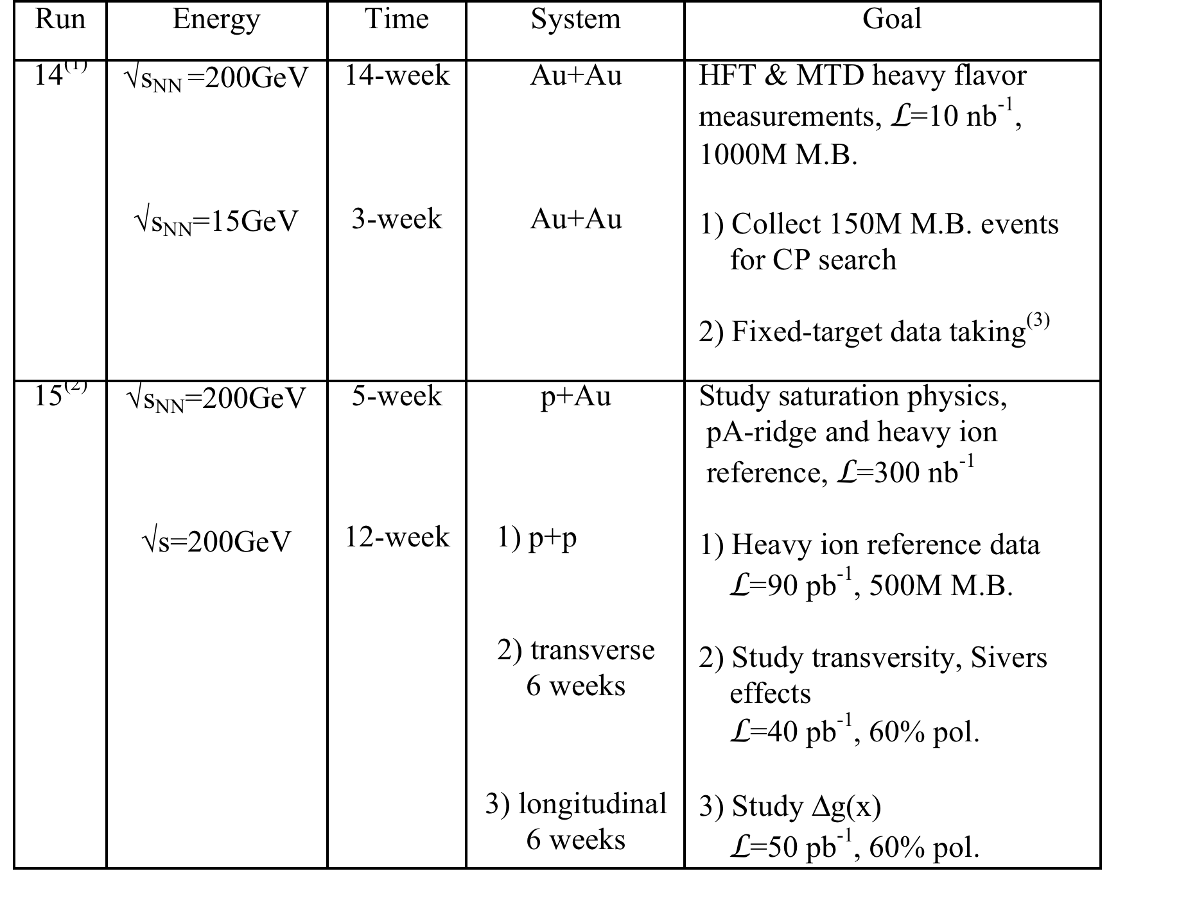
Request in 2013 BUR

Slide 5
Physics in 2015+ for η>1
(un-)polarized pp
(un-)polarized pA
unravel the underlying subprocesses
causing A_{N}
measure the sign change for the
Sivers fct. between pp and SIDIS
measure ΔG at low x
central and forward diffractive
production in p^{(↑)}p, p^{(↑)}A
elastic scattering in p^{(↑)}p^{(↑)}
study saturation effects
measure g^{A}(x,Q²) and g^{A}(x,Q²,b)
unravel the underlying subprocess
causing A_{N}
study GPDs
what equipment do we need
STAR: main detector and endcap
refurbished FMS
Preshower detector in front of the FMS → talk Akio Sunday
Roman Pot upgrade to Phase-II

Slide 6
How well can we do on the physics
with this upgrades

Slide 7
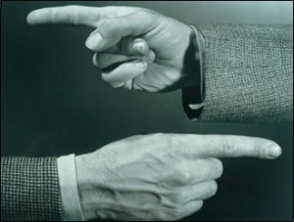
Helicity Structure
Can ΔΣ and ΔG explain it all ?

Slide 8
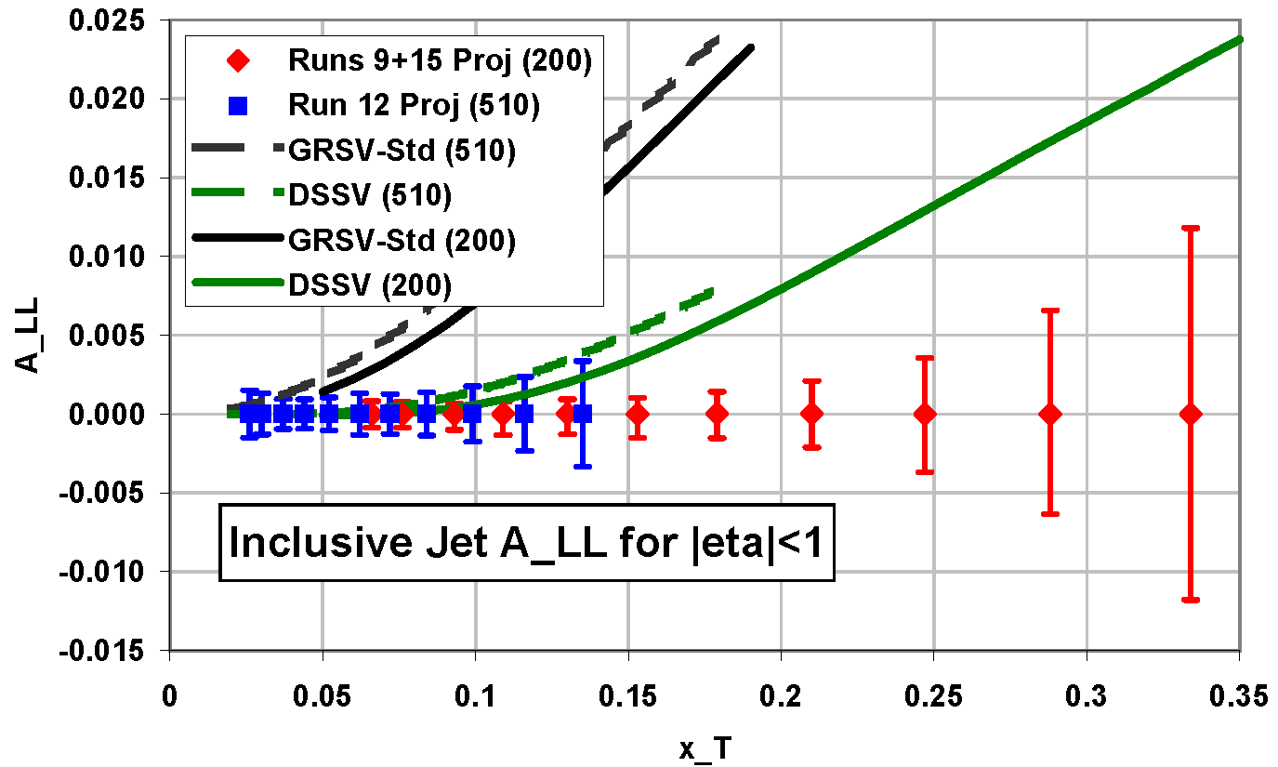
Gluon contribution to the Spin of the Proton
Data ≤ 2009 at 200 GeV
yield
first time a significant
non-zero Δg(x)
Δχ²=2%
Can we improve ?
YES
add 510 GeV (12+13)
and more 200 GeV (15)
data
2013 500 GeV
2015 200 GeV

Slide 9
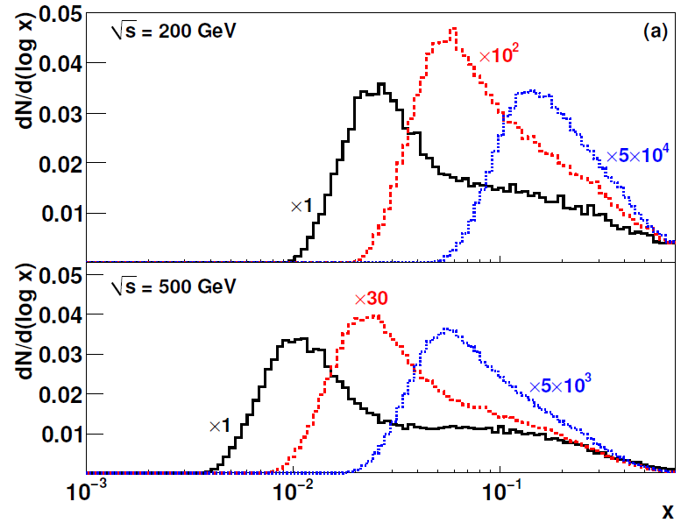
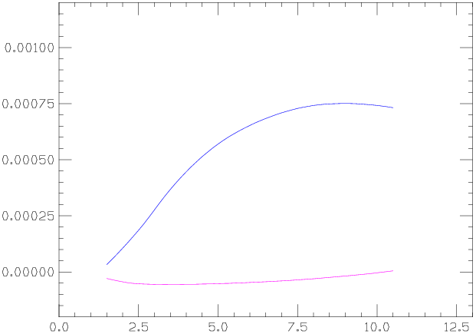
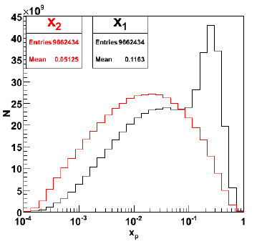
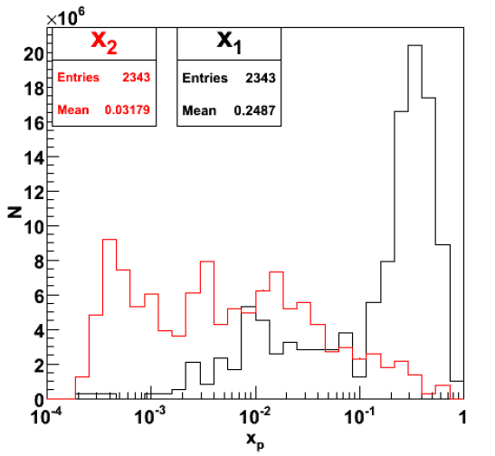
ΔG at low x
Many different mid-rapidity probes, but not sensitive to low-x.
Fwd–Rapidity (3.1<η<3.9), 500 GeV
π⁰
π⁰-π⁰
Mid–Rapidity, Single π⁰
W. Vogelsang NLO
A_{LL} π⁰
<x_{g}>~0.01 for π⁰
<x_{g}>~0.001 for π⁰- π⁰
GSC
Unfortunately, rate drops by x10 for fwd-mid, and x100 for fwd-fwd
Relative Lumi needs to be controlled super well
DSSV

Slide 10
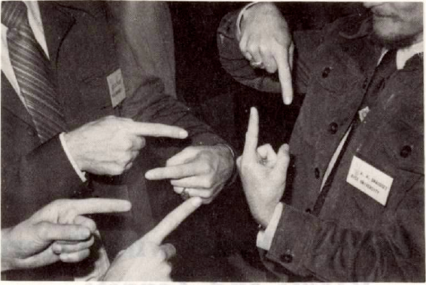
Physics with Transverse Beam Polarisation

Slide 11

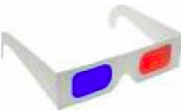

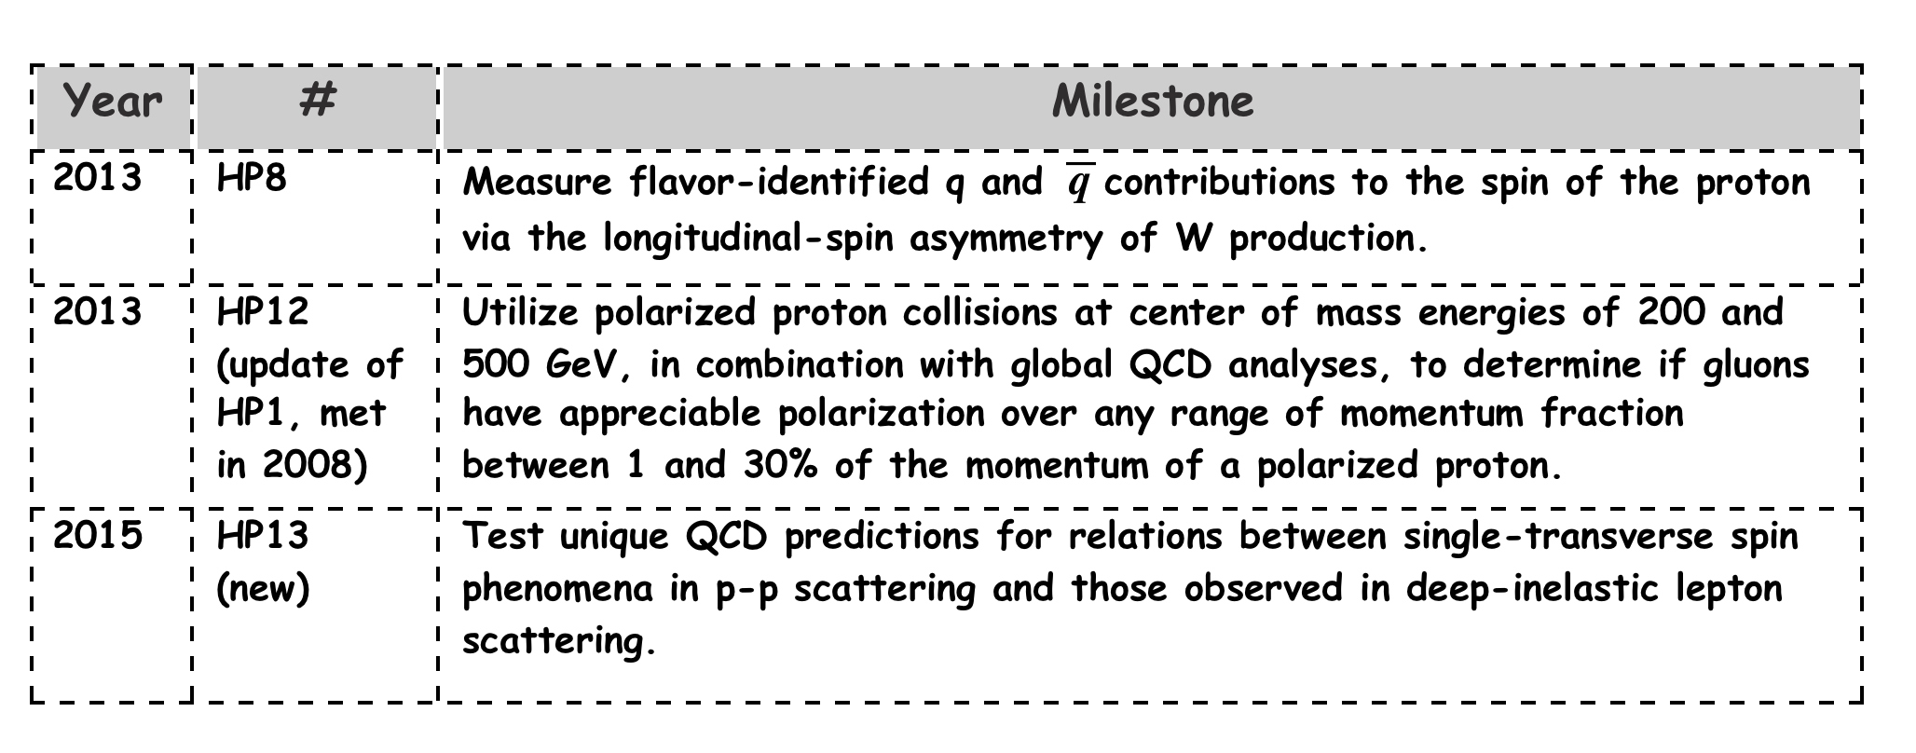
Quantum tomography of the nucleon
Join the real
3D experience !!
TMDs
GPDs
Physics, which gave Jlab the 12 GeV upgrade
and is part of the motivation for eRHIC
2D+1 picture in momentum space 2D+1 picture in coordinate space
  transverse momentum generalized parton distributions
  dependent distributions → exclusive reaction like DVCS
Quarks
unpolarised polarised

Slide 12
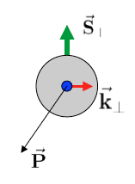
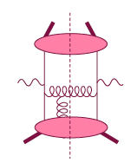
Theory: TMDs vs. Twist-3
Intermediate Q_{T}
Q>>Q_{T}/p_{T}>>Λ_{QCD}
Transverse
momentum
dependent
Q>>Q_{T}>=Λ_{QCD}
Q>>p_{T}
Collinear/
twist-3
Q,Q_{T}>>Λ_{QCD}
p_{T}~Q
Efremov, Teryaev;
Qiu, Sterman
Sivers fct.
Q_{T}/P_{T}
Λ_{QCD}
<<
Q_{T}/P_{T}
<<
Q
Need 2 scales
Q² and p_{t}
Remember pp:
most observables one scale
Exception:
DY, W/Z-production
Need only 1 scale
Q² or p_{t}
But
should be of reasonable size
should be applicable to
most pp observables
A_{N}(π⁰/γ/jet)

Slide 13
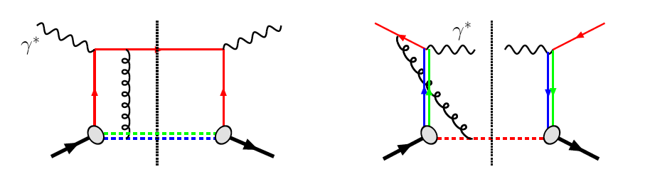
The famous sign change of the Sivers fct.
critical test for our understanding of TMD’s and TMD factorization
Twist-3 formalism predicts the same
DIS:
γq-scattering
attractive FSI
pp:
qqbar-anhilation
repulsive ISI
QCD:
Sivers_{DIS} = - Sivers_{DY} or Sivers_{W} or Sivers_{Z0}
A_{N}(direct photon) measures the sign change through Twist-3
For details on A_{N} DY and W/Z see talks this afternoon

Slide 14
Transverse PHYSICS: What else do we know
Collins / Transversity:
  conserve universality in hadron hadron interactions
  FF_{unf} = - FF_{fav} and δu ~ -2δd
  evolve ala DGLAP, but soft because no gluon contribution (i.e. non-singlet)
TMDs Sivers, Boer Mulders, ….
  do not conserve universality in hadron hadron interactions
  k_{t} evolution → is strong
    till now most predictions did not account for evolution
  wrong theory approach for hadrons in final state
  u and d Sivers fct. opposite sign d >~ u
  Sivers and twist-3 qq and qg correlators are correlated
    global fits find sign mismatch, if they assume AN is complete caused by Sivers like effect
    → possible explanations, like node in k_{t} or x don’t work

Slide 15
A_{N}: How to get to THE underlying Physics
Goal: measure less inclusive
SIVERS/Twist-3
Collins Mechanism
Rapidity dependence of
A_{N} for π⁰ and eta with increased p_{t} coverage
A_{N} for jets
A_{N} for direct photons
A_{N} for heavy flavour → gluon
asymmetry in jet fragmentation
  π^{+/-}π⁰ azimuthal distribution in jets
  Interference fragmentation function
S_{P}
S_{P}
k_{T,q}
p
p
p
p
Sensitive to proton spin –
parton transverse motion correlations
not universal between SIDIS & pp
S_{q}
k_{T,π}
Sensitive to transversity
universal between SIDIS & pp & e+e-

Slide 16
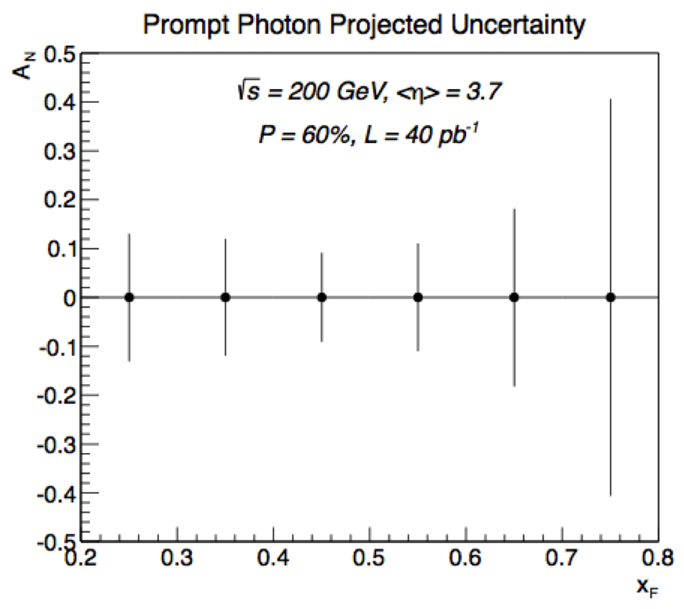
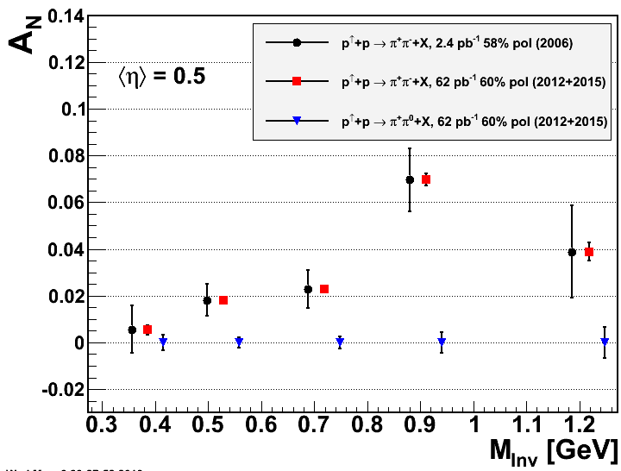
What Can be achieved in RUN 15 p↑p↑
SIVERS/Twist-3
Collins Mechanism
A_{N} for direct photons
Interference fragmentation function
assumes preshower
in front of FMS

Slide 17
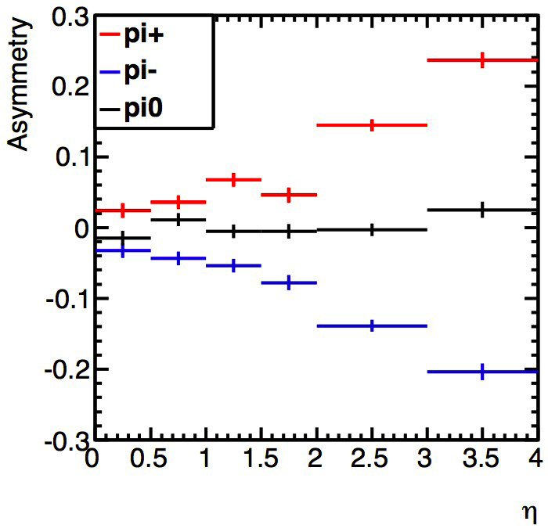
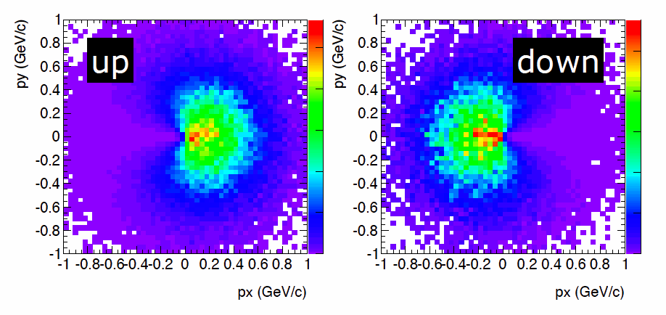
Transversely Polarized Proton MC
    Developed by Tom Burton (https://code.google.com/p/tppmc/)
    Sivers and Collins asymmetries included
    IFF and A_{N}(DY/W) need to be still included
Collins with positivity bounds as input
Sivers Mechanism
Also developed:
Fast smearing generator tool to smear generator particle responses in p and energy and to include PID responses, “detectors” can be flexible defined in the acceptance.
allows for fast studies of detector effects on physics observables
currently all eSTAR used smearing parameterizations are implemented

Slide 18
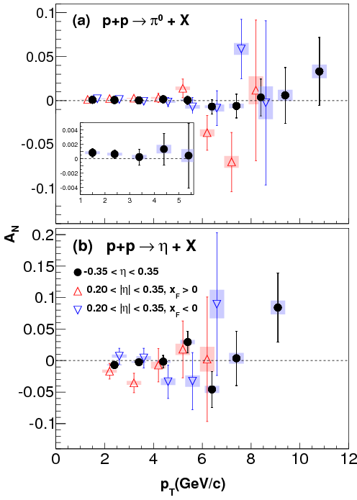
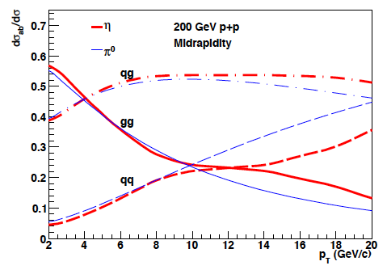
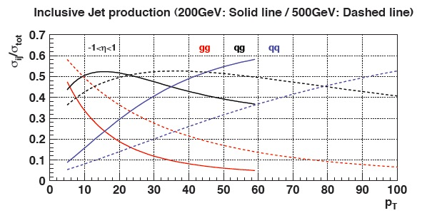
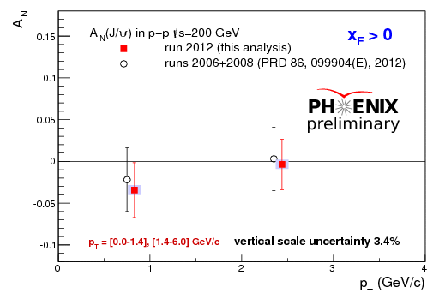

Hints for Gluon Sivers /Twist-3
Mid Rapidity A_{N}(π⁰) dominated by gg and qg
no hint of a
non-zero
A_{N}(π⁰), A_{N}(J/Ψ)
and
A_{N}(jet)
gluon Sivers ~ 0
Twist-3 gg correlator ~0 ?
PHENIX
200 GeV
Mid Rapidity A_{N}(jet) mainly gg & qg
Forward Rapidity A_{N}(J/Ψ) only gg:
p_{T} [GeV/c]

Slide 19
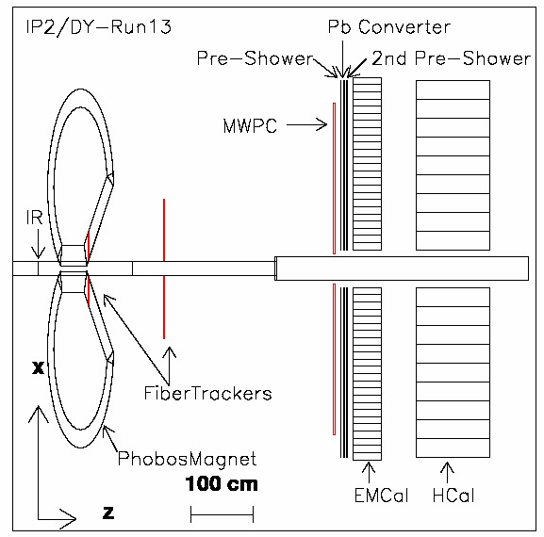
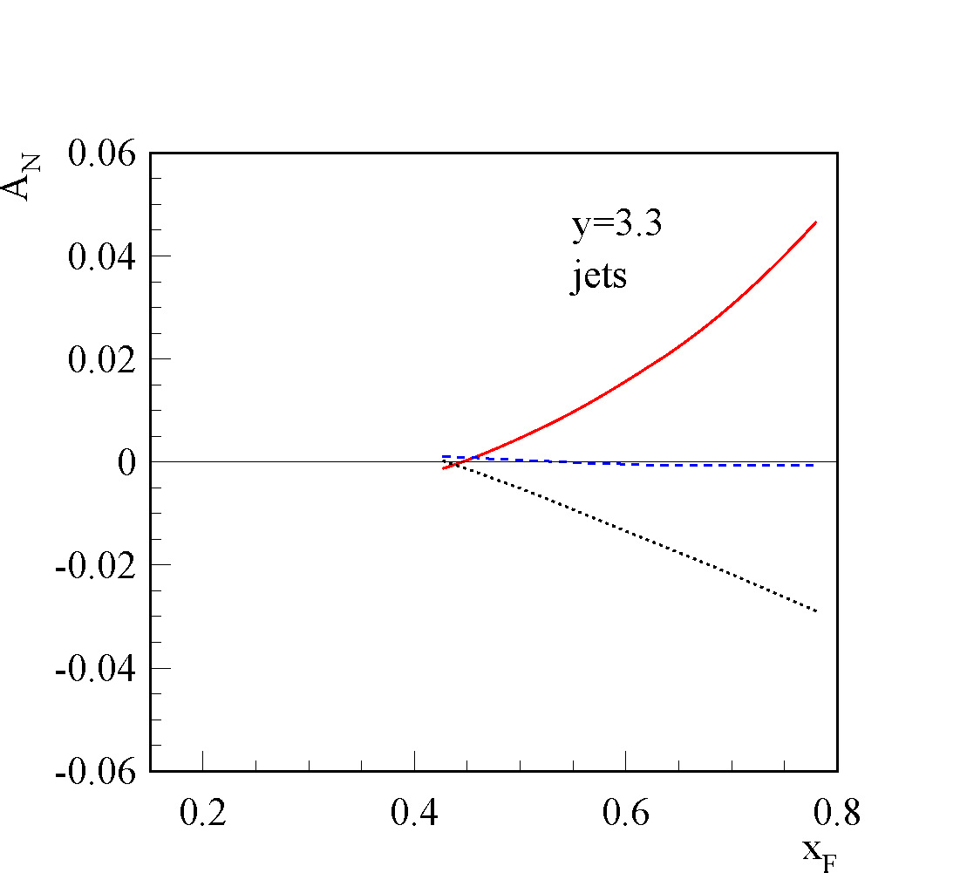
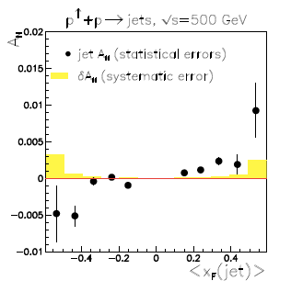
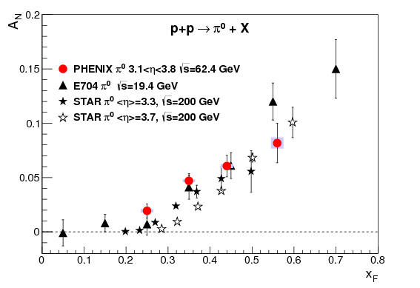
A_{N}DY: Hcal and Ecal at η>3
2013 Final configuration
2011 Configuration
Theory: arXiv:1103.1591 A_{N}(jet)
√s=200 GeV
from p↑+p→π
Remember:
Twist-3 “Sivers” seems not to be the explanation for the big forward A_{N}(π)
“new” Sivers function SIDIS fit
“old” Sivers function SIDIS fit
arXiv: 1304.1454
Determine A_{N}(jet) at same rapidity of big A_{N}(π⁰) η>3
RUN-11: A_{N}DY collected ~ 6.5/pb

Slide 20
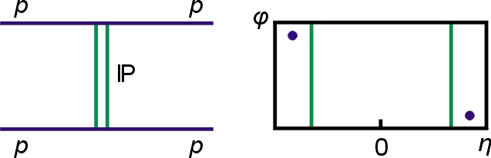
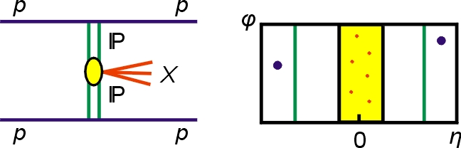
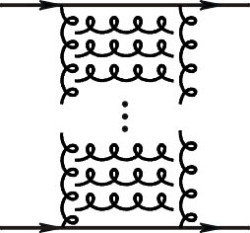
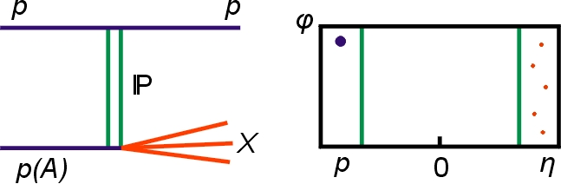
Processes with Tagged Forward Protons
QCD color singlet exchange: C=+1(IP), C=-1(Ο)
Discovery Physics
p + p → p + p elastic
p + p → p + X + p
diffractive X= particles, glueballs
pQCD Picture
Gluonic exchanges
p + p → p + X SDD
Notes:
20

Slide 21
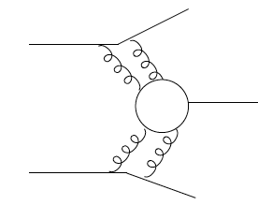
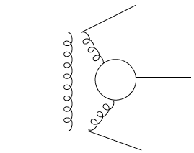
Central Exclusive Production in DPE
Method is complementary to:
GLUEX experiment (2015)
PANDA experiment (>2015)
COMPASS experiment (taking data)
In the double Pomeron exchange process each proton “emits” a Pomeron and the two Pomerons interact producing a massive system M_{X}
where M_{X} = π⁺ π⁻, χ_{c}( χ_{b}), qq(jets), H(Higgs boson), gg(glueballs)
The massive system could form resonances. We expect that because of the constraints provided by the double Pomeron interaction, glueballs, hybrids, and other states coupling preferentially to gluons, will be produced with much reduced backgrounds compared to standard hadronic production processes.
p
p
For each proton vertex one has
t four-momentum transfer
ξ = Δp/p
M_{X}=√ξ₁ξ₂s invariant mass
M_{x}
Notes:
21
21

Slide 22
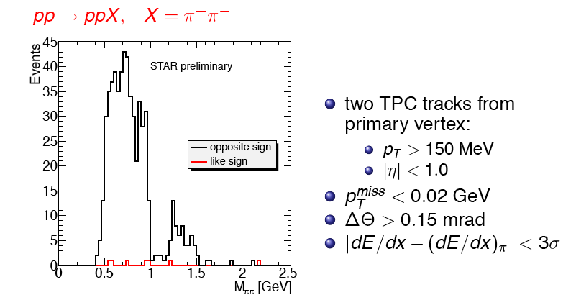
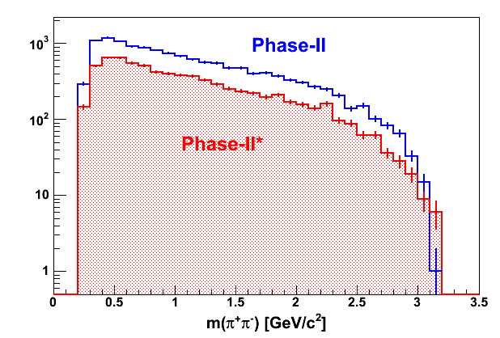
Run 2009 – proof of principle:
Tagging forward proton is crucial
Note small like sign background after momentum conservation cut

Slide 23
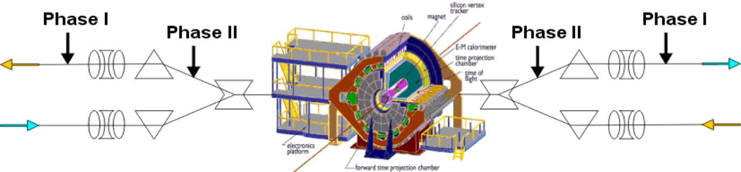
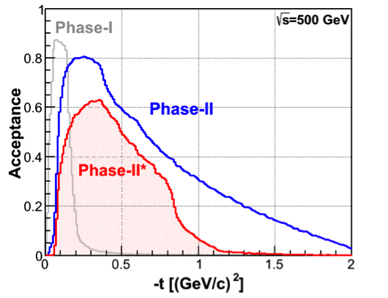
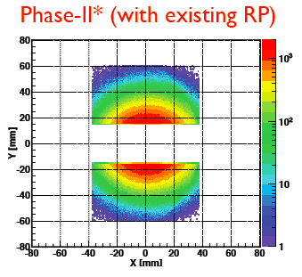
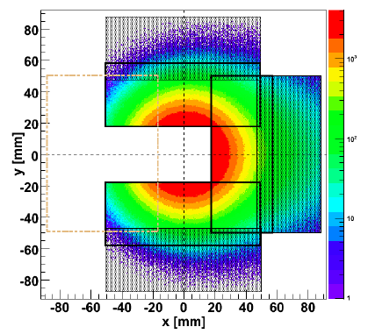
Forward Proton Tagging UPGrate
W. Guryn
at 55-58m
at 15-17m
Follow PAC recommendation to develop a solution to run pp2pp@STAR with
std. physics data taking → No special β* running any more
should cover wide range in t → RPs at 15m & 17m
Staged implementation
  Phase I (currently installed): low-t coverage
  Phase II (proposed) : for larger-t coverage
  1st step reuse Phase I RP at new location only in y
  full phase-II: new bigger acceptance RPs & add RP in x-direction
    full coverage in φ not possible due to machine constraints
Good acceptance also for spectator protons from
deuterium and He-3 collisions
Phase-II: 1st step
1st step
full Phase-II

Slide 24

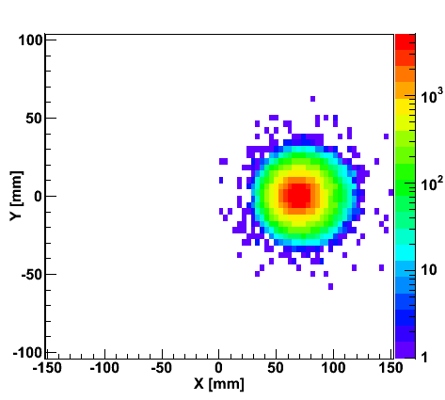
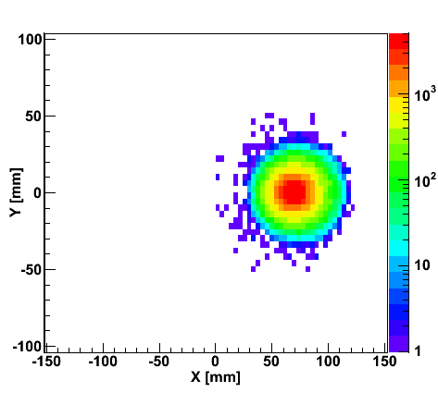
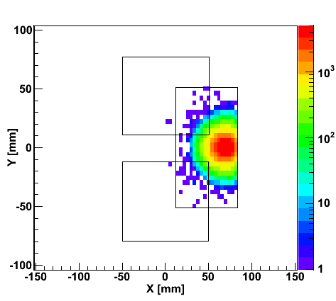
“Spectator” proton from deuteron with the current RHIC optics
Study: JH Lee
generated
Passed DX aperture
Accepted in RP
Rigidity (d:p =2:1)
The same RP configuration with the current RHIC optics (at z ~ 15m between DX and D0)
needs full PHASE-II RP

Slide 25
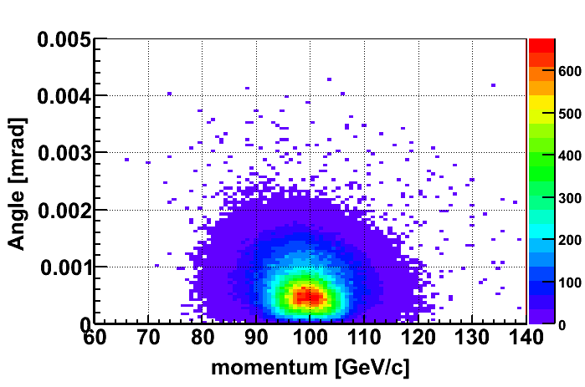
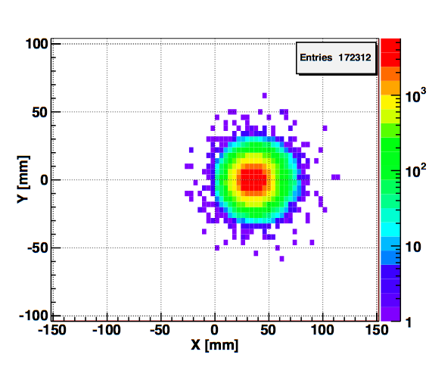
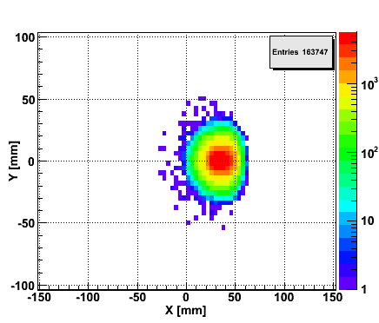
Spectator proton from ³He with the current RHIC optics
Momentum smearing mainly due
to Fermi motion + Lorentz boost
Angle [rad]
Study: JH Lee
generated
Passed DX aperture
Accepted in RP
The same RP configuration with the current RHIC optics (at z ~ 15m between DX-D0)
Acceptance ~ 92% with full PHASE-II RP

Slide 26
The Beauty of RHIC
mix and match beams as one likes
polarised p↑A
→ unravel the underlying sub-processes to A_{N}
getting the first glimpse of GPD E for gluons
  A_{UT}(J/ψ) in p↑A

Slide 27
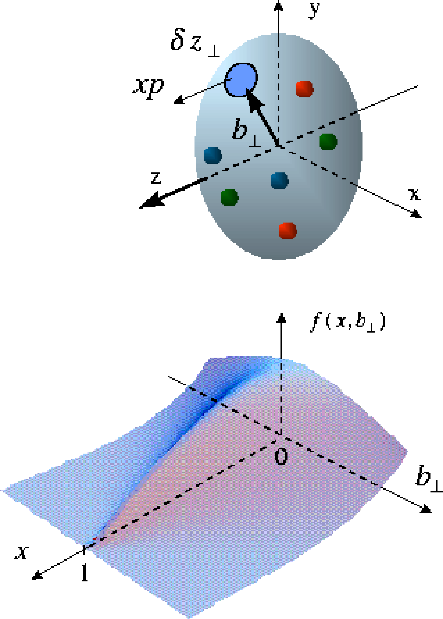
Generalized Parton Distributions
the way to 3d imaging of the proton and the orbital angular momentum L_{q} & L_{g}
Measure them through exclusive reactions
golden channel: DVCS
e’
γ
e
γ_{L}*
(Q²)
x+ξ
x-ξ
~
~
p
H, H, E, E (x,ξ,t)
p’
t
Spin-Sum-Rule in PRF:
from g₁
GPDs:
Correlated quark momentum
and helicity distributions in
transverse space
responsible for orbital angular momentum

Slide 28
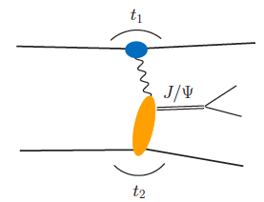
From ep tO pp to γ p/A
Get quasi-real photon from one proton/nuclei
Ensure dominance of γ from one identified proton
by selecting very small t₁, while t₂ of “typical hadronic
size”
small t₁ ←→ large impact parameter b (UPC)
~Z²
Final state lepton pair not from γ* but from J/ψ
  Done already in AuAu
  Estimates for J/ψ (hep-ph/0310223)
transverse target spin asymmetry → calculable with
GPDs
information on helicity-flip distribution E for gluons
golden measurement for eRHIC
Gain in statistics doing polarized p↑A

Slide 29
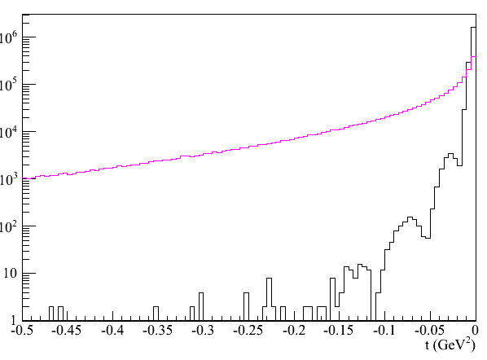
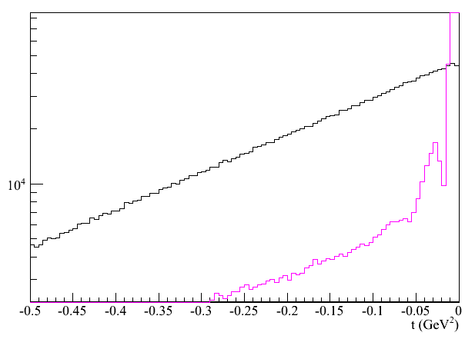
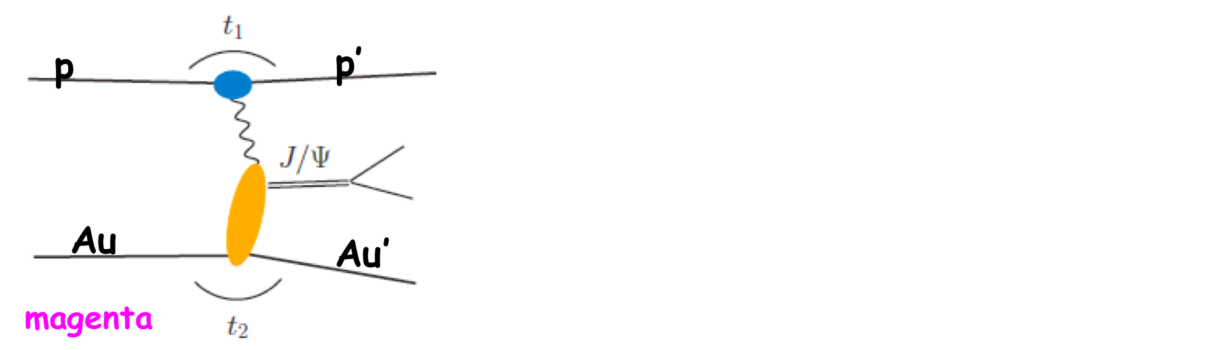
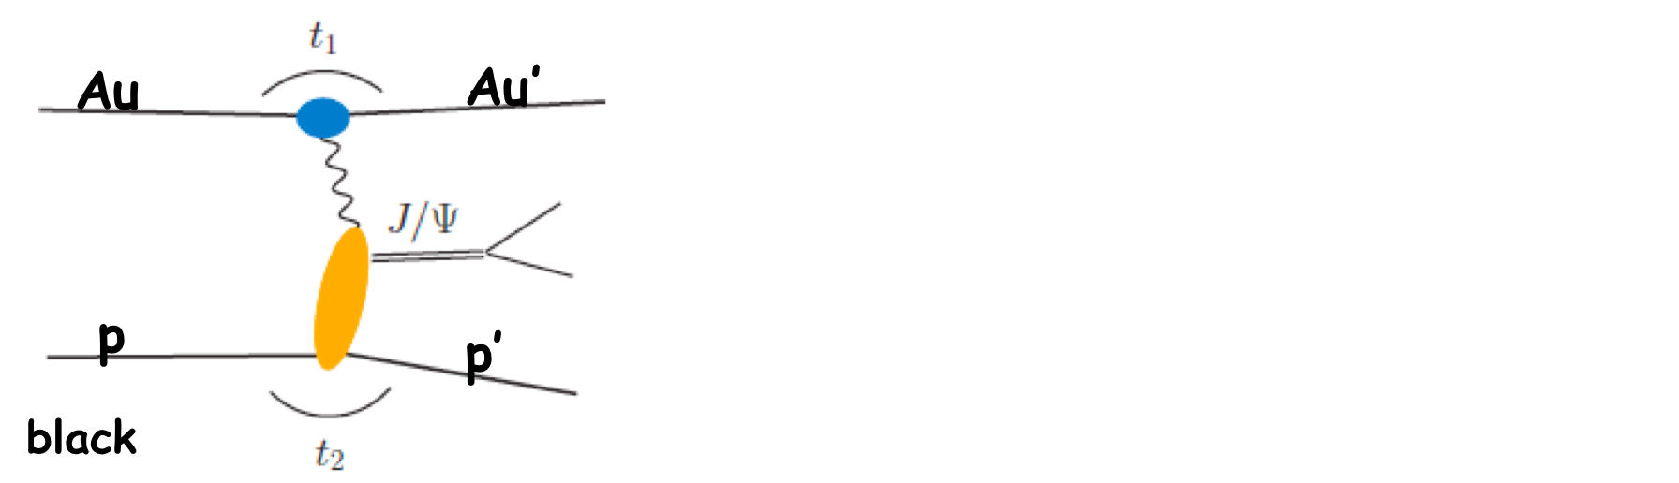
From ep tO pp to γ A
BACKGROUND
SIGNAL
Simulation: planned 2015 p↑A run will give
1000 exclusive J/Ψs
enough to measure A_{UT} to see it is different from zero
t spectrum for beam generating γ
t spectrum for target beam
RP-Veto
Request RP

Slide 30
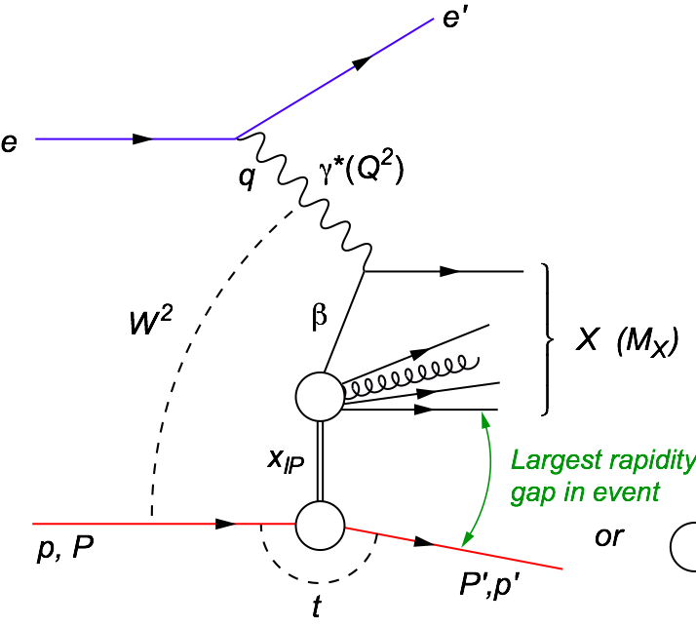

Saturation
Hard diffraction
Why is diffraction so important
Sensitive to spatial gluon distribution
  Hot topic:
    Lumpiness?
    Just Wood-Saxon+nucleon g(b)
  Incoherent case:
  measure fluctuations/lumpiness in g_{A}(b)
VM: Sensitive to gluon momentum distributions
  σ ~ g(x,Q²)²
Diffraction in p+A:
  coherent diffraction
  (nuclei intact)
  breakup into nucleons
  (nucleons intact)
  incoherent diffraction
  Predictions: σdiff/σtot in e+A ~25-40%
  HERA: 15% of all events are hard diffractive

Slide 31

Diffractive Physics
Adrian Dumitru
To be sure it was diffraction need to make sure p and/or A are intact
→ RP and ZDC
need to look seriously into
rapidity gap triggers
Big Question:
Does the diffractive cross section increase in pA if we are saturated regime like in eA?
Current answer is YES

Slide 32

NSAC performance
milestones
for pA / AA
R_{pA} for photons
R_{pA} for J/Ψ
will do the trick
Can UPC in pA
gives us
g(x,b)

Slide 33


Exclusive Vector Meson Production
  Unique probe - allows to measure momentum transfer t in pA diffraction
  → in general, one cannot detect the outgoing nucleus and its momentum
Dipole Cross-Section:
STAR Preliminary Au+Au UPC
γ*+Au➔Au+ρ
small size (J/Ψ): cuts off saturation region
large size (φ,ρ, ...): “sees more of dipole amplitude” → more sensitive to saturation
J/ψ
ϕ

Slide 34









Spatial Gluon Distribution Through Diffraction
  Idea: momentum transfer t conjugate to transverse position (b_{T})
    coherent part probes “shape of black disc”
    incoherent part (dominant at large t) sensitive to “lumpiness” of the source (fluctuations, hot spots, ...)
Spatial source distribution:
t = Δ²/(1-x) ≈ Δ² (for small x)
ϕ, nosat

Slide 35

Physics Objectives
Improve lepton-photon-hadron separation in the FMS to do
Some examples
  J/Ψ physics in pAu and pp at forward rapidities → R_{dA}
  current status from chris perkins from run-08
need to simulate J/Ψ signal to background
with the FMS preshower

Slide 36



Do Gluons Saturate
Gluon density dominates at x<0.1
small x
Gluon density dominates at x<0.1
x=10⁻⁵
QCD
FIT
large x
x=1
Rapid rise in gluons described naturally by linear pQCD evolution equations
This rise cannot increase forever - limits on the cross-section
  → non-linear pQCD evolution equations provide a natural way to tame this growth and lead to a saturation of gluons, characterised by the saturation scale Q²_{s}(x)
Notes:
Counter-intuitively the best way is through an EM process: DIS
y = inelasticity = fraction of the incoming electron energy carried by photon in the rest frame of the nucleon
The structure function F2 is sensitive to the sum of quark and anti-quark momentum distribution in the nucleon.
The apparent scaling of the data with Q2 at large x in early DIS data from SLAC was termed “Bjorken scaling” and motivated the parton model.
In the parton model, FL = 0, while in QCD, it is directly proportional to the gluon structure function, FL(x,Q2) ~ aS xG(x,Q2), at low x.
DGLAP: fixed x -> evolution along Q2
sigma (gamma N) = sig_T + sig_L
sig_L ~ FL
sig_tot ~ F2/Q^2
\frac{d^2 \sigma^{ep \rightarrow eX}}{dx dQ^2} = \frac{4 \pi \alpha^2_{e.m.}}{xQ^4} \left[ \left(1-y+\frac{y^2}{2} \right ) F_2(x,Q^2) - \frac{y^2}{2} F_L(x,Q^2) \right]

Slide 37


pA vs. dA
pA will resolve the question the double interaction mechanism plays a role in dA
Hopefully get this time a result which will be published
2008: 44 nb⁻¹
2015: 300 nb⁻¹
→ factor 6 increase
inclusive σ(π⁰) ~ 1/p_{T}⁶
going to p_{T}^{trig}>3 GeV luminosity needs to be increased by 11
increased FMS + STAR triggering performance
should be able to go in and out of saturation regime

Slide 38

A_{N} in p↑A or Shooting Spin Through CGC
strong suppression of odderon STSA in nuclei.
Q_{s}=1GeV
Y. Kovchegov et al.
arXiv:1201.5890
Very unique RHIC possibility p↑A
Synergy between CGC based
theory and transverse spin physics
A_{N}(direct photon) = 0
The asymmetry is larger for
peripheral collisions
r=1fm
r=1.4fm
r=2fm
π⁰
STAR: projection for upcoming pA run
Curves: Feng & Kang arXiv:1106.1375
solid: Q_{s}^{p} = 1 GeV
dashed: Q_{s}^{p} = 0.5 GeV

Slide 39

Summary
Carl’s
✔
✔
2015 pp/pA run gets us started
on many physics topics
to be discussed in the pp-pA-LoI
✔
✔ may be
✔

Slide 40
BACKUP

Slide 41

Study BY Len on IMPACT ON FMS photon reconstruction
SET-UP used:
Use FCS simulation using only the clusters and tracks within the FMS geometry at 200 GeV.
Photon reconstruction efficiency (~100%) and π⁰-ϒ separation are comparable under 80 GeV for the FMS and the FCS EMCal.
Energy resolution is better for the FCS. This has not been adjusted for the current estimate because the AN measurement is not very sensitive to the smearing in energy scale.
The charged track detection efficiency is set at 86%, per Akio’s study of the FMS pre-shower model, which showed that the first layer can be used to accept 98% of the photons and reject 86% of the charged hadrons.

Slide 42


200 GeV pAu: UPC kinematics
Au
Au’
no cuts
p
p’
Adding cut by cut:
leptons without cuts
μ₂: -1 < η < 2
μ₁ and μ₂: -1 < η < 2
t₁>-0.016 and -0.2<t₂<-0.016
all cuts

Slide 43

200 GeV pAu: Decay kinematics
all cuts
Au
Au’
p
p’
magenta
p
p’
black
Au
Au’
Adding cut by cut:
leptons without cuts
μ₂: -1 < η < 2
μ₁ and μ₂: -1 < η < 2
t₁>-0.016 and -0.2<t₂<-0.016
J/Ψ reconstructed through
e+e- and/or μ+μ- channels

Slide 44

What pHe³ can teach us
Polarized He³ is an effective neutron target → d-quark target
  Polarized protons are an effective u-quark target
Therefore combining pp and pHe³ data will allow a full
quark flavor separation u, d, ubar, dbar
Two physics trusts for a polarized pHe3 program:
Measuring the sea quark helicity distributions through W-production
  Access to Δdbar
  Caveat maximum beam energy for He³: 166 GeV
    Need increased luminosity to compensate for lower W-cross section
Measuring single spin asymmetries A_{N} for pion production and Drell-Yan
  expectations for A_{N} (pions)
    similar effect for π± (π⁰ unchanged)
³He: helpful input for understanding
of transverse spin phenomena
Critical to tag spectator protons from 3He with roman pots

Slide 45


A_{L}^{W}: Future Possibilities
Can we increase p-beam energy?
  325 GeV: factor 2 in σ_{W} BUT despite the original design of magnets can only got to 10% more → 275 GeV
Increased beam-energy and polarized He-3 beam → full flavor separation
A_{L}^{W}: pp @ 500 GeV
A_{L}^{W}: He3-p @ 432 GeV
polarised He-Beams
  had a a workshop to discuss possibilities
  https://indico.bnl.gov/conferenceDisplay.py?confId=405
  no show stoppers, but need most likely one additional pair of snakes
increase luminosity of RHIC
phase 2 of pp2pp@STAR can separate scattering on n or p

Slide 46

rates: pp vs ³He p collisions
1st rough estimate (Vogelsang): not too bad, about a factor of 4-5 in
dσ (bin) [pb]
W⁺
p_{T} > 20 GeV
pp @ 500
p ³He @ 332
rate is per nucleon
i.e. scaled by 1/A
y

Slide 47
what do we mean by “Direct”….
proton – proton:
Au – Au or d-Au
(1)
(2)
(3)
(4)
(5)
γ
“Fragmentation”
much better called internal bremsstrahlung
Induced
De-excitation
for excited
states
Prompt
Fragmentation
(6)
Thermal Radiation
QGP / Hadron Gas
π⁰
EM & Weak Decay

Slide 48
What is in Pythia 6.4
Processes included which would fall under prompt (1)
  14: qqbar → gγ
  18: qqbar → γγ (19: qqbar → γZ⁰ 20: qqbar → γW⁺
  29: qg → qγ
  114: gg → γγ
  115: gg → gγ (106: gg → J/Psiγ 116: gg → Z⁰γ )
  initial and final internal bremsstrahlung (g and γ) (3)
    Pythia manual section 2.2
  Process 3 and 4 are for sure not in pythia
  I’m still checking 5
  the decay of resonances like the π⁰ is of course in pythia

Slide 49
Collected Luminosity with longitudinal Polarization
Year | √s [GeV] | Recorded PHENIX | Recorded STAR | Pol [%]
2002 (Run 2) | 200 | / | 0.3 pb⁻¹ | 15
2003 (Run 3) | 200 | 0.35 pb⁻¹ | 0.3 pb⁻¹ | 27
2004 (Run 4) | 200 | 0.12 pb⁻¹ | 0.4 pb⁻¹ | 40
2005 (Run 5) | 200 | 3.4 pb⁻¹ | 3.1 pb⁻¹ | 49
2006 (Run 6) | 200 | 7.5 pb⁻¹ | 6.8 pb⁻¹ | 57
2006 (Run 6) | 62.4 | 0.08 pb⁻¹ |  | 48
2009 (Run9) | 500 | 10 pb⁻¹ | 10 pb⁻¹ | 39
2009 (Run9) | 200 | 14 pb⁻¹ | 25 pb⁻¹ | 55
2011 (Run11) | 500 | 27.5 / 9.5pb⁻¹ | 12 pb⁻¹ | 48
2012 (Run12) | 500 | 30 / 15 pb⁻¹ | 82 pb⁻¹ | 50/54

Slide 50
Collected Luminosity with transverse Polarization
Year | √s [GeV] | Recorded PHENIX | Recorded STAR | Pol [%]
2001 (Run 2) | 200 | 0.15 pb⁻¹ | 0.15 pb⁻¹ | 15
2003 (Run 3) | 200 | / | 0.25 pb⁻¹ | 30
2005 (Run 5) | 200 | 0.16 pb⁻¹ | 0.1 pb⁻¹ | 47
2006 (Run 6) | 200 | 2.7 pb⁻¹ | 8.5 pb⁻¹ | 57
2006 (Run 6) | 62.4 | 0.02 pb⁻¹ |  | 53
2008 (Run8) | 200 | 5.2 pb⁻¹ | 7.8 pb⁻¹ | 45
2011 (Run11) | 500 | / | 25 pb⁻¹ | 48
2012 (Run12) | 200 | 9.2/4.3 pb⁻¹ | 22 pb⁻¹ | 61/58

