Slide 1
Near Term Physics Goals in relation to The long Term Goals

Slide 2
Physics in 2015+ for η>1
(un-)polarized pp
(un-)polarized pA
unravel the underlying subprocesses
causing A_{N}
measure the sign change for the
Sivers fct. between pp and SIDIS
measure ΔG at low x
central and forward diffractive
production in p^{(↑)}p, p^{(↑)}A
elastic scattering in p^{(↑)}p^{(↑)}
study saturation effects
measure g^{A}(x,Q²) and g^{A}(x,Q²,b)
unravel the underlying subprocess
causing A_{N}
study GPDs
what equipment do we need
STAR: main detector and endcap
refurbished FMS
Preshower detector in front of the FMS
Roman Pot upgrade to Phase-II
status / plans
will be discussed in
the following

Slide 3
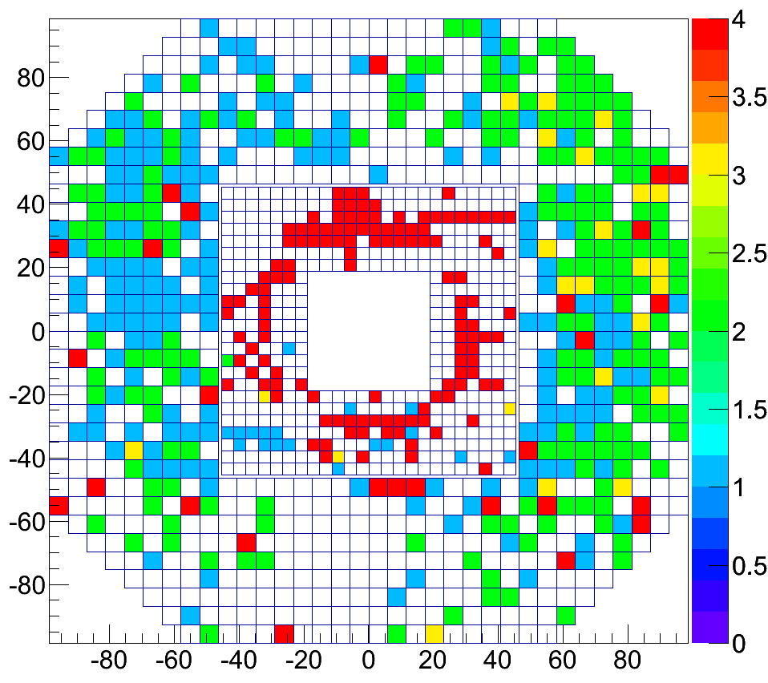
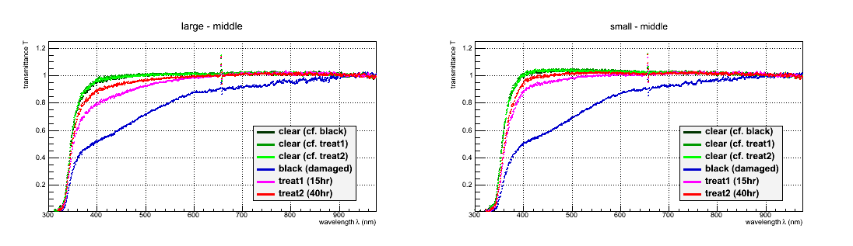
FMS Refurbishment
S. Trentalange
Summer 2013
  Remove FMS lead glass/unwrap cells (5 PM)
  Expose to sunlight (2 PM) → underway
Fall/Winter 2013
  Fix large cell PMT bases → found free new PMTs at Fermi-Lab
  Glue (?) PMTs to lead glass (5 PM)
  Re-wrap cells with aluminized mylar (3 PM)
Summer 2014
  Re-stack FMS (6 PM)
  Test electronics (3 PM)
People: Trentalange/Mondal/Dilks/Heppelman/Marshall/Boone
+ extra UCLA/PSU/StoneyBrook/Valparaiso Students as needed
✔
No Signal
Gain Jumps
Gain Varies
Multiple
Large Cell
Small Cell
Relative Absorption
Relative Absorption
Small cells:
Radiation damage
Large cells:
Gain problems
~41% (323) bases
300 500 700 900
Wavelength (nm)
300 500 700 900
Wavelength (nm)

Slide 4
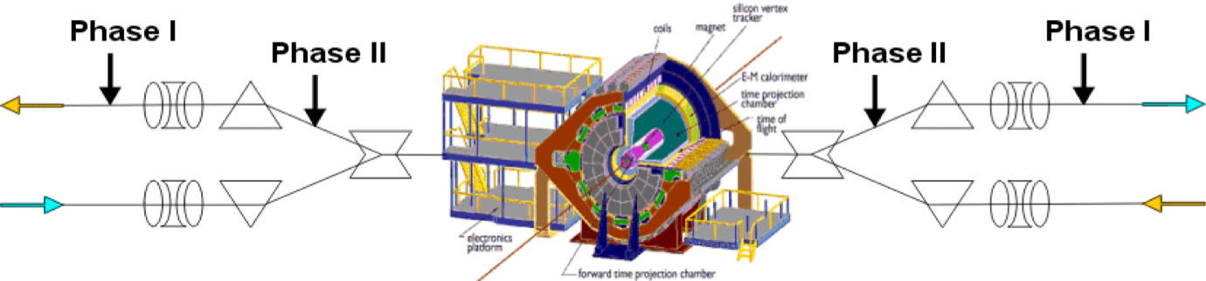
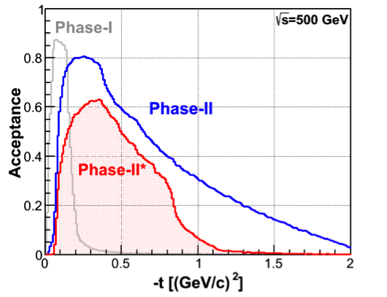
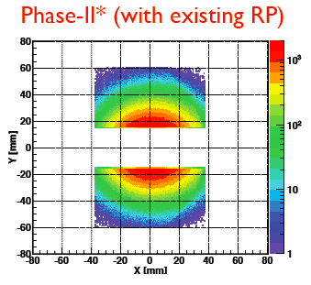
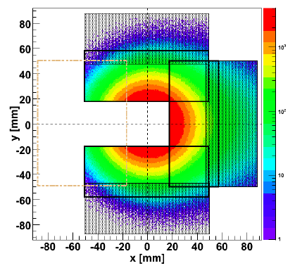
Forward Proton Tagging UPGrate
W. Guryn
at 55-58m
at 15-17m
Follow PAC recommendation to develop a solution to run pp2pp@STAR with
std. physics data taking → No special β* running any more
should cover wide range in t → RPs at 15m & 17m
Staged implementation
  Phase I (currently installed): low-t coverage
  Phase II (proposed) : for larger-t coverage
  1st step reuse Phase I RP at new location only in y
  full phase-II: new bigger acceptance RPs & add RP in x-direction
    full coverage in φ not possible due to machine constraints
Good acceptance also for spectator protons from
deuterium and He-3 collisions
Phase-II: 1st step
1st step
full Phase-II

Slide 5

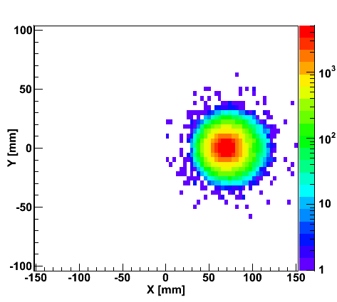
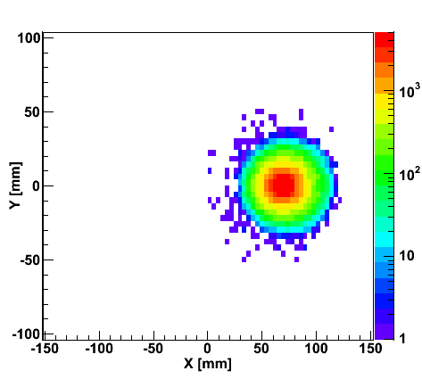
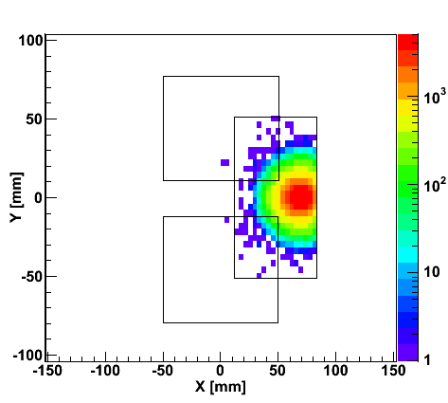
“Spectator” proton from deuteron with the current RHIC optics
Study: JH Lee
generated
Passed DX aperture
Accepted in RP
Rigidity (d:p =2:1)
The same RP configuration with the current RHIC optics (at z ~ 15m between DX and D0)
needs full PHASE-II RP

Slide 6
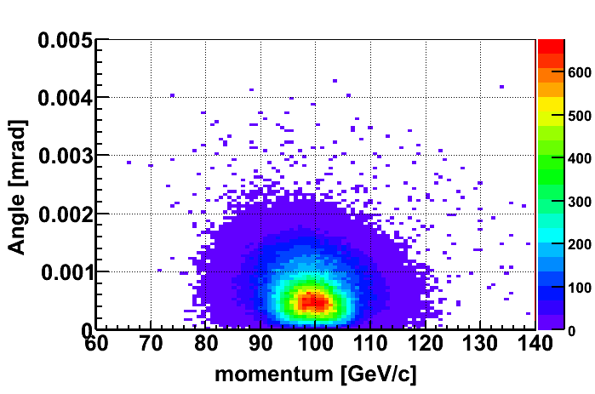
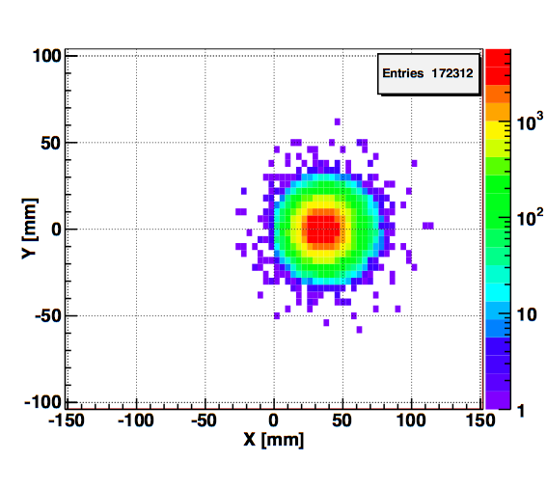
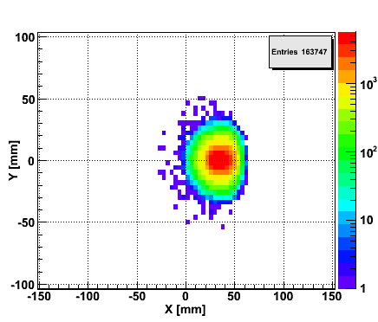
Spectator proton from ³He with the current RHIC optics
Momentum smearing mainly due
to Fermi motion + Lorentz boost
Angle [rad]
Study: JH Lee
generated
Passed DX aperture
Accepted in RP
The same RP configuration with the current RHIC optics (at z ~ 15m between DX-D0)
Acceptance ~ 92% with full PHASE-II RP

Slide 7
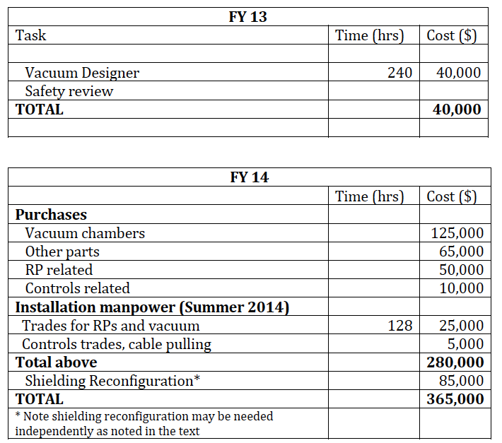
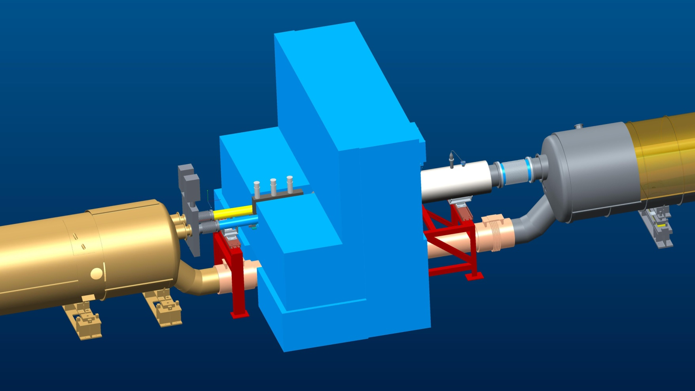
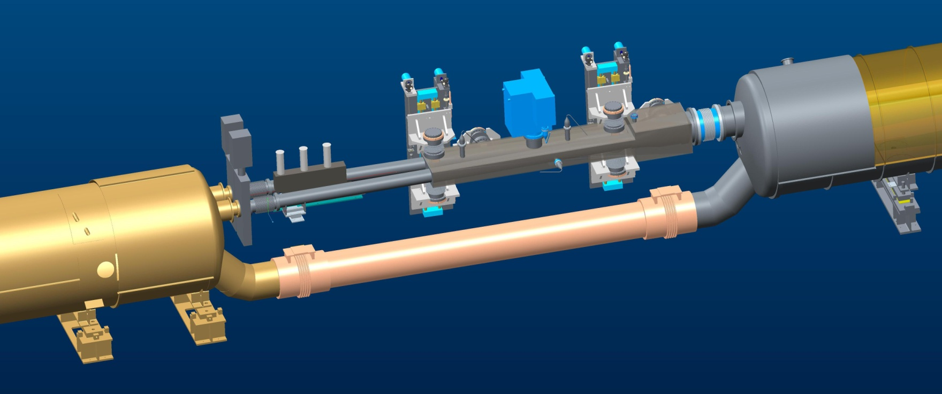
RP: Project STATUS
COST:
Update on DX-D0 Chamber design:
Design is being done in the C-AD vacuum group: S. Nayak eng. and K. Hamdi design.
The first layout has been produced for vertical and horizontal RPs (see figures below) and the detailing will start soon.
The distance between vertical RPs is 1.8m.
The design is very simple and reuses exiting RF shield design, which simplifies approval process, no impedance calculations are needed.
The review process in C-AD also started, acc. safety next.
Shielding modifications in DX-D0 area are being worked on by Al Pendzick (the amount of material will not be affected)
Amount of material in front of ZDC acceptance does not change nor does the location of the ZDC
Tuesday 08/27: first preliminary design review
paid by CAD
SHIELD
DX
HORIZONTAL ROMAN POTS
D0
Preliminary
Preliminary
DX – D0 Current Layout
DX MAG.
+0.8” SHIFT
DX/D0 CHAMBER
20 to 25 mm SHIFT

Slide 8
A PreShower for the FMS
Goal:
lepton-hadron separation and photon-lepton separation
Design:
2 scintillator planes (0.5cm) (x,y) + 1 rad.leng. Pb-converter
+ 1 scintillator plane (0.5cm)
Pb-converter from old multiplicity detector can be reused
Readout:
PMTs (found at FermiLab for free) need to modify bases
XP-2972 tubes and CW bases were purchased for AGS/E-864
400 sets have been loaned to A_{N}DY
QTboards exist in A_{N}DY
Need to pay for:
Scintillator, cables, integration, PMT-modification, ….
Ogawa
O. Eyser
Status:
integrated into STARSim
in active contact with FMS-group, STAR-operations group and STAR-designer
aim for proposal to STAR by end of September
Nice side effect:
finally (!!!!) integrate FMS software fully in STAR software framework
T. Burton, Y. Pan, M. Mondal

Slide 9
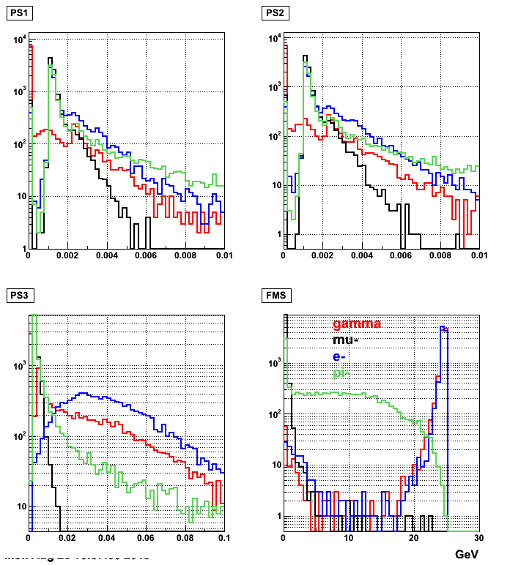
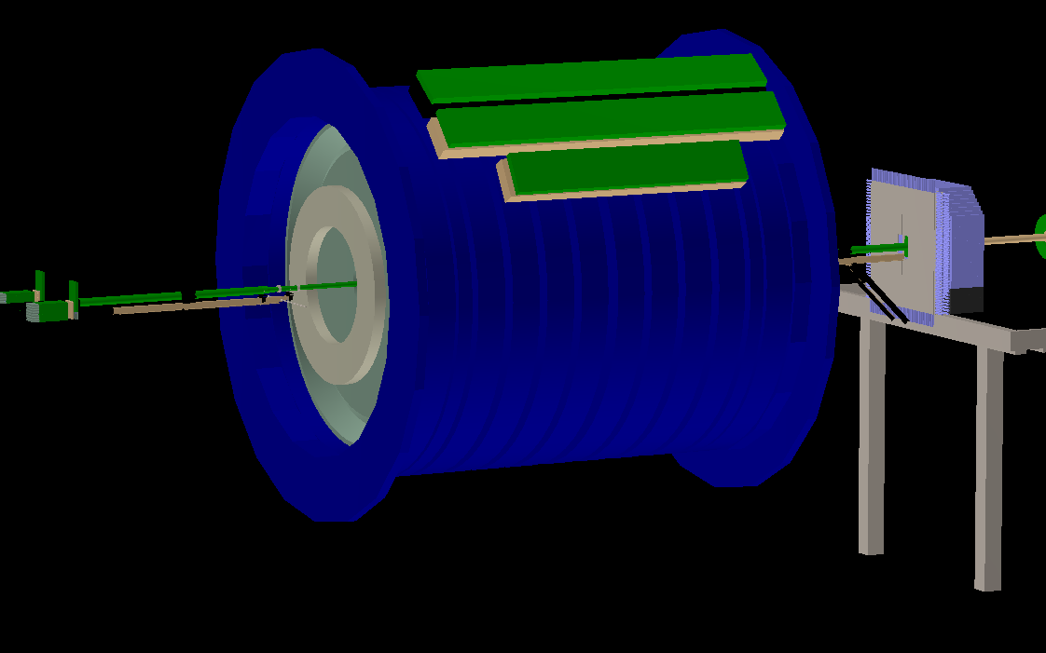
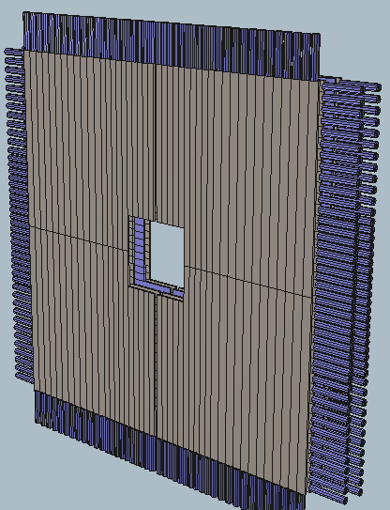
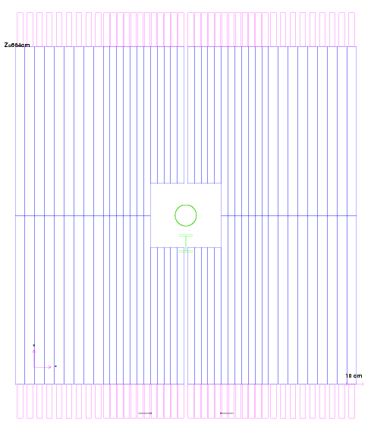
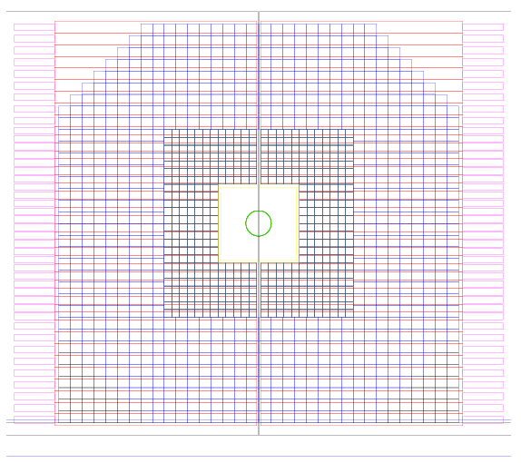
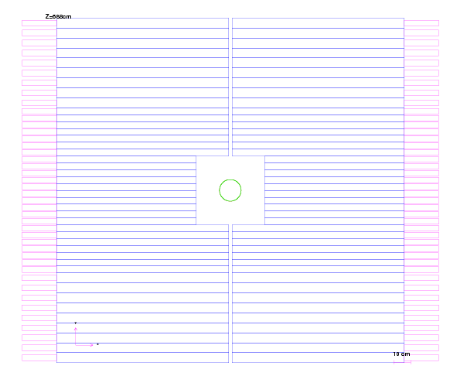
A PreShower for the FMS
This design now has
12x4cm + 9*5.8cm = 21 pmt/layer/quad
21*3layer = 63ch / quad (which fits in 2 QTboards with 1 spare)
63*4quads = 252 pmt total (8 QTboards)
4 cm wide part -> 5.8 cm wide part transition roughly matches
with FMS small cell -> large cell transition.
Layer 1
FMS+Preshower
Layer 2,3

Slide 10
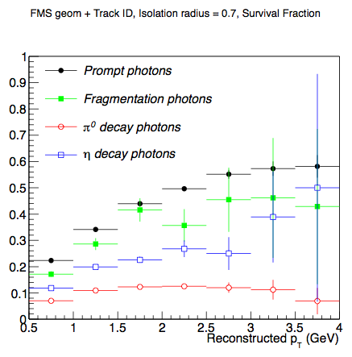
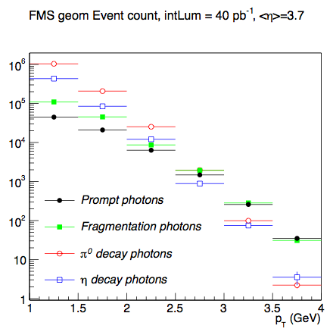
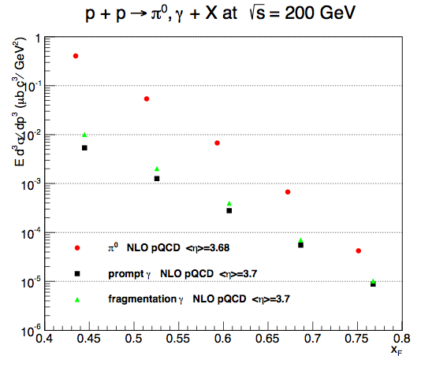
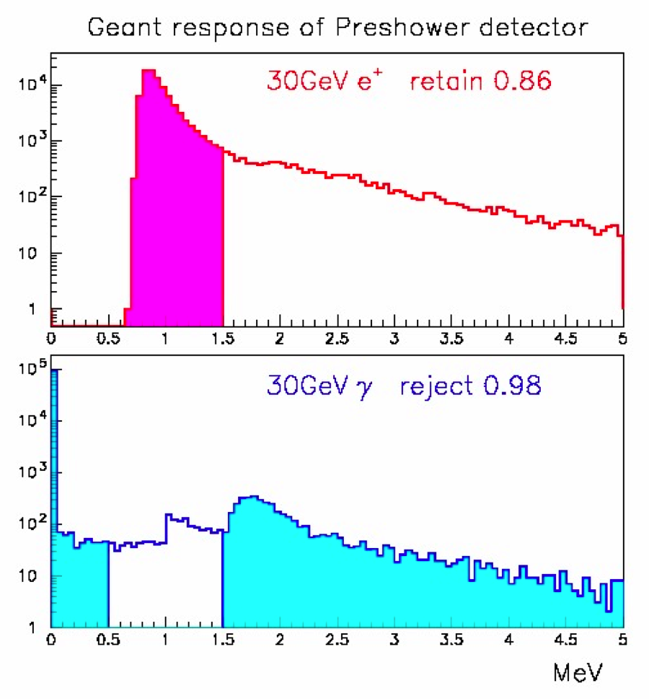
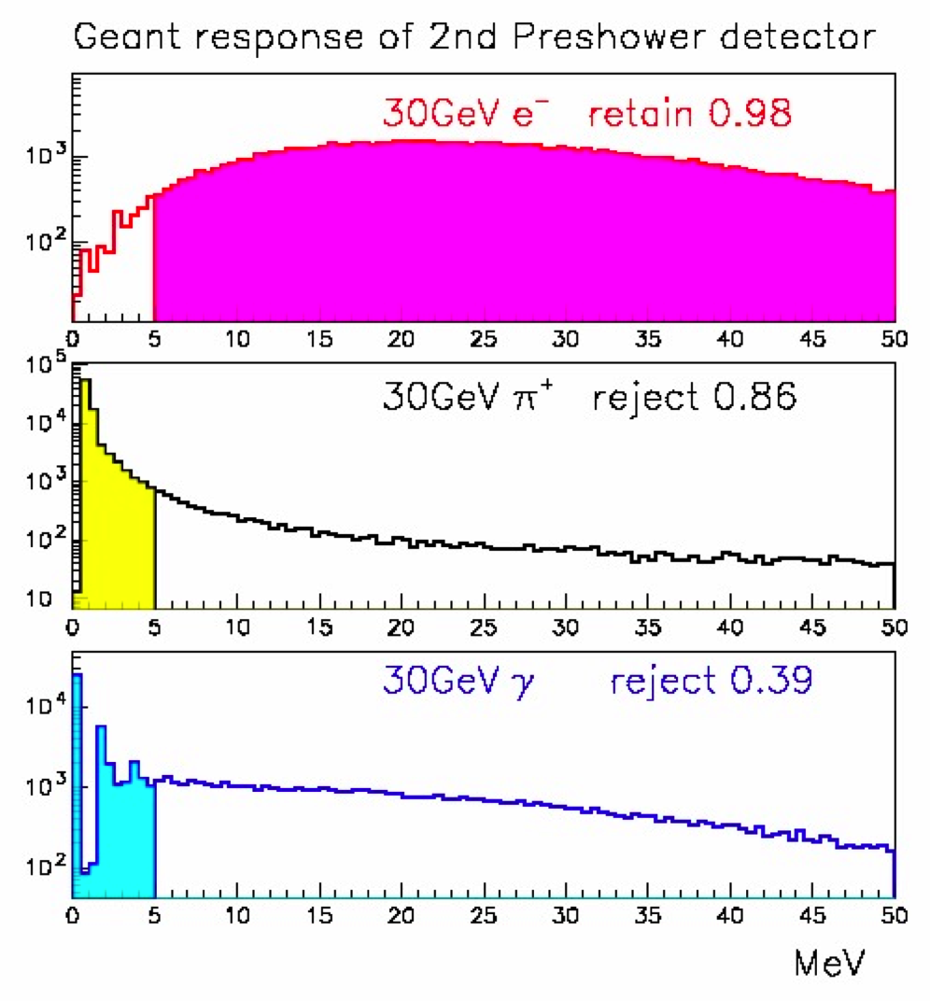
A PreShower for the FMS
Layer1+2:
Retain 86% electrons/hadrons
Reject 98% photons
Layer3+Pb:
Retain 98% electrons
Reject 85% hadrons
Reject 39% photons
W. Vogelsang
+
=

Slide 11
How well can we do on the physics
with this upgrades

Slide 12
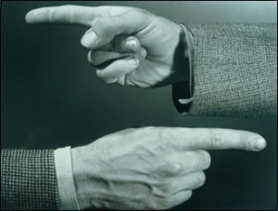
Helicity Structure
Can ΔΣ and ΔG explain it all ?

Slide 13
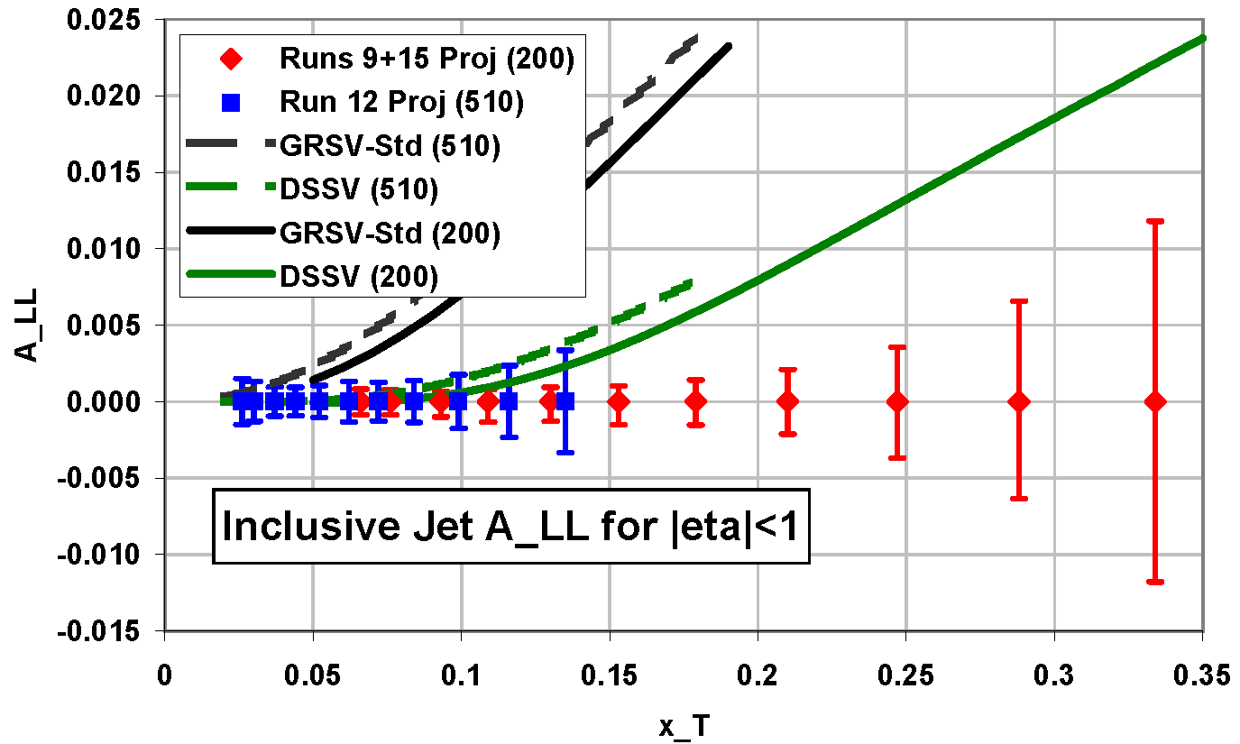
Gluon contribution to the Spin of the Proton
Data ≤ 2009 at 200 GeV
yield
first time a significant
non-zero Δg(x)
Δχ²=2%
Can we improve ?
YES
add 510 GeV (12+13)
and more 200 GeV (15)
data
2013 500 GeV
2015 200 GeV

Slide 14
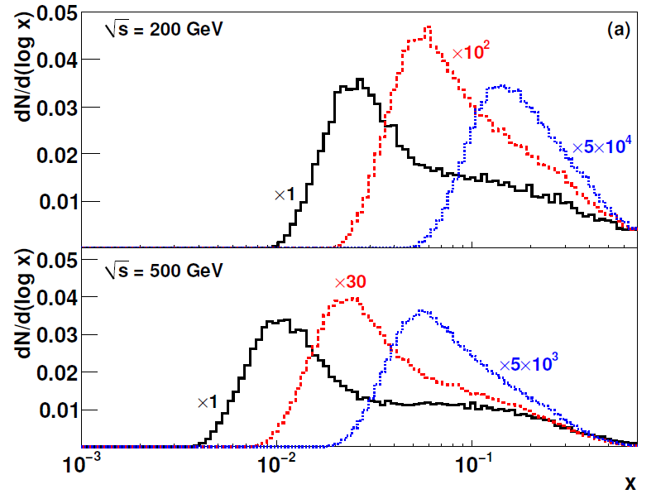
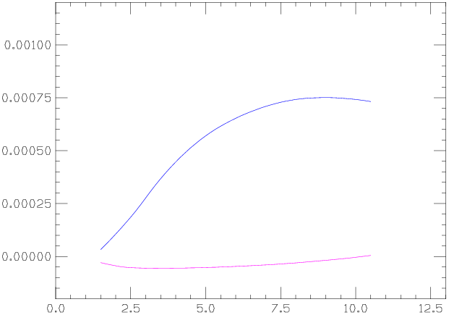
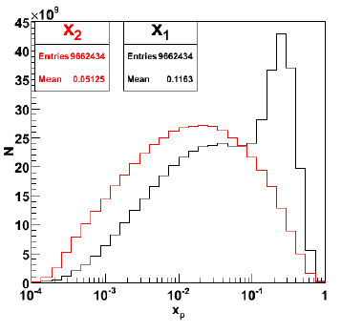
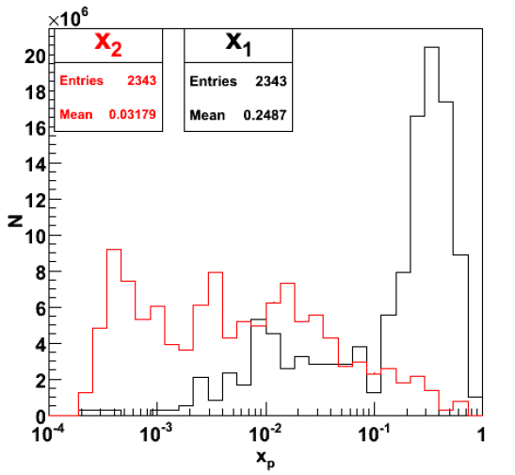
ΔG at low x
Many different mid-rapidity probes, but not sensitive to low-x.
Fwd–Rapidity (3.1<η<3.9), 500 GeV
π⁰
π⁰-π⁰
Mid–Rapidity, Single π⁰
W. Vogelsang NLO
A_{LL} π⁰
<x_{g}>~0.01 for π⁰
<x_{g}>~0.001 for π⁰- π⁰
GSC
Unfortunately, rate drops by x10 for fwd-mid, and x100 for fwd-fwd
Relative Lumi needs to be controlled super well
DSSV

Slide 15
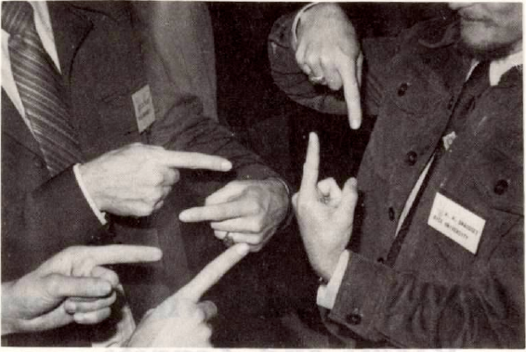
Physics with Transverse Beam Polarisation

Slide 16
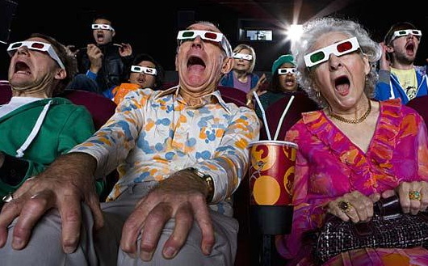
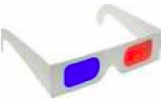

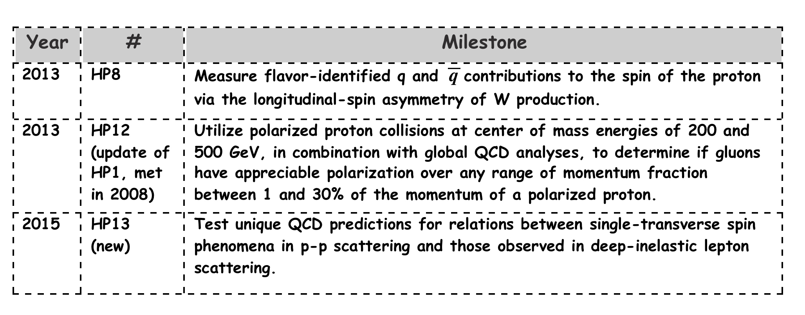
Quantum tomography of the nucleon
Join the real
3D experience !!
TMDs
GPDs
Physics, which gave Jlab the 12 GeV upgrade
and is part of the motivation for eRHIC
2D+1 picture in momentum space 2D+1 picture in coordinate space
  transverse momentum generalized parton distributions
  dependent distributions → exclusive reaction like DVCS
Quarks
unpolarised polarised

Slide 17
A_{N}: How to get to THE underlying Physics
Goal: measure less inclusive
SIVERS/Twist-3
Collins Mechanism
Rapidity dependence of
A_{N} for π⁰ and eta with increased p_{t} coverage
A_{N} for jets
A_{N} for direct photons
A_{N} for heavy flavour → gluon
asymmetry in jet fragmentation
  π^{+/-}π⁰ azimuthal distribution in jets
  Interference fragmentation function
S_{P}
S_{P}
k_{T,q}
p
p
p
p
Sensitive to proton spin –
parton transverse motion correlations
not universal between SIDIS & pp
S_{q}
k_{T,π}
Sensitive to transversity
universal between SIDIS & pp & e+e-

Slide 18
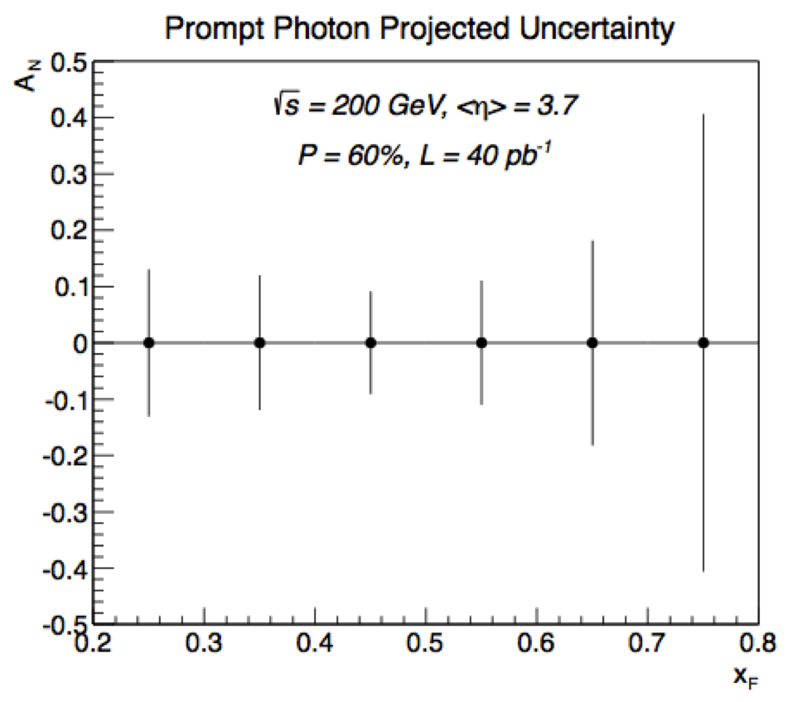
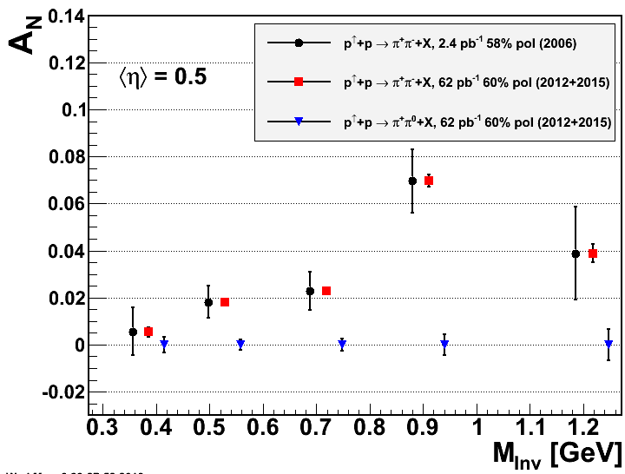
What Can be achieved in RUN 15 p↑p↑
SIVERS/Twist-3
Collins Mechanism
A_{N} for direct photons
Interference fragmentation function
assumes preshower
in front of FMS

Slide 19
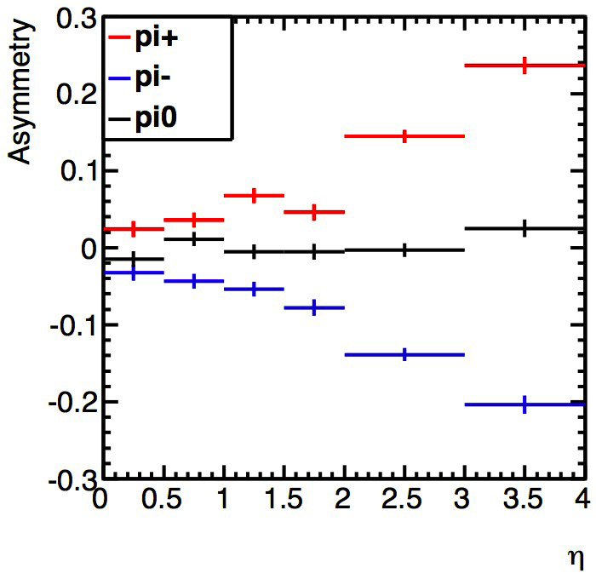
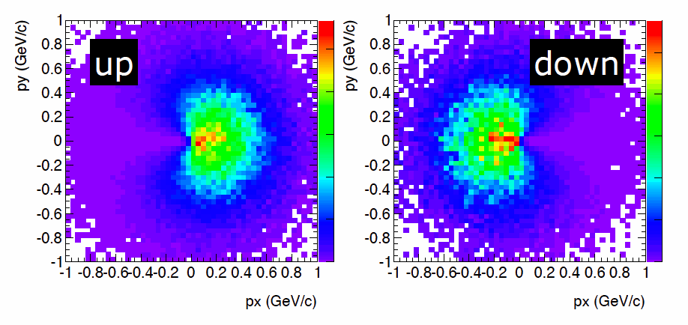
Transversely Polarized Proton MC
    Developed by Tom Burton (https://code.google.com/p/tppmc/)
    Sivers and Collins asymmetries included
    IFF and DY/ W A_{N} need to be still included
Collins with positivity bounds as input
Sivers Mechanism
Also developed:
Fast smearing generator tool to smear generator particle responses in p and energy and to include PID responses, “detectors” can be flexible defined in the acceptance.
→ allows for fast studies of detector effects on physics observables

Slide 20
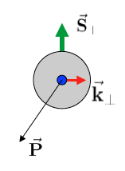
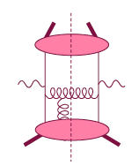
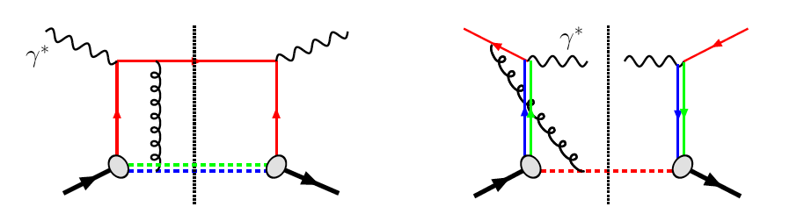
The sign change of the Sivers fct.
Intermediate Q_{T}
Q>>Q_{T}/p_{T}>>Λ_{QCD}
Transverse
momentum
dependent
Q>>Q_{T}>=Λ_{QCD}
Q>>p_{T}
Collinear/
twist-3
Q,Q_{T}>>Λ_{QCD}
p_{T}~Q
Efremov, Teryaev;
Qiu, Sterman
Sivers fct.
Q_{T}/P_{T}
Λ_{QCD}
<<
Q_{T}/P_{T}
<<
Q
critical test for our understanding of TMD’s and TMD factorization
QCD:
DIS:
attractive FSI
Drell-Yan:
repulsive ISI
Sivers_{DIS} = - Sivers_{DY} or Sivers_{W} or Sivers_{Z0}

Slide 21
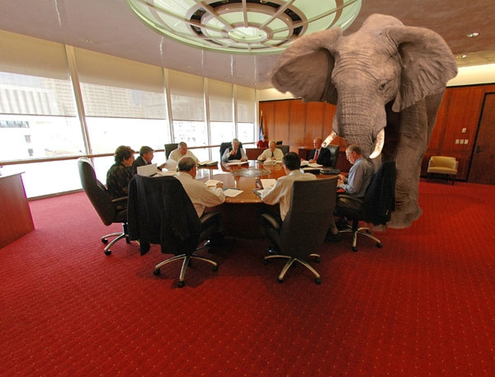
What Can PHENIX and STAR DO
Delivered Luminosity: 500pb⁻¹ (~6 weeks for Run14+)
STAR A_{N}(W):
-1.0 < y < 1.5
W-fully reconstructed
PHENIX A_{N}(DY):
1.2<|y|<2.4
The pink elephant in the room is
what are the evolution effects for A_{N}^{DY}
→ lets see what we know
Extremely clean measurement of δA_{N}(Z₀)+/-10%
for <y> ~0

Slide 22
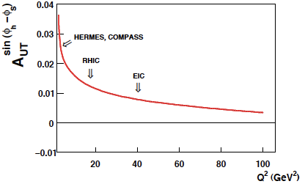
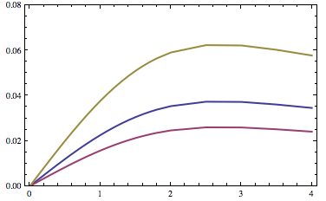
Directly working on TMDs
Aybat-Prokudin-Rogers, 2011
Many calculations on energy dependence of DY and now TMDs
Collins-Soper Evolution, 1981
Collins-Soper-Sterman, 1985
Boer, 2001
Idilbi-Ji-Ma-Yuan, 2004
Kang-Xiao-Yuan, 2011
Collins 2011
Aybat-Collins-Rogers-Qiu, 2011
Aybat-Prokudin-Rogers,2012
Idilbi, et al., 2012
Boer 2013
Sun, Yuan, arXiv: 1304.5037
Need Measurements:
to see how strong evolution effects
for TMDs are
till now many predictions neglect
TMD evolution effects
Sun-Yuan, 2013
W⁺ √s=500 GeV
DY √s=200 GeV

Slide 23
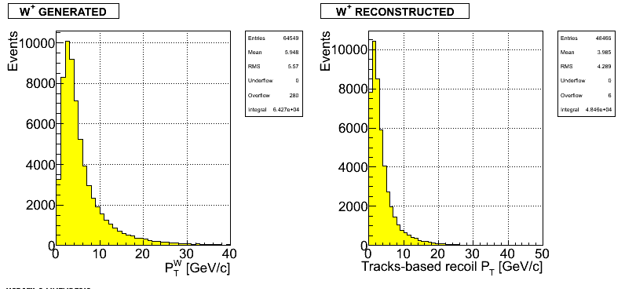
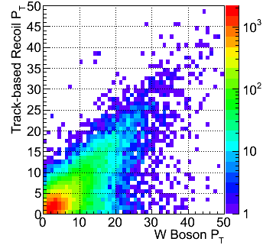
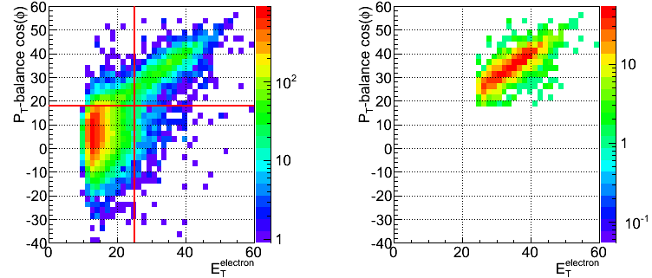
Analysis Strategy
S. Fazio
D. Smirnov
Follow the analysis steps of the A_{L} W candidate selection via high p_{t} lepton
Data set 2011 transverse 500 GeV data set (25 pb⁻¹)
Monte Carlo:
In transverse plane:
Recoil reconstructed using tracks and towers:
Part of the recoil not within STAR acceptance
→ event-by-event MC correction applied
2011-data: very strong narrow correlation
W p_{T} from recoil not
yet corrected for
neutrals (n, K⁰_{L}) and lost
tracks

Slide 24
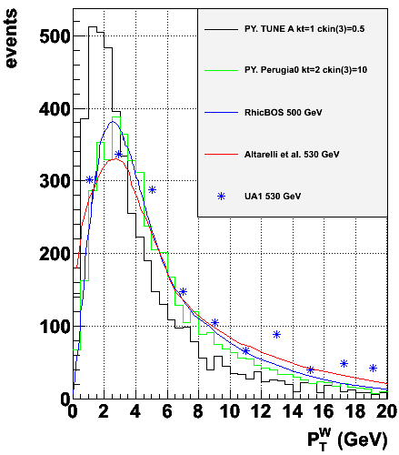

W p_{t} reconstrution
data before correction
data after correction
Tracks+cluster recoil
Jets recoil
100%
15%
Reconstructing recoil via jets (P_{T}>0.5 GeV) has no impact on the correction
Correction goes sky-rocket for P_{T} < 2 GeV
Fitted function used for correcting the data
Fit: 3rd order polynomial + straight line

Slide 25


W p_{t} reconstrution
Method used at FermiLAB: Phys.Rev.Lett. 73 (1994) 2296-2300
Breith-Wigner distribution for M_{W}
Assigning a M_{W} leads to: 2 possible solutions for P_{L}(ν) -> P_{L}(W)-> cos(θ) and φ
Collins-Soper frame -> both solutions for P_{L}(W) uniquely determine φ and |cos(θ)|
  Choose the P_{L}(ν), which falls in the most populated bin of the grid
Have the first A_{N}
but need a bit more checks
fully reconstructed W’s also important input to high x PDFs for LHC
Now we just use a constant for M_{W} and pick the solution with smaller absolute value
the anti-correlated arm can be caused by picking the wrong solution, we are working on it...

Slide 26

Generalized Parton Distributions
the way to 3d imaging of the proton and the orbital angular momentum L_{q} & L_{g}
Measure them through exclusive reactions
golden channel: DVCS
e’
γ
e
γ_{L}*
(Q²)
x+ξ
x-ξ
~
~
p
H, H, E, E (x,ξ,t)
p’
t
Spin-Sum-Rule in PRF:
from g₁
GPDs:
Correlated quark momentum
and helicity distributions in
transverse space
responsible for orbital angular momentum

Slide 27

From ep tO pp to γ p/A
Get quasi-real photon from one proton/nuclei
Ensure dominance of γ from one identified proton
by selecting very small t₁, while t₂ of “typical hadronic
size”
small t₁ ←→ large impact parameter b (UPC)
Z²
Final state lepton pair not from γ* but from J/ψ
  Done already in AuAu
  Estimates for J/ψ (hep-ph/0310223)
transverse target spin asymmetry → calculable with
GPDs
information on helicity-flip distribution E for gluons
golden measurement for eRHIC
Gain in statistics doing polarized p↑A
Simulation: planned 2015 p↑A run will give
1000 exclusive J/Ψs
enough to measure A_{UT} to see it is different from zero

Slide 28




Processes with Tagged Forward Protons
QCD color singlet exchange: C=+1(IP), C=-1(Ο)
Discovery Physics
p + p → p + p elastic
p + p → p + X + p
diffractive X= particles, glueballs
pQCD Picture
Gluonic exchanges
p + p → p + X SDD
Notes:
28

Slide 29


Central Exclusive Production in DPE
Method is complementary to:
GLUEX experiment (2015)
PANDA experiment (>2015)
COMPASS experiment (taking data)
In the double Pomeron exchange process each proton “emits” a Pomeron and the two Pomerons interact producing a massive system M_{X}
where M_{X} = π⁺ π⁻, χ_{c}( χ_{b}), qq(jets), H(Higgs boson), gg(glueballs)
The massive system could form resonances. We expect that because of the constraints provided by the double Pomeron interaction, glueballs, hybrids, and other states coupling preferentially to gluons, will be produced with much reduced backgrounds compared to standard hadronic production processes.
p
p
For each proton vertex one has
t four-momentum transfer
ξ = Δp/p
M_{X}=√ξ₁ξ₂s invariant mass
M_{x}
Notes:
29
29

Slide 30


Run 2009 – proof of principle:
Tagging forward proton is crucial
Note small like sign background after momentum conservation cut

Slide 31

Diffractive Physics
Adrian Dumitru
To be sure it was diffraction need to make sure p and/or A are intact
→ RP and ZDC
need to look seriously into
rapidity gap triggers
Big Question:
Does the diffractive cross section increase in pA if we are saturated regime like in eA?

Slide 32


NSAC performance
milestones
for pA / AA
R_{pA} for photons
R_{pA} for J/Ψ
will do the trick
Can UPC in pA
gives us
g(x,b)
STAR Preliminary Au+Au UPC
γ*+Au➔Au+ρ

Slide 33

Physics Objectives
Improve lepton-photon-hadron separation in the FMS to do
Some examples
  J/Ψ physics in pAu and pp at forward rapidities → R_{dA}
  current status from chris perkins from run-08
need to simulate J/Ψ signal to background
with the FMS preshower

Slide 34



Do Gluons Saturate
Gluon density dominates at x<0.1
small x
Gluon density dominates at x<0.1
x=10⁻⁵
QCD
FIT
large x
x=1
Rapid rise in gluons described naturally by linear pQCD evolution equations
This rise cannot increase forever - limits on the cross-section
  → non-linear pQCD evolution equations provide a natural way to tame this growth and lead to a saturation of gluons, characterised by the saturation scale Q²_{s}(x)
Notes:
Counter-intuitively the best way is through an EM process: DIS
y = inelasticity = fraction of the incoming electron energy carried by photon in the rest frame of the nucleon
The structure function F2 is sensitive to the sum of quark and anti-quark momentum distribution in the nucleon.
The apparent scaling of the data with Q2 at large x in early DIS data from SLAC was termed “Bjorken scaling” and motivated the parton model.
In the parton model, FL = 0, while in QCD, it is directly proportional to the gluon structure function, FL(x,Q2) ~ aS xG(x,Q2), at low x.
DGLAP: fixed x -> evolution along Q2
sigma (gamma N) = sig_T + sig_L
sig_L ~ FL
sig_tot ~ F2/Q^2
\frac{d^2 \sigma^{ep \rightarrow eX}}{dx dQ^2} = \frac{4 \pi \alpha^2_{e.m.}}{xQ^4} \left[ \left(1-y+\frac{y^2}{2} \right ) F_2(x,Q^2) - \frac{y^2}{2} F_L(x,Q^2) \right]

Slide 35


pA vs. dA
pA will resolve the question the double interaction mechanism plays a role in dA
Hopefully get this time a result which will be published
2008: 44 nb⁻¹
2015: 300 nb⁻¹
→ factor 6 increase
inclusive σ(π⁰) ~ 1/p_{T}⁶
going to p_{T}^{trig}>3 GeV luminosity needs to be increased by 11
increased FMS + STAR triggering performance
should be able to go in and out of saturation regime

Slide 36

A_{N} in p↑A or Shooting Spin Through CGC
strong suppression of odderon STSA in nuclei.
Q_{s}=1GeV
Y. Kovchegov et al.
arXiv:1201.5890
Very unique RHIC possibility p↑A
Synergy between CGC based
theory and transverse spin physics
A_{N}(direct photon) = 0
The asymmetry is larger for
peripheral collisions
r=1fm
r=1.4fm
r=2fm
π⁰
STAR: projection for upcoming pA run
Curves: Feng & Kang arXiv:1106.1375
solid: Q_{s}^{p} = 1 GeV
dashed: Q_{s}^{p} = 0.5 GeV

Slide 37

Summary
Carl’s
✔
relatively low cost upgrades with
high physics potentials
✔
✔
✔ may be
✔

Slide 38
BACKUP

Slide 39


500 GeV pp: UPC kinematics
no cuts
Adding cut by cut:
leptons without cuts
μ₂: -1 < η < 2
μ₁ and μ₂: -1 < η < 2
-0.8<t₁<-0.1 and -0.8<t₂<-0.1
all cuts

Slide 40


500 GeV pp: UPC kinematics
Beam: t₁
kinematics of proton 1 and 2
target: t₂
Adding cut by cut:
leptons without cuts
μ₂: -1 < η < 2
μ₁ and μ₂: -1 < η < 2
-0.8<t₁<-0.1 and -0.8<t₂<-0.1

Slide 41

500 GeV pp: Decay kinematics
all cuts
Using SARTRE:
Cross section 500 GeV: 6.9 nb
200 GeV: 1.1 nb
in agreement with theoretical calculations
500 GeV: → 1600 J/Ψ in 290 pb⁻¹
550 J/Ψ in 100 pb⁻¹
200 GeV: → 3650 J/Ψ in 1800 pb⁻¹
200 J/Ψ in 100 pb⁻¹
no trigger efficiencies or detector effects
included yet
need more statistics → p↑Au
Adding cut by cut:
leptons without cuts
μ₂: -1 < η < 2
μ₁ and μ₂: -1 < η < 2
-0.8<t₁<-0.1 and -0.8<t₂<-0.1
J/Ψ reconstructed through
e+e- and/or μ+μ- channels

Slide 42


200 GeV pAu: UPC kinematics
Au
Au’
no cuts
p
p’
Adding cut by cut:
leptons without cuts
μ₂: -1 < η < 2
μ₁ and μ₂: -1 < η < 2
t₁>-0.016 and -0.2<t₂<-0.016
all cuts

Slide 43


200 GeV pAu: UPC kinematics
Beam: t₁
p: t_{γ}
kinematics of proton 1 and 2
Au: t_{γ}
target: t₂
t_{p’}
t_{Au’}

Slide 44

200 GeV pAu: Decay kinematics
all cuts
Au
Au’
p
p’
magenta
p
p’
black
Au
Au’
Using SARTRE:
Cross section 200 GeV: 38.5 nb
200 GeV: 1.6 10³ nb
in agreement with theoretical calculations
200 GeV: → 5450 J/Ψ in 51 pb⁻¹
11000 J/Ψ in 100 pb⁻¹
200 GeV: → 1558 J/Ψ in 1.2 pb⁻¹
155800 J/Ψ in 100 pb⁻¹
no trigger efficiencies or detector effects
included yet
Caveat: Q²-distribution for Au (=t₁)
needs to be extended in MC
→ more statistics 38.5 nb → ~10³ nb
Adding cut by cut:
leptons without cuts
μ₂: -1 < η < 2
μ₁ and μ₂: -1 < η < 2
t₁>-0.016 and -0.2<t₂<-0.016
J/Ψ reconstructed through
e+e- and/or μ+μ- channels

Slide 45

What pHe³ can teach us
Polarized He³ is an effective neutron target → d-quark target
  Polarized protons are an effective u-quark target
Therefore combining pp and pHe³ data will allow a full
quark flavor separation u, d, ubar, dbar
Two physics trusts for a polarized pHe3 program:
Measuring the sea quark helicity distributions through W-production
  Access to Δdbar
  Caveat maximum beam energy for He³: 166 GeV
    Need increased luminosity to compensate for lower W-cross section
Measuring single spin asymmetries A_{N} for pion production and Drell-Yan
  expectations for A_{N} (pions)
    similar effect for π± (π⁰ unchanged)
³He: helpful input for understanding
of transverse spin phenomena
Critical to tag spectator protons from 3He with roman pots

Slide 46


A_{L}^{W}: Future Possibilities
Can we increase p-beam energy?
  325 GeV: factor 2 in σ_{W} BUT despite the original design of magnets can only got to 10% more → 275 GeV
Increased beam-energy and polarized He-3 beam → full flavor separation
A_{L}^{W}: pp @ 500 GeV
A_{L}^{W}: He3-p @ 432 GeV
polarised He-Beams
  had a a workshop to discuss possibilities
  https://indico.bnl.gov/conferenceDisplay.py?confId=405
  no show stoppers, but need most likely one additional pair of snakes
increase luminosity of RHIC
phase 2 of pp2pp@STAR can separate scattering on n or p

Slide 47

rates: pp vs ³He p collisions
1st rough estimate (Vogelsang): not too bad, about a factor of 4-5 in
dσ (bin) [pb]
W⁺
p_{T} > 20 GeV
pp @ 500
p ³He @ 332
rate is per nucleon
i.e. scaled by 1/A
y

Slide 48
what do we mean by “Direct”….
proton – proton:
Au – Au or d-Au
(1)
(2)
(3)
(4)
(5)
γ
“Fragmentation”
much better called internal bremsstrahlung
Induced
De-excitation
for excited
states
Prompt
Fragmentation
(6)
Thermal Radiation
QGP / Hadron Gas
π⁰
EM & Weak Decay

Slide 49
What is in Pythia 6.4
Processes included which would fall under prompt (1)
  14: qqbar → gγ
  18: qqbar → γγ (19: qqbar → γZ⁰ 20: qqbar → γW⁺
  29: qg → qγ
  114: gg → γγ
  115: gg → gγ (106: gg → J/Psiγ 116: gg → Z⁰γ )
  initial and final internal bremsstrahlung (g and γ) (3)
    Pythia manual section 2.2
  Process 3 and 4 are for sure not in pythia
  I’m still checking 5
  the decay of resonances like the π⁰ is of course in pythia

Slide 50

Study BY Len on IMPACT ON FMS photon reconstruction
SET-UP used:
Use FCS simulation using only the clusters and tracks within the FMS geometry at 200 GeV.
Photon reconstruction efficiency (~100%) and π⁰-ϒ separation are comparable under 80 GeV for the FMS and the FCS EMCal.
Energy resolution is better for the FCS. This has not been adjusted for the current estimate because the AN measurement is not very sensitive to the smearing in energy scale.
The charged track detection efficiency is set at 86%, per Akio’s study of the FMS pre-shower model, which showed that the first layer can be used to accept 98% of the photons and reject 86% of the charged hadrons.

