Slide 1
Physics Goals for a 500 GeV-Run

Slide 2
Run-15: GoAls
200 GeV longitudinal polarized pp
  increase statistics on A_{LL} jets and di-jets at mid rapidity
  explore A_{LL} in FMS
200 GeV transverse polarised pp
  understand the underlying physics of forward A_{N}
    direct γ A_{N}; A_{N} for diffractive and rapidity gap events
    improve statistics on A_{N}(π⁰,η) → reach high p_{t} with good statistics
    improve statistics on all mid-rapidity Sivers, IFF and Collins observables
    central and forward diffractive production in p^{(↑)}p, p^{(↑)}A
    elastic scattering in p^{(↑)}p^{(↑)}
200 GeV transverse polarised pA
  study saturation effects
  first measurement of g^{A}(x,Q²) and g^{A}(x,Q²,b)
  unravel the underlying subprocess by measuring A_{N}(π⁰,γ)
  study GPDs trough exclusive J/Ψ
  AND
  much more

Slide 3
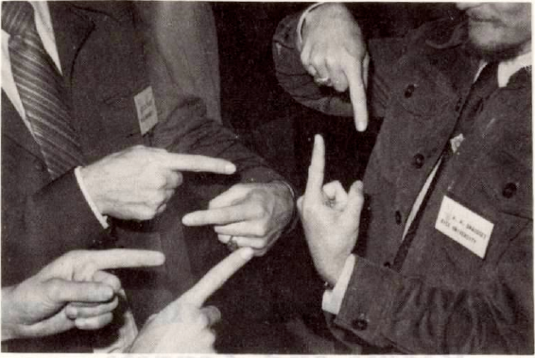
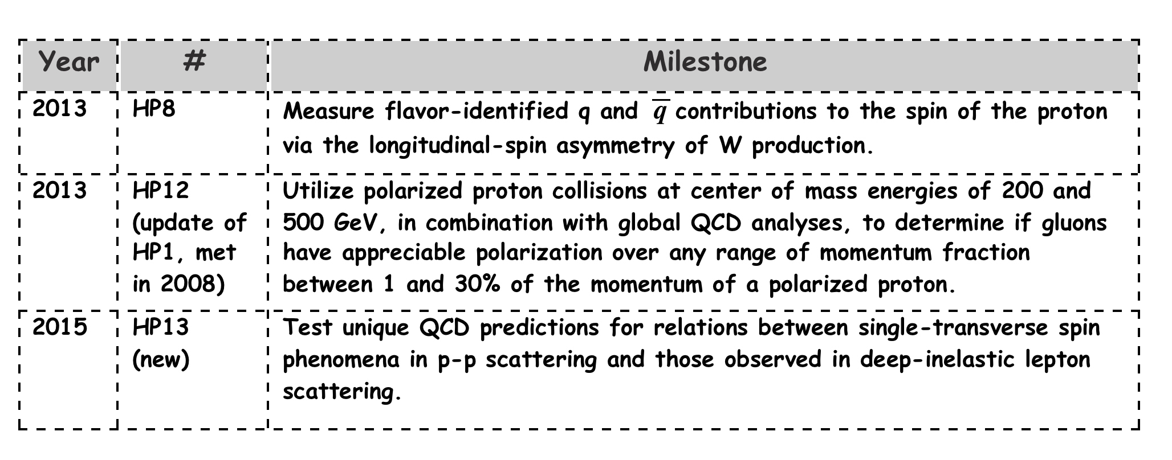
Physics Goals for a 500 GeV Run
Resolve HP13 → transverse polarized pp Run
as early as Run-16

Slide 4
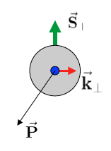
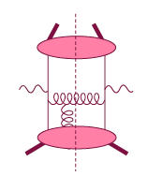
Theory: TMDs vs. Twist-3
Intermediate Q_{T}
Q>>Q_{T}/p_{T}>>Λ_{QCD}
Transverse
momentum
dependent
Q>>Q_{T}>=Λ_{QCD}
Q>>p_{T}
Collinear/
twist-3
Q,Q_{T}>>Λ_{QCD}
p_{T}~Q
Efremov, Teryaev;
Qiu, Sterman
Sivers fct.
Q_{T}/P_{T}
Λ_{QCD}
<<
Q_{T}/P_{T}
<<
Q
Need 2 scales
Q² and p_{t}
Remember pp:
most observables one scale
Exception:
DY, W/Z-production
Need only 1 scale
Q² or p_{t}
But
should be of reasonable size
should be applicable to
most pp observables
A_{N}(π⁰/γ/jet)

Slide 5
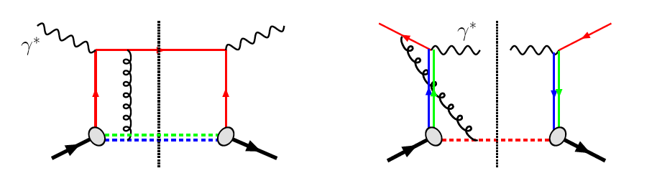
The famous sign change of the Sivers fct.
critical test for our understanding of TMD’s and TMD factorization
Twist-3 formalism predicts the same
DIS:
γq-scattering
attractive FSI
pp:
qqbar-anhilation
repulsive ISI
QCD:
Sivers_{DIS} = - Sivers_{DY} or Sivers_{W} or Sivers_{Z0}
A_{N}(direct photon) measures the sign change through Twist-3
All can be measured in one 500 GeV Run

Slide 6
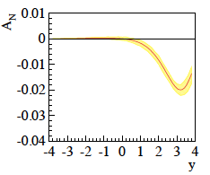
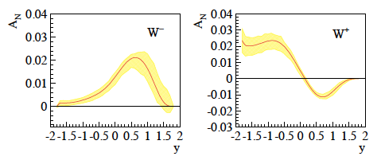
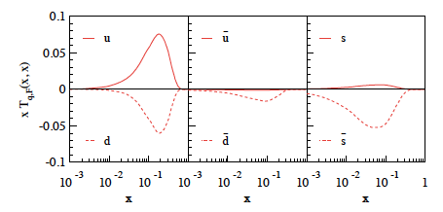
New Theory predictions
Z. Kang et al. arXiv:1401.5078v1
0 < p_{T} 3 GeV
4 < Q < 9 GeV
0 < p_{T} 1 GeV
Q² = 2.4 GeV²
sea quarks
completely
unconstrained
impacts A_{N}(DY,W±, Z⁰,γ)
new calculations for
A_{N}(Z⁰,γ) coming

Slide 7
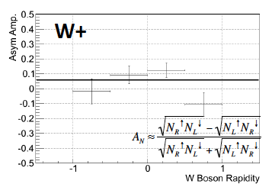
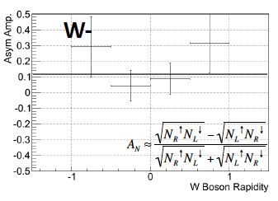
A_{n} W±
Proof of principle from Run-11 data:
https://drupal.star.bnl.gov/STAR/blog/rfatemi/2014/feb/06/sal-and-dima-w-update
Need no upgrade only more statistics
~ 650 pb⁻¹ delivered → Run-13

Slide 8
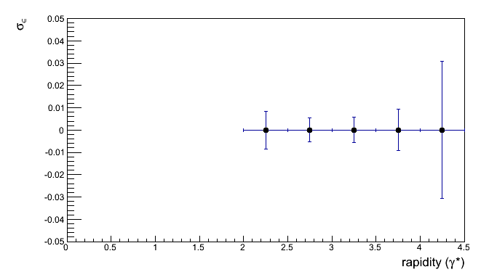
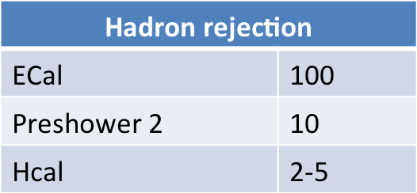
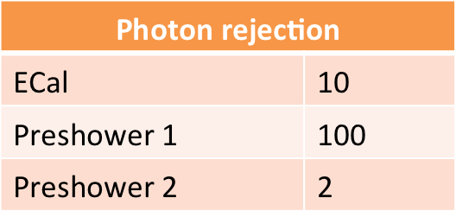
A_{n} DY
Details:
https://drupal.star.bnl.gov/STAR/system/files/2014-01-11_DrellYan.pptx
Requirements:
  Drell-Yan needs ~10⁷-10⁶ suppression of hadron pairs
    Forward rapidity naturally suppresses QCD background
    Track multiplicities are small with reasonable hadron rejection
    charge identification is mainly helping a small m_{inv}<2 GeV/c²
  Transverse asymmetries need h>2
  Background asymmetries a problem if S/B~1
  Mapping out 4< m_{inv}<9 GeV/c² needs a recorded lumi of 1 fb⁻¹
scales with 1/polarization !!!
L_{int} = 1fb⁻¹
rejections per track:
→ FMS
→ just building one
can be replaced by
postshower
→ use FMSPS technology
possible till run 16
tracking: → charge separation: 2

Slide 9
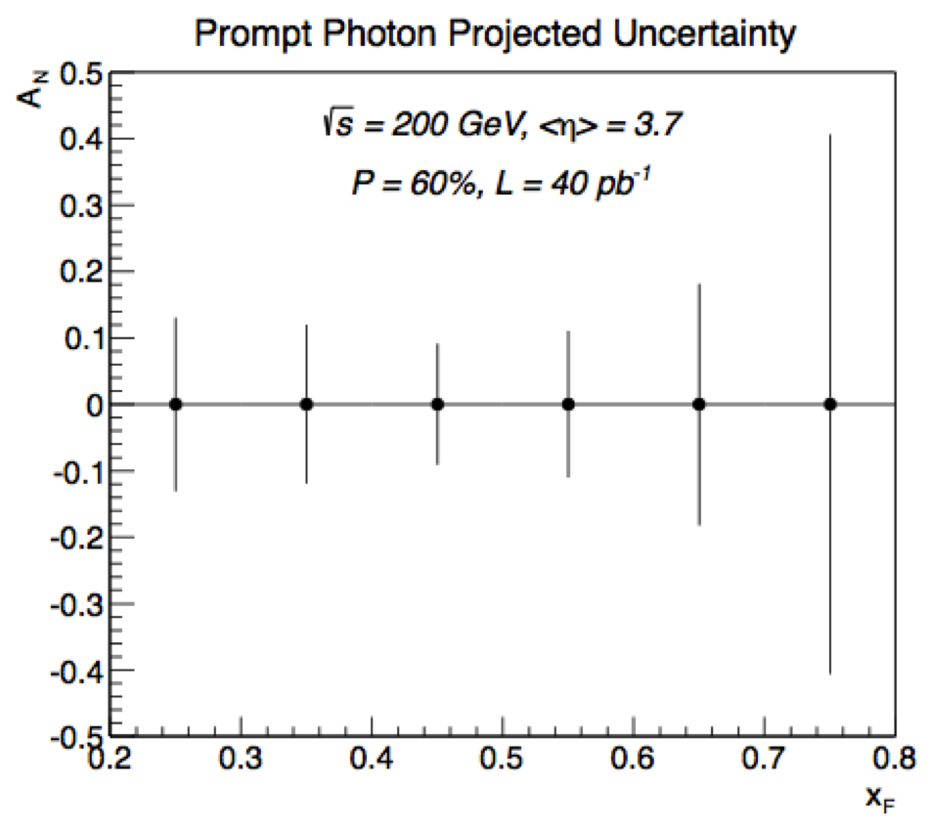
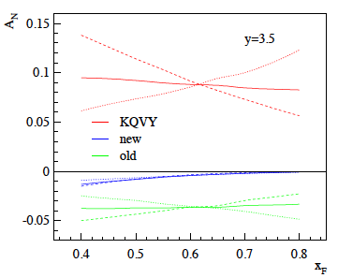
A_{n} direct Photon
Proof of principle from Run-15 200 GeV data:
500 GeV need to reach same high x_{f} as at 200 GeV
bigger background from merged π⁰
Can the FMS Preshower help to separate merged π⁰
from single γ ?
√s = 200 GeV
dashed curve is the direct asymmetry A_{N}^{dir},
dotted curve is the fragmentation asymmetry A_{N}^{frag},
solid curve is the overall spin asymmetry.
The different colors represent different assumptions
about the magnitude of the Sivers asymmetry
Old paper by Z. Kang no evolution

Slide 10
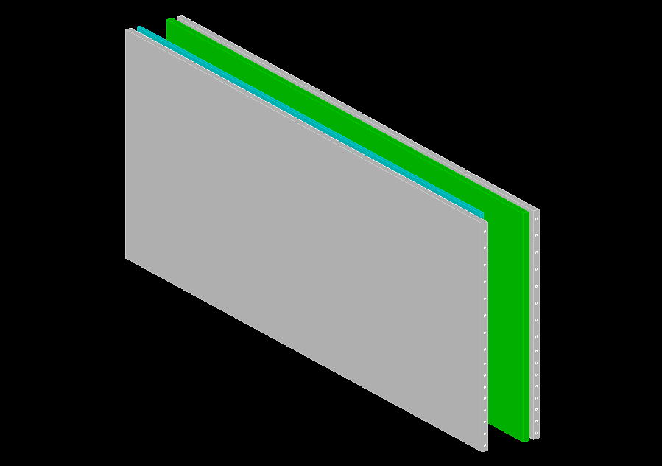
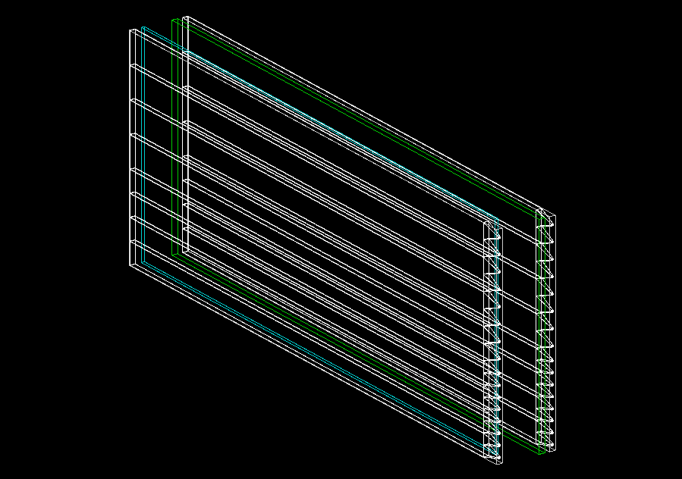
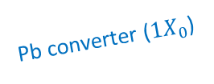
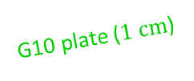
Optical Simulation
PS Simulations Oleg
scintillator with Al-wrap
Four channels each of 4.0/5.8 cm slats
Two MPPTs per channel
Al wrap is 0.5 mm
(mainly for surface definition at this point)
Pb converter ($1X_{0}$)
G10 plate ($1 \text{cm}$)
scintillator with Al-wrap
MPPT readout
Use primary photons/electrons/pions/protons (10 GeV)
Stores single MPPT readout (number of photons)

Slide 11
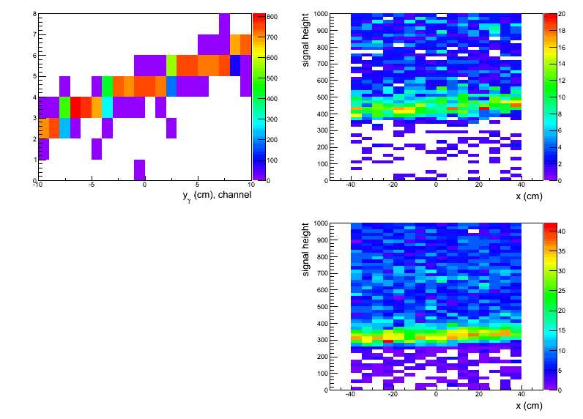
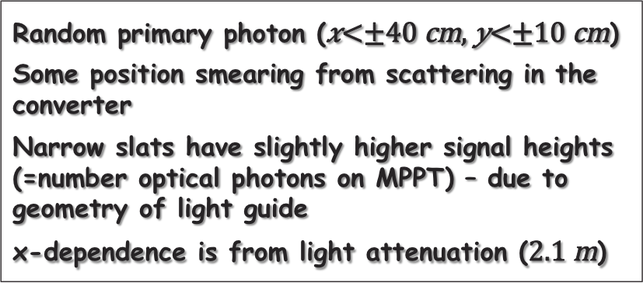
Photon Response in PS3
narrow slats
wide slats
channel
narrow slats
Random primary photon ()
Some position smearing from scattering in the converter
Narrow slats have slightly higher signal heights (=number optical photons on MPPT) – due to geometry of light guide
x-dependence is from light attenuation ()
wide slats

Slide 12
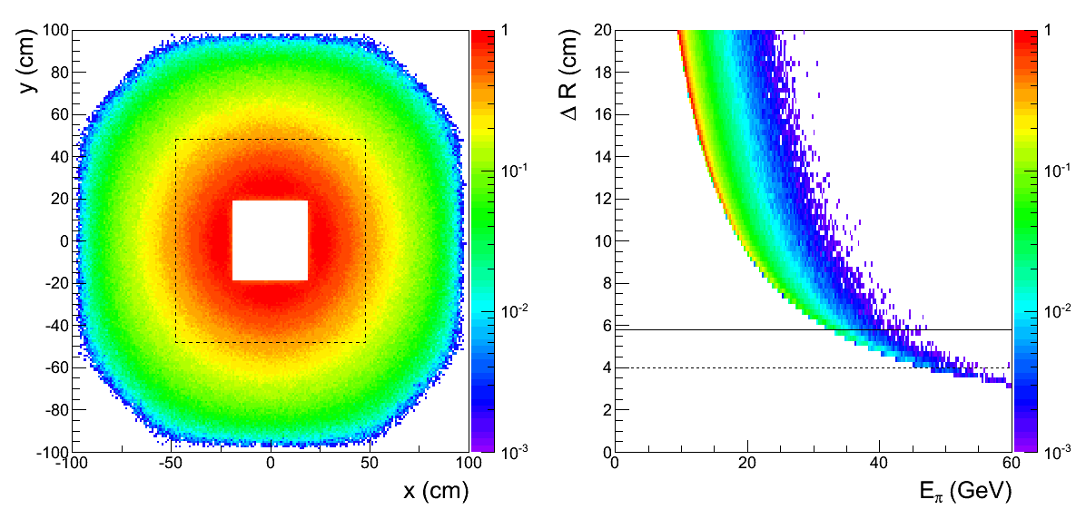
π⁰ --> γγ in FMS
large towers
small towers
Distribution of π⁰ on the FMS surface
PYTHIA p+p @ 500 GeV
Separation of two gammas from π⁰ decay on the FMS surface

Slide 13
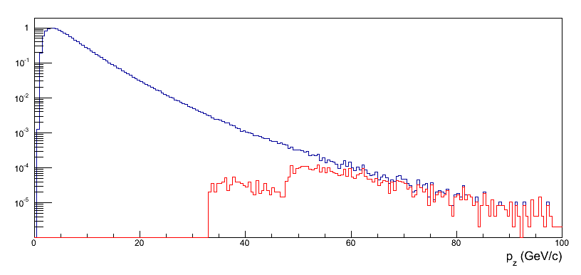
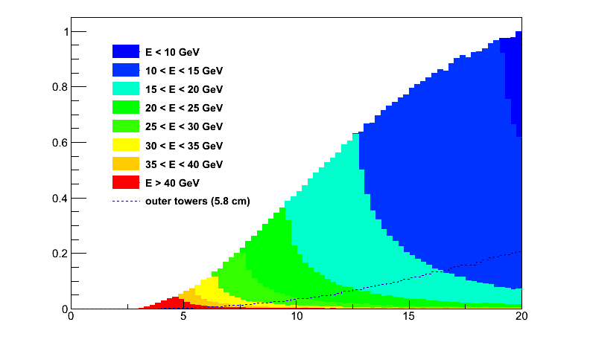
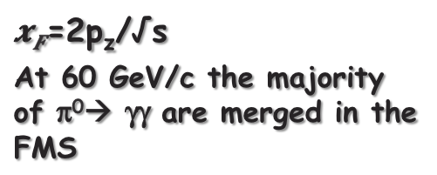
Merged clusters from π⁰ Decay
π⁰→ γγ in FMS acceptance
=2p_{z}/√s
At 60 GeV/c the majority of π⁰→ γγ are merged in the FMS
merged clusters
merging in outer region
(5.8 cm tower size)
merging in inner region
(4.0 cm tower size)
Although the cluster start to merge at lower energies in the larger towers, the fraction of merged clusters is dominated by large rapidities
cluster separation (cm)

Slide 14
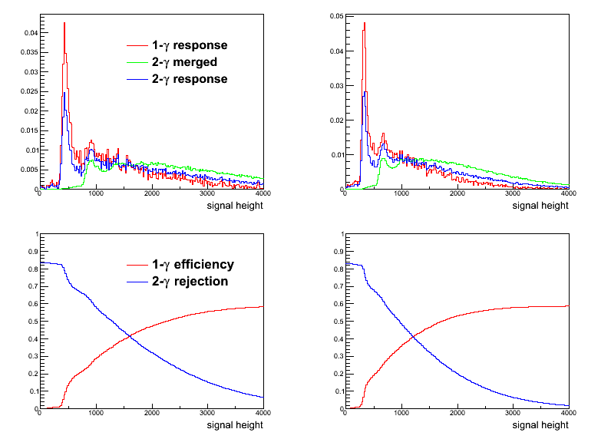


Two Photon Rejection
single interaction in converter
two interactions in converter
response is sum of efficiency weighted merged and single photon distributions
narrow slat
wide slat
efficiency for single photon is

Slide 15
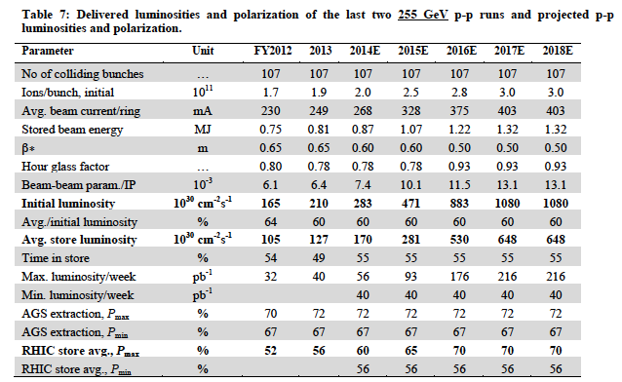
Summary
With minor upgrades, postshower behind FMS
A_{N}(DY,W±, Z⁰,γ)
and sign change
can all be measured in
one 500 GeV transverse polarised pp run
Needed delivered L_{int} ~ 600 – 800 pb⁻¹

Slide 16
BACKUP

Slide 17
what do we mean by “Direct”….
proton – proton:
Au – Au or d-Au
(1)
(2)
(3)
(4)
(5)
γ
“Fragmentation”
much better called internal bremsstrahlung
Induced
De-excitation
for excited
states
Prompt
Fragmentation
(6)
Thermal Radiation
QGP / Hadron Gas
π⁰
EM & Weak Decay

Slide 18
What is in Pythia 6.4
Processes included which would fall under prompt (1)
  14: qqbar → gγ
  18: qqbar → γγ (19: qqbar → γZ⁰ 20: qqbar → γW⁺
  29: qg → qγ
  114: gg → γγ
  115: gg → gγ (106: gg → J/Psiγ 116: gg → Z⁰γ )
  initial and final internal bremsstrahlung (g and γ) (3)
    Pythia manual section 2.2
  Process 3 and 4 are for sure not in pythia
  I’m still checking 5
  the decay of resonances like the π⁰ is of course in pythia

Slide 19
Collected Luminosity with longitudinal Polarization
Year | √s [GeV] | Recorded PHENIX | Recorded STAR | Pol [%]
2002 (Run 2) | 200 | / | 0.3 pb⁻¹ | 15
2003 (Run 3) | 200 | 0.35 pb⁻¹ | 0.3 pb⁻¹ | 27
2004 (Run 4) | 200 | 0.12 pb⁻¹ | 0.4 pb⁻¹ | 40
2005 (Run 5) | 200 | 3.4 pb⁻¹ | 3.1 pb⁻¹ | 49
2006 (Run 6) | 200 | 7.5 pb⁻¹ | 6.8 pb⁻¹ | 57
2006 (Run 6) | 62.4 | 0.08 pb⁻¹ |  | 48
2009 (Run9) | 500 | 10 pb⁻¹ | 10 pb⁻¹ | 39
2009 (Run9) | 200 | 14 pb⁻¹ | 25 pb⁻¹ | 55
2011 (Run11) | 500 | 27.5 / 9.5pb⁻¹ | 12 pb⁻¹ | 48
2012 (Run12) | 500 | 30 / 15 pb⁻¹ | 82 pb⁻¹ | 50/54

Slide 20
Collected Luminosity with transverse Polarization
Year | √s [GeV] | Recorded PHENIX | Recorded STAR | Pol [%]
2001 (Run 2) | 200 | 0.15 pb⁻¹ | 0.15 pb⁻¹ | 15
2003 (Run 3) | 200 | / | 0.25 pb⁻¹ | 30
2005 (Run 5) | 200 | 0.16 pb⁻¹ | 0.1 pb⁻¹ | 47
2006 (Run 6) | 200 | 2.7 pb⁻¹ | 8.5 pb⁻¹ | 57
2006 (Run 6) | 62.4 | 0.02 pb⁻¹ |  | 53
2008 (Run8) | 200 | 5.2 pb⁻¹ | 7.8 pb⁻¹ | 45
2011 (Run11) | 500 | / | 25 pb⁻¹ | 48
2012 (Run12) | 200 | 9.2/4.3 pb⁻¹ | 22 pb⁻¹ | 61/58

Slide 21
Key measurements for polarized pp scattering
deliverables | observables | what we learn | requirements | comments/competition
HP13 (2015) Test unique QCD predictions for relations between single-transverse spin phenomena in p-p scattering and those observed in deep-inelastic lepton scattering. | A_{N} for γ , W^{+/-},Z⁰, DY | Do TMD factorization proofs hold. Are the assumptions of ISI and FSI color interactions in pQCD are attractive and repulsive, respectively correct | high luminosity trans pol pp at √s=500 GeV DY: needs instrumentation to suppress QCD backgr. by 10⁶ at 3<y<4 | A_{N} DY: >=2020 might be to late in view of COMPASS A_{N}W,Z: can be done earlier, i.e. 2016
HP13 (2015) and flavor separation | A_{N} for γ , charged identified(?) hadrons, jets and diffractive events in pp and pHe-3 | underlying subprocess causing the big A_{N} at high x_{f} and y | high luminosity trans pol pp at √s=200 GeV, (500 GeV jets ?) He-3: 2 more snakes; He-3 polarimetry; full Phase-II RP | the origin of the big A_{N} at high x_{f} and y is a legacy of pp and can only be solved in pp what are the minimal observables needed to separate different underlying subprocesses
transversity and collins FF | IFF and A_{UT} for collins observables, i.e. hadron in jet modulations A_{TT} for DY | TMD evolution and transversity at high x cleanest probe, sea quarks | high luminosity trans pol pp at √s=200 GeV & 500 GeV | how does our kinematic reach at high x compare with Jlab12 A_{TT} unique to RHIC
flavour separated helicity PDFs polarization dependent FF | A_{LL} for jets, di-jets, h/γ-jets at rapidities > 1 D_{LL} for hyperons | Δg(x) at small x Δs(x) and does polarization effect fragmentation | high luminosity long. pol pp at √s=500 GeV Forward instrumentation which allows to measure jets and hyperons. Instrumentation to measure the relative luminosity to very high precision | eRHIC will do this cleaner and with a wider kinematic coverage
Searches for a gluonic bound state in central exclusive diffraction in pp | PWA of the invariant mass spectrum in pp→p’M_{X}p’ in central exclusive production | can exotics, i.e. glue balls, be seen in pp | high luminosity pp at √s=200 GeV & 500 GeV full Phase-II RP | how does this program compare to Belle-II & PANDA

Slide 22
Key measurements for p↑A scattering
deliverables | observables | what we learn | requirements | comments/competition
DM8 (2012) determine low-x gluon densities via p(d) A | direct photon potentially correlations, i.e. photon-jet | initial state g(x) for AA-collisions | A-scan | LHC and inclusive DIS in eA eA: clean parton kinematics LHC wider/different kinematic reach; NA61
impact parameter dependent g(x,b) | c.s. as fct. of t for VM production in UPC (pA or AA) | initial state g(x,b) for AA-collisions | high luminosity, clean UPC trigger | LHC and exclusive VM production in eA eA: clean parton kinematics LHC wider/different kinematic reach
“saturation physics” | di-hadron correlations, γ-jet, h-jet & NLO DY, diffraction pT broadening for J/Ψ & DY -> Q_{s} | is the initial state for AA collisions saturated measurement of the different gluon distributions CNM vs. WW | capability to measure many observables precisely large rapidity coverage to very forward rapidities polarized pA A scan | complementary to eA, tests universality between pA and eA
CNM effects | R_{pA} for many different final states K⁰, p, K, D⁰, J/Ψ, .. as fct of rapidity and collision geometry | is fragmentation modified in CNM heavy quarks vs. light quarks in CNM | A scan to tag charm in forward direction → μ-vertex | separation of initial and final state effects only possible in eA
long range rapidty correlations “ridge” | two-particle correlation at large pseudo-rapidity Δη | do these correlations also exist in pA as in AA | tracking and calorimetry to very high rapidities | interesting to see the √s dependence of this effect compared to LHC
is GPD E_{g} different from zero | A_{UT} for J/Ψ through UPC Ap↑ | GPD E_{g} is responsible for L_{g}→ first glimpse |  | unique to RHIC till EIC turns on
underlying subprocess for A_{N}(π⁰) | A_{N} for π⁰ and γ | underlying subprocess for A_{N}(π⁰) sensitivity to Q_{s} | good π⁰ and γ reconstruction at forward rapidities | resolving a legacy in transversely polarized pp collisions

Slide 23
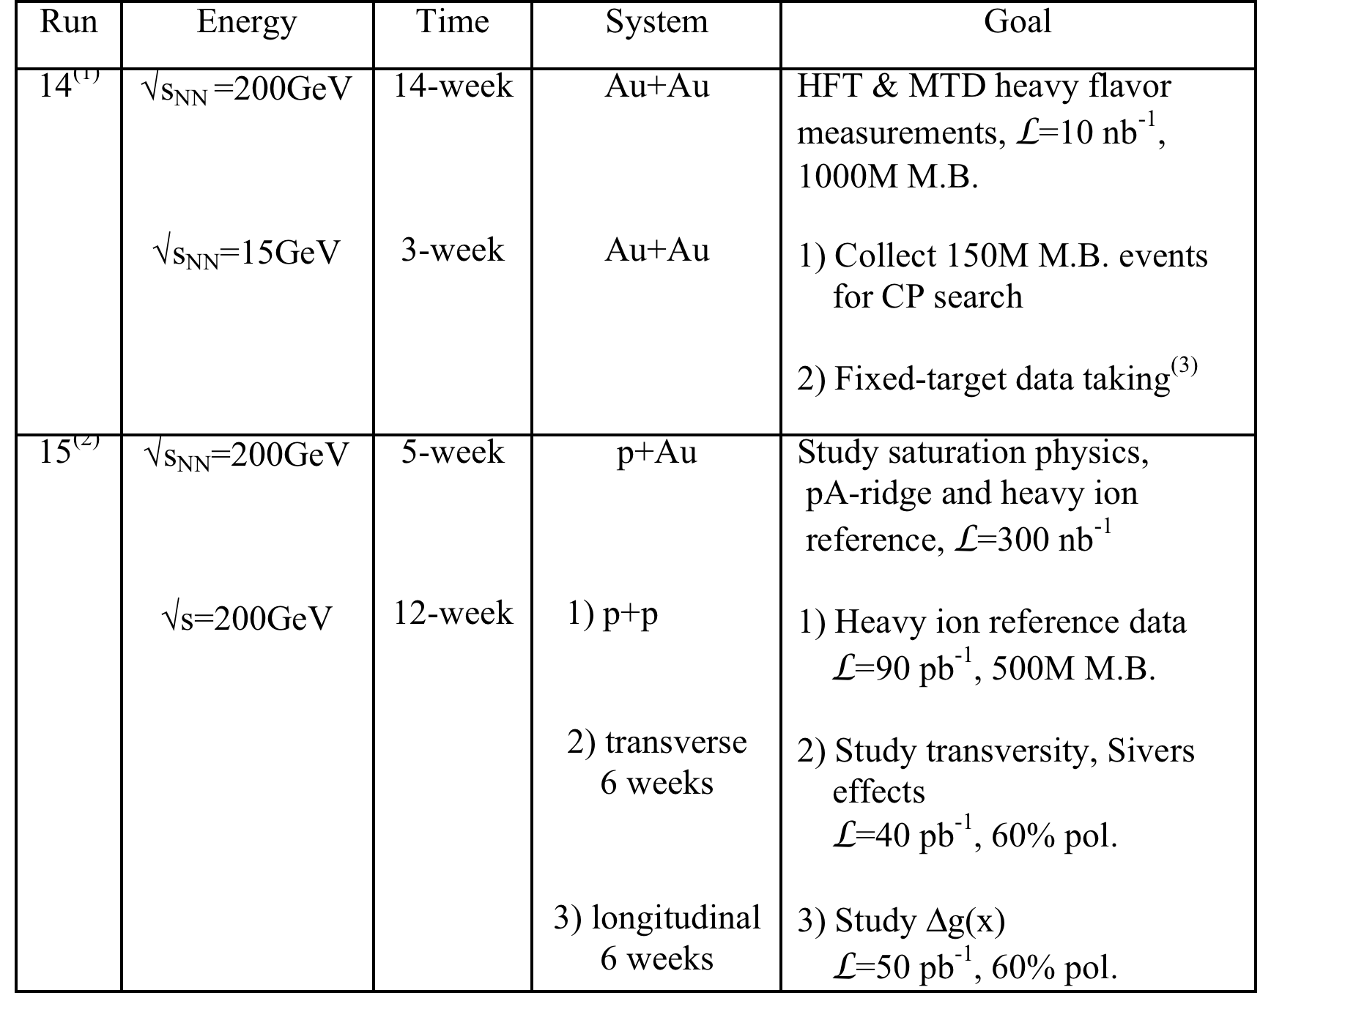
Request in 2013 BUR

Slide 24
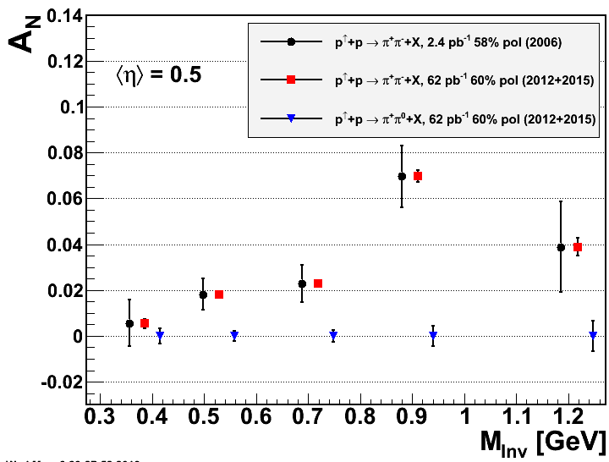
What Can be achieved in RUN 15 p↑p↑
SIVERS/Twist-3
Collins Mechanism
A_{N} for direct photons
Interference fragmentation function
assumes preshower
in front of FMS

