Slide 1
A small summary of the RSC meeting devoted to relative lumi
E.C. Aschenauer

Slide 2
Summary
Two nice presentations
PHENIX: http://www.phenix.bnl.gov/WWW/publish/shura/RSC/2012/2012-01-27/RelLum_PHENIX_27jan2012.pdf
STAR: http://www.phenix.bnl.gov/WWW/publish/shura/RSC/2012/2012-01-27/Lum_Mon_RSC_IIb.ppt
Both experiments agree the effect is due to the ZDC
Both experiments see that N⁺⁺ - N⁻⁻/N⁺⁺ + N^{-–} =A_{pv} and
N⁺⁻ - N⁻⁺/N⁺⁻ + N⁻⁺ = A₁₈₀ are non zero
this is consistent with an collinear angle of the beams (not the same as a crossing angle) and/or an offset of the beams or a misalignment of the ZDCs

Slide 3
Summary
The collinear angle is not optimized by CAD → put to zero
Correlation between size of A_{pv} and A₁₈₀ gives information of collinear angle vs. offset
Results PHENIX toy MC

Slide 4
SUMMARY
More ideas on what could cause the “relative Lumi problem”
Longitudinal polarization profile
First look to data in Run-9 by Sasha for 250 GeV
Dima had a first look for Run-11 250 GeV running
→ ZDC and BBC sample differently along the length of the bunch

Slide 5
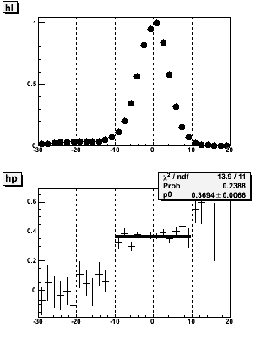
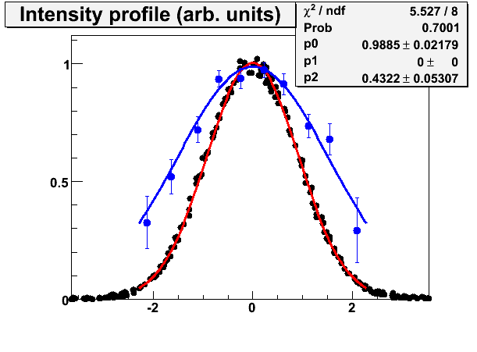
Transverse Longitudinal Profile
Fill 10490 Yellow1 (250 GeV) 2009
Intensity
Polarization
Intensity profile
Transverse Polarization profile
Known effect
No hint for longitudinal polarization profile in 2009

Slide 6
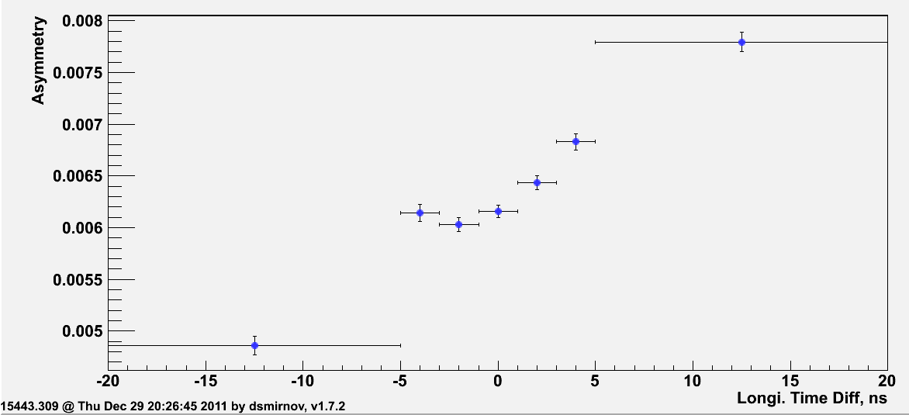
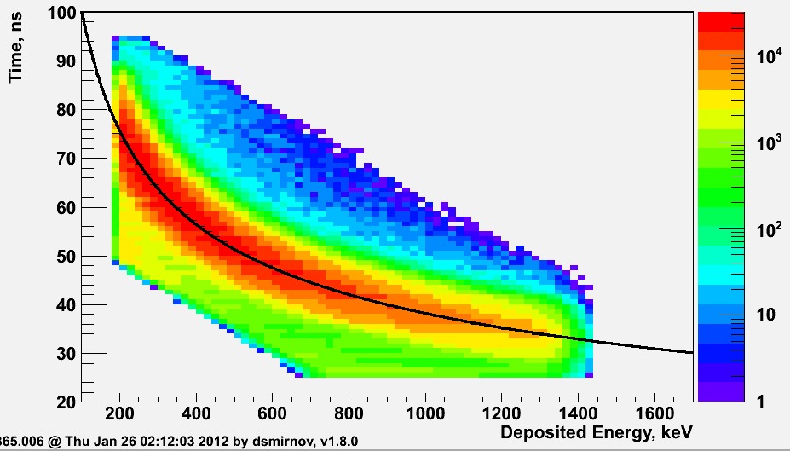
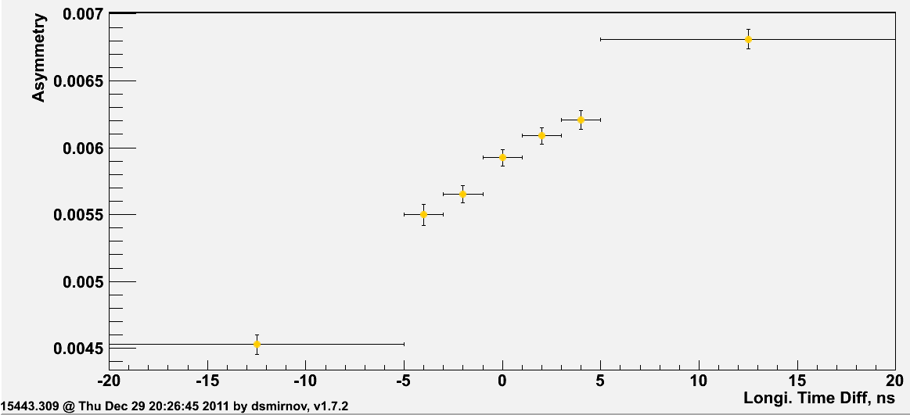
2011: Longitudinal Profile at 250 GeV
Combined 8 fills declared by Haixin and Mei to have the same machine settings
15365, 15366, 15368, 15372, 15376, 15378, 15380, 15386, 15390, 15393, 15399, 15425, 15427, 15435, 15436, 15438, 15443
Blue Beam
Maybe there is some hint for a
longitudinal profile.
BUT need still to study in much
more detail background
Fraction in carbon sample
Yellow Beam
Background

Slide 7
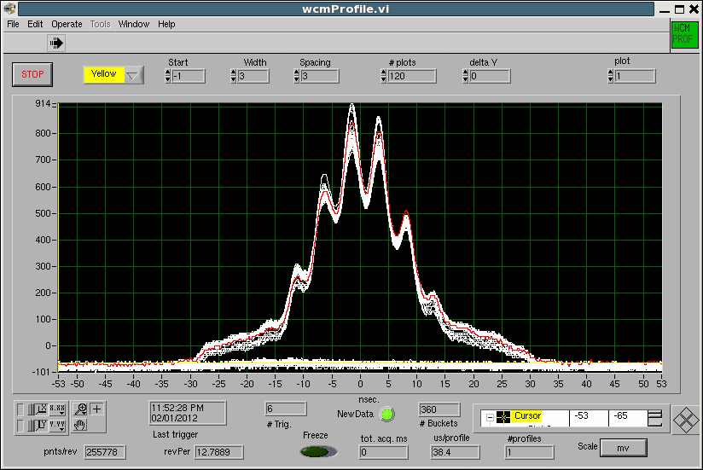
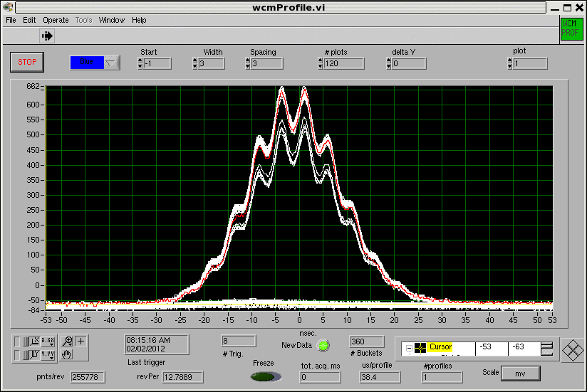
Summary
Questions to be answered by existing data and comparing PHENIX and STAR
impact of rotator tuning on relative lumi
how is the spot on the ZDC SMD moving
Is there an impact if the rotator is optimized for one expriment on the relative lumi of the other one? → non-closed orbits
Do we have an impact of the hugely changed longitudinal bunch shape since 2011→ 9MHz cavity. These plots are from last night particularly bad as rebucketing did not work.

Slide 8
Proposed machine tests
PHENIX proposal to study the effect
Baseline: Four √s=200 GeV pp with transverse polarization fills with +/- 400 and +/- 200 μrad angle.
All 4 stores should have the same spin pattern.
8 hour stores
Do not want fills early in Run-12
Depending on the study’s success, we may expand the request to some additional stores during the 200 GeV p+p running and possibly 1 or 2 additional fills at √s=500 with transverse polarization.
STAR can do the same
but first would like to verify if Angelica’s says she moves the beam by 100μrad the TPC confirms this, can be done in APEX
would be good to do this before PHENIX study to test BPMs
Run with different spin patters, for details see Hal’s talk

Slide 9
Other Action items
Angelika promised to give a talk about why she trusts the BPMs
Andrew offered to simulate STAR with his toy MC

