Slide 1
Current eRHIC IR Design
Important features
  10 mrad crossing angle
    Needs to be integrated into the current STAR and upgrades
    Important for luminosity and separation of forward protons from exclusive reactions as well as to separate breakup neutrons from the outgoing beam
  Free space to first beam element 4.5m
    This can be changed → consequence loss in luminosity → linear proportional to the increase of L*
      Impact on physics program needs to be estimated
  Current IR design already optimized for the detection of break up neutrons and protons from exclusive reactions
    Any change needs a re-optimization
  We need to figure out how to switch between ep/eA and pp,
  dA and AA collisions
    What to do with the yellow beam line
    How to put the non-colliding electron beams around STAR

Slide 2
Current eRHIC IR Design
How will the following be integrated into eSTAR
  luminosity monitor for ep / eA
    Main concern space
  Electron polarization measurement
    Main concern space
  Low Q2 lepton detection
    As long as the outgoing lepton beam design is not changed the design on slide 5 should work
Of course there are a lot of more details, which need a very close look.

Slide 3

Integration into Machine: IR-Design
eRHIC - Geometry high-lumi IR with β*=5 cm, l*=4.5 m
and 10 mrad crossing angle → this is required for 10³⁴ cm⁻² s⁻¹
Outgoing Proton direction already far advanced
Q5
D5
Q4
325 GeV p
125 GeV/u ions
θ=10.3255 mrad
10.26m
3 m
θ=4 mrad
θ=0.0036745 mrad
0.44843 m
0.2582 m
0.315726 m
5.3 m
10 mrad
30 GeV e⁻
4.5
10
20
30
39.98 m
60.0559 m
90.08703 m

Slide 4
February 12, 2011, IP configuration for eRHIC
1.045 m
1.719 m
1.95 m
5.475 m
1.1m
1.057 m
p_{c}/2.5
1.902 m
D=120 mm
θ=10 mrad
θ=4 mrad
1.9 cm (p_{o}/2.5)
ZDC
4.50 m
θ=10 mrad
IP
2
4
6
8
10
12
14
16
Combined function:
1.6 m, 2.230 T, -109 T/m
Θ=4 mrad
beam
neutrons
D=120 mm

Slide 5
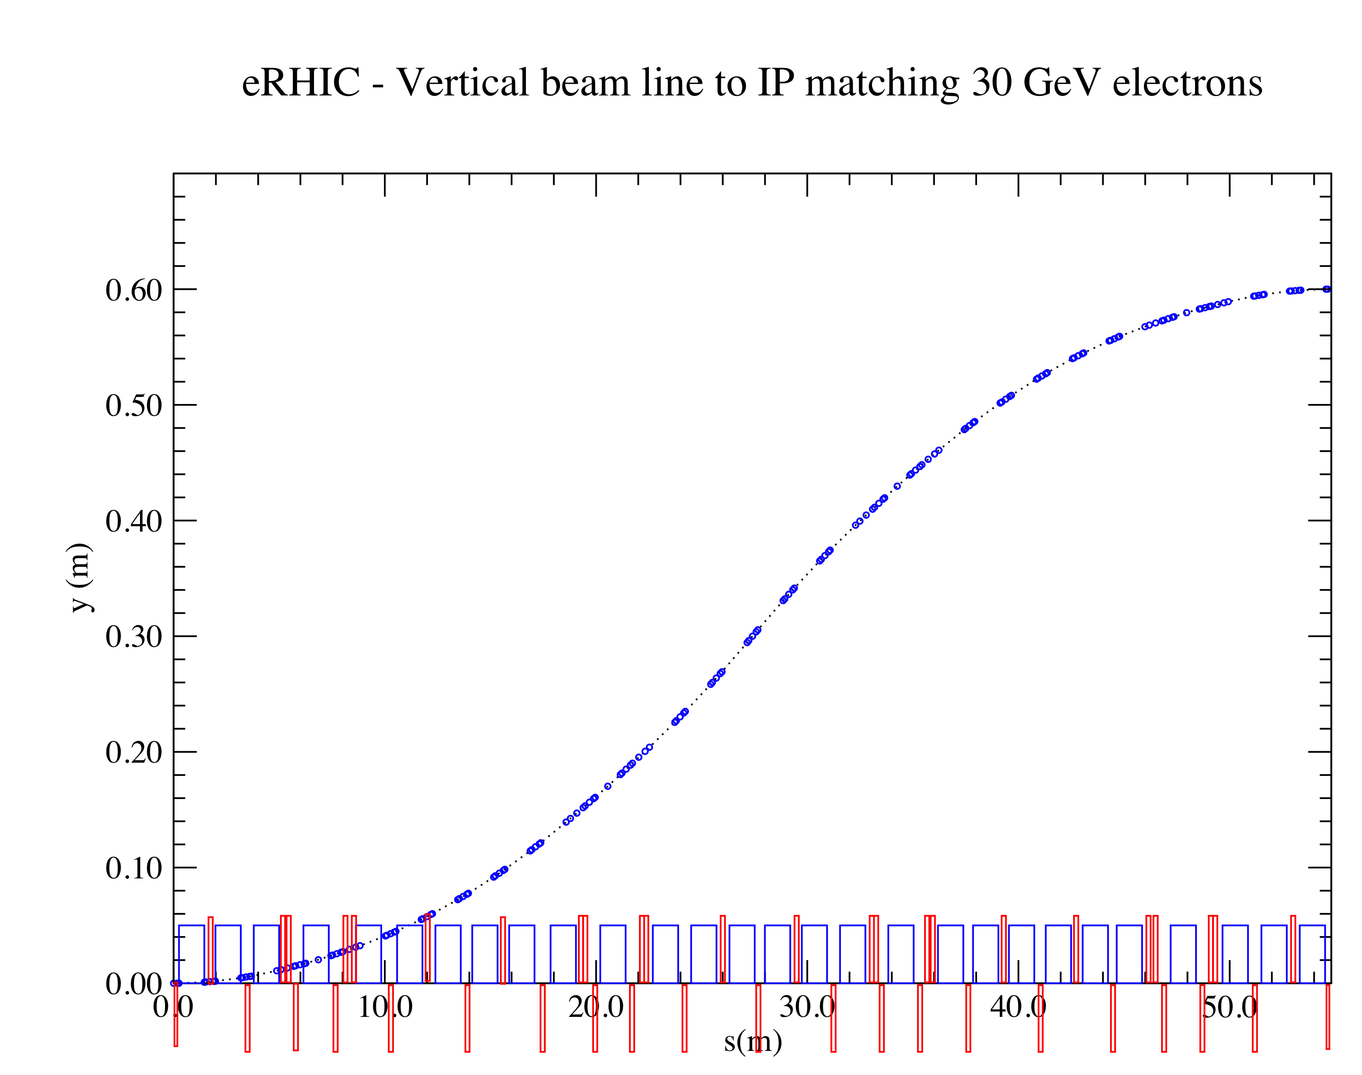
Integration into Machine: IR-Design
Outgoing electron direction currently under detailed design
detect low Q² scattered leptons
want to use the vertical bend to separate very low-Θ e’ from beam-electrons
can make bend faster for outgoing beam → faster separation
for 0.1º<Θ<1º will add calorimetry after the main detector
space for
low-Θ e-tagger

Slide 6
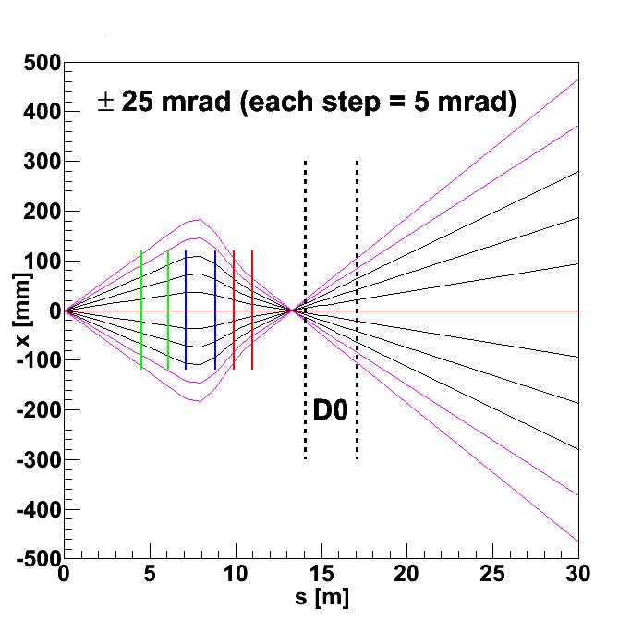
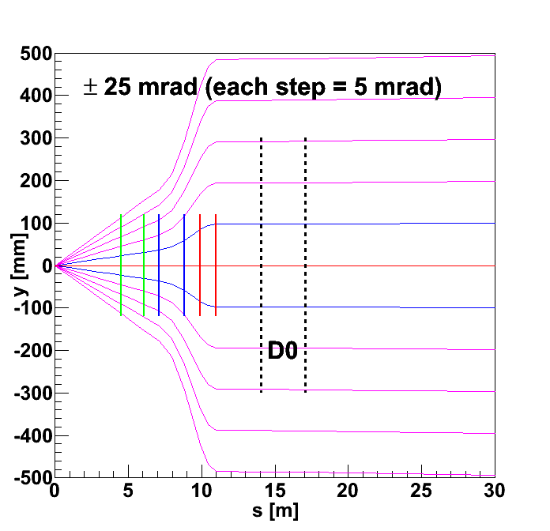
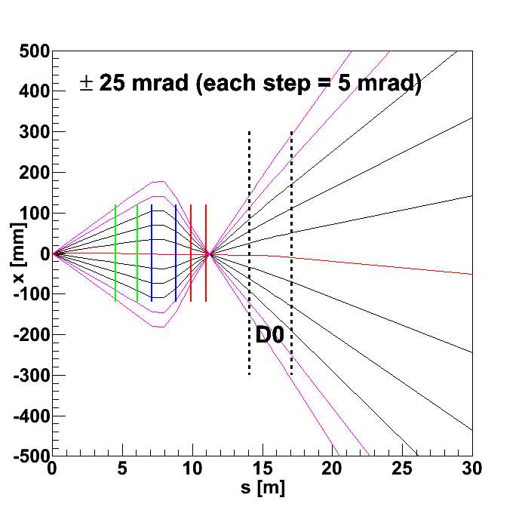
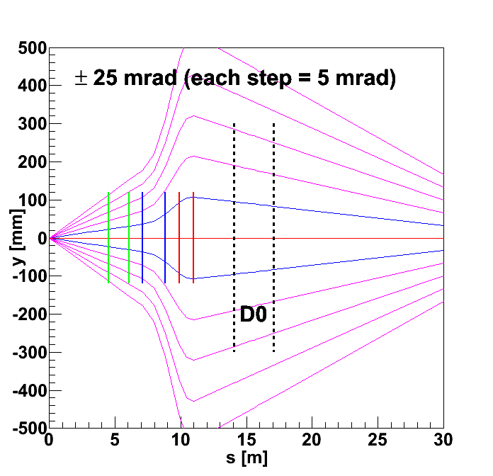
Latest beam optics for outgoing nominal protons
Beam transport using Hector:
studies by JH
outgoing protons with 20% momentum loss

Slide 7
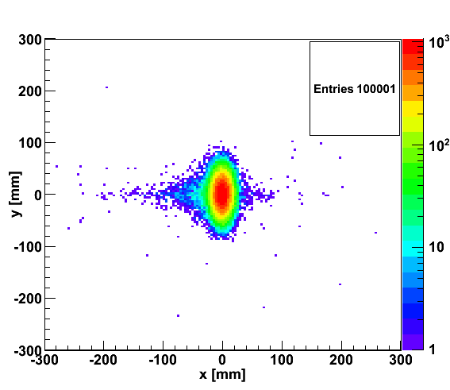
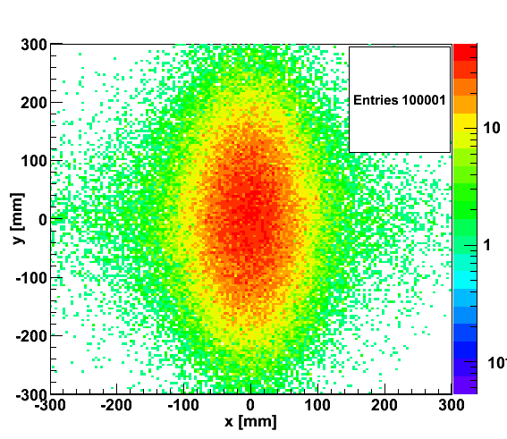

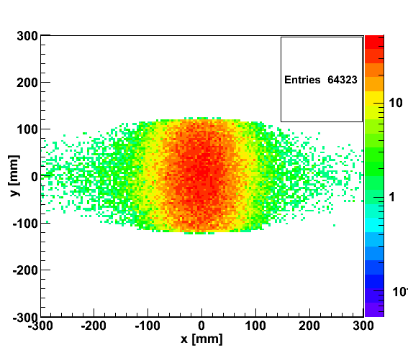
proton distribution in y vs x at s=20 m
without quadrupole aperture limit
25x250
5x50
with quadrupole aperture limit
25x250
5x50

Slide 8
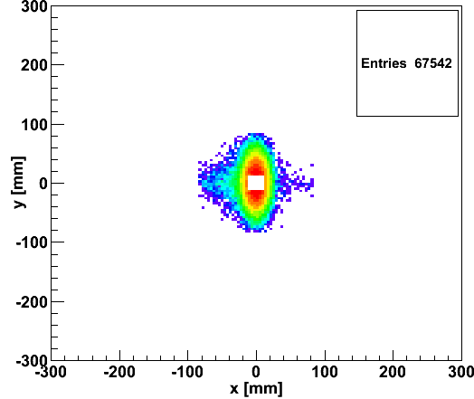
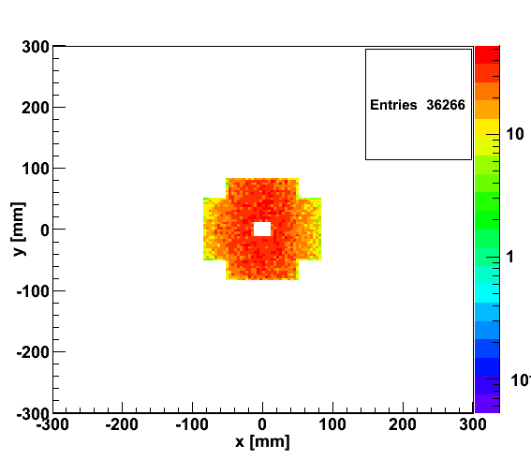
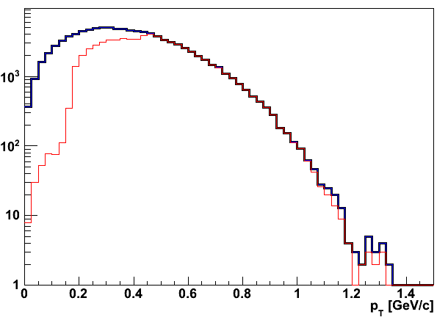
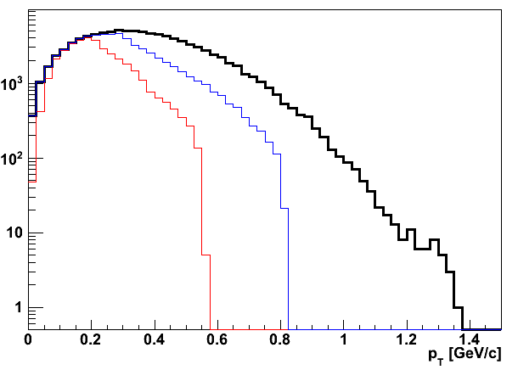
Accepted in“Roman Pot”(example) at s=20m
25x250
5x50
25x250
5x50
Generated
Quad aperture limited
RP (at 20m) accepted

