Slide 1

Detector R&D and Design

Slide 2

Golden Measurements: Physics of strong color fields
Science Deliverable | Basic Measurement | Detector Requirements | Machine Requirements
integrated gluon distributions nuclear wave fct. saturation, Q_{s} | inclusive DIS F_{2,L} | → very good electron ID very good momentum and angular resolution for e’ | need to reach x~10⁻⁴ large x,Q² coverage → medium lumi highest √s
k_{T}-dependent gluons; gluon correlations non-linear QCD evolution/universality | semi-inclusive DIS di-hadron correlations | very similar to inclusive DIS excellent particle ID → wide coverage range in η | need to reach x~10⁻⁴ large x,Q² coverage → medium lumi highest √s
transport coefficients in cold nuclear matter parton energy loss; shower evolution energy loss mechanism | semi-inclusive DIS; light and heavy hadrons (c,b), Jets | → very good electron ID very good momentum and angular resolution for e’ → excellent particle ID excellent vertex resolution | large x,Q² coverage multi-dim binning → medium - high lumi low - high √s

Slide 3

Golden Measurements: Spin Physics
Science Deliverable | Basic Measurement | Detector Requirements | Machine Requirements
spin structure at small x contribution of Δg, ΔΣ to spin sum rule | inclusive DIS | → very good electron ID very good momentum and angular resolution for e’ | need to reach x=10⁻⁴ large x,Q² coverage about 10fb⁻¹ medium lumi high √s
full flavor separation in large x,Q² range strangeness, s(x)-s(x) polarized sea | semi-inclusive DIS | very similar to inclusive DIS excellent particle ID separate π, K, p over a wide range in η | need to reach x=10⁻⁴ large x,Q² coverage polarized ³He beam medium lumi high √s
electroweak probes of proton structure flavor separation electroweak parameters | very high Q² hadronic final state | very good coverage for hadronic final state → kinematic from q-jet | 20x250 to 30x325 positron beam polarized ³He beam high lumi highest √s

Slide 4
Golden Measurements: 3D-Imaging in b_{T} / k_{T}
Science Deliverable | Basic Measurement | Detector Requirements | Machine Requirements
Sivers + unpol PDF valence, sea quarks & gluons quantum interference multiparton correlations spin-orbit correlations & role of OAM matching low-high p_{T} | semi-inclusive DIS transverse nucl. pol. di-hadron/(di-jets) heavy-flavor production | → very good electron ID very good momentum and angular resolution for e’ excellent particle ID separate π, K, p over a wide range in η full Φ-coverage around γ* excellent vertex res. | large x,Q² coverage 5D binning high lumi low - high √s
chiral odd fcts. valence, sea quarks & gluons transversity & IFF Collins-FF Boer-Mulders fct. | semi-inclusive DIS | as above | as above
quark and gluon imaging via GPDs in b_{T}-space access to L_{q} and L_{g} | exclusive DIS DVCS, J/Ψ, ρ, Φ | → very good electron ID very good momentum and angular resolution for e’ → exclusivity and high resolution in t → Roman pots | large x,Q²,t coverage 4D binning polarized beams high lumi low - high √s

Slide 5
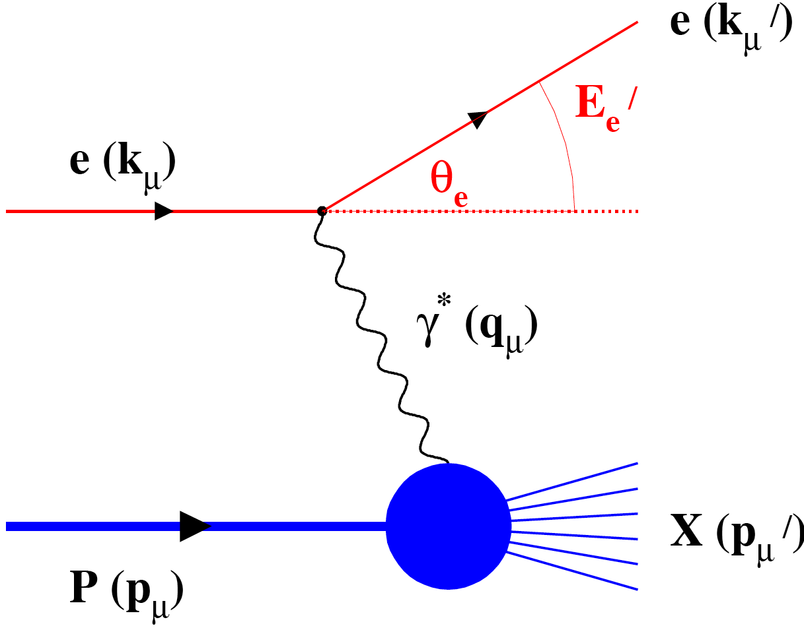
Deep Inelastic Scattering
Kinematics:
Measure of resolution power
Measure of inelasticity
Measure of momentum fraction of struck quark
e-
p/A
0º 180º
Challenge:
need to cover wide range in beam energies
lepton: 5 - 30 GeV
hadron (p/Au) 100 – 325 GeV / 25 – 130 GeV
Resolution in x, Q² dominated how well the scattered lepton is measured
low momentum: Multiple scattering → low material
high momentum: position resolution from tracking detector
all momenta: Brems-strahlung → low material

Slide 6
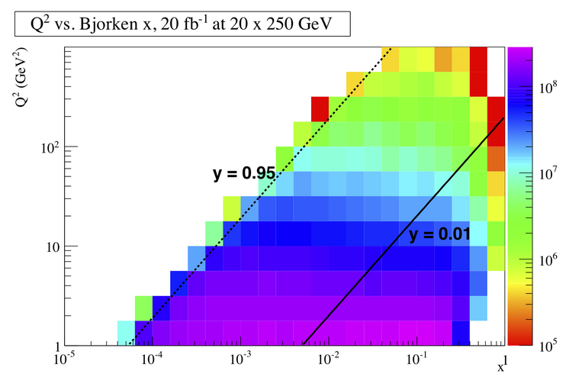
DIS Kinematics
Potential limitations in kinematic coverage:
high y limited by
radiative corrections
can be suppressed by
by requiring hadronic
activity
y=0.85
HERA
y>0.005
y=0.05
Strong x-Q² correlation
  high x → high Q²
  low x → low Q²
low y limited by
theta resolution for e’
→ use hadron method

Slide 7
Required Lepton-Hadron Separation
Need very good e-PID for
high Q² events

Slide 8
Kinematics of scat. electron
cuts: Q2>1GeV² && 0.01<y<0.9

Slide 9
Kinematics of semi-inclusive hadrons
PIONS:
cuts: Q2>1GeV² && 0.01<y<0.9 && 0.1<z<0.9

Slide 10
Kinematics of exclusive hadrons
ρ→π⁺+π⁻:
cuts: Q2>1.0GeV² && 0.01<y<0.9

Slide 11
Important for Detector Design
DIS:
  with increasing center-of-mass energy lepton goes more and more in original beam direction
  high Q² events go into central detector
  low Q2 events have small scattering angle and close to original beam energy
  need low forward electron tagger for low Q² events
  low-mass high resolution trackers over wide angular acceptance
Semi-Inclusive DIS
  hadrons go from very forward to central to even backward with lepton beam energy increasing
  good particle-ID over the entire detector (1<p<30-60GeV)
Exclusive Reactions:
  decay products from excl. ρ / φ / J/ψ go from very forward to central to even backward with lepton beam energy increasing

Slide 12
Additional Remarks
Charm detection
  structure functions
    detecting lepton form decay in addition to scattered via displaced vertex should be enough
  charm in fragmentation
    need to reconstruct D⁰ meson completely to measure its z
      good PID
Very high luminosity 10³⁴ cm⁻¹s⁻¹
  will be systematic limited basically in every measurement
  needs a lot of care to account for this in the design
    detector: alignment, ……
    polarization measurements: bunch by bunch;
    luminosity measurement
    relative luminosity measurement

Slide 13
DVCS: ep → e’p’γ
cuts: Q2>1.0GeV² && 0.01<y<0.9
&& Eγ>1GeV

Slide 14
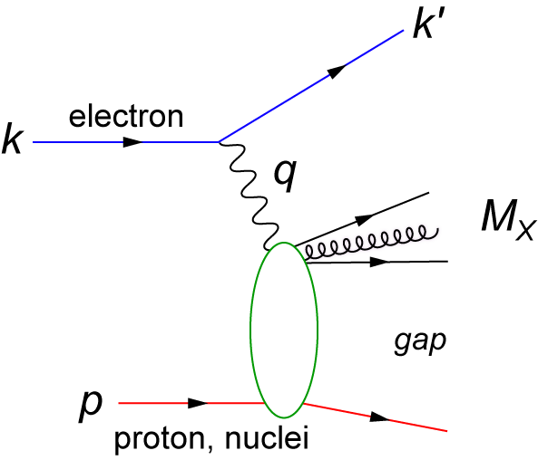
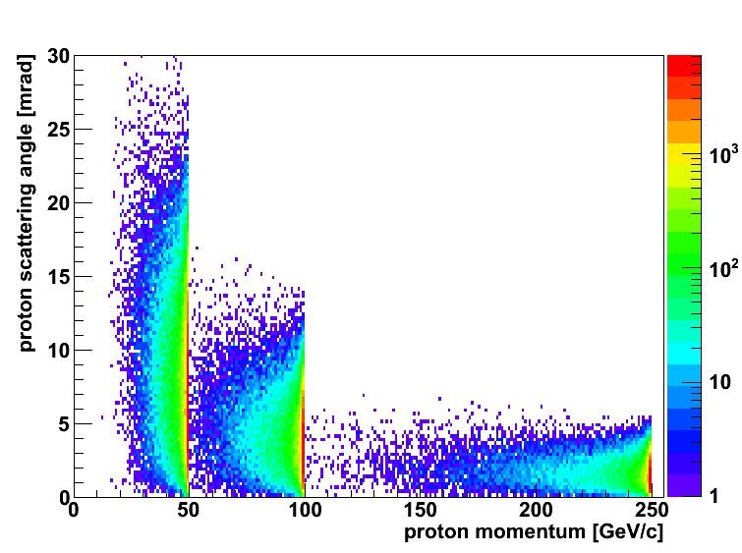
Diffractive Physics: p’ kinematics
Diffraction:
t=(p4-p2)² = 2[(mp^{in}.mp^{out})-(E^{in}E^{out} - pz^{in}pz^{out})]
→ “ Roman Pots” acceptance studies see later
?
5x50
p’
5x100
5x250

Slide 15
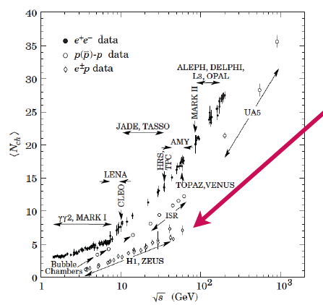
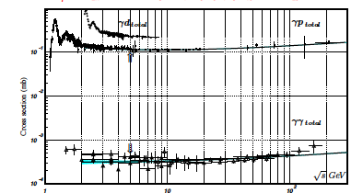
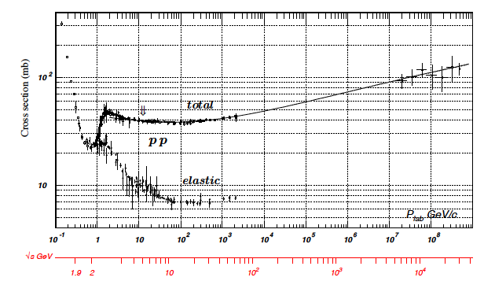
Some thought about rates
low multiplicity
4-6 √s = 40-65 GeV
N_{ch} (ep) ~ N_{ch} (eA) < N_{ch}(pA)
→ no occupancy problem
Cross section:
Pythia σ_{ep}: 0.030 – 0.060 mb
Luminosity: 10³⁴ cm⁻¹ s⁻¹ ⁼ 10⁷ mb⁻¹ s⁻¹
Interaction rate:
300 -600 kHz

Slide 16
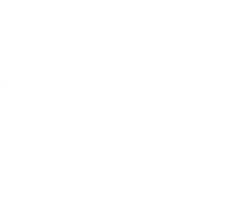
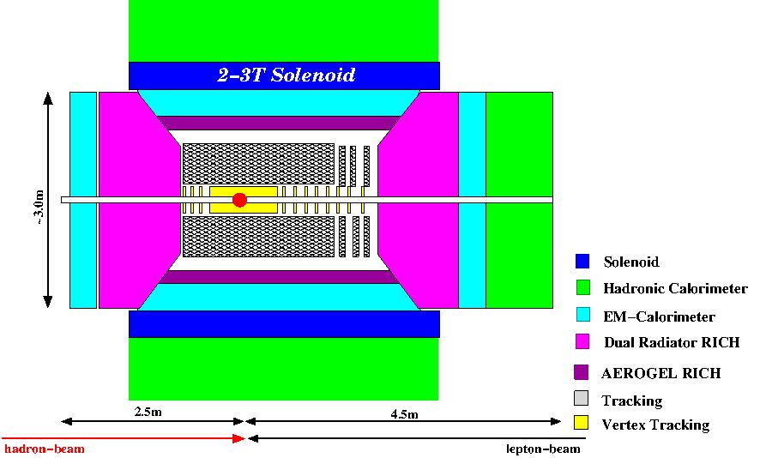
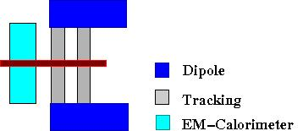
Emerging Detector Concept
Forward / Backward
Spectrometers:
detector currently modeled in
FLUKA
GEANT-4
and in a fast simulation
  together with ZEUS and STAR
important for Detector R&D and
physics capabilities
high acceptance -5 < η < 5 central detector
good PID (π,K,p and lepton) and vertex resolution (< 5μm)
tracking and calorimeter coverage the same → good momentum resolution, lepton PID
low material density → minimal multiple scattering and brems-strahlung
very forward electron and proton/neutron detection → maybe dipole spectrometers

Slide 17
EIC R&D Proposals in April
5 proposals and one LoI
  Development of a new detecctor technology for fiber sampling calorimeters for EIC and STAR
  PI: H. Huang; Institutes: UCLA, Texas A&M, Penn State Univ.
  Front end readout module for detector data acquisition and trigger system
  PI: C. Cuevas; Jefferson Lab.
  DIRC-based PID for the EIC Central Detector
  PI: P. Nadel-Turonski; Catholic University of America, Old Dominion University,
  Jefferson Lab, GSI (Darmstadt)
  Liquid scintillator calorimetry for the Electron Ion Collider
  PI: J. Frantz; Institutes: Ohio University
  Proposal to test improved radiation tolerant silicon photomultipliers
  PI: C. Zorn; Jefferson Lab.
  Letter of Intent for Detector R&D towards an EIC detector
  PI: K. Dehmelt; BNL, Florida Inst. Of Technology, Iowa State Univ., LBNL,
  LANL, MIT, Riken BNL Res. Cntr., Stony Brook Univ., Univ.Virginia, Yale Univ.
  simulations hardware
  currently deferred for funding

Slide 18
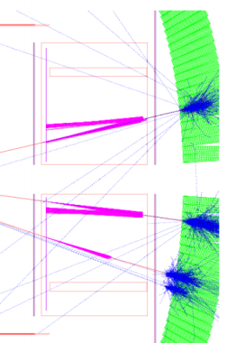
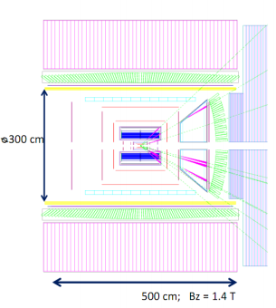
Simulation framework…
The most important work over the coming year involves simulations to propose viable technology choices for R&D.
Several simulation framework exists.
The work plan involves driving processes:
  F_{L} drives momentum precision.
  PID driven by strange particles:
    Δs measurements
    Charm via hadrons
No funds requested for simulations in LoI
  Applying for a postdoc for simulation is the goal for the autumn EIC R&D call

Slide 19
Details on LoI: Simulation Issues I:
Material and position resolution budgets:
  Depends upon source of Q².
  Depends upon measurement channel.
  Golden channel to push tracking: F_{L}
Choices between Fast Drift TPC & GEM tracking outside of the thin micro-vertex tracking layer
  Nothing is thinner than a TPC.
  Can have a “thinnest direction”?
  Can it resolve multiple tracks from overlapping events?
  Collision rate limitation?
High performance dE/dx measurements via Cluster Counting.
What magnetic field configurations could be considered to maintain high performance at high η?
  Solenoid not optimal for resolution at small angles.

Slide 20
Details on LoI: Simulation Issues II:
What form of B-field-insensitive detector can be used for PID?
  RICH with various readout choices:
    CsI photocathode, SiPM
  High Resolution TOF alone or within RICH
    SiPM, MCP-PM readouts…
Proximity-focus RICH in central arm.
  Can PID momentum-limits be extended via blob-ID??
  TOF within RICH by RICH
  Jlab: looks to DIRC technologies
Limits on Ring radius resolution due to B-field

Slide 21
Hardware tasks during 1st year
Measurements of fast TPC performance characteristics.
Development of very large area GEM detectors.
Development of GEM-based CsI-photocathode detectors for PID in barrel and endcap.
Development of methods to minimize electronics-induced gaps in large area GEM detectors.
Development of a 3-coordinate strip-pixel readout.

Slide 22
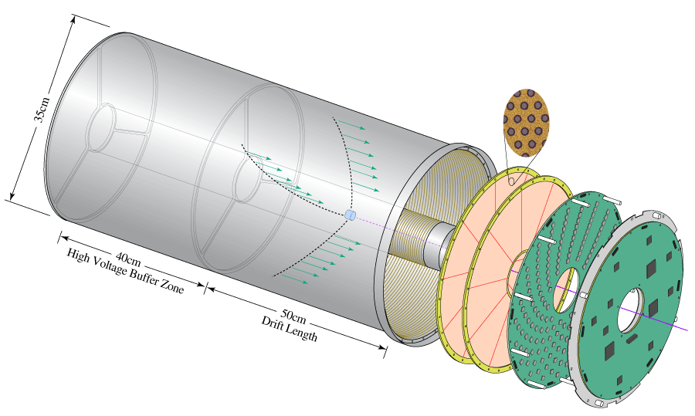
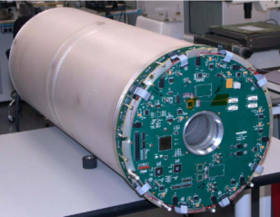
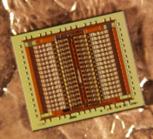
Fast Drift TPC Development
GEM Readout TPC for the Laser Electron Gamma Source (LEGS) at BNL
Double GEM Readout
Designed and built by BNL Instrumentation Division
GEM TPC Test Facility in BNL Physics Dept
Custom ASIC
32 channels - mixed signal
40,000 transistors
low-noise charge amplification
energy and timing, 230 e⁻, 2.5 ns
neighbor processing
multiplexed and sparse readout
G. De Geronimo et al., IEEE TNS 51 (2004)

Slide 23
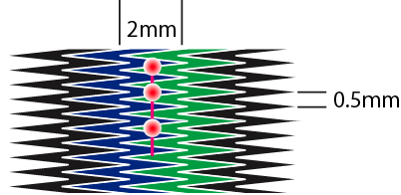
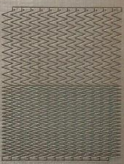
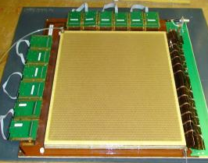
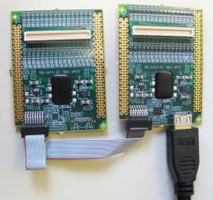
Large-Area Readout Using Zigzag Strips
Follow up on previous BNL R&D to reduce required
strip & channel numbers. Position errors < 80µm
achieved with 2mm strip pitch in small prototypes:
Bo Yu, BNL
Bo Yu, BNL
Test performance with
medium-size 3-GEM det.
using analog SRS readout
with APV25 hybrid cards
(128 ch. per card) at BNL
& Florida Tech
30cm × 30 cm
Triple-GEM
Hans Muller, CERN
First commercially produced
front-end APV25 hybrids (RD51)

Slide 24
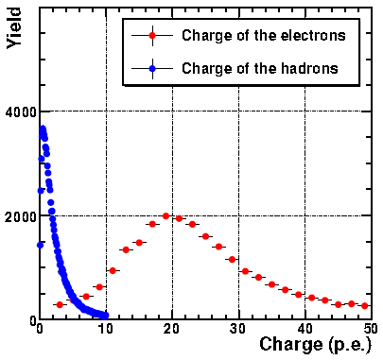
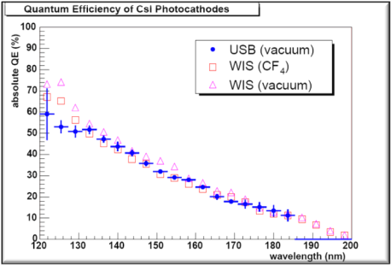
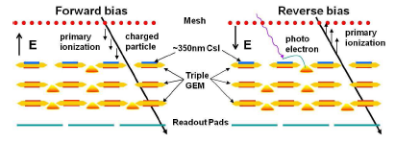
CsI Photocathode Research
The Stony Brook group wishes to investigate the feasibility of CsI-coated GEMs as a large area, B-field tolerant solution for RICH work.
Operating in CF₄ the PHENIX HBD detector
demonstrated the highest measured N₀ (327) of any
large Cherenkov Detector.
However, there are limitations due to the
sensitivity range of CsI (110 – 200 nm).
  Windows provide
  provide higher cutoff.
  Most (not all) optics for
  reflection provide higher
  cutoff.
  Aerogel opaque in VUV

Slide 25
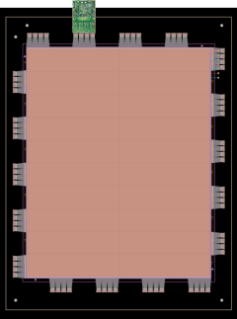
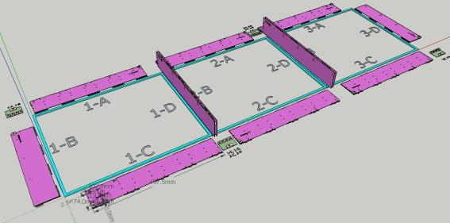
Large Area GEM w/ “hidden” Readout
EIC requires large area GEM coverage: disks with radii up to ~ 2m
Single mask technique, GEM splicing: GEM foils up to 2 m x 0.5 m.
Large area coverage requires segmentation with narrow dead areas
Optimized for the large GEM chambers of Super-Bigbite
Readout cards perpendicular to the active area
Flexible extensions of readout-board: directly plug in the front end card
R&D proposal: build a 1 m x 0.9 m prototype with two segments.

Slide 26
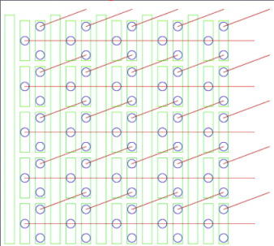
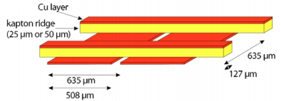
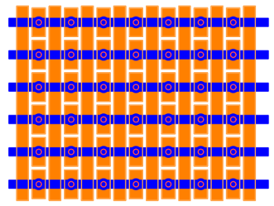
Strip-pixel R&D
PROPOSED
COMPASS
Position by charge division (~100 μm).
Readout count set by occupancy:
  2D uses X-Y charge matching allows
  up to 10 particles per “patch”
  3D uses chg & GEOMETRY matching
  requires R&D to determine limit.
STAR FGT
NOTE: Redundancy “hardens” detector against failure.

Slide 27
and Summary
Work has started on hardware
“pure” physics simulations are very well underway
  Need to include detector effects in the golden experiment simulations
    Have the fast smearing generator
    ESIM, Fluka and Geant-4 tools
    Nicolai’s “STARsim” tool
A dedicated eRHIC detector is a must to realize the physics potential of the machine and described in
http://arXiv.org/pdf/1108.1713
  address question: what can a dedicated ep/eA detector do in pp, AA, pA collisions
Groups are welcome to join the effort

Slide 28
BACKUP

Slide 29
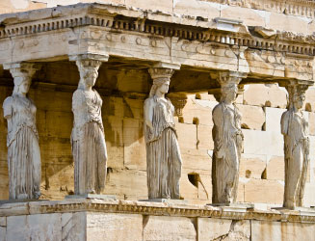
The Pillars of the eRHIC Physics program
spin Physics
Hadronisation
Electro Weak
physics of
strong color
fields
3D Imiging
Wide physics program with high requirements on detector and machine performance

Slide 30
Deep Inelastic Scattering
Kinematics:
e’
Measure of resolution power
e
γ
γ_{L}*
(Q²)
x+ξ
x-ξ
Measure of inelasticity
~
~
H, H, E, E (x,ξ,t)
p
p’
Measure of momentum fraction of struck quark
t
Exclusive events:
e+p/A → e’+p’/A’+γ / J/ψ / ρ / φ
detect all event products in the detector
Special sub-event category rapidity gap events
e+p/A → e’+γ / J/ψ / ρ / φ / jet
don’t detect p’ → HERA: 20% non-exclusive event contamination
missing mass technique as for fixed target does not work → resolution

Slide 31
Kinematics of scat. electron
cuts: Q2>0.1GeV² && 0.01<y<0.9

Slide 32
Kinematics of scat. electron
cuts: Q2>0.1GeV² && 0.01<y<0.9

Slide 33
Kinematics of semi-inclusive hadrons
KAONS:
cuts: Q2>1GeV² && 0.01<y<0.9 && 0.1<z<0.9

Slide 34
Kinematics of semi-inclusive hadrons
PROTONS:
cuts: Q2>1GeV² && 0.01<y<0.9 && 0.1<z<0.9

Slide 35
Kinematics of exclusive hadrons
J/ψ → e^{+/-}/ μ^{+/-}:
no cuts

Slide 36
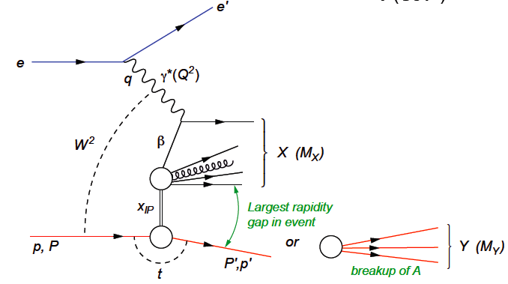
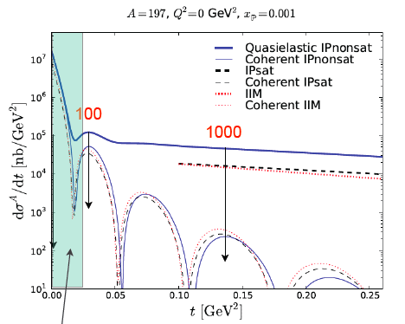
How to detect coherent/in-coherent events in ep/A ?
e+p/A → e’+p’/A’ + γ / J/ψ / ρ / φ / jet
Challenges to detect p’/A’
  Beam angular divergence limits smallest outgoing Θ_{min} for p/A that can be measured
  Can measure the nucleus if it is separated from the beam in Si (Roman Pot) “beamline” detectors
    p_{Tmin} ~ p_{z}^{A} θ_{min}
      For beam energies = 100 GeV/n and θ_{min} = 0.1 mrad
  Large momentum kicks, much larger
  than binding energy (~8 MeV)
    For large A, coherently diffractive nucleus
    cannot be separated from beamline
    without breaking up
    → break up neutron detection
    → veto incoherent events
incoherent dominates at a t at 1/e
of coherent cross section
→ p_{t} << p_{tmin}
p_{t}=√t

Slide 37
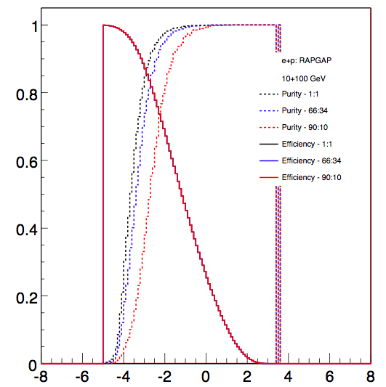
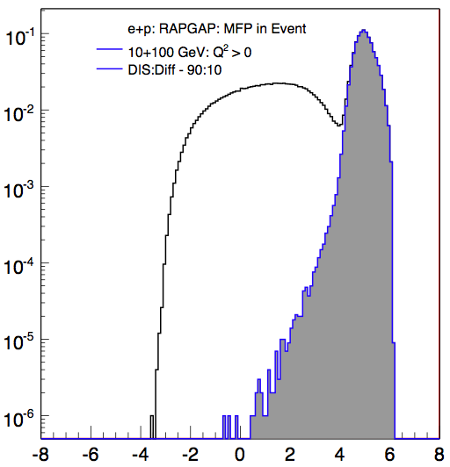
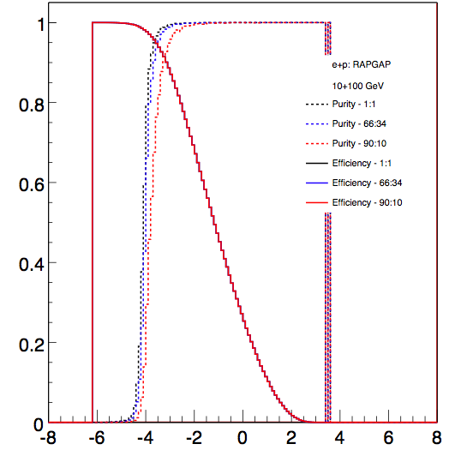
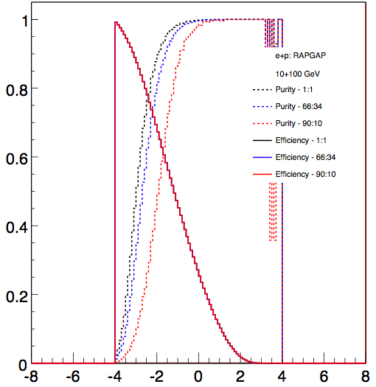
How to detect coherent/in-coherent events in ep/A ?
Rely on rapidity gap method
  simulations look good
  clear difference between DIS and
  diffractive events
  high eff. high purity
  possible with gap alone
    ~1% contamination
    ~80% efficiency
  depends critical on detector
  hermeticity
    However, reduce the acceptance by 1 or 2 units of rapidity and these values drop significantly
  improve further by veto on
  breakup of nuclei (DIS)
Very critical
  mandatory to detect nuclear
  fragments from breakup
  n: Zero-Degree calorimeter
  p, A frag: Forward Spectrometer
Efficiency
Purity
Rapidity
Rapidity

Slide 38
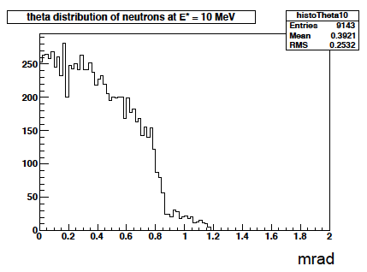
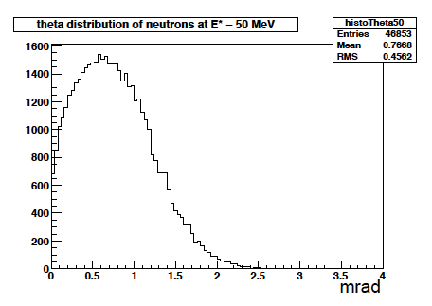
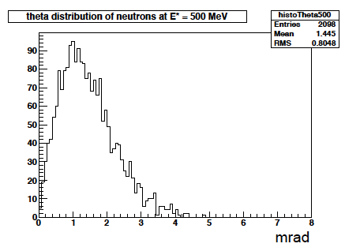
Kinematics of Breakup Neutrons
Results from GEMINI++ for 50 GeV Au
Results:
With an aperture of ±3 mrad we are in relative good shape
• enough “detection” power for t > 0.025 GeV²
• below t ~ 0.02 GeV² we have to look into photon detection
‣ Is it needed?
Question:
For some physics rejection power for incoherent is needed ~10⁴
→ How efficient can the ZDCs be made?
by Thomas Ullrich
+/-5mrad acceptance seems sufficient

Slide 39
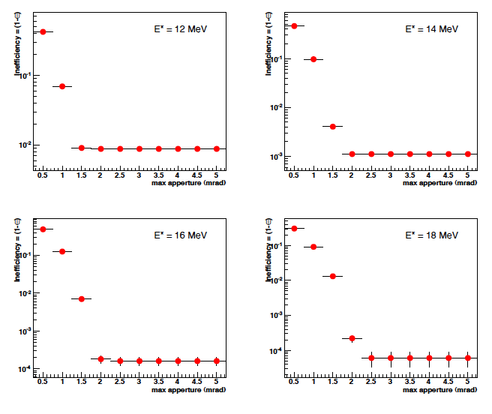
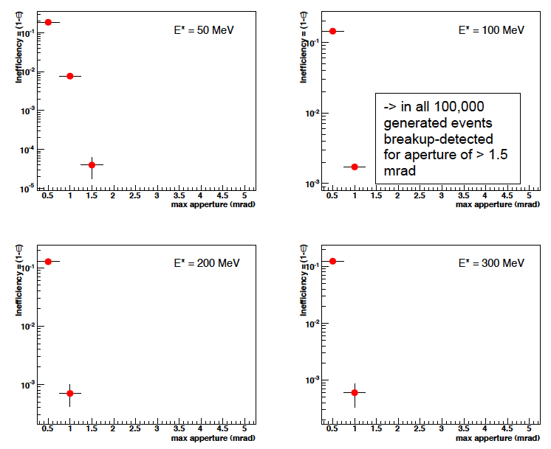
Detection efficiency of Breakup Neutrons
Results:
With an aperture of ±3 mrad we are in relative good
shape even for 50 GeV Au beams
• enough “detection” power for t > 0.025 GeV²
• below t ~ 0.02 GeV² we have to look into photon detection
‣ Is it needed?
Assumptions:
• Gemini++ is correct, was verified by SMM
• E* ~ -t/2mN
• Can we make a ZDC 100% (>99.9999%) efficient
‣ do we understand neutron detection on the 10⁻⁴ level?

Slide 40
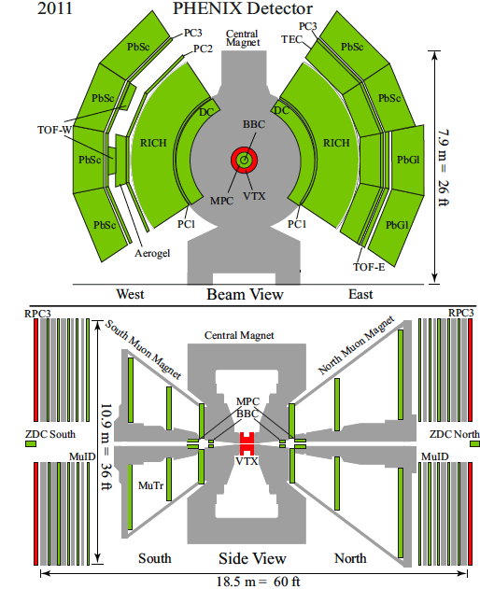
What can PHENIX and STAR do?
MPC 3.1 < | η | < 3.9
2.5º < Θ < 5.2º
Muon Arms 1.2 < | η | < 2.4
South: 12º < Θ < 37º
North: 10º < Θ < 37º
Central Arms | η | < 0.35
60º < Θ < 110º
scattered lepton can only be
detected at mid-rapidity
| η | < 0.35 very high Q²
no acceptance for TMD/GPD
physics
small acceptance for semi-inclusive
physics
PHENIX:
in its current incarnation it is not suited
for eRHIC physics
p/A
e-

Slide 41
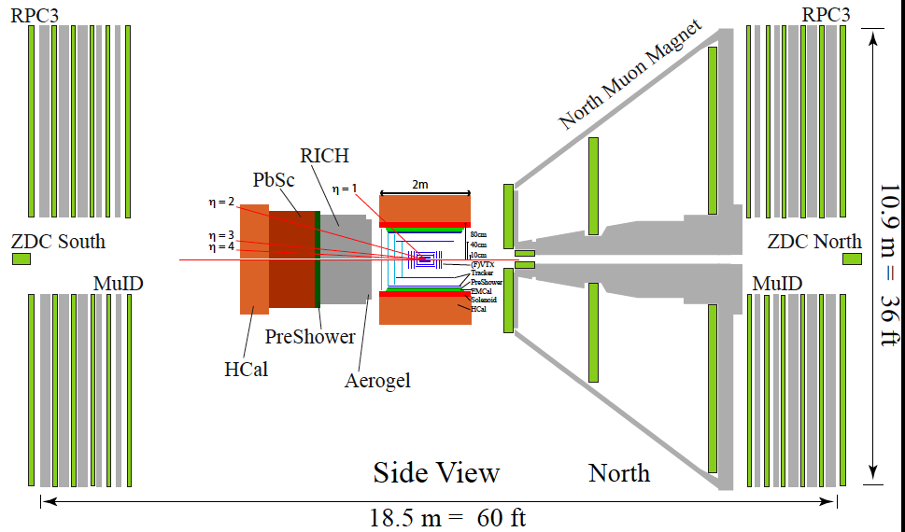
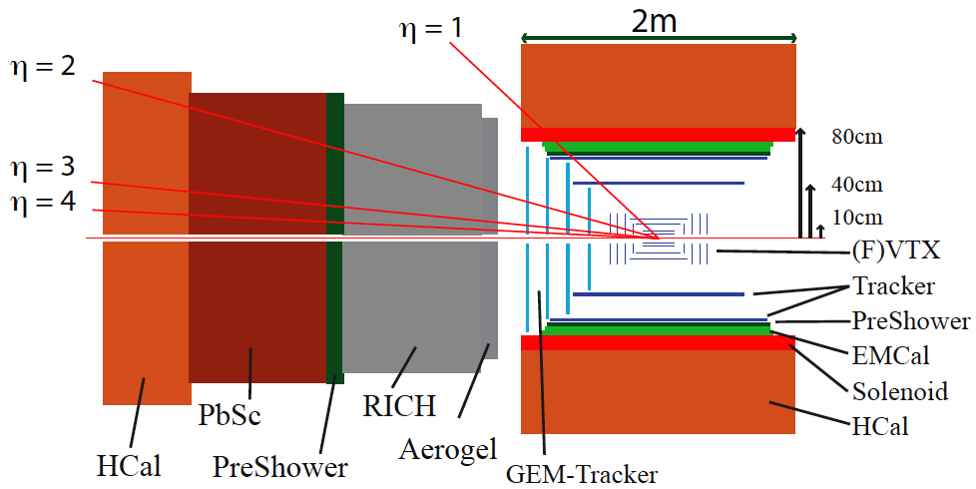
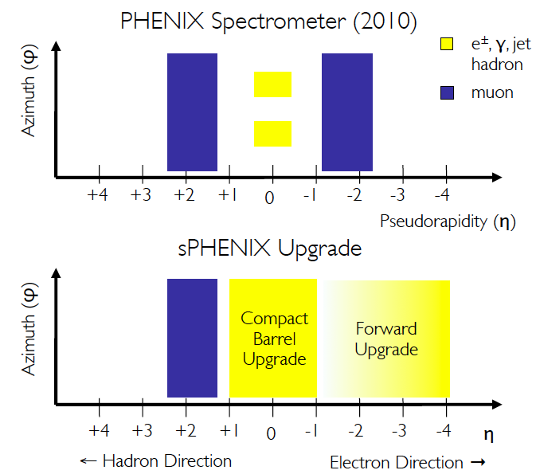
The New PheniX Spectrometer
Design completely driven by AA, dA and pp physics program
p/A
e-
What can be done:
inclusive physics → reasonable coverage for scattered lepton
  but need to close the gap between 1<η<2
  high mass tracking → Q² – x resolution
semi-inclusive physics
  no PID in central detector and hadron beam direction
  will loose significant part of the physics program
exclusive physics program
  limited acceptance for coherent physics
    but need to add roman pots
  design is not suited for rapidity gap events
Design not compatible with most of the eRHIC physics program

Slide 42
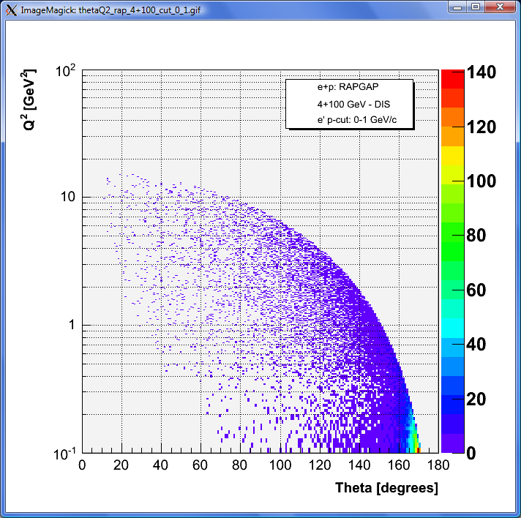
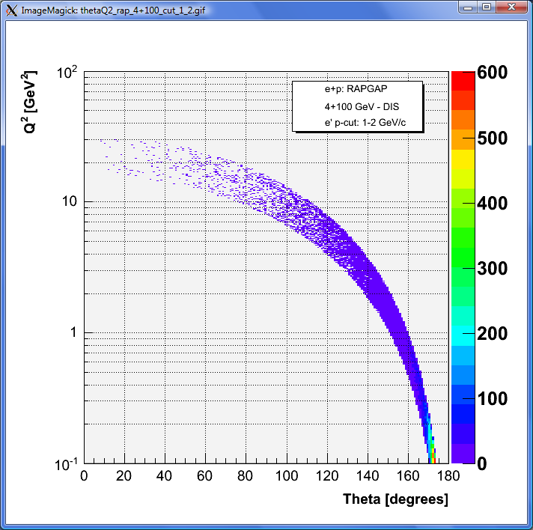
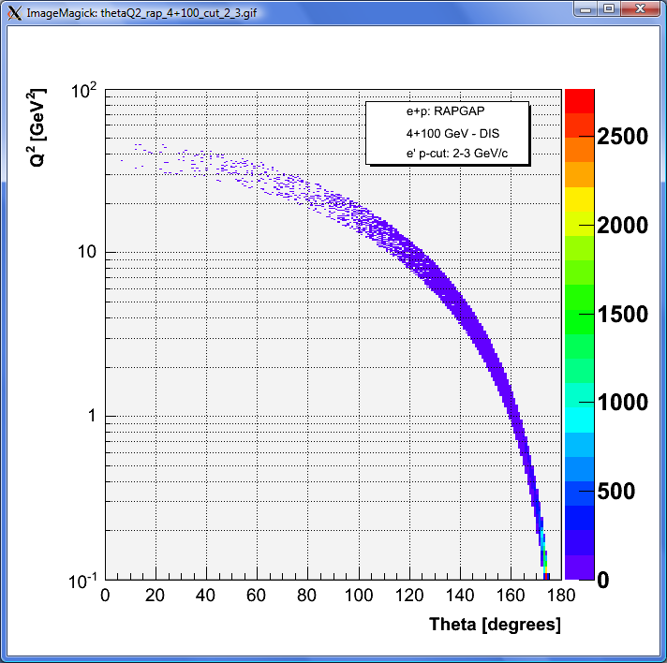
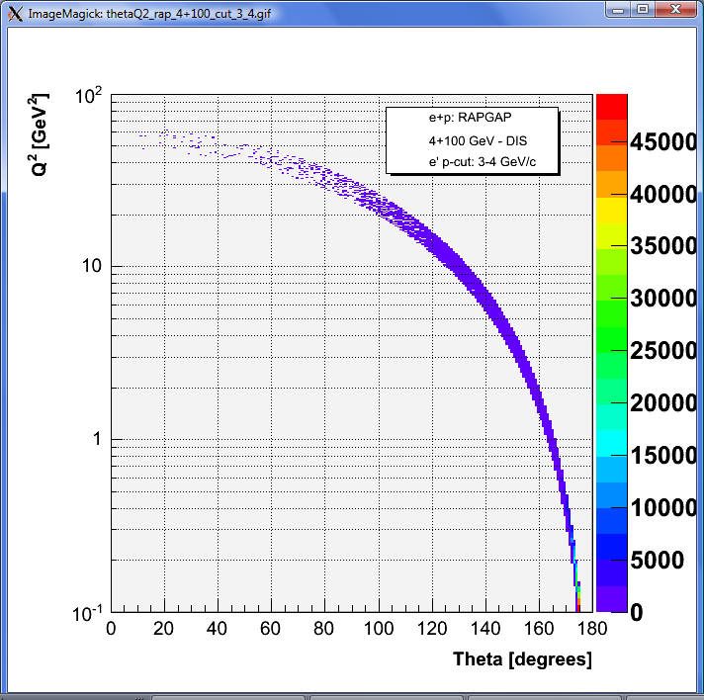
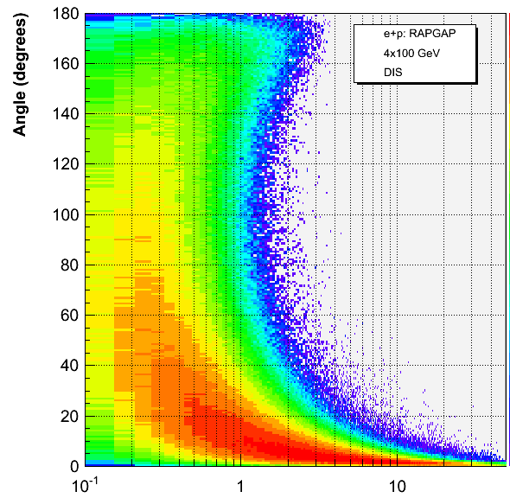
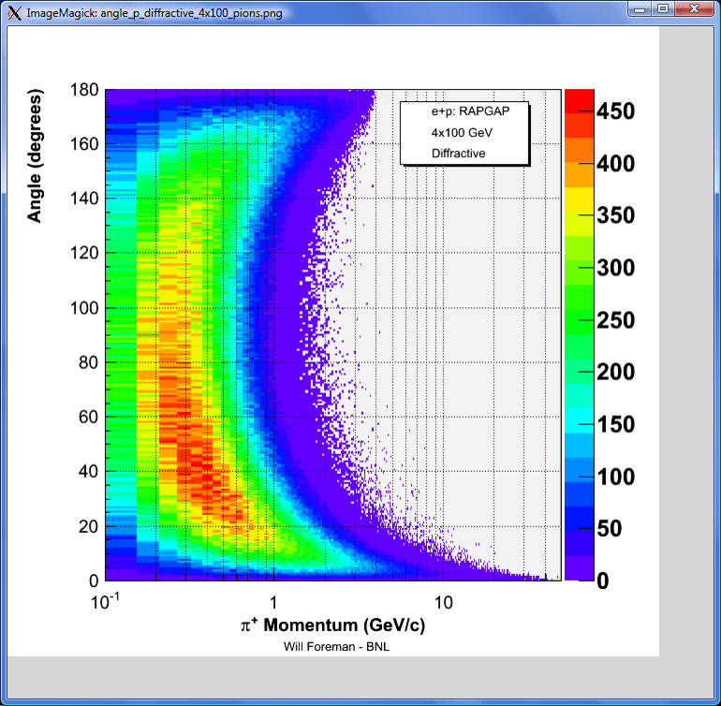
What will the current PheniX see
p_{e}: 0-1 GeV
p_{e}: 1-2 GeV
p_{e}: 2-3 GeV
p_{e}: 3-4 GeV
4x100
Current PheniX detector
not really useable for
DIS
acceptance not matched to DIS kinematics
4x100
4x100

Slide 43
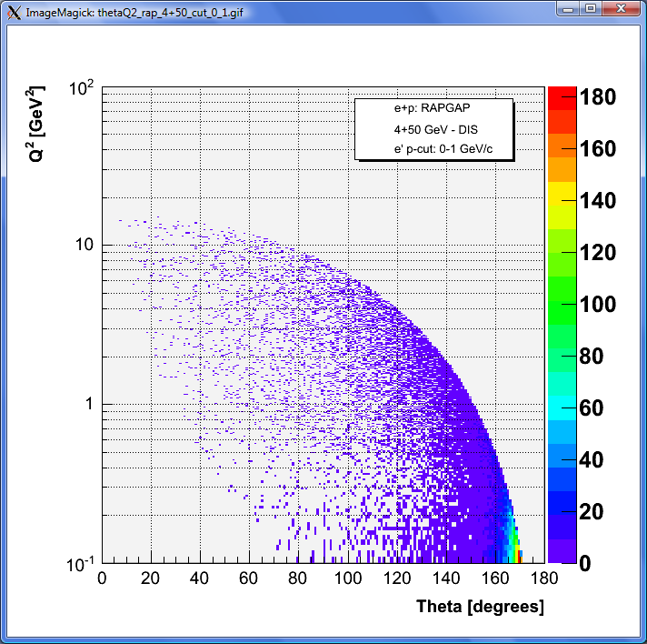





What can we detect
p_{e}: 0-1 GeV
p_{e}: 1-2 GeV
p_{e}: 2-3 GeV
p_{e}: 3-4 GeV
No dependence on hadron beam energy
Q²>0.1GeV²
4GeV → >5º
10GeV → >2º
20GeV → >1º
New PheniX has close to full coverage for scattered lepton
4x50
Forward upgrade
identified hadrons
5 GeVx50GeV
4x100
20 GeV x 250 GeV
central arm
unidentified
North μ arm
only muons

Slide 44

STAR Experiment as of 2014
MRPC ToF Barrel
MTD
EMC Barrel
EMC End Cap
FMS
BBC
FPD
TPC
Roman Pots
Phase 2
computing
DAQ1000
COMPLETE
Trigger and DAQ
Upgrades
FGT
HFT
Ongoing
R&D

Slide 45




eRHIC phase 1: kinematic range
5 GeV e + 50 GeV/nucleon
5 GeV e + 325 GeV/nucleon
Inclusive physics
  “Forward” (-2.5 <~ η < -1) electron acceptance essential to span deep-inelastic (DIS) regime
semi-inclusive physics
  need to investigate how well PID coverage is matched to SIDIS kinematics
  Both backward and forward hadron coverage valuable for SIDIS
exclusive physics program
  Need forward proton and expanded photon detection (→DVCS)
    Roman pots (also valuable for spectator proton tagging in e+³He)
  EM calorimetry for -4 < η < -1
  rapidity gap event acceptance needs to be checked
DIS region
TPC+
BEMC+TOF
Missing today
EEMC+FGT
SIDIS region
Missing today
Missing today

Slide 46

Evolving from STAR into eSTAR
proton
nucleus/electron
Lepton Beam Direction:
ToF: π, K identification, t₀, electron
ECal: electrons and photons
GCT:
a compact tracker with enhanced electron capability
Combine high-threshold (gas) Cherenkov with TPC(-like) tracking
Hadron Beam Direction:
optimized for p+A and transverse spin physics
  Charged-particle tracking
  e/h and γ/π⁰ discrimination
  Baryon/meson separation
What is the momentum resolution at forward rapidity (B=0.5T too low?)
~ 6 GEM disks
Tracking: 2.5 < η < 4
FMS
FHC
ToF
ECal
TPC i.s.
GCT
W powder HCal
TPC i.s.
Preshower
1/2” Pb radiator
Shower “max”
RICH
Baryon/meson separation
Design closer to eRHIC physics program needs
But: need to simulate golden measurements to understand the details
EIC Generic Detector R&D Panel:
GCT: LOI toward multi-institution R&D effort
HCal: R&D proposal

Slide 47
Processes used to study the Physics
exclusive /diffractive
reactions
ep/A → e’p’/A’VM
semi-inclusive
reactions
ep/A→ e’πX
inclusive
reactions
ep/A → e’X
electro-weak
reactions
Close to 4π
acceptance
Excellent
electron
identification
Background
suppression
good jet
identification
PID:
to identify
Hadrons
Detect
outgoing
scattered
proton
excellent
absolute
and/or
relative
luminosity
Detect
very low Q²
electron
very precise
polarization
measurement
high demands on
momentum and/or
energy resolution
good vertex
resolution

Slide 48

Design Nikolai Smirnov, CDF (BaBar) magnet
Magnet, R=1.5 m,
dZ=2.4 m
B-field = 1.4 T
4 layers of Si-vertex
detector
“small “, low diffusion,
fast TPC (~ 25 pad rows)
With “HBD performance”
Aerogel Ch. D.
EMCAL
HCAL + Muon Detector
2 layers of MicroPattern Gas Det R position = 64, 100 cm

Slide 49
Design Nikolai Smirnov, CDF (BaBar) magnet II
Magnet, R=1.5 m,
dZ=2.4 m
B-field = 1.4 T
4 layers of Si-vertex detector
“small” low diffusion,
fast TPC
(~ 25 pad rows)
“HBD”; CF4 Ch. D.
Aerogel Ch. D.
EMCAL
HCAL + Muon Detector
2 layers of MicroPattern Gas Det R position = 64, 100 cm

Slide 50
Magnetic Field: Super simple resolution estimates
Multiple scattering contribution:
Intrinsic contribution (first term):
z = charge of particle
L = total track length through detector (m)
γ= angle of incidence w.r.t. normal of detector plane
n_{r.l.} = number of radiation lengths in detector
msc
B=central field (T)
σ_{rφ}=position resolution (m)
L’=length of transverse path through field (m)
N=number of measurements
intr
Assumptions:
  circular detectors around interaction point
  n_{r.l.} = 0.03 (from Hall D CDC)

Slide 51


“Easier” Solenoid Field – 2T vs. 4T?
p = 50 GeV
p = 5 GeV
B=2T
B=4T
Intrinsic contribution ~ 1/B
Multiple scattering contribution ~ 1/B

Slide 52


Multiple scattering contribution
p = 50 GeV
p = 5 GeV
Multiple scattering contribution dominant at small angles (due to B_{T} term in denominator) and small momenta

Slide 53


δp/p angular dependence
p = 50 GeV
p = 5 GeV
Can improve resolution at forward angles by offsetting IP

Slide 54


Solenoid and Dipole field
p = 50 GeV
p = 5 GeV
As expected, substantially improves resolutions at small angles

Slide 55
Magnetic Field Considerations
Solenoid Fields – Overview:
Experiment | Central Field | Length | Inner Diameter
ZEUS | 1.8 T | 2.8 m | 0.86 m
H1 | 1.2T | 5.0 m | 5.8 m
BABAR | 1.5T | 3.46 m | 1.4 m
BELLE | 1.5T | 3.0 m | 1.7 m
GlueX | 2.0T | 3.5 m | 1.85 m
ATLAS | 2.0T | 5.3 m | 2.44 m
CMS | 4.0T | 13.0 m | 5.9 m
PANDA^{(*design)} | 2.0T | 2.75m | 1.62 m
CLAS12^{(*design)} | 5.0T | 1.19 m | 0.96 m
Suggest 4-5m long Solenoid with diameter ~3m and B-Field of ~3T
need dipoles in forward direction for particles
with very small scattering angle

Slide 56
The Physics we want to study
What is the role of gluons and gluon self-interactions in nucleons and nuclei?
  Observables in eA / ep:
    elastic/diffractive events: rapidity gap events, elastic VM production, DVCS
    inclusive events: structure functions F₂^{A}, F_{L}^{A}, F_{2c}^{A}, F_{Lc}^{A}, F₂^{p}, F_{L}^{p},………
What is the internal landscape of the nucleons?
  What is the nature of the spin of the proton?
    Observables in ep
      inclusive & semi-inclusive events: Asymmetries → polarized cross-sections,
      inclusive events: electroweak Asymmetries (γ-Z interference, W^{+/-})
  What is the three-dimensional spatial landscape of nucleons?
    Observables in ep/eA
      semi-inclusive events: single spin asymmetries (TMDs)
      elastic/diffractive events: cross sections, SSA of exclusive VM, PS and DVCS (GPDs)
What governs the transition of quarks and gluons into pions and nucleons?
  Observables in ep / eA
    semi-inclusive events: cross sections, R_{eA}, azimuthal distributions, jets

Slide 57




Most Compelling Physics Questions
most compelling physics questions
spin physics
imaging
what is the polarization of gluons at
small x where they are most abundant
what is the spatial distribution of
quarks and gluons in nucleons/nuclei
what is the flavor decomposition of
the polarized sea depending on x
understand deep aspects of gauge
theories revealed by k_{T} dep. distr’n
determine quark and gluon contributions
to the proton spin at last
possible window to
orbital angular momentum
physics of strong color fields
quantitatively probe the universality of
strong color fields in AA, pA, and eA
understand in detail the transition to the non-linear
regime of strong gluon fields and the physics of saturation
how do hard probes in eA interact with the medium

