Slide 1
Visions for RHIC’s Short- and Long-Term Future
Steve Vigdor
DNP Town Meeting
Oct. 25, 2012
Ongoing and Proposed Upgrades
Science Drivers for RHIC’s 2nd Decade
Rough 10-Year Running Schedule & Timeline Drivers
eRHIC Design & How eRHIC Complements RHIC Science

Slide 2
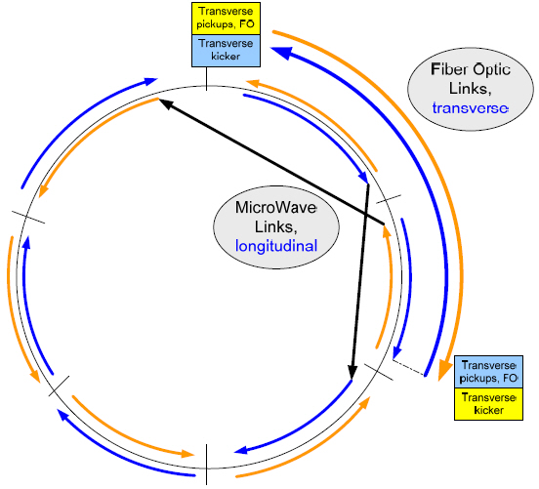
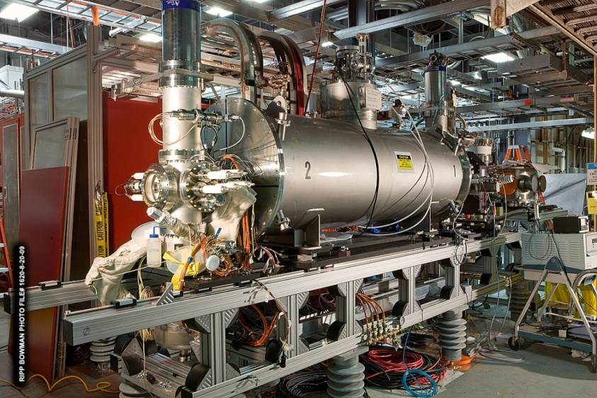
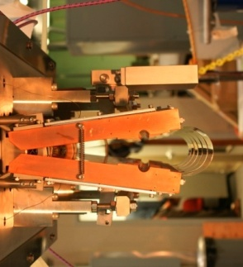
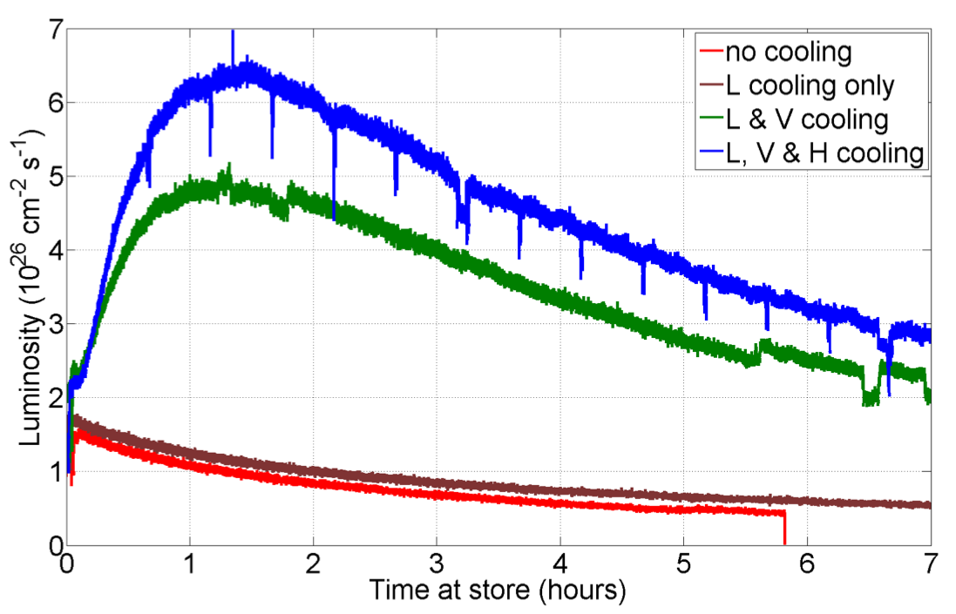
RHIC-II Era is Here, Done Very Cost-Effectively !
Y h+v pickups
B h+v kickers
EBIS
Horiz. Kicker (open)
Measure deviations from central moment-um in pickups, correct with kickers
Y h+v kickers
B h+v pickups
RHIC breakthrough in bunched-beam stochastic cooling ⇒ now ~x18 over original design HI luminosity, 5 years earlier, at ~1/7 the cost in 2007 NP LRP
New Electron Beam Ion Source used in 2012 for new species, e.g., U beams
2012 RHIC U-U run
Install electron lenses for 2013 run to ⇒ ~×2 polarized pp luminosity
Notes:
2

Slide 3
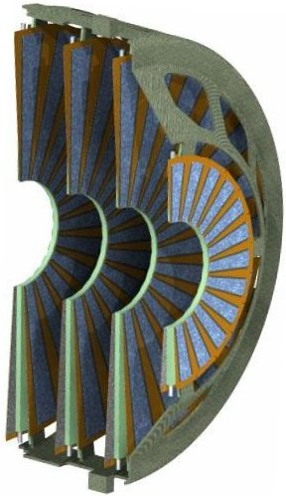
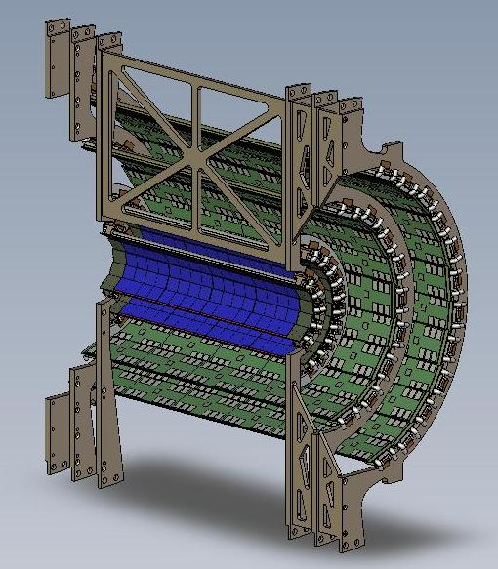
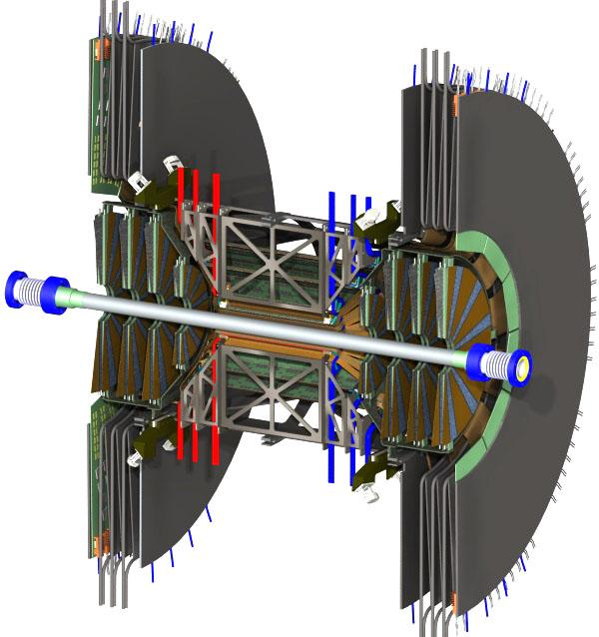
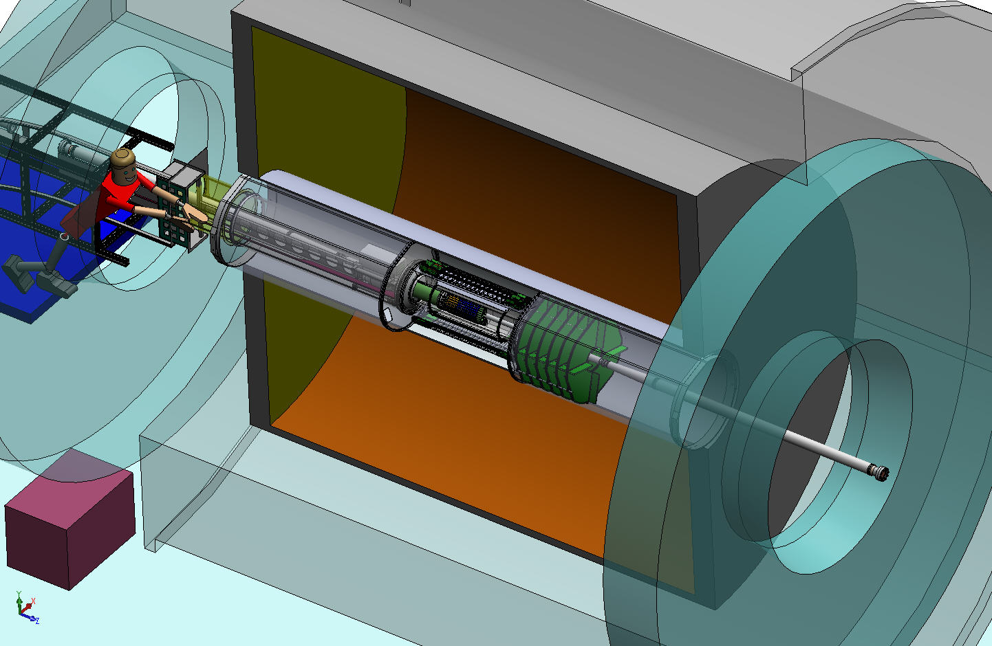
A Suite of Ongoing Detector Upgrades
PHENIX VTX & FVTX upgrades greatly improve vertex resolution, heavy flavor ID
μ trigger upgrade installed in FY10-11 enhances W prod’n triggering for spin program.
FVTX
VTX
Install for Run 12
Install for Run 11
A_{L} for W±
Ready for Run 12
STAR Heavy Flavor Tracker receives CD-2/3 review in 2011. Will permit topological recon-struction of charmed hadrons.
STAR Forward GEM Tracker to be installed for Runs 12 and 13, will enhance forward tracking, W charge sign discrimination.
STAR Muon Telescope Detector (Run 14) to improve quarkonium
SSD
IST
PXL
FGT
HFT
Identify heavy flavor hadron directly
Precision measurement HF hadron energy loss and collectivity
Ready for Run 14
Notes:
3

Slide 4
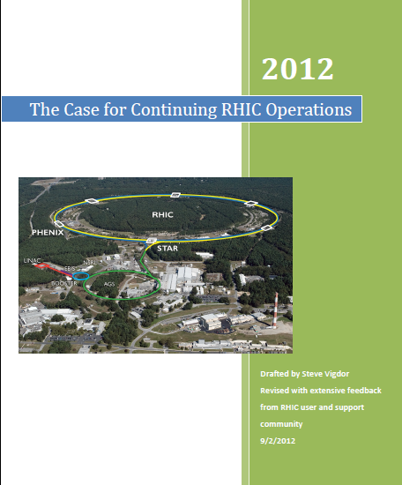

Slide 5
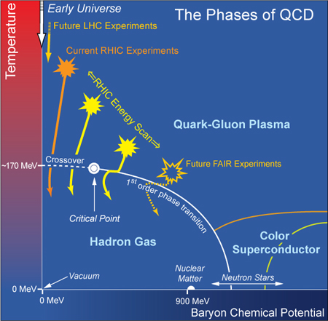
Broad Science Goals for the Next Decade
Quantify properties of the QGP and features of the QCD phase diagram, as functions of temperature and net quark density from the onset of deconfinement toward even earlier universe conditions.
Exploit new discovery potential in searches for a QCD critical point and for the nature and influence of quantum fluctuations in initial densities and the excited QCD vacuum (sphalerons).
LHC Experiments
Continue explorations of the role of soft gluons in cold nuclear matter (gluon saturation, contributions to proton spin).
Full-energy RHIC Experiments
RHIC and LHC are complementary. Both are needed to explore the temperature-dependence of QGP properties (span factor ~1000 in √s). RHIC has unique reach to search for the QGP onset, unique ion species versatility and unique polarized proton capability, until EIC is realized. And QCD matter is RHIC’s primary focus.
~155 MeV
Search for a QCD Critical endpoint via low-energy scan in RHIC-II era

Slide 6
10 Basic Questions Going Into the RHIC Era
Basic questions going into the RHIC era | RHIC/LHC answers to date
Is RHIC’s kinematic reach sufficient to create matter in the anticipated Quark-Gluon Plasma (QGP) phase? | Yes
Is the QGP weakly coupled, with approximately ideal gas (i.e., asymptotic freedom) behavior? | No
Can we experimentally demonstrate the transition from hadronic to quark-gluon degrees of freedom in reaching QGP? | Hints^{a)}
Do partons lose energy rapidly in traversing QGP? | Yes
Does color screening in the QGP suppress the formation of quarkonium (i.e., bound states of same flavor quark-antiquark systems)? | Strong Hints^{a)}
Can we find evidence of high-temperature excited QCD vacuum fluctuations, analogous to the electroweak sphalerons postulated as the source of the universe’s baryon asymmetry? | Hints^{a)}
Is there a locus of first-order phase transitions and a Critical Point in the QCD phase diagram? | Hints^{a)}
Do we see evidence of gluon density saturation in cold nuclear matter at low Bjorken x? | Strong Hints^{a)}
Do gluon spin preferences account for a significant part of the “missing” proton spin? | Yes
Is there a significant flavor-dependence in sea quark polarizations within a polarized proton? | Insufficient data to date
p/d + A
p+p
It is the responsibility of RHIC and LHC to design measurements to address the more quantitative 2nd-generation questions emerging from the definitive answers above, and to resolve the hints surrounding the others.
a) “Hints” implies that significant data have been collected, hinting at a definitive answer. However, questions of interpretation remain, with clear follow-up measurements proposed (and outlined in Sec. 6 of RHIC White Paper) to resolve the ambiguities.

Slide 7
Questions For the Next Decade
Question | Facilities Needed to Answer | Comments | Related Table 1 Question #’s
How perfect is “near-perfect” liquid? | RHIC & LHC (& ⇒ BOTH REQ’D) | Flow power spectra, next 5 years | 1 + 2
Nature of initial density fluctuations? | RHIC, LHC & EIC | Benefits from asymmetric ion collisions at RHIC | 2 + 8
How does strong coupling emerge from asymptotic freedom? | RHIC & LHC | Following 5 years @ RHIC; jets need sPHENIX upgrade | 2 + 4
Evidence for onset of deconfinement and/or critical point? | RHIC; follow-up @ FAIR, NICA | Phase 2 E scan in following 5 years, needs low-E electron cooling | 3 + 7
Sequential melting of quarkonia? | RHIC & LHC | LHC mass resolution a plus; RHIC det. upgrades help; √s-dependence important | 5
Are sphaleron hints in RHIC data real? | Mostly RHIC | Exploits U+U and μ_{B} ≠ 0 reach at RHIC | 6
Saturated gluon densities? | RHIC, LHC & EIC | Want to see onset at RHIC; need EIC to quantify | 8
Where is missing proton spin? | RHIC & EIC | EIC will have dramatic impact | 9 + 10
Addressing these questions requires an ~10-year program of A+A (various ion species), p+p and p/d + A runs at various RHIC energies.

Slide 8
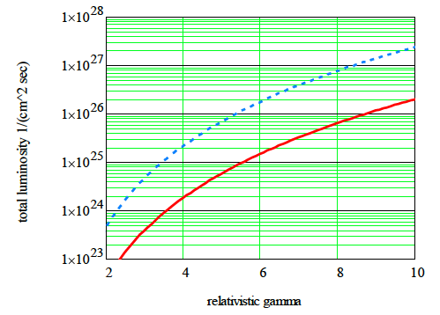
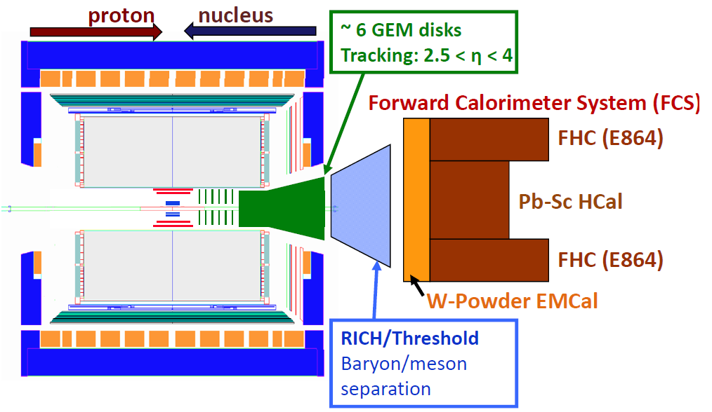
Contemplated Future Upgrades
Low-E electron cooling for further pursuit of onset of deconfinement/CP
sPHENIX solenoid, EMCAL + HCAL for jet physics @ RHIC
STAR forward up-grade for p+A and transverse spin (e.g., DY) physics
PHENIX MPC-EX, STAR TPC pad rows
Will likely use high brightness SRF electron gun for bunched beam electron cooling; up to ~10x L; ready after 2017 [Fermilab Pelletron (cooled 8 GeV pbar for Tevatron use) is alternative option]
RHIC with cooling and long bunches (ΔQsc = 0.05, σs = 3m)
RHIC w/o cooling
Other machine possibilities: pol’d ³He; coherent e-cooling for L_{pp}
BNL review Oct. 5-6, 2012

Slide 9
Timeline for RHIC’s Next Decade
Years | Beam Species and Energies | Science Goals | New Systems Commissioned
2013 | 500 GeV $\vec{p}+ \vec{p}$ 15 GeV Au+Au | Sea antiquark and gluon polarization QCD critical point search | Electron lenses upgraded pol’d source STAR HFT
2014 | 200 GeV Au+Au and baseline data via 200 GeV p+p (needed for new det. subsystems) | Heavy flavor flow, energy loss, thermalization, etc. quarkonium studies | 56 MHz SRF full HFT STAR Muon Telescope Detector PHENIX Muon Piston Calorimeter Extension (MPC-EX)
2015-2017 | High stat. Au+Au at 200 and ~40 GeV U+U/Cu+Au at 1-2 energies 200 GeV p+A 500 GeV $\vec{p}+ \vec{p}$ | Extract η/s(T_{min}) + constrain initial quantum fluctuations further heavy flavor studies sphaleron tests @ μ_{B}≠0 gluon densities & saturation finish p+p W prod’n | Coherent Electron Cooling (CeC) test Low-energy electron cooling STAR inner TPC pad row upgrade
2018-2021 | 5-20 GeV Au+Au (E scan phase 2) long 200 GeV + 1-2 lower √s Au+Au w/ upgraded dets. baseline data @ 200 GeV and lower √s 500 GeV $\vec{p}+ \vec{p}$ 200 GeV $\vec{p}+ A$ | x10 sens. increase to QCD critical point and deconfinement onset jet, di-jet, γ-jet quenching probes of E-loss mechanism color screening for different qq states transverse spin asyms. Drell-Yan & gluon saturation | sPHENIX forward physics upgrades

Slide 10
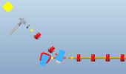
Schedule Drivers: Technically Driven Project Timelines, Plus Running Period Lengths for Desired Uncertainties
E.g., low-energy electron cooling can be implemented in 2 phases:
Phase I (available for use in 2017) √s_{NN} = 5-9 GeV (e-beam energy 0.9-2 MeV)
Phase II (2018+) [additional 3 MeV booster cavity] √s_{NN} = 9-20 GeV (e-beam energy 2-5 MeV)
10 m
cooling section
electron
u-turn,
delay line
Beam dump
10 m cooling section
3 MeV booster
cavity needed for
2nd stage.
energy
correction
cavity
gun
Schematic of electron cooler in warm sector 3 based on CeC proof-of-principle layout, and using technology and/or components from R&D ERL + CeC PoP

Slide 11
Timelines for Possible Projects
Low-energy cooling Accelerator Improvement Project:
Requires start of the project (engineering phase) at the end of 2012 with high priorities and resources from C-AD.
2012 – feasibility study
2013-2014 – engineering design, drawings, purchase orders, and manufacturing for gun, magnets, power supplies, RF, etc.
2014-2015 – installation
2016 – commissioning of electron beam and transport; start cooling of ion beam – first 3-D electron cooling in a collider, expect some learning curve and optimization before luminosity improvement.
2017 – luminosity improvement in physics – Phase I
2018+ – luminosity improvements in physics – Phase II
Aggressive Critical Decision timeline for sPHENIX upgrade:
CD0 2QFY2013 allows R&D funds to be expended and PED funds to be requested (these are part of TPC)
CD1 1QFY2014 PED funds can be expended
CD 2/3 1QFY2015 A year of design brings the project to a CD2 review; CD3 approval allows procurement to begin on long lead time items like the solenoid
CD4 4QFY2018 3.5 years of construction (2Q2015-4QFY2018)
4QFY2019 Commissioning complete

Slide 12
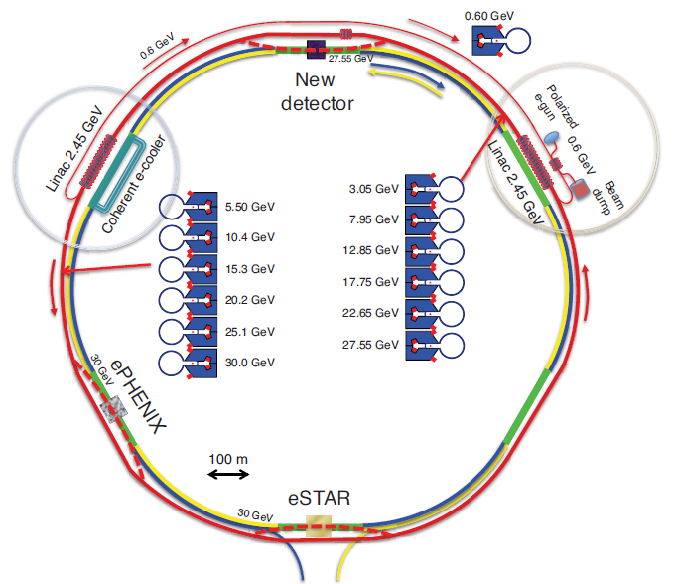
RHIC’s 3rd Decade: Reinvention as eRHIC ⇒ Path Forward for Cold QCD Matter
Why eRHIC is a cost-effective approach:
Reuses RHIC tunnel & detector halls ⇒ minimal civil construct’n
Reuses significant fractions of STAR & PHENIX detectors
Exploits existing HI beams for precocious access to very high gluon density regime
Polarized p beam and HI beam capabilities already exist – saves ~$2B RHIC replacement cost
Provides straightforward upgrade path by adding SRF linac cavities
eRHIC @ BNL: add e⁻ ERL in RHIC tunnel ⇒ L_{ep} ~ 10³⁴ cm⁻²s⁻¹
Takes advantage of RHIC needs and other accelerator R&D @ BNL:
E.g., coherent electron cooling can also enhance RHIC pp lumi.
E.g., FFAG developments for muon collider considered for significant cost reductions
Design allows easy staging (start w/ 5-10 GeV, upgrade to ~20 GeV e⁻). Underwent successful technical design review in 2011. Bottom-up cost eval. + value engineering in progress.

Slide 13
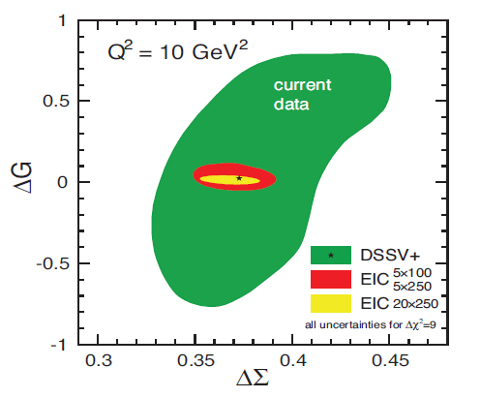
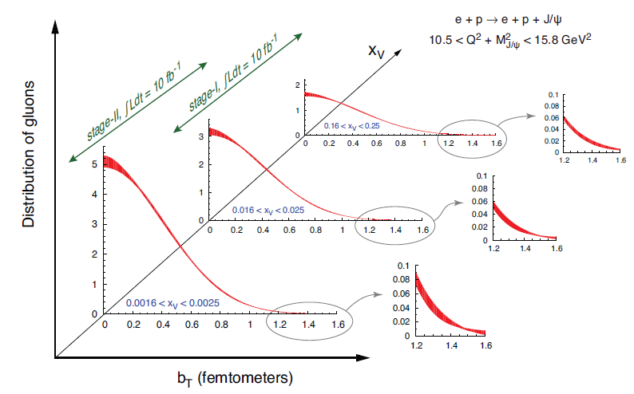
How eRHIC Complements RHIC: Spin & Imaging
e+p DIS @ √ s > 50 GeV ⇒ access to softer gluons, much tighter constraints on total gluon and quark contributions to p spin
Charged-current DIS ⇒ new electroweak structure functions that further constrain flavor-dependence of sea quark polariz’ns
Semi-inclusive DIS and deep exclusive reactions take us from 1D (vs. x_{Bj}) to 3D (add transverse space or momentum dim’ns) imaging of nucleon
E.g., exclusive J/ψ prod’n ⇒ unprecedented info on transverse spatial distrib’n of gluons as fcn. of x

Slide 14
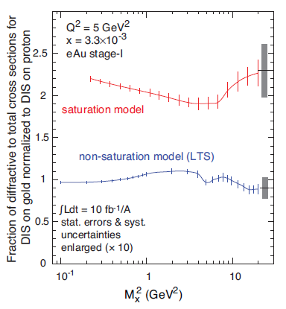
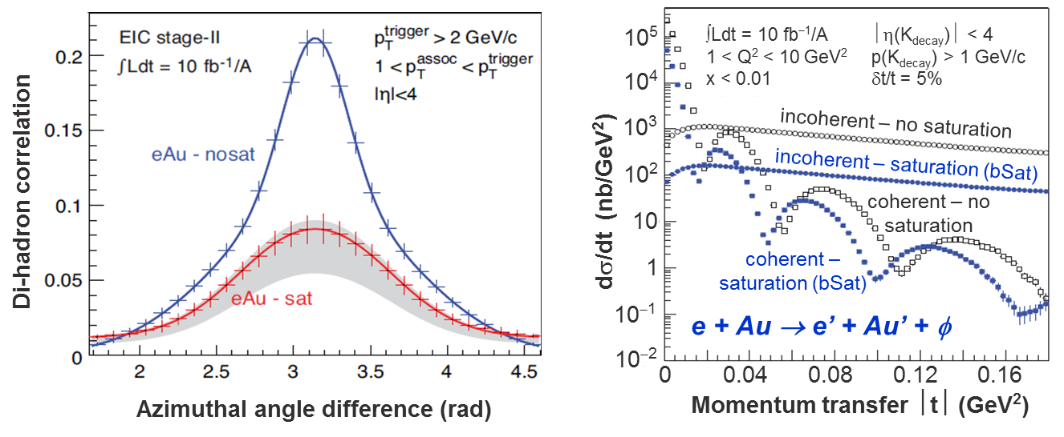
How eRHIC Complements RHIC: Initial State
Coherent contrib’ns from many nucleons in heavy nucleus ⇒ precocious access to saturation regime
e+A DIS measures low-x gluon density far more precisely than they are known
Inclusive diffractive cross sections greatly enhanced by saturation
Exclusive diffractive prod’n of vector mesons of size > 1/Q_{sat} ⇒ “gluonic form factor” of nuclei
Di-jet and di-hadron coinc. yields suppressed in e+A

Slide 15
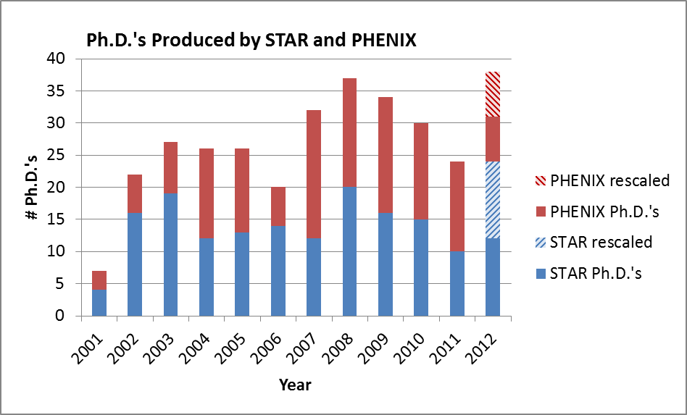
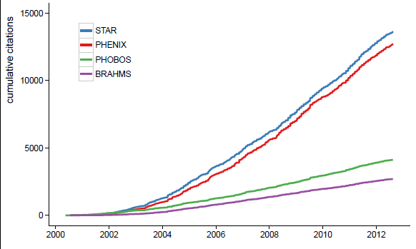
RHIC’s Most Important Products: Productivity, Impact, Education
Collaboration | Total # Refereed Papers | Total # Citations for Refereed Papers | # PRL’s | # Citations for 2005 White Paper | Position of 2005 White Paper Among Most Cited NP Papers 2001-12 | # Papers with >250 Citations
PHENIX | 126 | 13,292 | 57 | 1358 | 5 | 12
STAR | 160 | 14,434 | 54 | 1382 | 4 | 15
PHOBOS^{a)} | 39 | 4057 | 15 | 1049 | 7 | 1
BRAHMS^{b)} | 22 | 2649 | 10 | 1040 | 8 | 3
Total = | 347 | 34,432 | 136 | 4829 |  | 31
Also, >40% of all-time top-cited Nuclear Theory arXiv papers are RHIC-related!
No rate falloff in sight!
Cumulative Citations of RHIC Exp’ts
Plus >150 tenured faculty positions worldwide + 5 cover story articles +…

Slide 16
Summary
RHIC’s first 12 years have been marked by:
Important discoveries in QCD matter
High productivity
High scientific impact ⇒ increased visibility for U.S. NP
Great technical versatility and breakthroughs
Cost-effective upgrades to facility performance & versatility
RHIC’s next decade is required to:
Quantify transport properties of the Quark-Gluon Plasma
Pursue discovery potential unveiled by results to date
Combine with LHC heavy ion program to span suitably wide initial temperature range to accomplish the above
Reap science payoff from just completed and ongoing RHIC facility upgrades
Pursue the unique accelerator science and spin physics opportunities that come with only operating U.S. collider and only worldwide polarized collider
Provide a cost-realizable path to an Electron Ion Collider

Slide 17
Backup Slides

