Slide 1
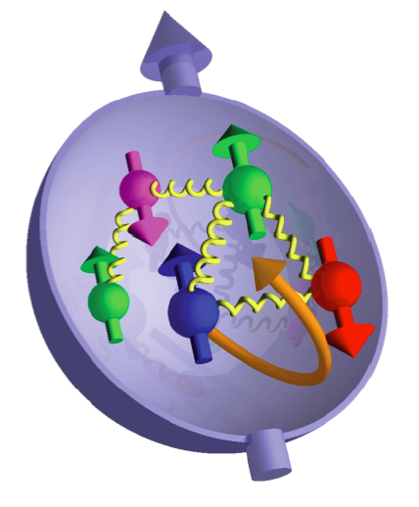
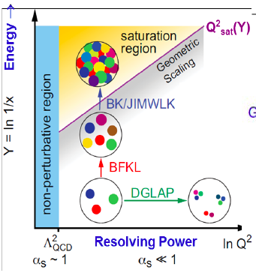
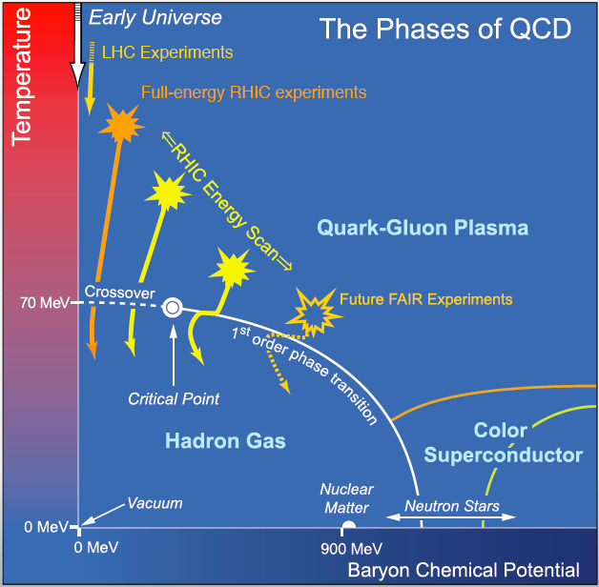
the RHIC Physics Program
A versitile facility making it possible to study many aspects of the strong force:
condensed QCD matter and its phase structure
transitions between degenerate vacuum states
gluon saturation
proton spin
“It’s time to stop testing QCD and start understanding it” Dokshitzer

Slide 2
Selected Scientific Highlights from RHIC
A QGP is created in RHIC A+A collisions at temperatures several times T_{C} (the hottest man-made temperature ever measured)
This hot dense QCD matter
-equilibrates in less than 1 fm/c
-is opaque to fast moving partons
-suppresses heavy quarks nearly as much as light quarks
-has a viscosity near a lower bound established from string theory (perfect liquid)
-propogates quantum fluctuations from the initial state through the perfect liquid phase into the final state
-melts quarkonium states
Collisions at RHIC created the Heaviest antimatter nucleus ever measured and the first anti-hypernucleon ever measured
Hadrons and di-hadrons are suppressed in the low-x coherent regime: providing indications of gluon recombination (A Color Glass Condensate)
The gluon contribution to the proton spin has been measured (RHIC is the worlds only polarized proton collider)

Slide 3
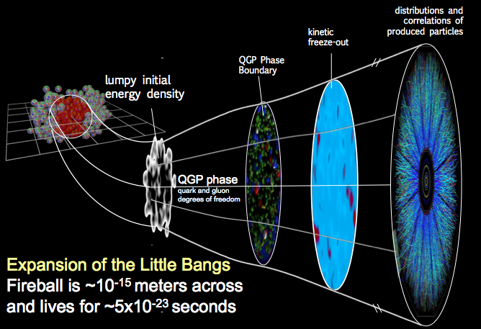
A Standard Model
Experimental and theoretical advances have brought us a a detailed picture of the evolution of heavy ion collisions:
Comparisons to models now leading to ever increasing accuracy in quantities like the transport properties of the quark gluon plasma

Slide 4
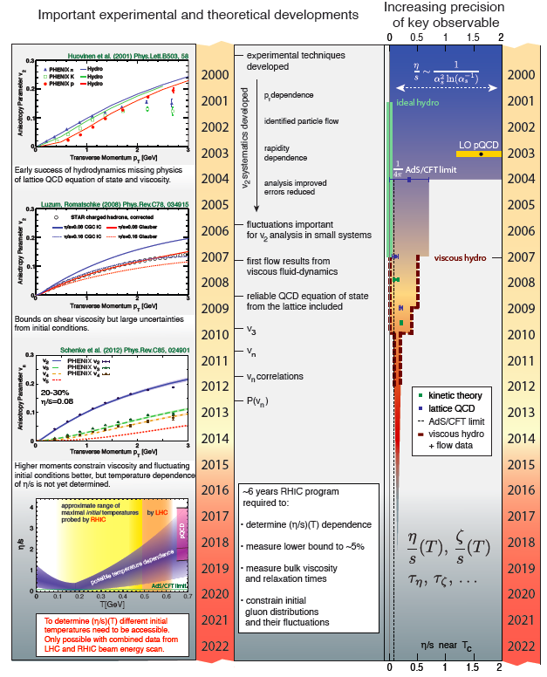
Motivations for the Next Decade
Quantify properties of the QGP and features of the QCD phase diagram, as functions of temperature and net quark density from the onset of deconfinement toward even earlier universe conditions.
Exploit new discovery potential in searches for a QCD critical point and for the nature and influence of quantum fluctuations in initial densities and the excited QCD vacuum (sphalerons).
Continue explorations of the role of soft gluons in cold nuclear matter (gluon saturation, contributions to proton spin)
RHIC and LHC are complementary. Both are needed to explore the temperature-dependence of QGP properties (span factor ~1000 in √s). RHIC has unique reach to search for the QGP onset, unique ion species versatility and unique polarized proton capability, until EIC is realized. And QCD matter is RHIC’s primary focus.
I’m not sure about including these plots: it’s a lot of information to try to convey

Slide 5
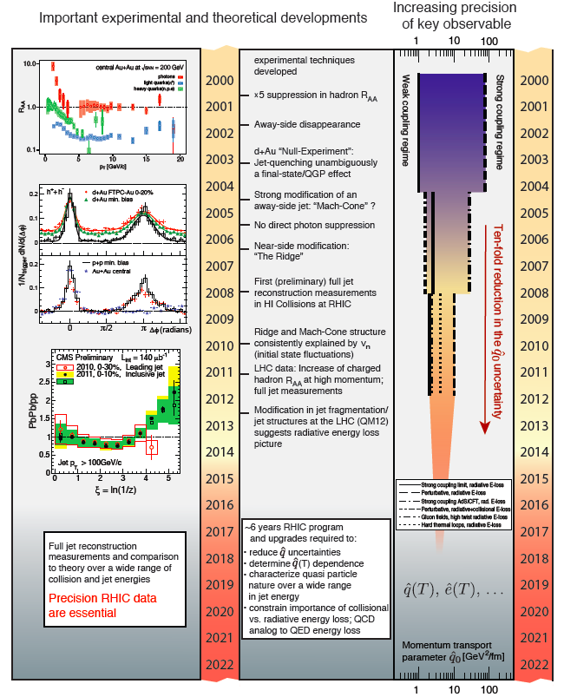
Motivations for the Next Decade
Quantify properties of the QGP and features of the QCD phase diagram, as functions of temperature and net quark density from the onset of deconfinement toward even earlier universe conditions.
Exploit new discovery potential in searches for a QCD critical point and for the nature and influence of quantum fluctuations in initial densities and the excited QCD vacuum (sphalerons).
Continue explorations of the role of soft gluons in cold nuclear matter (gluon saturation, contributions to proton spin)
RHIC and LHC are complementary. Both are needed to explore the temperature-dependence of QGP properties (span factor ~1000 in √s). RHIC has unique reach to search for the QGP onset, unique ion species versatility and unique polarized proton capability, until EIC is realized. And QCD matter is RHIC’s primary focus.
I’m not sure about including these plots: it’s a lot of information to try to convey

Slide 6
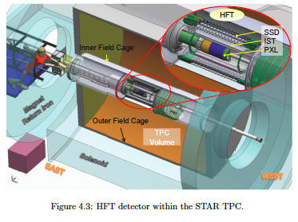
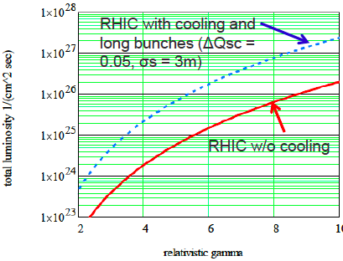
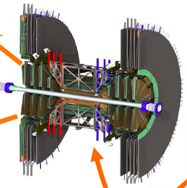
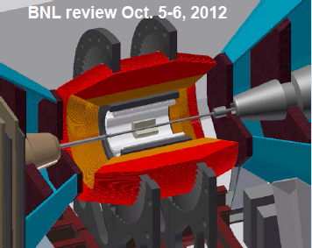
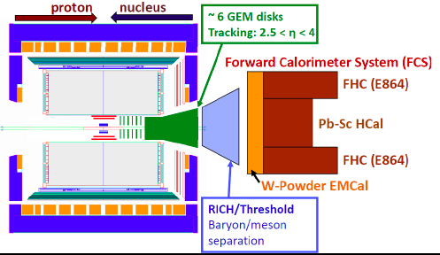
Upgrade Program
Forward GEM Tracker (2013) _{in process}
Spin physics with W’s: flavor dependence of sea quark polarization
Heavy Flavor Tracker (2014) _{in process}
Measurement of open heavy flavor hadrons for heavy quark interactions in the QGP: QGP transport properties
Muon Telescope Detector (2014) _{in process}
Muon trigger for Quarkonium: screening lengths in the QGP
Inner TPC Upgrade (2017) ~$3-4M
Expands coverage to higher rapidity and lower p_{T}
essential for studying glue (eRHIC) and major enhancement of all of STAR’s future physics programs: long range correlations
Forward Upgrades (2017 onward) ~$10-20M
Very Forward Gem Tracker, Forward Calorimetry System: studying the gluon dynamics of saturation; leading up to eRHIC
To Do: Add PHENIX upgrades to the list

Slide 7
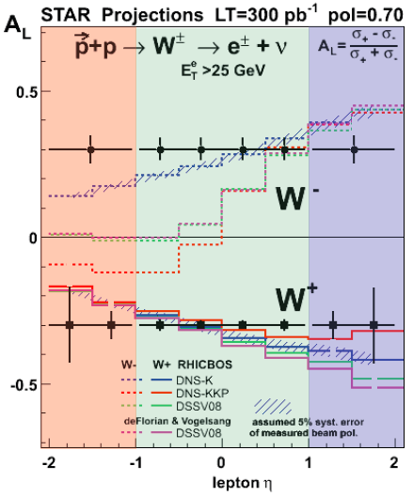
2013 | 2014 | 2015 | 2016 | 2017 | 2018 | 2019 | 2020 | 2021 | 2022
Full Heavy Flavor Tracker
Earliest Possible e-cooling
eRHIC
Muon Telescope Detector
STAR Inner TPC Upgrade
Muon Piston Cal. Ext.
STAR/PHENIX Forward Detectors
sPHENIX
Figure on what we expect from 500 GeV p+p running: Hopefully this will come in Carl’s talk
polarization of the u, ubar, d, and dbar quarks in the proton
500 GeV p+p 15 GeV A+A | 200 GeV A+A 200 GeV p+p | Au+Au, U+U, Cu+Au at 1-2 energies 200 GeV p+A, 500 GeV p+p | BESII 5-20 GeV Au+Au; 200 and 100 GeV Au+Au; 500 GeV p+p; 200 GeV polarized p+A

Slide 8
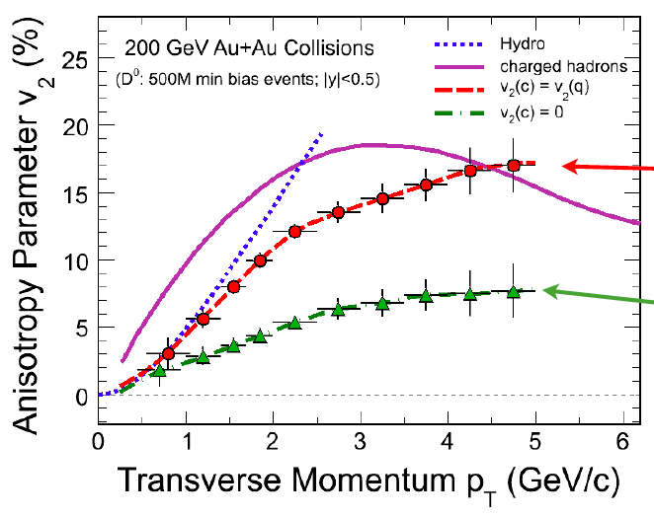
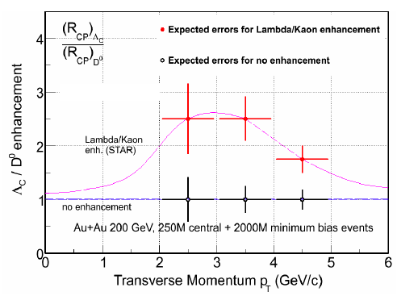
2013 | 2014 | 2015 | 2016 | 2017 | 2018 | 2019 | 2020 | 2021 | 2022
Full Heavy Flavor Tracker
Earliest Possible e-cooling
eRHIC
Muon Telescope Detector
STAR Inner TPC Upgrade
Muon Piston Cal. Ext.
STAR/PHENIX Forward Detectors
sPHENIX
500 GeV p+p 15 GeV A+A | 200 GeV A+A 200 GeV p+p | Au+Au, U+U, Cu+Au at 1-2 energies 200 GeV p+A, 500 GeV p+p | BESII 5-20 GeV Au+Au; 200 and 100 GeV Au+Au; 500 GeV p+p; 200 GeV polarized p+A

Slide 9
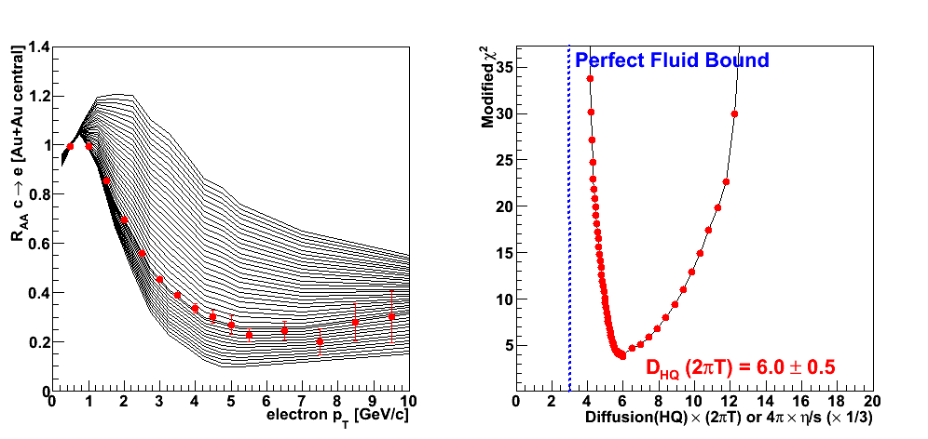
2013 | 2014 | 2015 | 2016 | 2017 | 2018 | 2019 | 2020 | 2021 | 2022
Full Heavy Flavor Tracker
Earliest Possible e-cooling
eRHIC
Muon Telescope Detector
STAR Inner TPC Upgrade
Muon Piston Cal. Ext.
STAR/PHENIX Forward Detectors
sPHENIX
500 GeV p+p 15 GeV A+A | 200 GeV A+A 200 GeV p+p | Au+Au, U+U, Cu+Au at 1-2 energies 200 GeV p+A, 500 GeV p+p | BESII 5-20 GeV Au+Au; 200 and 100 GeV Au+Au; 500 GeV p+p; 200 GeV polarized p+A

Slide 10
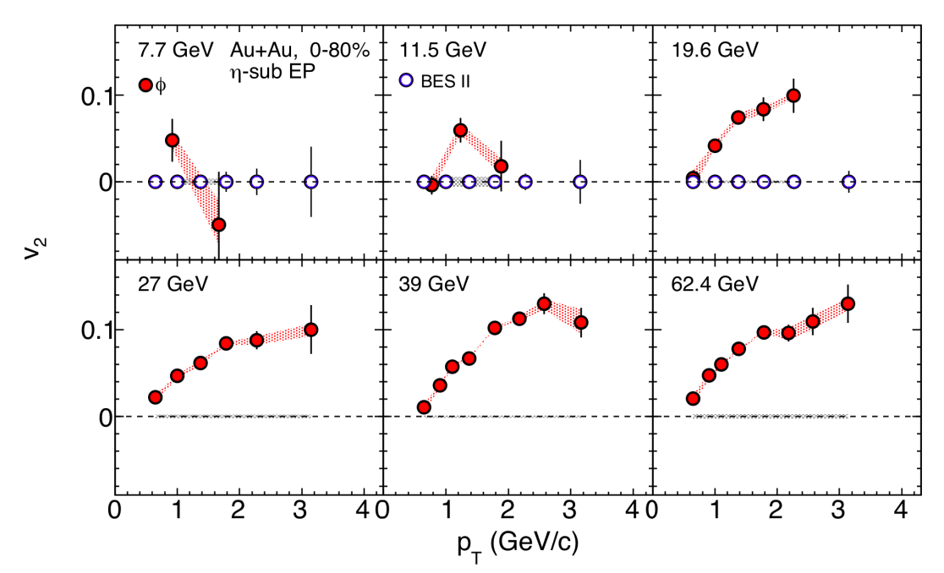
2013 | 2014 | 2015 | 2016 | 2017 | 2018 | 2019 | 2020 | 2021 | 2022
Full Heavy Flavor Tracker
Earliest Possible e-cooling
eRHIC
Muon Telescope Detector
STAR Inner TPC Upgrade
Muon Piston Cal. Ext.
STAR/PHENIX Forward Detectors
sPHENIX
500 GeV p+p 15 GeV A+A | 200 GeV A+A 200 GeV p+p | Au+Au, U+U, Cu+Au at 1-2 energies 200 GeV p+A, 500 GeV p+p | BESII 5-20 GeV Au+Au; 200 and 100 GeV Au+Au; 500 GeV p+p; 200 GeV polarized p+A

Slide 11
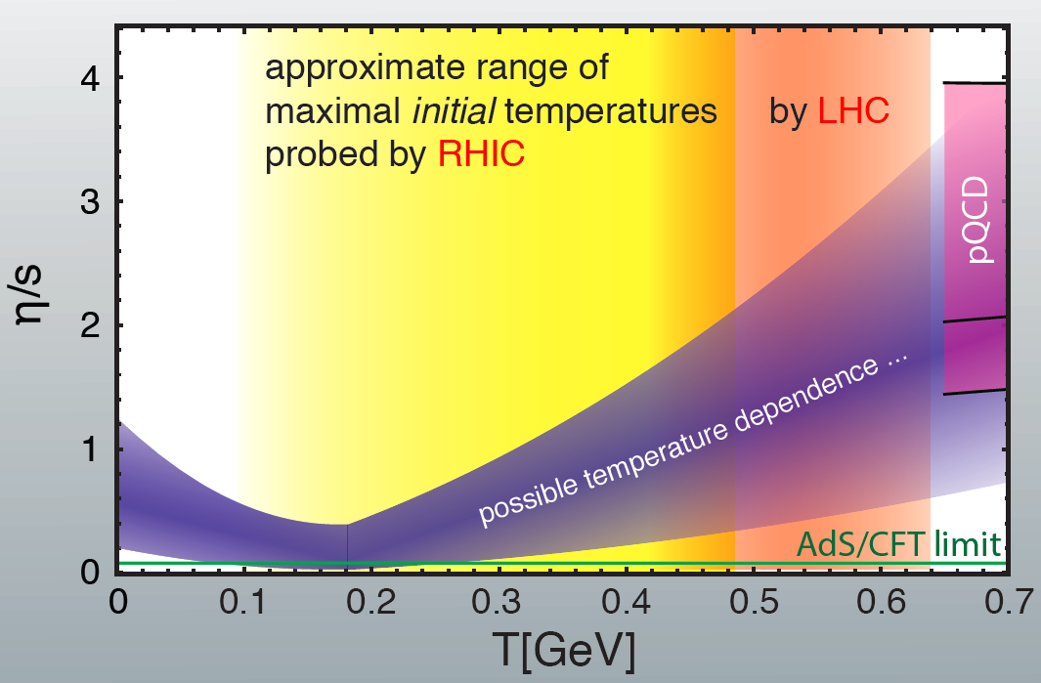
2013 | 2014 | 2015 | 2016 | 2017 | 2018 | 2019 | 2020 | 2021 | 2022
Full Heavy Flavor Tracker
Earliest Possible e-cooling
eRHIC
Muon Telescope Detector
STAR Inner TPC Upgrade
Muon Piston Cal. Ext.
STAR/PHENIX Forward Detectors
sPHENIX
500 GeV p+p 15 GeV A+A | 200 GeV A+A 200 GeV p+p | Au+Au, U+U, Cu+Au at 1-2 energies 200 GeV p+A, 500 GeV p+p | BESII 5-20 GeV Au+Au; 200 and 100 GeV Au+Au; 500 GeV p+p; 200 GeV polarized p+A

Slide 12
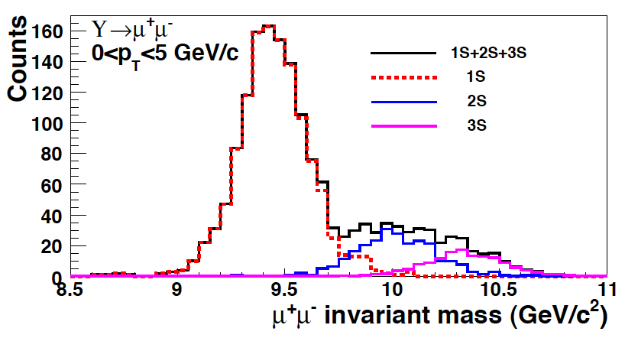
2013 | 2014 | 2015 | 2016 | 2017 | 2018 | 2019 | 2020 | 2021 | 2022
Full Heavy Flavor Tracker
Earliest Possible e-cooling
eRHIC
Muon Telescope Detector
STAR Inner TPC Upgrade
Muon Piston Cal. Ext.
STAR/PHENIX Forward Detectors
sPHENIX
500 GeV p+p 15 GeV A+A | 200 GeV A+A 200 GeV p+p | Au+Au, U+U, Cu+Au at 1-2 energies 200 GeV p+A, 500 GeV p+p | BESII 5-20 GeV Au+Au; 200 and 100 GeV Au+Au; 500 GeV p+p; 200 GeV polarized p+A

Slide 13
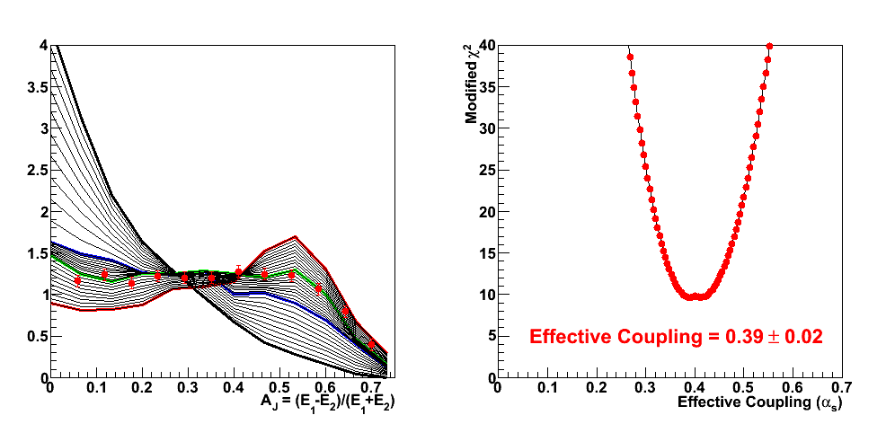
2013 | 2014 | 2015 | 2016 | 2017 | 2018 | 2019 | 2020 | 2021 | 2022
Full Heavy Flavor Tracker
Earliest Possible e-cooling
eRHIC
Muon Telescope Detector
STAR Inner TPC Upgrade
Muon Piston Cal. Ext.
STAR/PHENIX Forward Detectors
sPHENIX
500 GeV p+p 15 GeV A+A | 200 GeV A+A 200 GeV p+p | Au+Au, U+U, Cu+Au at 1-2 energies 200 GeV p+A, 500 GeV p+p | BESII 5-20 GeV Au+Au; 200 and 100 GeV Au+Au; 500 GeV p+p; 200 GeV polarized p+A

Slide 14
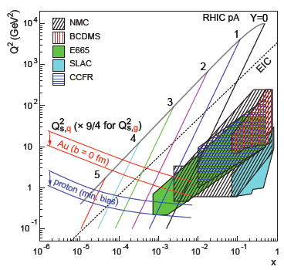
2013 | 2014 | 2015 | 2016 | 2017 | 2018 | 2019 | 2020 | 2021 | 2022
Full Heavy Flavor Tracker
Earliest Possible e-cooling
eRHIC
Muon Telescope Detector
STAR Inner TPC Upgrade
Muon Piston Cal. Ext.
STAR/PHENIX Forward Detectors
sPHENIX
500 GeV p+p 15 GeV A+A | 200 GeV A+A 200 GeV p+p | Au+Au, U+U, Cu+Au at 1-2 energies 200 GeV p+A, 500 GeV p+p | BESII 5-20 GeV Au+Au; 200 and 100 GeV Au+Au; 500 GeV p+p; 200 GeV polarized p+A

Slide 15
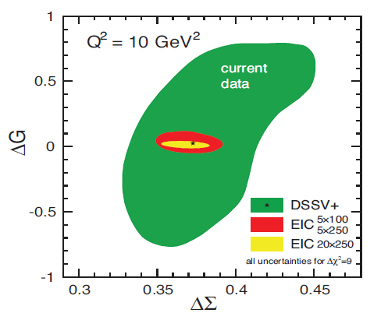
2013 | 2014 | 2015 | 2016 | 2017 | 2018 | 2019 | 2020 | 2021 | 2022
Full Heavy Flavor Tracker
Earliest Possible e-cooling
eRHIC
Muon Telescope Detector
STAR Inner TPC Upgrade
Muon Piston Cal. Ext.
STAR/PHENIX Forward Detectors
sPHENIX
500 GeV p+p 15 GeV A+A | 200 GeV A+A 200 GeV p+p | Au+Au, U+U, Cu+Au at 1-2 energies 200 GeV p+A, 500 GeV p+p | BESII 5-20 GeV Au+Au; 200 and 100 GeV Au+Au; 500 GeV p+p; 200 GeV polarized p+A

Slide 16
Closing Comments: Science Case
RHIC collisions create conditions similar to those present one microsecond after the Big Bang
-Near perfect liquid-like QGP discovered: un-anticipated result opened new possibility to study fluctuations in gluon fields at different scales
-Approaching a level of clarity and a standard model of heavy-ion collisions leading to well constrained parameters like viscosity etc. (Required many data sets and working out what models and effects are most relevant)
RHIC paradigms confirmed by LHC
-But RHIC covers the region of most interest for QCD thermodynamics
-Heavy-ion physics is not energy frontier physics: Bulk phenomena (accessible at RHIC) remain key to our field
Experimental results continue to guide theory breakthroughs
Flexibility and reach of RHIC is unique and extremely valuable
Future progress requires continued studies at RHIC: RHIC is in mid-stride
RHIC’s next decade is required to:
Quantify transport properties of the Quark-Gluon Plasma
Pursue discovery potential unveiled by results to date
Combine with LHC heavy ion program to span suitably wide initial temperature range to accomplish the above
Reap science payoff from just completed and ongoing RHIC facility upgrades
Pursue the unique accelerator science and spin physics opportunities that come with only operating U.S. collider and only worldwide polarized collider
Provide a cost-realizable path to an Electron Ion Collider

Slide 17
Take Away Message
1)RHIC has pioneered a vibrant new subfield – condensed QCD matter physics – and has led the rapid climb up a steep learning curve marked by continuing S&T breakthroughs. If RHIC operations were terminated, the U.S. would unilaterally cede leadership in this high-impact field.
2)Discoveries and techniques at RHIC have established deep intellectual connections to other physics forefronts. These give RHIC broader scientific impact than other Nuclear Physics research avenues.
3)Critical directions for future research in this subfield involve probing hot QCD matter from below to above the transition to Quark Gluon Plasma. This transition appears to occur within the RHIC energy range, at energies not accessible at LHC. This is NOT energy frontier science!
4)RHIC has nearly completed major performance upgrades that facilitate the next decade’s science. It provides the most cost-effective base to realize the next QCD frontier with EIC. Crisis management for the coming decade must preserve a viable path to a vibrant future in the next decade.
RHIC possesses strong discovery potential in a range of QCD related topics: Critical Point, mechanism responsible for matter/anti-matter assymetry at EW transition, Saturation

